Slide 1
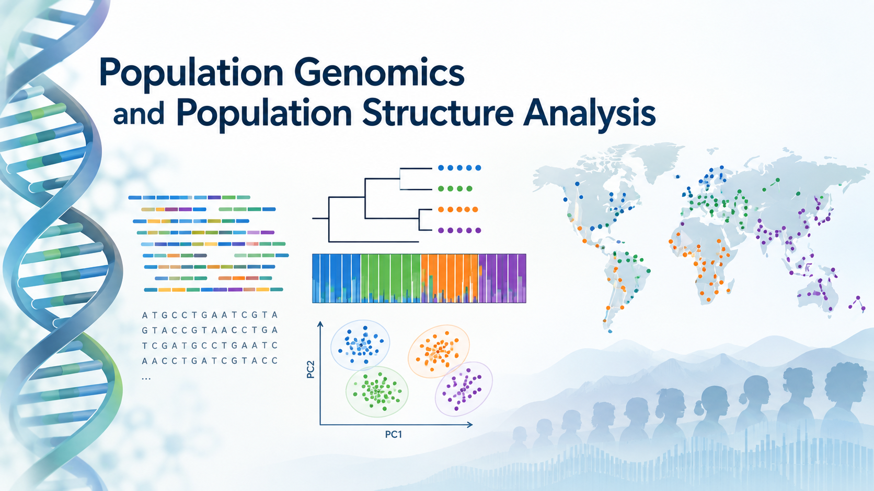

Nikolay Oskolkov, Group Leader (PI) at NIRI, Riga, Latvia

Slide 2


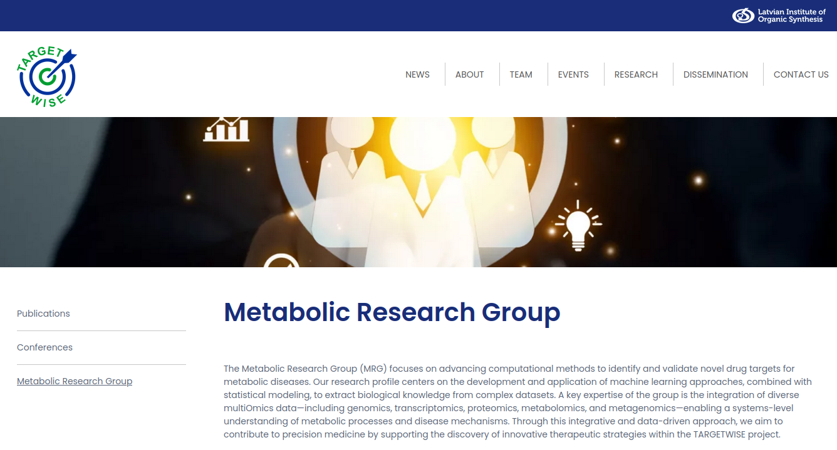
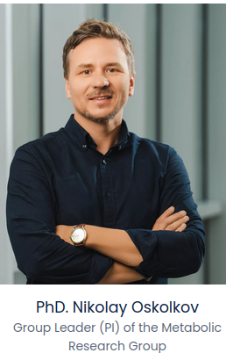
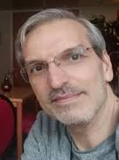
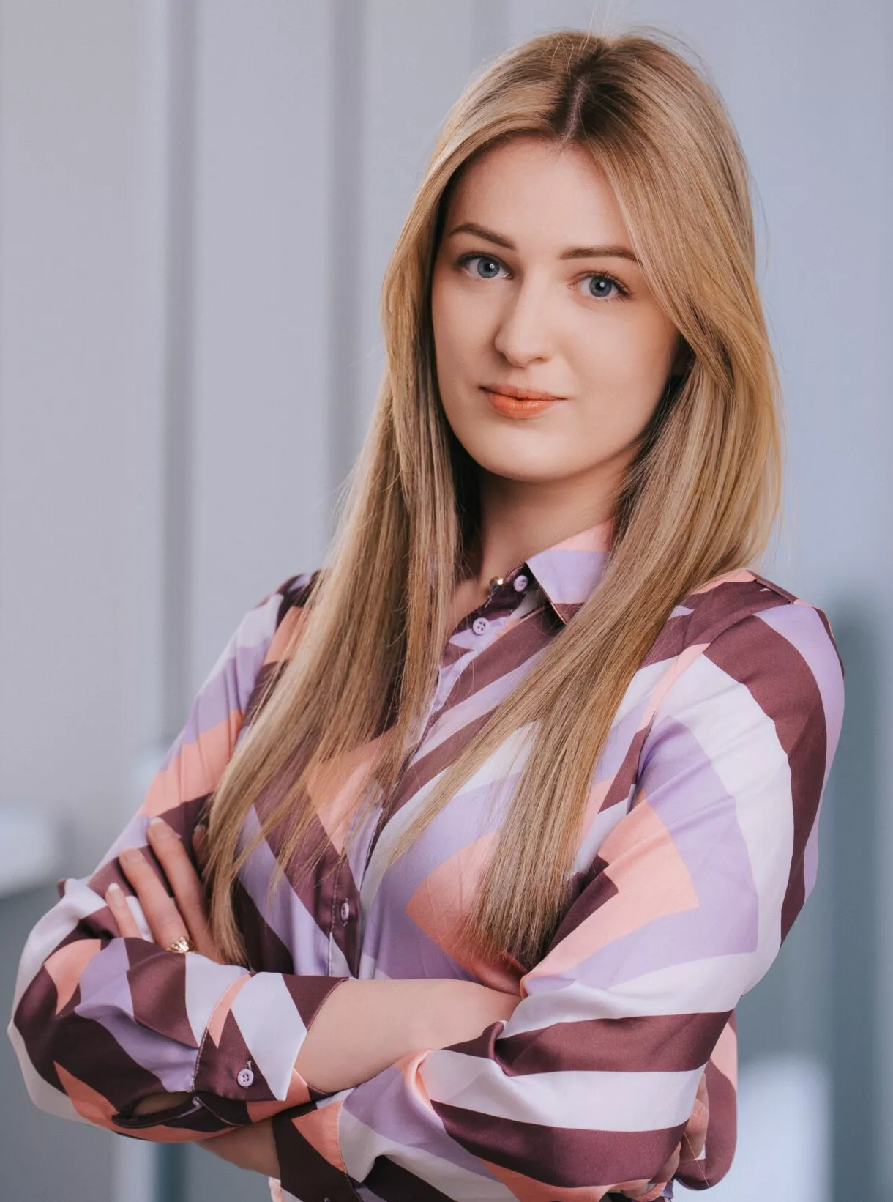
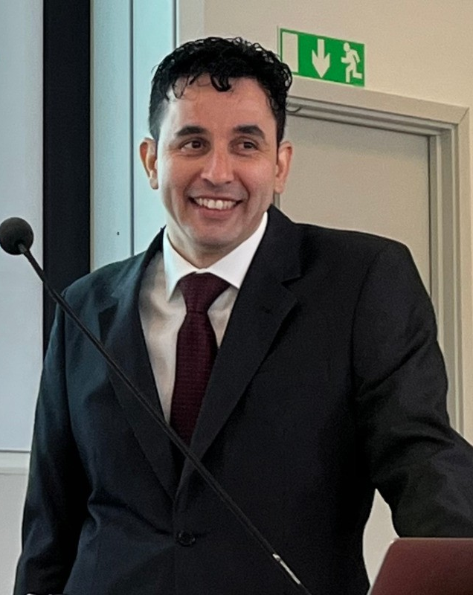
Metabolic Research Group at NIRI
Mohammad Banabazi, postdoc
in Metabolic Research Group
1 more postdoctoral fellow and 1 PhD student to be hired
If you know anyone who might be interested,
please contact me!
Kristina Grausa, PhD student
in Metabolic Research Group
Daniel Rivas, MD, postdoc
in Metabolic Research Group

Slide 3
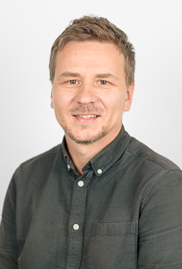



About us
Organizer: Oliver Hooker, PR Stats courses
oliver@prstats.org
Instructor:
Dr. Nikolay Oskolkov, MRG Group Leader, NIRI, Riga,
lecturer at Lund University, Lund,Sweden
nikolay.oskolkov@niri.lv
@NikolayOskolkov
Personal homepage:
https://nikolay-oskolkov.com
@oskolkov.bsky.social

Slide 4
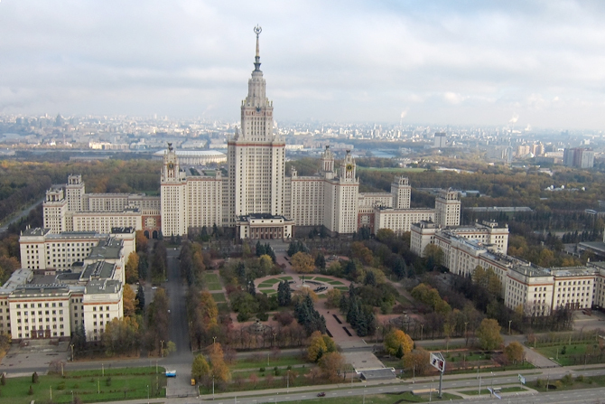

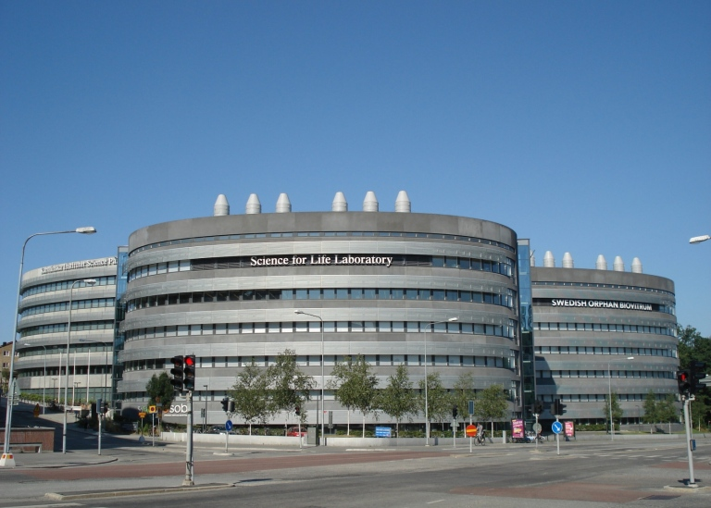
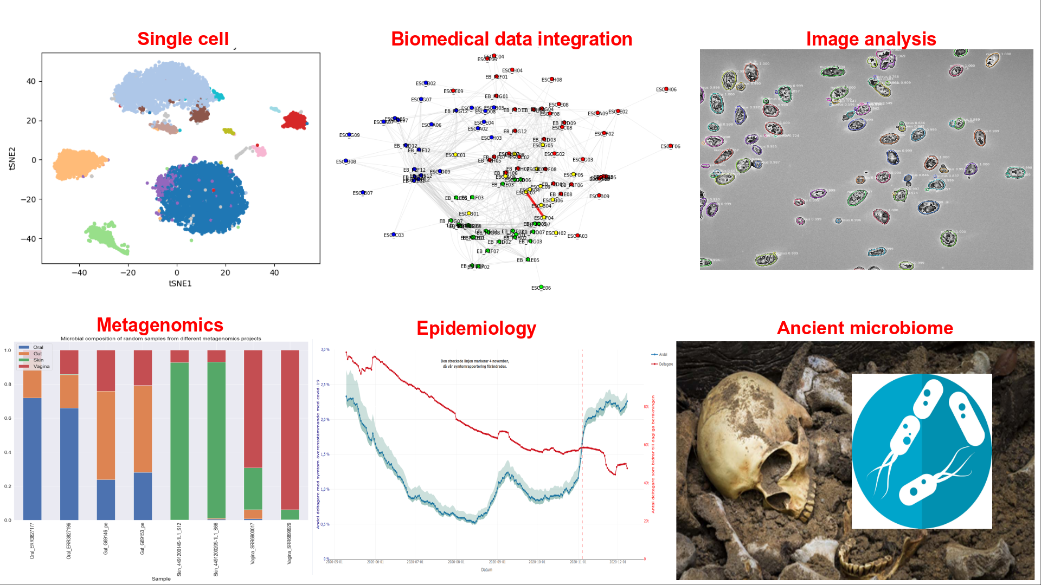
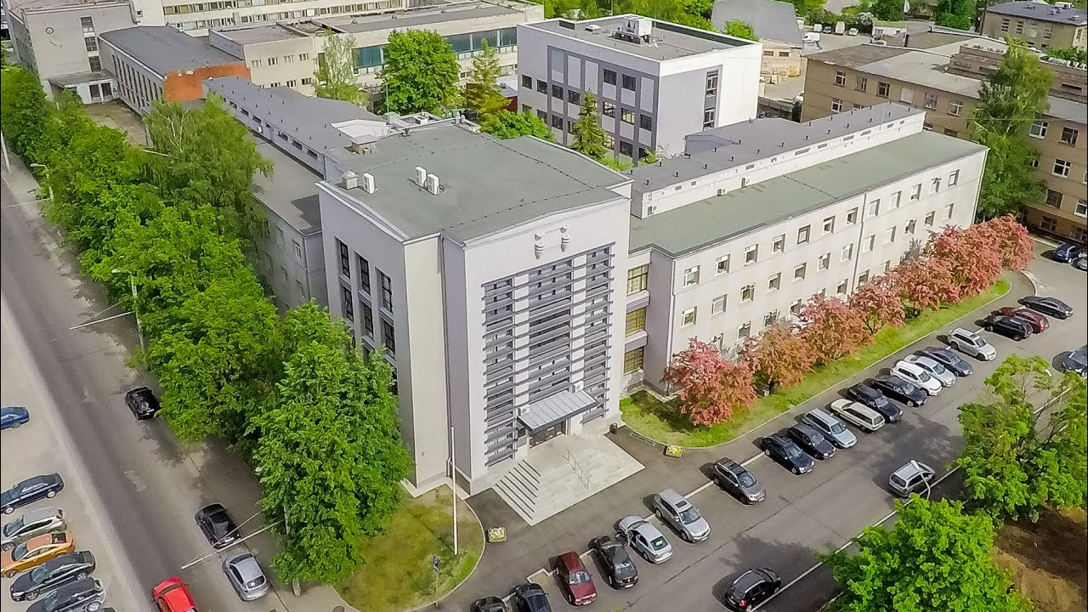
Brief introduction: who am I
2007 PhD in theoretical physics in Moscow, Russia
2011 medical genomics at Lund University, Sweden
2016 bioinformatician at NBIS SciLifeLab, Sweden
2025 Metabolic Research Group leader, NIRI, Latvia
60+ publications; h-index = 28; 4,600+ citations
Moscow State University
Lund University
SciLifeLab
NIRI=LIOS+BMC

Slide 5


About you
Name
University / Institute / Company
Research interest(s)
Previous experience with computational analysis and bioinformatics
Motivation to join the course
Expectations from the course

Slide 6
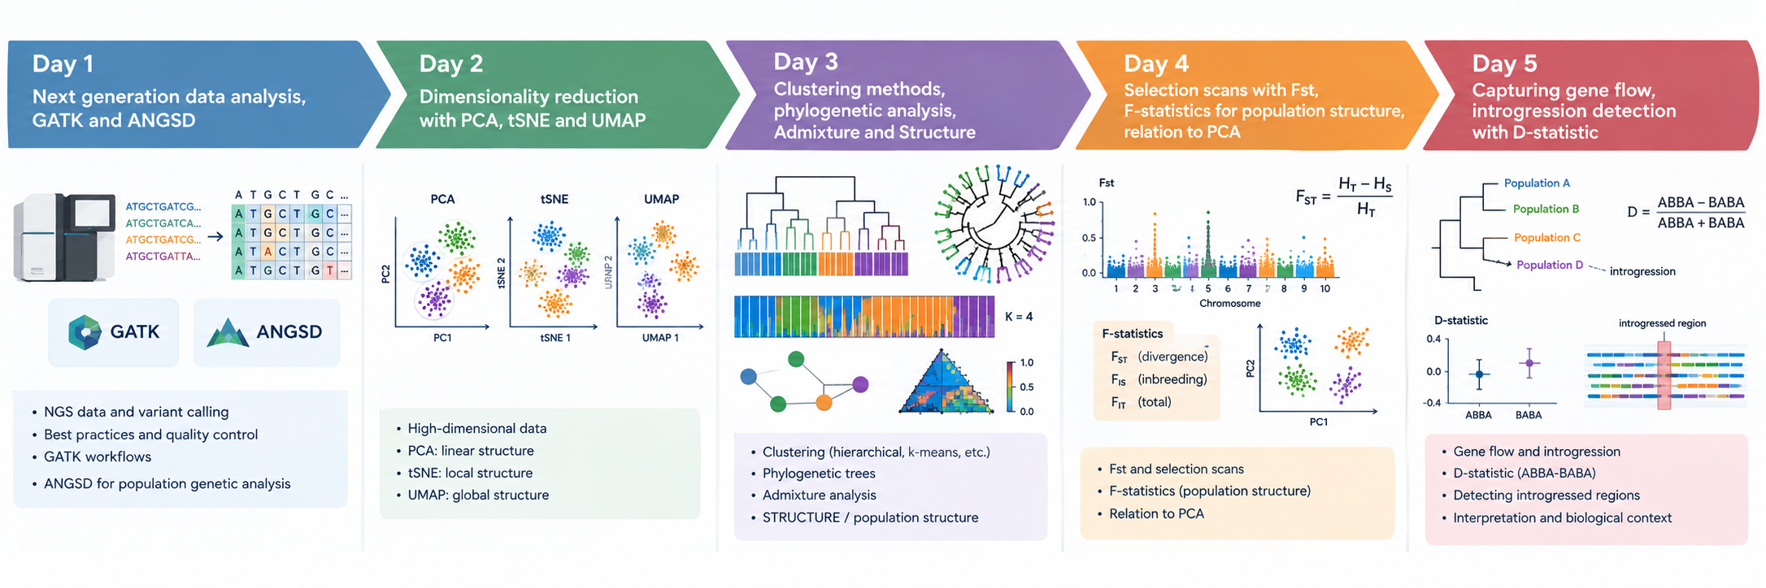
Course outline
Day 1: introduction to next generation data analysis, GATK and ANGSD
Day2: dimensionality reduction with PCA, tSNE and UMAP
Day3: clustering methods, phylogenetic analysis, Admixture and Structure
Day4: selection scans with Fst, F-statistics for population structure, relation to PCA
Day5: capturing gene flow, introgression detection with D-statistic

Slide 7
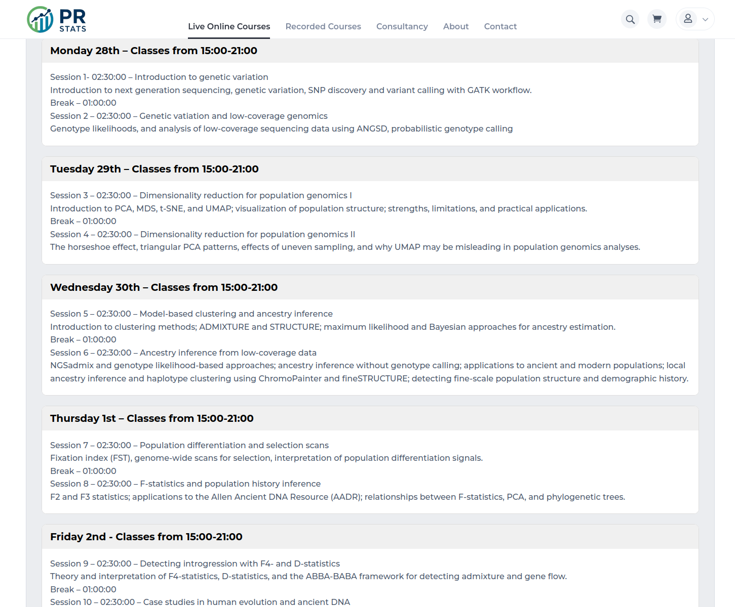
Course program

Slide 8
Housekeeping rules
Please ask your questions anytime, it is ok to interrupt me, or you can raise your hand and ask. You can also ask questions online in the zoom chat or later by email.
I kindly ask you to please keep your webcams on for better communication, this is of course not mandatory an up to you but will help me to adjust me explanations
The course includes 10 lectures (~1 h each) and 10 practicals (~1.5 h each), there is a 15 min break after each lecture and 1 h lunch break every day of the course. We can potentially make longer breaks if needed.
During practicals, we will use Rmarkdown and Jupyter notebooks. At the end of each practical, I will use rendered html-versions of the notebooks to go through command lines with my explanations.
The material is based on data and problems from computational biology, however the concepts discussed are general and can be applied for other types of data.

Slide 9
Practical information: time and github repo
The course will take place from 2 pm to 8 pm UK time ( 3 pm to 9 pm CET)
The course GitHub repository containing lectures and exercises is:
https://github.com/NikolayOskolkov/PopGen_PopStructure
Please bookmark this address!

Slide 10
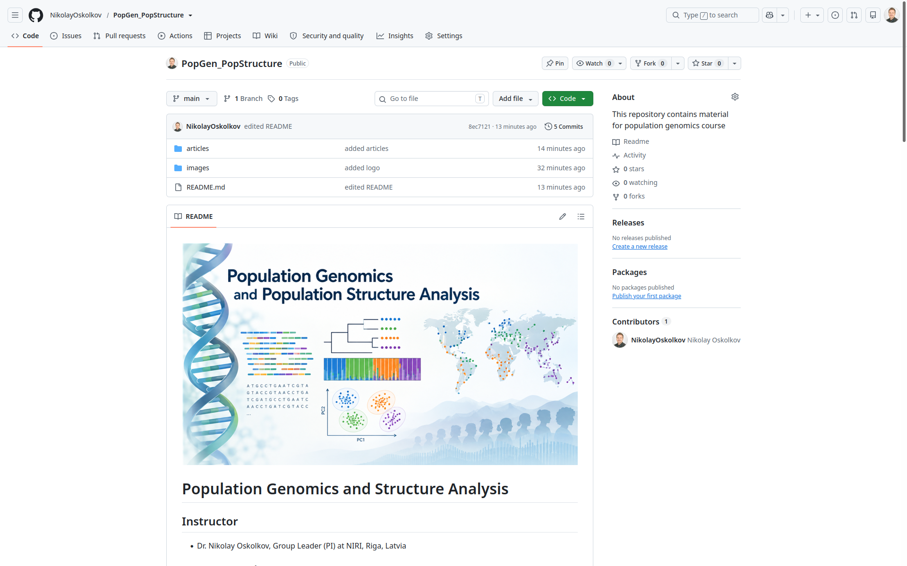

Slide 11
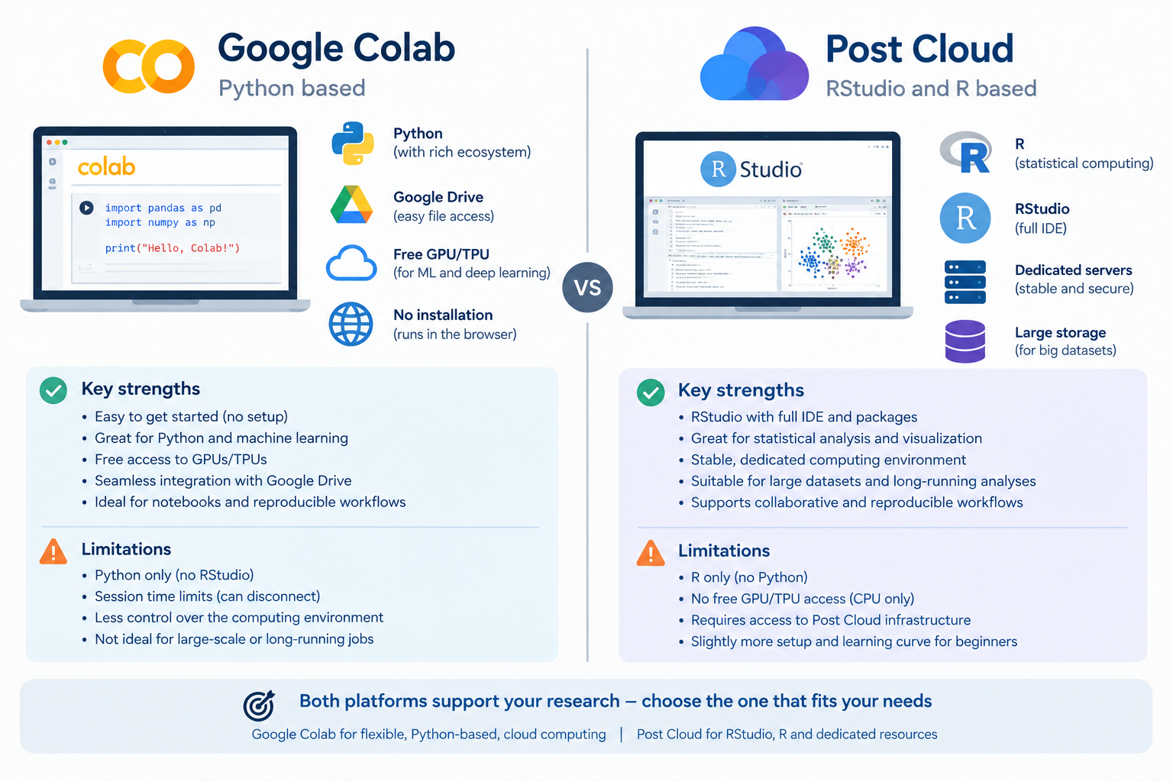

Slide 12
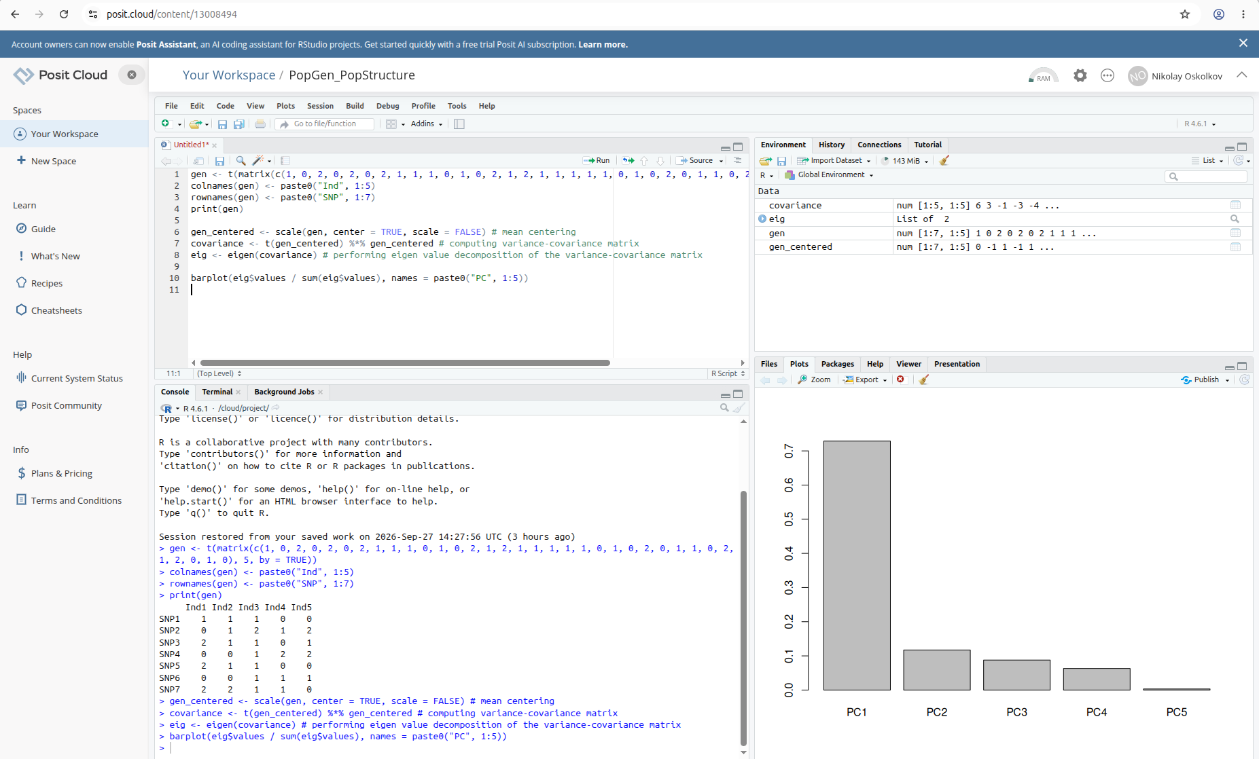

Slide 13
To run Jupyter notebooks on Google Colab please do the following:
1. Clone this repo: https://github.com/NikolayOskolkov/PopGen_PopStructure
2. Upload the repo to your Google drive
3. Start the Jupyter notebook from the Google drive and mount your google drive:
#Mount Google Drive to Colab
from google.colab import drive
drive.mount('/content/drive')
!ls -l /content/drive/MyDrive/
import os
os.chdir("/content/drive/MyDrive/data")
N.B. you need a Google account
to be able to run Google Colab!

Slide 14
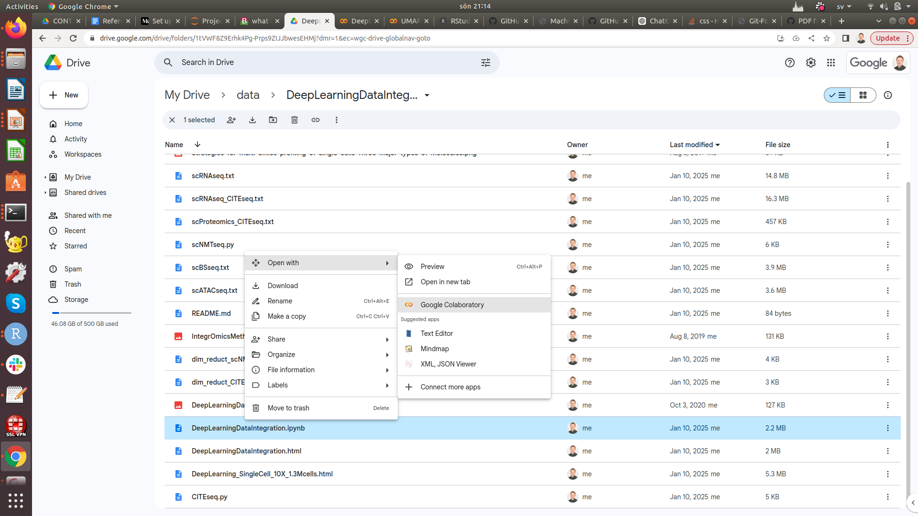

Slide 15
