Slide 1
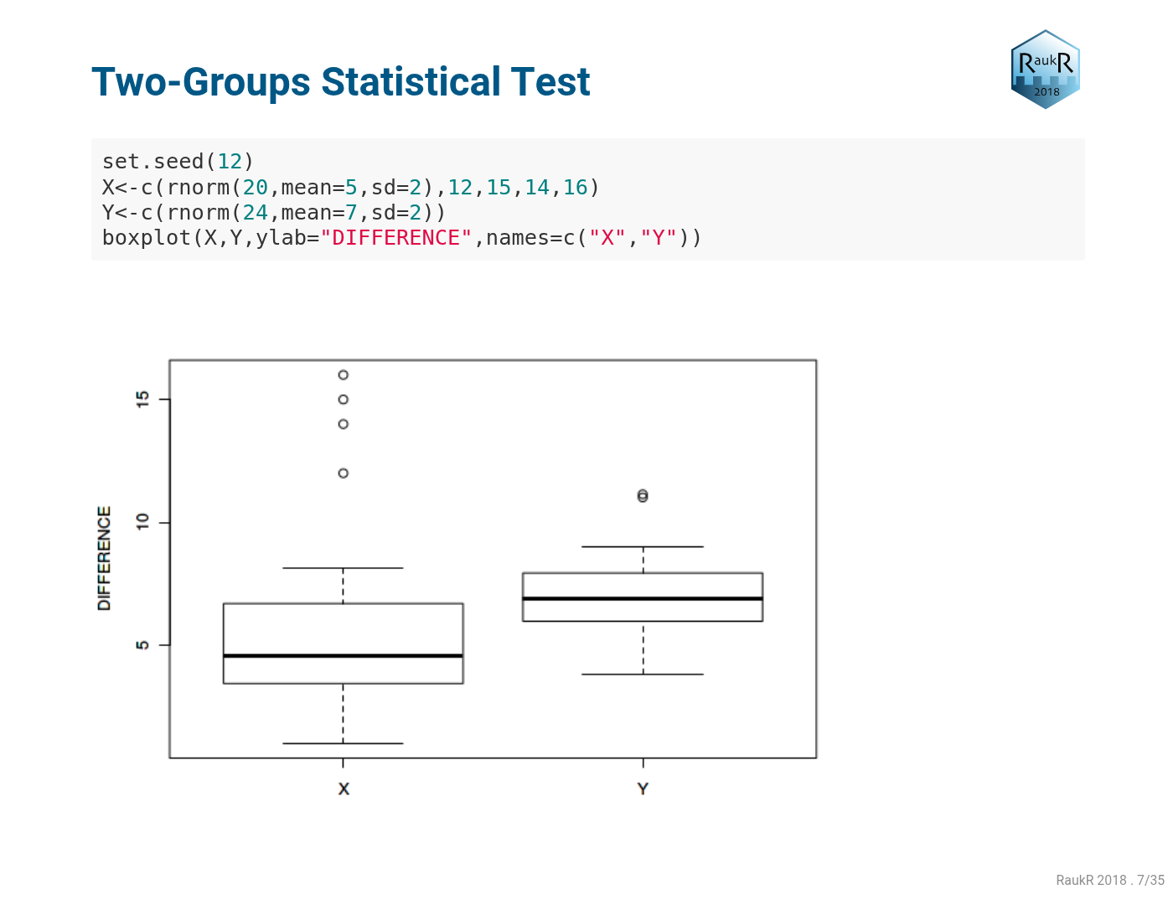

Slide 2
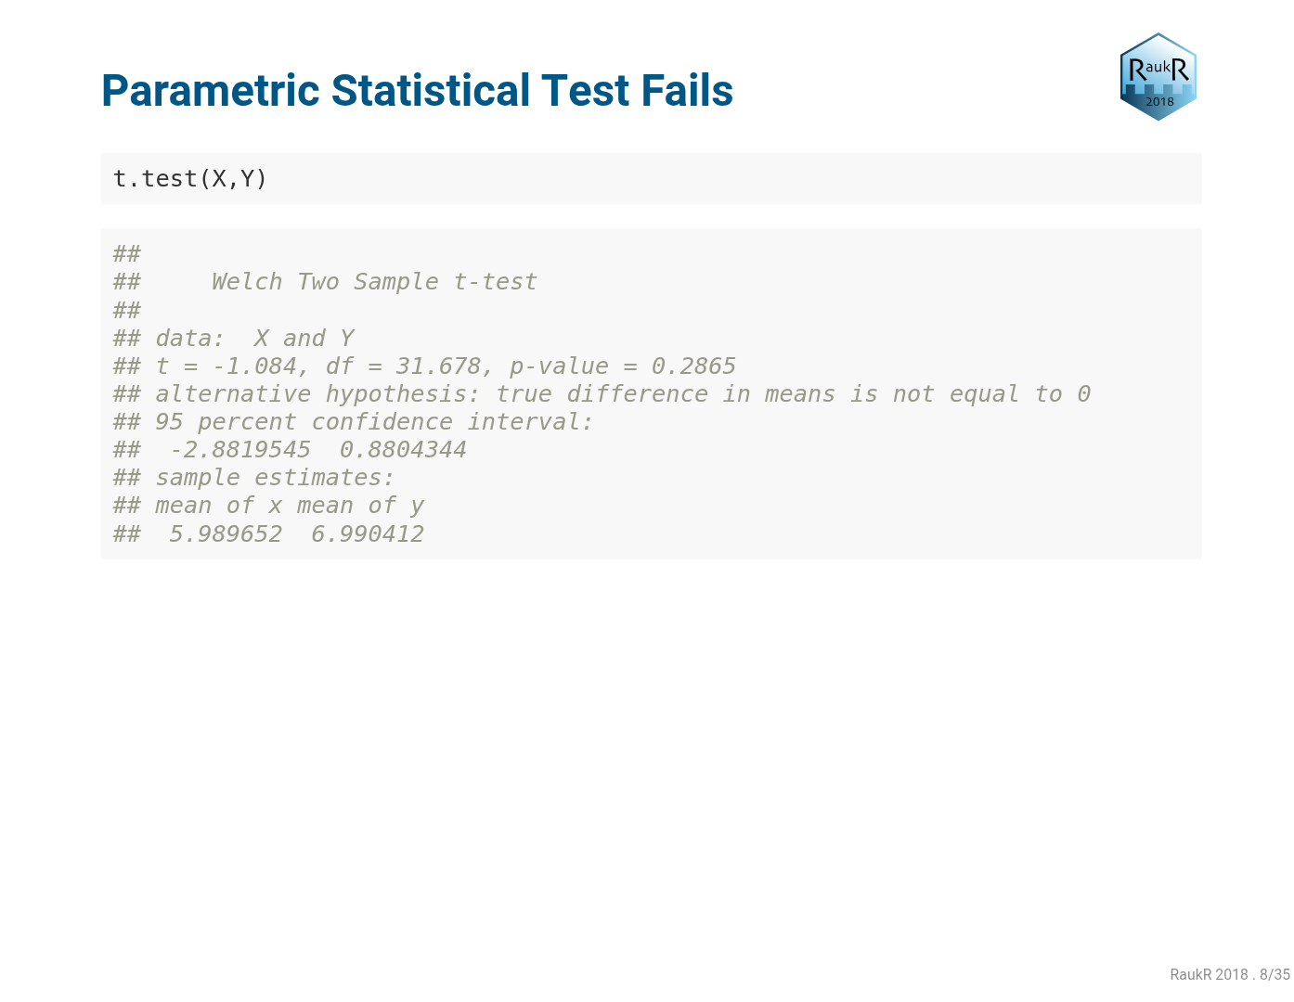

Slide 3
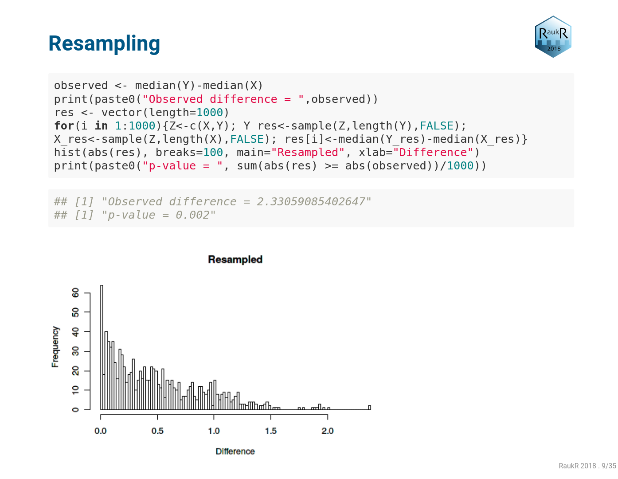

Slide 4
Compare with Mann-Whittney U test:
wilcox.test(X, Y)

Slide 5
Practice parametric vs. non-parametric correlation:
set.seed(12)
n<-10
x<-rnorm(n)
y<-3+2*x+10*rnorm(n)
plot(y~x)
x<-c(x,3)
y<-c(y,30)
plot(y~x)
cor.test(x,y)
cor.test(x,y,method="spearman")

