Slide 1


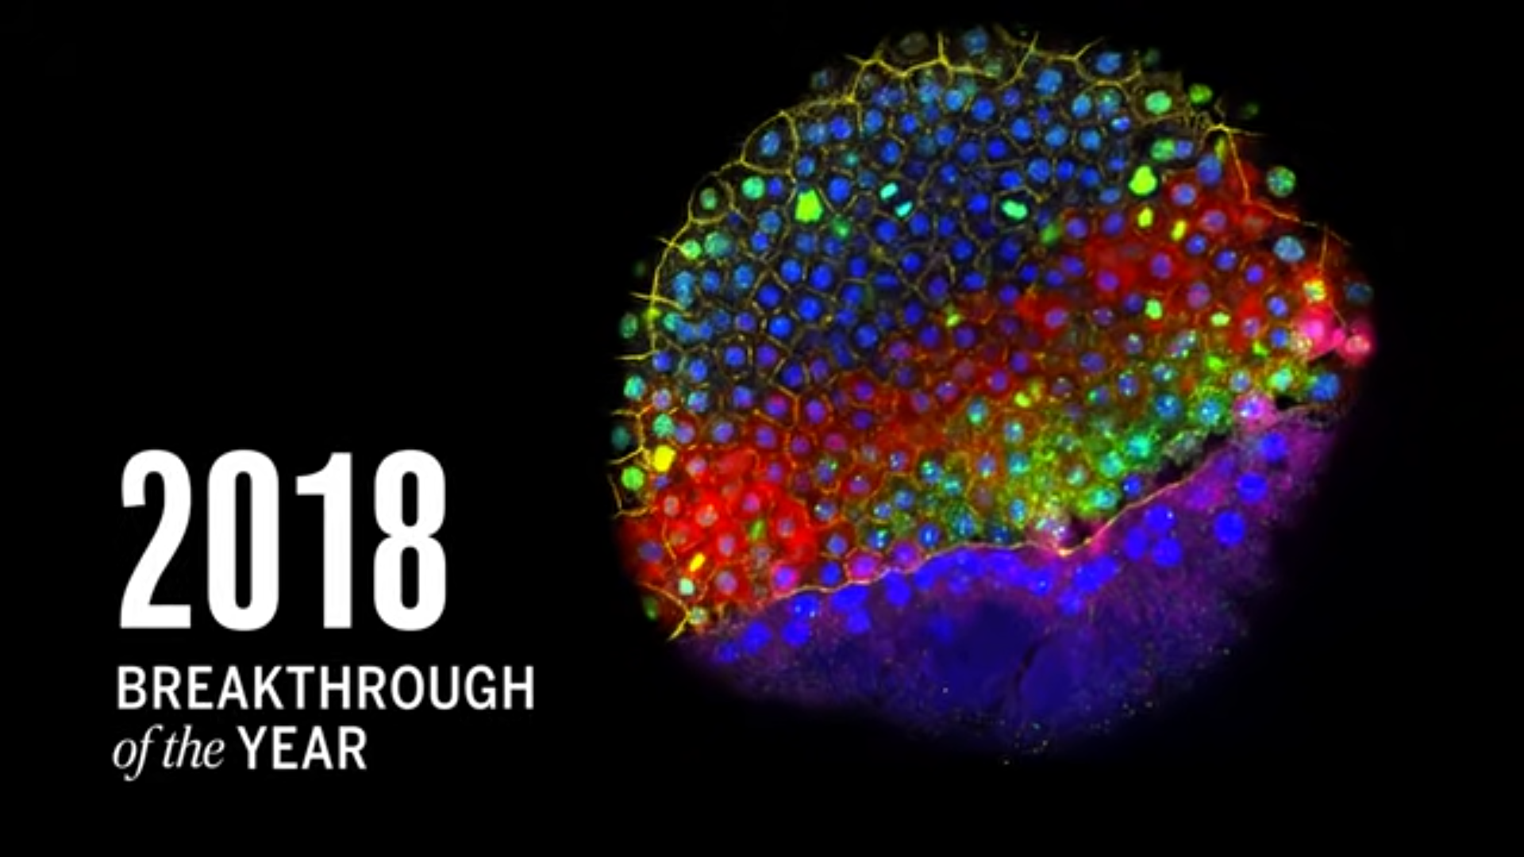
Single-Cell RNAseq Data Analysis
Swedish Bioinformatics Workshop, 27.10.2022
Nikolay Oskolkov, NBIS SciLifeLab
SCIENCE
Nature method of the year: 2019 (single cell multiomics), 2020 (spatial transcriptomics)

Slide 2
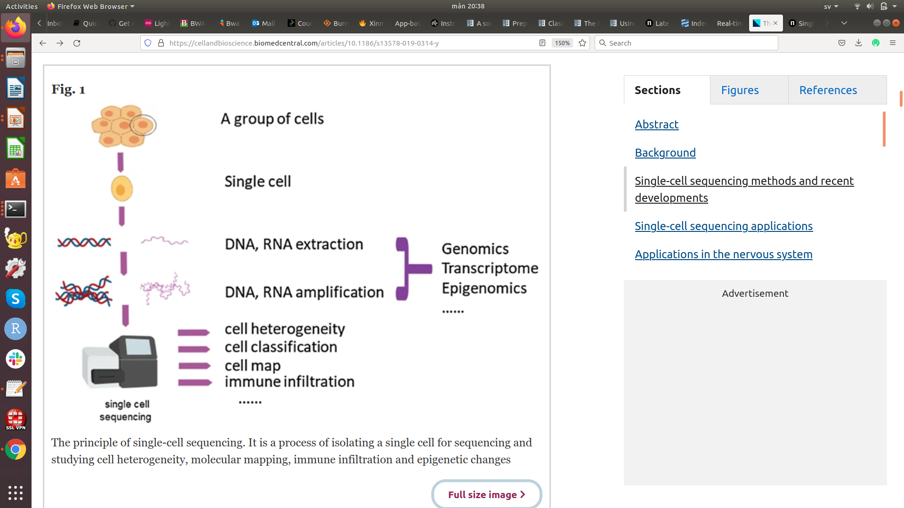
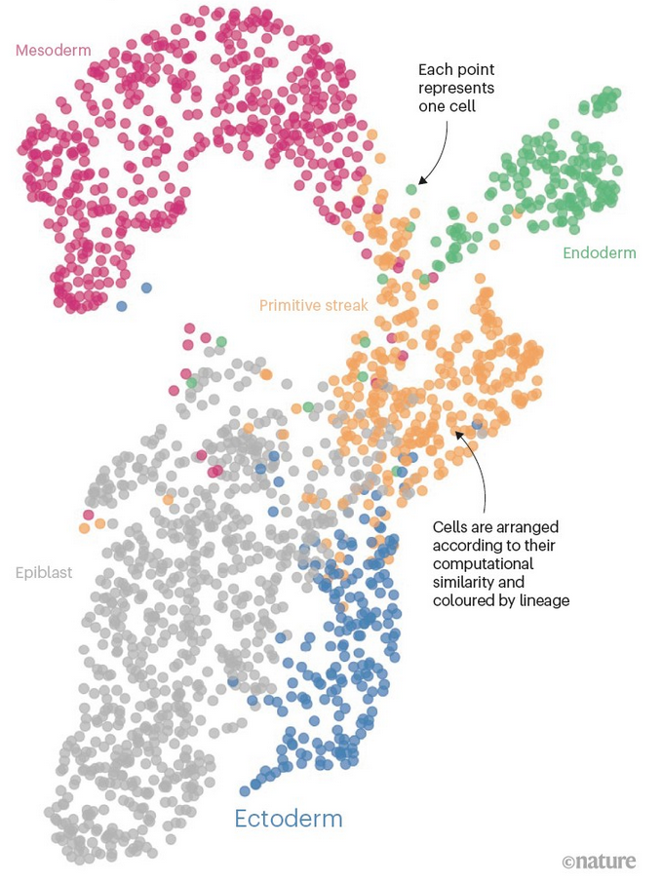
Recent Advances in Single Cell Biology

Slide 3

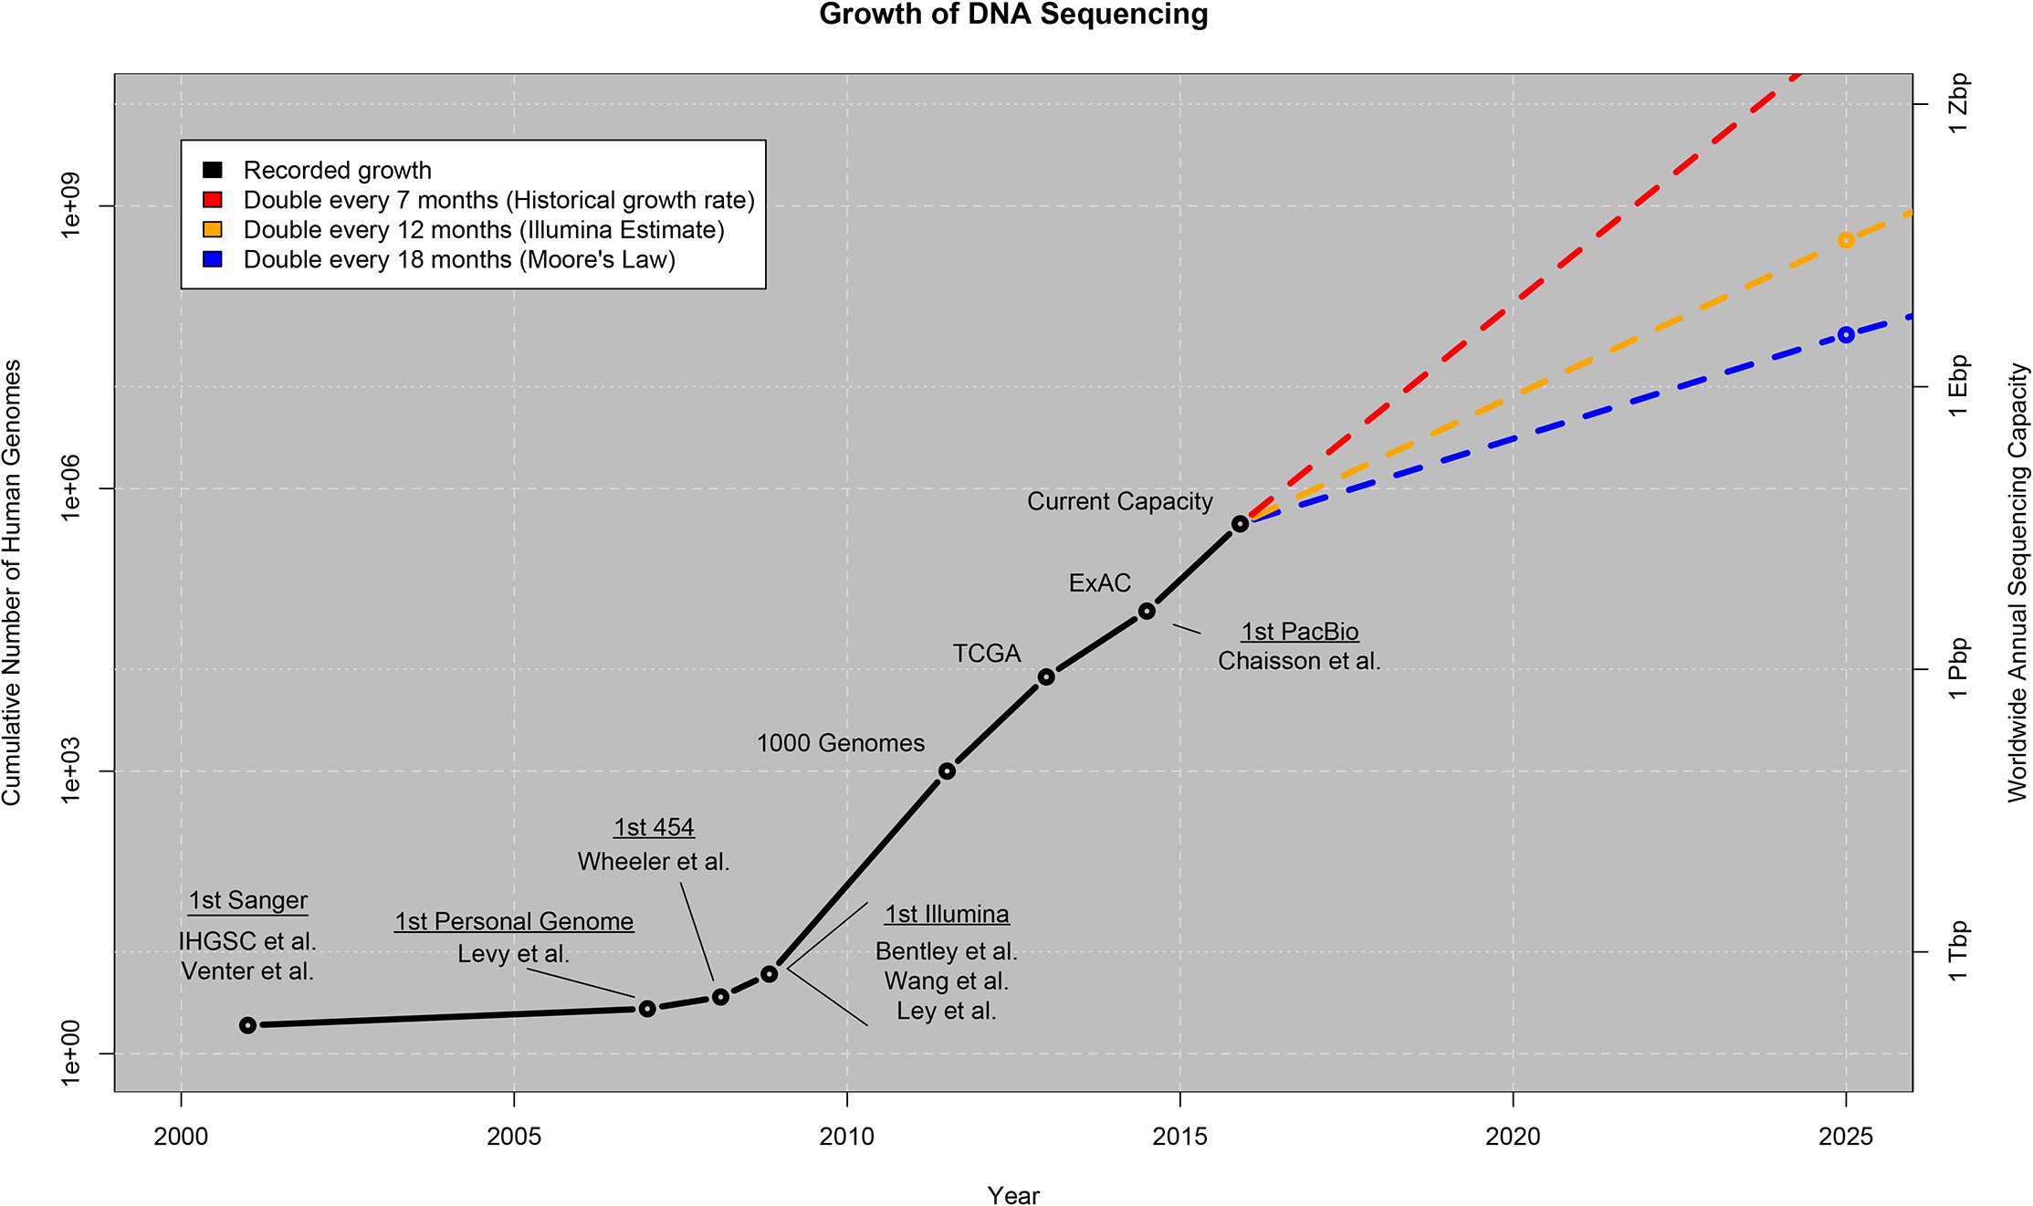
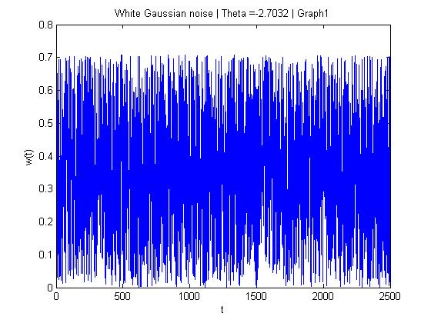
Big Data in Genomics
Genomics / WGS
: Little Data
N₁ ~ 10³
P₁ ~ 10⁶
N₁ * P₁ = N₂ * P₂ = 10⁹
Stephens et al., (2015). Big Data: Astronomical or Genomical? PLoS Biology 13(7)
scRNAseq
: Big Data
N₂ ~ 10⁶
A file with White Noise can
also take a lot of disk space
P₂ ~ 10³

Slide 4
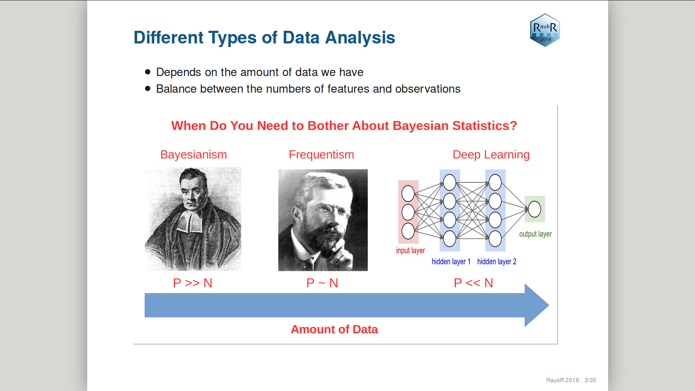

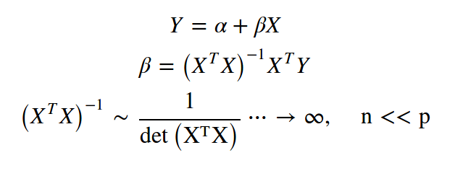
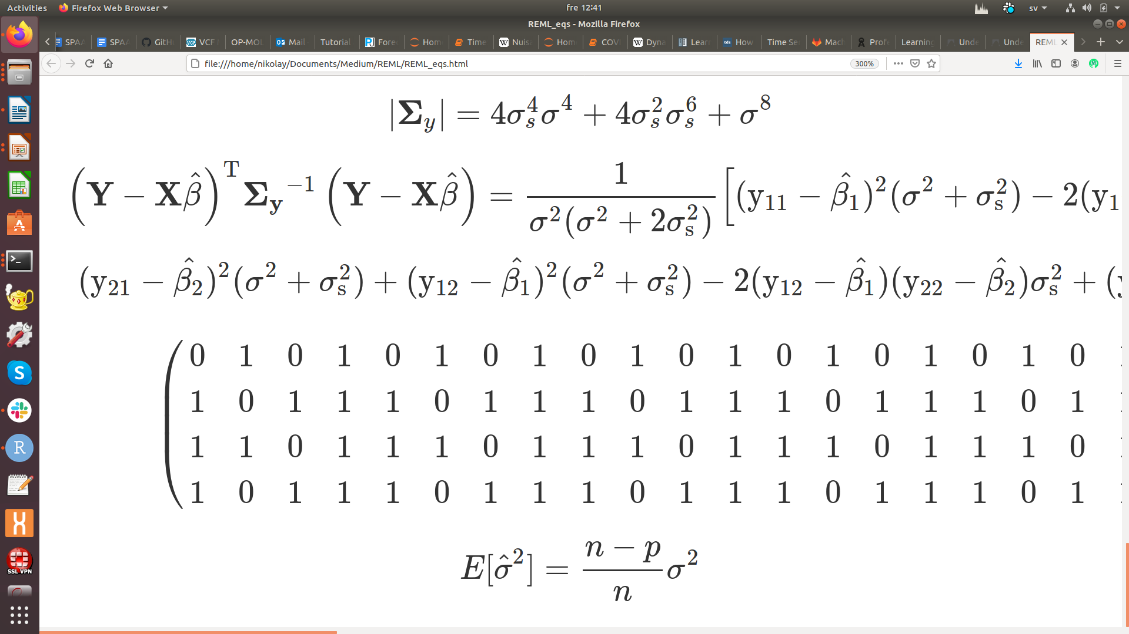
The Choice of Statistical Analysis
P is the number of features (genes, proteins, genetic variants etc.)
N is the number of observations (samples, cells, nucleotides etc.)
Biology / Biomedicine
Ex.1
Ex.2
Biased ML variance
estimator in HD-space

Slide 5
Main Steps in scRNAseq Analysis:
1) Quality Control
2) Removing technical variation
3) Dimension reduction
4) Clustering
5) Differential gene expression

Slide 6
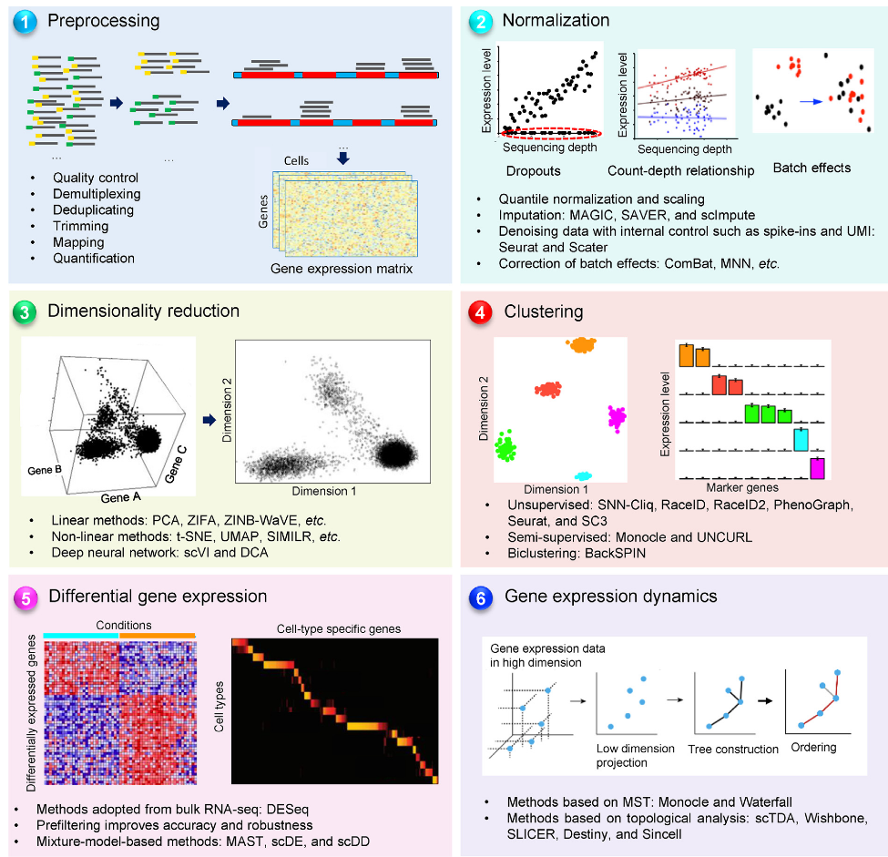
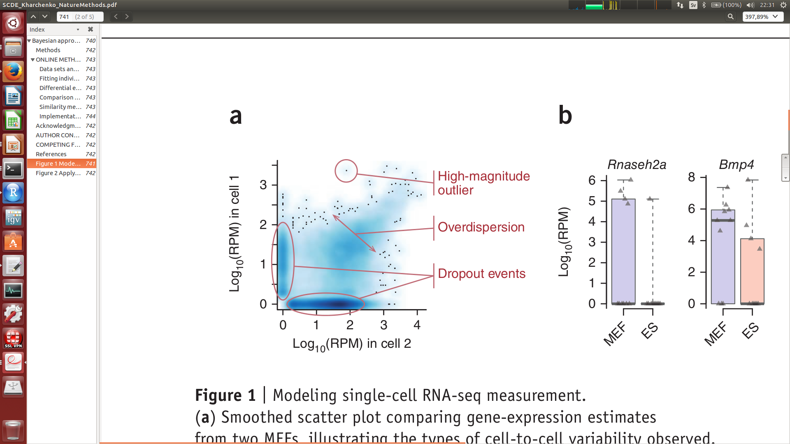
A Typical scRNAseq Workflow
Some steps are similar to bulk RNAseq,
but the majority are not
Mu et al., Gen. Prot. Bio. 2019

Slide 7
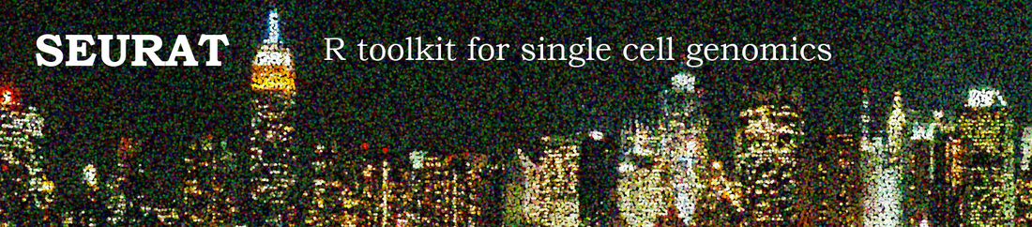

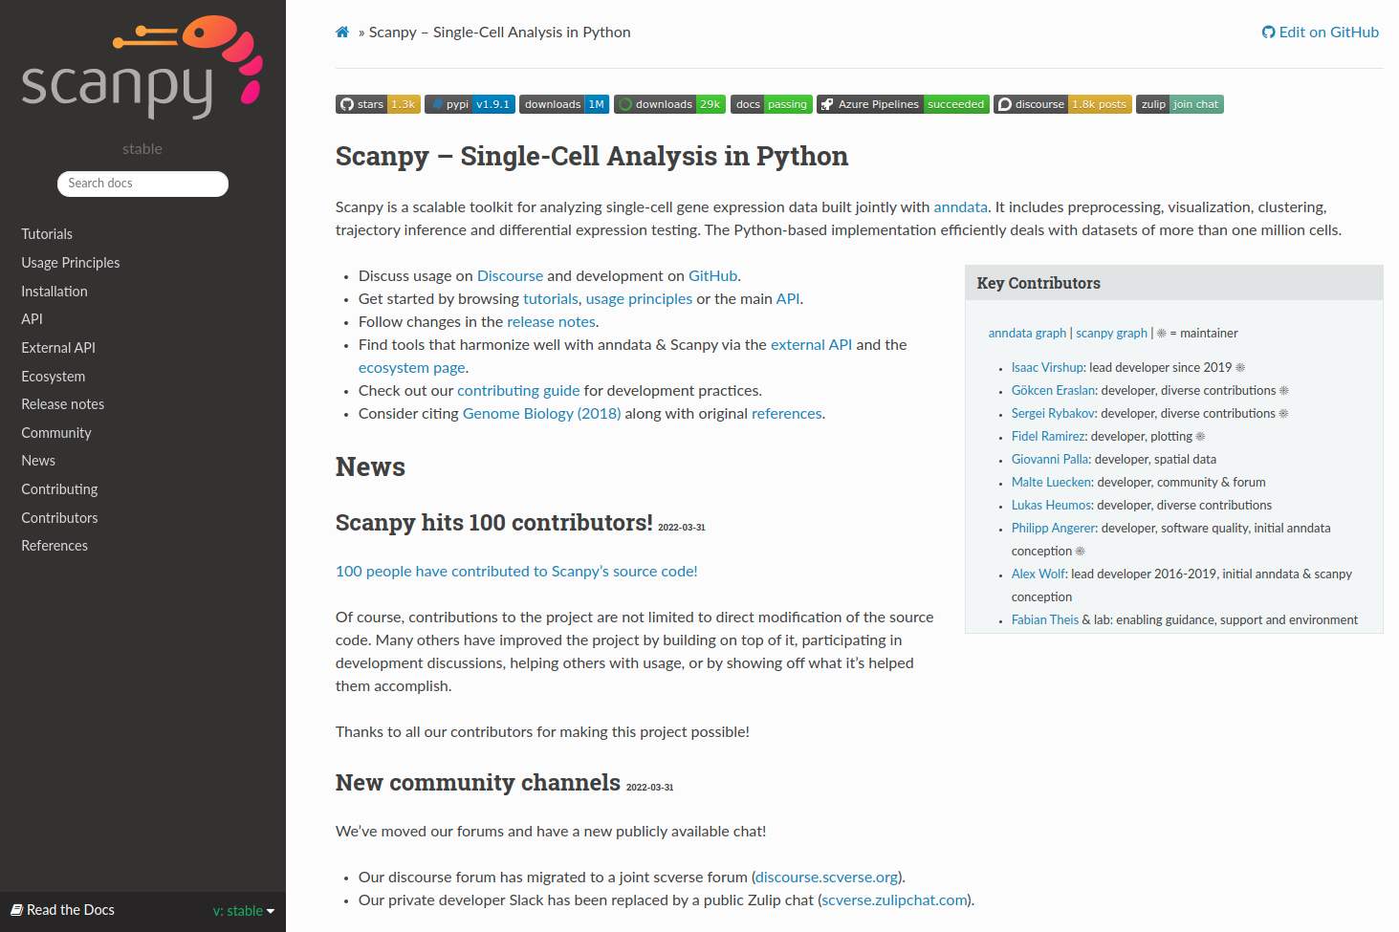
Most Popular scRNAseq Workflows
SEURAT: Rahul Satija Lab
SCRAN: John Marioni Lab
SCANPY: Fabian Theis Lab

Slide 8
Quality Control:
1) Cell filtering
2) Gene filtering

Slide 9
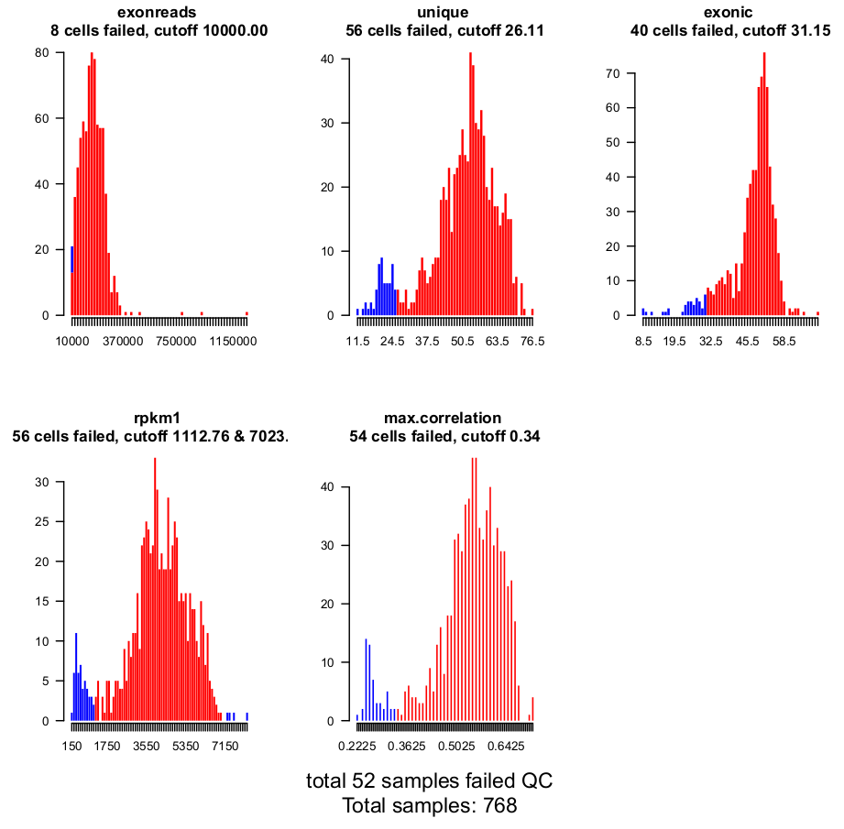
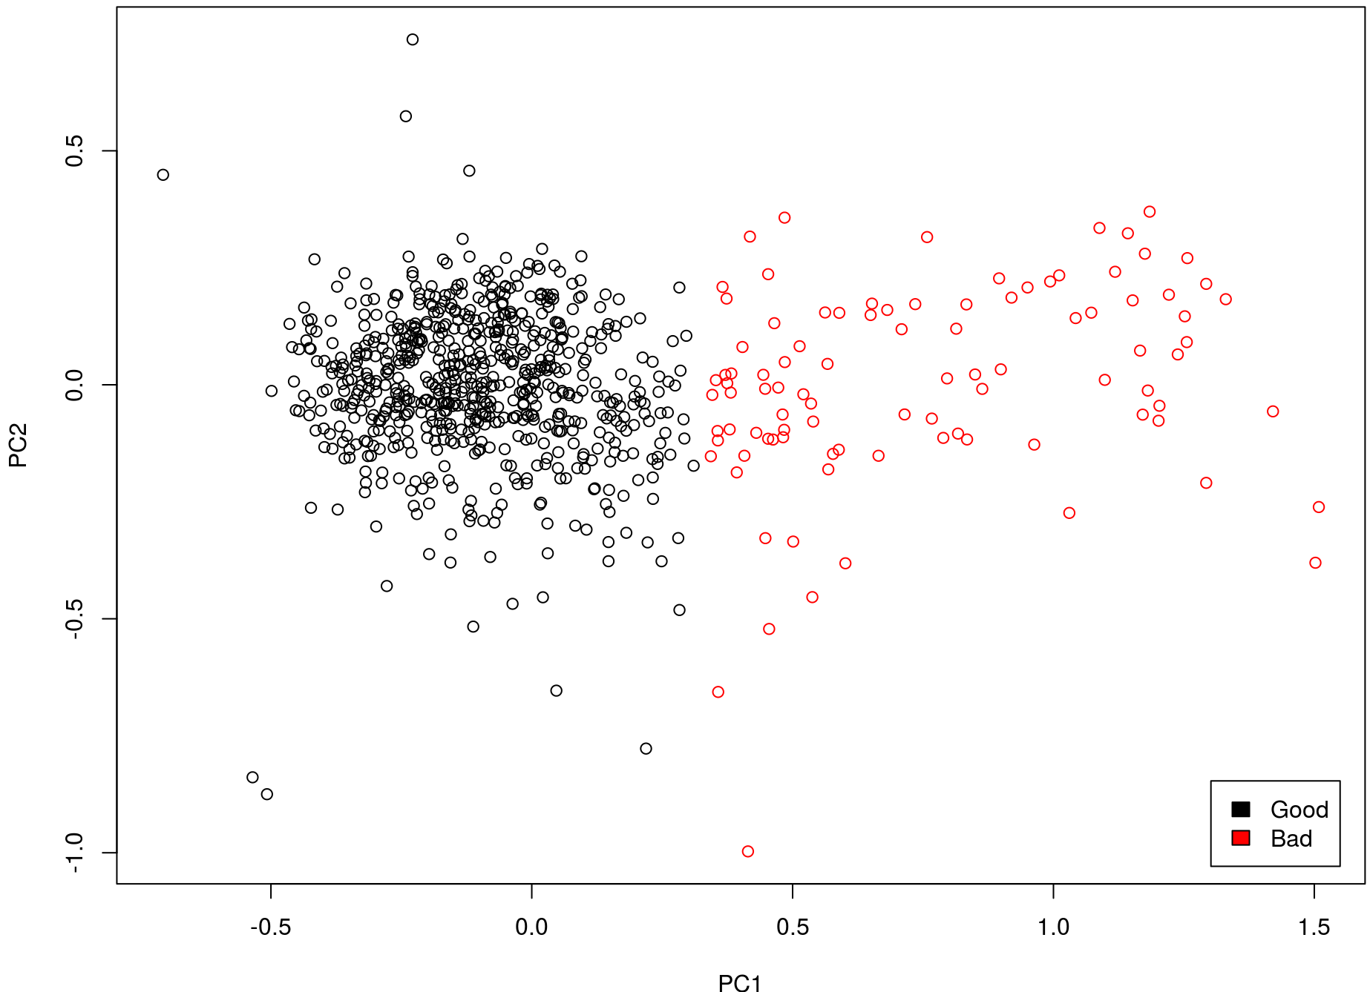
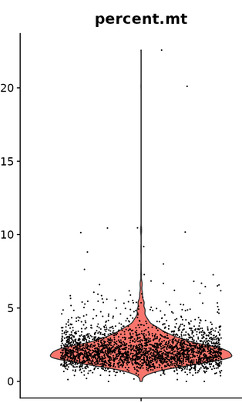
Cell Filtering
Univariate filtering: STAR stats
Multivariate filtering: SCATER
Removing cells with large mitochondrial
RNA counts – these cells are low quality
(dying or broken membrane cells)

Slide 10
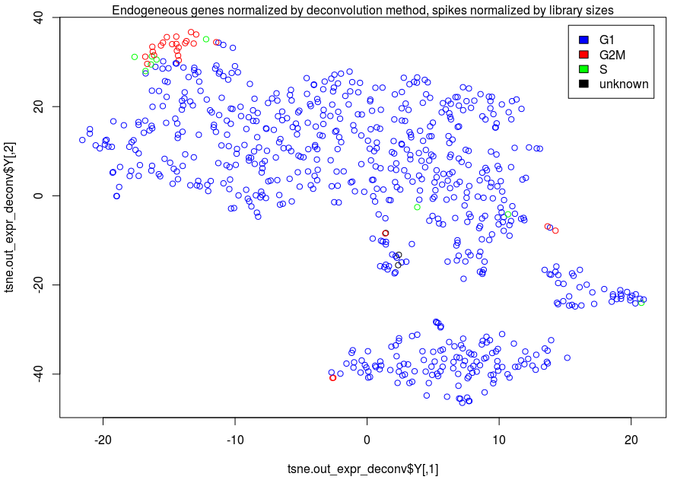
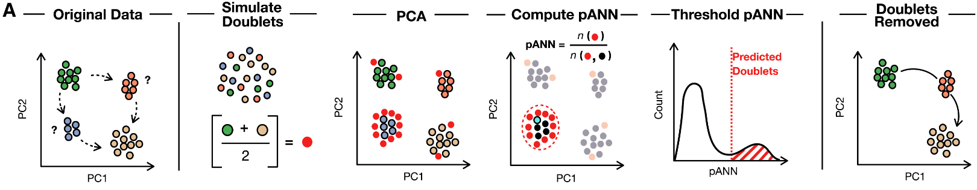
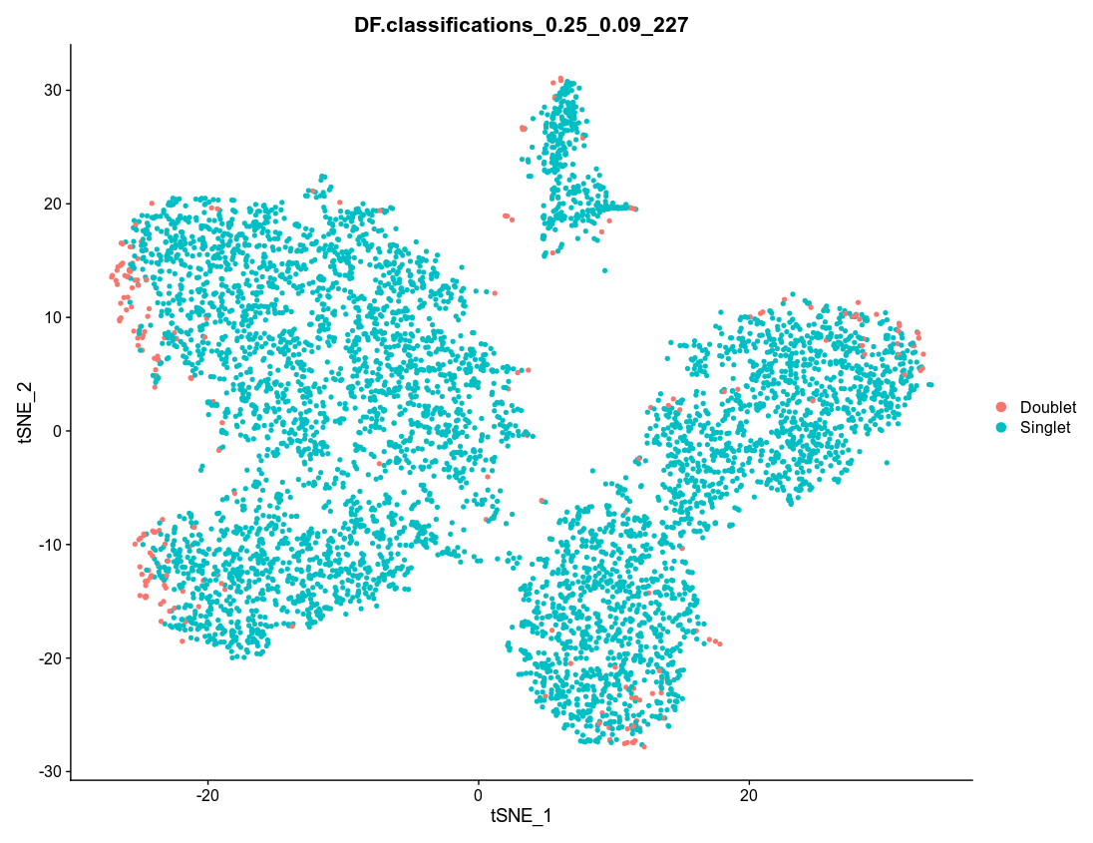
Cell Filtering
Doublets sometimes are important to remove: DoubletFinder
McGinnis et al., Cell Syst. 2019
Keep an eye on cycling cells, they sometimes might form separate clusters: CYCLONE
N. Oskolkov et al.,
Skeletal Muscle 2022

Slide 11
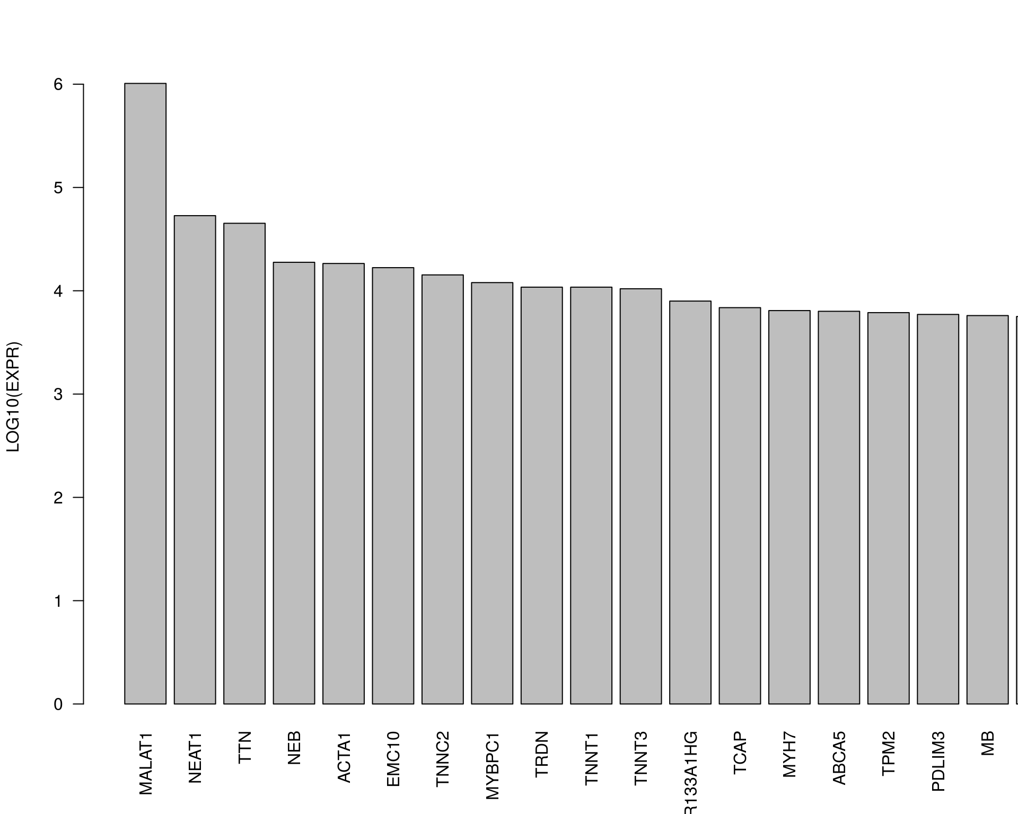
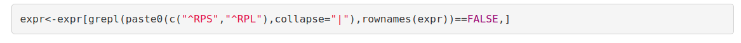
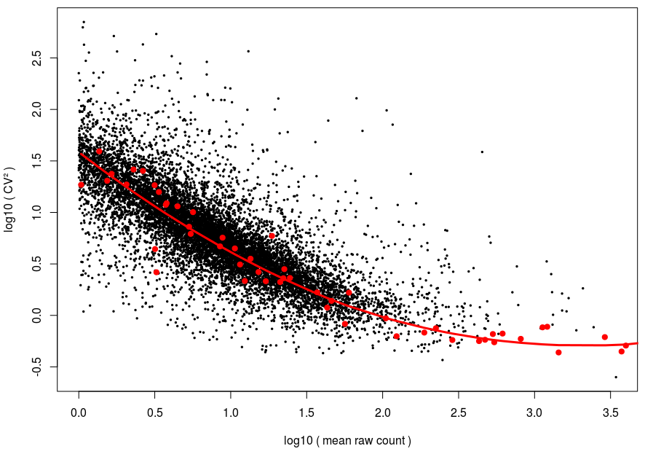
Gene Filtering
Inherited from bulk RNAseq:
remove lowly-expressed genes
(mean across cells count >=1)
Removing ribosomal house keeping genes
Selecting highly-variable genes
MALAT1 is a nuclear lincRNA, which
typically indicates broken cell membrane
and correlates with mitochondrial contamination
Typically MALAT1 is removed in order not
to bias other genes counts

Slide 12
Removing technical variation:
1) Normalization
2) Batch correction

Slide 13
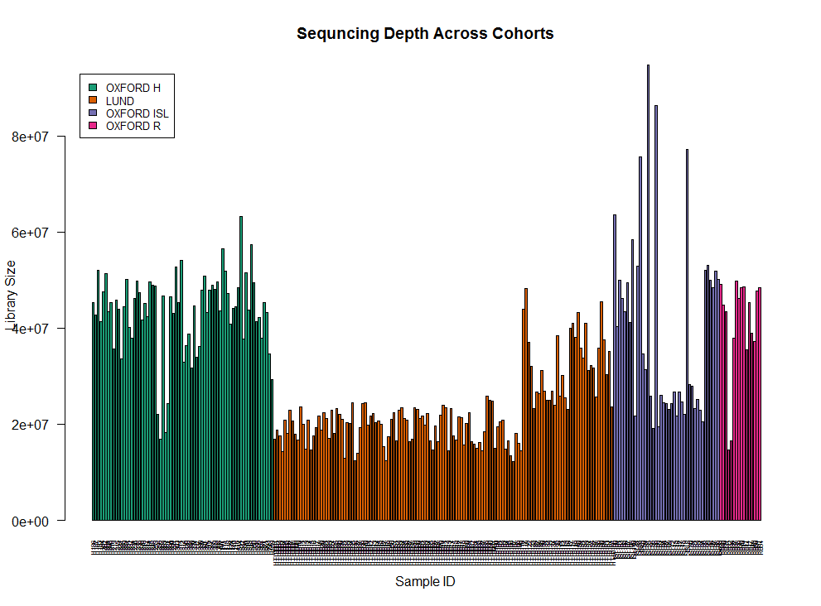
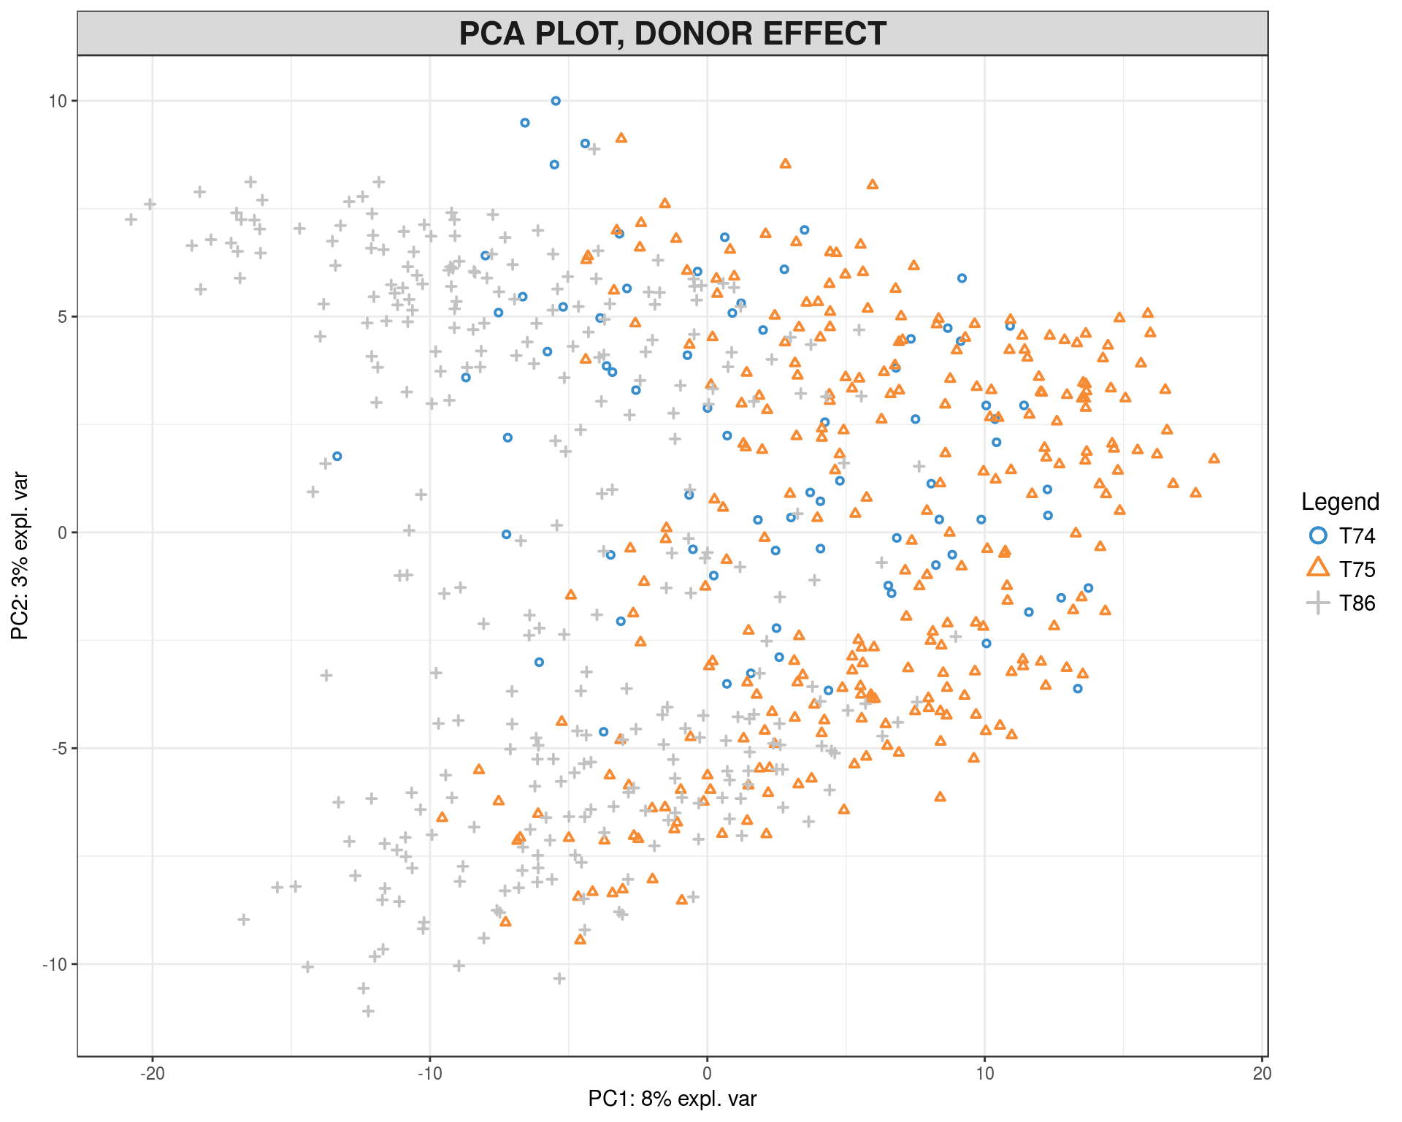
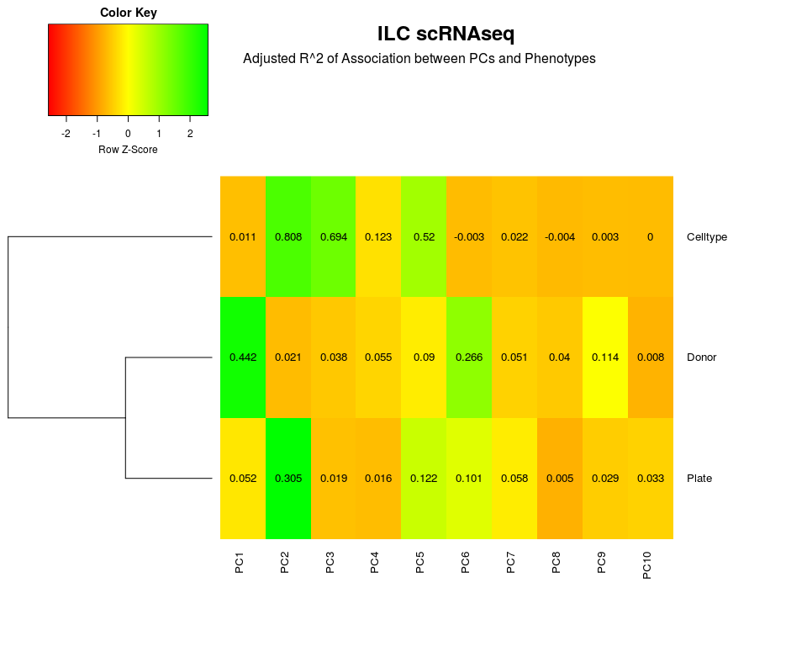
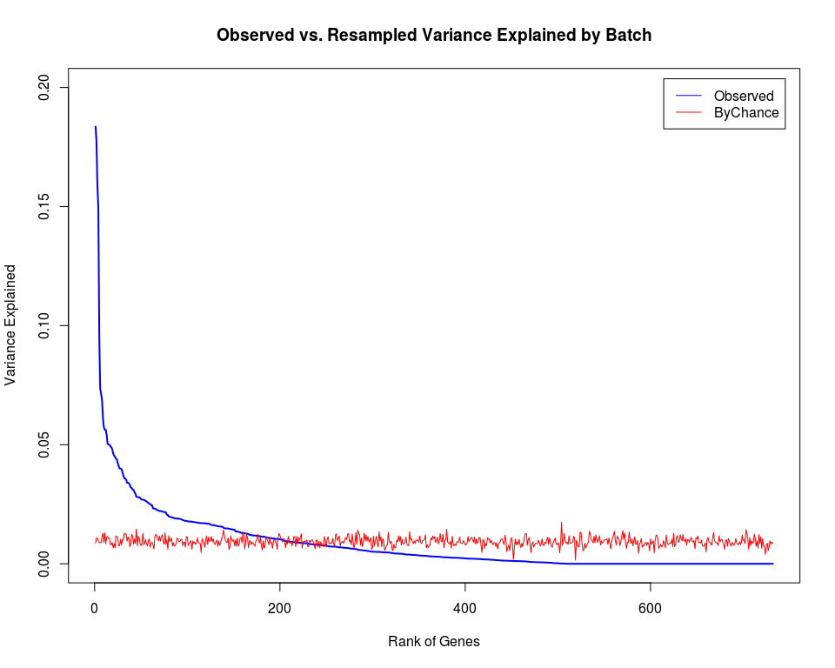
How to Detect Technical Variation
Difference in sequencing depth:
Genome-Wide Batch-effects:
Genome-Wide Batch-effects:
Per-Gene Batch-effects:

Slide 14
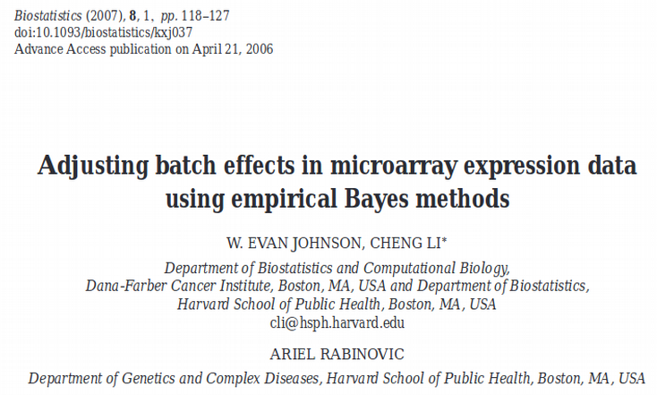
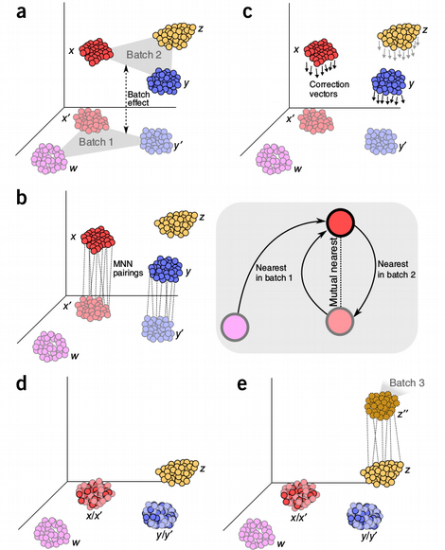
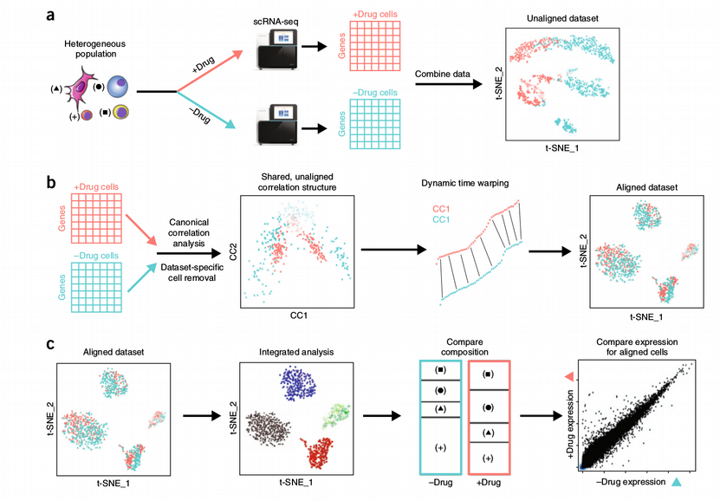
Batch Correction: Linear vs. Non-Linear
Limma and Combat:
gene_expr ~ cell_type + batch
Mutual Nearest Neighbor (MNN)
Seurat: CCA + DTW
Butler et al.,
Nature Biotechnology 2018
Haghverdi et al.,
Nature Biotechnology 2018

Slide 15
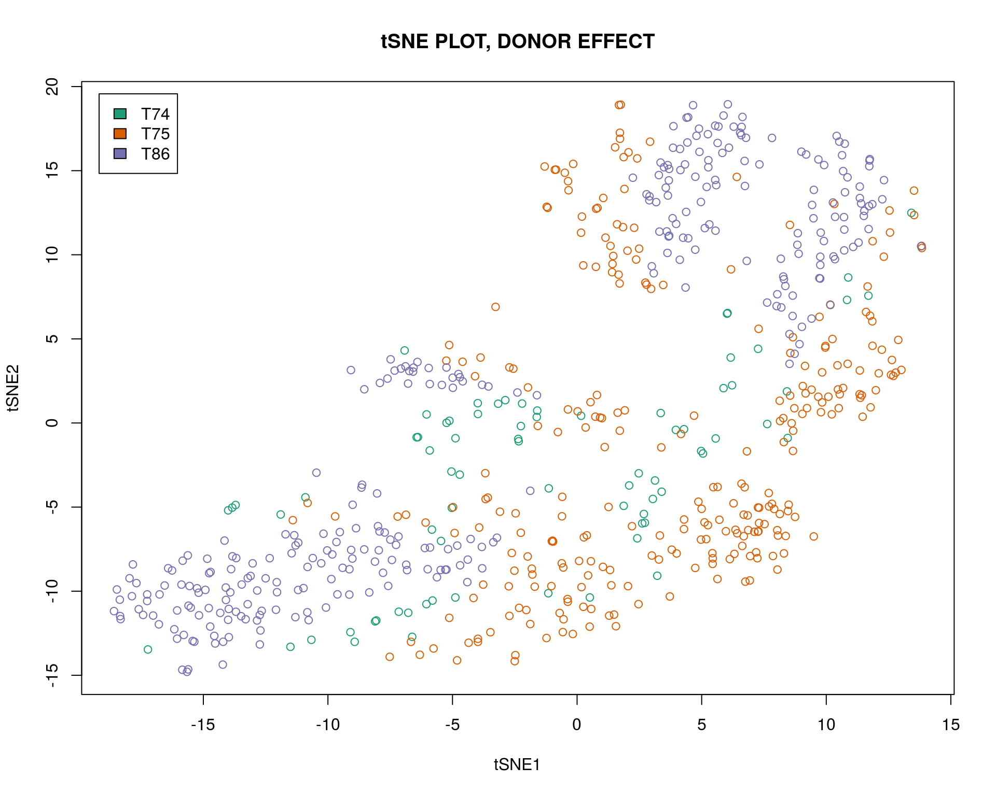
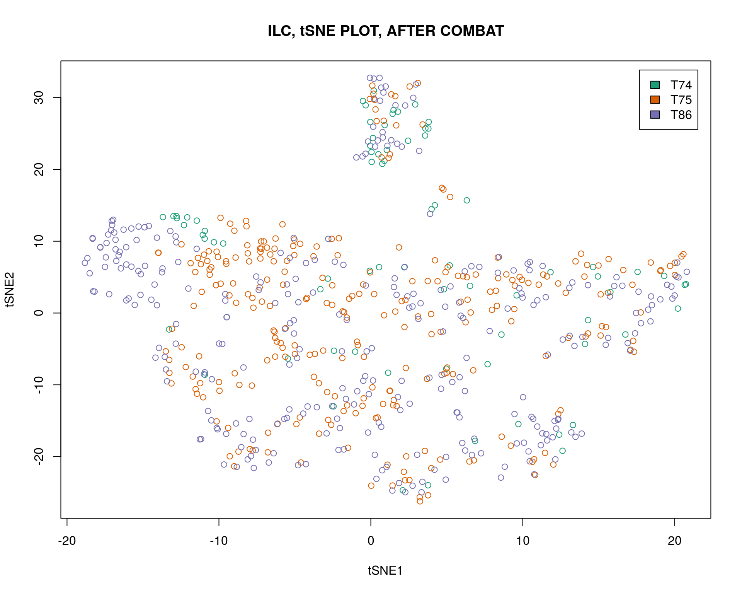
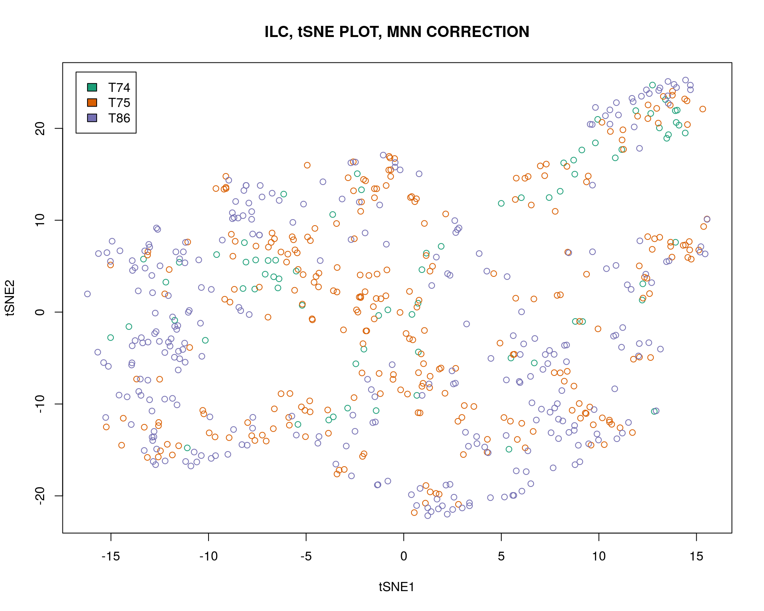
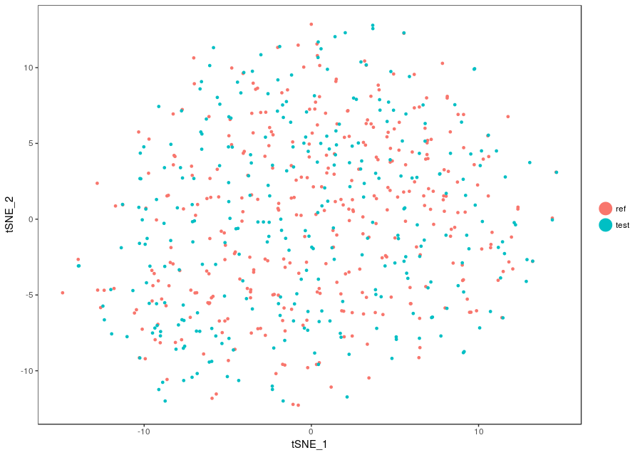
Batch Correction: Algorithm Comparison
UNCORRECTED
COMBAT
MNN
SEURAT
Å. Björklund et al.,
Nature Immunology 2016

Slide 16
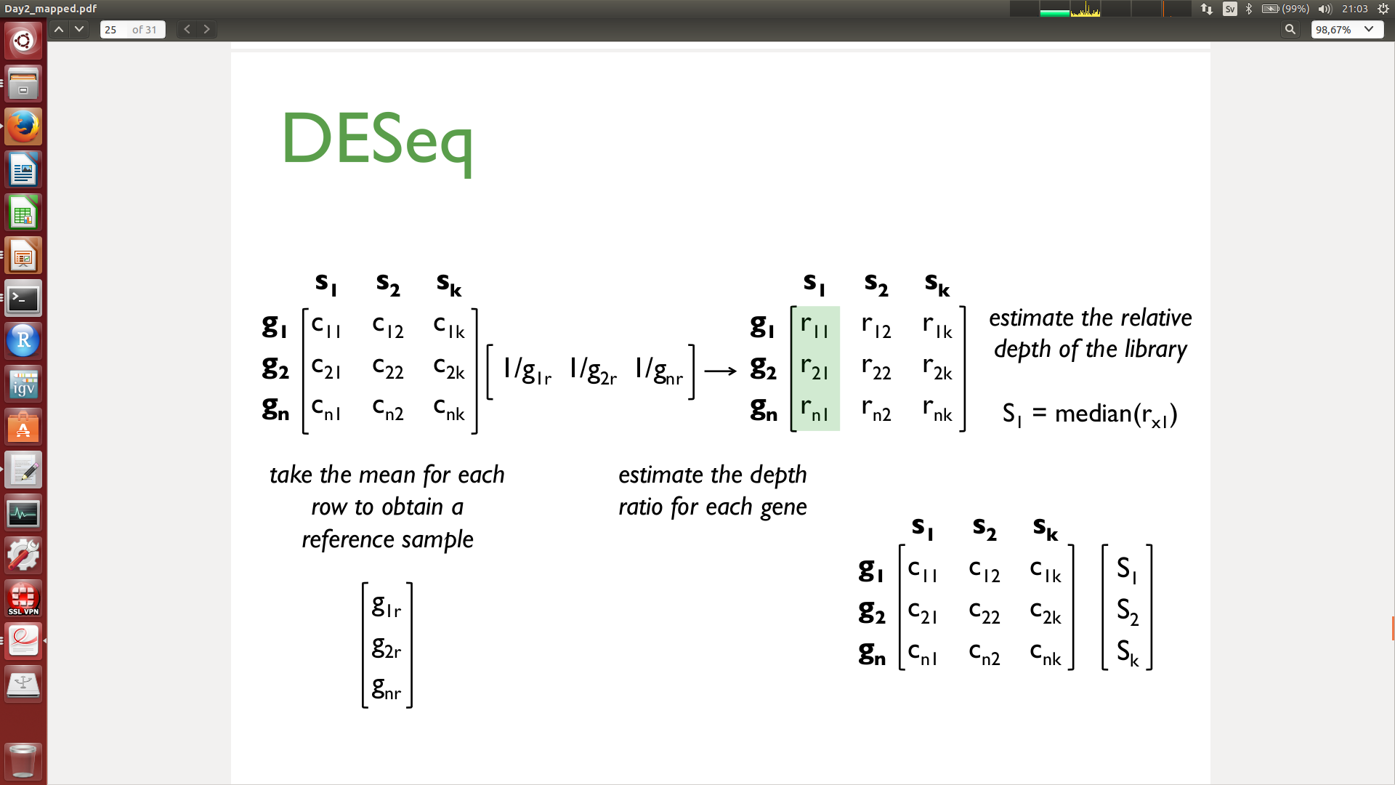
Traditional Normalization: DESeq, TMM
Build reference library based on geometric mean of all libraries, calculate size factors as ratios against the reference library
PROBLEM: scRNAseq count matrix has a lot of zeroes, hence size factors might be diverging!

Slide 17
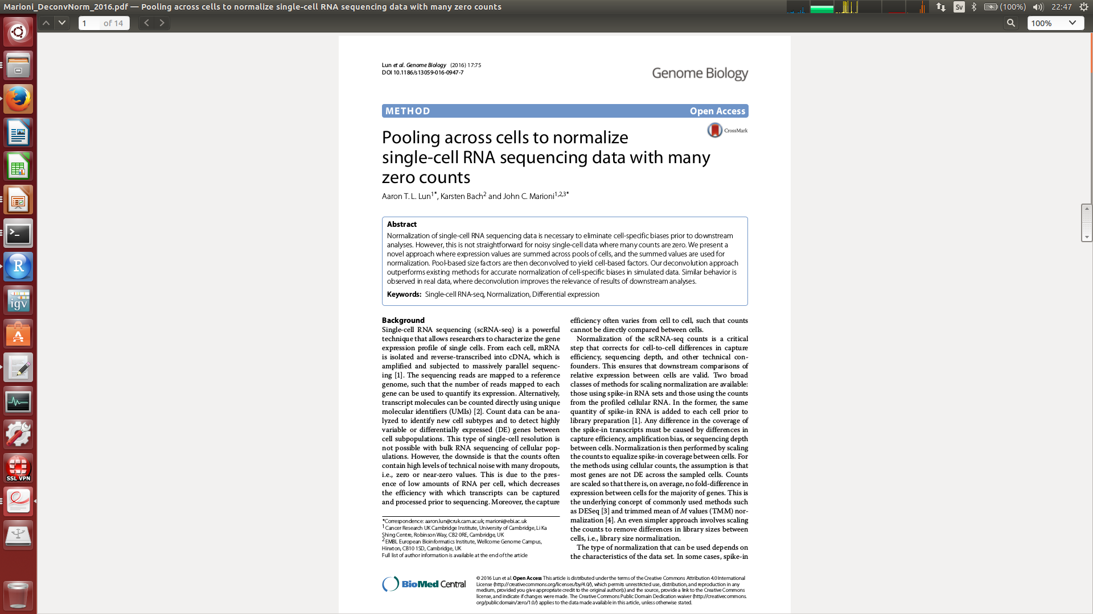
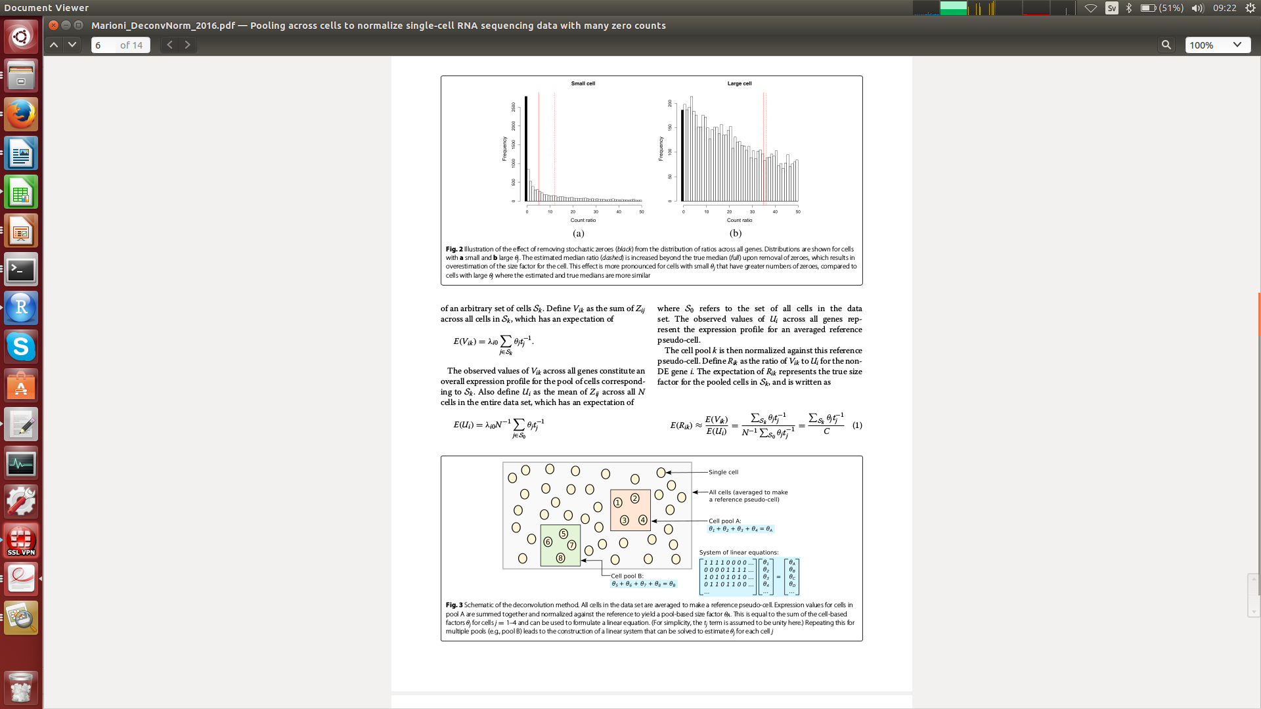
Deconvolution Normalization

Slide 18
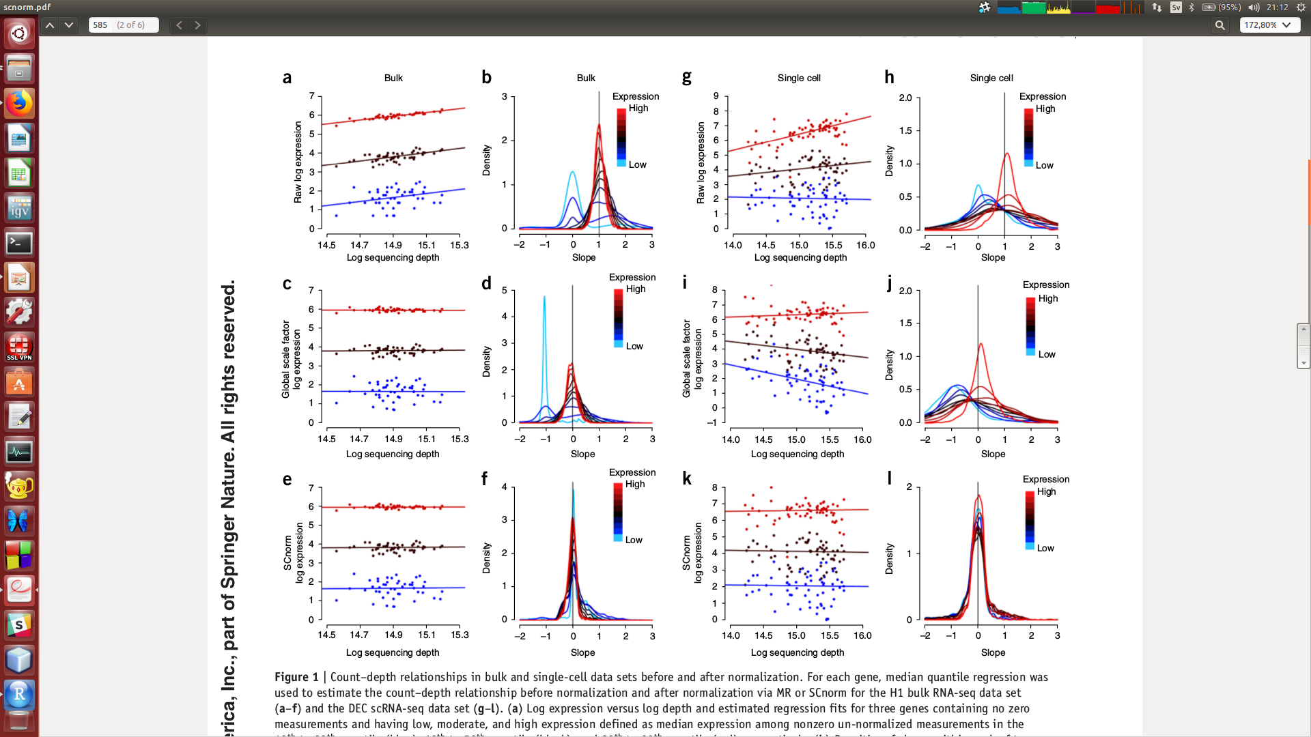
SCNORM and SCTransform Normalization
Individual size factor per cell per group of genes
R. Bacher et al.,
Nature Methods 2017

Slide 19
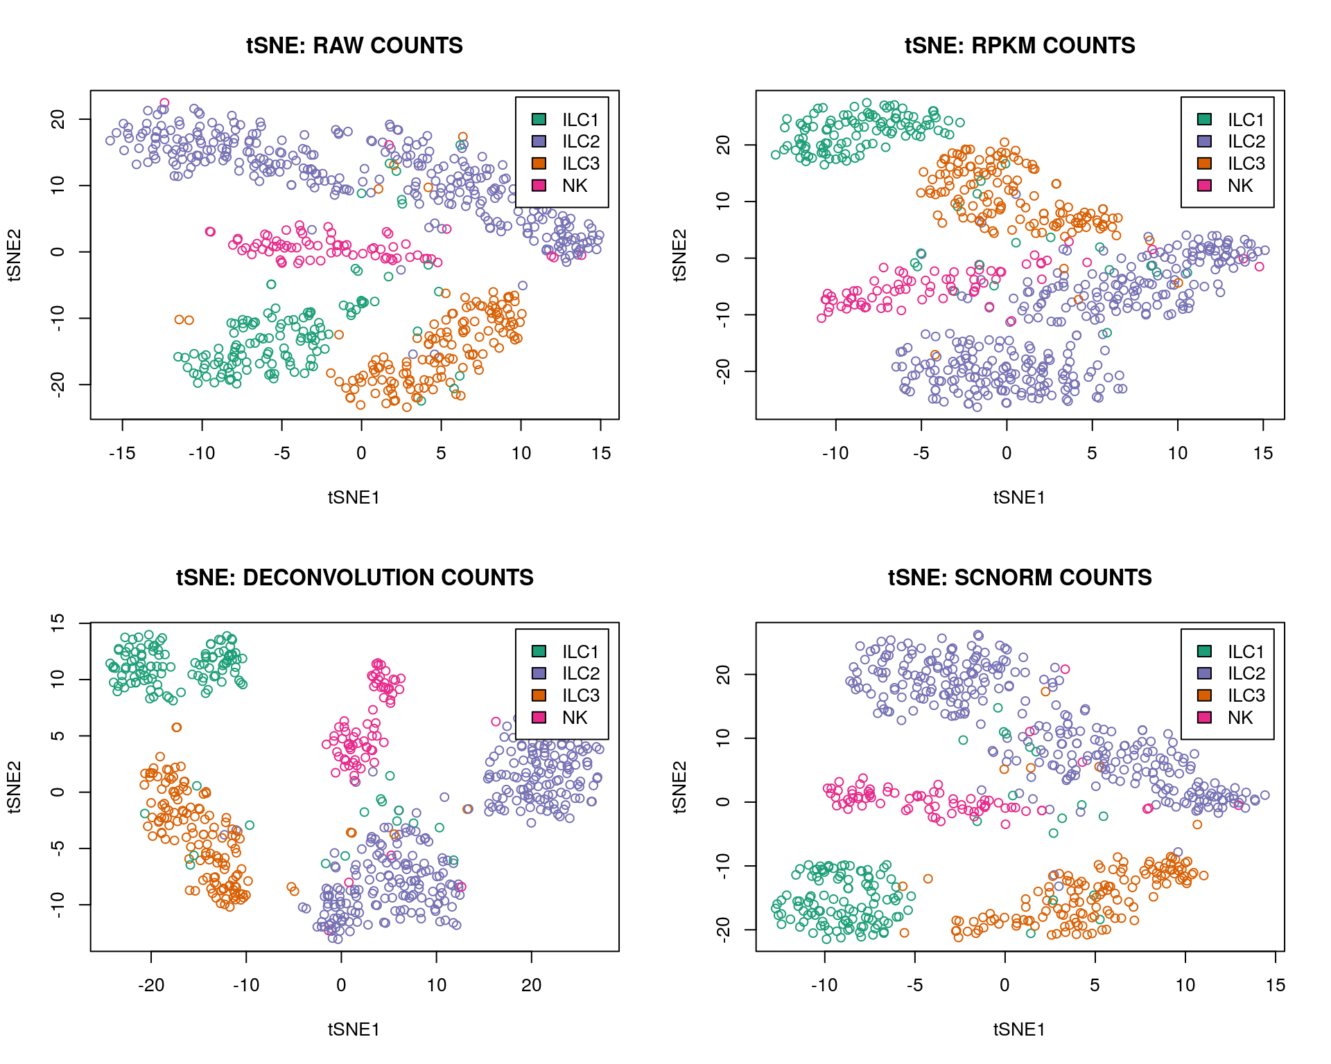
Normalization: Algorithm Comparison

Slide 20
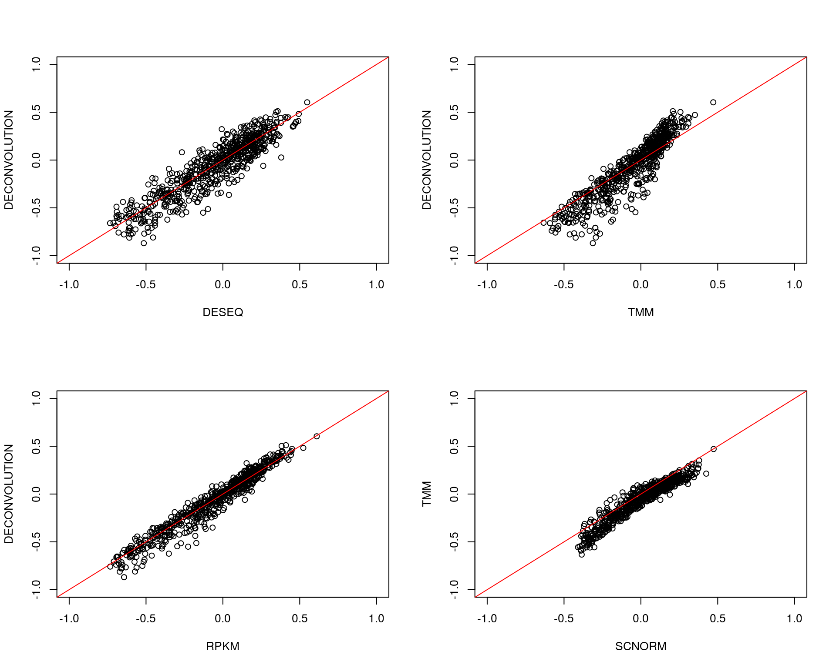
Normalization: Size Factors Comparison

Slide 21
Dimensionality Reduction
1) Linear (PCA)
2) Non-Linear (tSNE, UMAP)

Slide 22
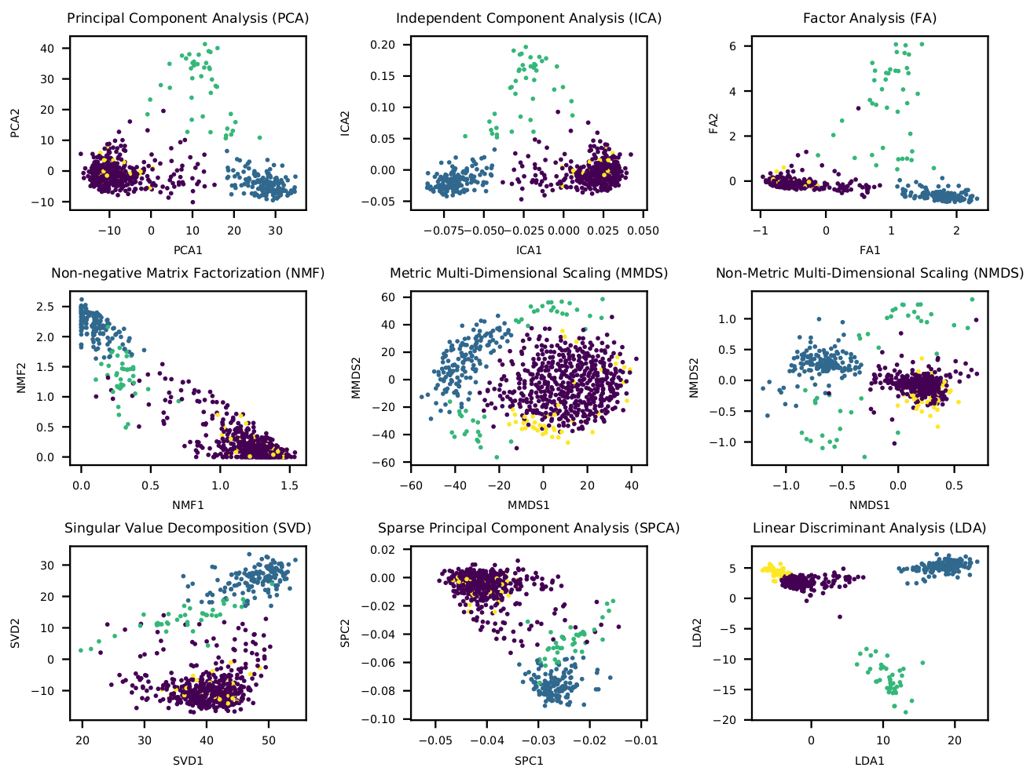
Linear Dimension Reduction
M.Bartoschek, N. Oskolkov et al.,
Nature communications 2018

Slide 23
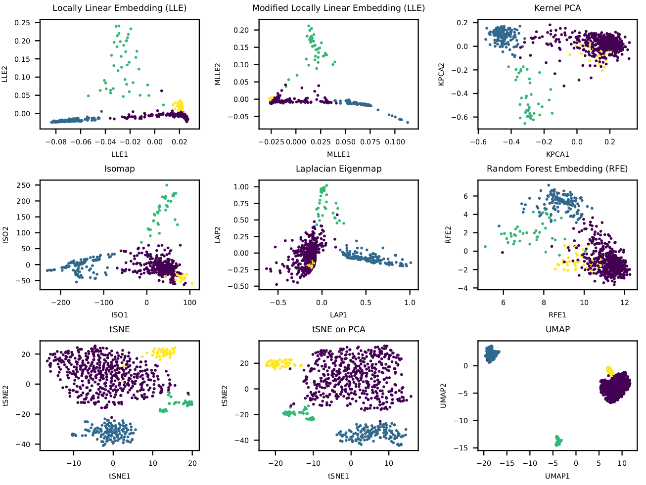
Non-Linear Dimension Reduction
M.Bartoschek, N. Oskolkov et al.,
Nature communications 2018

Slide 24
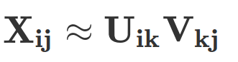
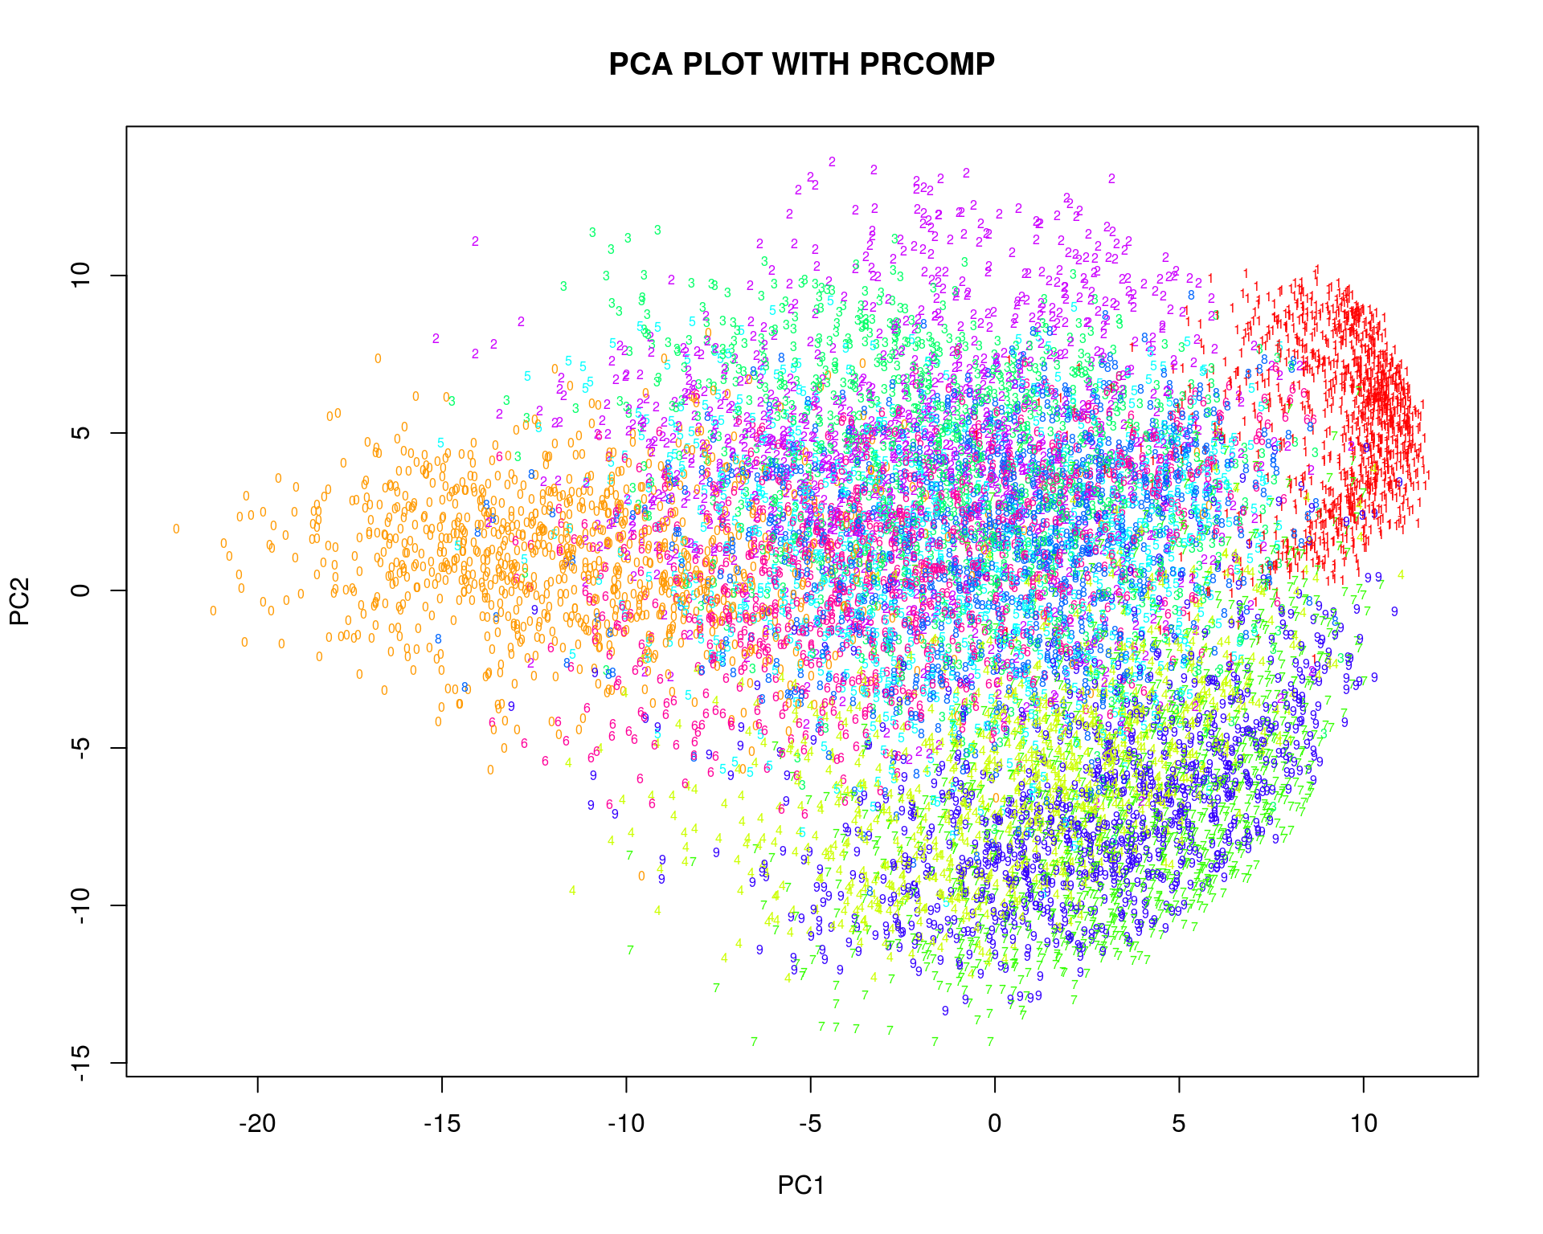
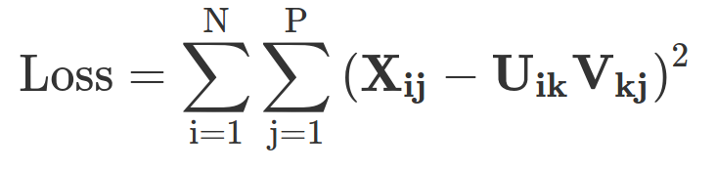
Matrix Factorization: Linear
P
D
P
x
V_{kj}
D
N
X_{ij}
≈
N
U_{ik}
Loadings
Data
Low-dimensional
data representation
(embeddings)

Slide 25
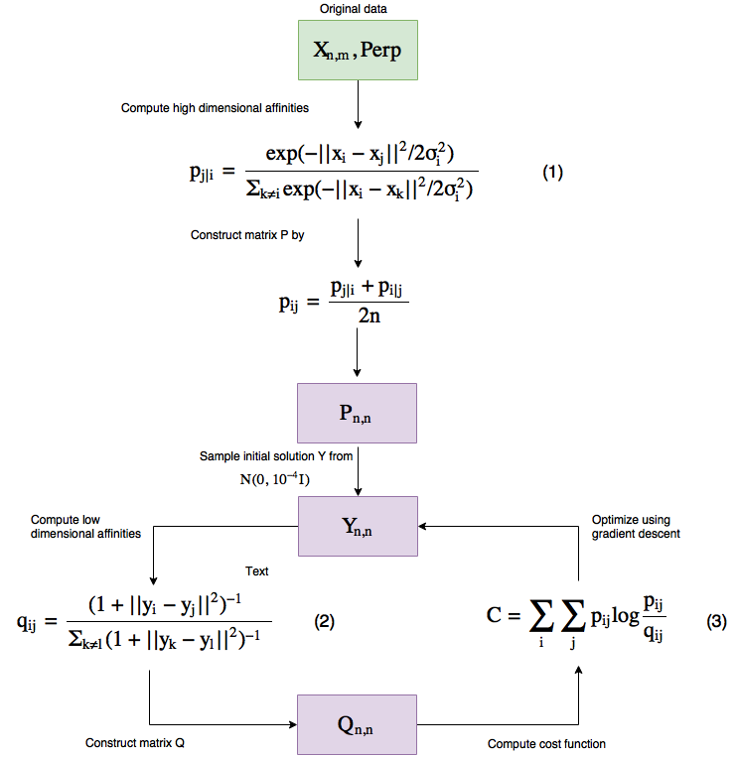
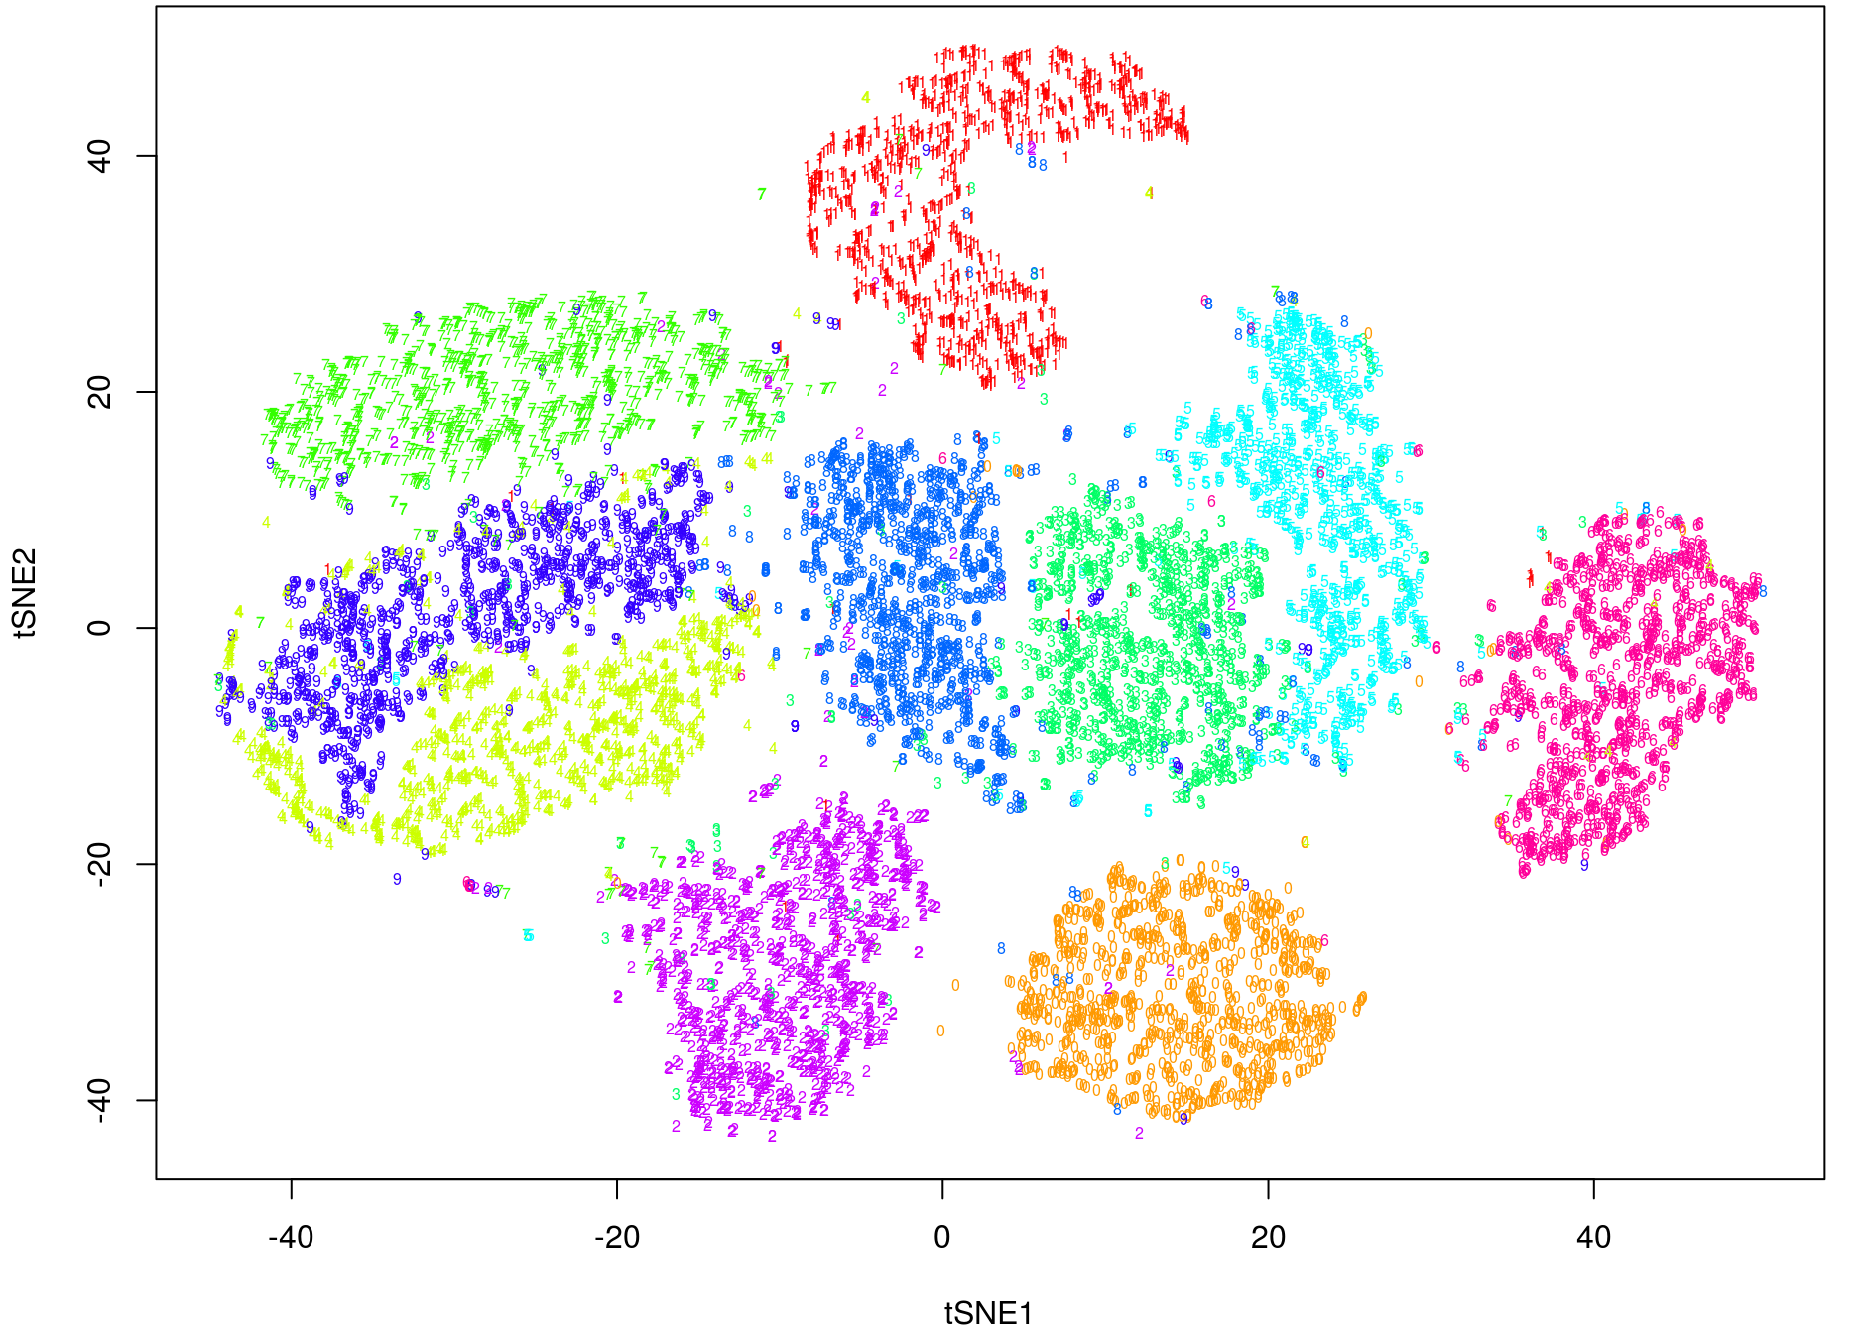
Neighbour Graph: Non-Linear

Slide 26
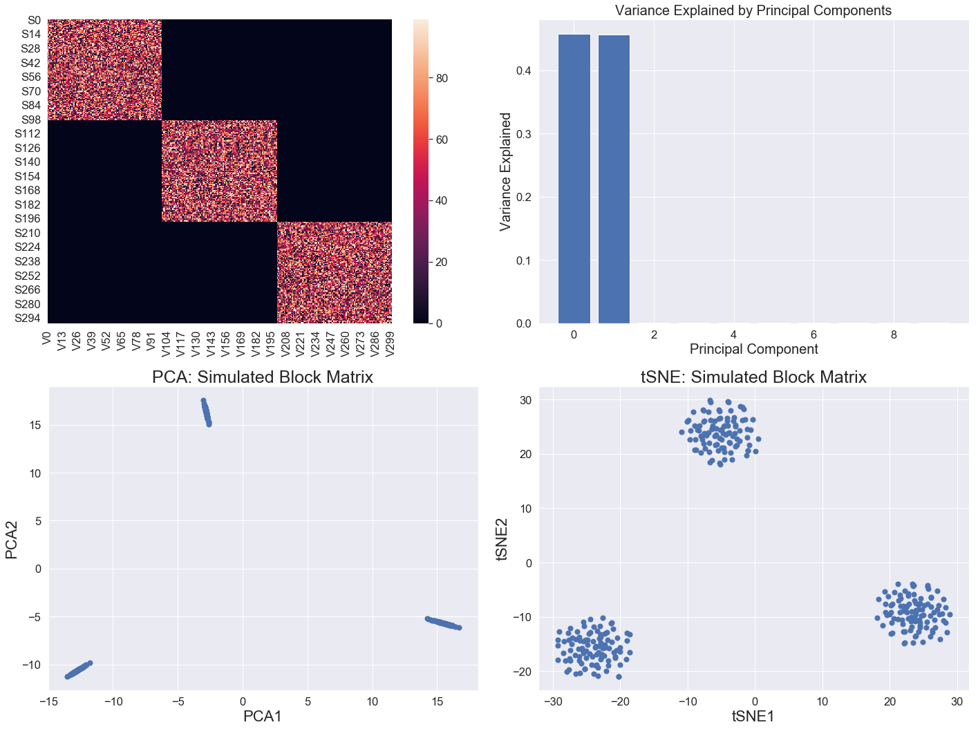
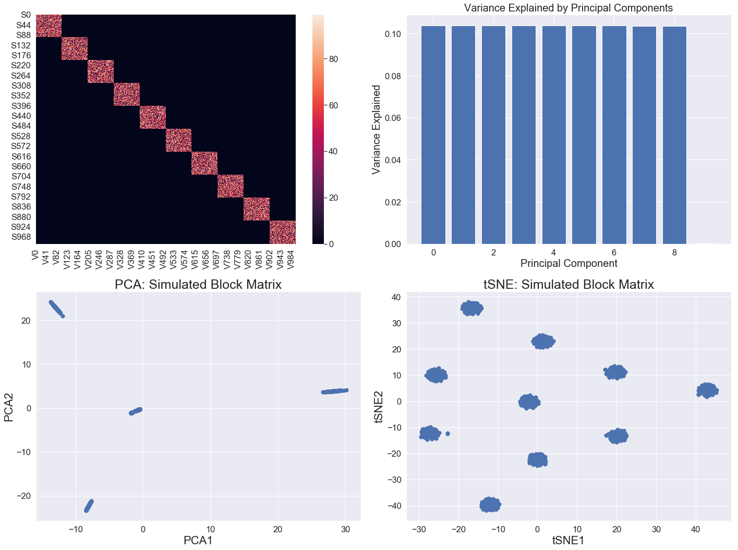
PCA vs. tSNE
when number of populations increases

Slide 27
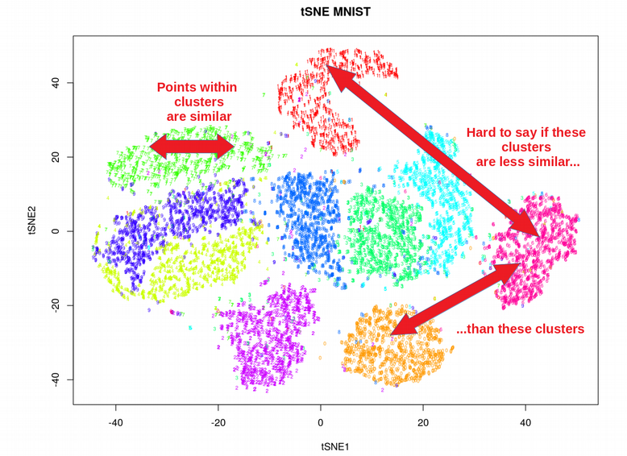
Limitations of tSNE
tSNE does not scale for large data sets?
tSNE does not preserve global structure?
tSNE can only embed into 2-3 dims?
tSNE performs non-parametric mapping?
tSNE can not work with high-dimensional
data directly (PCA needed)?
tSNE uses too much memory at large
perplexities (FitSNE does not solve it)?

Slide 28

How is UMAP different from tSNE
UMAP uses local connectivity for high-dim probabilities
UMAP does not normalize probabilities (speed-up)
UMAP can deliver a number of components for clustering
UMAP uses Laplacian Eigenmap for initialization
UMAP uses Cross-Entropy (not KL) as cost function
This is similar to tSNE cost function
This term is UMAP specific

Slide 29
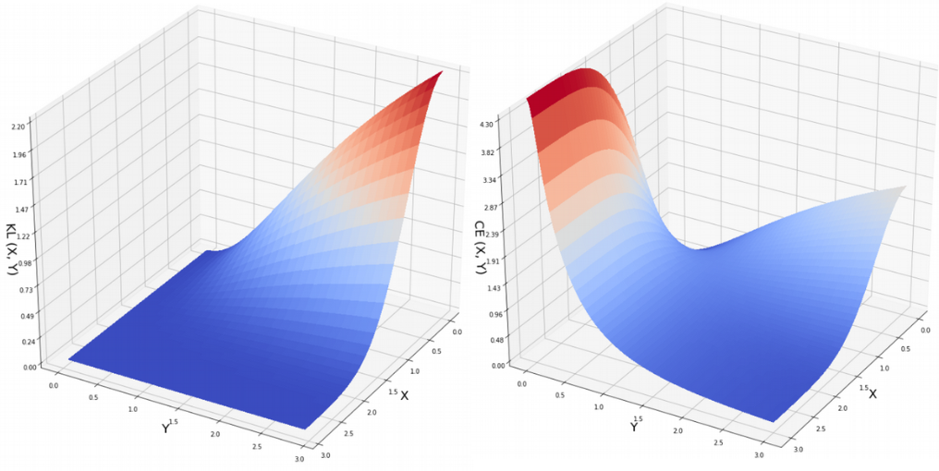
Cost Function Makes UMAP
Preserve More Global Structure than tSNE
X → infinity, Y can be any
X → infinity, Y → infinity

Slide 30
Cluster Analysis
1) Hierarchical clustering
2) Centroid - based clustering
3) Graph - based clustering
4) Density-based clustering

Slide 31
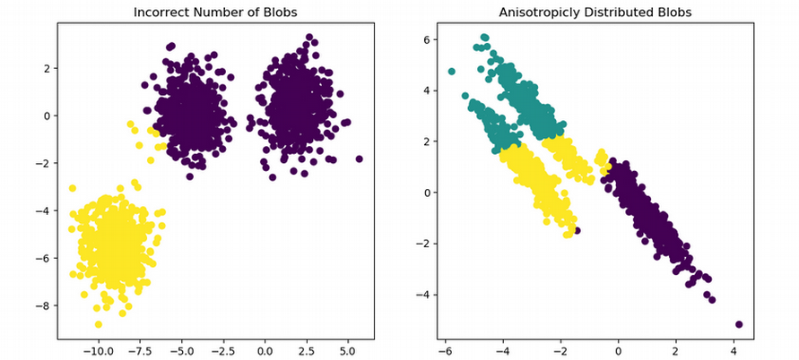
Dimension Reduction vs. Clustering
Disagreement between Dimensionality Reduction and Clustering

Slide 32


Dimension Reduction vs. Clustering
Why do I see 8 clusters, and they say that there are 3 clusters?

Slide 33

Graph-based Clustering
SNN-cliq and other graph-based clustering methods seem to be most robust for scRNAseq

Slide 34


How to select optimal number of PCs

Slide 35

How to select optimal perplexity
Van der Maaten: “Loosely speaking, one could say that a larger / denser dataset requires a larger perplexity.“
log(Perp) = -0.179 + 0.51*log(N)
Perp ~ N^(1/2)

Slide 36

Clustering on Raw Expression Matrix

Slide 37

Clustering on two tSNE dimensions

Slide 38

Clustering on leading PCA components

Slide 39




National Bioinformatics
Infrastricture Sweden (NBIS)

