Slide 1
Desktop apps in a world dominated by the Web

Slide 2

Who me?
Didn’t finish FMI… Логическо…
Started in Telerik around 2011 – WPF and Silverlight
MobiSystems for a bit – Office Suite for Windows
Started SourceWeave
Gymnastics Scoring Systems
.NET Development Consulting – mostly Web and Cloud hosted systems
… Bancrupted the company…
Sales Engineer in Progress – Full Circle… kinda

Slide 3
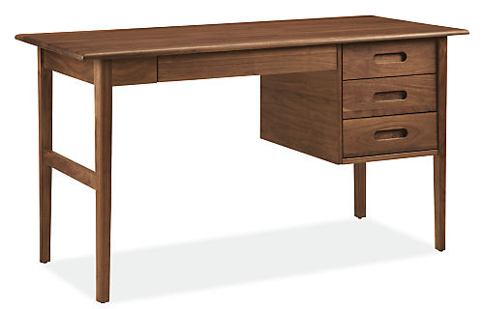
Desktop development – my two cents

Slide 4

Gymnastics software v1 - Rhythmic
Admin Panel – a.k.a. – do it all module
Hall
Monitors
Judge
Input
TV graphics
Tablet
Monitors
Views
ViewModels
Models
SignalR Hub
REST API
DAL - Repositories
Players
Competitions
Etc…
Common – EVERYTHING!
Database - SQLite

Slide 5
Gymnastics software v2 - Artistic
Admin Panel
Admin Panel – WEB
Control Hub for Other
modules
Hall
Monitors
Judge
Input
TV graphics
Tablet
Monitors
Views
ViewModels
Models
SignalR Hub
REST API
DAL - Repositories
Players
Competitions
Etc…
Common – EVERYTHING!
Database - SQLite

Slide 6

What happens when you have to extend?

Slide 7
Problems
DB and Desktop app are hosted on the same machine
Different Data Access chains from different UIs
REST API for Web and mobile based modules
Direct DAL access for Desktop
I’m sure there are many more, but should be enough to rethink.

Slide 8
Solution?

Slide 9






How I would do it, if I could do it over again…
Whatever Module
External Access?
Desktop
Web
Mobile
REST API
SignalR
Business Logic
Access Control
Data Access Layer
Database

Slide 10
Benefits of the approach
Completely detached Clients
Go with whatever you want
Add a new one when you have to
Highly testable
Scalable… if you do your job right…

Slide 11
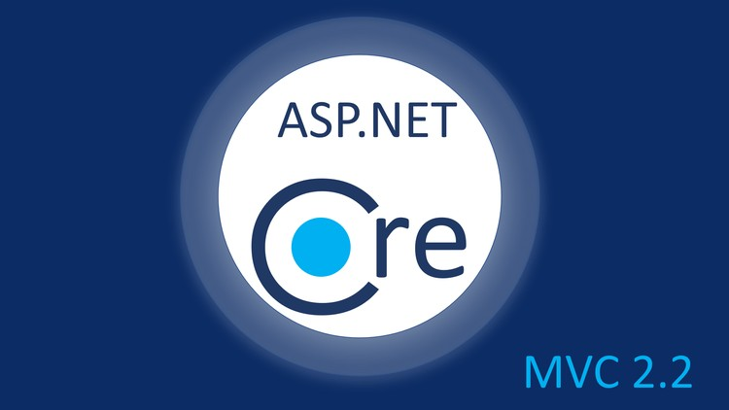

How we actually did it...
Desktop
Web
Mobile
REST API
REST API
Access Control
JWT, OAuth
Business Logic
Business Logic
Data Access Layer
Data Access Layer
Database – AWS - RDS

Slide 12
How we actually did it...
Desktop
Web
Mobile
REST API
REST API
Access Control
JWT, OAuth
Business Logic
Business Logic
Data Access Layer
Data Access Layer
Database – AWS - RDS

Slide 13
Some ways to handle REST in .NET
HttpWebRequest/Response classes
WebClient class
HttpClient Class
3rd party libraries

Slide 14

Let’s see some code

Slide 15
References
https://swapi.co/
https://bit.ly/2BI3C4T
https://youtu.be/_lwCVE_XgqI
https://github.com/olcay/SharpTrooper
https://bit.ly/2WG9fvH - how to POST with WebClient

Slide 16
Questions?

Slide 17
Thank you!
Контакти:
linkedin.com/in/nikolayvasilev/
github.com/NikolayVasilev/DesktopAppsWithWeb
nvasilev.me
Следващо събитие:
ML.NET – Machine Learning за .NET с примери

