Slide 1
Desktop apps in a world dominated by the Web

Slide 2

Who me?
Started in Telerik around 2011 – WPF and Silverlight
MobiSystems for a bit – Office Suite for Windows
Started SourceWeave
Gymnastics Scoring Systems
.NET Development Consulting – mostly Web and Cloud hosted systems
… Bancrupted the company…
Sales Engineer in Progress – Full Circle… kinda

Slide 3
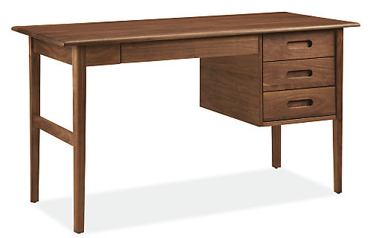
Desktop development – my two cents

Slide 4

Gymnastics software v1 - Rhythmic
Admin Panel – a.k.a. – do it all module
Hall
Monitors
Judge
Input
TV graphics
Tablet
Monitors
Views
ViewModels
Models
SignalR Hub
REST API
DAL - Repositories
Players
Competitions
Etc…
Common – EVERYTHING!
Database - SQLite

Slide 5
Gymnastics software v2 - Artistic
Admin Panel
Admin Panel – WEB
Control Hub for Other
modules
Hall
Monitors
Judge
Input
TV graphics
Tablet
Monitors
Views
ViewModels
Models
SignalR Hub
REST API
DAL - Repositories
Players
Competitions
Etc…
Common – EVERYTHING!
Database - SQLite

Slide 6
Thank you!
Контакти:
linkedin.com/in/nikolayvasilev/
github.com/NikolayVasilev/DesktopAppsWithWeb
nvasilev.me
Следващо събитие:
Заглавие на следващото събитие

