Slide 1
Things to note:
Call for Volunteers for the Final Presentation, the instruction from Spring 24 is posted.
Take the office hour poll

Slide 2
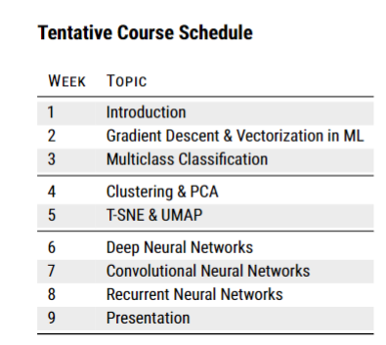
Agenda for Section 1
Gradient Descent for SLR (Today)
Gradient Descent for MLR (Wednesday)
Gradient Descent Implementation with Vectorization & SGDRegressor in Sklearn (Next Monday)
Multiclass Classification (Next Wednesday)
HW1: Implementing Gradient Descent for Logistic Regression

Slide 3
Motivation: Models you have learned
Linear regression
Parametric
Logistic regression
ML Models
KNN
Nonparametric
Tree based models

Slide 4
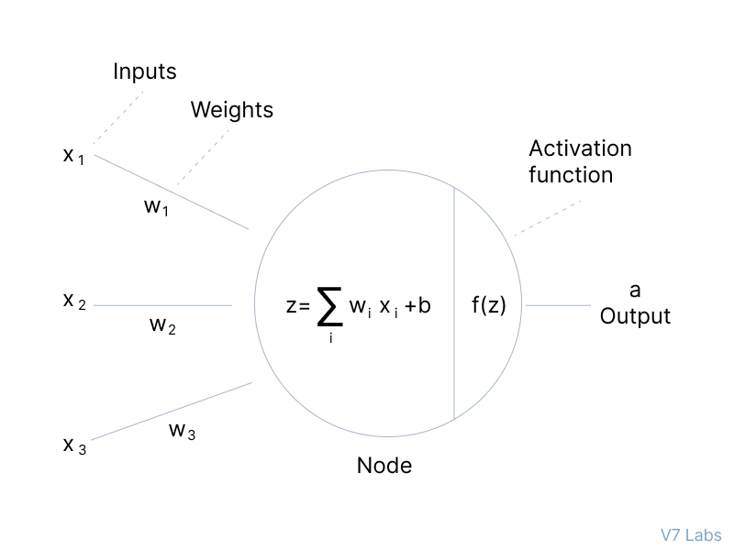
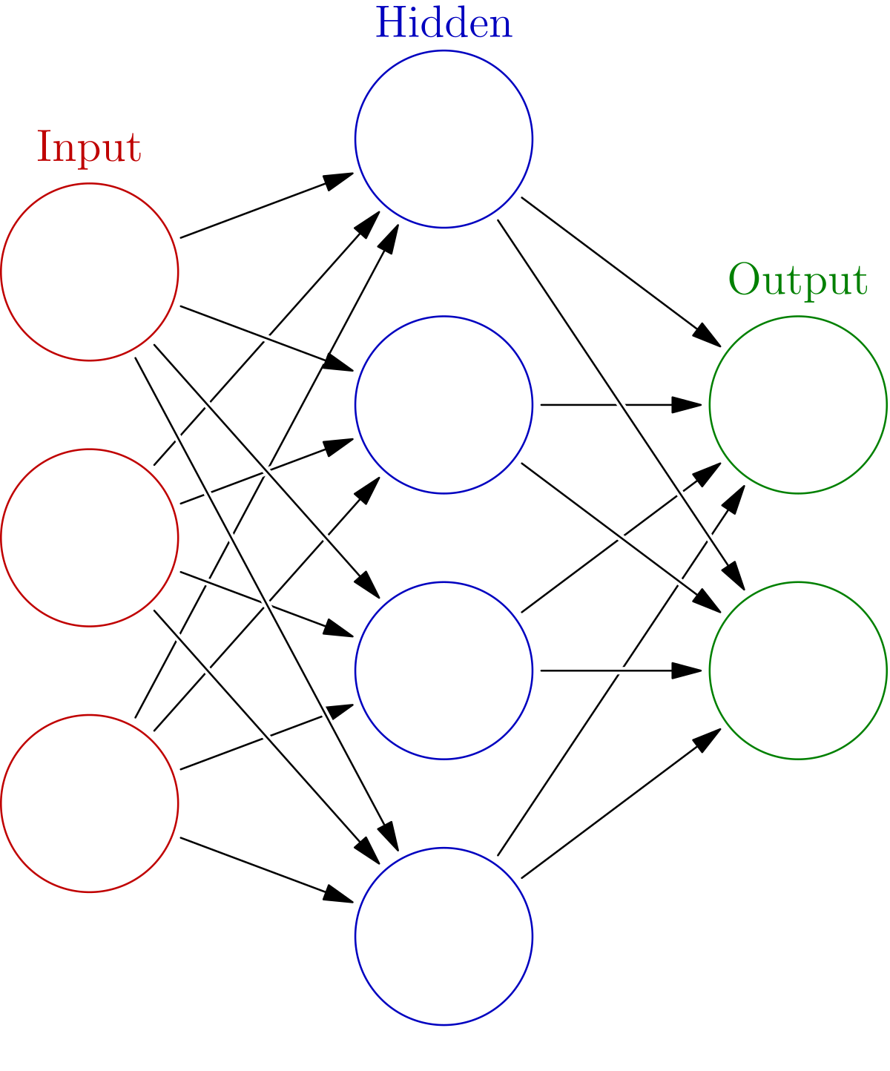
Neural Nets (parametric): linear regression + activation Function
A NN with Two Layers

Slide 5
Agenda for Today
After-class Assignment:
Gradient Descent Implementation using for loops in SLR (Fill in Code Blanks)
Lecture:
Cost Function Intuition- using SLR
Visualizing the Cost Function
Gradient Descent
Gradient Descent for SLR
Learning Rate in GD
Implementing Gradient Descent
Running Gradient Descent

Slide 6
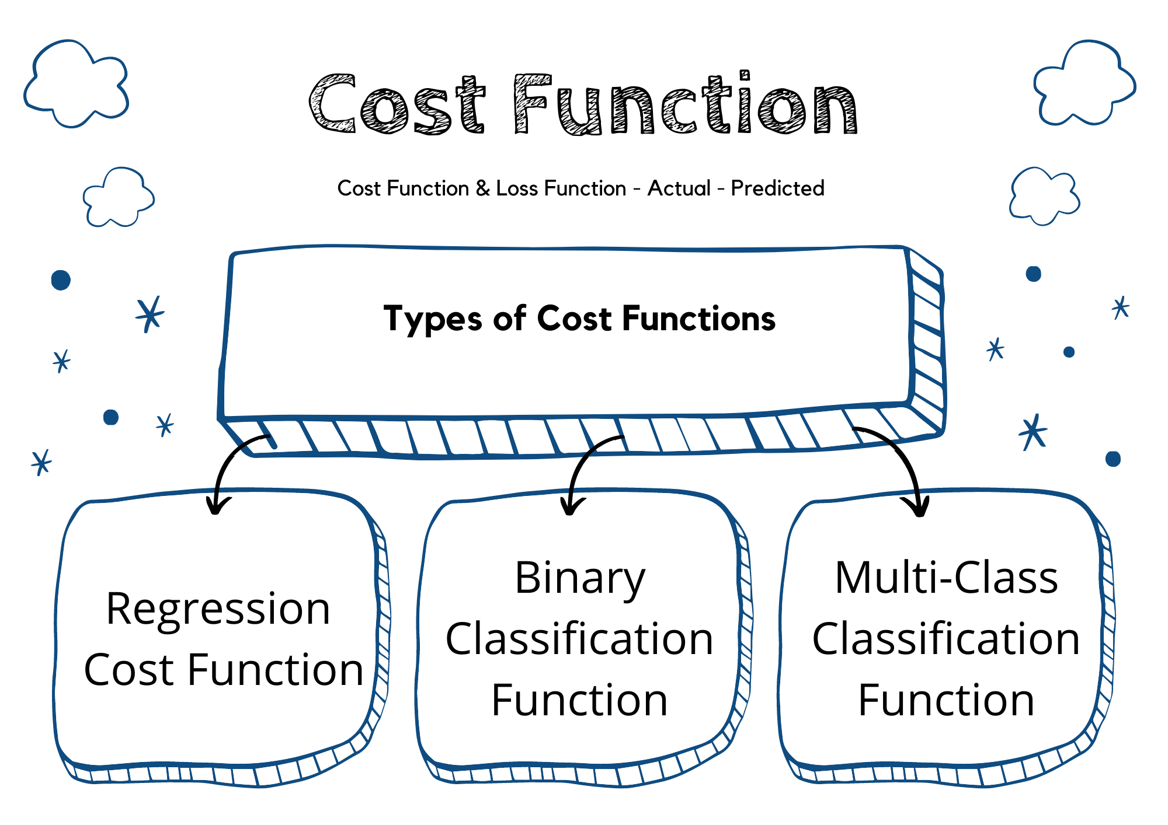
Cost Function
in ML

Slide 7



Cost Function:
Quantify the error between the predicted values and the actual values
Where,
Linear regression
Gradient Descent is used as an optimization algorithm to find the optimal parameters for models.
Parametric
Logistic regression
Neural Nets
Notes:
Maximum likelihood estimation

Slide 8
Using SLR as an illustration
Cost Function
Intuition

Slide 9

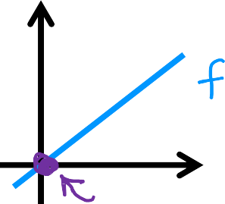







model:
simplified
f_{w} x = wx
^{f}w,b
x = wx + b
parameters:
w, b
cost function (MSE):
w
goal:
minimize J w, b
w,b
minimize J w
w

Slide 10
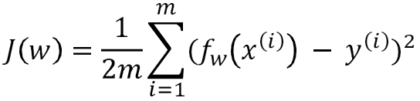





f_{w}(x) = wx
(for fixed w, function of x)
input
(function of w)
parameter
3
f_{w}
3
: actual value
2
y
1
0
w = 1
2
J(w)
1
0
0
1
-0.5 0 0.5 1 1.5 2 2.5
w
1
x
_{x} i
2
3
m
m
1
L(wx ^{i} - y ^{i} )²
i=1
1
J (1) =
- y ^{i} )² =
= ( 0² +0² +0² ) = 0
2
w
2m
2m
i=1

Slide 11


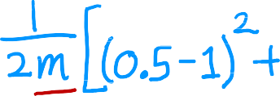
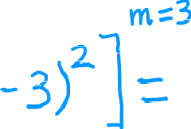
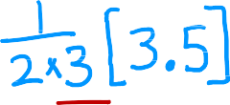






f_{w}(x) = wx
(function of x)
(function of w)
3
f_{w}(x)
3
: actual value
2
2
y
J(w₁)
1
1
w = 0.5
0
0
0
1
2
3
-0.5
0 0.5 1 1.5 2 2.5
w
x
J 0.5 =

Slide 12



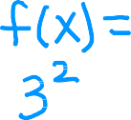


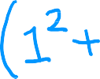



f_{w}(x)
(function of x)
(function of w)
3
f_{w}
3
: actual value
2
2
y
J(w)
1
1
w = 0
0
0
0
1
2
3
-0.5
0 0.5 1 1.5 2 2.5
w
x
J 0 =

Slide 13
Linear Regression with One Variable
Visualizing the Cost Function

Slide 14
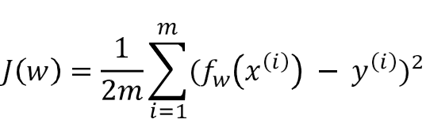







goal of linear regression:
J(w)
(function of w)
3
2
J(w)
minimize J w
w
1
to find optimal w
0
-0.5
0 0.5 1 1.5 2 2.5
w

Slide 15


x = wx + b
General SLR:
^{f}w,b
Parameters
w, b
Cost Function
Objective
minimize J w, b
w,b

Slide 16
^{f}w,b
(function of x)
Given w and b, we can calculate J(w, b)
500
400
300
price in
$1000'5
200
100
0
0
1000 2000
size in feet²
3000
^{f}w,b
x = 0.06x + 50

Slide 17
^{f}w,b
x
(function of x)
Given w and b, we can calculate J(w, b)
500
400
300
price in
$1000'5
200
100
0
0
1000 2000
size in feet²
3000
^{f}w,b
x = wx + b

Slide 18
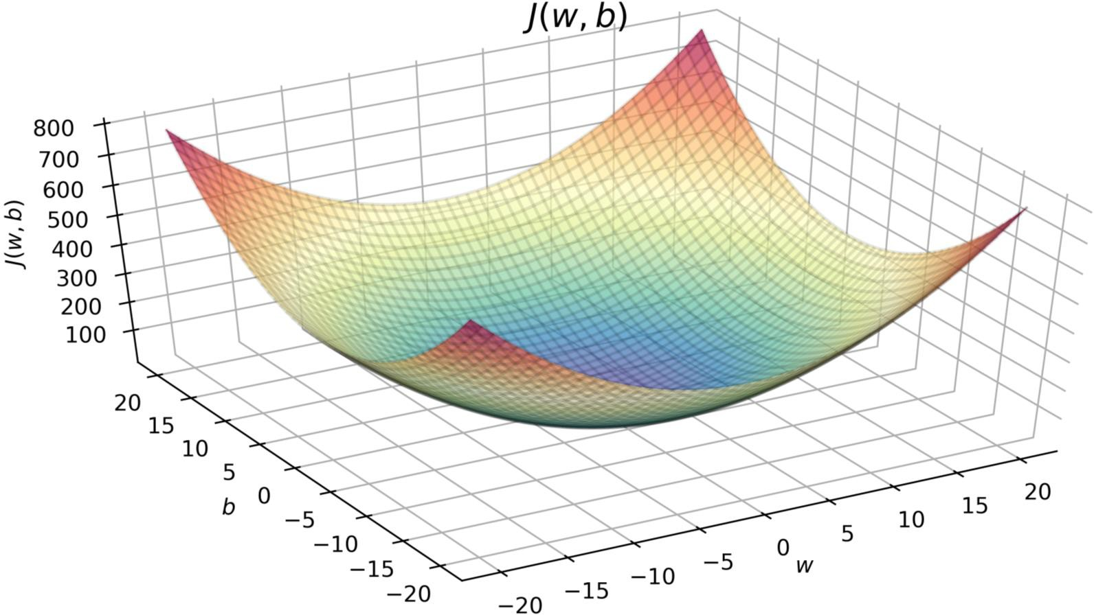


^{J}(w,b)
(function of w, b)
J w = -10, b = -15

Slide 19
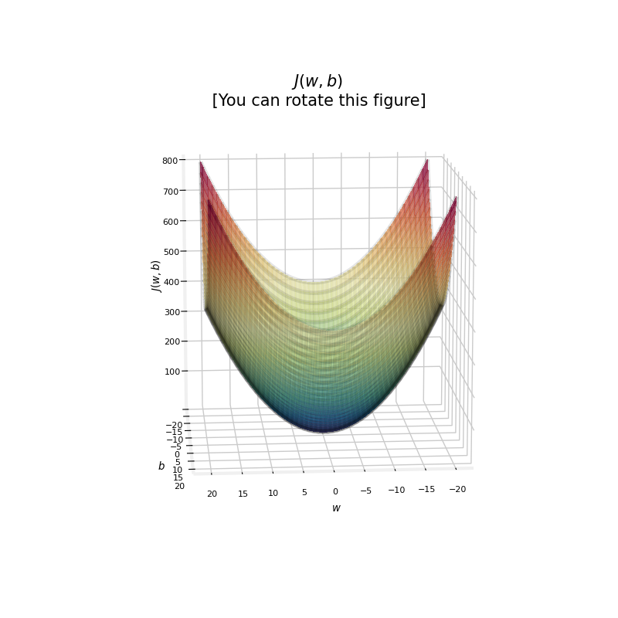
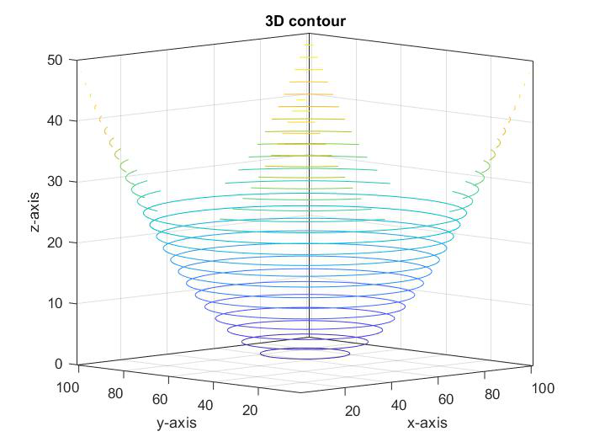
J(w, b)

Slide 20
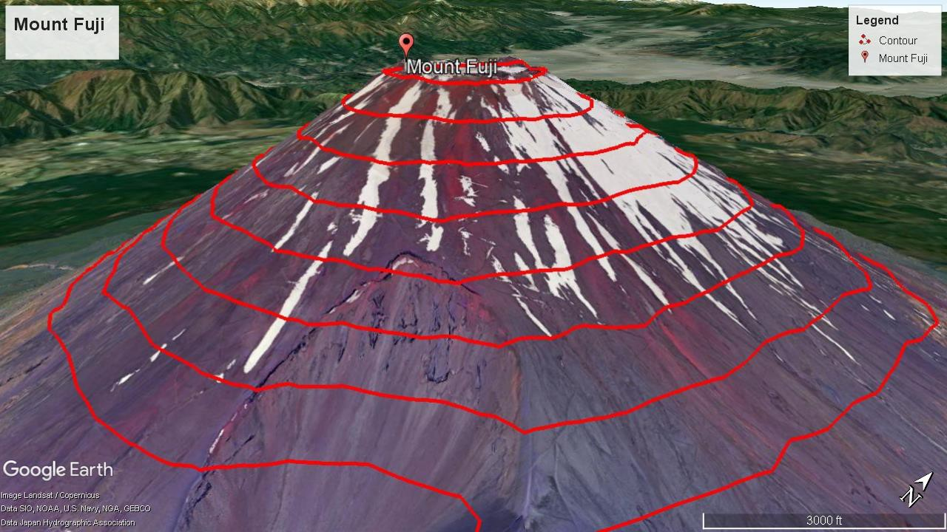
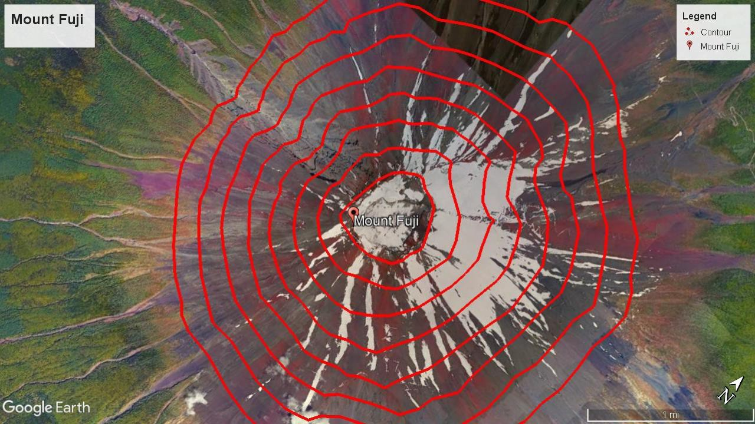
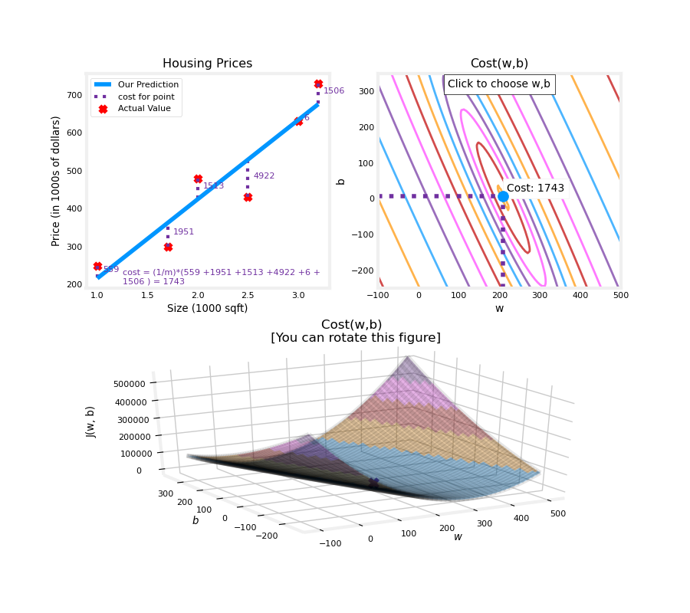
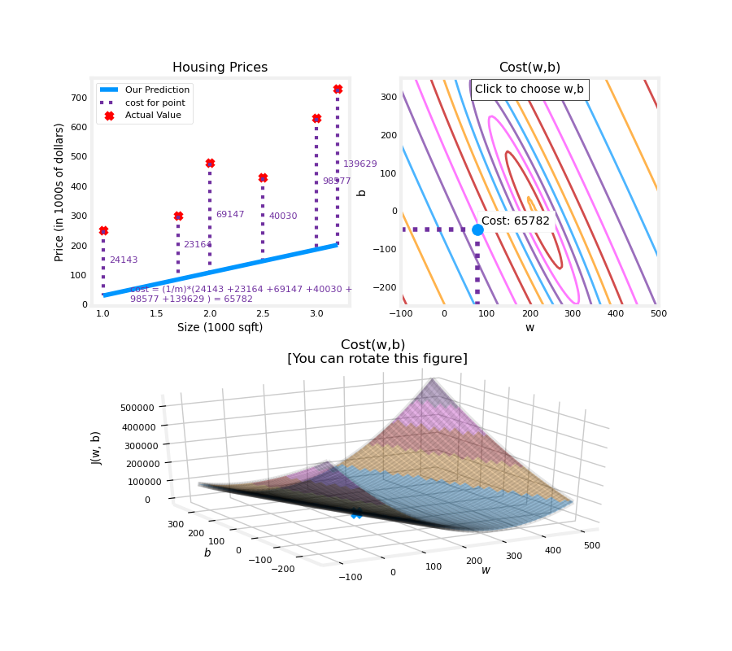
Cost Function Visualization – 3D

Slide 21
An optimization algorithm used to minimize the cost function in machine learning
Gradient Descent

Slide 22

J w, b
Have some cost function
Want
min J w, b
w,b
Outline:
Start with some w, b
(set w=0, b=0)
Keep changing w, b to reduce J w, b
Until we settle at or near a minimum

Slide 23



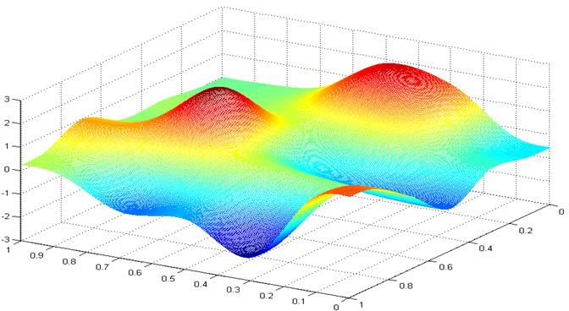











J w, b
Every step taken in gradient descent moves closer to the global (or at least local) minimum!
b
w
Notes:
Local minima

Slide 24
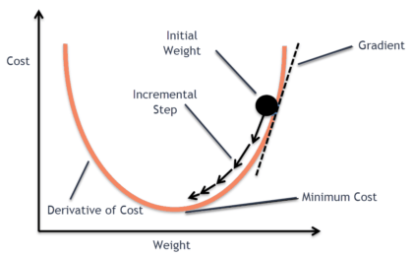




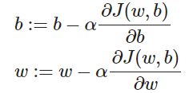
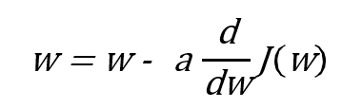

How to ensure that every step taken in gradient descent moves closer to the global (or at least local) minimum
J(w, b)
b
w
:
Notes:
Derivative, partial dericative with respect to each variable

Slide 25

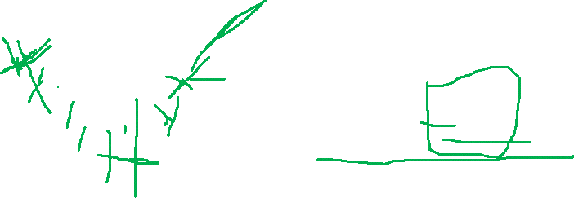



Repeat until convergence: {
J w
w
:
}
J w
w

Slide 26
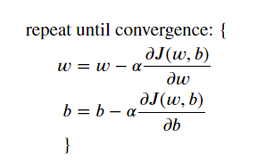

Gradient descent algorithm
Learning rate Derivative
Simultaneously update w and b
Correct: Simultaneous update
a
tmp_w = w - a _{aw} J w, b
Incorrect
a
tmp_w = w - a J w, b
aw
a
tmp_b = b - a J w, b
w = tmp_w
a
ab
tmp_b = b - a J w, b
ab
b = tmp_b
w = tmp_w b = tmp_b

Slide 27
how big each step is toward finding the minimum of a cost function
Learning Rate:
A key parameter

Slide 28





w = w - a
d
J w
dw
J(w)
minimum
If a is too small.
Gradient descent may be slow.
w
If a is too large.
Gradient descent may:
Overshoot, never reach minimum
Fail to converge, diverge
J(w)
w
minimum

Slide 29
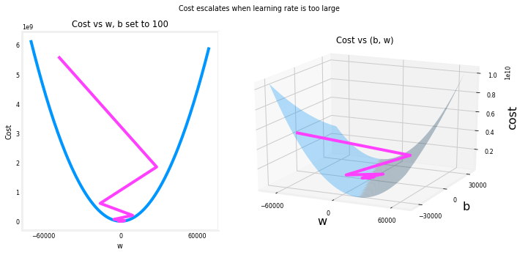
If a is too large

Slide 30



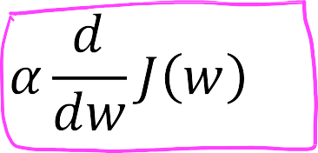
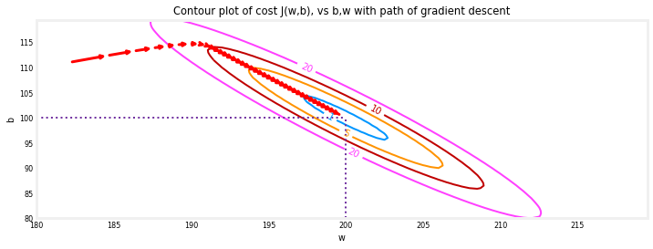
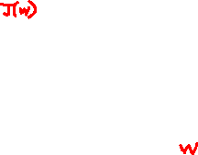
Can reach local minimum with fixed learning rate
not as large
large
Near a local minimum,
Derivative becomes smaller
Update steps become smaller
Can reach minimum without
decreasing learning rate

Slide 31
Training SLR
Gradient Descent for SLR

Slide 32













Cost function
SLR model
f_{w,b}(x) = wx + b
Gradient descent algorithm

Slide 33


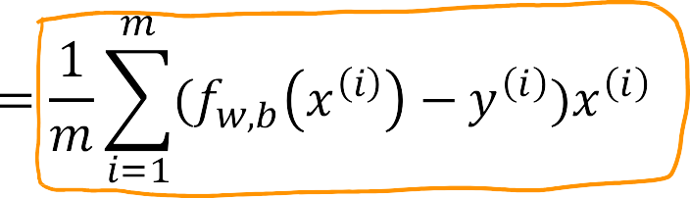


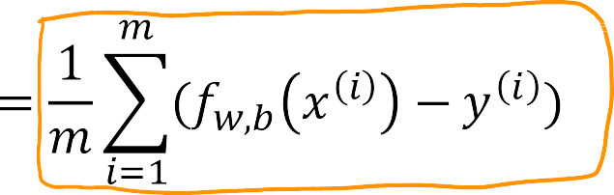
(Optional)The chain rule
a
_{aw} J w, b =
a
J w, b =
ab

Slide 34




Gradient descent algorithm
repeat until convergence {
Update
w and b
simultaneously
}

Slide 35



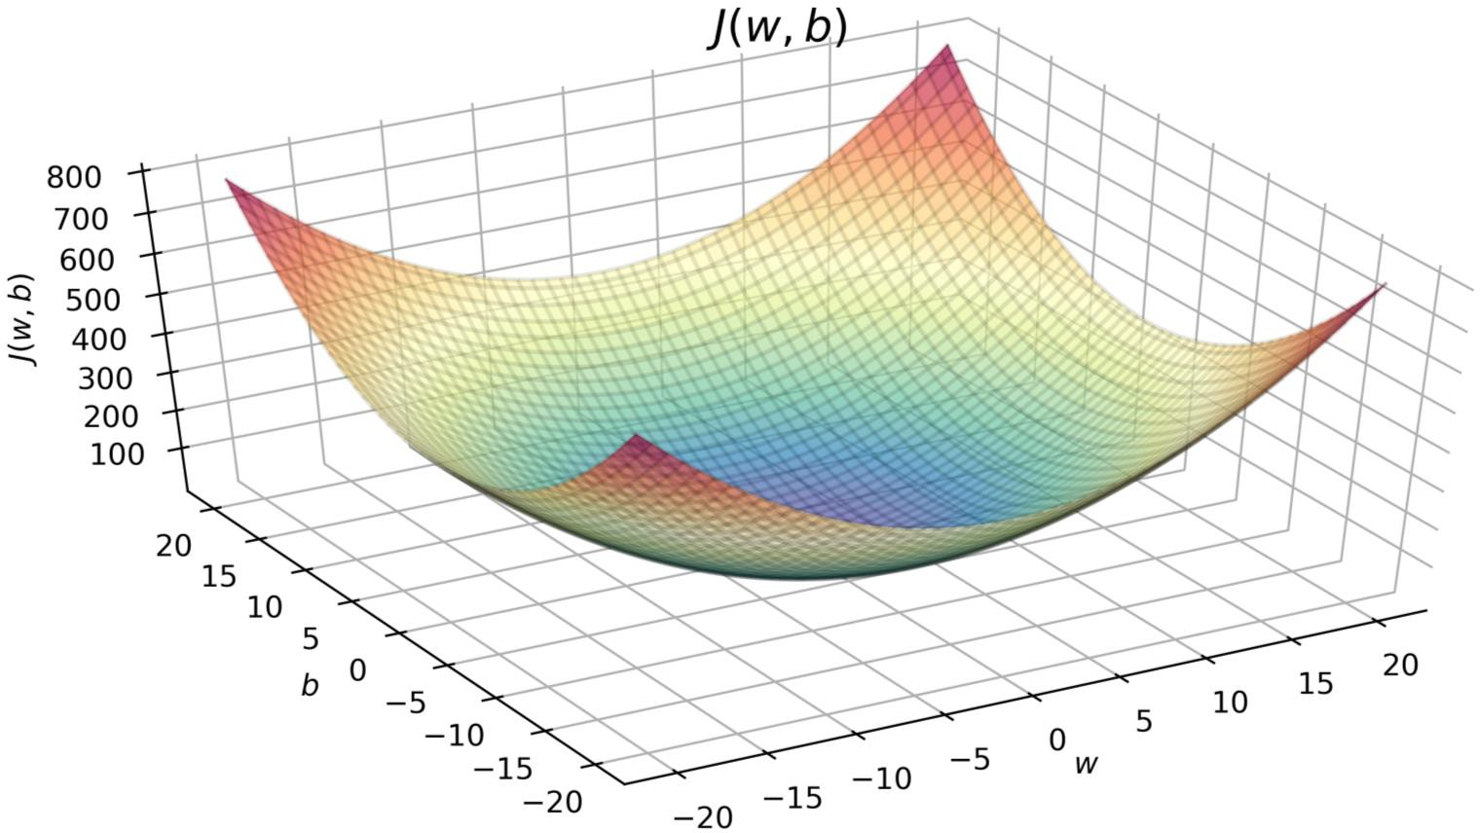

squared error cost
convex function
w
global minimum
b

Slide 36
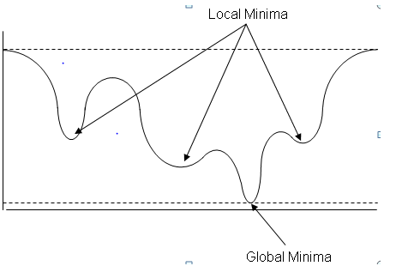

J(w)
w = w - a · 0
w = w

Slide 37
More than one local minimum
J w, b
b
w

Slide 38
With Simple Linear Regression
Implementing Gradient Descent

Slide 39
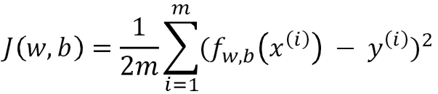


Implement GD using for loop
Step functions:
compute_cost: in each step, computing the cost J (w, b) as (w, b) gets updated
compute_gradient: Return the total gradient update from all the examples
gradient_descent: update (w, b)repeat until convergence
Quiz 1 for details:

Slide 40
Training Linear Regression
Running Gradient Descent

Slide 41
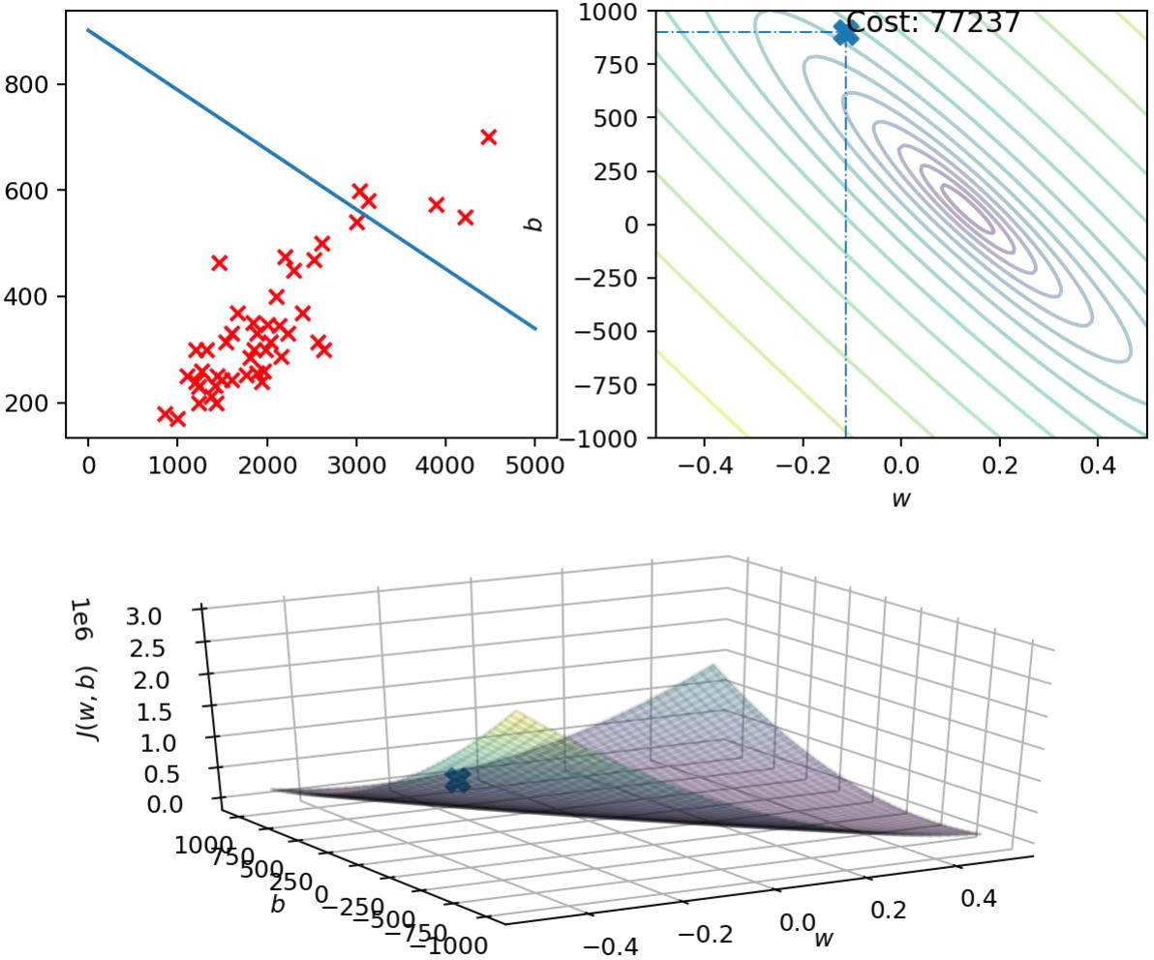







f_{w,b}
x
J w, b
pric e in
$1000'5
size in feet²
J w, b

Slide 42
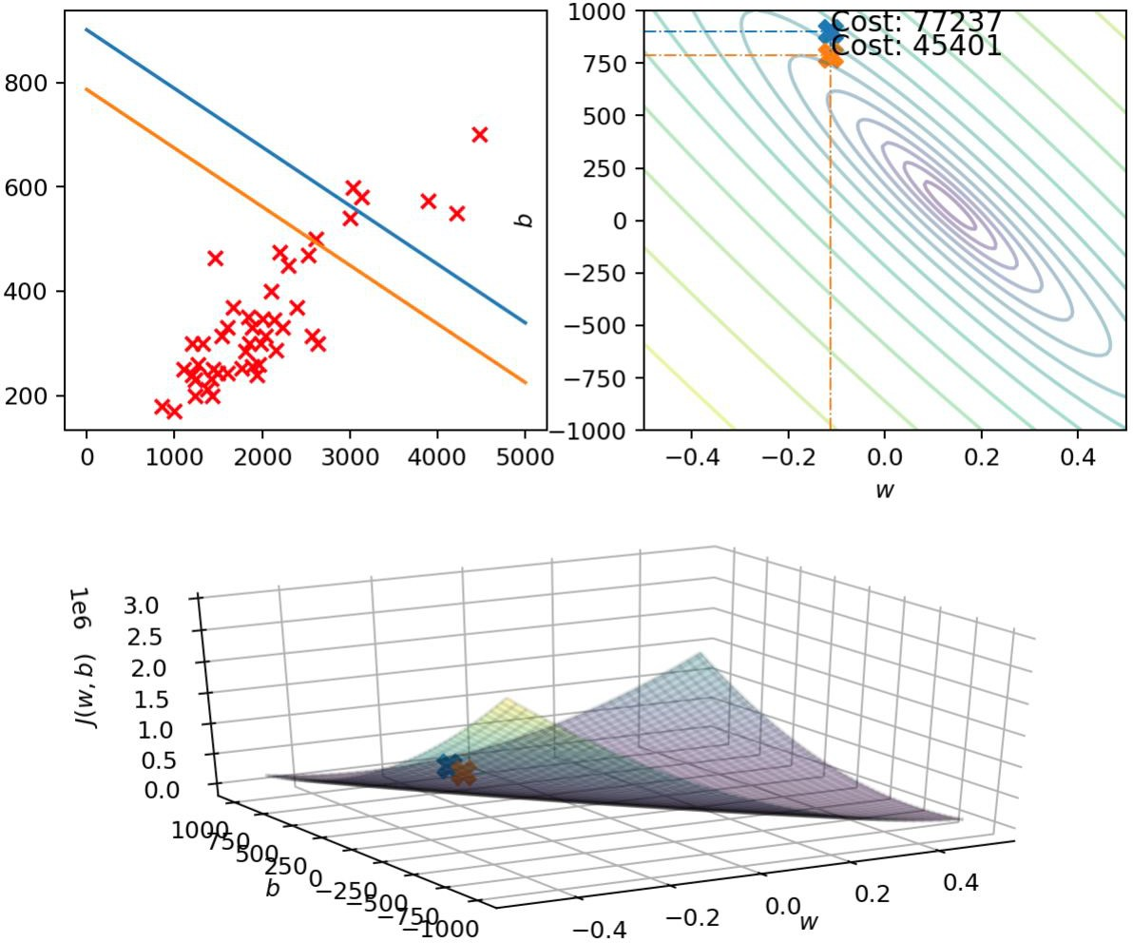
x
J w, b
f_{w,b}
J w, b
f_{w,b} siie
J w, b
pric e in
$1000'5
size in feet²
J w, b
size in feet²
J w, b

Slide 43
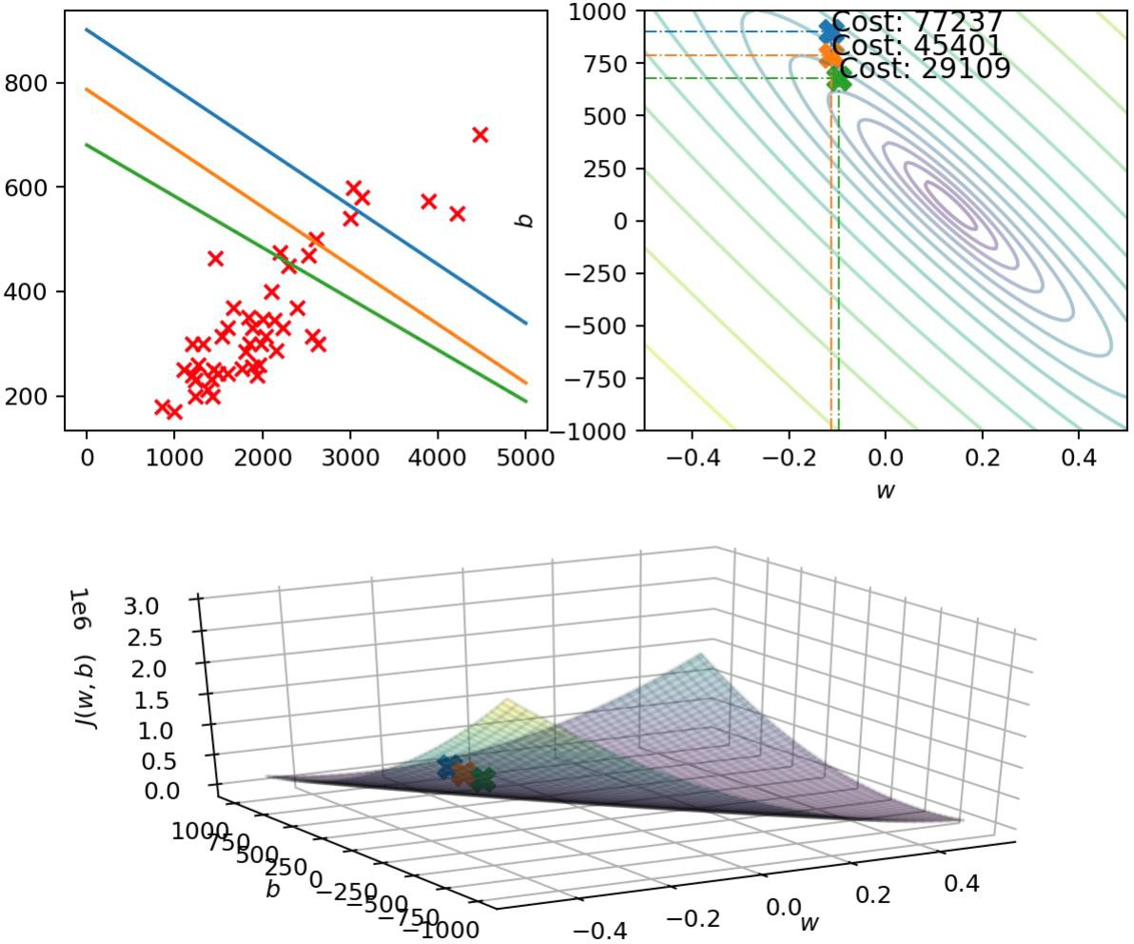
x
f_{w,b}
J w, b
J w, b

Slide 44
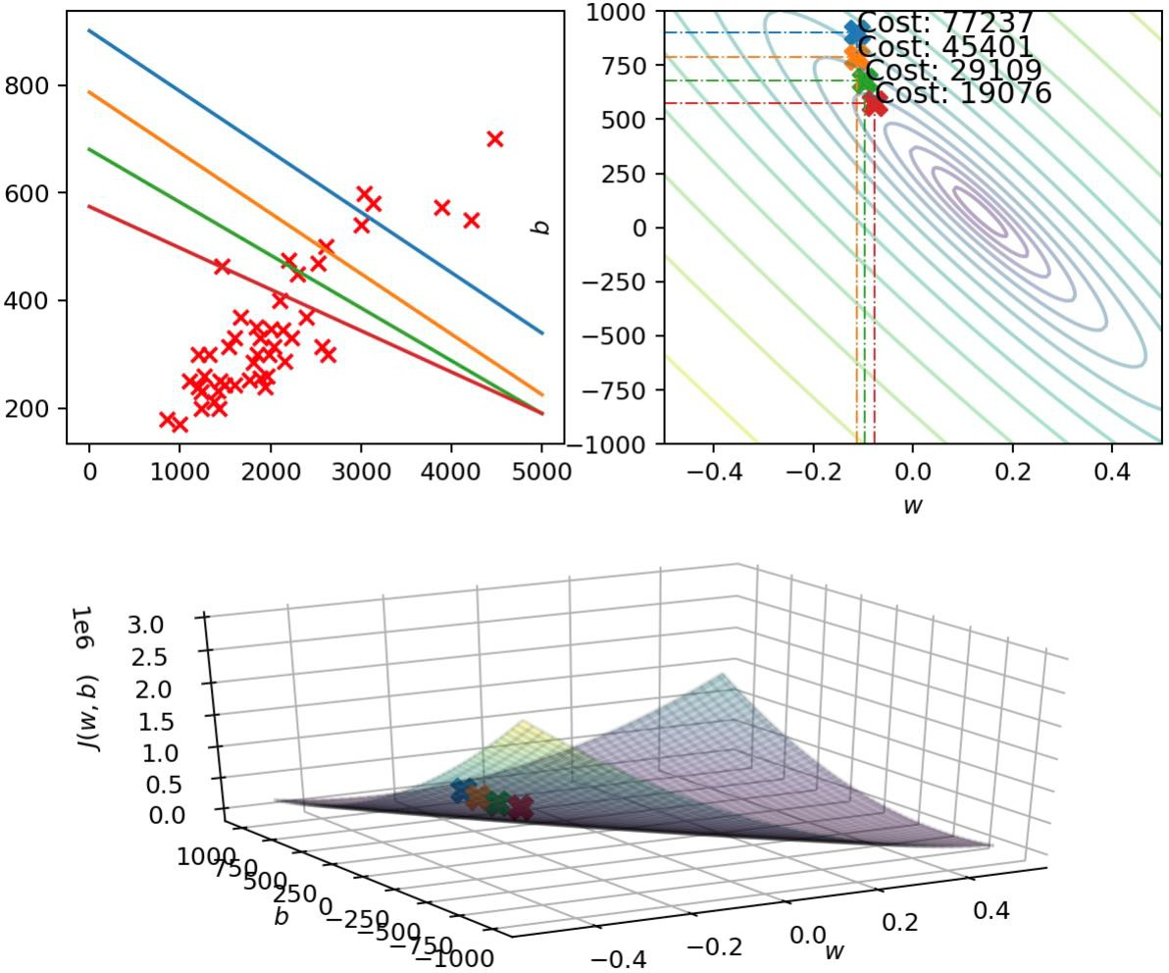
f_{w,b} siie
J w, b
f_{w,b} siie
J w, b
pric e in
$1000'5
size in feet²
J w, b
J w, b

Slide 45

f_{w,b} siie
J w, b
pric e in
$1000'5
size in feet²
J w, b

Slide 46
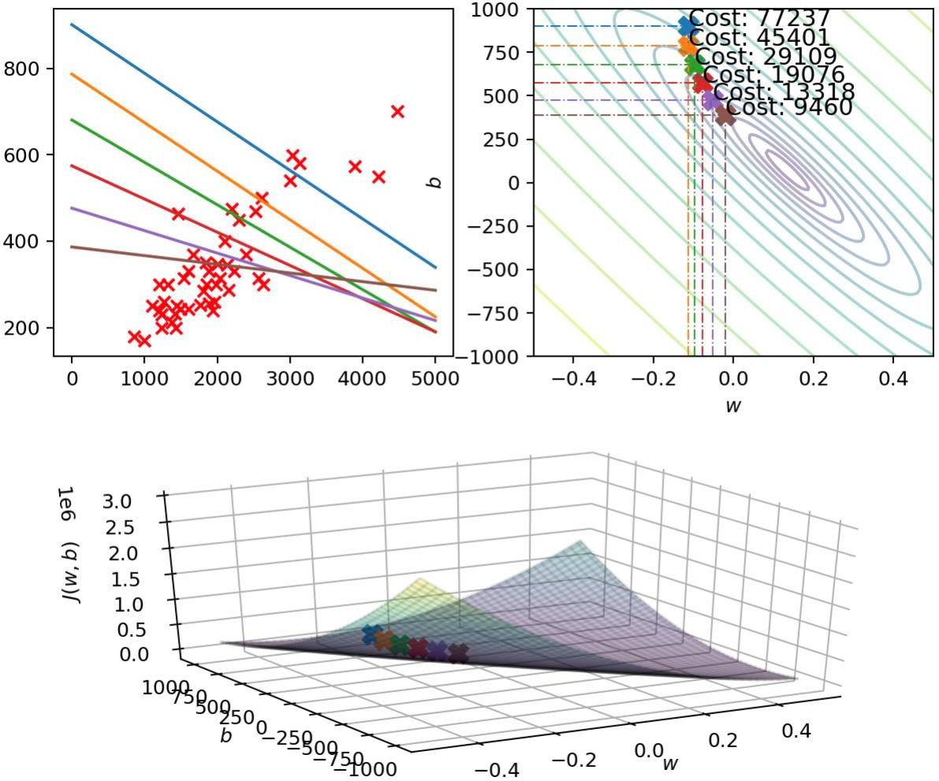
f_{w,b} siie
J w, b
f_{w,b} siie
J w, b
pric e in
$1000'5
size in feet²
J w, b
J w, b

Slide 47
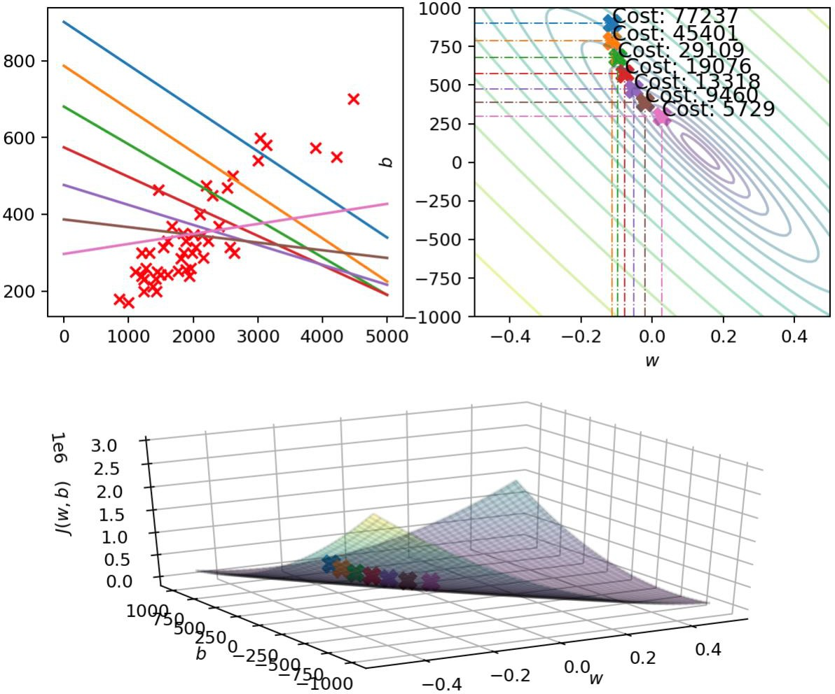
f_{w,b} siie
J w, b
pric e in
$1000'5
size in feet²
J w, b

Slide 48
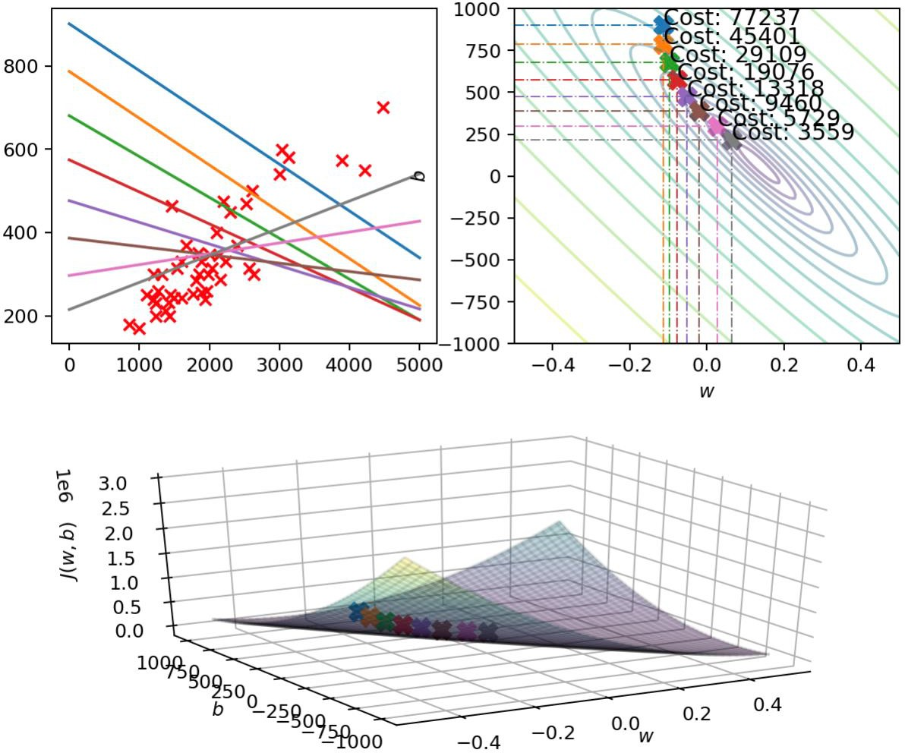
f_{w,b} siie
J w, b
pric e in
$1000'5
size in feet²
J w, b

Slide 49
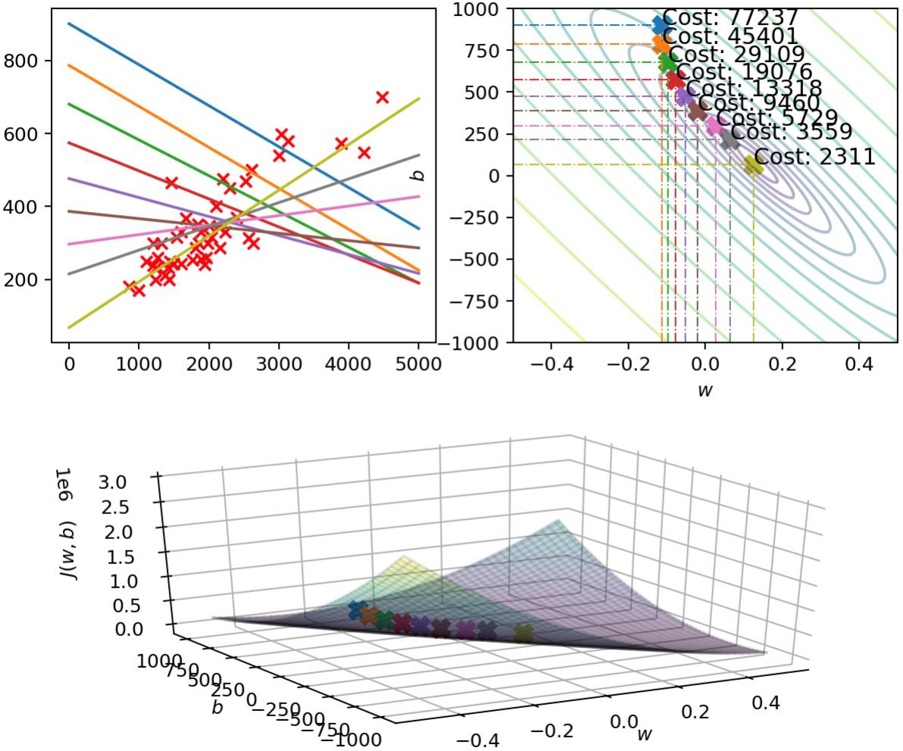
f_{w,b} siie
J w, b
pric e in
$1000'5
size in feet²
J w, b

Slide 50
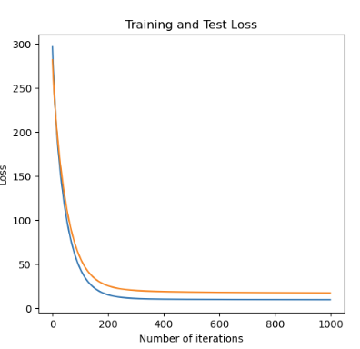
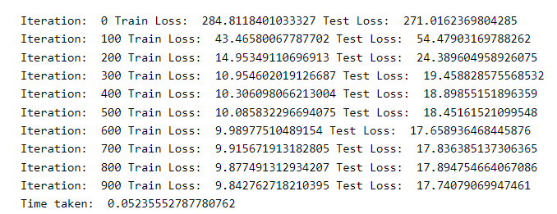
Learning curve

Slide 51
Quiz1:Implement gradient descent for SLR using for loop
Fill in the code blanks

Slide 52
Reference:
https://www.deeplearning.ai/

