Slide 1
Wiley Edge Final Project Team 2
Melodymap - Full Stack web application
Mahir Khan Nargis
Ruaraidh MacLennan
Nikoleta Koleva
Abdullah Khan

Slide 2
Team Introduction
Responsibilities:
Mahir Khan Nargis - Database design, Backend Development, REST API Development and Spring Security
Ruaraidh MacLennan - Frontend Development, Integration with Spotify API, Flowchart Creation
Nikoleta Koleva - Unit testing, Backend Development, Spring Security, Class diagram
Abdullah Khan - Frontend Development, CSS styling

Slide 3
Project Introduction
Project Goal:
Develop a comprehensive music management system.
Objective:
Create a full-stack application that allows users to execute CRUD operations on songs and playlists retrieved from the Spotify API.
User Operations:
Create / Login with user accounts
Song Operations:
Create, Read, Update, Delete (CRUD) operations with songs retrieved from the Spotify API
Playlist Operations:
Create, Read, Update, Delete (CRUD) operations with playlists
Artist Operations:
Create, Read, Update, Delete (CRUD) operations with artists

Slide 4









Technologies
Frontend: HTML5, CSS3, JavaScript
Backend: Spring Boot with JDBCTemplate, MySQL Workbench
Database: SQL
External API: Spotify Web API
Security: Spring Security
Testing: JUnit

Slide 5
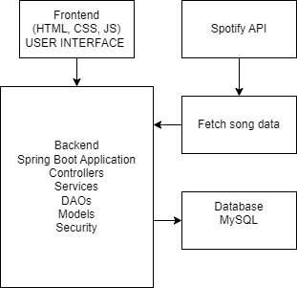
System Architecture
Frontend
User Interface for managing users, songs, and playlists
Backend
Controllers: Handling HTTP requests
Services: Business logic for CRUD operations
DAOs: Data access objects for interacting with the database
Security: Authentication and Authorization

Slide 6
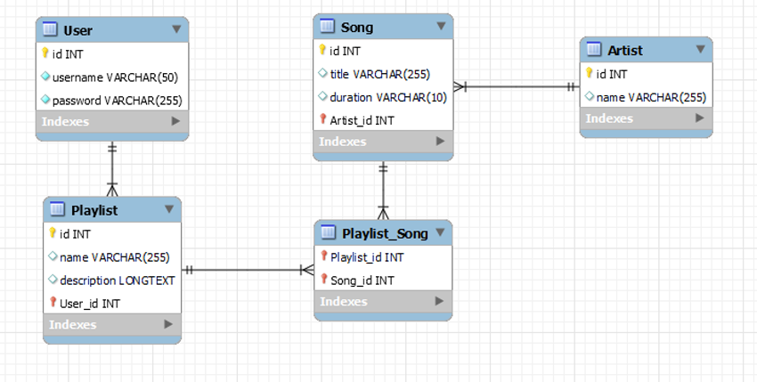
Database
User: Stores user credentials
Playlist: Stores playlist details linked to users
Song: Stores song details linked to artists
Artist: Stores artist details
Playlist_Song: Many-to-many relationship between playlists and songs

Slide 7
API Endpoints
List key API endpoints and their functions:
POST /user/login: User login
POST /song/add: Add a new song
GET /playlist/{id}/songs: Retrieve songs in a playlist
POST /playlist/add: Create a new playlist
POST /playlist/{playlistId}/addSong/{songId}: Add a song to the playlist
DELETE /playlist/{id}: Delete a playlist
PUT /artist/{id}: Update artist
DELETE /artist/{id}: Delete artist

Slide 8

Unit Testing
Stateful unit testing
DAO and service layer
Testing framework - JUnit 5
Test database
Set up methods
Clean up methods
Methods for testing CRUD operations and exception handling

Slide 9
Spring Security
Password Encoder Bean: BCryptPasswordEncoder algorithm is used to encode passwords for secure storage and verification.
Spring security is used to configure the security settings for the application.
For development purposes we are allowing all requests without authorization.

Slide 10
Integration with Spotify API
After creating a spotify account, ClientId is used for authentication
Retrieve song and artist data: Query spotify database
Update local database with Spotify data
Example get song API call:
`https://api.spotify.com/v1/search?q=${query}&type=track&limit=10`

Slide 11
Frontend Development
Html:
register.html
login.html
dashboard.html
playlist.html
Css:
registerstyles.css
loginstyles.css
dashboardstyles.css
playliststyles.css
Javascript:
registerscript.js
loginscript.js
dashboardscript.js
playlistscript.js
Colour scheme:

Slide 12
Project Demo
Users can create new accounts by registering with a username and password
Users can log in with their credentials to access the dashboard
Users can create a new playlist by providing a name and description
Users can search for songs from the Spotify API
Display search results with song details (title, artist, duration)
Users can add selected songs from the search results to their playlist
Ensure the song details are saved along with the playlist
The playlist view displays all songs added to the playlist
Show song details (title, artist, duration) within the playlist
Users can remove songs from their playlist
Provide an option to delete a song and update the playlist view accordingly
The dashboard provides an overview of all playlists created by the user
Upon returning to the dashboard, users can select a playlist to view its details

Slide 13
Future work
Filter Spotify songs by genre/artist
Adding genre table to the database
Restrict access to certain endpoints, requiring authentication and proper authorization
Login to Spotify and retrieve personal playlists
Update existing playlists in Spotify

Slide 14

Questions and Answers

Slide 15
The End
Thank you for your attention!

