Slide 1
N-Layer architecture
Pavel Kyurkchiev
PhD. researcher
@pkyurkchiev
https://github.com/pkyurkchiev

Slide 2
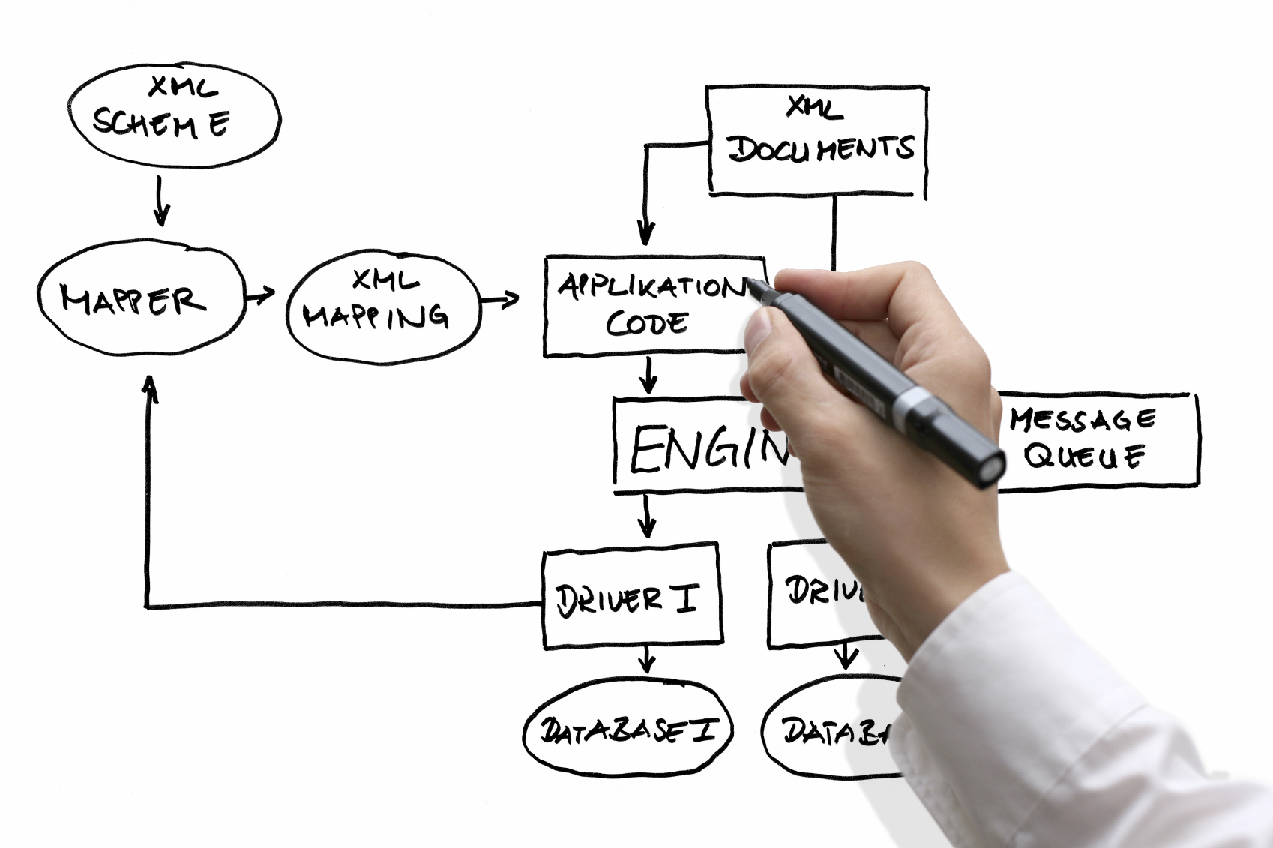

Slide 3
Definition: N-layer application architecture provides a model by which developers can create flexible and reusable applications. By segregating an application into tiers, developers acquire the option of modifying or adding a specific layer, instead of reworking the entire application.

Slide 4
Common layers:
Presentation layer
Application layer
Business layer
Data access layer

Slide 5
Data access layer
A data access layer (DAL) in computer software, is a layer of a computer program which provides simplified access to data stored in persistent storage of some kind, such as an entity-relational database.

Slide 6
Data access layers: Persistence layer, logging, networking, and other services which are required to support a particular business layer

Slide 7
ORM (Object-Relational Mapping)

Slide 8
Business layer
In software development, business logic or domain logic is the part of the program that encodes the real-world business rules that determine how data can be created, stored, and changed.

Slide 9
Business layers: Business logic layer (BLL), domain layer

Slide 10
Business layer structure
Business logic
Business rules
Business logic comprises

Slide 11
Business layer: - Prescribes how business objects interact with one another; - Enforces the routes and the methods by which business objects are accessed and updated.

Slide 12
Business rule: Model real-life business objects (such as accounts, loans, itineraries, and inventories.

Slide 13
Business logic vs Business rule: Business logic is the portion of an enterprise system which determines how data is transformed or calculated, and how it is routed to people or software (workflow). Business rules are formal expressions of business policy.

Slide 14
Business logic vs Business rule: Anything that is a process or procedure is business logic, and anything that is neither a process nor a procedure is a business rule.

Slide 15
Application layer
Service layer is a conceptual layer within a network service provider architecture.

Slide 16
Application layers: Service layer or GRASP Controller Layer

Slide 17
Presentation layer
The presentation tier displays information related to such services as browsing products, purchasing and shopping cart contents etc.

Slide 18
Presentation layers: UI layer, view layer, presentation tier in multitier architecture

Slide 19
Most popular multilayer architecture

Slide 20
3-layer architecture
Presentation layer
Business logic layer
Data access layer
Database

Slide 21
Benefits of using n-layer:
Secure
Easy to manage
Scalable
Flexible

Slide 22
More efficient development N-tier architecture is very friendly for development, as different teams may work on each tier. This way, you can be sure the design and presentation professionals work on the presentation tier and the database experts work on the data tier.

Slide 23
Easy to add new features If you want to introduce a new feature, you can add it to the appropriate tier without affecting the other tiers.

Slide 24
Easy to add new features If you want to introduce a new feature, you can add it to the appropriate tier without affecting the other tiers.

Slide 25
Easy to reuse Because the application is divided into independent tiers, you can easily reuse each tier for other software projects. For instance, if you want to use the same program, but for a different data set, you can just replicate the logic and presentation tiers and then create a new data tier.

