Slide 1
ANR & SWT & Reboot
MTK/周砾雄(Lixiong.Zhou@mediatek.com)

Slide 2
Agenda
ANR
ANR Knowledge Background
ANR Checking SOP
ANR Analysis Knowledge Base
ANR Debug & Dump
Case Share
SWT
Overview
Watchdog’s Principle
SWT Debug
Case Share
Reboot
Categories
Reason
Debug

Slide 3
ANR

Slide 4
ANR knowledge background
What’s ANR?
ANR Type
ANR Generate Principle
How & What System(AMS) do when ANR
Proportion of bug and performance

Slide 5

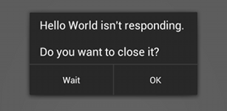
What’s ANR?
ANR stands for “Application Not Responding”
ANR happens when an application’s UI thread blocks for a period of time.
A dialog shows when ANR happens.
?
?
?

Slide 6
ANR Generate Principle(1/3)
Long Time Execution
Flow Break
System Server
App Process
System Server
App Process
Timeout
Timeout

Slide 7
ANR Generate Principle(2/3)
Application
SystemServer
MainThread
InputDispatcher
(touch/keyevent)
Msg Queue
MSG 1
MSG 2
MSG onClick
MSG onTouch
MSG 3
AMS
(broadcast/service bindcall)
MSG 4
MSG 5
MSG onBind
MSG onReceive

Slide 8
ANR Generate Principle(3/3)
Application
SystemServer
MainThread
InputDispatcher
Msg Queue
MSG 1
MSG 2
Msg1 + msg2 exec too long → ANR
MSG onClick
AMS
MSG onTouch
onClick/onTouch indeed
exec too long → ANR
MSG 3
MSG 4
MSG 5
MSG onBind
As mentioned above
MSG onReceive

Slide 9
How & What System(AMS) do when ANR
AMS
APP MainThread
print event_log
Timeout of broadcast
dumpStackTraces()
10s/60s
print “ANR In” in log
Timeout executing service
appNotResponding()
20s/200s
create ANR.DB
Input dispatching timed out
show ANR Dialog
8s

Slide 10
ANR Type(1/2)
Type | Function call | Log sample | Time out (s)
Input dispatch | onClick(),onTouch(),onKeydown(),onKeyup()…… | Input dispatching timed out | 8
Broadcast | onReceive() | Timeout of broadcast | FG: 10 BG 60
Service | onBind(),onCreate(),onStartCommand(),onUnbind(),onDestroy() | Timeout executing service | FG: 20 BG 200

Slide 11
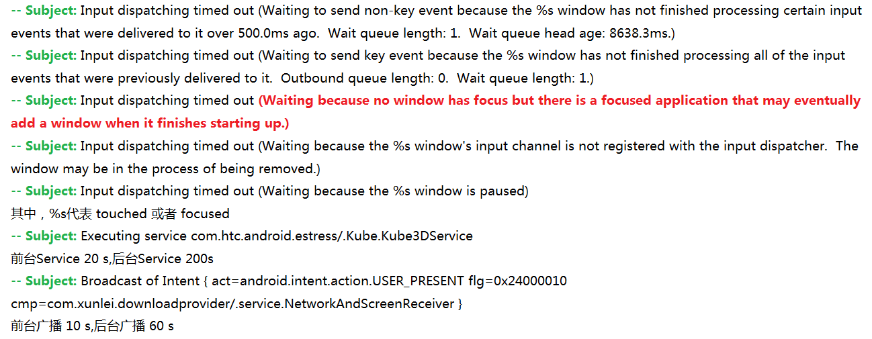
ANR Type(2/2)

Slide 12
ANR occur，It might not really execute “onReceive()”, “onBind()”, “onTouch()” or other methods too long. However, at the mostly, it is because of “Main thread”：
It took too long time deal with messages prior at these methods. But why?——> ANR Analysis

Slide 13
Proportion of bug and performance

Slide 14
Bug Issue & Performance Issue
ANR Bug | ANR performance
Dead Lock | IO wait high or heavy IO workload
Frequently message and last bound time | SQLite or wait lock
Stuck in binder server (not return) / driver | CPU occupied by other few process, CPU hotter(limit CPU core and frequency)
Memory leak | JE, NE, or other proc NE lead to
………… | …………

Slide 15
ANR Checking SOP
Prepare
LOG
Check System Performance
Bug?
Check ANR Process

Slide 16

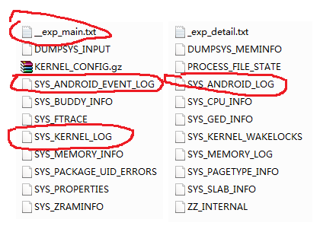
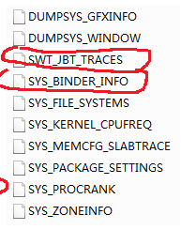

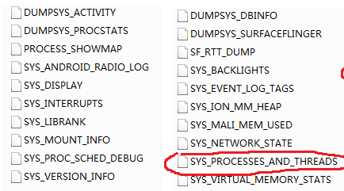

Prepare LOG

Slide 17
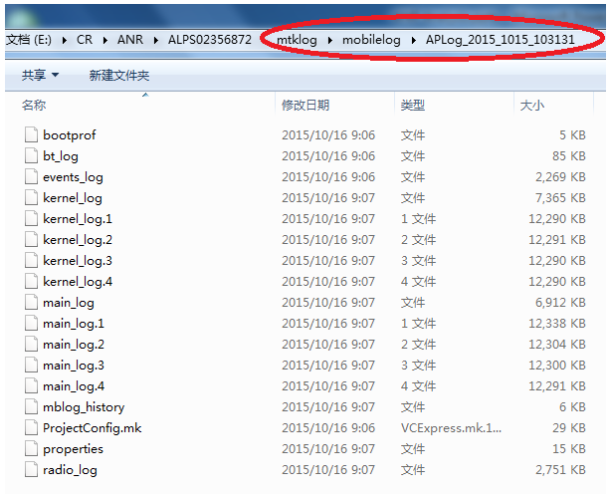

Prepare LOG

Slide 18
SOP
SOP
SOP

Slide 19
Steps Of Analyze ANR
Step 1: Confirm the time & pid of ANR from event log
Step 2:Check the call stack of main thread in ANR process
Whether there are lots of message in message queue
Whether it may perform a long time directly
Check whether there is a lock synchronization
Check whether it is performing binder communication, if so ,we should check the binder server
Step 3: If can not get the root cause by above steps, it is may be a performance issue
Check Item | Log file
CPU loading | __exp_main.txt main_log
IO Wait | As above
CPU cores & CPU freqency | SYS_KERNEL_LOG
memory | sys_buddy_info/sys_memory_info

Slide 20
ANR Analysis Knowledge Base
Search ANR pid & time
Search & Check Call Stack
Message History & Queue
CPU Usage
CPU Policy
Process Schedule Stats Information
Binder Info
Memory Info
Dexopt
Signal Processing
Check ANR Process
Check System Performance

Slide 21
Check Main Thread State

Slide 22

Search ANR pid & time
event_log/SYS_ANDROID_EVENT_LOG
main_log/sys_log/SYS_ANDROID_LOG
Suggested time period to check:
(anr_time - anr_timeout) ~ (anr_time + 2 secs)
10-14 16:19:12.661 822 845 E ANRManager: ANR in com.android.systemui, time=281371314
10-14 16:19:12.661 822 845 E ANRManager: Reason: Broadcast of Intent { act=android.intent.action.TIME_TICK flg=0x50000114 (has extras) }

Slide 23
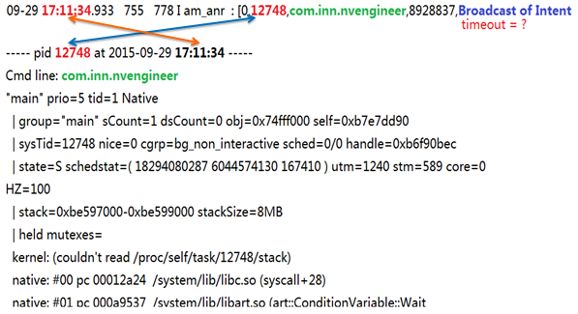
Check Main Thread Stack
In swt_jbt_trace file, we should locate the man thread at anr time point

Slide 24
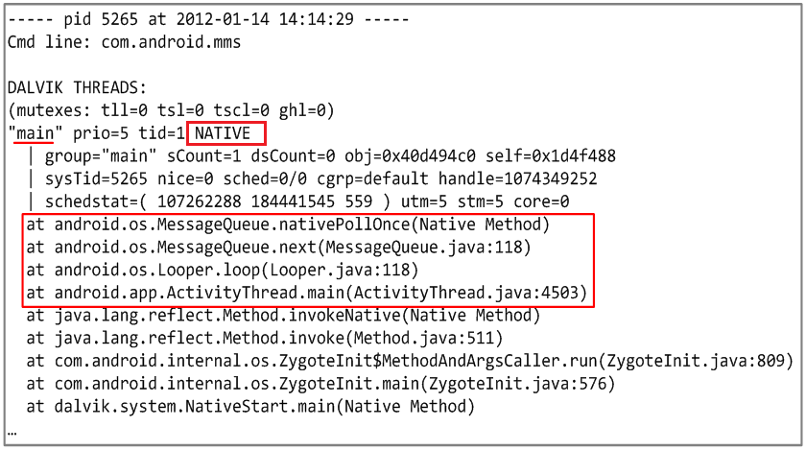
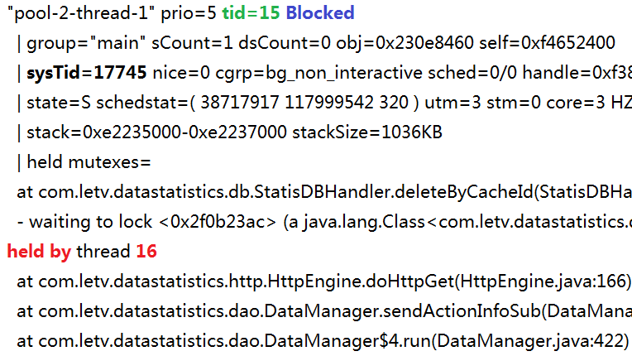
ThreadState(1/2)
Idle shows when the main thread’s message queue is not processing any message
Blocked shows this thread is blocked by another thread, so we should go on check other thread.

Slide 25
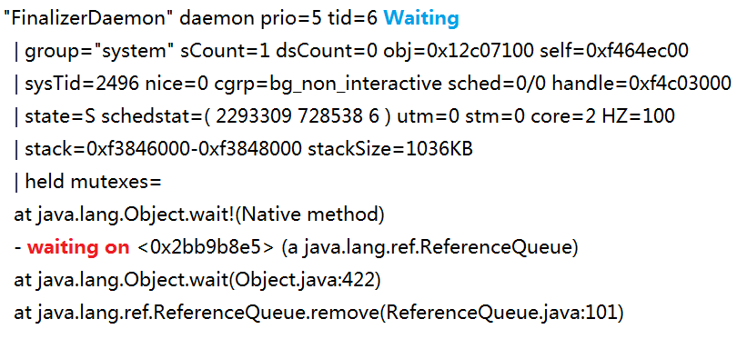
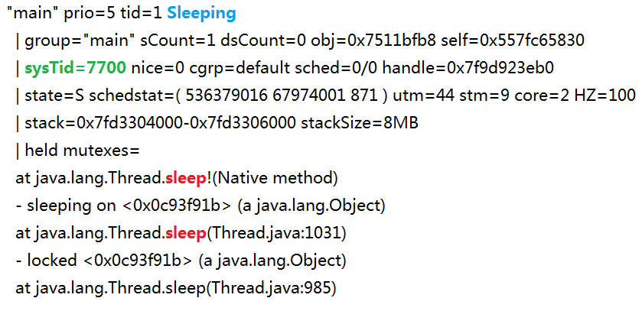
ThreadState(2/2)
Waiting Or TimedWaiting shows this thread is waiting on Sb. to notify().We could find out it by call stack and “code”
Sleeping shows “main” is Sleeping due to call Sleep(ms).We need check out how long it will.

Slide 26
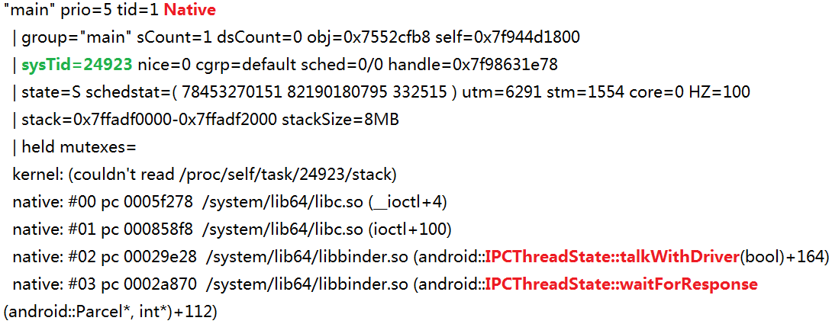
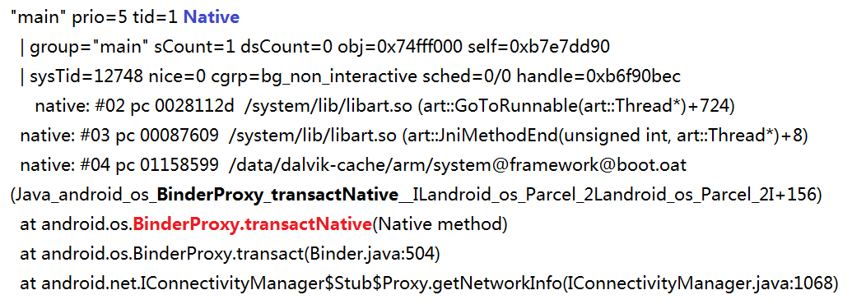
Stuck in binder(1/2)
Following stacks means it is stuck in binder communication
But, following stacks don’t means it is stuck in binder

Slide 27
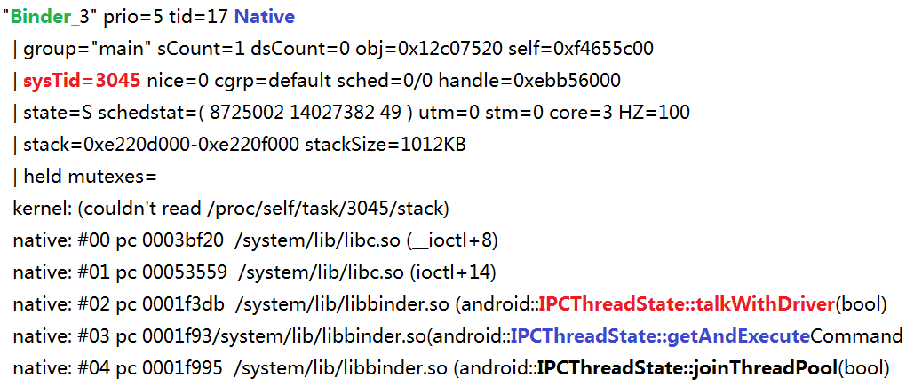
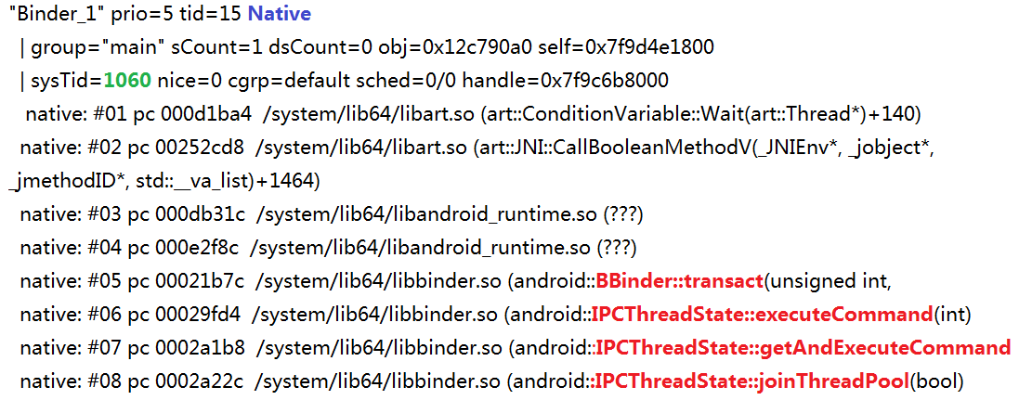
Stuck in binder(2/2)
For server end following binder thread means it is idle
For server end following binder thread means it is busy now

Slide 28
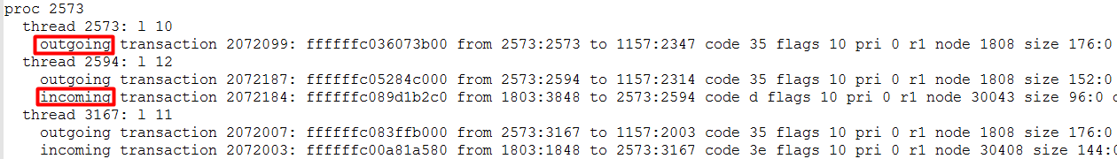
How To Analyze Binder Stuck Issue(1/3)
If we found main thread is stuck, we should confirm the server process first.
The most useful log is sys_binder_info file
Clent end: pid and tid
sequence number in service file
Server end: pid and tid
Outgoing:meaning current thread is performing binder request to other process
Incoming: meaning current thread is performing binder service for other process

Slide 29
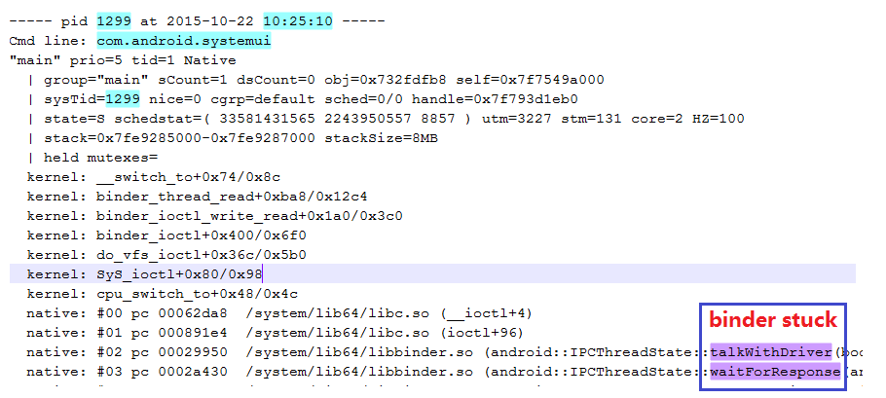
How To Analyze Binder Stuck Issue(2/3)
Step 1.Locate ANR pid & time
Step 2.Locate the call stack of the main thread

Slide 30

How To Analyze Binder Stuck Issue(3/3)
Step 3.Check binder info to find out binder server
Step 4.Check process and thread,334:1005 map to /system/bin/mediaserver:Binder_1
Step 5:Check server end binder thread’s stack from swt_jbt_trace

Slide 31
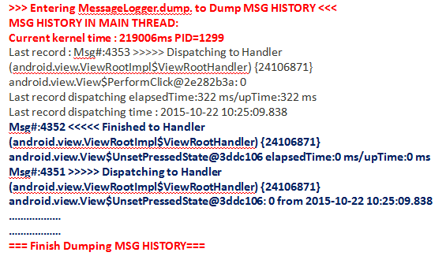
Message History & Queue(1/2)
When ANR occurs, AMS will dump last 20 message histories of main thread .(Just for eng or user debug version)
“__exp_main.txt” / main_log / sys_log.

Slide 32
Message History & Queue(2/2)
Msg#:2 <<<<< Finished to Handler (android.app.ActivityThread$H) {1162af80} null elapsedTime : 2 ms /upTime : 2 ms
Msg#:1 >>>>> Dispatching to Handler (android.app.ActivityThread$H) {1162af80} null: 138 from 2015-01-01 11:02:47.435
Information of Message History
Msg# :2 message serial number.
Msg ID: 138
Handler: target handler, to Handler (android.app.ActivityThread$H) followed by the callback (it might be null).
Callback:null (it might be null), followed Handler
Dispatching time: 2015-01-01 11:02:47.435 ,The time when the last message was dispatched.
upTime: 2 ms,Total CPU execution time.
elapsedTime: 2 ms, Total execution time including sleep time.

Slide 33
Check CPU Loading, IOWait, Cores & Frequency ….

Slide 34
CPU Information(1/2)
In kernel log we can get following information
1
2
3
4
5
6
1:current little online cpu numbers
2:current big online cpu numbers
3:current cpu loading
4:current io wait
5:little online cpu numbers after adjusting
6:big online cpu number after adjusting
So, If we found anr was not caused by thread block, we should check cpu information around anr period.

Slide 35
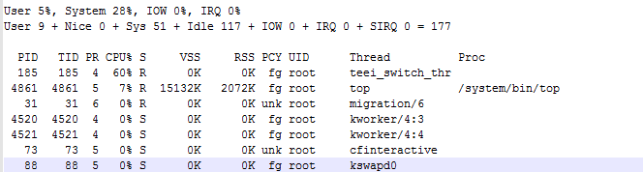
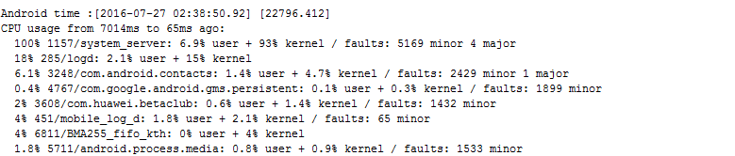
CPU information(2/2)
Also can get CPU information from SYS_CPU_INFO
check the anr cpu usage
In __exp_main.txt of anr db file
From this log, we can know the usage of CPU by every process

Slide 36
CPU information
If cpu loading is too high(>80%?), we’d better to find which APP use too high and confirm whether it is normal
If io wait is too high(>50%?), we’d better first to check the I/O speed of flash.
If cpu core is less and frequency is slow, but cpu loading is higher, we should check the thermal issue

Slide 37
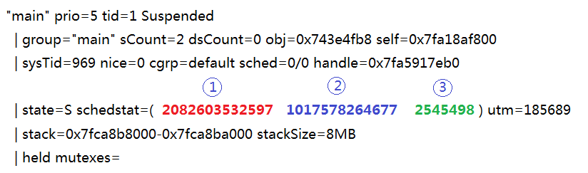
Process Schedule Stats Information(1/N)
Check Process Schedule Stats Information between 2 timestamps
Time spent on the CPU
Time spent waiting on a run queue
# of time slices run on this CPU

Slide 38
Process Schedule Stats Information(2/N)
Inc ----> Y
Dec ----> N
Field 1 | Field 2 | Conclusion
Y | Y | It means the thread has been scheduled to run and has been waiting in the run queue
Y | N | It means this thread has been scheduled to run
N | Y | It means this thread has been waiting in the run queue but hasn’t been scheduled at all. In this case, we have to check FTRACE to find out who was occupying CPU.
N | N | It means the thread isn’t waiting for CPU scheduling. The process was either waiting for other thread to notify or it is really IDLE.

Slide 39
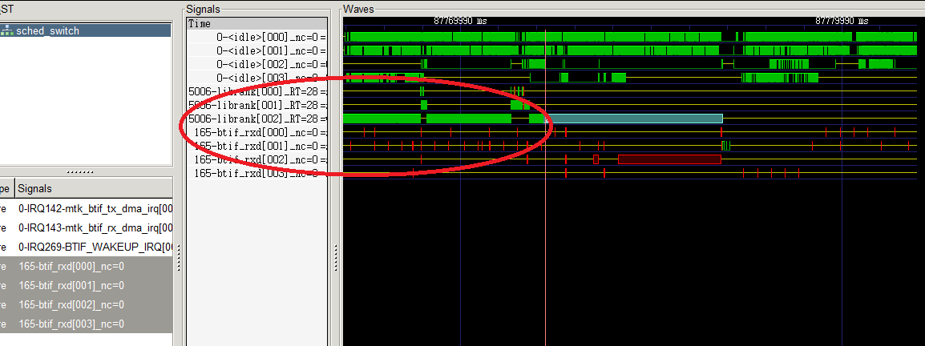
Process Schedule Stats Information(3/N)
librank was occupying CPU[2] in range of red circle

Slide 40
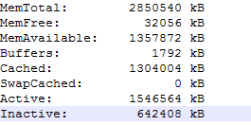
Memory Info(1/2)
In sys_memory_info of db file, we can see the memory information
In SYS_BUDDY_INFO, we can see the use of physic memory
If the sum of Memfree and cached is small, there is memory issue
1
2
3
…
n
From this information we can see the fragment of physic memory
1: the number of 2⁰ continuous pages
2:the number of 2^{n} continuous pages
If there is only 2⁰ continuous pages, the fragmentation is serious.

Slide 41
Memory Info(2/2)
We also can get memory info from SYS_MEMORY_LOG, it record the memory change of a period of time including system memory and every process 'memory.
One process
One process
We should check which part or process use lots of memory , and analyze it as memory issue.

Slide 42
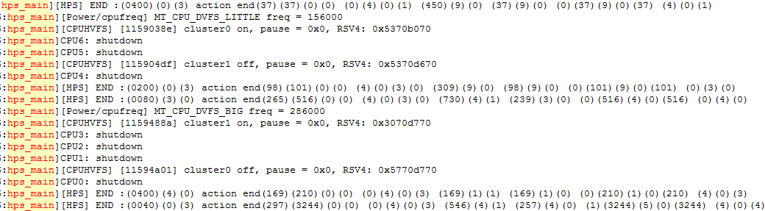
CPU Policy
File : “kernel_log”
Keyword : “hps_main” and “cpufreq”

Slide 43
Dexopt
File : main_log/sys_log
Keyword:
ensurePackageDexOpt
DexOpt: load 206ms, verify+opt 1492ms, 2050764 bytes
04-17 11:06:11.484 282 676 I ActivityManager: ensurePackageDexOpt too long duration ms: 1100
04-17 11:06:44.662 3200 3200 D dalvikvm: DexOpt: load 15ms, verify+opt 130ms
04-17 11:06:44.680 282 2254 I ActivityManager: ensurePackageDexOpt done duration ms: 336
Notes:
http://online.mediatek.inc/_layouts/15/mol/topic/ext/Topic.aspx?mappingId=e6470a4e-6511-4391-8101-07629c14da39

Slide 44
Signal Processing
Signal | Name | Description
3 | SIGQUIT | When ANR occurs, will send sig 3 to dump call stack.
9 | SIGKILL | Kill Process.
11 | SIGSEGV | When NE occurs will send sig 11.
18 | SIGTSTP | Restart process.
19 | SIGSTOP | Stop process.
Notice: Signal 3、19 will freeze process, so need to observe how long these signals make process freeze. If the time of process freezing is too long will lead to ANR or SWT.

Slide 45
For bug, ANR process owner should fix it by themselves or other relative owner.
For performance, we should collect and analysis more information, such as CPU usage, memory info, binder info, IO wait and so on.

Slide 46
ANR SOP(1/2)
对应的so
END
Check ANR的时间点及进程的pid
Start
找到ANR该进程的backtrace
Dead Locked
SYS_ANDROID_EVENT_LOG
线程之间的held by是否形成一个环
Held by
Y
?
Y
？
SWT_JBT_TRACES
Check main thread
N
特殊Native call
Binder blocked
N
N
Y
？
？
CPU usage
Y
？
binder对端
END
优化CPU Usage过高的进程
N

Slide 47
N
N
ANR SOP(2/2)
END
优化memory过高的进程或者碎片
优化CPU Usage过高的进程
Y
Y
CPU usage
Memory
？
N
？
Idle?
?
Y
N
？
Message过多/执行时间长
N
优化Message
Y
N
Log print
Io wait
N
Io call
？
N
？
？
No focus window
Y
Y
？
优化log打印
Y
优化io过高的进程
Y
END
Check Activity状态是否为resume

Slide 48
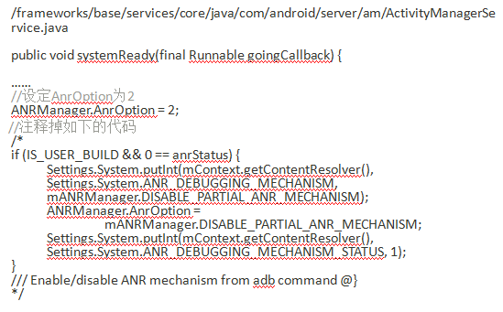
ANR debug & dump
For User/UserDebug：
Dynamic adb shell command adb shell dumpsys activity log anr 2
Modify code in AMS

Slide 49
ANR debug & dump
MTK dump stack trace for ANR at the default:
 | USER/USERDEBUG | ENG
cpu usage | Y | Y
pre cpu usage | Y | Y
pre dump callstack | N | N
dump call stack | Y | Y
dump message history | N | Y

Slide 50
Case Share

Slide 51
SWT

Slide 52
Why need SWT
System Server is a core process in Android system.
Some core services or looper threads run in it
Once they are long time occupied, User experience will be very bad.
So, the watchdog mechanism is introduced to monitor the services or looper thread.
Once they are long time occupied, the android system will be restarted by watchdog.
Secure Info
Manage Process
Start Process
System Server
UI Input
Privider Service
Content Provider
Broadcast
………………

Slide 53
How To Work
Watchdog Thread
Just call monitor to try get lock, if long time can not get lock, may be hanged.
run
Check All Monitors registered before
Check State
Just post to the front of its own looper thread, if not process by a long time, may be hang by the ahead of message
OK
Wait 30s
Check Handlers added before
Check State is OK
If someone have waited over half of its setting time then dump all process’s back trace
Over its setting time, then:
Dump All process’s back trace
Kill system server self

Slide 54


Register To Be Monitored
If some services want to be monitored, it should be implements interface Monitor
Then register it to Watchdog
If some looper thread want to be monitored, it is should be add Watchdog.
Such As:

Slide 55


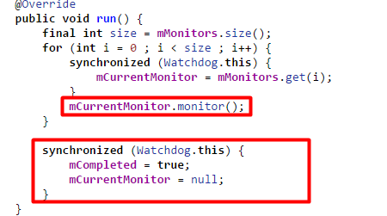
Check State
Every 30s, Watchdog thread will check all of their states
When check, Checker will post a message to the front of the looper.
When handle the message, it will check monitor and reset the state

Slide 56
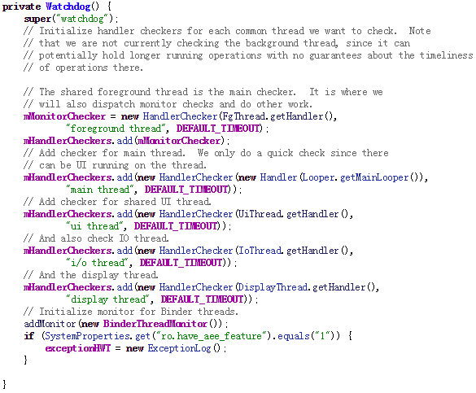
Services & Loopers

Slide 57
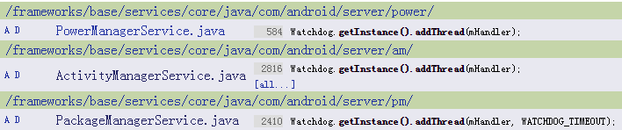
Services & Loopers

Slide 58
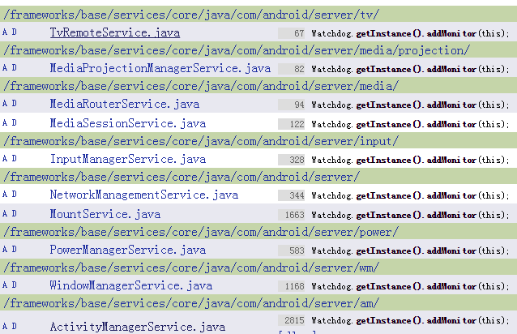
Services & Loopers

Slide 59
Services & Loopers
Services
All service’s lock time are 60s(except PackageManagerService:600s)
Looper Thread
Looper thread | Default Time
PowerManagerService | 60s
PackageManagerService | 600s
ActivityManagerService | 60s
Main Thread | 60s
Ui Thread | 60s
Android.fg | 60s
i/o | 60s
Display Thread | 60s

Slide 60
What to do when SWT happend
½ timeout
Pre dump system_server’s current back trace
Print in main log
timeout
**SWT happen **
We can get timepoint from event log
Write to event log
Dump all java process’s back trace
Do sysRq(dump kernel back trace)
Kill system_server

Slide 61
How To Debug
Step 1. Confirm the time point
From events log or SYS_ANDROID_EVENT_LOG
Step 2. Check block thread or lock
From SWT_JBT_TRACE
Check the predump back trace
Check the last back trace
Check binder information
Check lock state
Check performance information
Watchdog Timepoint
Who block the watchdog

Slide 62
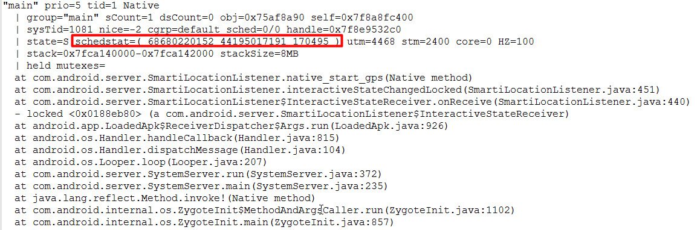
Check predump call stacks
As mentioned before, at half of timeout, system_server’s all threads stack will be dumped.
So we should get the half timeout point first. Such as:
Then ,Check the block thread’s stack at half timeout point
Predump Time Point is:22:07:45 – 60/2s= 22:07:15

Slide 63
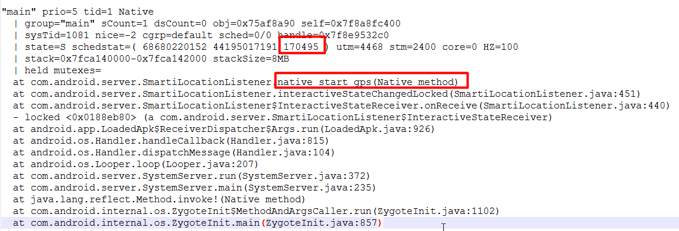
Check last stacks
We also should check the last stack to confirm whether the thread really blocked or really run too long.

Slide 64
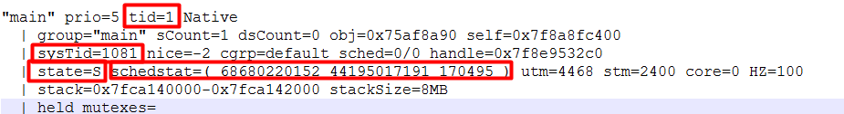
Important information in stack
1
2
3
Tid:the sequence number of starting the thread in this process
sysTid: the thread id in system
State: current state of this thread in system
Schedstat:
1: Time spent on the CPU
2:Time spent waiting on a runqueue
3: time slices run on this CPU
Check the differ of running time slices between predump and last stack, if there is a obviously difference, it’s meaning this stack run too long, else it’s meaning this thread is blocked or be suspended too long.

Slide 65
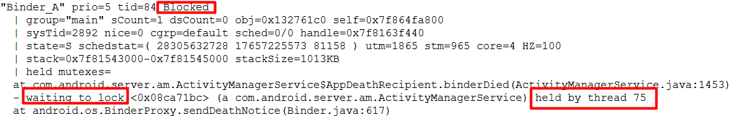
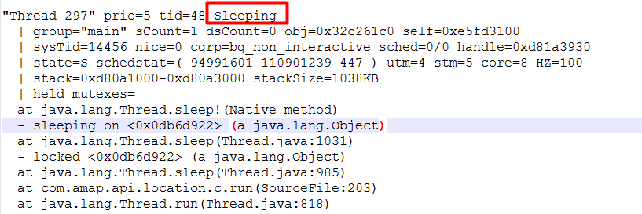
Thread is blocked(1/2)
By Competition lock
1
1
Means tid = 75, so we should check the thread of tid=75 in this process
By Sleeping
We should check the stack to find the reason of sleep.

Slide 66
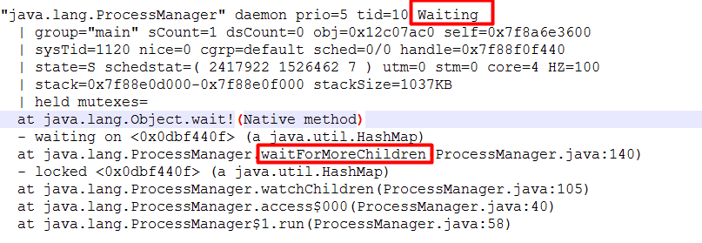
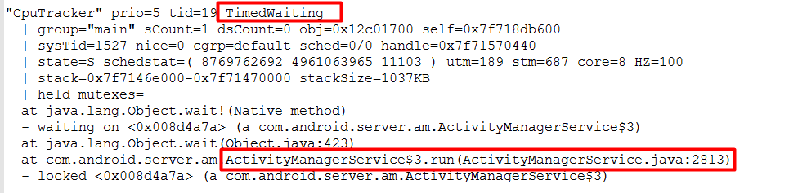
Thread is blocked(2/2)
By waiting
Means: Object.wait() or Object.wait(n) is being called. So, we should check the source code first.

Slide 67
Stuck in binder(1/2)
Following stacks means it is stuck in binder communication
But, following stacks don’t means it is stuck in binder

Slide 68
Stuck in binder(2/2)
For server end following binder thread means it is idle
For server end following binder thread means it is busy now

Slide 69
How To Analyze Binder Stuck Issue(1/3)
If we found main thread is stuck, we should confirm the server process first.
The most useful log is sys_binder_info file
Clent end: pid and tid
sequence number in service file
Server end: pid and tid
Outgoing: meaning current thread is performing binder request to other process
Incoming: meaning current thread is performing binder service for other process

Slide 70
How To Analyze Binder Stuck Issue(2/3)
Step 1.Locate ANR pid & time
Step 2.Locate the call stack of the main thread

Slide 71
How To Analyze Binder Stuck Issue(3/3)
Step 3.Check binder info to find out binder server
Step 4.Check process and thread,334:1005 map to /system/bin/mediaserver:Binder_1
Step 5:Check server end binder thread’s stack from swt_jbt_trace

Slide 72
Performance

Slide 73
CPU Information(1/2)
In kernel log we can get following information
1
2
3
4
5
6
1:current little online cpu numbers
2:current big online cpu numbers
3:current cpu loading
4:current io wait
5:little online cpu numbers after adjusting
6:big online cpu number after adjusting
So, If we found swt was not caused by thread block, we should check cpu information around swt period.

Slide 74
CPU information(2/2)
Get CPU information from SYS_CPU_INFO
Some time before SWT, may some ANR of app happened, so we can check the anr around the SWT.
In __exp_main.txt of anr’s db file
From this log, we can know the usage of CPU by every process

Slide 75
CPU information
If cpu loading is too high(>80%?), we’d better to find which APP use too high and confirm whether it is normal
If io wait is too high(>50%?), we’d better first to check the I/O speed of flash.
If cpu core is less and frequency is slow, but cpu loading is higher, we should check the thermal issue

Slide 76
Memory Info(1/2)
In sys_memory_info of db file, we can see the memory information
In SYS_BUDDY_INFO, we can see the use of physic memory
If the sum of Memfree and cached is small, there is memory issue
1
2
3
…
n
From this information we can see the fragment of physic memory
1: the number of 2⁰ continuous pages
2:the number of 2^{n} continuous pages
If there is only 2⁰ continuous pages, the fragmentation is serious.

Slide 77
Memory Info(2/2)
We also can get memory info from SYS_MEMORY_LOG, it record the memory change of a period of time including system memory and every process 'memory.
One process
One process
We should check which part or process use lots of memory , and analyze it as memory issue.

Slide 78
Case Share

Slide 79
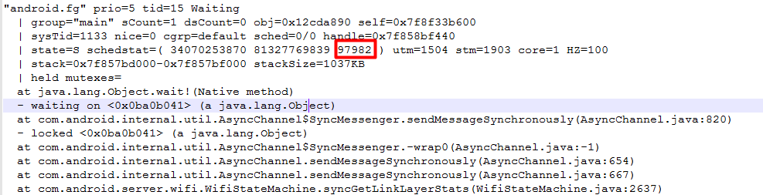
Case 1
CRID: ALPS02848434
Analyse:
1. get time point of SWT in sys_android_event_log
2.Check predump stack

Slide 80
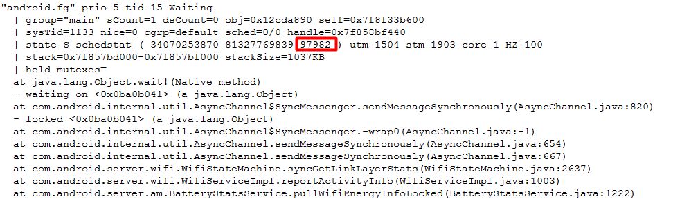
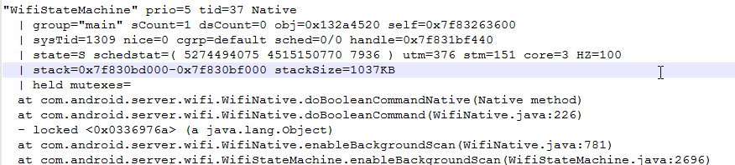
Case 1
3.Check last stack
We can see there is no change between predump and last stack. So we can sure that this thread is blocked. And blocked by wait. From the wifi knowledge we should check the WifiStateMachine thread. And we’d better let the owner of wifi go on analyze this issue.

Slide 81
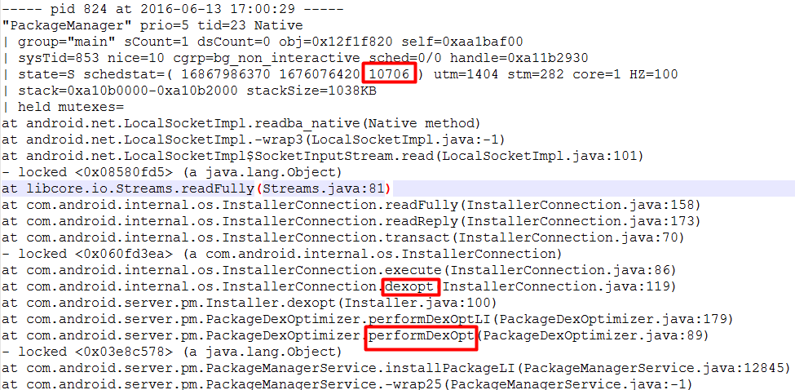
Case 2
CRID:ALPS02758402
Analyze:
1. get time point and blocked thread
2. Check predump stack

Slide 82
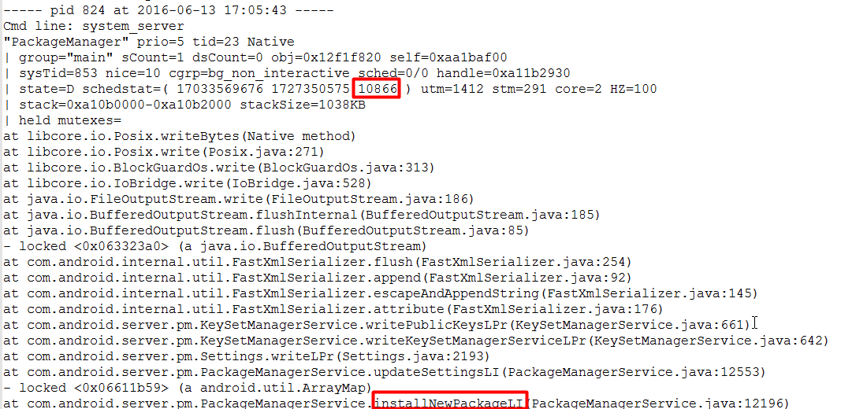
Case 2
3. Check last stack
We can see it, this thread is not fully blocked. So we should to confirm what has done by this thread.
Then check main log

Slide 83
Case 2
We found following information from main log
That’s meaning it takes a too long time to dex2oat,so we should let it do quickly.
Then we finally give a patch to customer.

Slide 84
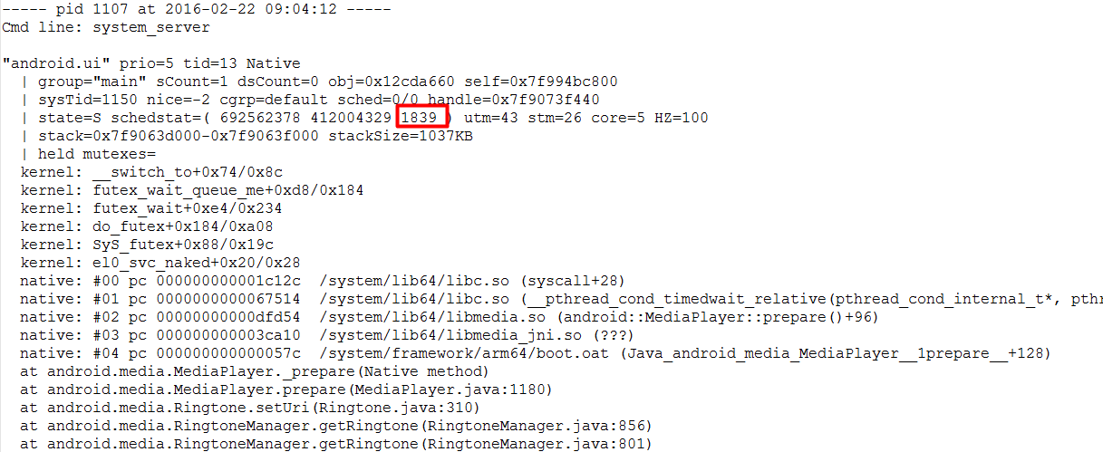
Case 3
CRID:ALPS02578376
Analyse:
1. get time point and blocked thread
2.Check predump stack

Slide 85
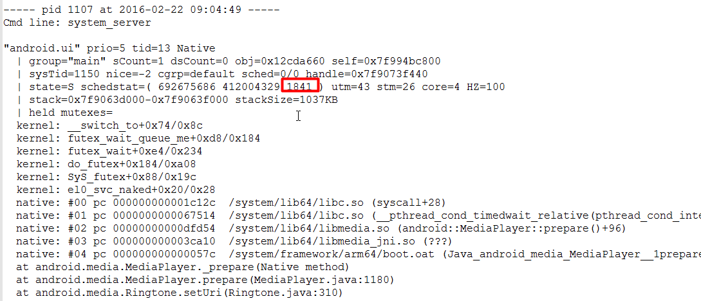
Case 3
3. Check last stack
We can see that it is blocked by Mediaplayer

Slide 86
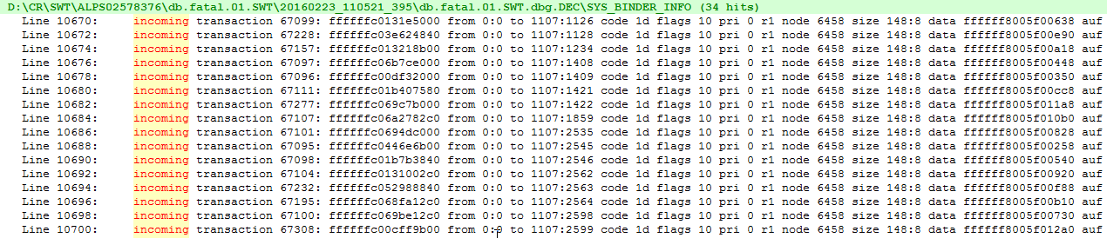
Case 3
According the code of MediaPlayer, we know the function of prepare will perform a binder communication with mediaserver asynchronously and will be notify by mediaserver also with binder communication. But we check sys_binder_info, we found all of binder thread in system_system are occupied.
If all binder thread are occupied, the new binder request will not be processed, so the android.ui thread can not be notified. Then cause SWT.

Slide 87
Case 3
As mentioned before, if all binder threads are occupied, the new binder request can not be processed, including someone publish provider. So from now on ,there is no anybody can have binder communication with system_server.

Slide 88
Case 4
CRID:ALPS02947564
Analyse:
Get time point and pid
Check predump stack
Cmd line: system_server
"android.fg" prio=5 tid=14 Blocked
| group="main" sCount=1 dsCount=0 obj=0x12cd0c10 self=0xa9187e00
| sysTid=942 nice=0 cgrp=default sched=0/0 handle=0xa085a930
| state=S schedstat=( 892620493 1166957552 1861 ) utm=51 stm=38 core=0 HZ=100
| stack=0xa0758000-0xa075a000 stackSize=1038KB
| held mutexes=
at com.android.server.am.ActivityManagerService.monitor(ActivityManagerService.java:21166)
- waiting to lock <0x03abc805> (a com.android.server.am.ActivityManagerService) held by thread 88
at com.android.server.Watchdog$HandlerChecker.run(Watchdog.java:200)
at android.os.Handler.handleCallback(Handler.java:815)
at android.os.Handler.dispatchMessage(Handler.java:104)
at android.os.Looper.loop(Looper.java:207)
at android.os.HandlerThread.run(HandlerThread.java:61)
at com.android.server.ServiceThread.run(ServiceThread.java:46)

Slide 89
Case 4
Check thread of hold the lock
Check last stack
Actually, from the two stack, we can fount that there is a dead lock.
Solution
Just check stack and try to find why, and then resolve it.
Notice
It is danger to modify the code of framework, especially those run in System_server
"Binder_B" prio=5 tid=88 Blocked
| group="main" sCount=1 dsCount=0 obj=0x135d10a0 self=0x99173e00
| sysTid=2876 nice=0 cgrp=default sched=0/0 handle=0x9777a930
| state=S schedstat=( 6306323924 4301998027 11509 ) utm=433 stm=197 core=3 HZ=100
| stack=0x9767e000-0x97680000 stackSize=1014KB
| held mutexes=
at android.app.ActivityThread.acquireExistingProvider(ActivityThread.java:5137)
- waiting to lock <0x0fffa826> (a android.util.ArrayMap) held by thread 11
at android.app.ActivityThread.acquireProvider(ActivityThread.java:5017)
at android.app.ContextImpl$ApplicationContentResolver.acquireUnstableProvider(ContextImpl.java:2023)
at android.content.ContentResolver.acquireUnstableProvider(ContentResolver.java:1517)
at android.content.ContentResolver.query(ContentResolver.java:482)
at android.content.ContentResolver.query(ContentResolver.java:441)

Slide 90
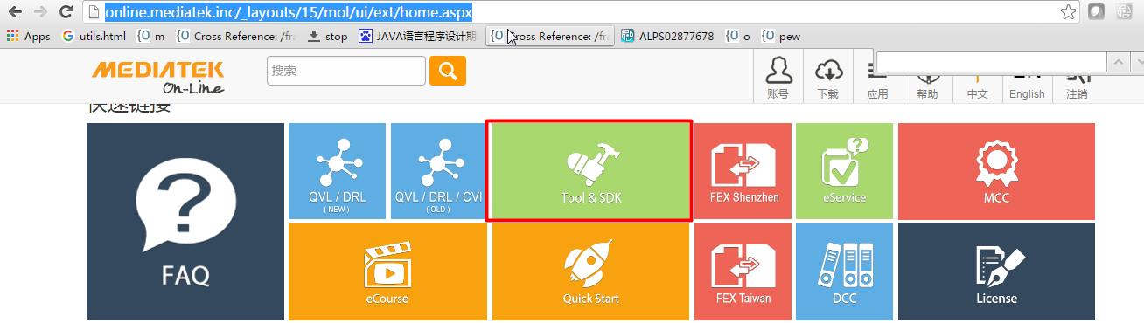
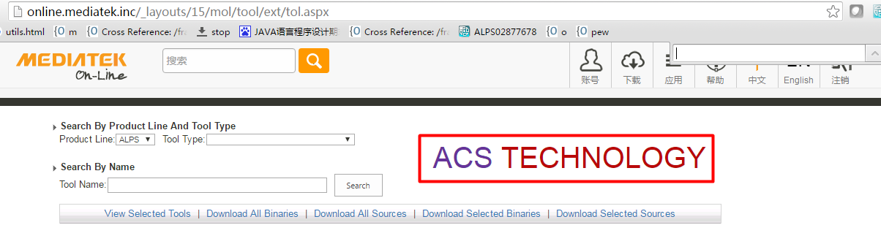
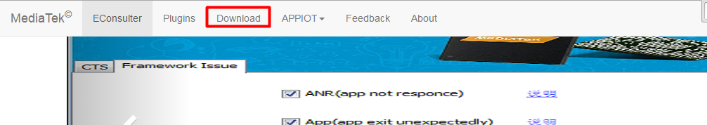
Useful tool
Tool name:E-Consulter
Download:
Use eservice count login and download

Slide 91
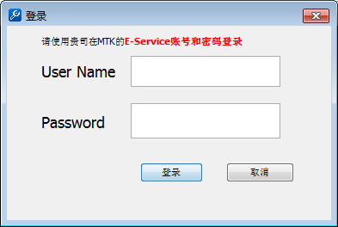
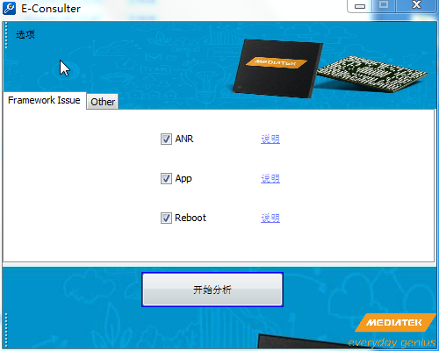
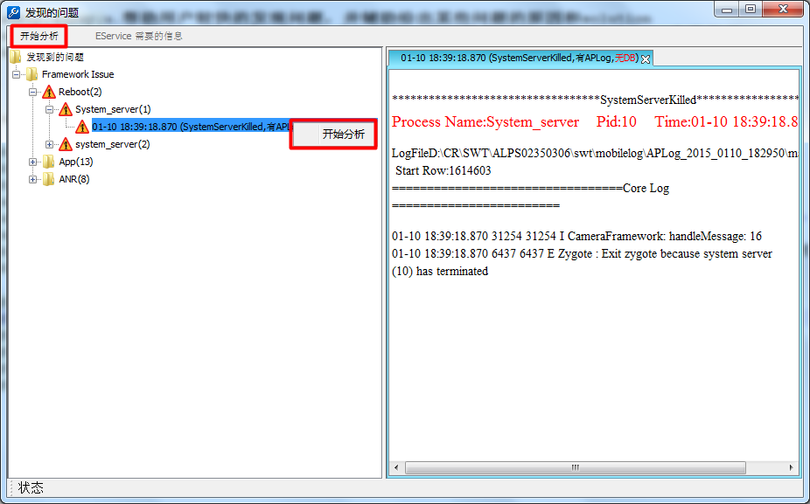
How to use
Login---Use esevice count and password
Select the phenomenon of you concern, if swt ,you can select reboot.
Then all this category of issue will be list

Slide 92

Read report
Then click right button to analyze detail

Slide 93
Reboot

Slide 94
OverView
We can let the mobile be in the initial state by performing reboot.
So there are normal reboot and abnormal reboot.
Normal Reboot
Reboot system by the reboot flow
Such as :Long press power button
Abnormal Reboot
May some exceptions happened in core processes or kernel or hardware.
May hang detected in system or kernel

Slide 95

How to check normal reboot
If reboot system, we always call shutdown thread, so in system_log, we can find following logs:
Or in last_kmsg
[ 358.968339] (0)[1:init]Reboot Process(adbd:377).
[ 360.033989] (0)[1:init]reboot: Restarting system with command ''
[ 360.034334] -(0)[1:init][<ffffffc0000becf4>] SyS_reboot+0x19c/0x1f0

Slide 96
How to check Whether reboot
Always ,If normal reboot, we can not see the change of system_server’s pid in events log. Logs as following, 969 is system_server’s pid
Abnormal reboot
Java Exception in Zygote or System_server
Native Exception in Zygote ,System server, surfaceflinger or other core process
Trigger watchdog in system_server(SWT)
Kernel Exception
Kernel Panic
Thremal Reboot
Hardware Reboot
Hang detectet
…….
For abnormal reboot
If exception happened, just analyze exception
But for Watchdog, we should check lots of logs

