Slide 1
Credit Cards Infographics
Nikos Kefalas
Stavros Tsiloglou

Slide 2
Contents
Basic Concepts
Basic terms for better understanding of our presentation.
Visualization
Diagrams because they are better than numbers for our understanding.
Clustering
Creation of labels.
Credits
Sources

Slide 3
Basic Concepts
Balance
Credit Limit
Balance amount left in accounts to make purchases
Limit of Credit Card per Customer
Purchases
Payments
Amount of purchases made from account
Amount of Payment per Customer
Subdivisions
Segmentation of the Four Basics Categories

Slide 4
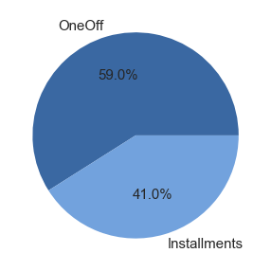
Purchases
Comparison
One Off Purchases -
Installments Purchases

Slide 5
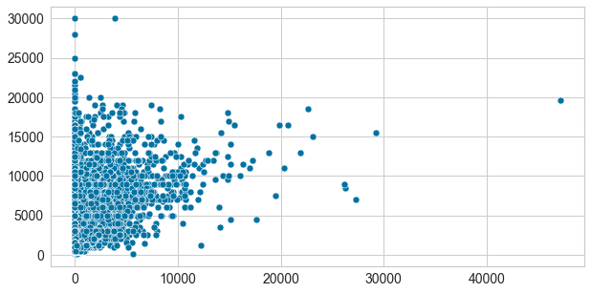
Credit Limit - Cash Advance
Conclusion
Low credit limit equals more cash advance

Slide 6
Clustering
High One-Off Purchases, High Payments & High Credit Limit
High Spenders
Average One-Off Purchases, Average Payments & Average Credit Limit
Medium Spenders
Low One-Off Purchases, Low Payments & Low Credit Limit
Low Spenders

Slide 7
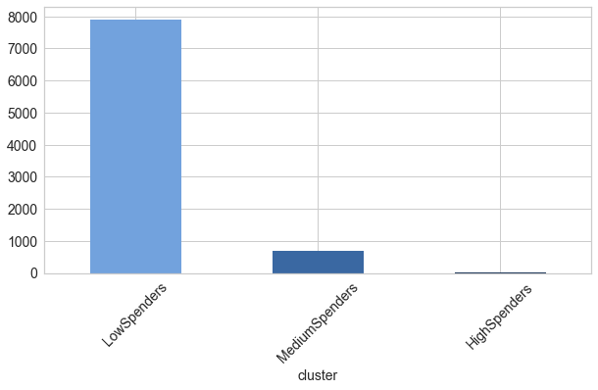

Classes
Amount of customers per Class

Slide 8
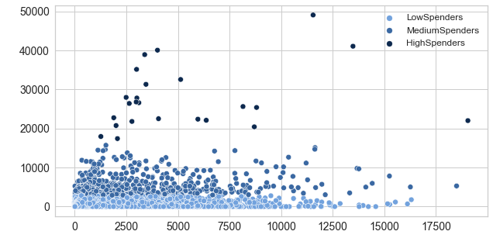

Purchases - Balance

Slide 9
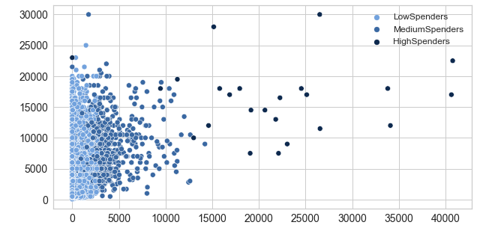

Credit Limit - OneOff Purchases

Slide 10
Credits
Kaggle
Dataset
Slides
Credit Card Dataset For Clustering
Slidesgo - Banking Infographics
Thank You !
For staying with us till the end

