Slide 1


PLS PATH MODELLING : Computation of latent variables with the estimation mode B
UNITE DE SENSOMETRIE ET CHIMIOMETRIE
Nantes-France
Mohamed Hanafi

Slide 2
References
Herman Wold (1985). Partial Least Squares. Encyclopedia of statistical sciences ,
vol 6 Kotz, S & Johnson, N.L(Eds), John Wiley & Sons, New York, pp 581-591.
Jan-Bernd Lohmöller, 1989. Latent variable path modelling with partial least squares.
Physica-Verlag, Heildelberg

Slide 3




Data sets
p₁
p₂
p_{m}
n
  Several groups of variables
  Multiple data sets
  Multiblock data sets
  Partitioned matrices

Slide 4

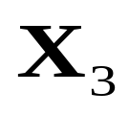
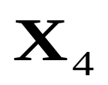

Path Model
p₁
n
p₃
p₄
p₂
n
n
n
  Path :
    is specified by the investigator
    likes to explore a specific point of view from the data
    directed graph

Slide 5

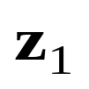



PLS PM = One principle and two models
Principle
All information between blocks of observable is assumed to be conveyed by latent variables (linear combination of variables).
Outer Model ( Factor model, measurement model)
➔ relating Manifest variables to their LV
➔shows the manifest variables as depending on the LV
Inner Model(Structural model, Path model)
➔ relating endogeneous LV to other LVs
➔ shows the LV as dependent on each other

Slide 6



Real Application :
European Customer Satisfaction Model (ECSM)
ECSM is based on well-established theories and applicable for a number of different industries
Image
Loyalty
Customer Expectation
Perceived Value
Custumer satisfaction
Complaints
Fornell, C. (1992).Journal of Marketing, 56, 6-21.
Perceived quality

Slide 7
PLS PM for two blocks
p₁
p₂
n
n
Applications
  Ecology
  Food science
  Biospectroscopy
  Ect….

Slide 8
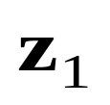

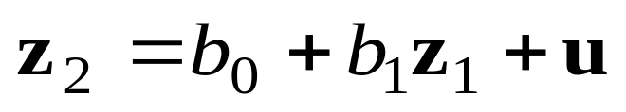
PLS PM for two blocks : models
Outer Model ( Factor model, measurement model)
➔ relating Manifest variables to their LV
➔shows the manifest variables as depending on the LV
Inner Model(Structural model, Path model)
➔ relating endogeneous LV to other LVs
➔ shows the LV as dependent on each other
Inner model

Slide 9



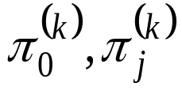
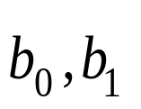
PLS PM for two blocks : Estimation
 | Estimated parameters | Computation
Latent variables |  | Iterative
Outer model Inner model |  | OLS
Inner and outer models are not estimated simultaneously!!!

Slide 10
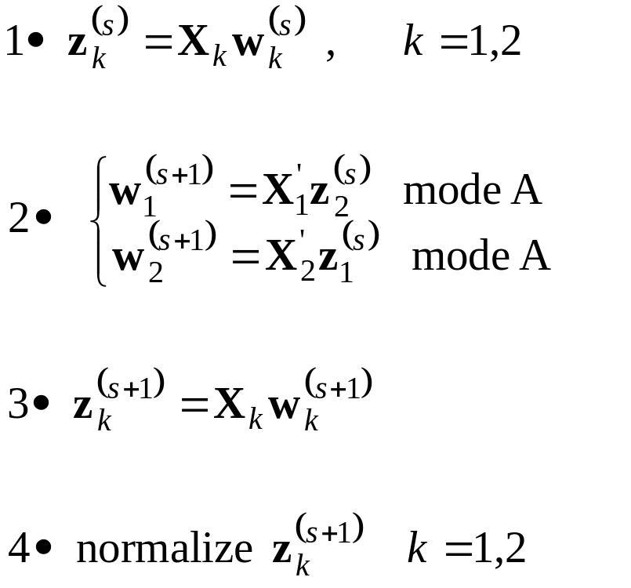

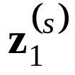

Computation of latentes variables
Two estimation modes
MODE A for X2
MODE B for X2

Slide 11
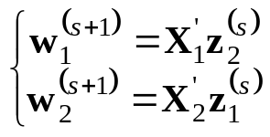
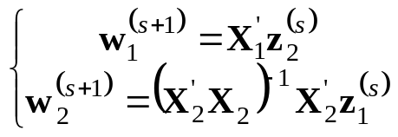
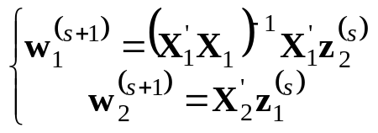
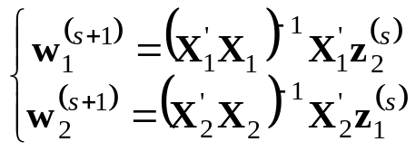
Compact description of the algorithm
 |  | X₁
 |  | MODE A | MODE B
X₂ | MODE A
 | MODE B

Slide 12
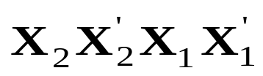
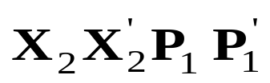
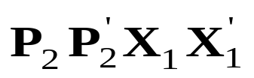
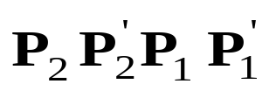
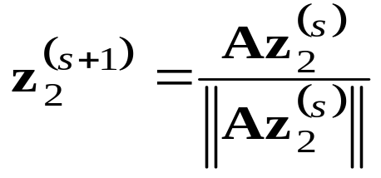
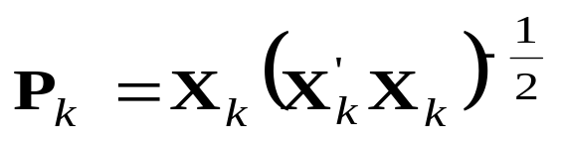
Link with Power Method
 |  | X₁
 |  | MODE A | MODE B
X₂ | MODE A
 | MODE B

Slide 13

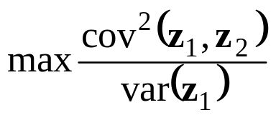
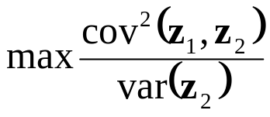

Link with psychometric methods
 |  | X₁
 |  | MODE A | MODE B
X₂ | MODE A
 | MODE B
Tucker, L. R. (1958).
Van den Wollenberg. A. L. (1977).
Interbattery method
Redundancy Analysis
Hotelling H. (1936).
Redundancy Analysis
Canonical correlation
Hotelling H. (1936). Biometrika, 28, 321-377.
Tucker, L. R. (1958). Psychometrika, 23, 111-136.
Van den Wollenberg. A. L. (1977). Psychometrika, 42, 2, 207-219

Slide 14
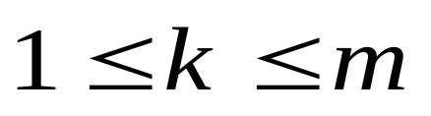
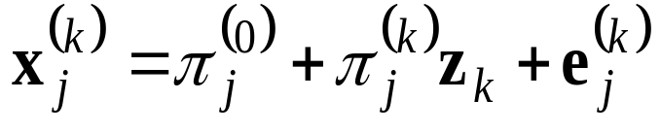
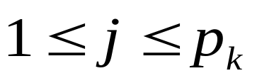
Several blocks
p₁
p₂
p_{m}
n
Outer model

Slide 15
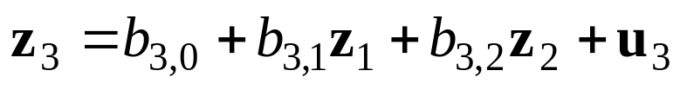
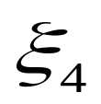

Inner Model

Slide 16


PLS PM : Estimation
 | Estimated parameters | Computation
Latent variables |  | Iterative
Outer mode Inner model |  | OLS
parameters

Slide 17

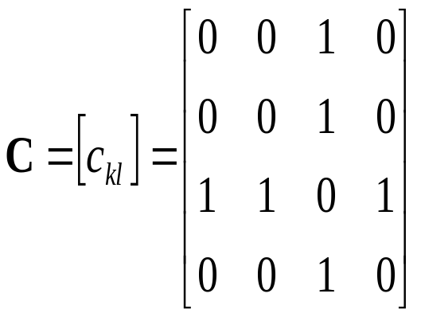

Notations

Slide 18
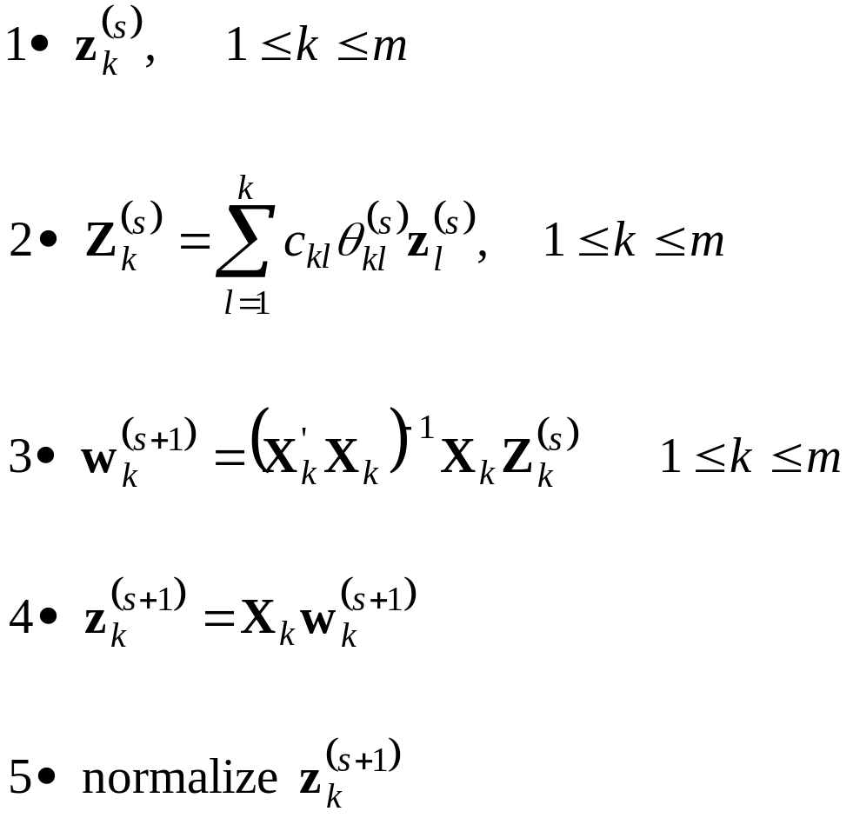
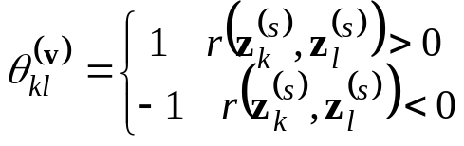

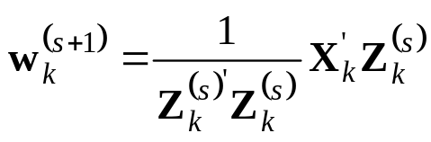

Lohmöller’s procedure (mode B)
Factorial Scheme | Centroid Scheme
Mode A | Mode B
Jan-Bernd Lohmöller, 1989. Latent variable path modelling with partial least squares.
Physica-Verlag, Heildelberg Chapter 2. page 29.

Slide 19
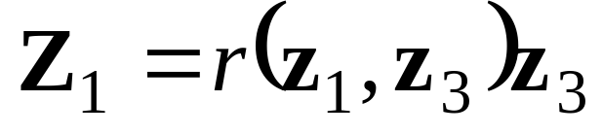
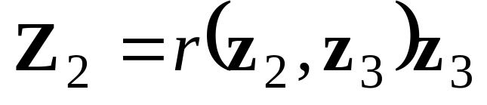
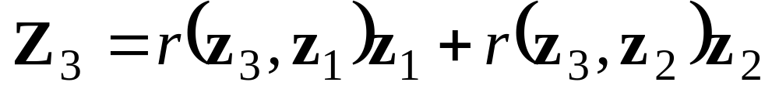
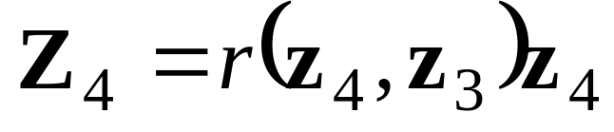

Slide 20
Remarks
Lohmöller’s procedure
  implemented in various softwares :
    PLS Graph (W. Chin)
    SPAD
    SmartPLS (Ringle and al.)

Slide 21
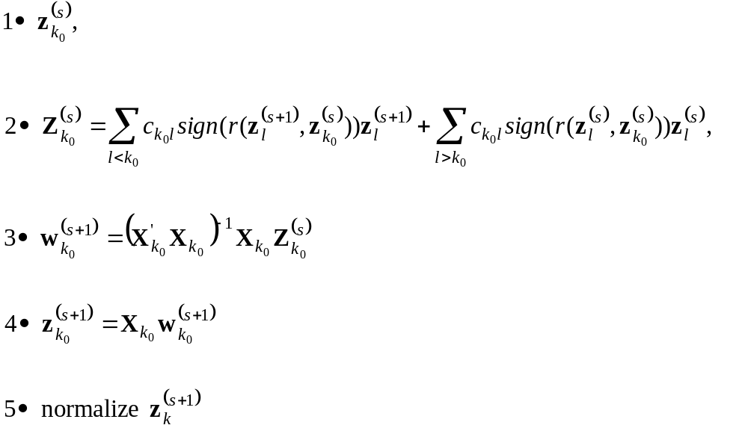
Wold’s procedure (Mode B)
Herman Wold (1985). Partial Least Squares. Encyclopedia of statistical sciences ,
vol 6 Kotz, S & Johnson, N.L(Eds), John Wiley & Sons, New York, pp 581-591.

Slide 22
Remarks
Wold’s procedure
  proposed by Wold for
    six blocks
    Centroid scheme
  Extended by Hanafi (2006)
    arbitrary number of blocks
    take into account the Factorial scheme
Hanafi, M (2006).Computational Statistics.

Slide 23
Computational Overview
Two blocks
 | algorithm | Convergence
Latent variables | Iterative | YES
Outer models Inner models | OLS | YES
No problem
More than two Blocks
 | algorithm | Convergence
Latent variables | Iterative | ?
Outer models Inner models | OLS | YES
No problem

Slide 24
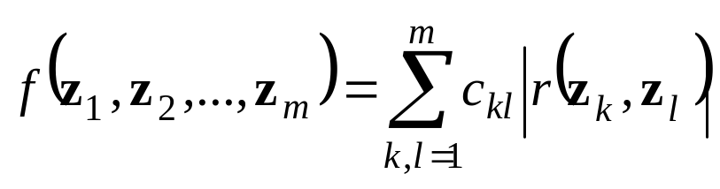
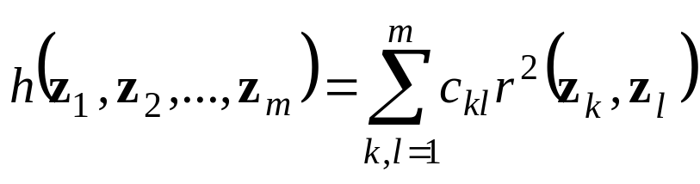
Monotony convergence of Wold’s procedure
.
MODE B + CONTROID SCHEME
MODE B + FACTORIAL SCHEME
Hanafi, M (2006).Computational Statistics

Slide 25
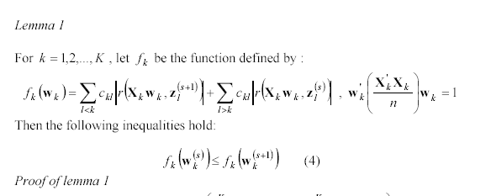
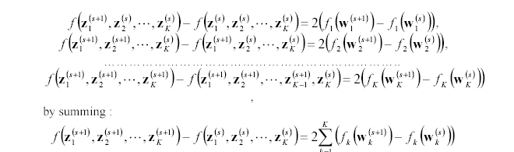
Proof : Centroid

Slide 26
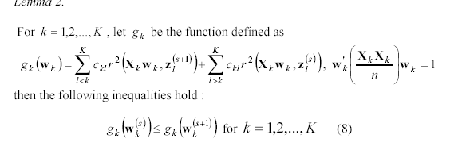
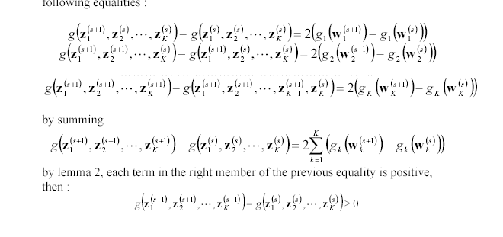
Proof : Factorial

Slide 27
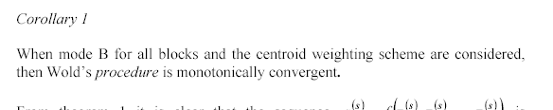
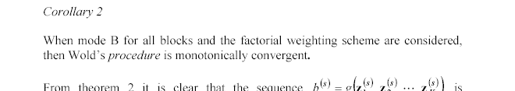

Slide 28
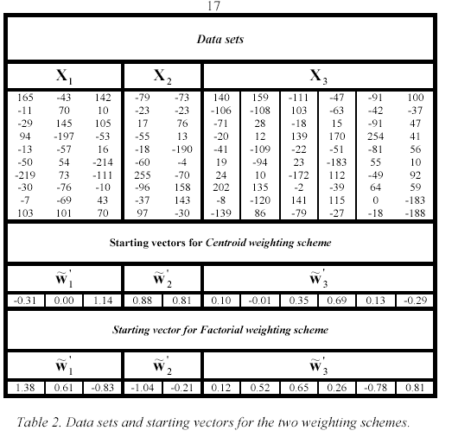
Not the case for Lohmöller’s procedure

Slide 29
Path for the exemple

Slide 30
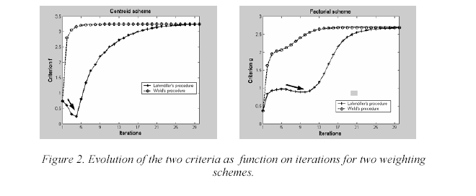
 | Centroid | Factorial
Wold’s procedure | 79 iterations | 73 iterations
Lohmöller’ s procedure | 159 iterations | 128 iterations

Slide 31
Lohmöller’s procedure revisited
  Hanafi and al (2005)
    Update c_{kk}=0 by c_{kk}=1 ➔ monotonically convergence of the procedure (Mode B+ centroid scheme)
  Hanafi and al (2006)
    Alternative procedure
Hanafi, M and Qannari, EM (2005).Computational Statistics and Data Analysis, 48, 63-67
Hanafi, M and Kiers, H.A.L. (2006).Computational Statistics and Data Analysis.

Slide 32
Wold’s procedure depends on starting vectors

Slide 33
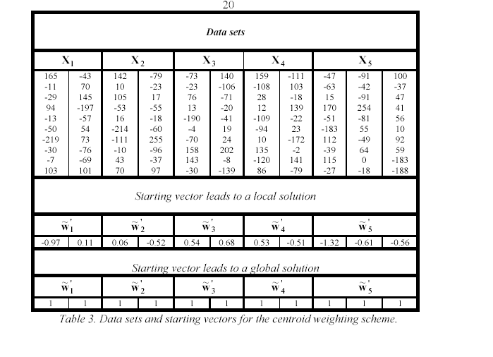
Value of the Criterion =7.10
Value of the Criterion =10.28

Slide 34
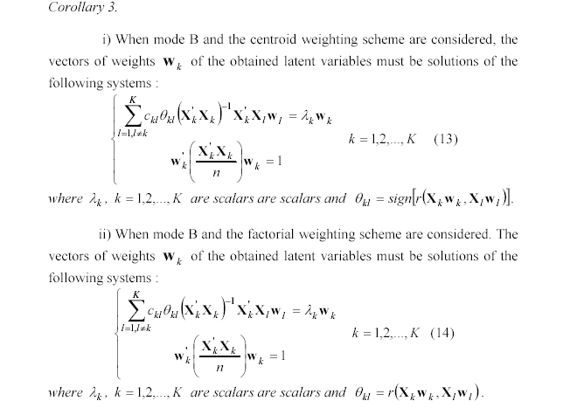
Characterization of latent variables

Slide 35
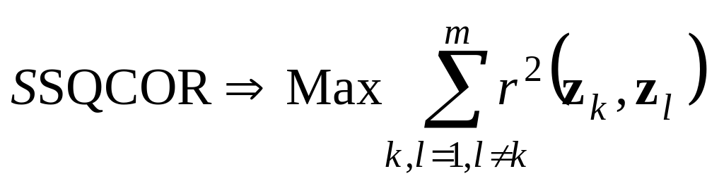
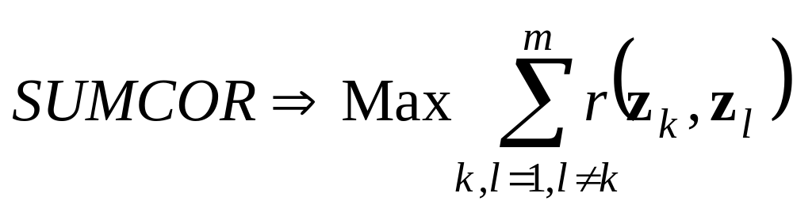
Generalized Canonical Correlation Analyses (CGA)
Kettering, J.R. (1971), Bimetrika
An overview for five generalizations of canonical correlation analysis
[Kettering (1971)]
[Horst (1965)]

Slide 36
Path model for GCA

Slide 37
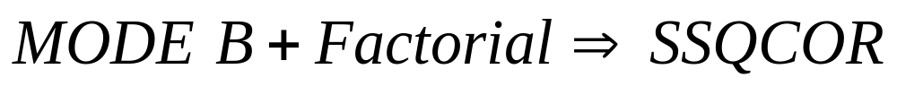

PLS PM and Generalized canonical correlation

Slide 38
Conclusions
Two blocks
  PLS PM = general framewok for psychometric methods
  The procedures of the computation of the latent variables are equivalent to a power method
More than two blocks ( with mode B for all blocks)
  Monotony property of Wold’s procedure
  Characterization of the latent variable as a solution (among other) of non linear systems of equations
  Strong link with generalized canonical correlation analysis
  PLS PM with the estimation mode B can be seen as an extension of CGA.

Slide 39
Perspectives
To what extend the solutions obtained by wold’s procedure are at least a local maximum?
Similar results for mode A and mixed mode ?
Optimisation principle for Latent variables ?

Slide 40
Computational Overview
Two blocks
 | algorithm | Convergence | Optimality
Latent variables | Iterative | YES | YES
Outer models Inner models | OLS | YES | Yes
No problem
More than two Blocks
 | algorithm | Convergence | Optimality
Latent variables | Iterative | ? | ?
Outer models | OLS | YES | Yes
Inner models | OLS | YES | Yes
No problem

Slide 41






Characterization of latent variables

