Slide 1
HOW TO CONVINCE PEOPLE THAT 3-WAY PCA IS
USEFUL AND EASY
R. Leardi
Department of Pharmaceutical and Food Chemistry and Technology, Via Brigata Salerno (Ponte), 16147 Genoa, Italy.

Slide 2
I just submitted a paper to “Food Quality and Preference”.
The reviewer said the paper required major revisions.
Its review started with the following sentences:
“The paper presents a much needed and interesting application of multi-way analysis to data from sensory descriptive analysis. Regrettably there are only published very few papers using multi-way analysis on these type of data. For that reason alone it should be published.”

Slide 3
WHY PEOPLE DON’T USE N-WAY PCA?
1) They don’t know it
2) They don’t understand it and/or think it’s too difficult
3) It is not implemented in the most used softwares

Slide 4
WHAT CAN WE DO?
1) Publish as many “simple” papers (applications) as possible
2) Explain it in the simplest possible way, mainly focusing on the “real” advantages
3) Write simple and user-friendly softwares

Slide 5
LEVEL OF KNOWLEDGE OF N-WAY METHODS
TRICAPPERS (except one)
Riccardo Leardi
Chemometricians
Non-chemometricians

Slide 6
DATA SET VENICE
(M.L. Tercier-Waeber¹, B. Gianni², G. Ferrari³)
¹Department of Inorganic and Analytical Chemistry, University of Geneva, Switzerland.
²Venice Water Authority-Consorzio Venezia Nuova, Venice, Italy.
³Magistrato alle Acque-Antipollution Section, Venice, Italy.
13 variables:
pH
NO₂⁻
NO₃⁻
NH₄⁺
PO₄³⁻
Dissolved organic P
Redox E
Cd (total)
Pb (total)
Cu (total)
Cd (dynamic)
Pb (dynamic)
Cu (dynamic)
12 samplings:
Samplings have been performed once per month, from January to December 2001, at the quadrature of the tide, in the 50 cm superficial water layer of each station.
Dynamic fraction: free metal ion and small labile complexes with size of few nanometers. It is the most easily bioavailable and therefore the most toxic fraction.

Slide 7
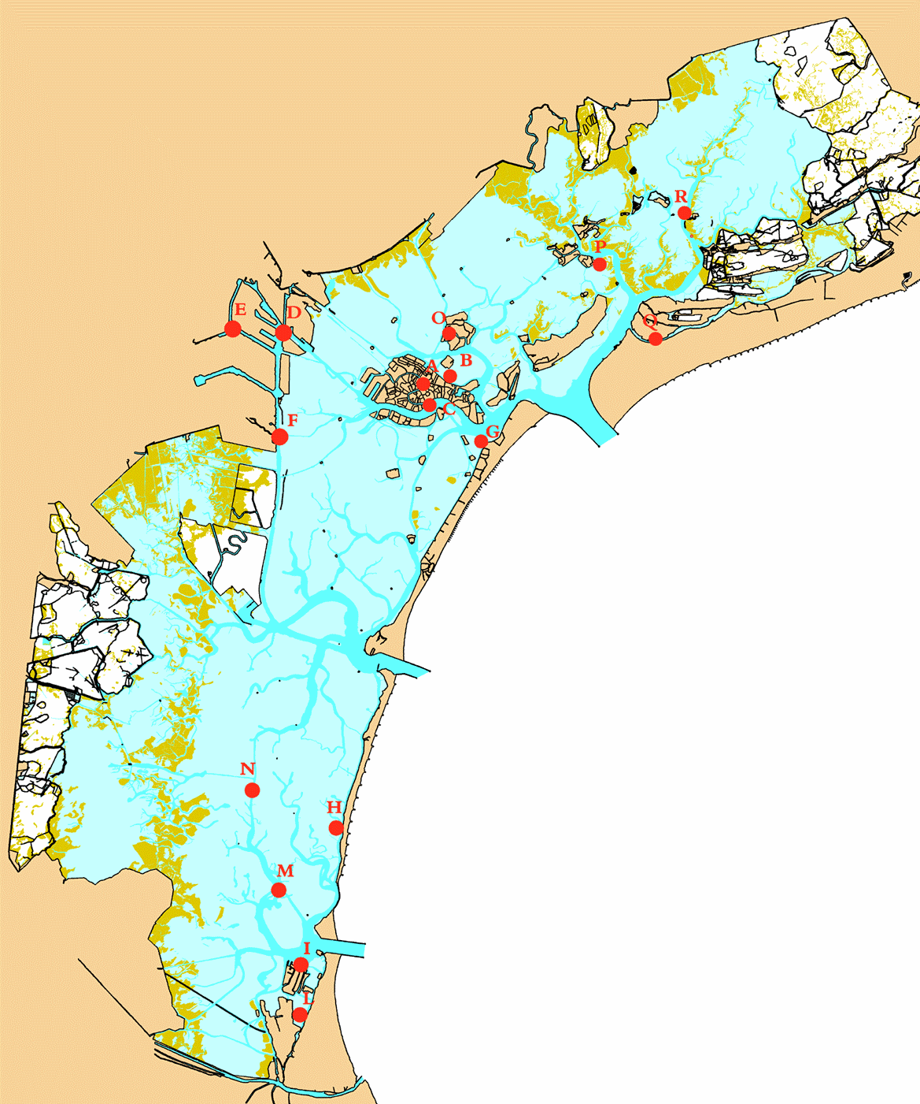
industrial contamination
urban contamination
urban-industrial contamination
16 sampling stations:
urban background
background
A: Canal Grande
B: Canale della Giudecca
C: Canale delle Fondamenta Nuove
D: Can. Vitt. Emanuele (Porto Marghera)
E: Can. Industriale Ovest (P. Marghera)
F: Can. Malamocco-Marghera (P. Marghera)
G: Canale di S. Maria Elisabetta (Lido)
H: Canale di Pellestrina
I: Chioggia
L: Chioggia
M: South Lagoon (reference)
N: South Lagoon (reference)
O: Canale di Sacca Serenella (Murano)
P: Canale di Burano
Q: Canale Pordelio (Ca’ Savio)
R: Canale S. Felice (reference)
Lido inlet
Malamocco inlet
Chioggia inlet

Slide 8
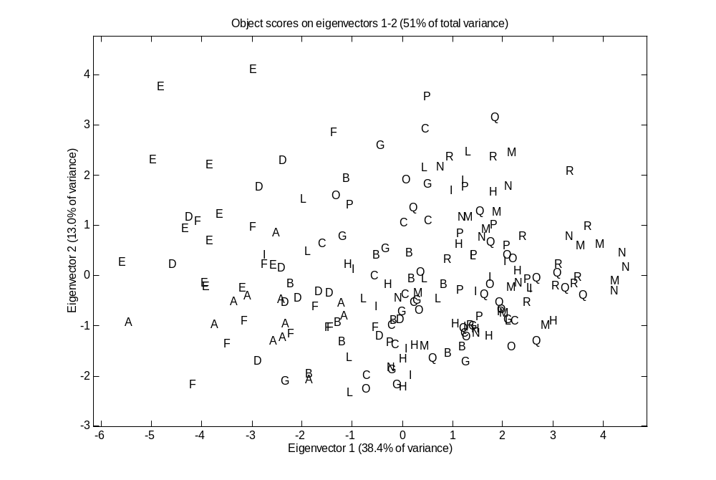

Slide 9
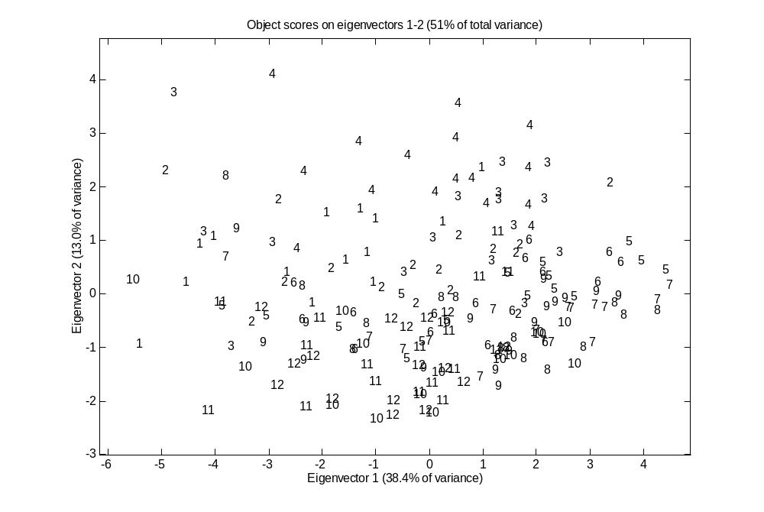

Slide 10
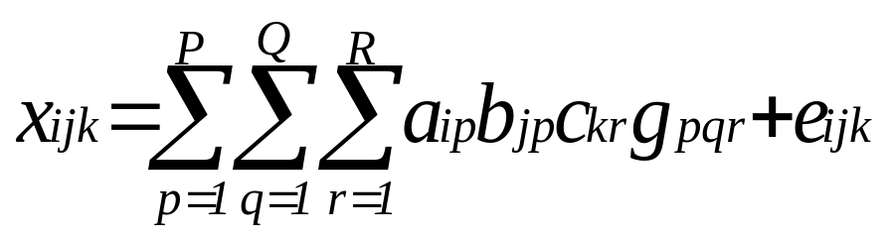
Three-way principal component analysis: Tucker3 model
K
R
C
Study of pollution profile
X
=
G
J
B
E
I
P
+
K
R
I
K
Mode 1: 16 stations
J
Q
Q
J
Mode 2: 13 variables
I (stations)
I
J (variables)
A
Mode 3: 12 months
K (months)
P
a_{ip}, b_{jq}, c_{kr} = elements of the loading matrices A, B and C of order IxP, JxQ, KxR resp.
g_{pqr} = element (p,q,r) of the PxQxR core array G;
the core array describes the relationship among the three loading matrices
e_{ijk} = error term for the element x_{ijk}; element of the IxJxK array E

Slide 11
THREE-WAY PCA RESULTS
2 components per each mode
40.3% of the total variance explained
Core matrix:
c111 c121 c112 c122
c211 c221 c212 c222
26.75 -3.89 -0.55 0.31
-0.26 0.93 7.42 -14.62
% explained variance:
28.8 0.6 0.0 0.0
0.0 0.0 2.2 8.6
Since the core matrix is almost totally superdiagonal, the three loading plots (samples, variables and conditions) can be interpreted jointly.

Slide 12
LOADING PLOT OF
MODE 1 (SITES)
0
+
-0.1
-0.2
E
H
P
M
Axis 2
F
B
Q
D
L
O
R
-0.3
A
C
G
I
N
-0.4
-0.5
-0.5
-0.4
-0.3
-0.2
-0.1
0
0.1
0.2
0.3
Axis 1

Slide 13
LOADING PLOT OF MODE 2 (VARIABLES)
0.6
NO₃⁻
0.5
Redox E
0.4
0.3
NO₂⁻
pH
Cd dyn.
Cu dyn.
Axis 2
0.2
Cd tot.
0.1
0
Pb dyn.
+
Cu tot.
NH₄⁺
-0.1
Pb tot.
PO₄³⁻
-0.2
dissolv. org. P
-0.6
-0.4
-0.2
0
0.2
0.4
Axis 1

Slide 14
LOADING PLOT OF MODE 3 (MONTHS)
0.5
1
0.4
0.3
4
3
0.2
2
11
0.1
12
Axis 2
0
+
10
-0.1
5
-0.2
9
-0.3
6
8
-0.4
-0.5
7
-0.4
-0.2
0
0.2
0.4
0.6
0.8
1
Axis 1

Slide 15
1
+
4
3
2
E
H
M
11
P
12
F
D
B
L
Q
+
A
C
I
O
N
R
10
G
5
9
6
8
7
NO₃⁻
Redox E
NO₂⁻
pH
Cd dyn.
Cu dyn.
Cd tot.
Pb dyn.
+
NH₄⁺
Cu tot.
Pb tot.
PO₄³⁻
dissolv. org. P

Slide 16
WHAT I DID
I wrote a simple Matlab program doing the following:
- Compute the loadings of a [2 2 2] Tucker3 model
- Maximise the superdiagonality of the core matrix
- Solve the “sign ambiguity”
- Display the loading plots of the three modes and the residuals
Everything automatically, after hitting the return key

Slide 17
HOW TO SOLVE THE SIGN AMBIGUITY
for each component
  look for the variable v with the highest loading (abs. value)
  look for the object o1 with the highest loading (same sign as v)
  look for the object o2 “opposite” to o1
  if mean(o1,v) > mean(o2,v)
    the sign is correct
  else
    invert sign of the object loadings for that component
  end
end
Repeat the same procedure for the condition loadings

Slide 18
DATA SET CARS
Objects (cars):
1) Fiat Tempra 1.6
2) Fiat Uno 45 Fire
3) Fiat Uno 60
4) Panda Ecobox
5) Fiat Tipo 1.4
6) VW Polo Kat
7) Alfa Romeo 33 1.7 K
8) Fiat Uno 1000 K
9) Fiat Panda 1000 K
10 )Fiat Tipo 1.4 K
Variables
1) CO
2) Total hydrocarbons
3) NOx
4) Formic aldehyde
5) Acetic aldehyde
6) Total aldehydes
7) Ethylene
8) Propylene
9) Acetylene
10) 1,3-butadyene
11) Benzene
12) Ethylbenzene
13) p,m-xylene
14) o-xylene
15) Toluene
16 ) Total aromatic comp.
Conditions
(cycles and gasoline)
1) Urban, A
2) Extra-urban, A
3) Mixed, A
4) Urban, B
5) Extra-urban, B
6) Mixed, B

Slide 19
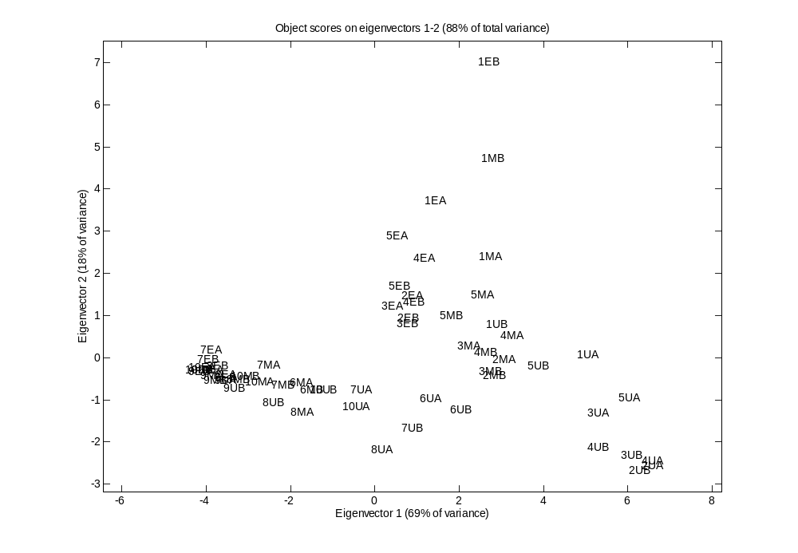

Slide 20
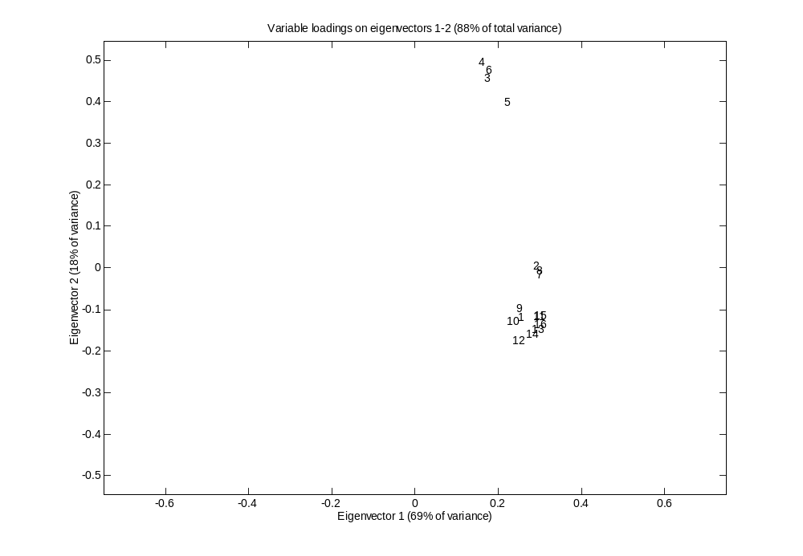

Slide 21
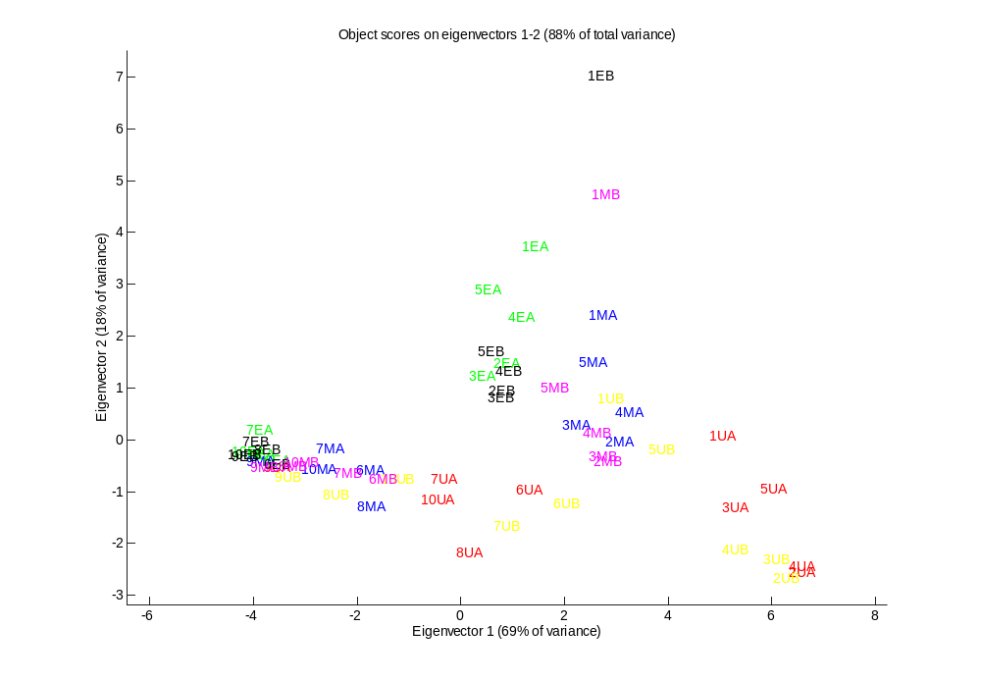

Slide 22
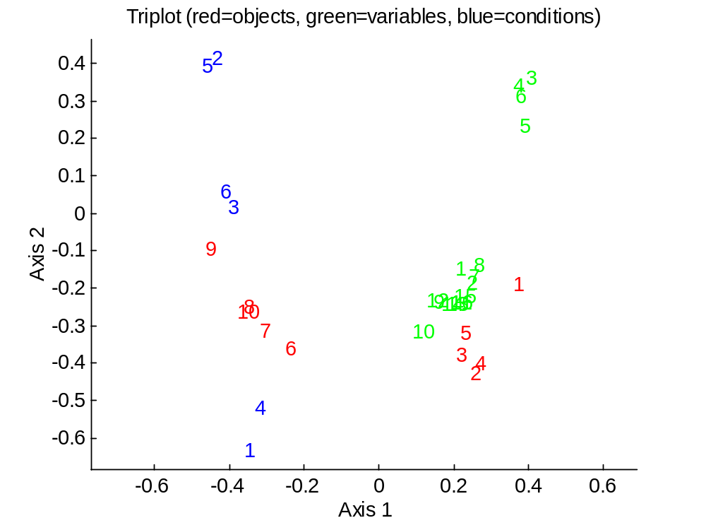
expl. Var.: 78.4%
core matrix:
-21.28 4.97 -0.88 3.90
2.25 -1.00 8.07 -13.23
% expl. var.:
48.0 2.6 0.1 1.6
0.5 0.1 6.9 18.5

Slide 23
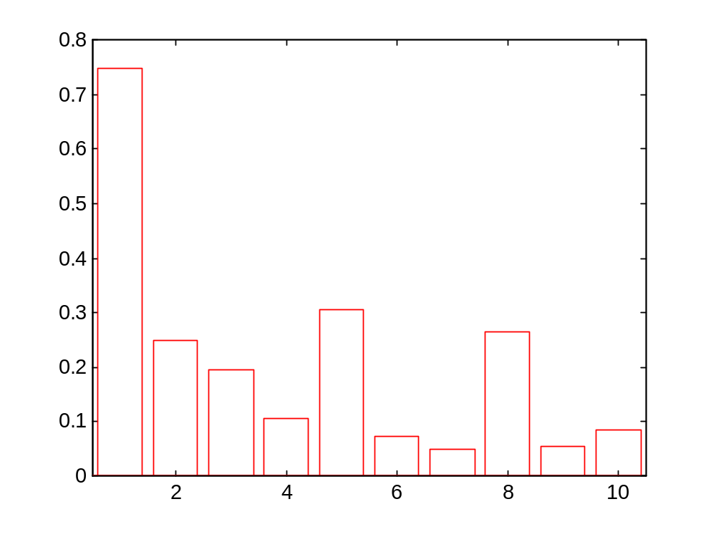

Slide 24
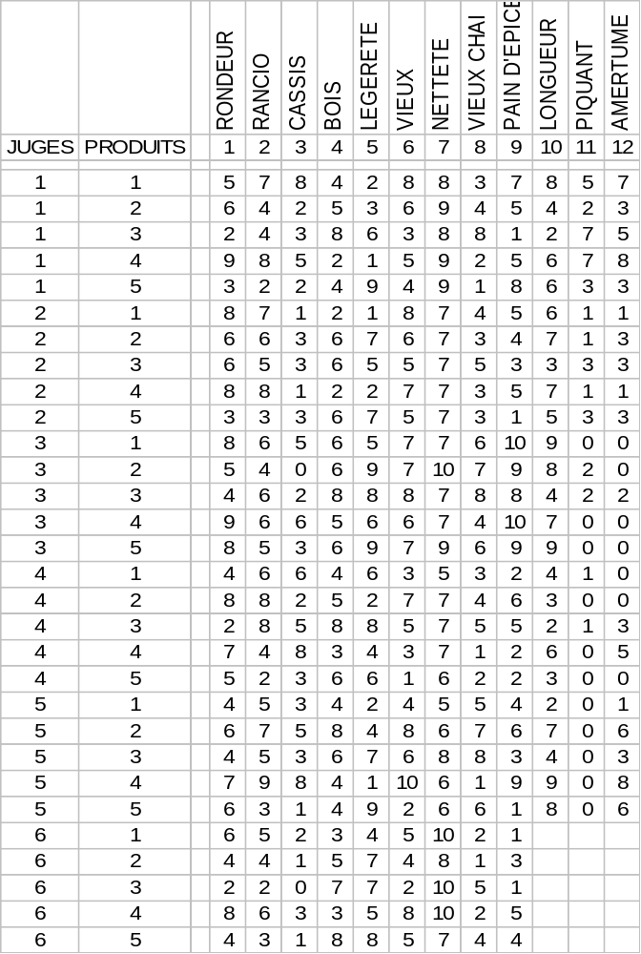
DATA SET PANEL TEST

Slide 25
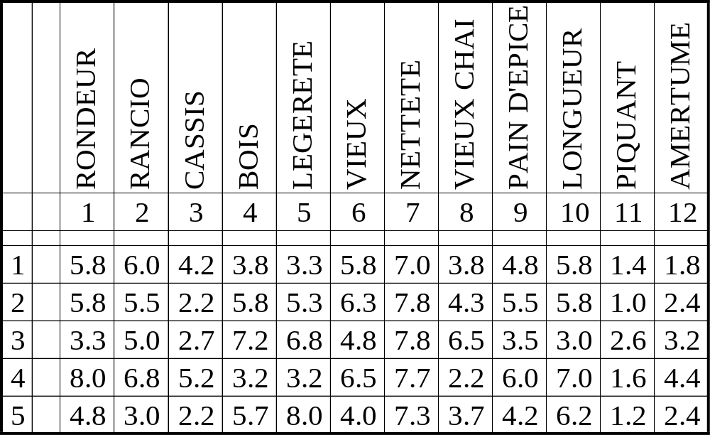
WHAT PEOPLE USUALLY DO:
LOOK AT AVERAGES

Slide 26
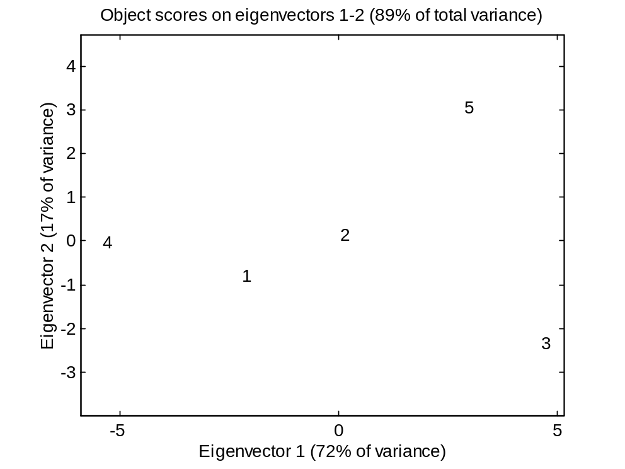
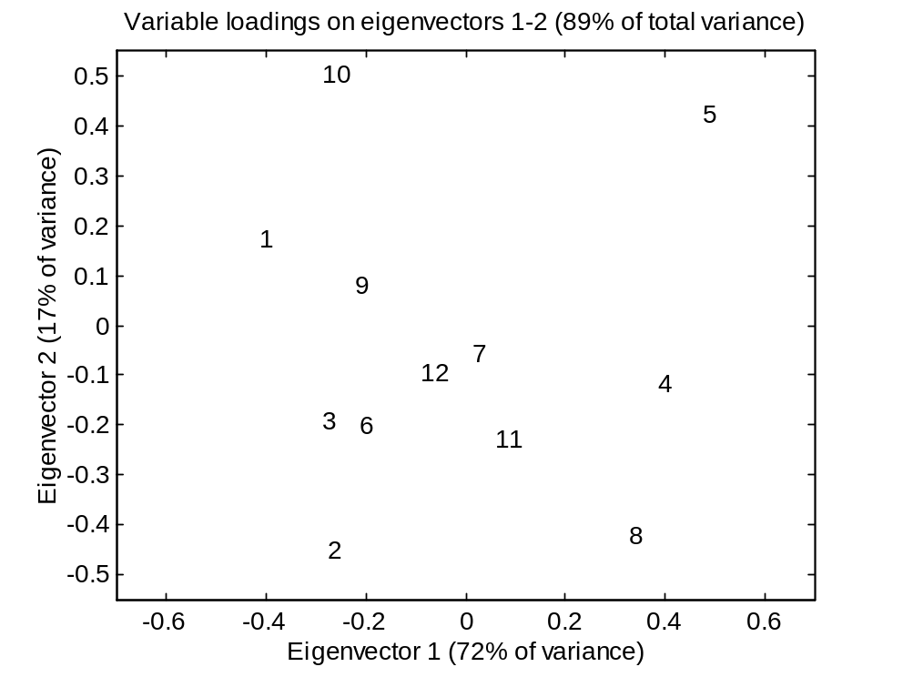
ONE STEP FORWARD:
PCA ON THE AVERAGE SCORES
Since it is based on average scores, an “hypothetical judge” is looked at, and there is no idea about the “experimental error” of the different judges and of the different attributes
The missing data are not taken into account, and therefore the averages can be biased depending on which data are missing

Slide 27
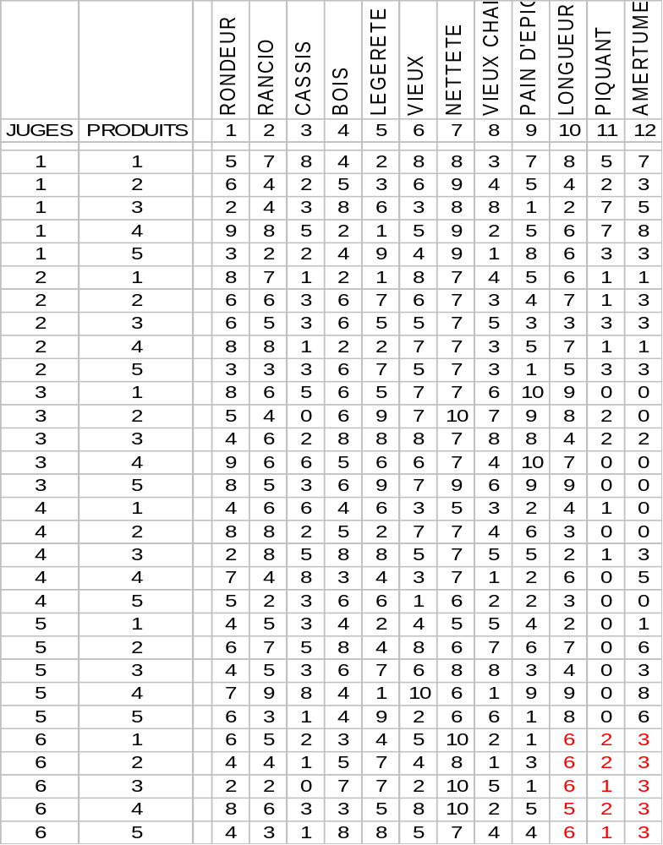
THREE-WAY PCA
It takes into account also the effect of the judges: this means that the way of scoring of each of them is taken into account, not just the “average”.
It is possible to “reconstruct” the missing data.

Slide 28
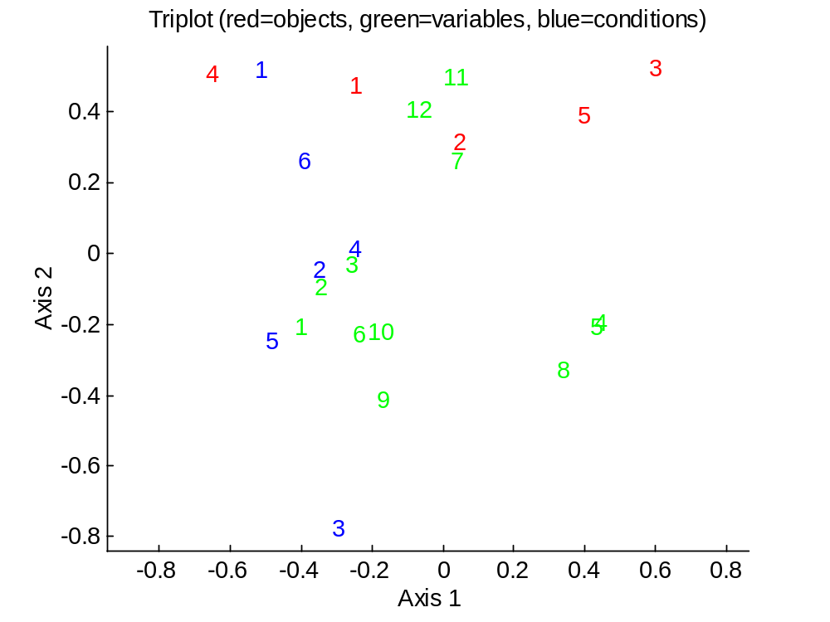
expl. var.: 37.1%
core matrix:
-9.01 -0.11 0.69 -0.66
0.47 -1.05 0.21 6.77
% expl. var.:
23.3 0.0 0.1 0.1
0.1 0.3 0.0 13.2

Slide 29
DATA SET STRAWBERRIES
(C. Patz, Research Center Geisenheim, Department of Wine Analysis and Beverage Research, Germany)
12 cultivars:
A) Andana
B) Arena
C) 88009/o2v2
D) 88009/o3v3
E) Cijosee
F) Cirano
G) Elsanta
H) Honeoye
I) Kimberly
J) Lambada
K) Pavana
L) Vima Zanta
9 attributes:
a) aromatic (flavour)
b) fruity (flavour)
c) sweet (taste)
d) sour (taste)
e) sweet/sour equilibrium
f) aromatic (taste)
g) watery (taste)
h) consistency
i) global score
10 panelists:
Panelist 01
...
Panelist 10
(with several missing data)

Slide 30
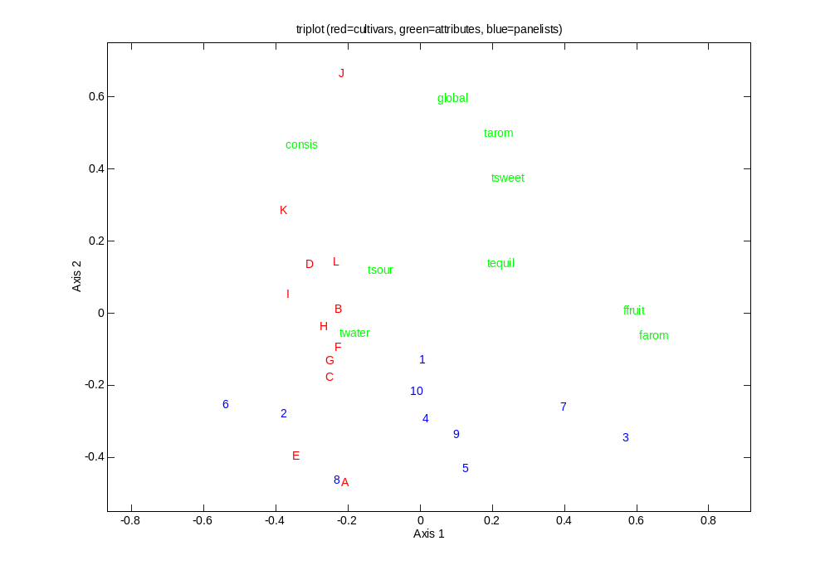
expl. var.: 53.3%
core matrix:
-17.88 -5.77 0.41 -0.10
0.04 0.26 -6.49 -15.77
% expl. var.:
26.5 2.8 0.0 0.0
0.0 0.0 3.5 20.6

Slide 31
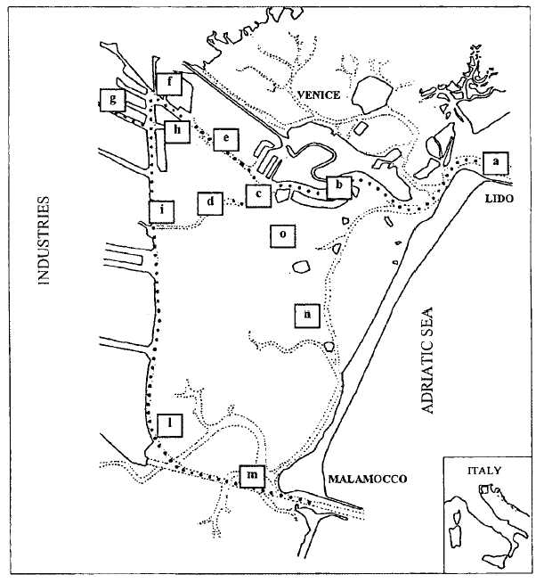
DATA SET VENICE (II)
(L. Alberotanza, Istituto per lo Studio della Dinamica delle Grandi Masse, Venezia, Italy)
Objects: 13 sampling sites
Variables:
1) chlorophyll-α
2) total suspended matter
3) water transparency
4) fluorescence
5) turbidity
6) suspended solids
7) NH₄⁺
8) NO₃⁻
9) P
10) COD
11) BOD₅
Samplings:
1) May ‘87
2) June ‘87
...
44) December ‘90

Slide 32
explained variance: 34.6%
core matrix:
-34.94 -1.99 1.86 -1.96
-1.39 2.12 -2.84 -30.48
% explained variance:
19.4 0.1 0.1 0.1
0.0 0.1 0.1 14.8

Slide 33
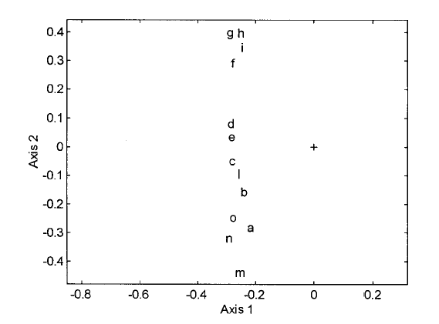
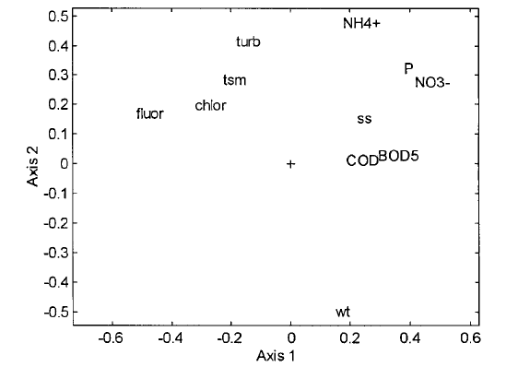
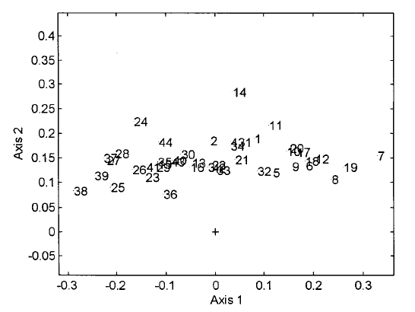
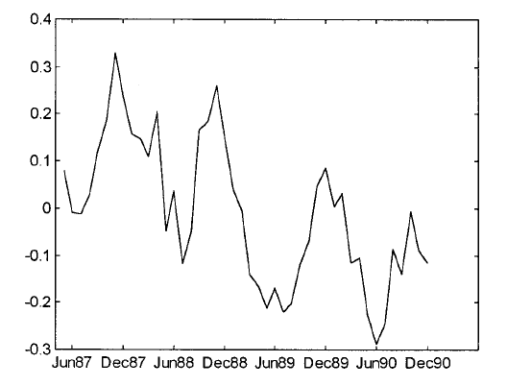

Slide 34
