Slide 1
Estimating and minimizing uncertainty in factor analytic results, both in 2-way and in 3-way models
Pentti Paatero, Shelly I Eberly, Philip K. Hopke
Univ. of Helsinki
US EPA
Clarkson University

Slide 2
Known methods for error estimation
Error propagation (EP) : std-dev of X elements must be known (or guessed). Compute Hessian matrix H of Q. Perform SVD of H. May approximate H by J^{T}J → compute SVD of J, the Jacobian of fitted values vs. factor elements.
Noise insertion (NI) = create perturbed versions of X by adding noise to its elements. Fit the model to perturbed versions of X, formulate histograms of results.
Bootstrap (BS) = create “resampled” versions of X by omitting and reweighting rows or columns or slices of X. Fit the model to resampled versions of X, formulate histograms of results.

Slide 3
Properties of known methods
(EP) +: computationally fast. EP reveals rotational ambiguity.
-: error structure of X may be unknown. The usual linear EP cannot represent unsymmetric errors caused by non-negativity.
(NI) +: simple to implement. Unsymmetric errors OK.
-: error structure of X may be unknown. NI does not reveal rotational ambiguity. NI is slow to compute
(BS) +: OK with unknown errors of X (almost?), OK with unsymmetric errors
-: BS does not reveal rotational ambiguity, BS is very slow. Not clear if BS is theoretically valid with these models.

Slide 4
The mode of individual items or “items’ mode”
One mode (A) is assumed to consist of individual observations or items that come from a population (also called the stochastic mode).
Examples: test subjects, quality control samples, air pollution samples
Bootstrap resampling is performed on the items’ mode
C. Spiegelman is studying feasibility of bootstrap on chemical species mode (he has lots of species).

Slide 5
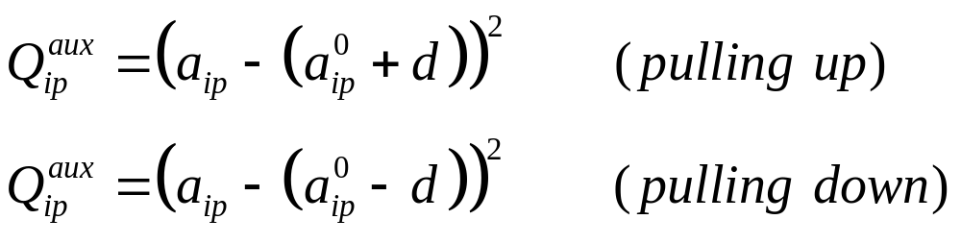
Bootstrap with rotational forcing (new)
The items’ mode is used simultaneously both for resampling and for rotational forcing
Rotational forcing: select randomly some factor elements a(i,p) in items’ mode A for pulling up or down
This generates additional auxiliary terms Q^{aux} into the object function that is minimized by the BS LS fit. Superscript 0 denotes full-data results:

Slide 6
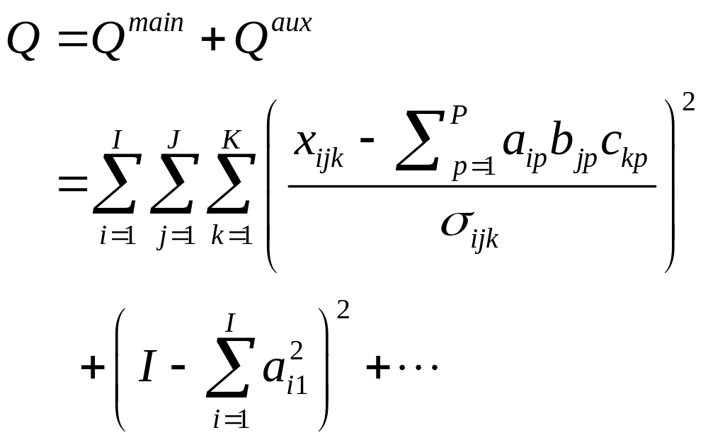
The PARAFAC object function Q
The following expression defines the object function for fitting 3-way data in PARAFAC. Some or all of elements of A, B, and C may be constrained, e.g. to be non-negative. Last term is an example of normalization equations in Q^{aux}.

Slide 7
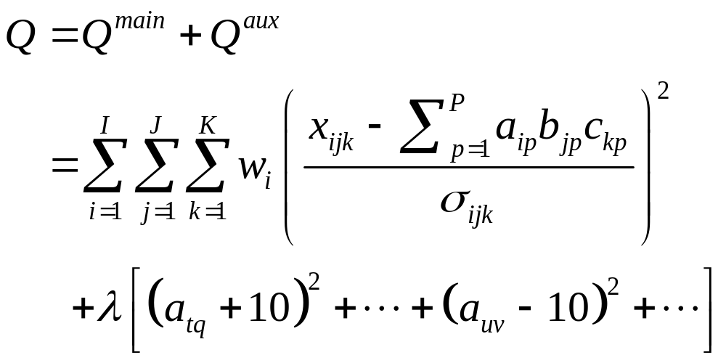
The PARAFAC bootstrap object function Q
The following expression defines the object function for fitting PARAFAC BS. The indices t,q,u, and v are examples of randomly select values. Normalization equations have been omitted for brevity.

Slide 8
Operations in one bootstrap replication with rotational forcing
2-way, X=A*B+E
Implement resampling as Poisson distribution of weights w_{i} = 0,1,2,3,4,5… on rows of X
Impose pulling equations on a few elements of A
Select starting values (A,B)
Solve the 2-way model
Identify/rearrange factors
Store the computed B values
3-way, X=[A,B,C]+E
Implement resampling as Poisson distribution of weights w_{i} = 0,1,2,3,4,5… on slices of X
Impose pulling equations on a few elements of A
Select starting values (A,B,C)
Solve the 3-way model
Identify/rearrange factors
Store the computed B and C values

Slide 9
BS operations, enhanced version: alternate without and with rotational forcing (2w and 3w)
Fit each new BS replication first without rotational forcing (i.e. λ=0). Store the results.
Then fit the same replication (= same weighting of rows or slices) with forcing activated. Again, store the results.
Then proceed with next BS replication.
The increase of the main Q value, caused by introducing rotational forcing, indicates if the strength of forcing λ is reasonable. Increases of 5 to 50 seem OK. Why?
Differences of computed factor values, when computed without and with rotation, reveal if rotational freedom is significant in increasing the uncertainty of results.

Slide 10
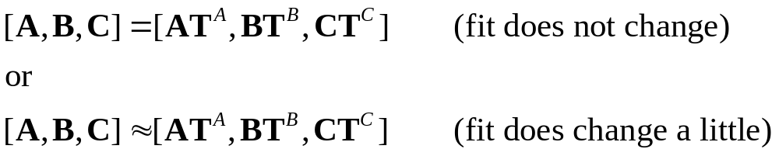
Rotational ambiguity in PARAFAC?
In 2-way (the exact rotation): A T T⁻¹ B = A B.
An approximate rotation may occur if some elements cannot rotate: F ≈ A T; G ≈ T⁻¹ B ;
F G ≈ A B.
In PARAFAC:

Slide 11
Starting values for BS computations
Starting from full-data best-fit results
+ usually individual factors preserve their identities
+ faster computations
- if the solution space consists of disjoint regions, part of
the space may not be accessible from the best-fit solution
Starting from random values
- factors appear in random order, must be identified and rearranged
+ the entire solution space is explored
? What to do with entirely different “wild” solutions ?
(They are more likely to occur with random starts.)

Slide 12
Practical implementation of 2w and 3w BS algorithms
The multilinear engine program (ME-2) is used for fitting the BS models.
ME-2 uses a modified conjugate gradient algorithm for the minimization of Q.
The user describes the model by specifying equations of the model one by one, using a special script language.
The user cannot define how the model is solved. Solving the model is the task of the ME-2.
Each term in Q corresponds to one equation.
One iteration step in ME-2 takes somewhat longer than a similar step in ALS. In most cases, ME-2 converges (much?) faster than ALS, however.

Slide 13
Clearing some misunderstandings about ME-2
“I cannot use ME-2 because all of my work is in Matlab”
-- Matlab can easily start a ME-2 run and retrieve the results from a file written by ME-2.
“I heard that ME-2 is written in FORTRAN. I do not know about FORTRAN.” The users of ME-2 do not have access to the FORTRAN code, so this is not a problem. The users only use the script language.
“Using ME-2 seems to be rather difficult.” Yes and no. The initial learning threshold is high but after this step has been mastered, the continuation should not be too difficult.
“Because ME-2 is so general, it cannot be fast, cf. e.g. matlab optimization algorithm that is very slow if many unknowns.” Not true. ME-2 uses efficiently the multilinear structure of the model, thus is not so general as the truly general minimization packages.

Slide 14
Experience with 2-way BS error estimation
It works!
It is currently being tested for analysis of atmospheric pollution sources by US EPA (a mixture problem).
In simulation tests, confidence intervals (CI) can be obtained with typical confidence levels of 0.90 to 0.98. Note that optimizing length and confidence level of a CI forms a tradeoff.
The obtained uncertainties may be a (nasty) surprise to some users.
The CI’s are often not symmetrical around the best-fit values.
Typically, 100 to 200 BS replications were run. Useful CI’s are obtained by taking e.g. the 4th smallest and largest results for a factor element.

Slide 15
Experience with 3-way BS error estimation
It works!
The implementation was finished 2 weeks ago. So far, no real work has been attempted.
In simulation tests, confidence intervals (CI) can be obtained with typical confidence levels of 0.90 to 0.98. Note that specifying length and conf-level of a CI forms a tradeoff.
If there are almost collinear factors, rotational ambiguity is observed as expected.
This approach does not reveal rotations between B and C columns. This would be an issue if A columns are (nearly) collinear.

Slide 16
Experience with 3-way BS error estimation – cont.
A and B have been normalized, so that C values contain the strength.
In simulation with random data, individual CI’s for C elements were large. Much of this variation was common to all elements within one C column. → Normalize C, too, and carry strength of a factor in a scalar coefficient. Will be done soon.
Results from a quick-and-dirty study with real data are in a separate file.

Slide 17
Open questions with BS error estimation.
How to obtain confidence levels when analyzing real data?
- Statistical information about error structures of real data is not available or is not reliable.
- Correct values are often not known. (They are known e.g. for the composition of marine aerosol.)
- Connection from percentile points to significance levels breaks if there is a significant amount of rotational ambiguity.
Stratified resampling? Example: how many summer days and winter days included in each BS replications, or weekend days vs. weekdays.
How to obtain error estimates or CI for the stochastical mode A? NI?
Joint work is called for!

Slide 18
Part 2. Minimizing the uncertainty
Uncertainty in PCA is studied first because
- analytical results are possible with PCA, making the study easier and more productive
- main results from PCA are expected to hold with other 2way models, such as PMF.
- the analysis is easier with 2way, and it has been carried almost through. Thus 2way results are described first.
- generalization to 3way is more complicated and full results are not ready. The principles are explained for 3way.
It is assumed that errors in all elements of X are independent and normally distributed with same std-dev. This assumption lets us have analytic results.
Ideas are presented but math derivations are omitted.

Slide 19
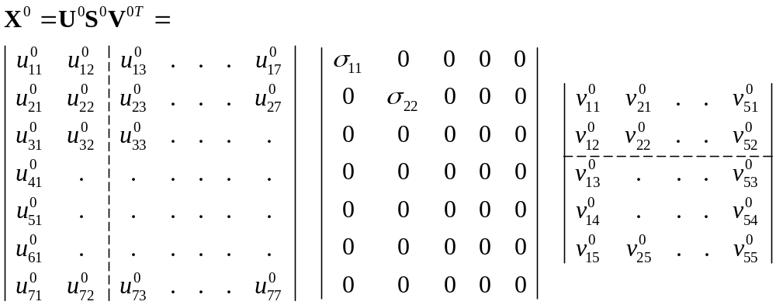
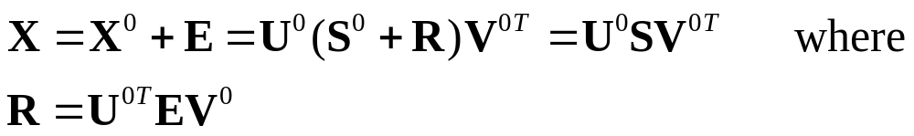
Matrix is = signal + noise
In the example, it is assumed that error-free matrix X⁰ contains 2 singular components. The error-free picture is:

Slide 20
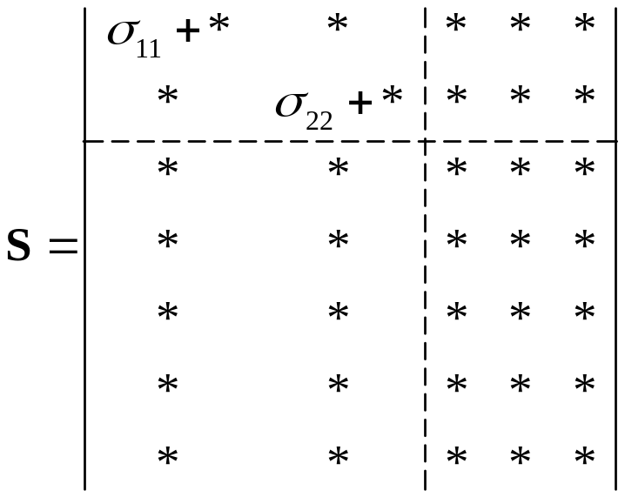
Picture after introducing noise. Not yet an SVD.
In expression X=U⁰SV^{0T} , the central matrix S is not diagonal. Matrix S is the sum of signal singular values on the diagonal and noise values in all locations. The matrices
U⁰ and V^{0T} contain the error-free singular vectors. The asterisks denote values that have same distribution as initial noise terms.

Slide 21
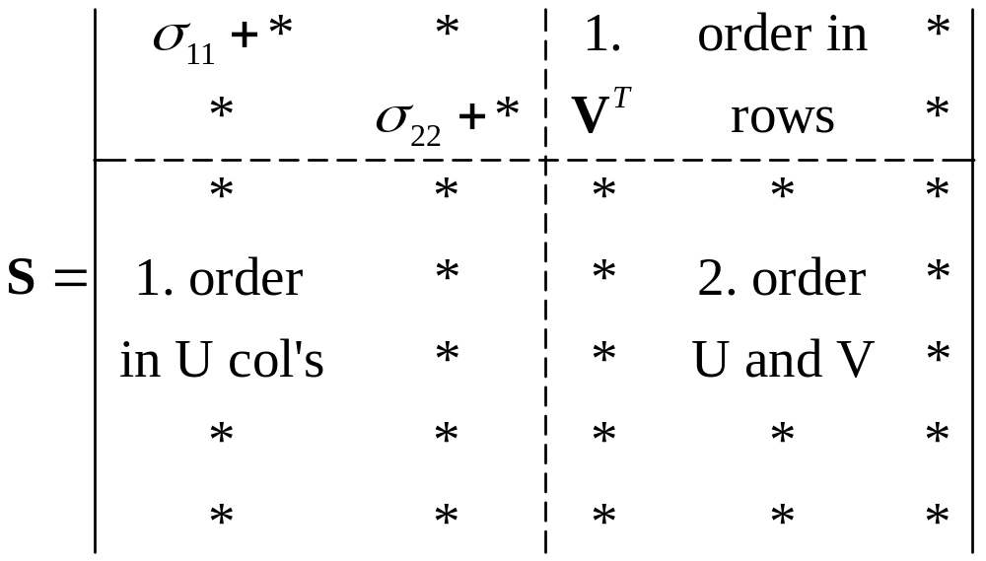
1st order and 2nd order errors in U and V of SVD
The magnitude of 1. order errors in col/row j depends on the ratio of σ_{jj} to noise elements *.
The magnitude of 2. order errors depends dramatically on the largest singular value(s) (d₁₁, d₂₂, …) of the noise values in the fourth block of S. If d₁₁ > 0.5 σ_{jj}, j:th singular component starts to become affected by 2. order errors.

Slide 22
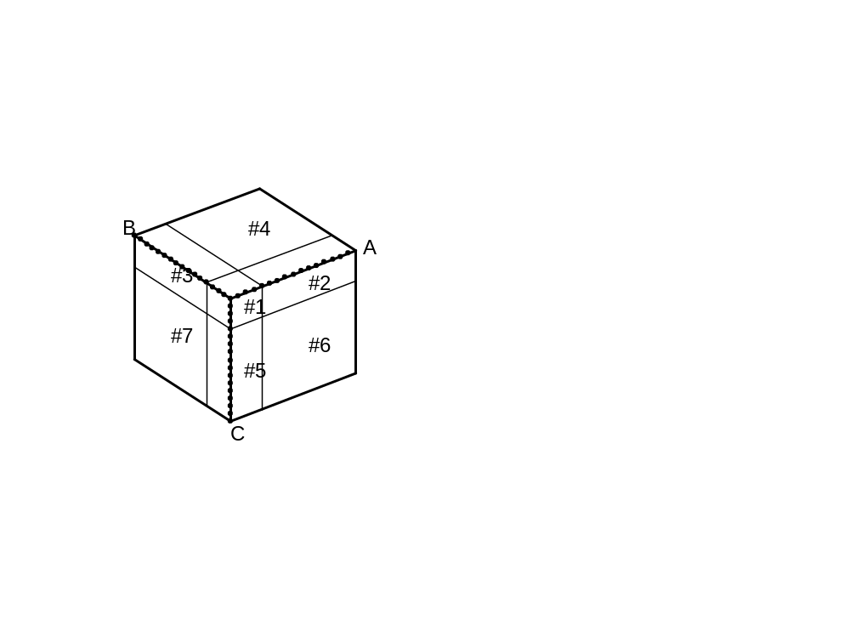
Noise effects in 3-way
True array is transformed so that true signal is in corner block #1. Noise is added, it appears in all elements.
1. order errors are determined by the ratios of signal values to noise in edge blocks # 5, 2, and 3.
2. order errors are determined by largest noise singular values in side slabs 6, 4, and 7. Full details have not been worked out.

Slide 23
How to minimize noise in results
Principle: improve the ratio of smallest signal singular value to largest noise singular value.
“Remove such rows/columns/slices that contribute more to noise than to weakest signal component.”
Transform matrix or array so that signal is concentrated into fewer rows/columns/slices, e.g. because of known or assumed smoothness. Then remove such slices that are known to not contain significant amounts of signal.
Scale properly. PCA with “autoscaling” is simply catastrophic if S/N ratios differ between variables! Scale so that noise is of same magnitude everywhere!

Slide 24
BS results, 2 factors, B mode (normalized)
2 factors, B mode (normalized)
full Bootstrap: smallest and largest values out of 70 BS replications
data 1 2 3 4 5 66 67 68 69 70
factors Situations
0.37 0.34 0.34 0.34 0.34 0.36 0.39 0.39 0.39 0.39 0.40 Lukken
0.61 0.55 0.55 0.56 0.56 0.57 0.67 0.67 0.67 0.68 0.68
0.42 0.41 0.41 0.41 0.41 0.41 0.43 0.43 0.43 0.43 0.43 Meedoe
0.30 0.20 0.20 0.21 0.21 0.25 0.34 0.34 0.34 0.34 0.34
0.36 0.34 0.34 0.34 0.34 0.34 0.37 0.37 0.37 0.37 0.37 JufNie
0.18 0.02 0.03 0.05 0.06 0.08 0.23 0.23 0.23 0.24 0.24
0.47 0.46 0.46 0.46 0.46 0.46 0.48 0.48 0.48 0.48 0.49 Pesten
0.25 0.13 0.14 0.15 0.15 0.20 0.31 0.31 0.31 0.32 0.32
0.38 0.36 0.36 0.36 0.36 0.37 0.39 0.40 0.40 0.40 0.40 Werken
0.57 0.52 0.52 0.53 0.53 0.53 0.61 0.64 0.64 0.65 0.65
0.43 0.42 0.42 0.43 0.43 0.43 0.44 0.44 0.44 0.44 0.44 MaNiet
0.35 0.24 0.25 0.27 0.27 0.28 0.38 0.38 0.38 0.39 0.39
full Bootstrap: smallest and largest values out of 70 BS replications
data 1 2 3 4 5 66 67 68 69 70
factors Situations
0.37 0.34 0.34 0.34 0.34 0.36 0.39 0.39 0.39 0.39 0.40 Lukken
0.61 0.55 0.55 0.56 0.56 0.57 0.67 0.67 0.67 0.68 0.68
0.42 0.41 0.41 0.41 0.41 0.41 0.43 0.43 0.43 0.43 0.43 Meedoe
0.30 0.20 0.20 0.21 0.21 0.25 0.34 0.34 0.34 0.34 0.34
0.36 0.34 0.34 0.34 0.34 0.34 0.37 0.37 0.37 0.37 0.37 JufNie
0.18 0.02 0.03 0.05 0.06 0.08 0.23 0.23 0.23 0.24 0.24
0.47 0.46 0.46 0.46 0.46 0.46 0.48 0.48 0.48 0.48 0.49 Pesten
0.25 0.13 0.14 0.15 0.15 0.20 0.31 0.31 0.31 0.32 0.32
0.38 0.36 0.36 0.36 0.36 0.37 0.39 0.40 0.40 0.40 0.40 Werken
0.57 0.52 0.52 0.53 0.53 0.53 0.61 0.64 0.64 0.65 0.65
0.43 0.42 0.42 0.43 0.43 0.43 0.44 0.44 0.44 0.44 0.44 MaNiet
0.35 0.24 0.25 0.27 0.27 0.28 0.38 0.38 0.38 0.39 0.39

Slide 25
2 factors, B mode (normalized)
full Bootstrap: smallest and largest values out of 70 BS replications
data 1 2 3 4 5 66 67 68 69 70
factors Situations
0.37 0.34 0.34 0.34 0.34 0.36 0.39 0.39 0.39 0.39 0.40 Lukken
0.61 0.55 0.55 0.56 0.56 0.57 0.67 0.67 0.67 0.68 0.68
0.42 0.41 0.41 0.41 0.41 0.41 0.43 0.43 0.43 0.43 0.43 Meedoe
0.30 0.20 0.20 0.21 0.21 0.25 0.34 0.34 0.34 0.34 0.34
0.36 0.34 0.34 0.34 0.34 0.34 0.37 0.37 0.37 0.37 0.37 JufNie
0.18 0.02 0.03 0.05 0.06 0.08 0.23 0.23 0.23 0.24 0.24
0.47 0.46 0.46 0.46 0.46 0.46 0.48 0.48 0.48 0.48 0.49 Pesten
0.25 0.13 0.14 0.15 0.15 0.20 0.31 0.31 0.31 0.32 0.32
0.38 0.36 0.36 0.36 0.36 0.37 0.39 0.40 0.40 0.40 0.40 Werken
0.57 0.52 0.52 0.53 0.53 0.53 0.61 0.64 0.64 0.65 0.65
0.43 0.42 0.42 0.43 0.43 0.43 0.44 0.44 0.44 0.44 0.44 MaNiet
0.35 0.24 0.25 0.27 0.27 0.28 0.38 0.38 0.38 0.39 0.39
full Bootstrap: smallest and largest values out of 70 BS replications C mode, 2 fact.
data 1 2 3 4 5 66 67 68 69 70
factors Emotions
4.88 4.42 4.43 4.53 4.54 4.55 5.23 5.24 5.27 5.35 5.37 Unpleasant
-0.55 -1.06 -1.06 -1.03 -1.03 -1.00 -0.19 -0.17 -0.16 -0.13 -0.13
3.03 2.64 2.65 2.66 2.68 2.68 3.42 3.51 3.53 3.56 3.59 Sad
-0.69 -1.26 -1.23 -1.16 -1.14 -1.05 -0.46 -0.42 -0.42 -0.41 -0.41
1.65 1.38 1.38 1.43 1.44 1.50 1.91 1.92 1.93 1.95 1.95 Afraid
-0.05 -0.35 -0.34 -0.32 -0.31 -0.26 0.06 0.13 0.13 0.19 0.20
4.81 4.08 4.11 4.17 4.19 4.34 5.38 5.39 5.39 5.61 5.66 Angry
-1.27 -2.11 -2.07 -1.81 -1.76 -1.74 -0.89 -0.85 -0.85 -0.84 -0.83
2.00 0.83 0.96 1.21 1.33 1.40 2.64 2.84 2.87 3.03 3.08 Approach
3.02 2.26 2.29 2.39 2.41 2.53 3.49 3.62 3.73 3.85 3.97
4.50 3.95 3.95 4.12 4.12 4.17 4.83 4.84 4.86 4.92 4.94 Avoid
-0.45 -0.95 -0.94 -0.93 -0.91 -0.86 -0.09 -0.07 -0.06 0.12 0.12
2.88 2.32 2.35 2.55 2.56 2.58 3.21 3.23 3.23 3.24 3.24 Support seek
0.62 0.25 0.25 0.25 0.26 0.32 0.96 0.98 0.99 1.07 1.09
2.75 2.40 2.40 2.42 2.42 2.46 3.13 3.21 3.21 3.25 3.28 Aggression
-0.59 -1.11 -1.09 -1.03 -1.01 -0.97 -0.36 -0.34 -0.33 -0.30 -0.30

Slide 26
3 factors, B mode (normalized)
full Bootstrap: smallest and largest values out of 70 BS replications
data 1 2 3 4 5 66 67 68 69 70
factors Situations
0.40 0.35 0.35 0.35 0.36 0.36 0.42 0.42 0.42 0.43 0.43
0.36 0.29 0.30 0.30 0.30 0.30 0.41 0.44 0.44 0.45 0.45
-0.23 -0.53 -0.53 -0.47 -0.46 -0.43 -0.15 -0.14 -0.14 -0.12 -0.10
0.42 0.40 0.40 0.41 0.41 0.41 0.43 0.43 0.43 0.43 0.43
0.43 0.38 0.39 0.39 0.39 0.41 0.44 0.44 0.44 0.44 0.44
0.39 0.26 0.27 0.28 0.29 0.29 0.42 0.42 0.42 0.43 0.43
0.37 0.35 0.35 0.36 0.36 0.36 0.41 0.42 0.42 0.42 0.43
0.36 0.32 0.32 0.33 0.33 0.33 0.37 0.37 0.37 0.38 0.38
0.62 0.47 0.49 0.51 0.52 0.53 0.65 0.65 0.65 0.65 0.65
0.42 0.38 0.38 0.39 0.39 0.39 0.46 0.46 0.47 0.47 0.48
0.49 0.35 0.35 0.37 0.37 0.41 0.55 0.55 0.55 0.56 0.56
0.33 0.24 0.24 0.26 0.26 0.27 0.36 0.36 0.36 0.37 0.37
0.38 0.31 0.32 0.32 0.32 0.33 0.40 0.40 0.40 0.41 0.41
0.37 0.36 0.36 0.36 0.36 0.36 0.40 0.43 0.43 0.45 0.45
-0.27 -0.54 -0.53 -0.53 -0.52 -0.44 -0.18 -0.17 -0.16 -0.16 -0.15
0.46 0.44 0.44 0.44 0.44 0.44 0.49 0.49 0.49 0.50 0.50
0.43 0.34 0.34 0.39 0.39 0.39 0.45 0.45 0.45 0.46 0.46
0.48 0.24 0.25 0.28 0.29 0.38 0.51 0.52 0.52 0.53 0.53

Slide 27
full Bootstrap: smallest and largest values out of 70 BS replications
data 1 2 3 4 5 66 67 68 69 70
factors C mode, Emotions
-1.32 -20.41 -18.67 -14.72 -13.99 -13.80 18.52 23.14 26.34 26.35 30.21
5.75 -25.97 -22.15 -22.15 -18.98 -14.05 18.16 18.31 18.96 23.06 24.83
-0.07 -1.25 -1.13 -0.75 -0.72 -0.41 0.05 0.10 0.12 0.12 0.13
-1.76 -18.32 -16.96 -14.44 -14.30 -13.01 14.96 14.98 15.27 18.49 23.93
4.19 -21.53 -16.16 -12.90 -12.77 -12.75 15.42 16.60 16.86 19.29 20.73
0.01 -0.77 -0.69 -0.33 -0.31 -0.17 0.15 0.21 0.23 0.24 0.26
-0.22 -7.41 -7.41 -6.12 -5.47 -2.75 7.16 8.70 8.70 8.76 11.43
1.91 -9.73 -7.18 -7.17 -7.08 -5.53 4.40 7.12 7.76 9.04 9.07
-0.15 -0.63 -0.58 -0.32 -0.31 -0.22 -0.10 -0.10 -0.10 -0.10 -0.10
-3.12 -30.00 -29.10 -24.54 -24.28 -23.79 23.36 25.83 27.14 27.20 33.53
6.76 -30.00 -23.89 -23.82 -22.39 -19.78 27.08 27.93 28.22 32.74 33.63
0.16 -1.06 -0.94 -0.56 -0.54 -0.25 0.39 0.42 0.42 0.45 0.47
7.42 -6.26 -4.63 -4.62 -4.28 4.07 31.81 33.43 35.13 35.46 35.59
-2.04 -30.00 -30.00 -30.00 -28.17 -26.61 1.39 9.33 9.94 10.00 11.76
-1.67 -2.21 -2.14 -2.01 -2.00 -1.97 -1.50 -1.50 -1.48 -1.29 -1.25
2.71 -0.69 0.58 0.88 1.27 1.36 9.40 9.47 9.72 14.36 18.11
0.88 -14.41 -10.64 -6.16 -5.75 -5.67 2.11 2.12 3.00 3.29 4.05
1.23 0.73 0.73 0.76 0.79 0.87 1.42 1.45 1.46 1.47 1.48
3.06 0.31 0.56 0.84 1.84 1.87 10.31 13.15 14.55 15.08 18.11
0.47 -14.66 -11.65 -11.07 -9.59 -6.75 1.69 1.82 2.66 2.95 3.25
-0.19 -0.40 -0.39 -0.37 -0.36 -0.33 -0.13 -0.13 -0.12 -0.12 -0.11
-1.20 -13.67 -11.80 -11.13 -10.65 -10.55 12.74 12.98 15.74 15.75 16.96
3.42 -14.83 -13.69 -13.67 -10.90 -10.55 12.78 12.83 13.35 14.01 15.89
0.05 -0.47 -0.41 -0.29 -0.28 -0.15 0.15 0.15 0.15 0.19 0.19

