Slide 1
Choosing the numbers of components in three-way component models
Henk A.L. Kiers & Eva Ceulemans
University of Groningen & Leuven University

Slide 2
Three-way component models
Data: x_{ijk} i=1,…,I, j=1,…J, k=1,…,K
Cand./Parafac ∑_{r}a_{ir}b_{jr}c_{kr} R comp^{s}
Tucker 3 ∑_{p}∑_{q}∑_{r}a_{ip}b_{jq}c_{kr}g_{pqr} P,Q,R comp^{s}
Tucker 2 ∑_{q}∑_{r}b_{jq}c_{kr}g_{iqr} Q,R comp^{s}
Tucker 1 ∑_{p}a_{ip}g_{pjk} P comp^{s}

Slide 3
How many components do we take?
Choose as many as needed theoretically
or
Add more as long as fit increases considerably
However:
Theory rarely helps
Fit criteria require (too) subjective judgments

Slide 4
Systematic/Automated procedures for choosing numbers of components
for Candecomp/Parafac:
Bro (1998), Bro & Kiers (2003)
for Tucker 3:
Timmerman & Kiers (2000)
    speeded up by Kiers & der Kinderen (2003)
for all 3-way component models (incl. comparison):
Ceulemans & Kiers (2006)

Slide 5
Bro (1998), Bro & Kiers (2003)
CORCONDIA: “Core consistency diagnostic”
  For each dimensionality, find CP solution A,B,C
  Compute Tucker3 core G for this CP solution A,B,C
    minimize || X − AG(C⊗B)' || ²
  If CP model is “appropriate”, then core should be simple
    Cand./Parafac ∑_{r}a_{ir}b_{jr}c_{kr} = Tucker 3 ∑_{p}∑_{q}∑_{r}a_{ip}b_{jq}c_{kr}g_{pqr} with superdiagonal core: g_{ppp} = 1; g_{pqr} = 0 for all cases in which NOT p=q=r
    If g_{pqr} ≠ 0 for some other p,q,r, then
      trilinear CP-terms alone are not enough
      ‘interaction’ terms play role
      present CP model not appropriate, due to
      - unsystematic components (hence too many components)
      - better fitting Tucker3 model
  Choose highest number of comp^{s} giving appropriate model

Slide 6
CORCONDIA
What is sufficiently “appropriate”?
Degree of superdiagonality: 1− ∑_{p}∑_{q}∑_{r}(g_{pqr}-δ_{pqr})²/r
CORCONDIA : 100 ×(1− ∑_{p}∑_{q}∑_{r}(g_{pqr}-δ_{pqr})²/r)
CORCONDIA decreases monotonically (in practice)
Look for clear drop, e.g.
    r=1 100.0 %
    r=2 100.0 %
    r=3 93.5%
    r=4 16.6%
    r=5 -0.1%
    r=6 5.8%
clearly optimal choice

Slide 7
CORCONDIA, performance
Good for practical data sets (6 examples)
Not very good for simulated data with random noise
  drop not too clear
Quite good for simulated data with structured noise
Final note:
After drop CORCONDIA may (will eventually) rise again; choose model before first drop
Overall conclusion:
use CORCONDIA as one diagnostic,
not as only diagnostic

Slide 8
Timmerman & Kiers (2003)
DIFFIT procedure
Compute Tucker3 fit for many values of {P,Q,R}
List fit values for different total numbers of components P+Q+R
Search for points of negligible relative increase
Choose {P,Q,R} just before small relative increase

Slide 9
DIFFIT procedure
P | Q | R | T | fit
1 | 1 | 1 | 3 | 20.4 %
1 | 2 | 2 | 5 | 23.2 %
2 | 1 | 2 | 5 | 23.7 %
2 | 2 | 1 | 5 | 22.5 %
2 | 2 | 2 | 6 | 25.6 %
2 | 2 | 3 | 7 | 27.4 %
2 | 3 | 2 | 7 | 27.6 %
3 | 2 | 2 | 7 | 29.5 %
3 | 3 | 2 | 8 | 29.7 %
3 | 2 | 3 | 8 | 29.6 %
2 | 3 | 3 | 8 | 27.7 %
Compute fit values for models with many choices for P,Q,R (P≥QR, etc).
For cases with same number of components T=P+Q+R → select best
List fit values for different P+Q+R, search for points of negligible increase
P | Q | R | T | fit
1 | 1 | 1 | 3 | 20.4 %
1 | 2 | 2 | 5 | 23.2 %
2 | 1 | 2 | 5 | 23.7 %
2 | 2 | 1 | 5 | 22.5 %
2 | 2 | 2 | 6 | 25.6 %
2 | 2 | 3 | 7 | 27.4 %
2 | 3 | 2 | 7 | 27.6 %
3 | 2 | 2 | 7 | 29.5 %
3 | 3 | 2 | 8 | 29.7 %
3 | 2 | 3 | 8 | 29.6 %
2 | 3 | 3 | 8 | 27.7 %
3.3
1.9
4.1
clearly optimal choice
0.2

Slide 10
Automated version
compare eigenvalues in PCA
Denote fit increases from T-1 to T as dif_{T}
Ignore intermediate small fit increases; selection: dif_{T(m)}
Stop after highest ratio dif_{T(m)}/dif_{T(m+1)}
20.4 / 4.1 = 4.98
4.1 / 0.2 = 20.5
2nd ratio highest
→ biggest drop
→ choose solution just before this drop
P | Q | R | T | fit
1 | 1 | 1 | 3 | 20.4 %
1 | 2 | 2 | 5 | 23.2 %
2 | 1 | 2 | 5 | 23.7 %
2 | 2 | 1 | 5 | 22.5 %
2 | 2 | 2 | 6 | 25.6 %
2 | 2 | 3 | 7 | 27.4 %
2 | 3 | 2 | 7 | 27.6 %
3 | 2 | 2 | 7 | 29.5 %
3 | 3 | 2 | 8 | 29.7 %
3 | 2 | 3 | 8 | 29.6 %
2 | 3 | 3 | 8 | 27.7 %
P | Q | R | T | fit | dif_{T}
1 | 1 | 1 | 3 | 20.4 % | 20.4%
1 | 2 | 2 | 5 | 23.2 %
2 | 1 | 2 | 5 | 23.7 % | 3.3%
2 | 2 | 1 | 5 | 22.5 %
2 | 2 | 2 | 6 | 25.6 % | 1.9%
2 | 2 | 3 | 7 | 27.4 %
2 | 3 | 2 | 7 | 27.6 %
3 | 2 | 2 | 7 | 29.5 % | 4.1%
3 | 3 | 2 | 8 | 29.7 % | 0.2%
3 | 2 | 3 | 8 | 29.6 %
2 | 3 | 3 | 8 | 27.7 %
P | Q | R | T | fit | dif_{T} | dif_{T(m)}
1 | 1 | 1 | 3 | 20.4 % | 20.4% | 20.4%
1 | 2 | 2 | 5 | 23.2 %
2 | 1 | 2 | 5 | 23.7 % | 3.3%
2 | 2 | 1 | 5 | 22.5 %
2 | 2 | 2 | 6 | 25.6 % | 1.9%
2 | 2 | 3 | 7 | 27.4 %
2 | 3 | 2 | 7 | 27.6 %
3 | 2 | 2 | 7 | 29.5 % | 4.1% | 4.1%
3 | 3 | 2 | 8 | 29.7 % | 0.2% | 0.2%
3 | 2 | 3 | 8 | 29.6 %
2 | 3 | 3 | 8 | 27.7 %
3.3
3.3
1.9
1.9
4.1
4.1
0.2
0.2

Slide 11
DIFFIT
Precautions:
  stop if dif_{T(m)} becomes too small (< 100/(T_{max}-3))
  compare Kaiser’s eigenvalue>1 criterion
  consider various cases with high diffit ratio and select on basis of interpretability/stability
Performance
  in simulation study: worked well (80% correct)
  computationally expensive: high number of Tucker3 analyses required

Slide 12
Fast DIFFIT
Kiers & der Kinderen (2003)
Compute Tucker’s (1966) approximate fit
  A first P eigenvectors of X_{a} X_{a}'
  B first Q eigenvectors of X_{b} X_{b}'
  C first R eigenvectors of X_{c} X_{c}'
  compute G from X, A,B, and C
Faster: No iterative procedure
Superfast:
  Solutions A for all P nested; hence for P=1,…,P_{max} in one go
  Solutions B for all Q nested; hence for Q=1,…,Q_{max} in one go
  Solutions C for all R nested; hence for R=1,…,R_{max} in one go
  Cores also nested:
  all subarrays of core obtained from X, A_{Pmax}, B_{Qmax}, C_{Rmax}

Slide 13
Fast DIFFIT
Performance
  Superfast
  360 simulated data sets: correct solution 336 cases (original DIFFIT in 331 cases)
Conclusion
  approximate fit good enough for
  choosing numbers of components
  enormous time gain

Slide 14
How choose between different 3-way models?
compare Kroonenberg & van der Voort (1987)
Ceulemans & Kiers (2006):
using “convex hull procedure” by
Ceulemans & van Mechelen (2005)
Each model, each (set of) number(s) of comp^{s}
  define number of free parameters fp (compare df)
  make plot of fit against fp
  find convex hull over points
  search elbow in convex hull, visually and mathematically
  choose model at elbow

Slide 15
Number of free parameters
Tucker 3 IP+JQ+KR+PQR−P²−Q²−R²
  last terms subtracted because one can always fix P² elements in A (by nonsingular transformation), etc.
Tucker 2_{(BC)} JQ+KR+IQR−Q²−R²
  equivalent to Tucker3 (I,Q,R), so substitute P=I
Tucker 1 IP+PJK−P²
  equivalent to Tucker3 (P,J,K)
Candecomp/PARAFAC (I+J+K)R−2R
  last terms subtracted because one can always freely scale each component in two modes
Note: If I<JK, take JK instead of I, etc.

Slide 16
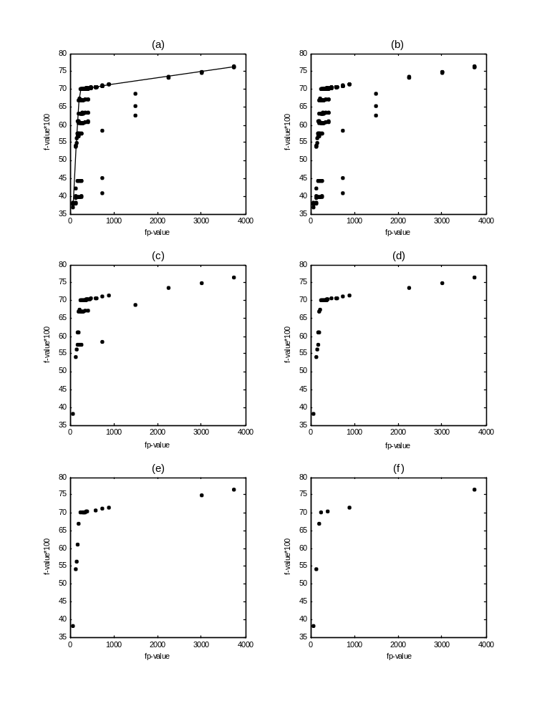
Plot of fit against fp
possibly approximate fit

Slide 17
Find convex hull over points
find for each fp (# free parameters), best solution
sort solutions by fp value, call them s₁,…,s_{p}
exclude s_{i} with f_{j}>f_{i} while j<i (= decrease);
successive points follow nondecreasing line
check consecutive triplets of consecutive points, and drop middle points below lines linking first and last points of triples
repeat this until convergence
you end up with convex hull

Slide 18

select best per fp
drop decreasers
in triplets,
drop cases
below lines
in triplets,
drop cases
below lines

Slide 19
Convex hull over points

Slide 20
Search elbow in convex hull visually and mathematically
consider only solutions on the convex hull: st_{i}
find point after which biggest direction change occurs
  select solution i for which
  (f_{i}-f_{i-1}/ fp_{i}-fp_{i-1}) / (f_{i+1}-f_{i}/ fp_{i+1}-fp_{i})
  is maximal

Slide 21
Performance
Extensive simulation study (8 times 3×3×5×5 design)
8 data models: T3, T2 (3x), T1 (3x), CP
  T3 Data constructed as AG(C⊗B)'+εE
    A, E random normal; ||E|| = ||AG(C⊗B)'||
    B, C random orthonormal
    G random uniform
    Ensure fit by smaller model is less than 98%
  T2, T1 data: likewise, but nonreduced modes: I
  CP: A,B,C random normal; core superidentity
Sizes: 200×10×10, 50×20×20, 27×27×27
PQR: 322, 333, 432 (or 32, 33, 34; or 2,3,4)
Error: 0,15,30,45,60%
5 replications

Slide 22
Simulation study
Analyses
To all 225 data sets for all 8 types of data convex hull approach applied
Convex hull procedure used all 8 types of models, with dimensionalities from 1 to 8
→ 565 different solutions
For T3, T2 only approximate fit (but later tested: results didn’t improve when using optimal fit);
For T1 and CP: optimal fit

Slide 23
Results Simulation study
Chosen model fitted almost as well as true model,
so choice was OK
(correction in data construction needed)
T1A data 225 correct choices
T1B data 225 correct choices
T1C data 225 correct choices
T2BC data 225 correct choices
T2AB data 224 correct choices
T2AC data 224 correct choices
CP data 224 correct choices
T3 data 208 correct choices

Slide 24
Results Simulation study
T3 data 208 correct choices, 17 wrong choices
Most wrong choices:
200×10×10 data, 322, 432 models, 45-60% error
Cause of errors is asymmetry in mode sizes?
To check this:
  Further study: compare 10×10×10 vs 625×25×25 data
  Results:
    625×25×25 data 1 out of 75 wrong
    10×10×10 data 32 out of 75 wrong
  Conclusion: Small size problematic!
In 18 of all 20 wrong choice cases: true model on hull !

Slide 25
Real data based Simulation study
T3 data constructed with 221 model for Chopin data
4 error levels × 5 replications = 20 data sets
169 models tested (up to dimensionalities 5)
Results: All model choices correct
2nd study: using 322 (slightly better model)
Results: 10 model choices wrong!
cause: 221 is almost as well, therefore often selected

Slide 26
Comparison DIFFIT vs convex hull for selecting among T3 models
DIFFIT: scree test on selection of models based on fit vs P+Q+R plot
Convex hull approach: scree test on selection of models based on fit vs fp plot
225 T3 data sets:
  DIFFIT: 18 wrong choices
  Convex hull: 12 wrong choices
Optimal (?): Convex hull on fit vs P+Q+R plot
  convex hull takes ‘distance’ between consecutive solutions into account (DIFFIT doesn’t)
  DIFFIT independent of data size (fp dependent on data size)
Result: only 5 wrong choices

Slide 27
Sequences in Plots
In practice: don’t simply use automatic procedure,
but also inspect different solutions on (or near) convex hull
Label points by dimensionalities
Search visually for elbow
Some remarkable (problematic?) findings

Slide 28
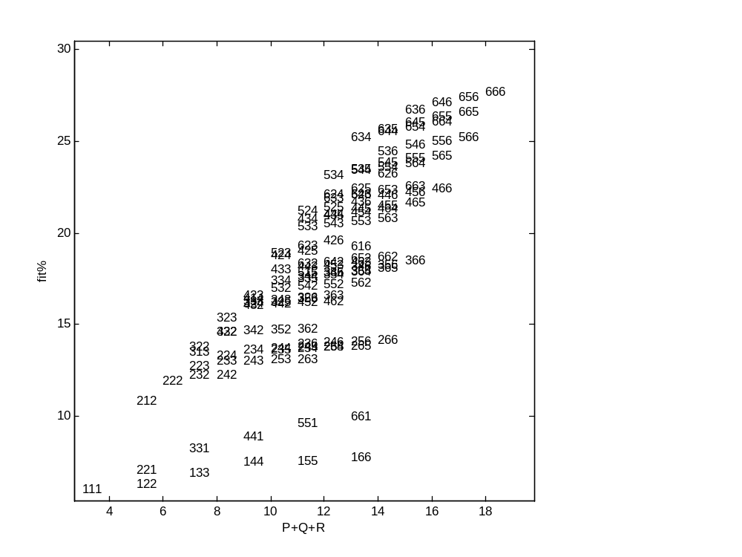
Solutions for food risk data set (414×24×9):
fit vs P+Q+R plot

Slide 29
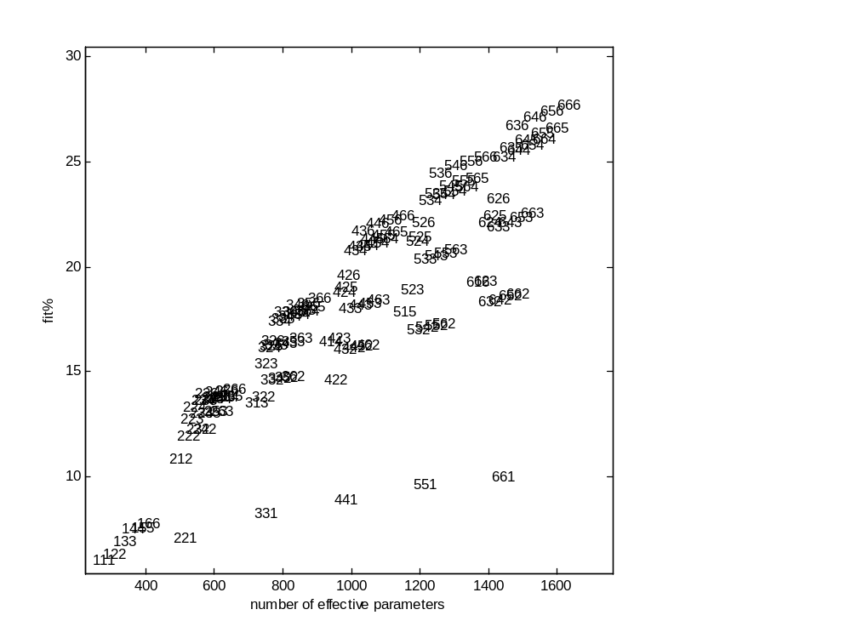
Solutions for food risk data set (414×24×9) :
fit vs fp plot

Slide 30
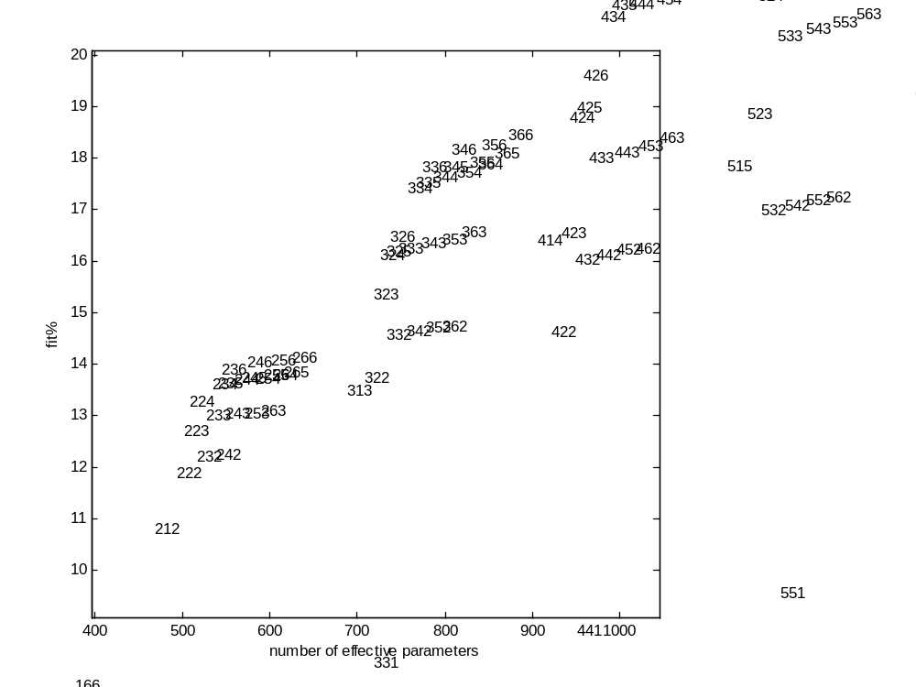
Solutions for food risk data set (414×24×9) :
fit vs fp plot
‘Striation’: shows that 3 is enough for B
Almost vertical increases when adding C-mode: C needs many components

Slide 31
can we take this seriously?
Solutions for food risk data set (414×24×9) :
fit vs fp plot

Slide 32
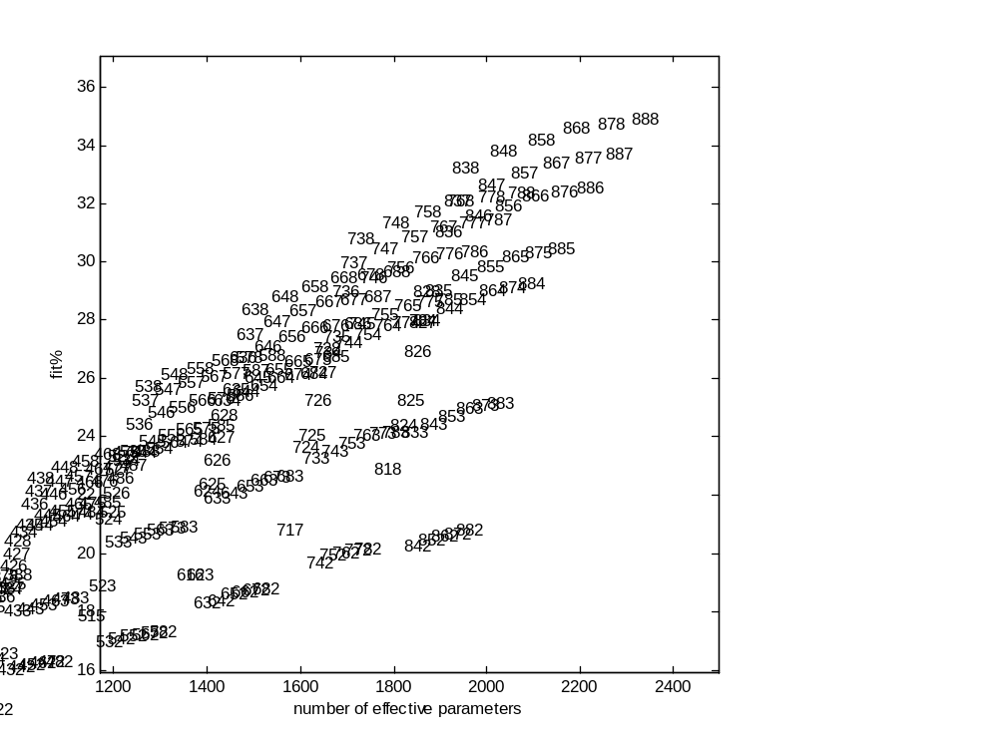
Solutions for food risk data set (414×24×9): fit vs fp plot, now till {8,8,8}

Slide 33
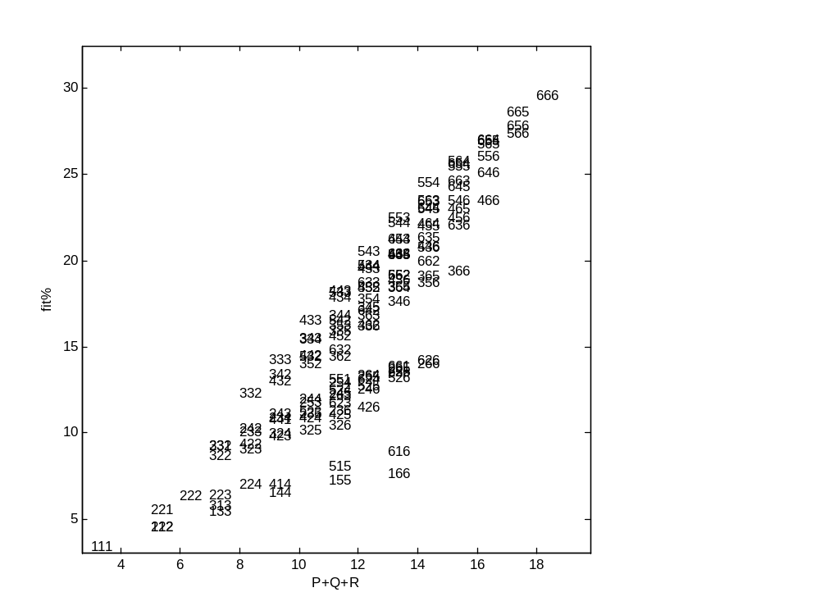
Other data set
Solutions for energy data set (49×7×26):
fit vs P+Q+R plot
Hardly any points
on hull...

Slide 34
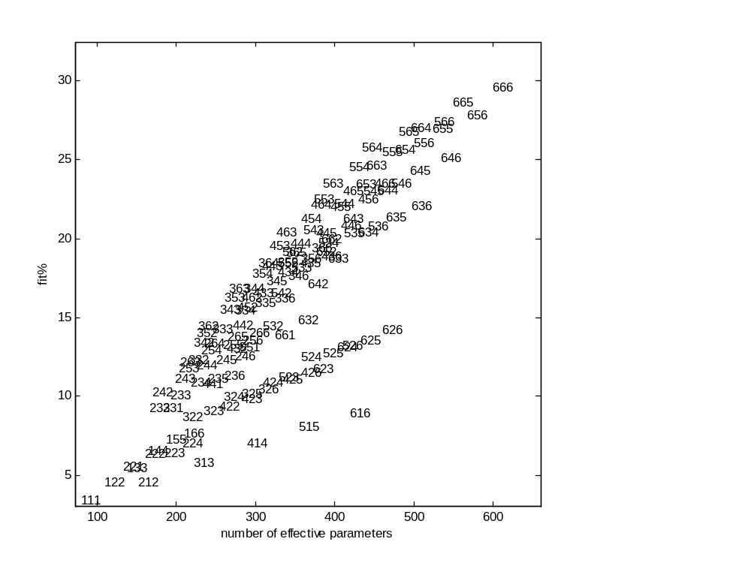
Solutions for energy data set: fit vs fp plot
Some ‘Striation’

Slide 35
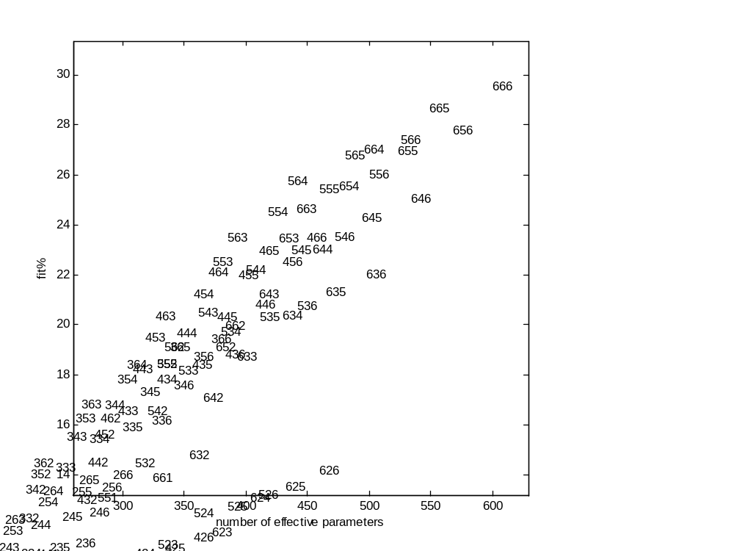
Zoomed in on elbow
Solutions for energy data set: fit vs fp plot
But what if we consider higher numbers of components?

Slide 36
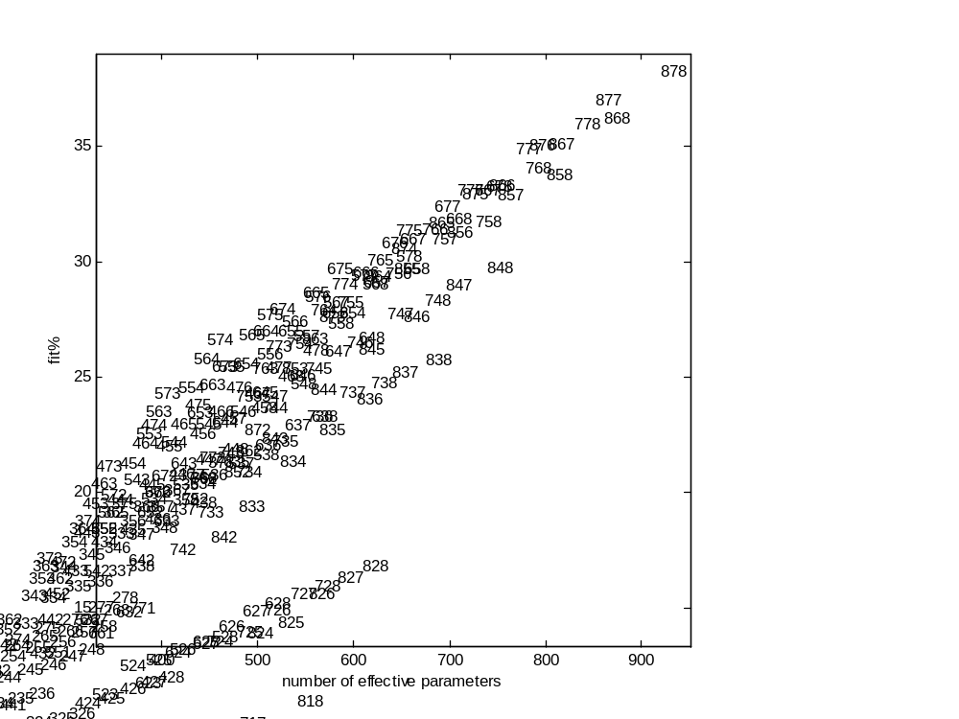
Solutions for energy data set: fit vs fp plot , now till {8,8,8}
Elbow very near to previous…

Slide 37
Discussion
Convex hull approach seems very useful
  Within T3, applied to P+Q+R
  Across 3-way component models: incredible performance: almost always correct choice out of 565 models!
What about AIC/BIC etc. ? Better?
What about model selection in other techniques:
convex hull on fit vs fp promising alternative to AIC, χ²?
What about cross-validation as an alternative?
Convex hull on fit vs P+Q+R plot promising, but,
how to use for comparing models of different types:
T3, T2, T1, CP?

