Slide 1
Bootstrap Confidence Intervals in Variants of Component Analysis
Marieke E. Timmerman¹, Henk A.L. Kiers¹, Age K. Smilde² & Cajo J.F. ter Braak³
¹Heymans Institute of Psychology, University of Groningen
²Biosystems Data Analysis, University of Amsterdam
³Biometris, Wageningen University
The Netherlands

Slide 2
Some background of this work
Validation (Harshman, 1984)
  Theoretical appropriateness
  Computational correctness
  Explanatory validity
  Statistical reliability

Slide 3
Some background of this work
Statistical reliability (Smilde, Bro & Geladi (2004) Multi-way analysis, p. 146) is related to ... the stability of solutions to resampling, choice of dimensionality and confidence intervals of the model parameters. The statistical reliability is often difficult to quantify in practical data analysis, e.g., because of small sample sets or poor distributional knowledge of the system.’
Notes:
small sample sets: nouja, dan valt er altijd te twijfelen aan de generalizeerbaarheid.
poor distr. knowledge: is daar nou niks aan te doen?

Slide 4
Statistical reliability
Model choice
  choice of dimensionality
  stability of solutions to resampling
Inference
  stability of solutions to resampling
  confidence intervals (CIs) of the model parameters
How to estimate CIs in component analysis? And what about the quality?

Slide 5

Confidence intervals of model parameters
Population Distribution Function F  parameters θ
Observed random Sample x  parameters = s(x)
Confidence Intervals (CI):
derived from sampling distribution of
Notes:
-CA focust op observed sample, en parameter schattingen daarvoor. In vervolg verhaal neem ik aan: RANDOM sample. Hoe de inferentie te doen?
Asymptotic results hard to derive, and relatively strict assumptions. I choose: Bootstrap

Slide 6


Bootstrap Confidence intervals
Population Distribution Function F  parameters θ
Observed random Sample x  parameters = s(x)
Empirical Distribution Function
Bootstrap Sample x*  parameters = s(x*)
Notes:
–Real world versus Bootstrap world.
-bootstrap Cis estimated on the basis of s(x*)
-For a population mean: very simple

Slide 7
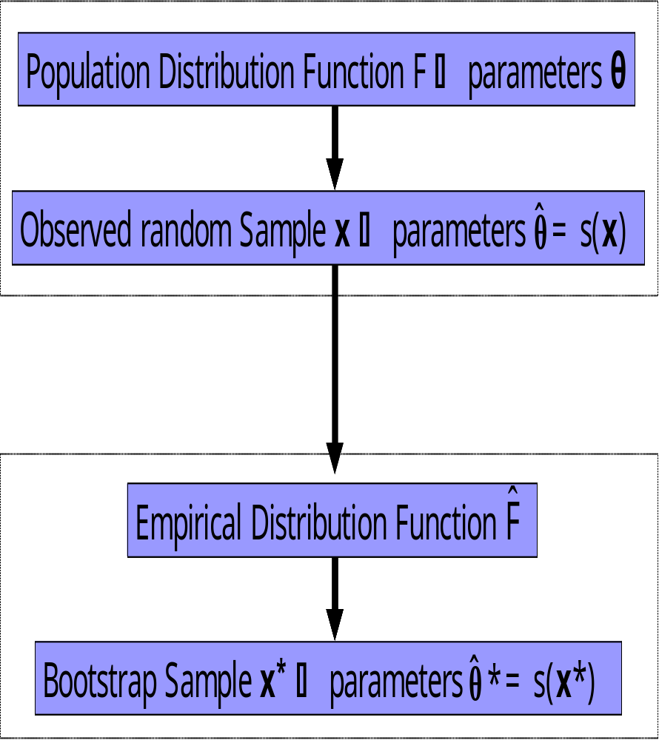
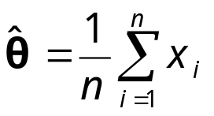
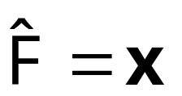
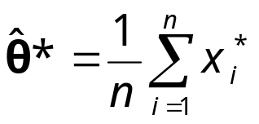
Example: CI for population mean μ
θ=μ
Notes:
–Real world versus Bootstrap world.
-For a population mean: very simple

Slide 8
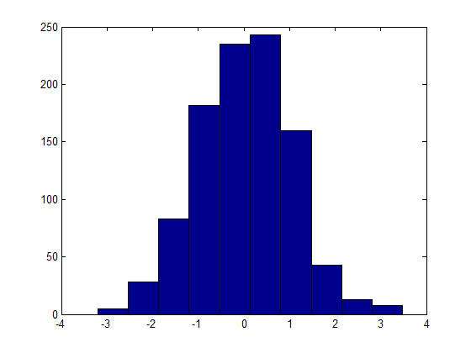

Example: CI for population mean μ
θ=μ
Notes:
–Real world versus Bootstrap world.
-For a population mean: very simple

Slide 9

Key questions for the Bootstrap procedure
Sample drawn from which Population(s)?
What is s(x) exactly?
If s(x) is non-unique, how to make s(x*) comparable?
How to define EDF?
How to estimate CIs from distribution of ?
Notes:
5 basisvragen, zie boven. Afhankelijk van variant is vraag moeilijk of makkelijk. Nu: illustratie met 1. PCA (heel simpele variant, maar heel goed om 2 tot 5 te illustreren. Dan PRC model en MLCA voor 1.

Slide 10
What’s next…
Principal Component Analysis
  Various answers to the key questions
  Simulation study: What’s the quality of the various resulting CIs?
Real multi-way/block methods
  Tucker3/PARAFAC
  Multilevel Component Analysis
  Principal Response Curve Model

Slide 11
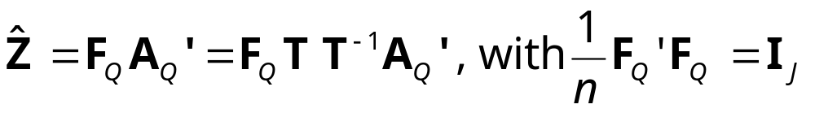
Principal Component Analysis
X (I×J): observed scores of I subjects on J variables
Z: standardized scores of X
F (I×Q): Principal component scores
A (I×Q): Principal loadings
Q: Number of selected principal components
T (Q×Q): Rotation matrix

Slide 12
1. Sample drawn from which Population(s)?
‘observed scores of
I subjects on J variables’

Slide 13
2. What is s(x) exactly?
Loadings:
  1. Principal loadings (A_{Q})
  2. Rotated loadings (A_{Q}T)
    a. Procrustes rotation towards external
    structure
    b. use one, fixed criterion (e.g., Varimax)
    c. search for ‘the optimal simple solution’
Oblique case: correlations between components
Variance accounted for
Notes:
Depends on interpretation

Slide 14
3. If s(x) is non-unique, how to make s(x*) comparable?
Loadings:
  1. Principal loadings (A_{Q})
  Sign of Principal loadings (A_{Q}) is arbitrary:
  reflect columns of A_{Q}* to the same direction
Notes:
Depends on interpretation chosen!

Slide 15
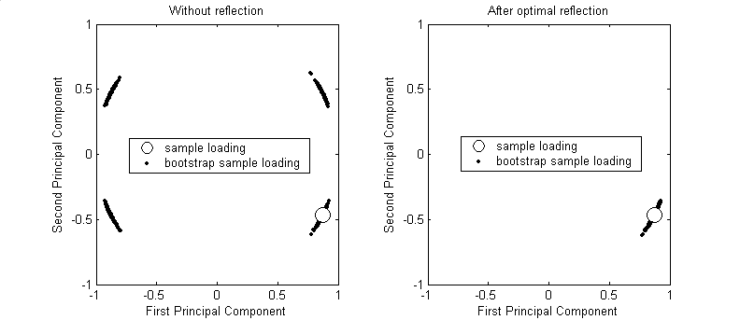
  1. Principal loadings (A_{Q})
  Sign of Principal loadings (A_{Q}) is arbitrary:
  reflect columns of A_{Q}* to the same direction
Notes:
Depends on interpretation chosen!

Slide 16
2. Rotated loadings (A_{Q}T)
a. Procrustes rotation towards external structure:
none (A_{Q}T* is unique)
Notes:
Depends on interpretation chosen!

Slide 17
2. Rotated loadings (A_{Q}T)
b. use one, fixed criterion (e.g., Varimax)
Sign & order of Varimax rotated loadings is arbitrary:
reflect & reorder columns of A_{Q}T*
Notes:
Depends on interpretation chosen!

Slide 18
2. Rotated loadings (A_{Q}T) c. search for ‘the optimal simple solution’
How are bootstrap solutions A_{Q}T* found?
  For each bootstrap solution: look for ‘optimal simple loadings’ (unfeasible):
  reflect & reorder columns of A_{Q}T*
  Procrustes rotation towards ‘optimally simple’ sample loadings:
  none (A_{Q}T* is unique)

Slide 19
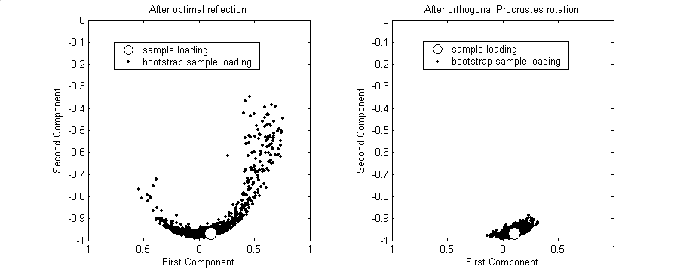
‘Fixed criterion’ versus
‘Procrustes towards (simple) sample loadings’
Instable varimax rotated solutions over samples?
Varimax rotated
bootstrap solutions
Procrustes rotated
bootstrap solutions

Slide 20
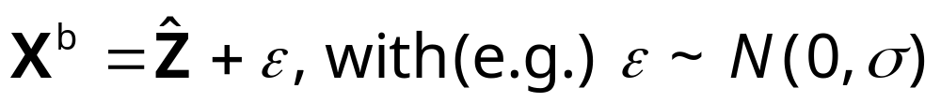
4. How to define the EDF?
  non-parametric:
  X^{b}: rowwise resampling of Z
  semi-parametric:
  parametric:
  elements of X^{b} from particular p.d.f.

Slide 21
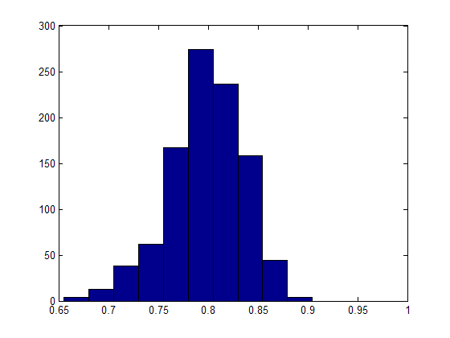
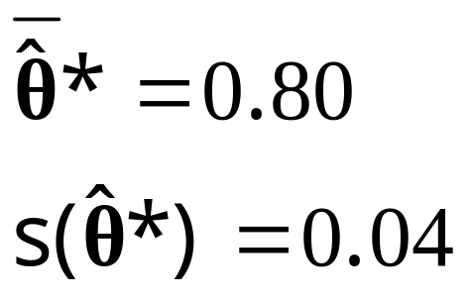
5. How to estimate CIs from the distribution of ?

Slide 22
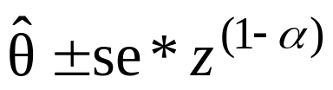
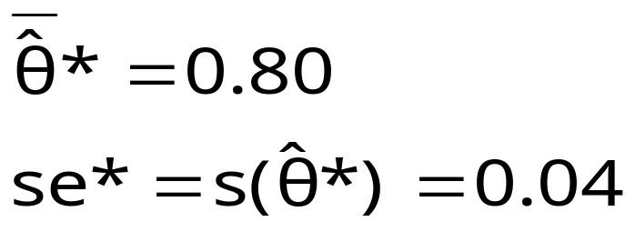
Based on bootstrap standard error (se*)
  Wald ( )
  ...

Slide 23
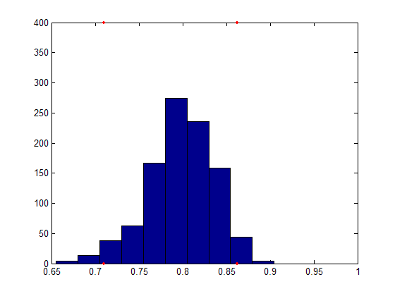
Percentile based methods
  percentile method
  BC_{a} method (Bias Corrected and Accelerated, corrects for potential Bias and skewness of bootstrap distribution)
  …

Slide 24
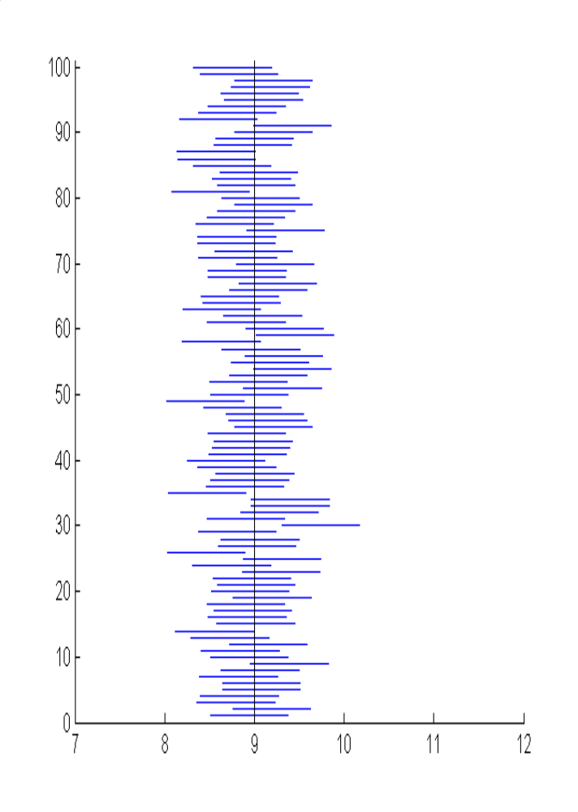
Quality of CI? → Coverage
θ
central 1-2α CI: [CI_{left};CI_{right})
P(θ<CI_{left})= α
P(θ>CI_{right})= α
with θ population parameter

Slide 25
But, what is the population parameter θ?
  Results from PCA on population data
  Orientation Population loadings should match Bootstrap loadings…
  1. Principal loadings (A_{Q}*)
  2. Rotated loadings (A_{Q}T*)
    a. Procrustes rotation towards external structure
    b. use one, fixed criterion (e.g., Varimax)
    c. search for ‘the optimal simple solution’
    -B searches for optimal simple loadings
    -Procrustes rotation towards ‘optimally
    simple’ sample loadings
  Bootstrap Varimax
  Bootstrap Procrustes

Slide 26
Simulation study
CI’s for Varimax rotated Sample loadings
Data properties varied:
  VAF in population (0.8,0.6,0.4)
  number of variables (8, 16)
  sample size (50, 100, 500)
  distribution of component scores
  (normal, leptokurtic, skew)
  simplicity of loading matrix
  (simple, halfsimple, complex)
Design completely crossed, 1000 replicates per cell

Slide 27
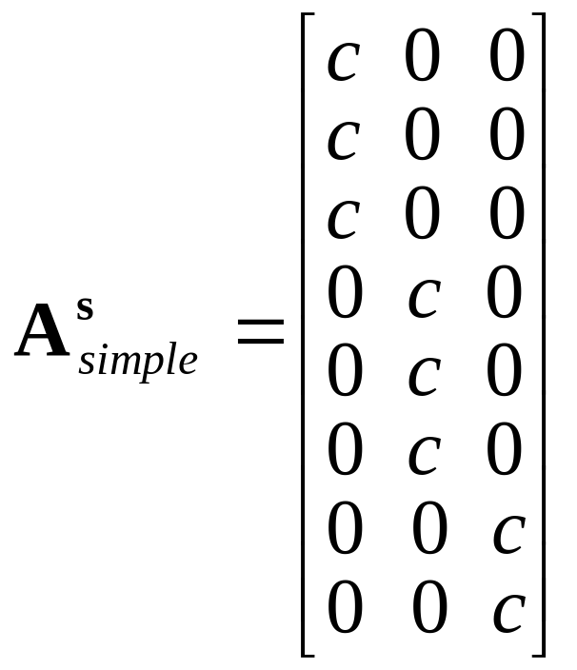
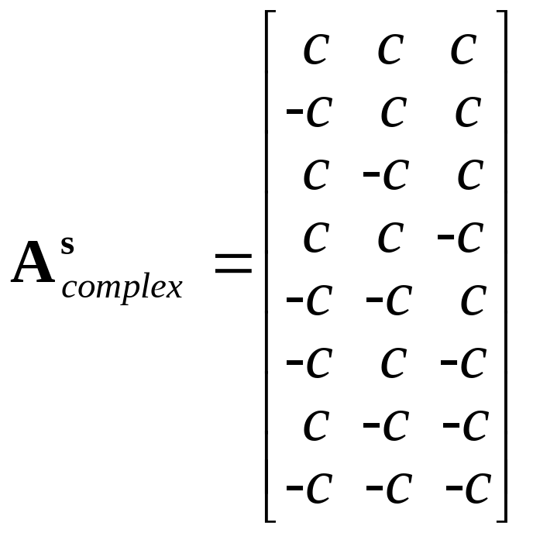
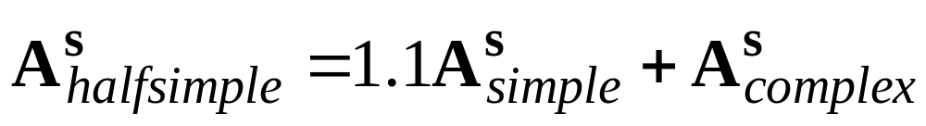
  Simplicity of loading matrix →
  Stability of Varimax solution of samples

Slide 28
Quality criteria for 95%CI’s
P(θ<CI_{left})= α P(θ>CI_{right})= α
95%coverage
(1-prop(θ<CI_{left})-prop(θ>CI_{right}))*100%
Exceeding Percentage (EP) ratio
prop(θ<CI_{left})/prop(θ>CI_{right})

Slide 29
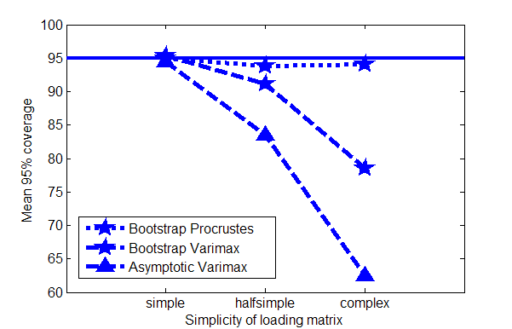

Slide 30
EP ratio (symmetry of coverage)
Bootstrap CI’s: Wald, Percentile, BC_{a}
In case of skew statistic distributions (i.e., high loadings, small sample size):
  BC_{a} by far best
  Wald performs poor (bootstrap & asymptotic)
Other conditions: hardly any differences

Slide 31
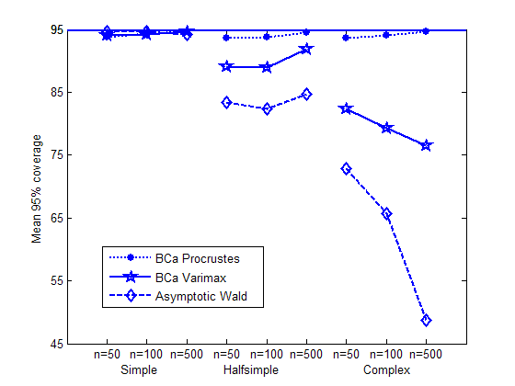

Slide 32
Empirical example
Item | Sample | BC_{a} Varimax | BC_{a} Procrustes
1 | .43 | [.16,.61] | [.21,.57]
2 | -.08 | [-.26,.10] | [-.27,.08]
… |  | …

Slide 33
Key questions for the Bootstrap procedure
Sample drawn from which Population(s)?
What is s(x) exactly?
If s(x) is non-unique, how to make s(x*) comparable?
How to define EDF?
How to estimate CIs from distribution of ?
Notes:
PCA: 2,3 belangrijkste. Benadering direct toepasbaar op multi-way/block modellen
4: in CA algemeen raw resampling lijkt beste
5: BCa methode lijkt best, relatief weinig distributieassumpties, dus breed toepasbaar.
In Multiway/block methoden is vraag 1 moeilijker dan in PCA. Enige voorbeelden volgen nu:

Slide 34
Real multi-way methods
Tucker3/PARAFAC
Sample drawn from which Population(s)?
Which mode(s) are considered fixed, which are random?
Examples:
subjects, measurement occasions, variables
measurement occasions (of one subject), variables, situations
judges, food types, variables

Slide 35
Tucker3/PARAFAC
2. What is s(x) exactly?
T3: Component matrices, for fixed modes only.
Core matrix. Possibly after rotation…
PF: Component matrices, for fixed modes only.
3. If s(x) is non-unique, how to make s(x*) comparable?
T3: Depends on view on rotation…
PF: Reflect and reorder

Slide 36











Multi-block methods
Multilevel Component Analysis,
for hierarchically ordered multivariate data
Examples:
  inhabitants within different countries
  measurement occasions within different subjects
①
①
...
①
①
⓪
①
⓪
①
①
①
①
①
⓪
...
①
⓪
...
⓪
...

Slide 37
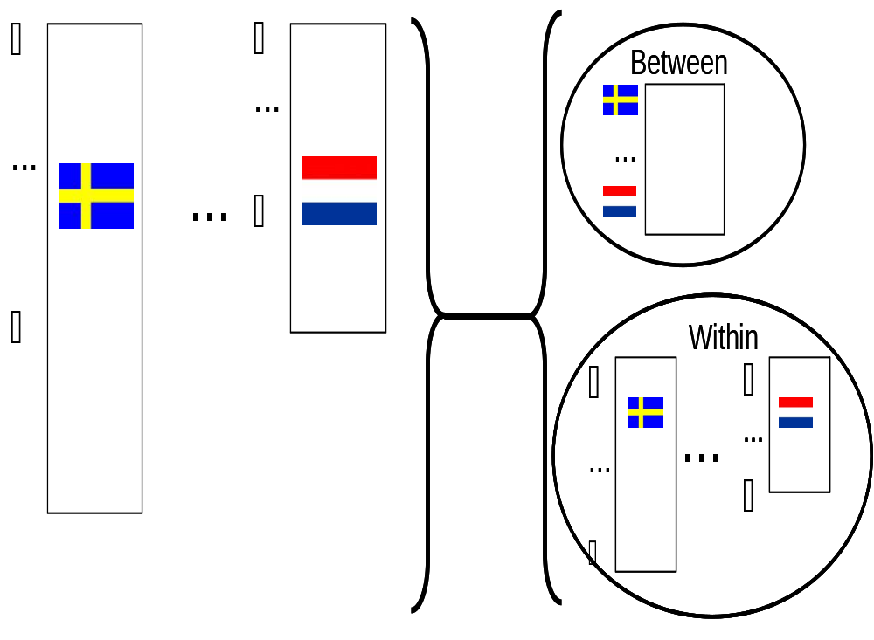

Slide 38
National
character
Weighted PCA
(Dis)similarities
between inhabitants
within each country
Simultaneous
Component Analysis

Slide 39
Sample drawn from which population(s)?
Which mode(s) are considered fixed,
which are random?
inhabitants within different countries
measurement occasions within different
subjects
pupils within classes

Slide 40
Another multi-block method
Principal response curve model for longitudinal multivariate data, obtained from objects within experimental conditions
‘How is the development over time influenced by the experimental conditions?’

Slide 41
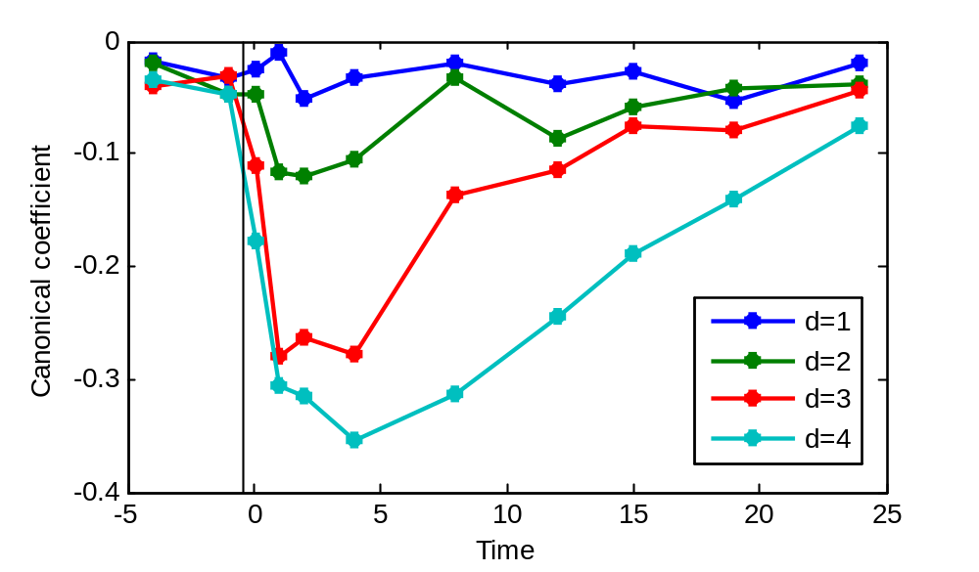
first PRCs of Invertebrate data

Slide 42
Experimental Design:
doses group (d=0,…,D) | replicate (i_{d}=1,…,I_{d}) | time (t=1,…,T=11)
 |  | 1 | 2 | … | 11
d=0 (control) | i₀=1
 | ,…,
 | I₀
… | … | …
d=D | i₀=1
 | ,…,
 | I_{D}

Slide 43
Results from a simulation experiment:
  BC_{a} confidence bands quality improves
    with decreasing replicate variation, and simpler error structures
    with increasing sample size
    ...but even sample size of 20 replicates per condition generally yields satisfactory results

Slide 44
To conclude
How to estimate CIs in component analysis?
  Use the bootstrap!
  5 Key questions for the Bootstrap procedure
    uniqueness of sample solution?
    which modes are random/fixed?
    ...
And what is the quality?
  Generally reasonable

