Slide 1
Including trilinear and restricted Tucker3 models as a constraint in Multivariate Curve Resolution Alternating Least Squares
Romà Tauler
Department of Environmental Chemistry,
IIQAB-CSIC, Jordi Girona 18-26, Spain
e-mail: rtaqam@iiqab.csic.es

Slide 2
Outline
Introduction
MCR-ALS of multiway data
Example of application: MCR-ALS with trilinearity constraint
Example of application: MCR-ALS with component interaction constraint
Conclusions

Slide 3
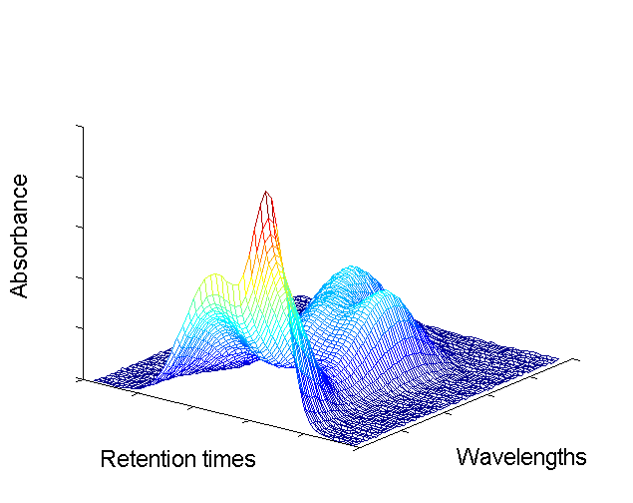
Motivations of this work
Multivariate Curve Resolution (MCR) methods have been shown to be powerful and useful tools to describe multicomponent mixture systems through constrained bilinear models describing the 'pure' contributions of each component in each measurement mode
Mixed information
Pure component information
λ
s₁
t_{R}
➔
s_{n}
S^{T}
c
1
c
n
D
C
Retention times
Wavelengths
Pure signals
Compound identity
source identification and Interpretation

Slide 4
Bilinear models for two way data:
J
J
J
X
or
C
Y^{T or} S^{T}
N
D
E
➔
I
+
I
I
N << I or J
N
PCA
X orthogonal, Y^{T} orthonormal
Y^{T} in the direction of maximum
variance
Unique solutions
but without physical meaning
Identification and Interpretation!
MCR
C and S^{T} non-negative
C or S^{T} normalization
other constraints (unimodality,
closure, local rank,… )
Non-unique solutions
but with physical meaning
Resolution!

Slide 5


An algorithm to solve Bilinear models using Multivariate Curve Resolution (MCR):
Alternating Least Squares (MCR-ALS)
C and S^{T} are obtained by solving
iteratively the two alternating LS equations:
Optional constraints ( non-negativity, unimodality, closure, local rank …) are applied at each iteration
Initial estimates for C or S^{T} are needed

Slide 6
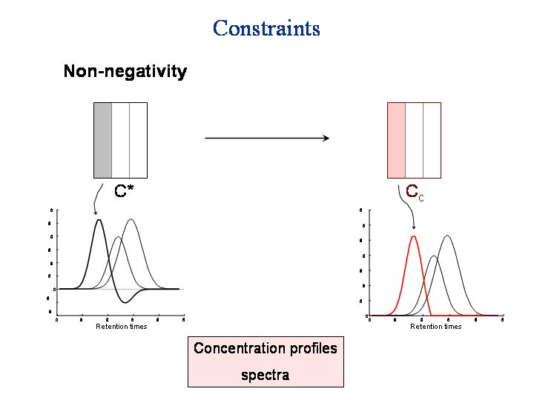
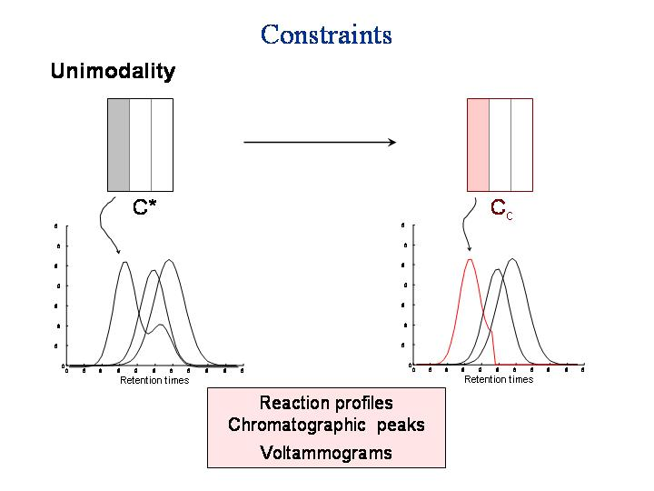
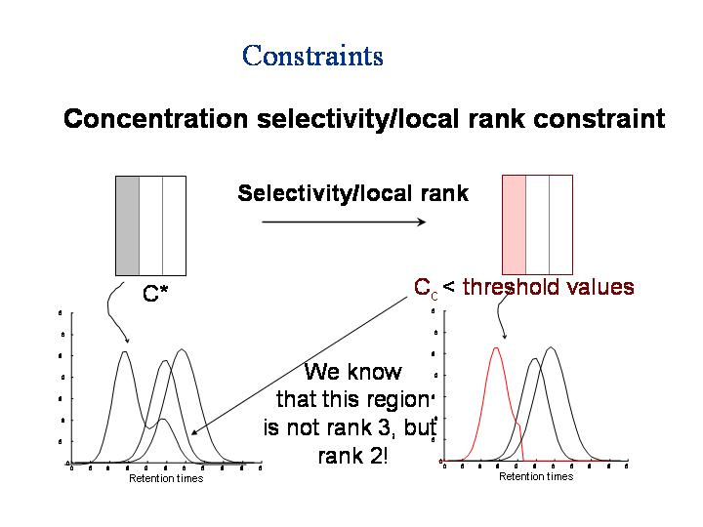
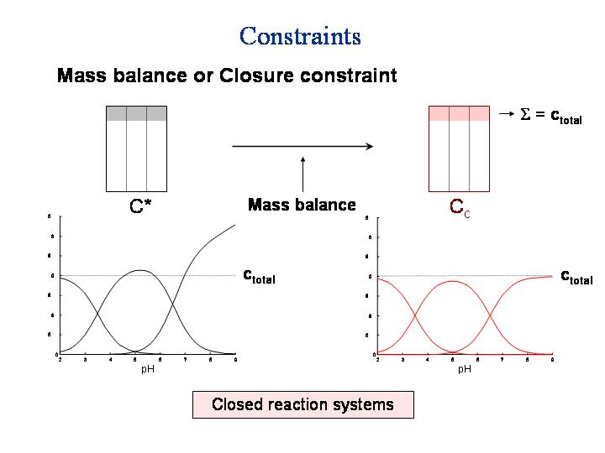
Constraints applied to resolved profiles have included non-negativity, unimodality, closure, selectivity, local rank and physical and chemical (deterministic) laws and models.

Slide 7
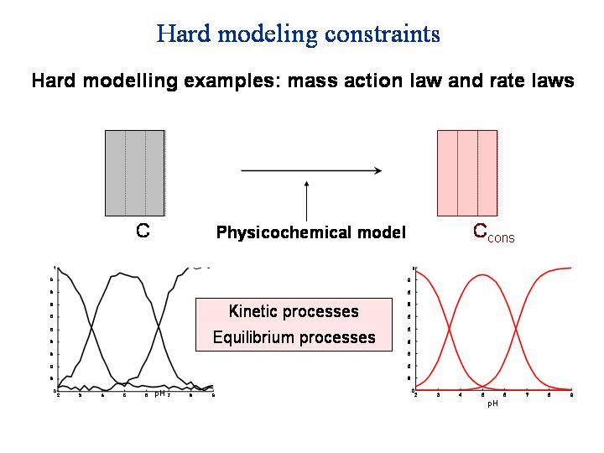
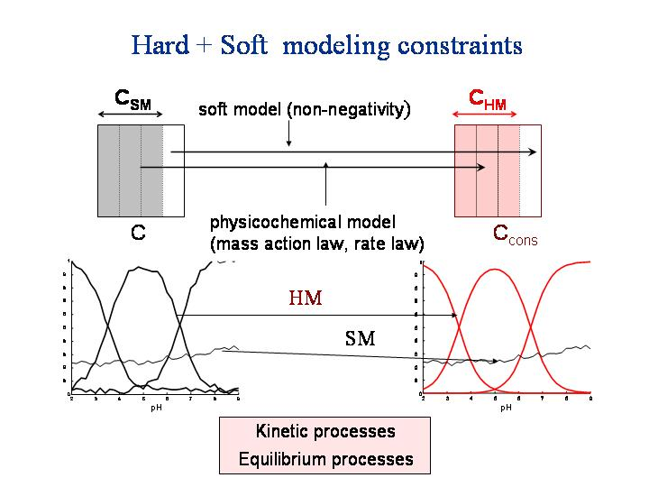
Hard + soft modelling constraints
MCR-ALS hybrid (grey) models

Slide 8
Flowchart of MCR-ALS
Journal of Chemometrics, 1995, 9, 31-58; Chemomet.Intel. Lab. Systems, 1995, 30, 133-146
Journal of Chemometrics, 2001, 15, 749-7; Analytica Chimica Acta, 2003, 500,195-210
D = C S^{T} + E
(bilinear model)
S^{T}
Data
Matrix
Resolved
Spectra
profiles
ALS
optimization
SVD
or
PCA
Initial
Estimation
Resolved
Concentration
profiles
D
E
C
+
Estimation of the number of components
Initial estimation
ALS optimization
CONSTRAINTS
Data matrix decomposition according to a bilinear model
Results of the ALS optimization procedure:
Fit and Diagnostics

Slide 9
MCR-ALS input had to be typed in the MATLAB command line
Until recently
Troublesome and difficult in complex cases where several data matrices are simultaneously analyzed and/or different constraints are applied to each of them for an optimal resolution
A new graphical user-friendly interface for MCR-ALS
J. Jaumot, R. Gargallo, A. de Juan and R. Tauler, Chemometrics and Intelligent Laboratory Systems, 2005, 76(1) 101-110
Now!
Multivariate Curve Resolution
Home Page
http://www.ub.es/gesq/mcr/mcr.htm

Slide 10
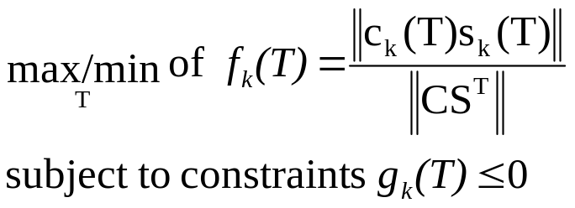
Reliability of MCR-ALS solutions
MCR solutions are not unique
Identification of sougth solutions => evaluation of rotation ambiguities => calculation of feasible band boundaries
R.Tauler (J.of Chemometrics 2001, 15, 627-46)
D = C S^{T} + E = D* + E
C_{new} = C T
S^{T}_{new} = T⁻¹ S^{T}
D* = C S^{T} = C TT⁻¹ S^{T} = C_{new}S^{T}_{new}
0.5
T_{max}
0.4
0.3
0.2
T_{min}
0.1
0
Rotation matrix T is not unique. It depends on the constraints.
T_{max} and T_{min} may be found by a non-linear constrained optimization algorithm!!!
0
5
10
15
20
25
30
35
40
45
50
T_{max}
1.5
1
0.5
T_{min}
0
0
5
10
15
20
25
30
35
40

Slide 11
Reliability of MCR-ALS results
Error estimation of MCR-ALS resolved profiles
Error propagation and Confidence intervals
J.Jaumot, R.Gargallo and R.Tauler, J. of Chemometrics, 2004, 18, 327–340
Resampling Methods
 | pK₁ |  | pK₂
Noise added | Value | Std. dev | Value | Std. dev
0 % | 3.6539 | 2e-14 | 4.9238 | 2e-14
0.1 % | 3.6540 | 6e-4 | 4.9226 | 0.0022
1 % | 3.6592 | 0.0061 | 4.9134 | 0.0264
2 % | 3.6656 | 0.0101 | 4.9100 | 0.0409
5 % | 4.0754 | 0.4873 | 5.3308 | 1.1217
Theoretical
Data
Experimental
Data
Montecarlo
Simulation
Noise Addition
Jackknife
Noise 1%
1
Mean, bands and confidence range of concentration profiles
0.8
Mean, bands and confidence range of spectra
0.9
0.7
0.8
0.6
0.7
0.5
0.6
Rel. conc
0.5
0.4
Absorbance /a.u.
0.4
0.3
0.3
0.2
0.2
0.1
0.1
0
3
4
5
6
7
8
0
pH
240
250
260
270
280
290
300
310
320
Wavelength /nm

Slide 12
Outline
Introduction
MCR-ALS of multiway data
Example of application: MCR-ALS with trilinearity constraint
Example of application: MCR-ALS with component interaction constraint
Conclusions

Slide 13
Extension of Bilinear Models
Matrix Augmentation (PCA, MCR, ...)
The same experiment monitored with different techniques
Y₁^{T}
Y₂^{T}
Y₃^{T}
Row-wise
=
X
=
D
=
D
D
D
D
D
D
D
D
D
D
1
D
1
1
1
2
2
2
2
3
3
3
3
Y^{T}
D
X
D
D
Column-wise
Row and column-wise
Y^{T}
Y₁^{T}
Y₂^{T}
Y₃^{T}
D
D
1
X₁
1
X₁
Y^{T}
D
D
D
D
D
1
D
1
2
2
3
D
X₂
D
=
=
=
2
=
2
X₂
D
D
D
D
4
D
D
4
5
5
6
D
X₃
6
D
3
3
D
D
X
X
Several experiments monitored with several techniques
Several experiments monitored with the same technique
D

Slide 14
Bilinear modelling of three-way data
(Matrix Augmentation or matricizing, stretching, unfolding )
MA-PCA
MA-MCR-ALS
contaminants
Y
sites
F
1
4
F
compartments
S
Loadings
sites
W
S
➔
5
sites
2
metals
sites
W
3
6
D_{aug}
X_{aug}
Augmented
scores matrix
Augmented
data matrix

Slide 15
Advantages of MA-MCR-ALS
Resolution local rank/selectivity conditions are achieved in many situations for well designed experiments (unique solutions!)
Rank deficiency problems can be more easily solved
Constraints (local rank/selectivity and natural constraints) can be applied independently to each component and to each individual data matrix.
J,of Chemometrics 1995, 9, 31-58
J.of Chemometrics and Intell. Lab. Systems, 1995, 30, 133

Slide 16
Bilinear modelling of three-way data
(Matrix Augmentation, matricizing, stretching, unfolding )
Xaug
contaminants
Y^{T}
sites
F
1
4
F
compartments
sites
S
PCA
MCR-ALS
W
S
➔
5
sites
2
contaminants
X
Y
contaminants
sites
W
3
6
sites
x_{i}
x_{ii}
z_{i}
Z
D
z_{ii}
compartments (F,S,W)
Scores
refolding
strategy!!!
(applied to
augmented
scores)
z_{i}
1
2
3
PCA
1st comp
x_{i}
Loadings
recalculation
in two modes
from augmented
scores
z_{ii}
4
5
6
PCA
1st comp
x_{ii}

Slide 17

MA-MCR-ALS
Trilinearity constraint
contaminants
Xaug
Y^{T}
sites
F
1
contaminants
F
compartments
X
Y^{T}
S
sites
W
S
MCR-ALS
sites
➔
2
sites
Z
compartments (F,S,W)
contaminants
sites
W
3
D
Substitution of
species profile
Selection of species profile
TRILINEARITY CONSTRAINT
(ALS iteration step)
1
1’
This constraint
is applied at each step
of the ALS optimization
and independently
for each component
individually
PCA
Rebuilding augmented scores
Folding
2
2’
Loadings
recalculation
in two modes
from augmented
scores
every augmented
scored wanted to
follow the trilinear
model is refolded
3
3’

Slide 18
MA-MCR-ALS
component interaction constraint
This is analogous to a restricted Tucker3 model
Xaug
metals
Y
sites
F
1
4
F
compartments
S
X
sites
W
Y
S
MCR-ALS
sites
=
2
5
Z
compartments (F,S,W)
contaminants
sites
W
3
6
Loadings
recalculation
in two modes
from augmented
scores
component interaction constraint
(ALS iteration step)
D
1’
4’
Folding
PCA
=
=
1
2
3
4
5
6
2’
5’
This constraint is applied at each step of the ALS optimization
and independently and individually for each component i
interacting augmented
scores are folded
together
3’
6’

Slide 19
Outline
Introduction
MCR-ALS of multiway data
Example of application: MCR-ALS with trilinearity constraint
Example of application: MCR-ALS with component interaction constraint
Conclusions

Slide 20
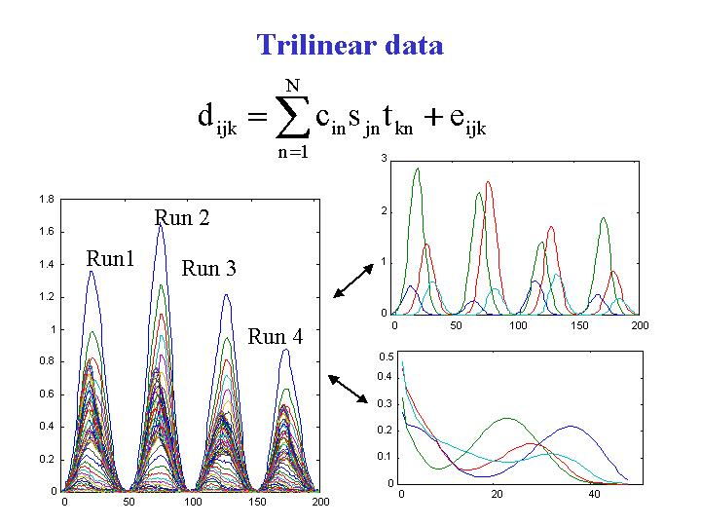
Run1
Run 2
Run 3
Run 4

Slide 21
D_{aug}
D₁
D₂
mixture 1
c_{A} c_{B} c_{C} c_{D}
C₁
C₂
C₃
C₄
Trilinearity Constraint
(flexible for
every species)
Extension of MCR-ALS to multilinear systems
S^{T}
mixture 2
=>
c_{E} c_{F} c_{G} c_{H}
D₁
D₂
mixture 3
c_{I} c_{J} c_{K} c_{L}
mixture 4
c_{M} c_{N} c_{O} c_{P}
Substitution of
species profile
c_{A}
c_{E}
c_{I}
c_{M}
c_{A}’ = z_{I1}c_{I}
c_{E}’ = z_{I2}c_{I}
c_{I}^{’ =} = z_{I3}c_{I}
c_{M}^{’ =} = z_{I4}c_{I}
Selection of species profile
c_{A} c_{E} c_{I} c_{M}
c_{I}
z_{I1} z_{I2} z_{I3} z_{I4}
PCA
Refolding
species
profile
using
Folding
species
profile
1 st loading
1st score
1st score
gives the
common
shape
Loadings give the
relative amounts!

Slide 22
D_{aug} = C_{aug} S^{T}
D₁
D₂
c_{A} c_{B} c_{C} c_{D}
C₁
C₂
C₃
C₄
mixture 1
MCR-ALS
using trilinear
Constraints
R.Tauler, I.Marqués and E.Casassas. Journal of Chemometrics,
1998; 12, 55-75
S^{T}
mixture 2
=
c_{E} c_{F} c_{G} c_{H}
Bilinear Model
D₁
D₂
mixture 3
c_{I} c_{J} c_{K} c_{L}
Unique
Solutions!
Like in PARAFAC!
mixture 4
c_{M} c_{N} c_{O} c_{P}
Trilinearity constraint
The profiles in the three modes are easily recovered!!!
z_{I1}
z_{I2}
z_{I3}
z_{I4}
C_{I} C_{II} C_{III} C_{IV}
z_{II1}
z_{II2}
z_{II3}
zI_{I4}
C
z_{III1}
z_{III2}
z_{III3}
z_{III4}
z_{IV1}
z_{IV2}
z_{IV3}
zI_{V4}
Trilinear Model
Z

Slide 23
Effect of application of the trilinearity constraint
1
Run1
0.9
Run 3
0.8
Profiles with
different
shape
0.7
0.6
Run 2
0.5
Run 4
Trilinearity
constraint
0.4
0.3
0.2
0.1
0
0
50
100
150
200
250
0.8
Run1
0.7
Run 3
Profiles with
equal shape
0.6
0.5
Run 2
Run 4
0.4
0.3
0.2
0.1
0
0
50
100
150
200
250
Notes:
51

Slide 24
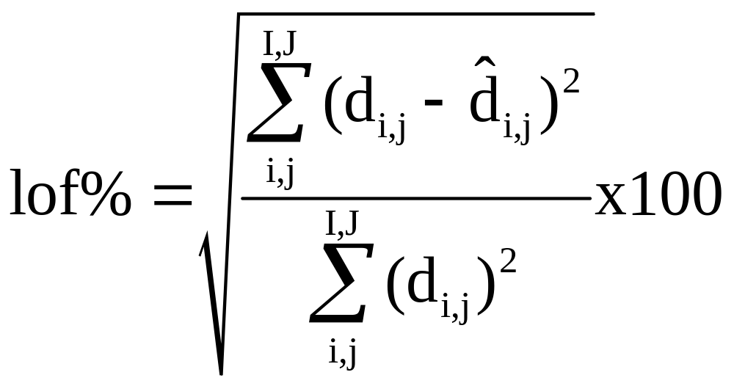
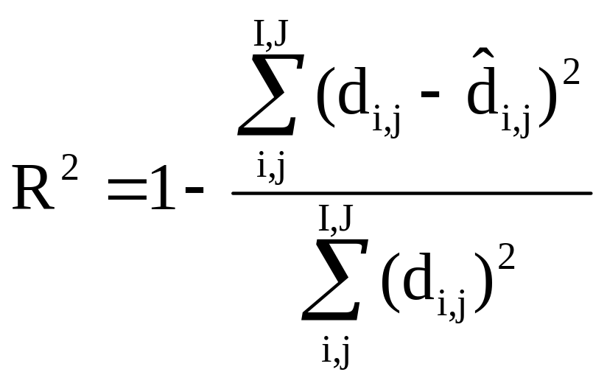
lack of fit
Explained variances

Slide 25
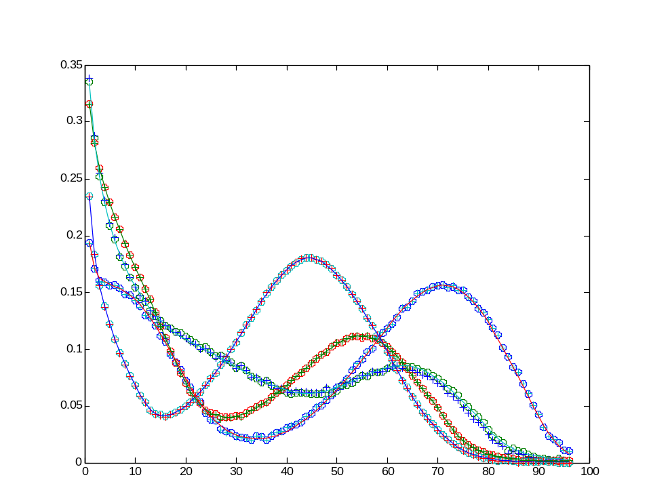
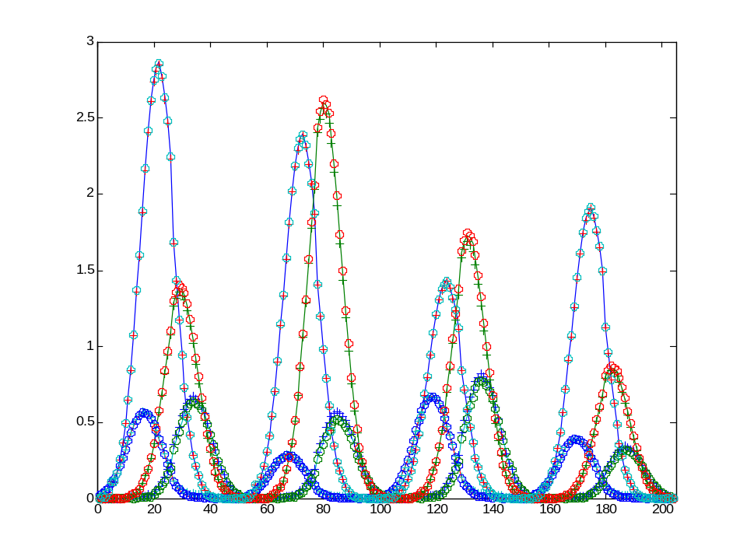
Example 1 Four chromatographic runs following a trilinear model
lof % R²
a) Theoretical 1.634 0.99973 (added noise)
b) MA-MCR-ALS-tril 1.624 0.99974
c) PARAFAC 1.613 0.99974
There is overfitting!!!
O PARAFAC
+ MA-MCR-ALS tril
- theoretical
O PARAFAC
+ MA-MCR-ALS tril
- theoretical

Slide 26
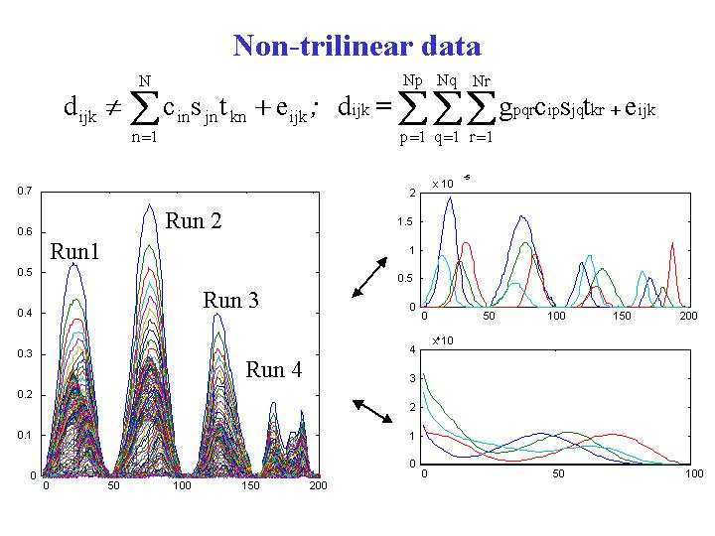
Run1
Run 2
Run 3
Run 4

Slide 27
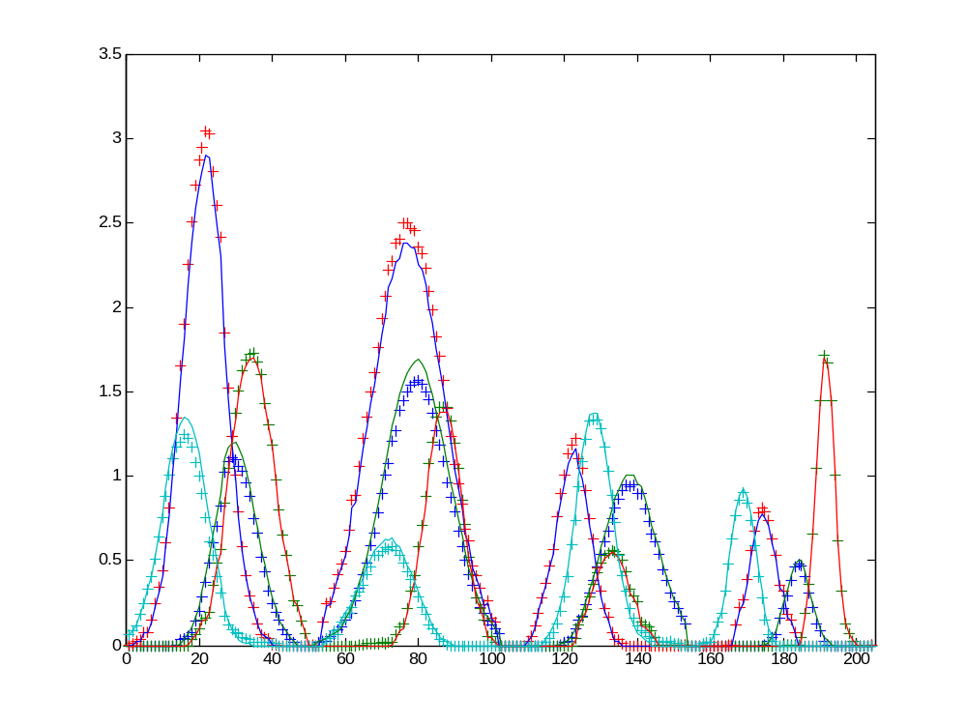
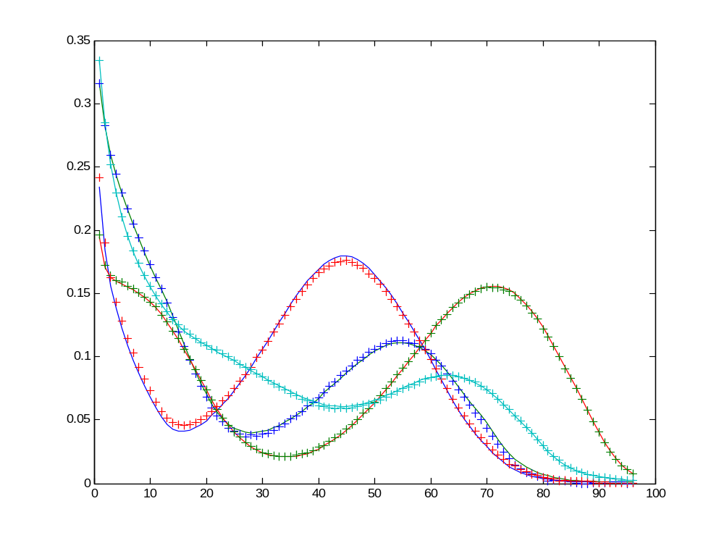
Example 2 Four chromatographic runs not following a trilinear model
lof % R²
a) Theoretical 0.9754 0.99995 (added noise)
b) MA-MCR-ALS-non-tril 0.9959 0.99990
Good MA and local rank (selectivity) conditions for total resolution without ambiguities
+ MA-MCR-ALS non tril
- theoretical
+ MA-MCR-ALS non tril
- theoretical

Slide 28
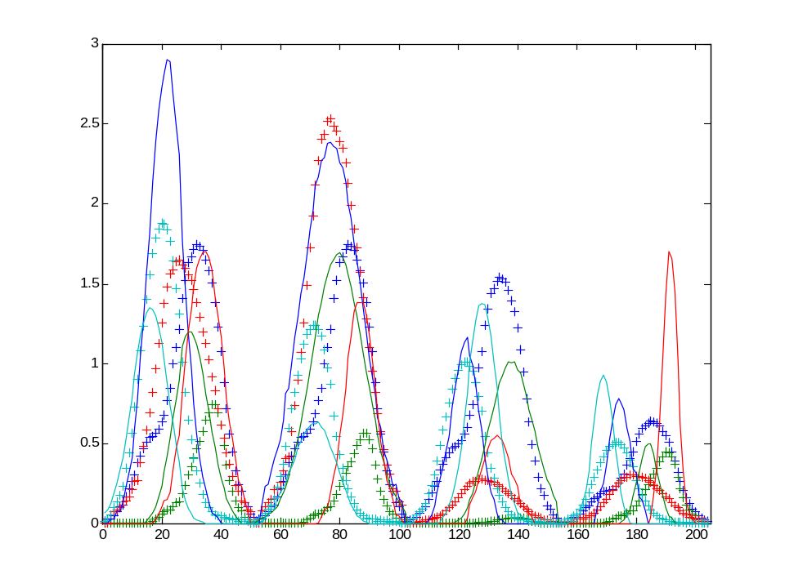
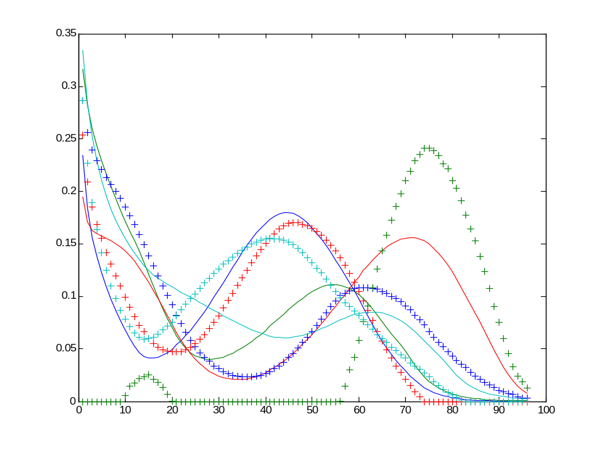
Example 2 Four chromatographic runs not following a trilinear model
lof % R²
a) Theoretical 0.9754 0.9999 (added noise)
b) MA-MCR-ALS-tril 17.096 0.9708
The data system is far from trilinear, and impossing trilinearity gives a much worse fit and wrong shapes of the recovered profiles
+ MA-MCR-ALS tril
- theoretical
+ MA-MCR-ALS tril
- theoretical

Slide 29
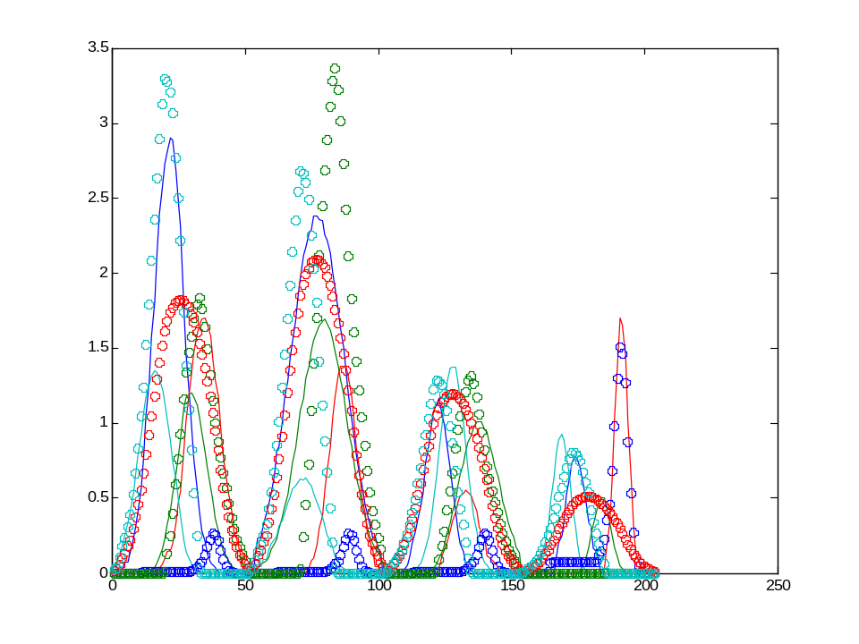
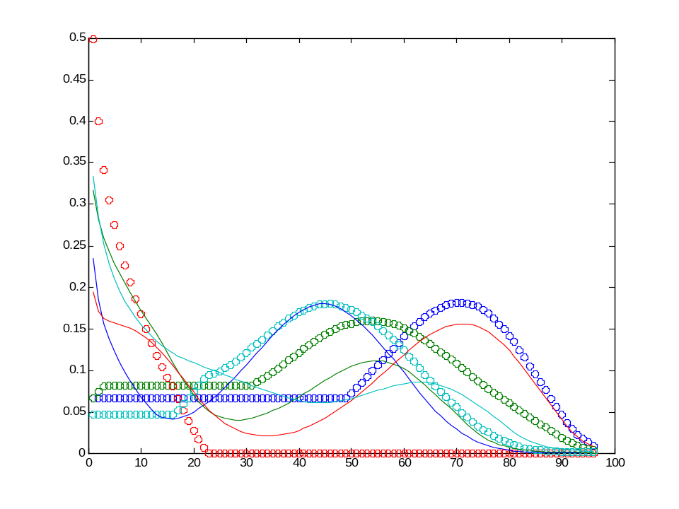
Example 2 Four chromatographic runs not following a trilinear model
lof % R²
a) Theoretical 0.9754 0.9999 (added noise)
b) PARAFAC lof (%) 14.34 0.9794
The data system is far from trilinear, and impossing trilinearity gives a much worse fit and wrong shapes of the recovered profiles
O PARAFAC
- theoretical
O PARAFAC
- theoretical

Slide 30
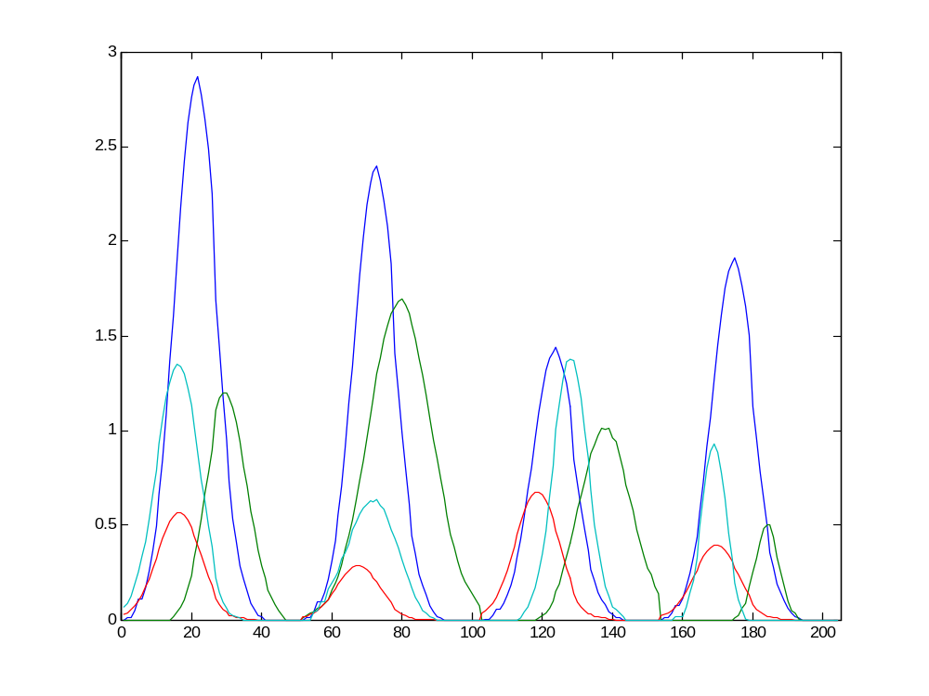
Example 3: A hybrid bilinear-trilineal model
2 components folow the trilinear model
(1st and 3rd) and 2 components (2nd and 4th) do not
Run1
trilinear
1
Run 2
Non-trilinear
3
2
Run 4
4
Run 3

Slide 31
D_{aug}
D₁
D₂
mixture 1
c_{A} c_{B} c_{C} c_{D}
C₁
C₂
C₃
C₄
A hybrid bilinear-trilinear model
S^{T}
mixture 2
=
c_{E} c_{F} c_{G} c_{H}
D₁
D₂
mixture 3
c_{I} c_{J} c_{K} c_{L}
mixture 4
c_{M} c_{N} c_{O} c_{P}
Substitution of
species profile
c_{A}or c_{C}
c_{E} orc_{G}
c_{I} or c_{K}
c_{M} or c_{O}
c_{A}’ = z_{I1}c_{I}
c_{E}’ = z_{I2}c_{I}
c_{I}^{’ =} = z_{I3}c_{I}
c_{M}^{’ =} = z_{I4}c_{I}
Selection of species profile
c_{A} c_{E} c_{I} c_{M}
c_{I}
z_{I1} z_{I2} z_{I3} z_{I4}
PCA
Refolding
species
profile
using
Folding
species
profile
1 st loading
1st score
1st score
gives the
common
shape
Loadings give the
relative amounts!

Slide 32
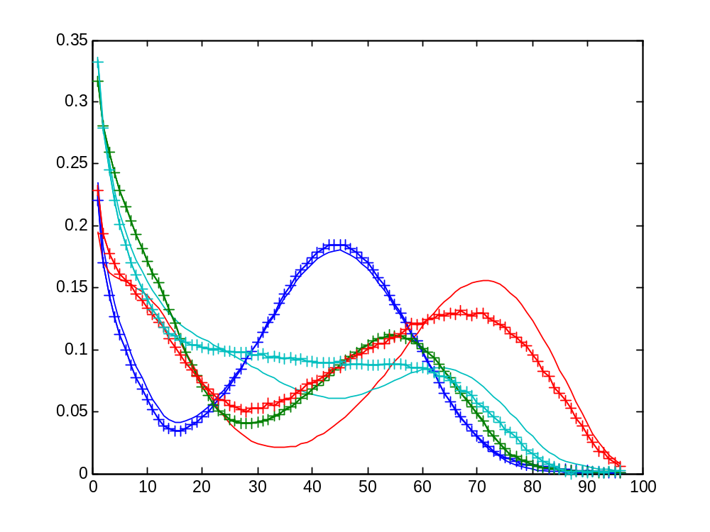
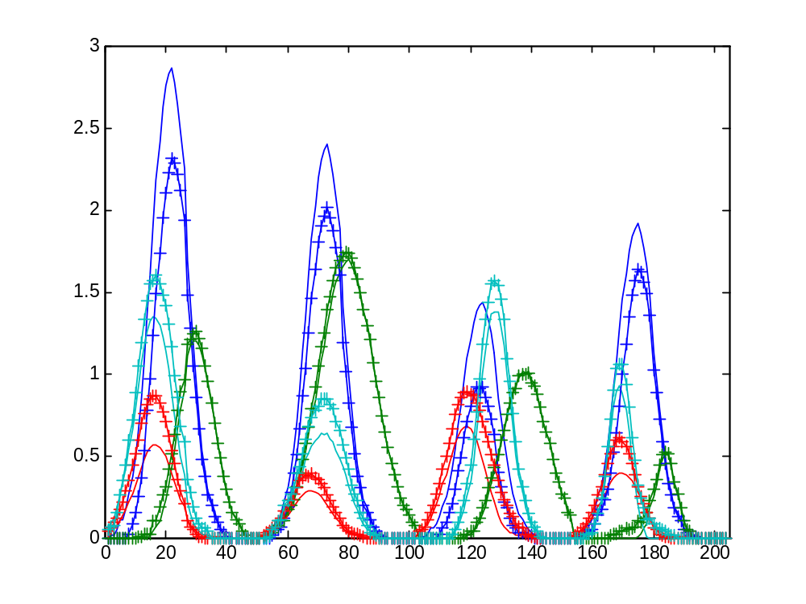
Example 3: A hybrid bilinear-trilineal model
MCR-ALS trilinearity constraint was not applied to any component
lof % R²
a) Theoretical 1.34 0.9998 (added noise)
b) MA-MCR-ALS-non tril 1.35 0.9998
The fit is good but spectral shapes of 3rd and 4th not
rotation ambiguity is still present!
+ MA-MCR-ALS non-tril
- theoretical
+ MA-MCR-ALS non-tril
- theoretical
0.9989,0.9999,0.9696,0.9895
0.9905,0.9990,0.9928,0.9970

Slide 33
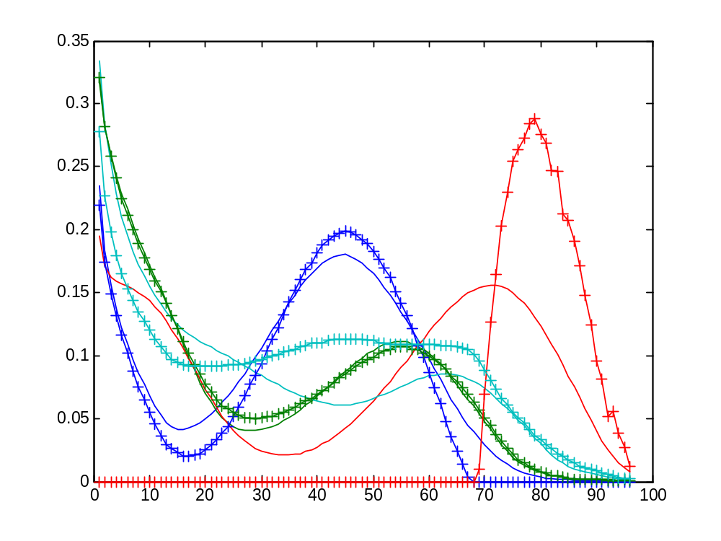
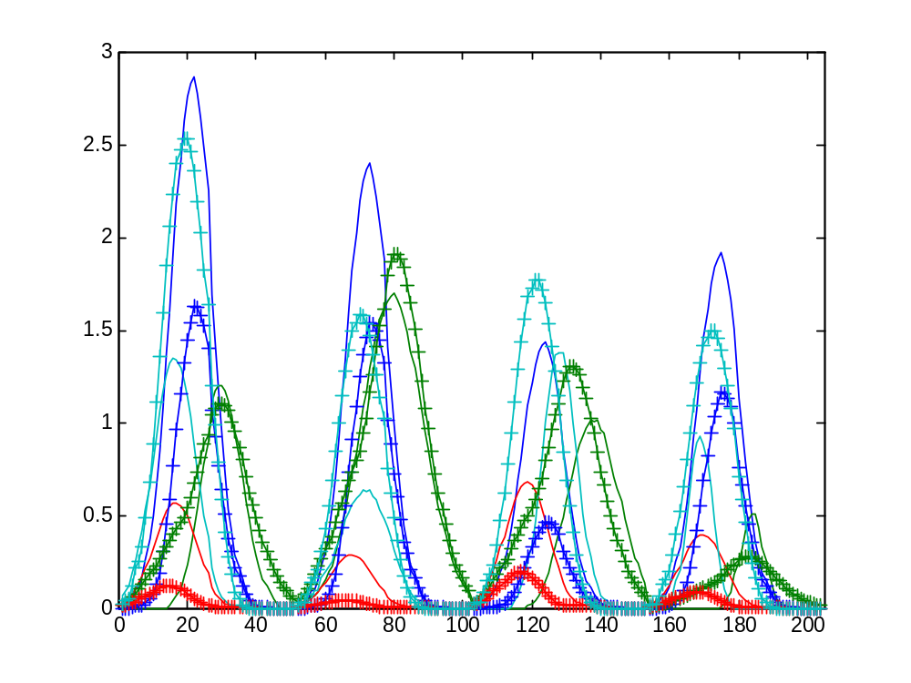
Example 3: A hybrid bilinear-trilineal model
MCR-ALS trilinearity constraint is applied to all components
lof % R²
a) Theoretical 1.34 0.9998 (added noise)
b) MA-MCR-ALS-tril 12.8 0.9936
The fit is not good and the all spectral shapes are wrong.
This is the worse case!!
Assuming trilinearity for non-trilinear data is not adequate!!
+ MA-MCR-ALS tril
- theoretical
+ MA-MCR-ALS tril
- theoretical
0.9872,0.9990,0.5199,0.9584
0.9715,0.9426,0.9540,0.8444

Slide 34
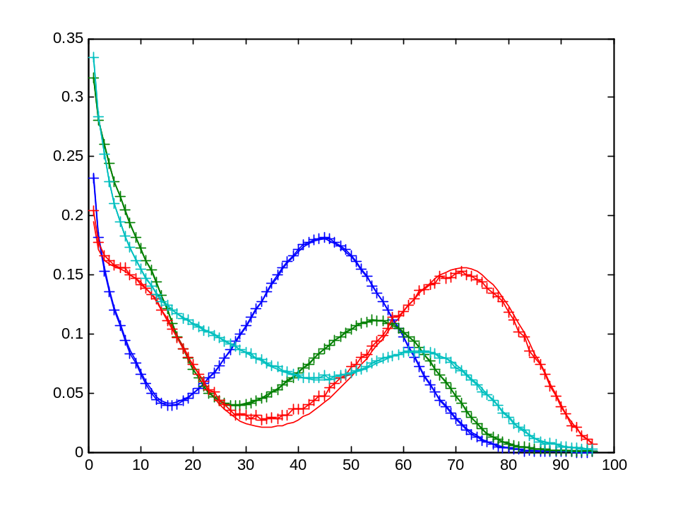
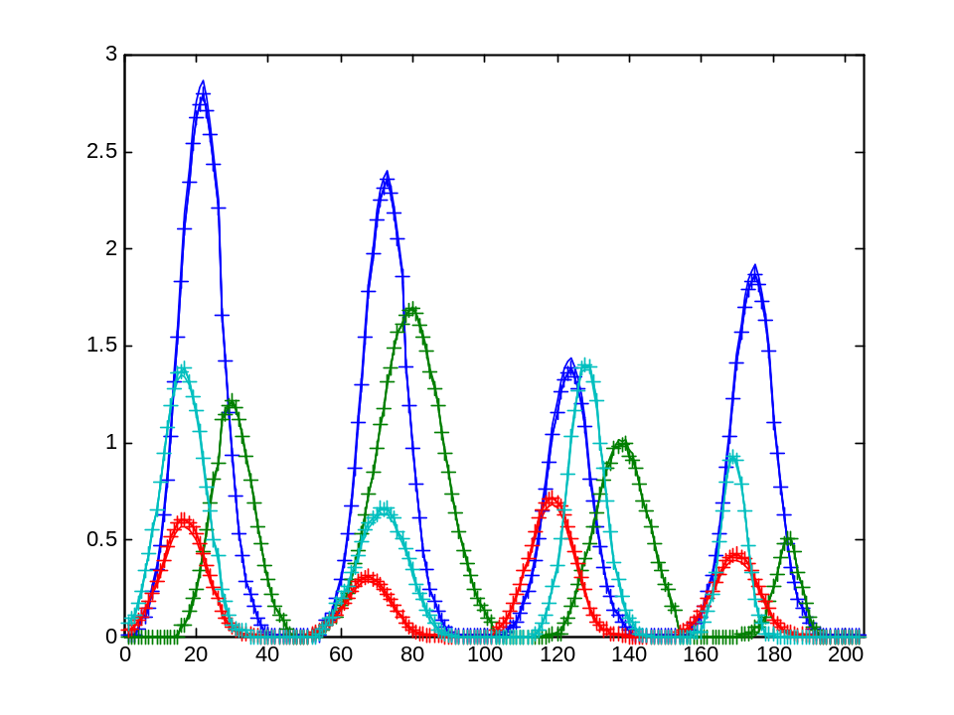
Example 3: A hyubrid bilinear-trilineal model
MCR-ALS trilinearity constraint is applied to 1st and 3rd components
lof % R²
a) Theoretical 1.34 0.9998 (added noise)
b) MA-MCR-ALS-mixt 1.36 0.9998
These are the best results obtained with the hybrid bilinear-trilineal model
+ MA-MCR-ALS partial tril
- theoretical
+ MA-MCR-ALS partial tril
- theoretical
0.9999,0.9999,0.9988,0.9999
0.9999,0.9999,0.9999,0.9998

Slide 35
Outline
Introduction
MCR-ALS of multiway data
Example of application: MCR-ALS with trilinearity constraint
Example of application: MCR-ALS with component interaction constraint
Conclusions

Slide 36
METAL CONTAMINATION PATTERNS IN SEDIMENTS, FISH AND WATERS FROM CATALONIA RIVERS USING MULTIWAY DATA ANALYSIS METHODS
Emma Peré-Trepat (UB), Antoni Ginebreda (ACA), Romà Tauler (CSIC)
mean of scaled concentrations of 11 metals
5
water
sediments
17 rivers, 11 metals (As, Ba, Cd, Co, Cu, Cr, Fe, Mn, Ni, Pb, Zn),
3 environmental conpartments: Fish (barb’, ‘bagra comuna’, bleak, carp and
trout), Sediment and Water samples
fish
4
3
2
1
0
As in fish and
Cd, Co and Pb in water
were not scaled;
only downweigthed
-1
As
Ba
Cd
Co
Cu
Cr
Fe
Mn
Ni
Pb
Zn
metals (variables)

Slide 37
Unit variance scaled concentrations boxplot
Fish
4
Values
2
0
1
2
3
4
5
6
7
8
9
10
11
4
Sediment
Values
2
0
1
2
3
4
5
6
7
8
9
10
11
6
Water
4
Values
2
0
1
2
3
4
5
6
7
8
9
10
11
As Ba Cd Co Cu Cr Fe Mn Ni Pb Zn
Notes:
EXPERIMENTAL DATA
In the frame of a multi annual environmental monitoring program from the Catalan Water Agency (Agència Catalana de l'Aigua), a number of samples from the whole geographical area of Catalonia (Spain) have been analyzed. River water samples, fish samples (like ‘barb’, ‘bagra comuna’, bleak, carp and trout) and sediment samples were included in this study. Main inorganic contaminants like heavy metal ions, were included in this study:
As, Ba, Cd, Co, Cu, Cr, Fe, Mn, Ni, Pb, Zn

Slide 38
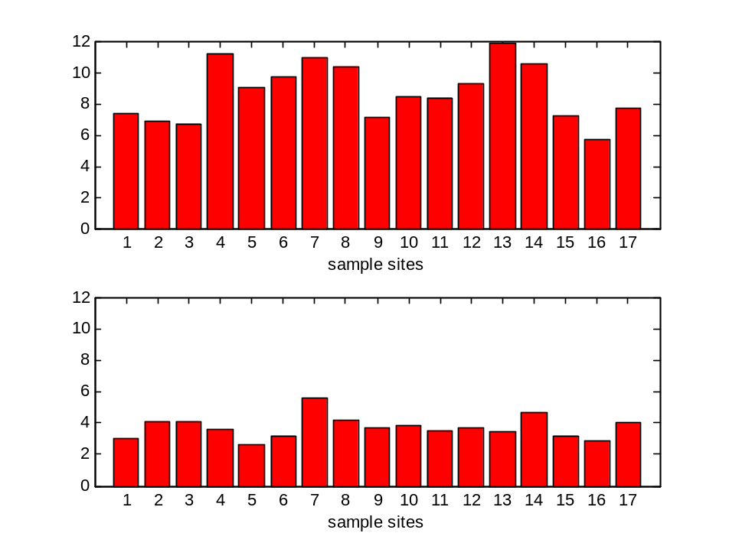
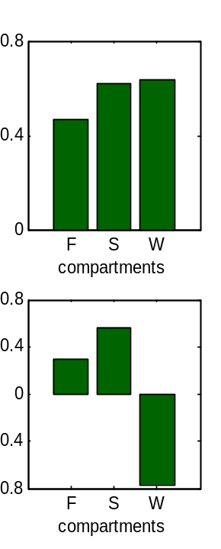
MA-PCA of scaled data and scores refolding
0.5
0.4
0.3
0.2
0.1
0
As
Ba
Cd
Co
Cu
Cr
Fe
Mn
Ni
Pb
Zn
metals
0.5
0
-0.5
As
Ba
Cd
Co
Cu
Cr
Fe
Mn
Ni
Pb
Zn
Little differences in
samples mode!!!
metals
%R² (3-WAY)
1rst Component | 2nd Component | Total
negative loadings
for water soluble
metal ions
MA-PCA + refolding
MA-PCA
64.7 | 11.7 | 76.4
67.3 | 13.2 | 80.5

Slide 39
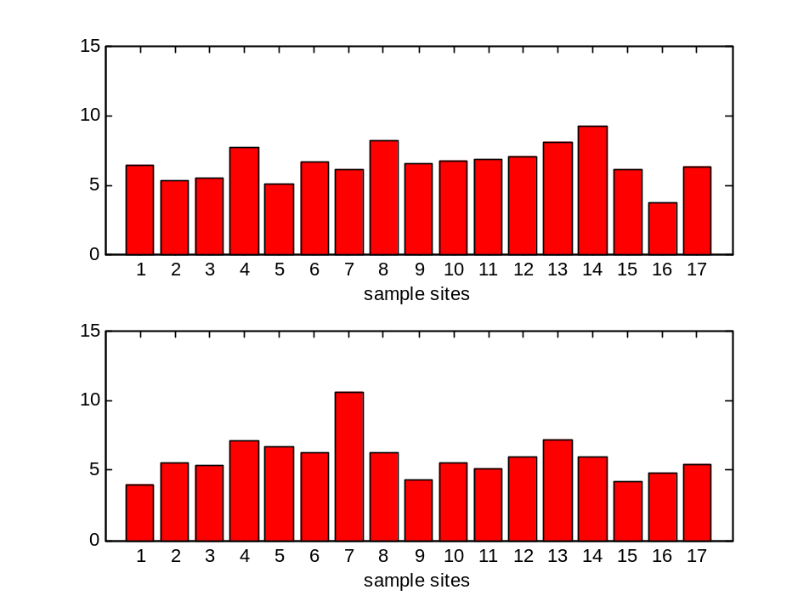
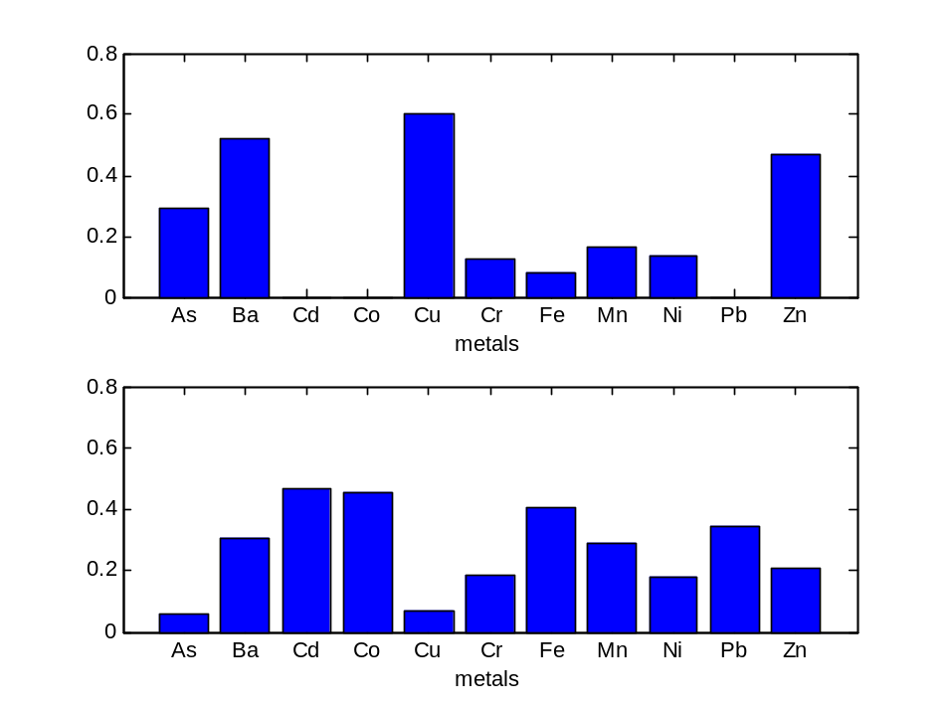
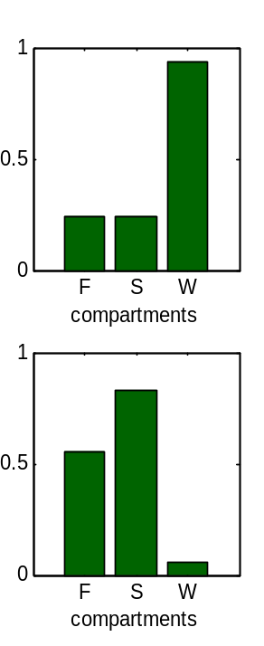
MA-MCR-ALS of scaled data with nn constraint and scores refolding
%R² (3-WAY)
1rst Component | 2nd Component | Total
MA-MCR-ALS + refolding
MA-MCR-ALS
47.0 | 40.7 | 76.9
48.2 | 42.8 | 80.5

Slide 40
MA-MCR-ALS
Trilinear model constraint
Xaug
contaminants
Y^{T}
sites
F
1
contaminants
F
compartments
X
Y^{T}
S
sites
W
S
MCR-ALS
sites
➔
2
sites
Z
compartments (F,S,W)
contaminants
sites
W
3
D
Substitution of
species profile
Selection of species profile
TRILINEARITY CONSTRAINT
(ALS iteration step)
1
1’
This constraint
is applied at each step
of the ALS optimization
and independently
for each component
individually
PCA
Rebuilding augmented scores
Folding
2
2’
Loadings
recalculation
in two modes
from augmented
scores
every augmented
scored wnated to
follow the trilinear
model is refolded
3
3’

Slide 41
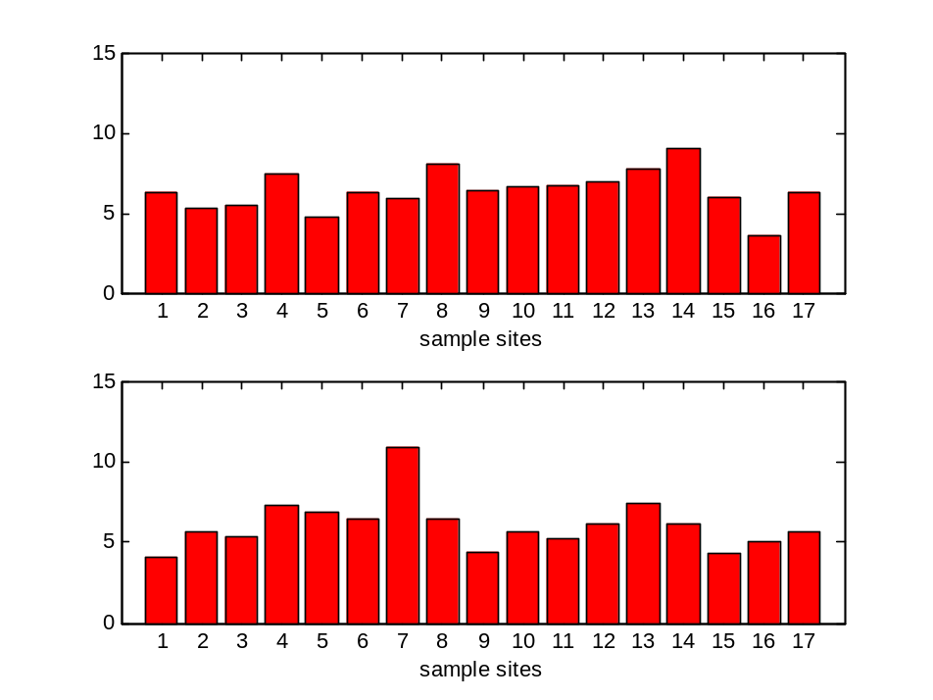
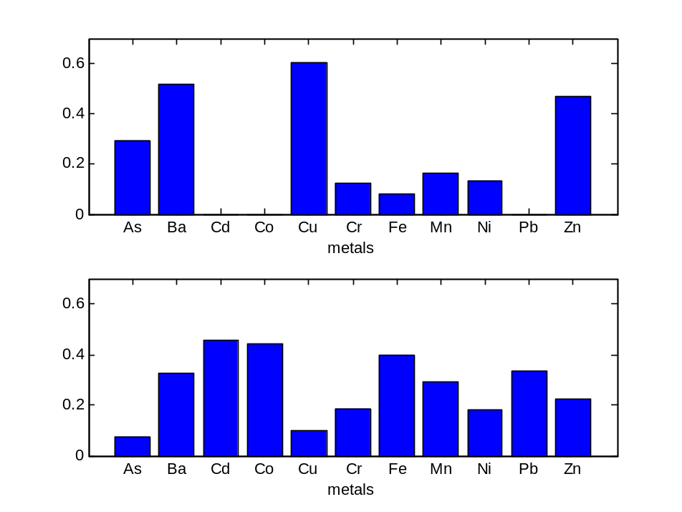
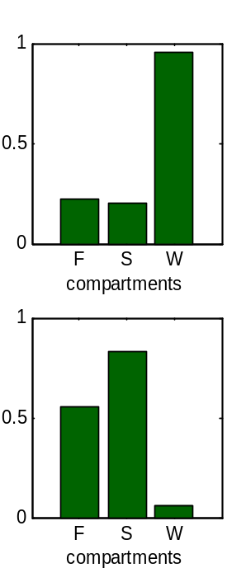
MA-MCR-ALS of scaled data with nn, with trilinearity model constraint and with scores refolding
%R² (3-WAY)
1rst Component | 2nd Component | Total
MA-MCR-ALS nn + trilinear
MA-MCR-ALS nn + refolding
45.3 | 42.2 | 76.8
47.0 | 40.7 | 76.9

Slide 42
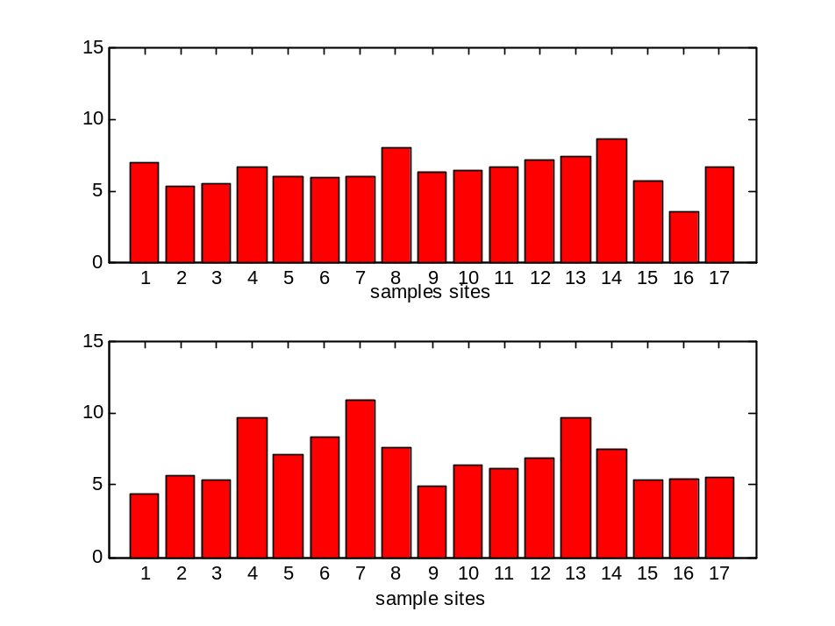
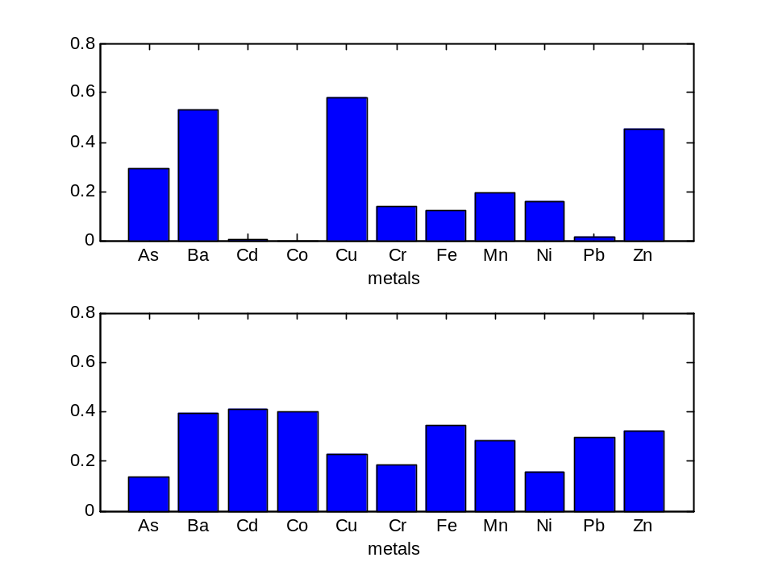
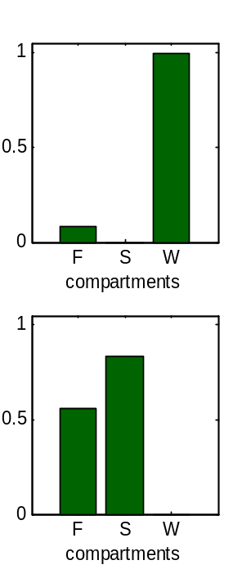
PARAFAC of scaled data
%R² (3-WAY)
1rst Component | 2nd Component | Total
PARAFAC
MA-MCR-ALS nn + trilinear
43.4 | 36.2 | 77.4
44.3 | 42.9 | 76.8

Slide 43
MA-MCR-ALS
component interaction constraint
Xaug
metals
Y
sites
F
1
4
F
compartments
S
X
sites
W
Y
S
MCR-ALS
sites
=
2
5
Z
compartments (F,S,W)
contaminants
sites
W
3
6
Loadings
recalculation
in two modes
from augmented
scores
component interaction constraint
(ALS iteration step)
D
1’
4’
Folding
PCA
=
=
1
2
3
4
5
6
2’
5’
This constraint is applied at each step of the ALS optimization
and independently and individually for each component i
interacting augmented
scores are folded
together
3’
6’

Slide 44
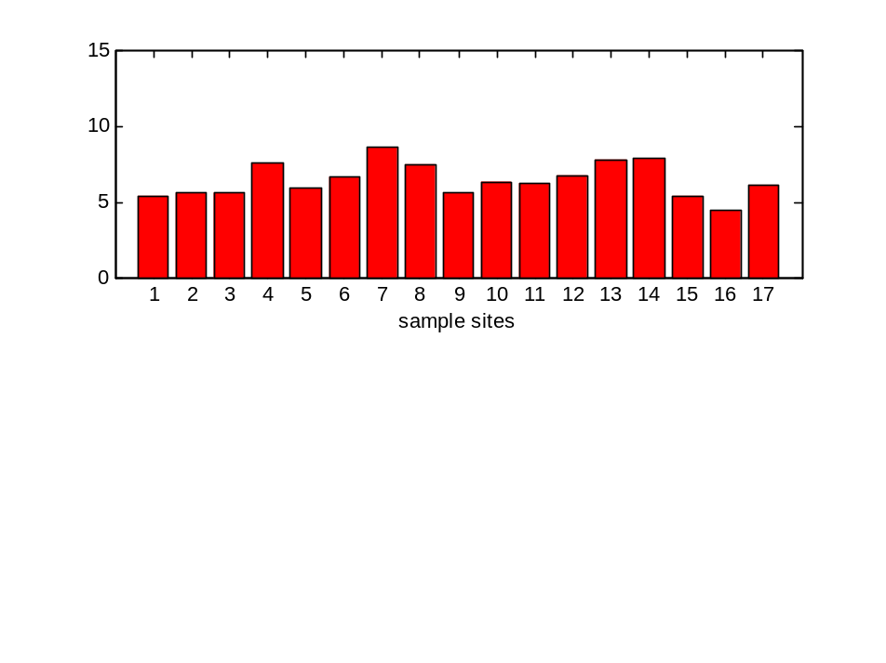
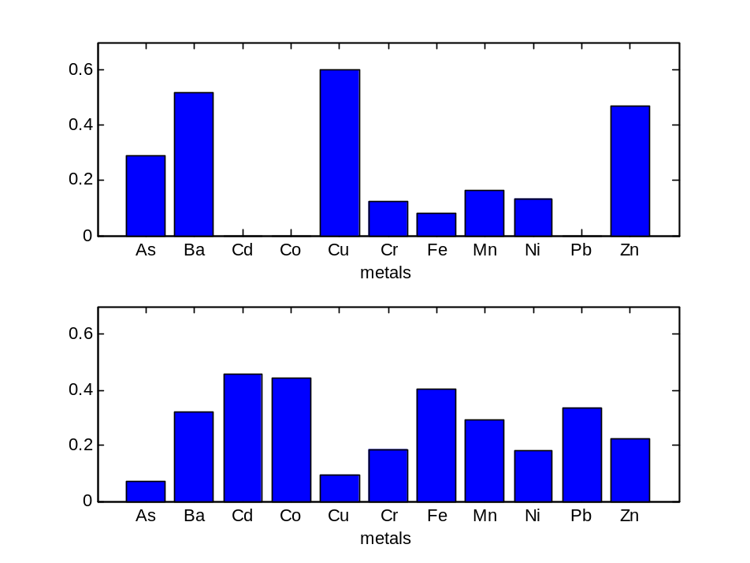
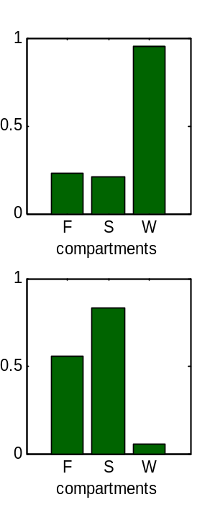
MA-MCR-ALS of scaled data with nn, component interaction and scores refolding
%R² (3-WAY)
1rst Component | 2nd Component | Total
MA-MCR-ALS nn + interaction
MA-MCR-ALS nn
45.2 | 41.4 | 75.8
model [1 2 2]
model [2 2 2]
45.3 | 42.2 | 76.8

Slide 45
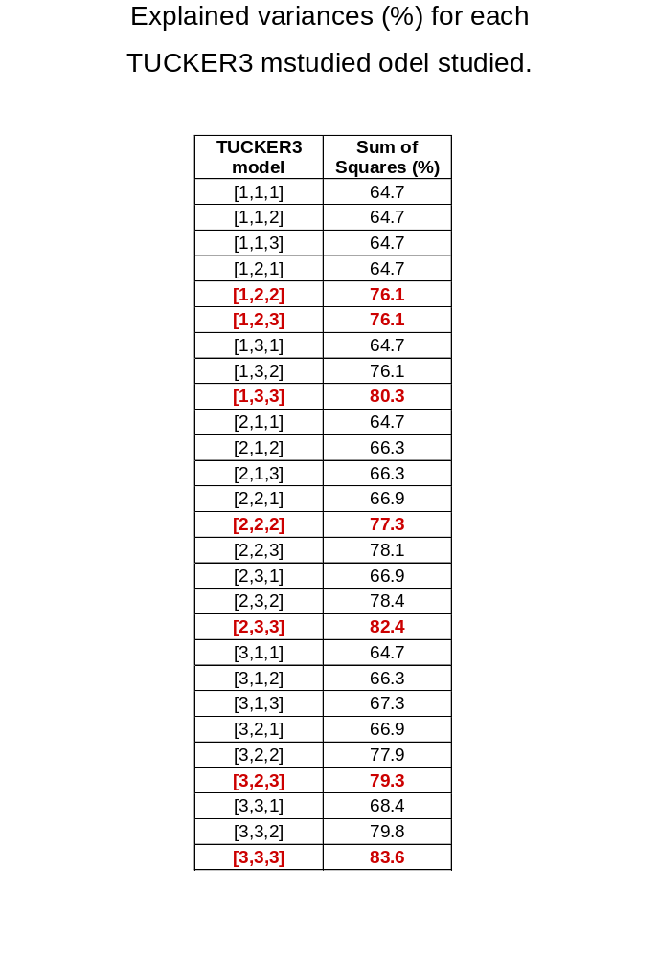
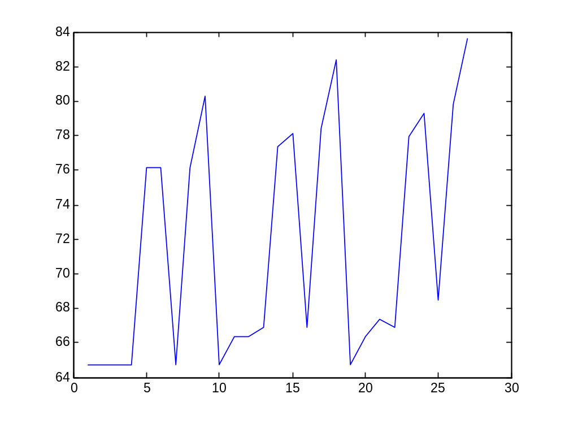
Tucker Models with non-negativity
constraints
[2 3 3]
[3 3 3]
[1 3 3]
[3 2 3]
[2 2 2] [2 2 3]
[1 2 2] [1 2 3]
parsimonious model
[1 2 2]

Slide 46
Tucker3-ALS of scaled data
0.4
1
1
0.2
0.5
0.5
0
0
5
10
15
0
1
2
3
4
5
6
7
8
9
10
11
0
1
2
3
1
1
0.5
0.5
0
1
2
3
4
5
6
7
8
9
10
11
0
1
2
3
%R² (3-WAY)
1rst Component | 2nd Component | Total
TUCKER3
PARAFAC
50.7 | 35.3 | 76.1
model [1 2 2]
model [2 2 2]
43.4 | 36.2 | 77.4

Slide 47
Summary of Results
CHEMOMETRIC METHOD | %R² (3-WAY) |  |  | %R² (2-WAY)
 | 1rst Component | 2nd Component | Total | 1rst Component | 2nd Component | Total
MA-PCA | 64.7 | 11.7 | 76.4 | 67.3 | 13.2 | 80.5
PARAFAC (non-negativity) | 43.4 | 36.2 | 77.4 | - | - | -
TUCKER3 (non-negativity) | 50.7 | 35.3 | 76.1 | - | - | -
MA-MCR-ALS (non-negativity) | 47.0 | 40.7 | 76.9 | 48.2 | 42.8 | 80.5
MA-MCR-ALS (non-negativity and triliniarity) | 44.3 | 42.9 | 76.8 | - | - | -
MA-MCR-ALS (non-negativity and component interaction constraints) | 45.2 | 41.4 | 75.8 | - | - | -

Slide 48
Outline
Introduction
MCR-ALS of multiway data
Example of application: MCR-ALS with trilinearity constraint
Example of application: MCR-ALS with Tuker3 constraint
Conclusions

Slide 49
Conclusions
It is possible to implement trilinearity constraints in MCR
using ALS algorithms in a flexible, adaptable, simple and fast way and it may be applied to only some of the components.
Intermediate situations between pure bilinear and pure trilinear hybrid models can be easily implemented using MA-MCR-ALS
Different number of components and interactions between components in different modes can be also easily implemented in hybrid MA-MCR models
For an optimal RESOLUTION, the model should be in accordance with the 'true' data structure

Slide 50
Guidelines for method selection
(resolution purposes)
Deviations
from trilinearity Mild Medium Strong
Array size
PARAFAC
Small PARAFAC2
Medium TUCKER
Large MCR
Journal of Chemometrics, 2001, 15, 749-771

Slide 51
Related works:
R.Tauler, A.Smilde and B.R.Kowalski. Journal of Chemometrics, 1995, 9, 31-58 (MCR-ALS extension to multiway)
R.Tauler, I.Marqués and E.Casassas. Journal of Chemometrics, 1998; 12, 55-75 (implementation of trilinearity constraint in MA-MCR-ALS)
A. de Juan and R.Tauler, Journal of Chemometrics, 2001, 15, 749-771 (comparison of MA-MCRE-ALS with PARAFAC and Tucker3)
E.Peré-Trepat, A.Ginebreda and R.Tauler, Chemometrics and Intelligent Laboratory Systems, 2006, (new implementation of the component interaction constraint in MA-MCR-ALS)

Slide 52
Acknowledgements
Ana de Juan (comparison of MCR-ALS with other multiway data analysis methods)
Emma Peré-Trepat (application of the component interaction constraint to environmental data)
Research Grant MCYT, Spain, BQU2003-00191
Water Catalan Agency (supply of environmental data set)

