Slide 1
Churn prediction – Analysis on Telco customers’ data

Slide 2
Chapters
1. Dataset
2. Touch base analysis
3. Parameters selection
4. Prediction model

Slide 3
1.
Dataset
Few words on the dataset used

Slide 4
Telcom Customers’ data
Multiple categorical variables describing the customers
Column about Total and Monthly charges
Column containing the information churned or not
Last column will play the role of the “target” in our analysis

Slide 5
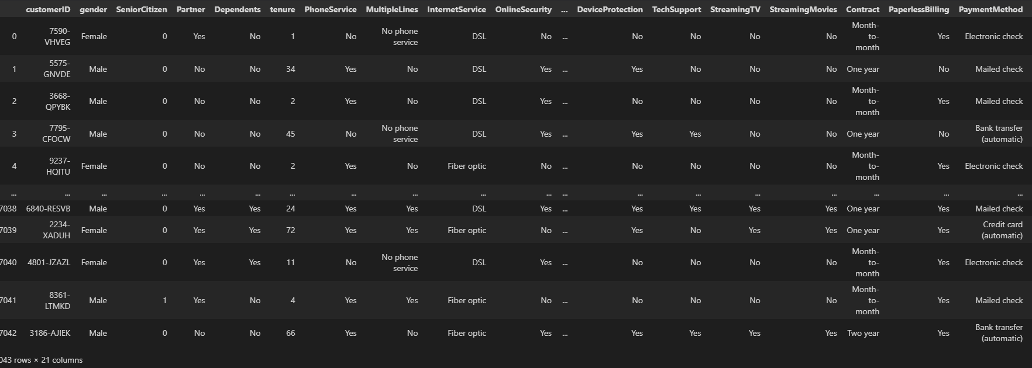
An example of the table – data set

Slide 6
2.
Touch base analysis
First takeouts from the dataset

Slide 7
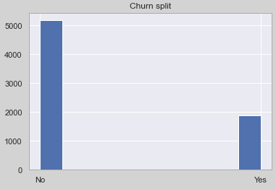
View on the actual churned clients
Churned customers are less than the ones who are not.
Out of almost 7K customers less than 2K are churned

Slide 8
Historical results lead to churn prediction
We want to create a prediction model based on the parameters that lead to this view

Slide 9
3.
Parameters selection
Highlight the important elements of the churn (or not) action

Slide 10
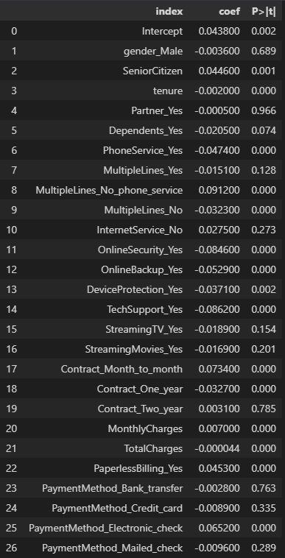
Most important variables based on OLS
Used OLS to find the most important variables that affect churn activity
Combination of coefficient and p-value give us the answer to the question: which variables are important?
Combination of high coefficient number and low p-value will do the trick

Slide 11
Ready to begin
Now that we have found the “drivers“ of the churn behavior we are ready to implement the appropriate model

Slide 12
4.
Prediction model
Application of the model chosen

Slide 13
Appropriate model choice
K-neighbors-Classifier
Logistic regression
Support Vector Classifier
We compared the 3 techniques of classification (yes or no in the question is the customer going to be churned) by comparing their results in accuracy metric (true positive & true negative accuracy)
Logistic regression was the “go to” model as it gave a better score.

Slide 14
Appropriate model choice
Fine tuning
We applied the model after we fine tuned its parameters.
We did that by trying different values of these parameters and checking the accuracy result again.
Model application
We apply the model on our test data. These data are like unseen data for our model, and we can get scores on how the model performed as we know their labels , chunrned or not.

Slide 15
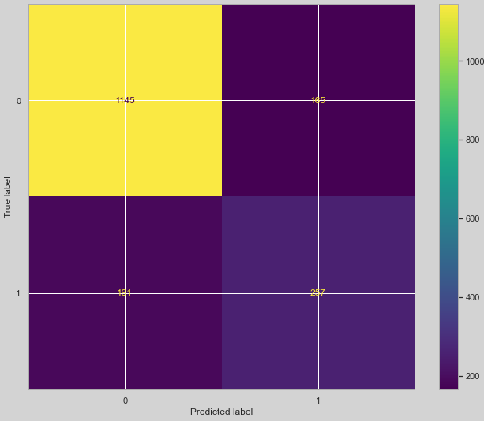
Results of the model implementation
Confusion matrix
The results depicted on the confusion matrix, show what our model achieved to predict right (top left and bottom right) and what did not. (bottom left and top right).

Slide 16
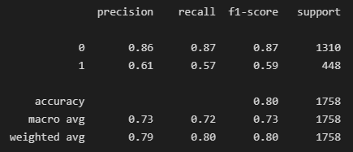
Classification report – metrics
Precision, recall and f1-score show better results on dealing with predicting the non churned customers. The model’s accuracy shows a decline due to its ability in predicting correct the churned clients (lower scores), but all in all an 80% accuracy is an acceptable result.

Slide 17
Key takeouts
Prediction model works decently (acc 80%) and provides a strong tool in the business needs, regarding customers’ retention and acquisition
Specific variables of the customer’s behaviour define the outcome of the churn activity – target those and act accordingly
The model itself can be optimized even more with the use of other parameters as well – addition of data can help the model’s training
Variables that show gender, marital status and other demographics do not add to the information gain of the model for predicting the churn outcome
HIGH VALUE 1

