Slide 1
Practical
Notes:
https://beta.polleverywhere.com/activities?group_id=-1

Slide 2
Last session !!!

Slide 3
The previous lessons

Slide 4
1st Course
SUPERVISED VS UNSUPERVISED
DIVIDE OUR DATA
COST FUNCTION
GRADIENT DESCENT
UNDERFITTING VS OVERFITTING

Slide 5
2nd Course
ANN presentation
LAYERS
ACTIVATION FUNCTION
FEEDFORWARD
How do NN learn(Backpropagation)
Develop our first ANN

Slide 6
Today
Examine the dataset
Finish the algorithm

Slide 7


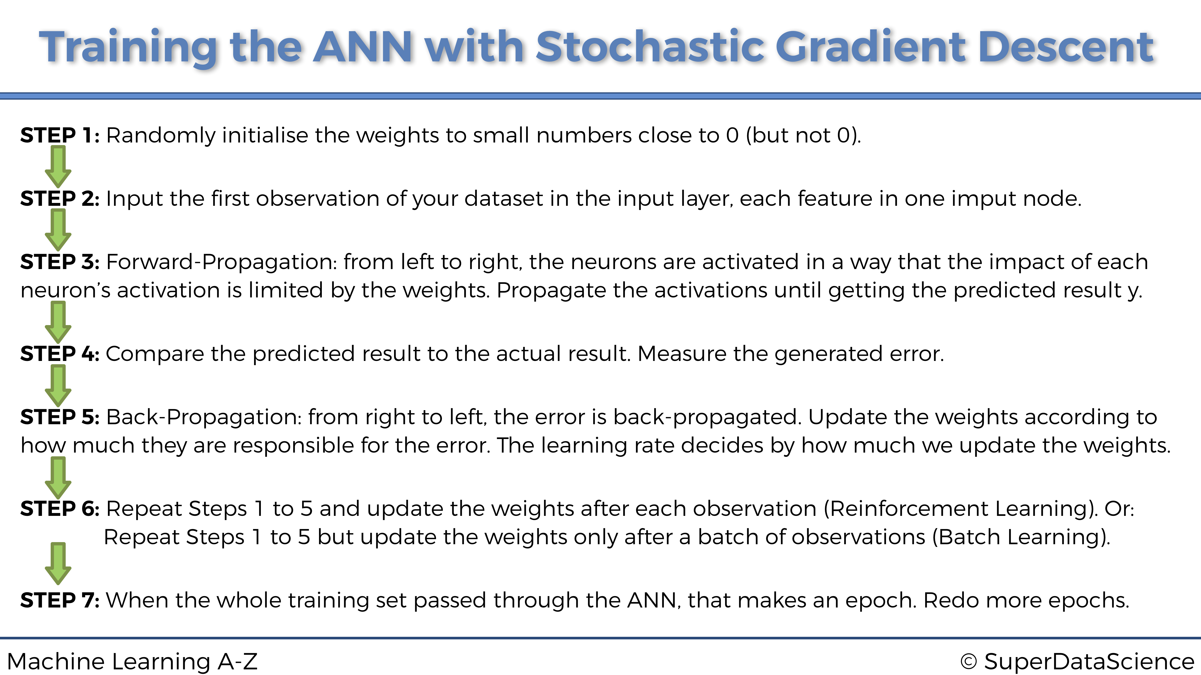

Slide 8
Thank you!!!

