Slide 1















The Impact of Castle Doctrine Laws on Homicide Rate:
A Causal Analysis Using Synthetic DiD, Meta Learners, Causal Random Forest, and Instrumental Variables
TEAM12 SECTION C
Tim Gong, Kavya Gupta, Tiantian Huang,
Vidhi Jain, Boqing Zheng

Slide 2
INTRODUCTION TO CASTLE DOCTRINE LAWS
WHAT ARE CASTLE DOCTRINE LAWS?
ORIGINAL INTENT
Enacted in 33 of 51 U.S. jurisdictions (including Washington D.C.)
Grants the right to use force (sometimes lethal) against intruders
No duty to retreat when inside one's home, vehicle, or legally occupied space
Empower citizens to protect themselves and their property
Prevent legal prosecution for use of force in self-defense
Notes:
In the United States, 33 of 51 jurisdictions, including Washington D.C., have enacted Castle Doctrine laws. These laws grant individuals the right to use reasonable, and sometimes lethal, force to defend themselves against intruders in their homes, vehicles, or other legally occupied spaces from the intruders, without a duty to retreat. Originally, the intent of these laws was to empower citizens to protect themselves and their property, and to avoid legal prosecution for the outcomes of the use of force.

Slide 3


CONTROVERSY & RACIAL BIAS CONCERNS
Castle Doctrine Laws have sparked controversy due to:
Escalation of lethal force use in ambiguous situations
Potential for racial bias in enforcement
Critics argue these laws encourage premature use of lethal force rather than true self-defense
Key Question:
Are these laws truly about self-defense, or do they disproportionately endanger certain groups?
Notes:
However, despite these intentions, Castle Doctrine laws have become increasingly controversial following incidents where innocent people were killed. 1992, Japanese exchange student Yoshihiro Hattori was killed in Louisiana, for mistakenly going to the wrong house for a Halloween party. More recently in 2023, Kaylin Gilllis was shot to death by the homeowner after she allegedly turned around in his driveway. Critics argue that Castle Doctrine laws inadvertently escalate violence, encouraging citizens to use lethal force prematurely. Some critics also point out that Castle Doctrine laws benefit racism for using lethal forces against colored people more recklessly with a reason to defend themselves.

Slide 4
EMPIRICAL EVIDENCE – IMPACT ON CRIME RATES
Cheng & Hoekstra (2013) Study:
Used Difference-in-Differences (DiD) and two-way fixed effects models to analyze the impact of Castle Doctrine laws
Found a statistically significant 8% increase in homicides & non-negligent manslaughters after law implementation
Key Insight:
Contradicts the deterrence argument
Instead of reducing crime, these laws may escalate violence
Notes:
A research by Cheng and Hoekstra (2013) explored the effects of Castle Doctrine laws using a difference-in-differences (DiD) framework. They observed a statistically significant 8% increase in reported murders and nonnegligent manslaughters following the implementation of Castle Doctrine laws, suggesting a possible escalation of violence rather than a deterrent effect.

Slide 5
EMPIRICAL METHODS – MAYBE BIASED?
Rand (2024) Report:
Points out that widely used two-way fixed effects models can produce biased estimates, especially when multiple units implement the policy of interest at different points in time.
Key Insight:
Perhaps more methods of causal inference need to be tried.
The perspective of the study could be adjusted for a state-level stratified study.

Slide 6


METHODOLOGY
GOAL
CHALLENGES
APPROACH
Crime rates are influenced by multiple factors (omitted variable bias)
Laws were passed in different years across states (non-uniform treatment timing)
Causal Inference Methods:
Synthetic Difference-in-Differences (Synthetic DiD)
Meta Learners: S-Learner, T-Learner
Causal Random Forest (CRF)
Instrumental Variable (IV) Approach (Hunting License and “Guns and Ammo” Subscriptions as IV)
Establish causal impact of Castle Doctrine Laws (CDL) on homicides

Slide 7
EXPLORATORY DATA ANALYSIS (EDA) SUMMARY
Data Quality:
Inspected missing values and imbalanced distributions
Variable Transformation:
Log-transformed variables to normalize extreme crime rate values
Crime Trends Analysis:
Compared treated vs. untreated states (before & after CDL implementation)
Plotted crime variable distributions to identify outliers
Key Insights:
Large variations in crime rates across states
Higher variance in homicide rate in CDL states

Slide 8
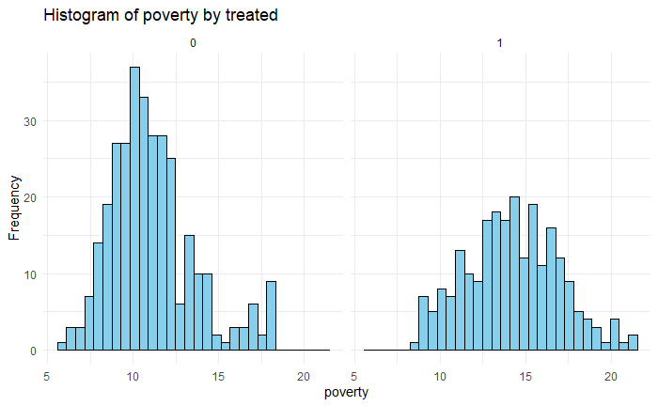
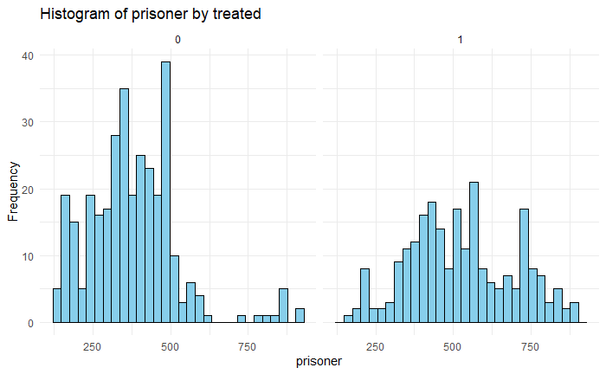
HETEROGENEITY IN COVARIATES
Clear heterogeneity in some covariates, as treated states generally exhibit a wider spread
This variation suggests that states adopting Castle Doctrine Laws have different baseline characteristics

Slide 9
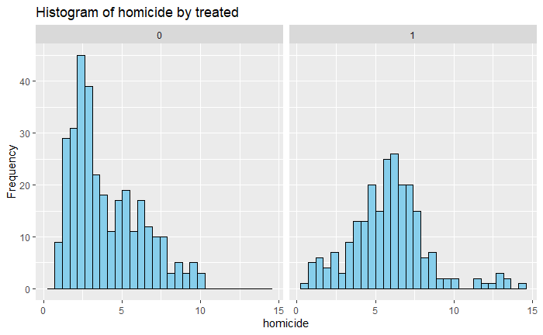
DISTRIBUTIONS OF HOMICIDE RATES
TREATED VS. CONTROL
Control states (didn’t pass CDL) have a higher concentration of lower homicide rates
Treated states exhibit a wider spread in homicide rates, with a noticeable shift toward higher values

Slide 10
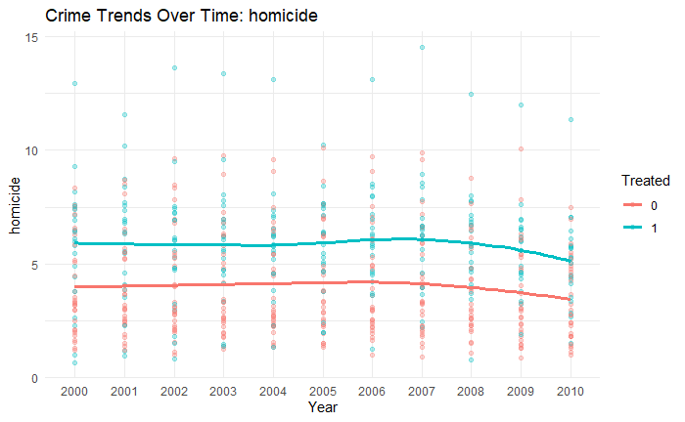
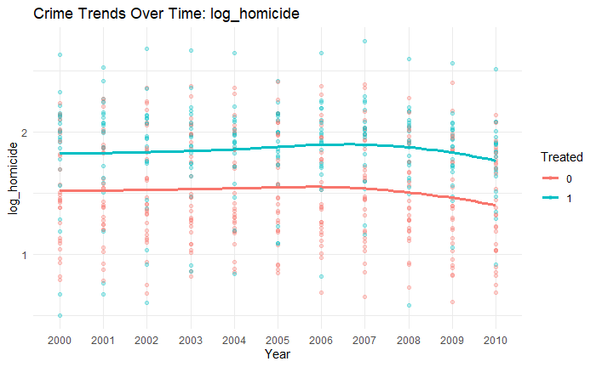
HOMICIDE RATES BEFORE AND AFTER
LOG TRANSFORMATION
Treated group homicide rates show minor upward trend after 2005
Histogram on previous slide shows a clear right-skewed distribution of homicide rates in control states. There are several extreme values in both control and treated states.
Log transformation reduces skewness and the impact of outliers

Slide 11
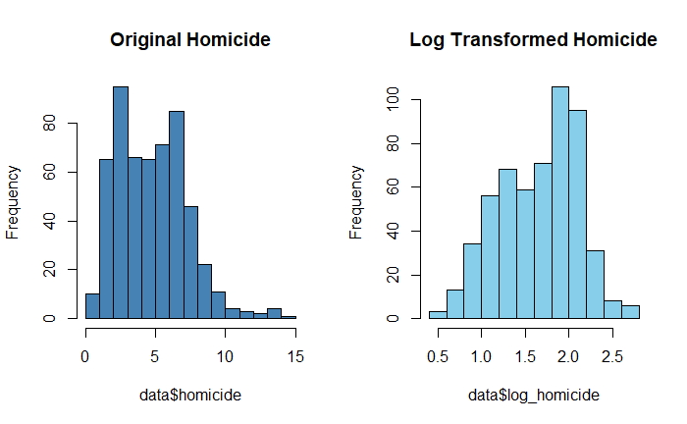
EFFECT OF LOG TRANSFORMATION ON HOMICIDE RATES
The original homicide rate distribution is right-skewed with extreme values
Log transformation normalizes the distribution, making it more symmetric and suitable for analysis.

Slide 12
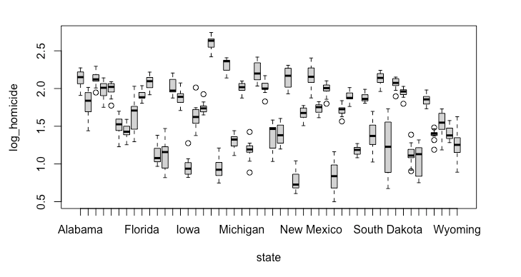
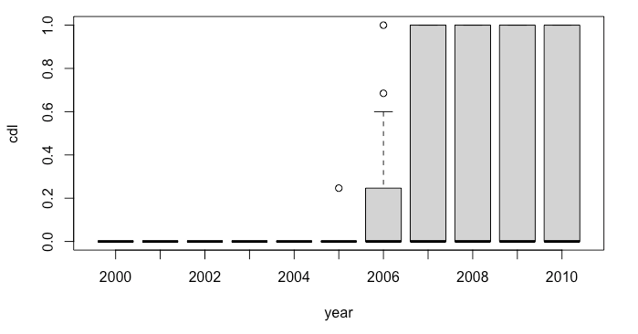
TRADITIONAL DID/TWO-WAY FE EXPLORATION
Balanced panel data: 50 states, 11 years, 550 data.
State homicide comparisons
Year-level policy comparisons
Heterogeneity of states was found, demonstrating the necessity of fixed effects models.
Policies implemented in each state in different years were found, demonstrating the possibility of using two-way fixed effects for DiD.

Slide 13
TRADITIONAL DID/TWO-WAY FE EXPLORATION
Trying out different fixed effects scenarios:
No FE (Pooled): lm(log_homicide ~ cdl, data = merged_data)
Only State FE: plm(log_homicide ~ cdl, data=data.panel,model="within")
State and Year FE: plm( log_homicide ~ cdl, data = data.panel, model = "within", effect = "twoways")
F-tests are taken for different combinations of situations:
Models | p-value | Interpretations
Pooled vs State | < 2.2e-16 | Significant difference, state FE necessary
State-year vs State | 1.892e-07 | Significant difference, Year FE necessary
We demonstrate the necessity of state and year fixed effects and therefore adopt a two-way fixed effects model.

Slide 14
TRADITIONAL DID/TWO-WAY FE EXPLORATION
In their study, Cheng & Hoekstra (2013) identified Socioeconomic and demographic factors as potential confounding variables that affect both policy implementation and crime.
Ran two-way FE models with different control variables.
Baseline Model: Castle Law + state & year fixed effects.
Economic Model: Adds unemployment, income, and poverty.
Demographics Model: Adds racial composition.
Criminal Model: Includes incarceration rates.
Welfare Model: Includes government spending on welfare.
Police Model: Controls for law enforcement levels.
Full Model: Includes all controls.

Slide 15
TRADITIONAL DID/TWO-WAY FE EXPLORATION
Models | cdl_Coefficient | p-value
Baseline | 33.11300 | 1.066356e-04
Economic | 33.63502 | 7.686324e-05
Demographics | 32.78777 | 1.943924e-04
Criminal | 32.05390 | 2.210152e-04
Welfare | 34.09709 | 7.791680e-05
Police | 34.55231 | 5.722536e-05
Full | 34.26402 | 1.364808e-04
Findings:
Castle Law implementation is consistently significant across all models.
Coefficient estimates are stable, indicating robustness.
ATE is that passing the law would increase the number of homicides by an average of 32-33.

Slide 16
TRADITIONAL DID/TWO-WAY FE EXPLORATION
Next, we perform OVB sensitivity analysis for different models to see the effect of different confounding variables on the robustness of the models.
Models | Robustness Value
Baseline | 0.162
Economic | 0.165
Demographics | 0.157
Criminal | 0.155
Welfare | 0.165
Police | 0.168
Full | 0.161
Findings:
Compared to the benchmark, the full model robustness decreased, indicating that not all factors are to be controlled.
Robust values suggest that demographic and criminal controls reduce robustness.
Therefore, we need to remove demographic and criminal variables to increase robustness.

Slide 17
TRADITIONAL DID/TWO-WAY FE EXPLORATION
Based on the previous explorations and inferences, our formal model is as follows
lm(formula = homicide_c ~ cdl + unemployrt + income + poverty + exp_subsidy + exp_pubwelfare + police + factor(state) + factor(year), data = merged_data)
The results shows:
ATE: 35.68, with p-value: 3.56e-05
Robustness value: 0.1727
Our traditional two-way fixed-effects model shows that the implementation of castle laws is significantly associated with approximately 36 additional homicides per state per year.
For our findings to be invalid, at least 17.27% of the change in treatment and outcomes would need to be due to unobserved confounders.

Slide 18
DID/TWO-WAY FE WITH IV EXPLORATION
WHAT WE DID:
Implemented an IV (Instrumental Variables) approach combined with Difference-in-Differences (DiD) by Fixed Effects (FE).
Used “Guns & Ammo” subscriptions and hunting license registrations as instruments for Castle Law implementation to address endogeneity concerns.
Controlled for economic, demographic, and law enforcement factors while accounting for state and year fixed effects.
MODEL:
ivreg( homicide_c ~ cdl + unemployrt + income + poverty + exp_subsidy + exp_pubwelfare + police + factor(state) + factor(year)
| unemployrt + income + poverty + exp_subsidy + exp_pubwelfare + police + factor(state) + factor(year) + GunsAmmo + HuntLic , data = merged_data)

Slide 19
DID/TWO-WAY FE WITH IV EXPLORATION
RESULTS:
CASTLE LAW HAS A SIGNIFICANT POSITIVE EFFECT ON HOMICIDES (COEFFICIENT = 166, P = 0.0093), REINFORCING PREVIOUS FINDINGS.
The implementation of Castle Laws is associated with an increase of approximately 166 homicides per state per year on average. This number is even bigger than the previous.
DIAGNOSTIC TESTS:
WEAK INSTRUMENT TEST (F-STAT = 6.628, P = 0.00145) → INSTRUMENTS ARE RELEVANT.
WU-HAUSMAN TEST (P = 0.01133) → IV ESTIMATION IS PREFERABLE OVER OLS DUE TO ENDOGENEITY CONCERNS.
SARGAN TEST (P = 0.43299) → INSTRUMENTS SATISFY EXOGENEITY.

Slide 20
DID/TWO-WAY FE WITH IV EXPLORATION
IV VALIDITY EVALUATION
Relevance Restriction ✅
Hunting licenses and ammunition purchases are strong proxies for gun availability.
States with higher gun availability are more likely to support pro-gun legislation, including Castle Laws.
Weak instrument test confirms relevance, validating our IV selection.
Exclusion Restriction ✅
Gun culture (hunting, shooting activities) does not directly impact homicide rates (Lemieux, 2014).
Gun laws, not gun culture, drive gun violence.
Legal hunting and ammunition ownership influence homicides only through legislation, satisfying exclusion criteria.
Independence Restriction ✅
Sargan test confirms that our IVs are not correlated with omitted variables, ensuring valid identification.

Slide 21
DID/TWO-WAY FE WITH IV EXPLORATION
CONCLUSION
DiD & FE without IV → ATE ≈ 36 (Castle Law increases homicide counts per year by 35 on average).
DiD & FE with IV → ATE ≈ 166 (Castle Law impact is stronger when addressing endogeneity).
Policy Implication: Castle Laws substantially increase homicides, challenging their effectiveness in crime deterrence.

Slide 22
SYNTHETIC DIFFERENCE-IN-DIFFERENCES (SYNTHETIC DID)
Why Synthetic DiD?
Traditional DiD assumes parallel trends, which may not hold in this case. Each state varies and we cannot see. For example, we cannot see Florida without CDL after 2005.
Synthetic DiD constructs a synthetic control group using a weighted combination of untreated states
Implementation Steps:
Selected only states that passed CDL in 2006 for comparability (synthdid package in R cannot use data where treatment is not simultaneous)
Constructed a synthetic control group by weighting untreated states
Estimated Average Treatment Effect on the Treated (ATT)

Slide 23
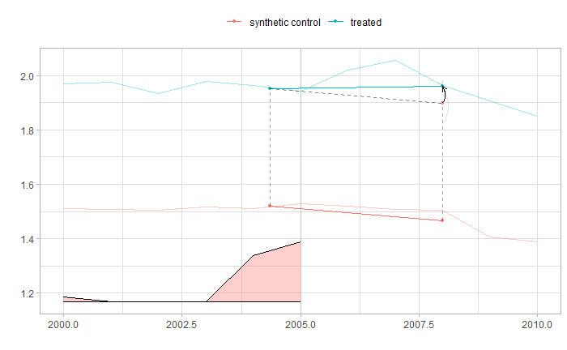
SYNTHETIC DID
STATES ADOPTED CDL 2006
Setup:
Use all states adopted CDL in 2006 as the treated group
Log-transformed homicide rate as the outcome variable
Result:
The estimated Average Treatment Effect on the Treated (ATT) is 0.0613, indicating that the adoption of CDL is associated with a 6.3% increase in homicide rates when converted back to the original scale.
However, 95% confidence interval (-0.02, 0.15) spans 0. The ATT is not statistically significant.

Slide 24
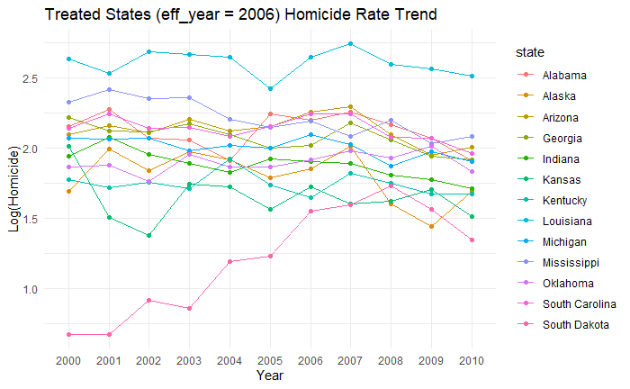
HETEROGENEITY IN HOMICIDE RATE TRENDS AMONG CDL STATES (2006)
Insights:
States that adopted CDL in 2006 exhibit divergent trends in log homicide rates over time.
Heterogeneity suggests that a single Synthetic DiD estimate may not fully capture the treatment effects across all states.
Next Step:
Apply Synthetic DiD to selected states individually in attempt to isolate treatment effects.

Slide 25
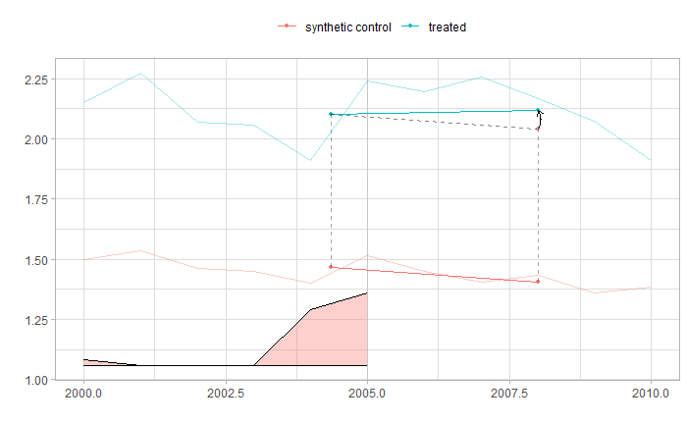

STATE-LEVEL SYNTHETIC DID: ALABAMA & LOUISIANA
Alabama
Louisana
Alabama:
Point Estimate: 0.08 → 8.4% increase in homicide rates post-CDL
95% Confidence Interval (-0.15, 0.31) → Not statistically significant
Louisana:
Point Estimate: 0.13 → 13.6% increase in homicide rates post-CDL
95% Confidence Interval (-0.15, 0.40) → Not statistically significant

Slide 26
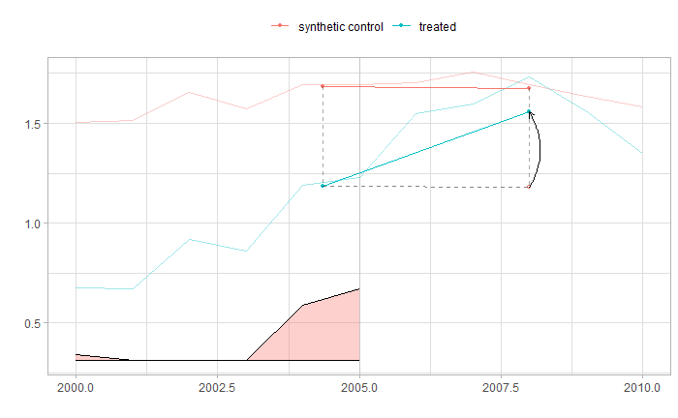
STATE-LEVEL SYNTHETIC DID:
SOUTH DAKOTA
Figures:
Point Estimate: 0.38 → Translates to a 46.2% increase in homicide rates post-CDL.
95% Confidence Interval (0.14, 0.62) → statistically significant at the 5% level.
Insights:
Unlike Alabama and Louisiana, South Dakota shows a clear and significant rise in homicides compared to its synthetic control after the CDL implementation.
State-specific factors may influence CDL's effect on homicides.
Further analysis is needed to identify why some states see a stronger impact than others.
South Dakota

Slide 27
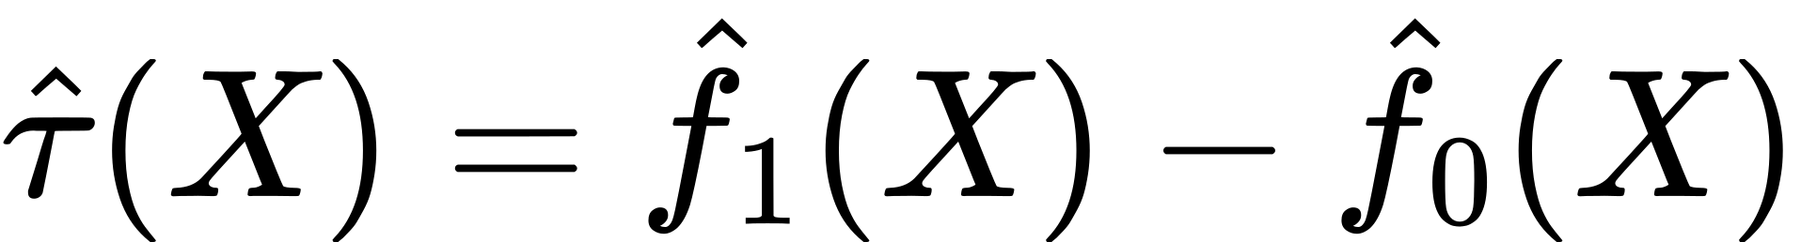
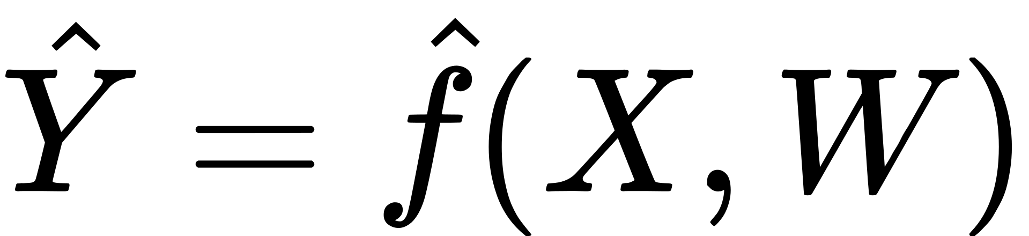
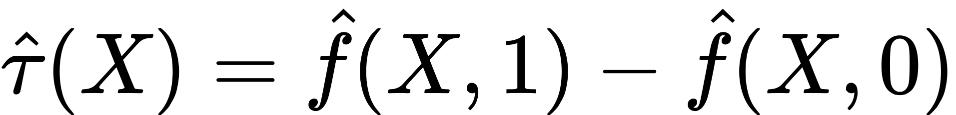
META LEARNERS: S-LEARNER & T-LEARNER
Why Meta Learners?
Machine learning-based causal estimation methods
CDL’s impact on homicide rates varies across states, suggesting heterogeneous treatment effects (HTE)
Synthetic DiD provides insight into state-level impacts, but it does not fully capture individual-level heterogeneity.
Implementation:
T-Learner: Separate Random Forest models for treated & control groups
S-Learner: Single Random Forest model with CDL status as a feature

Slide 28
S-LEARNER & T-LEARNER:
ATE ESTIMATES & BOOTSTRAP VALIDATION
Meta Learner | ATE | Bootstrap Confidence Intervals
T-Learner | 0.1425 (15.3% increase in homicide rates post-CDL) | ATE: 0.1444 (95% CI: 0.0999 – 0.1911) Statistically significant
S-Learner | 0.0074 (0.74% increase, much lower than the T-Learner estimate.) | ATE: 0.0074 (95% CI: 0.0020 – 0.0157) Statistically significant but much smaller effect size
The S-Learner’s smaller effect size could indicate model limitations, such as lack of flexibility in capturing heterogeneity.
Bootstrap validation confirms the statistical significance of both estimates, but their magnitudes differ considerably.

Slide 29
HETEROGENEOUS TREATMENT EFFECTS (HTE) BY INCOME GROUPS
Setup:
Divide the data into high-income and low-income groups based on the median income
Meta Learner | High Income | Low Income | Welch’s t-test
T-Learner | 0.222 | 0.063 | p-value < 0.001 Statistically significant difference
S-Learner | 0.006 | 0.008 | p-value = 0.1907 No statistically significant difference
Interpretation:
Higher-income states experience stronger treatment effects from CDL compared to lower-income states.
S-Learner may smooth out subgroup differences, underestimating the variation.

Slide 30
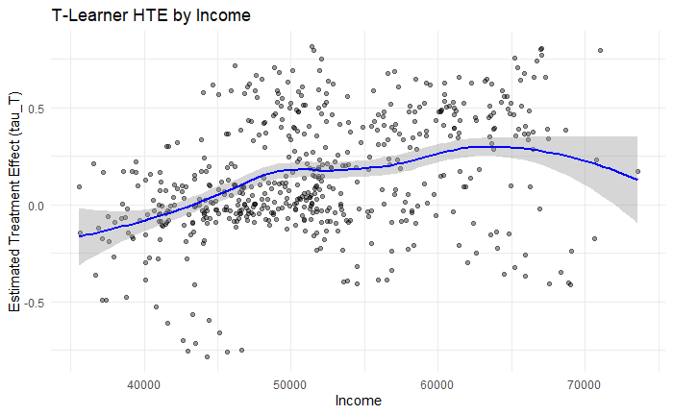
HETEROGENEOUS TREATMENT EFFECTS (HTE) BY INCOME GROUPS
The positive slope in the scatter plot further supports the increasing treatment effect with income.

Slide 31
HETEROGENEOUS TREATMENT EFFECTS (HTE) BY BLACK MALE POPULATION
Setup:
We divide the data into two groups based on the median percentage of Black males in two age brackets: 15-24 and 25-44.
BLACK MALES AGED 15-24:
Meta Learner | High % | Low % | Welch’s t-test
T-Learner | 0.172 | 0.011 | p = 0.019 Statistically significant difference
S-Learner | 0.112 | 0.003 | p < 0.001 Statistically significant difference
Interpretation:
Castle Doctrine laws appear to have a stronger effect on homicides in areas with a higher proportion of young Black males.

Slide 32
HETEROGENEOUS TREATMENT EFFECTS (HTE) BY BLACK MALE POPULATION
BLACK MALES AGED 25-44:
Meta Learner | High % | Low % | Welch’s t-test
T-Learner | 0.153 | 0.132 | p = 0.40 No statistically significant difference
S-Learner | 0.0108 | 0.0041 | p < 0.001 Statistically significant difference
Interpretation:
T-Learner does not detect a significant effect, while S-Learner finds a statistically significant but smaller effect.
The impact of Castle Doctrine laws is more pronounced for younger Black males, with less conclusive evidence for older Black male populations.

Slide 33
CAUSAL RANDOM FOREST (CRF)
Why Causal Random Forest?
Meta-learners (T-Learner & S-Learner) assume smooth functional relationships, which may not always hold.
CRF provides a non-parametric method to estimate heterogeneous treatment effects (HTE) while accounting for complex interactions.
Implementation:
Train a Causal Forest model using available covariates and treatment assignment.
Estimate Individual Treatment Effects (ITE) for each observation.
Compute the Average Treatment Effect (ATE) and visualize HTE patterns.

Slide 34
CAUSAL RANDOM FOREST (CRF) RESULT
Average Treatment Effect (ATE):
Estimate: 0.0451
95% Confidence Interval: (0.013, 0.078)
CDL implementation is associated with a 4.61% increase in homicide rates, and the effect is statistically significant.
Top 3 Variables Driving Treatment Effects (Feature Importance):
poverty, income, exp_subsidy
Best Linear Projection (BLP) Analysis:
Significant Variables:
exp_subsidy (Government Subsidies, p = 0.01): Negatively correlated with treatment effects, suggesting higher subsidies may mitigate the impact of CDL on homicide rates.
population (p = 0.047): State with larger populations tend to experience slightly smaller treatment effects.
police (Police Presence, p = 0.056): Shows marginal significance, indicating increased police presence may reduce the impact of CDL on homicide rates.

Slide 35
CONCLUSION

Slide 36
CONSISTENT EVIDENCE ACROSS METHODS
Our findings align with the study conducted by Cheng and Hoekstra (2013), which also found that Stand Your Ground laws lead to an increase in homicide rates.
While different methods in our analysis yield varying magnitudes of the treatment effect, most of them consistently indicate a positive and significant impact of CDL on homicide rates. This reinforces the argument that self-defense laws may escalate violence rather than deter crime.
Additionally, our heterogeneous treatment effect (HTE) analysis reveals disparities in the impact of CDL across demographic groups, suggesting that the law may disproportionately affect certain populations, a nuance that was not the central focus of prior studies.

Slide 37
LIMITATIONS
While we control for many covariates, unmeasured factors (e.g., social unrest, law enforcement changes) could still bias the estimates.
CDL's impact varies significantly by state, suggesting that a one-size-fits-all policy evaluation may not be appropriate.
Different methods yield varying effect sizes, indicating potential model dependency in causal inference.
IV and DiD approaches attempt to mitigate endogeneity, but assumptions about exogeneity and parallel trends may not fully hold.
We rely on available crime data, which may have reporting inconsistencies or missing values affecting the accuracy of our estimates.

Slide 38
POLICY IMPLICATIONS &
FUTURE RESEARCH DIRECTIONS
Policy Implications
Given the consistent evidence that CDL increases homicide rates, policymakers should reconsider the scope and application of these laws
Higher government subsidies and welfare spending are associated with lower treatment effects, suggesting that economic support programs may offset some of CDL’s negative impacts.
Future Research Directions
Future studies should investigate whether the observed increase in homicide rates persists over time or stabilizes
Further explore racial disparities and regional variations in the application of these laws

Slide 39
REFERENCE
Cheng Cheng & Mark Hoekstra (2012), https://www.nber.org/papers/w18134
Duke Center for Firearms Law (2022), https://firearmslaw.duke.edu/2022/01/the-dangerous-expansion-of-stand-your-ground-laws-and-its-racial-implications
Lemieux (2014), https://ijcjs.com/menu-script/index.php/ijcjs/article/view/149
McClellan & Tekin (2017), https://jhr.uwpress.org/content/52/3/621.short
Rand (2024), https://www.rand.org/research/gun-policy/methodology.html#quality-assessment-
The Guardian (2023), https://www.theguardian.com/us-news/2023/apr/18/stand-your-ground-laws-us-deaths-racist-violence

