Slide 1
NLP
Natural Language Processing

Slide 2
Libraries
NLTK
Spacy
Gensim

Slide 3
Text Preprocessing
Regular Expressions
Text Cleaning
Stop Words
Stemming

Slide 4
Text Representation
N-grams
Count Vectorizer
TF-IDF
Hashing Vectorizer
Embeddings

Slide 5
N-Grams
A feature extraction scheme for text data: any sequence of N words turns into a feature value.

Slide 6
Count Vectorizer
In CountVectorizer we only count the number of times a word appears in the document which results in biasing in favour of most frequent words.
This ends up in ignoring rare words which could have helped is in processing our data more efficiently

Slide 7
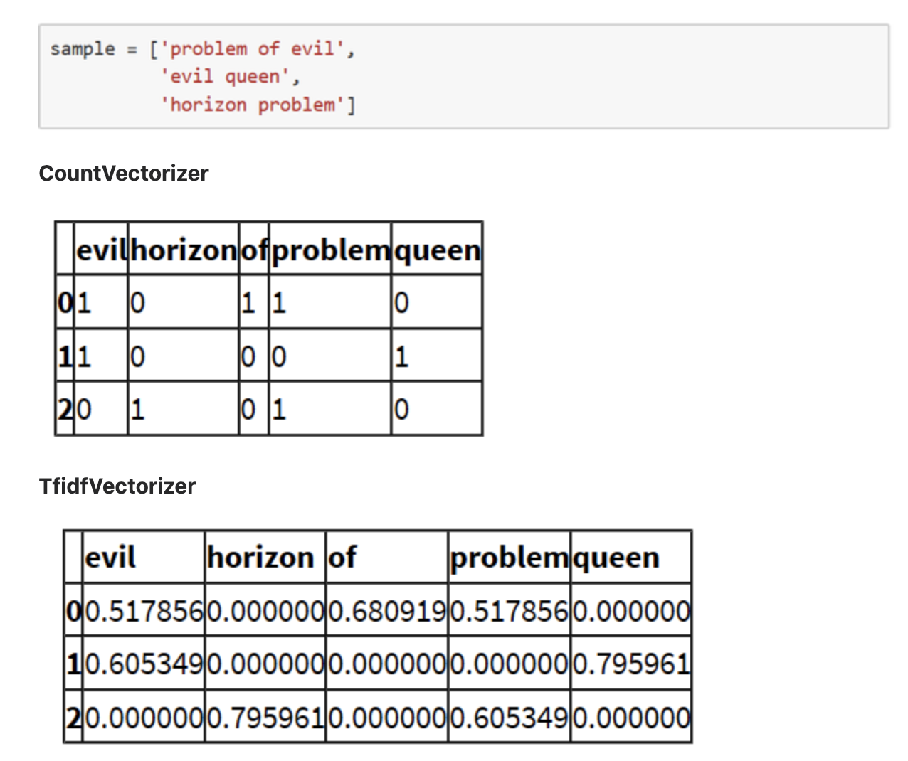
TF-IDF
In TfidfVectorizer we consider overall document weightage of a word.
It helps us in dealing with most frequent words and using it we can penalize them.
TF(t) = (Number of times term t appears in a document) / (Total number of terms in the document)
IDF(t)=log(Total number of documents / Number of documents with term t in it)
TF-IDF weight = Tf(t)*IDF(t)
This means that words like “a” and “the” will have very low scores as they’ll appear in all documents in your set.

