Slide 1
Microsoft FarmBeats
Niks Šķērsts, DvDz 3.

Slide 2
Problem:
By 2050 UN predicts population to reach 9.7 billion.[1]
[ Population growth would come with ~70% higher food demand ] [2]
[1] Growing at a slower pace, world population is expected to reach 9.7 billion in 2050 and could peak at nearly 11 billion around 2100 | UN DESA | United Nations Department of Economic and Social Affairs
[2] FarmBeats_UIUC (illinois.edu)

Slide 3
Solution?
More arable land:
Cut down more forests?
Efficient consumption:
Less waste of food.
Changes in diet. [ Example: NHS recommends 70g of cooked meat per day ]
Efficient manufacturing.
Population control.
[1] Meat in your diet - NHS (www.nhs.uk) - National health service UK.

Slide 4
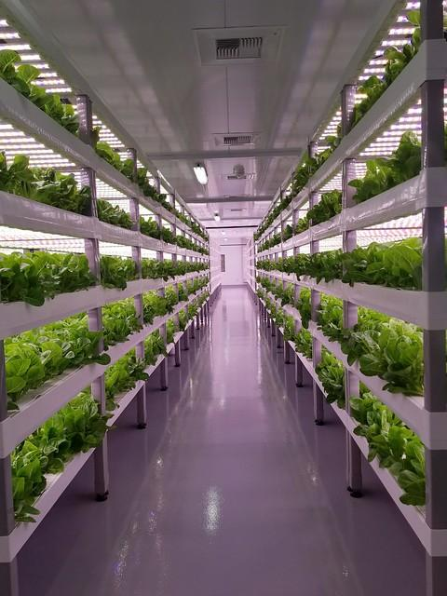
Efficient manufacturing
[1] Vertical Farming for the Future | USDA
[2] Strip Farming - Conference “Knowledge based bioeconomy” 16.12.2021. LLU.
[2] WeedBot - High precision laser weeding technology
[3] FarmBeats: AI, Edge & IoT for Agriculture - Microsoft Research
[4] etc

Slide 5
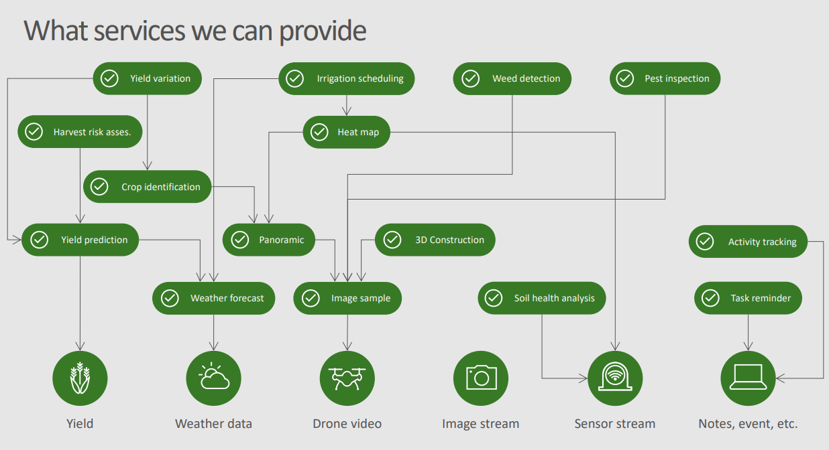
Funkcionalitāte
Source: FarmBeats_UIUC (illinois.edu) (32.lpp)

Slide 6
Idea
Use drones or balloons to collect image data.
Use sensors to collect soil, moisture data.
Missing data gets predicted by using machine learning.
Sensors and drones transmit data to server over internet.
Data gets summarized and sent to the client.
Source: FarmBeats-webpage-1.pdf (microsoft.com)

Slide 7
Rural internet
Countries that have more land, tend to have worse rural internet connection.
4G, 5G work in higher frequencies, thus have smaller coverage.
Building cellular towers in regions that are mainly used for agriculture isn’t viable.
Solution (sort of) - WhiteFi.
Provide internet over unused TV channel frequencies.
1 Ghz [WhiteFi] freq compared to 2 to 8 Ghz [4G] freq.
Downside: TV users take precedence. To avoid collision, WhiteFi users have to switch to a new frequency.
[1] White-Fi IEEE 802.11af | Electronics Notes (electronics-notes.com)
[2] nd.edu/4G

Slide 8
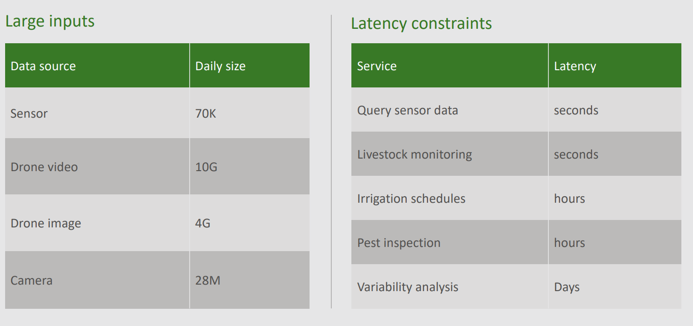
Source: FarmBeats_UIUC (illinois.edu)

Slide 9
Azure Gateway
Local computer that:
Processes most of the data before sending it off to the Azure cloud. [ e.g creates the panoramic picture ].
Data provided by drones is from 4G -> 10G in size. Transferring such amount of data each day is wasteful.
Upkeeps the service in case of internet outage.
Even with WhiteFi, it’s impossible to stay connected 24/7!
Creates and executes drone flight plans.
Hosts web server.
Stores drone and sensor data.
Sends off data to Azure Cloud.
[1] FarmBeats-webpage-1.pdf (microsoft.com)

Slide 10
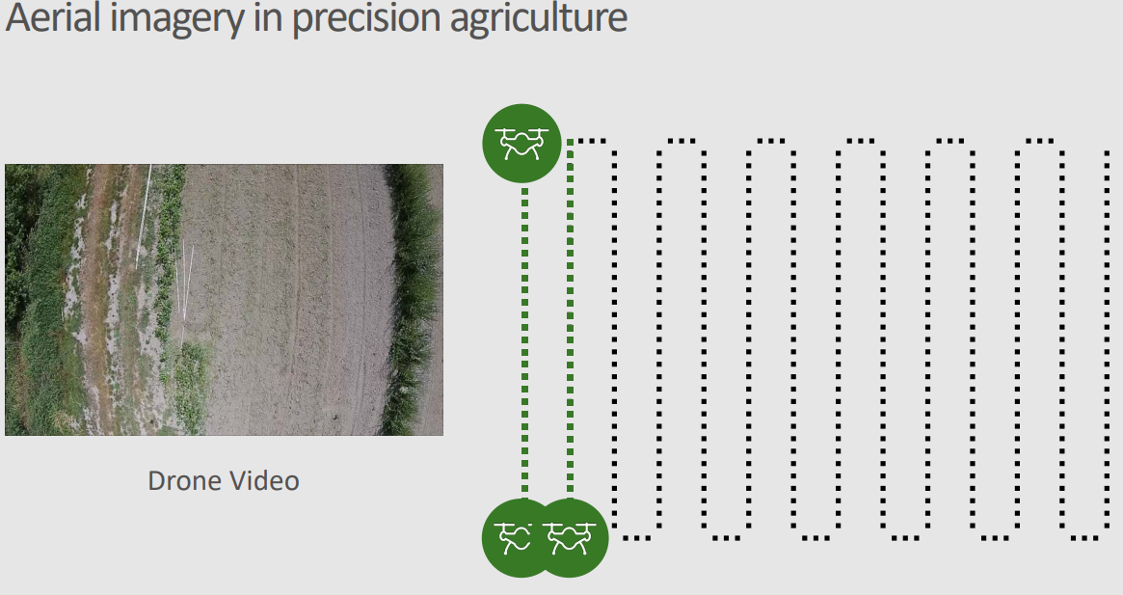
Using Drones
It is the task of Gateway to create the route the drones have to take.
Route is based on weather data. Main goal is to reduce energy consumption by using wind as means to change speed.
Batteries take time to charge. Time is money.
Drones won’t fly out in bad weather conditions.
etc.
Drones are equipped with multispectral camera that covers 790 nm to 550 nm spectre, as well as a standard RGB camera capable of capturing 1080p at 30 FPS.
[1] Parrot Sequoia+ multispectral drone camera - senseFly
[2] Parrot Sequoia+ multispectral camera for drone mapping | Pix4D
[3] FarmBeats-webpage-1.pdf (microsoft.com)
[4]FarmBeats_UIUC (illinois.edu) [Picture]

Slide 11
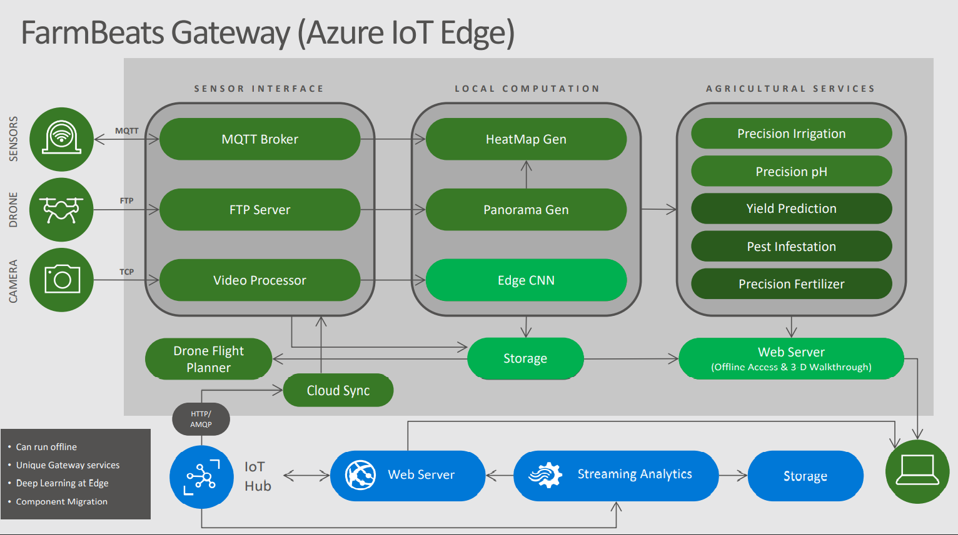
Source: FarmBeats_UIUC (illinois.edu) (26.lpp)

Slide 12
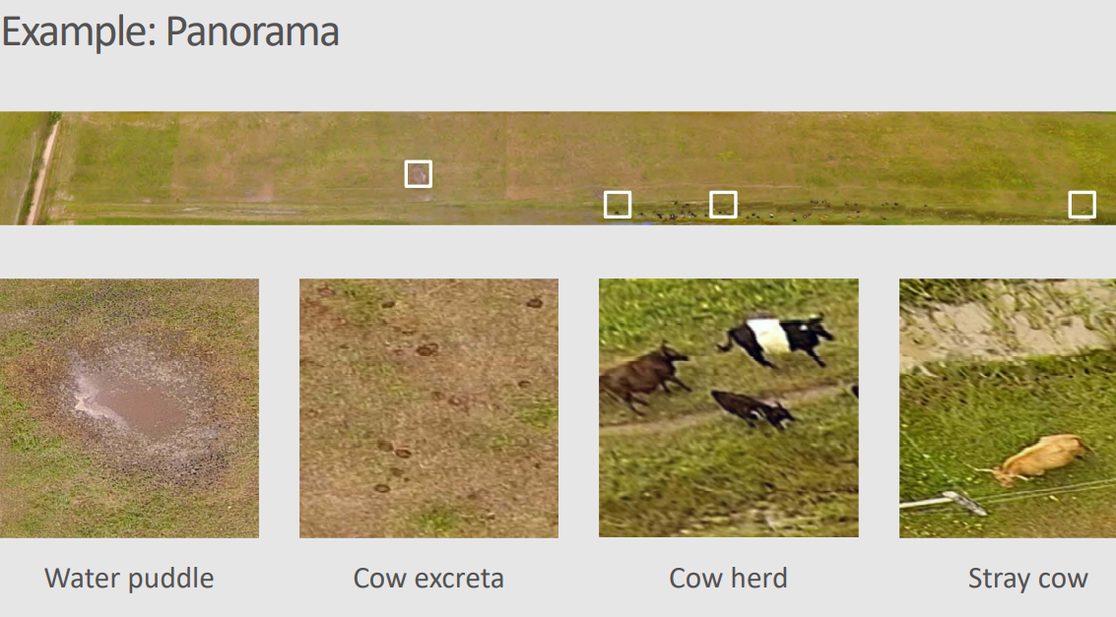
Sensori - Datu piemēri
Source: FarmBeats_UIUC (illinois.edu)

Slide 13
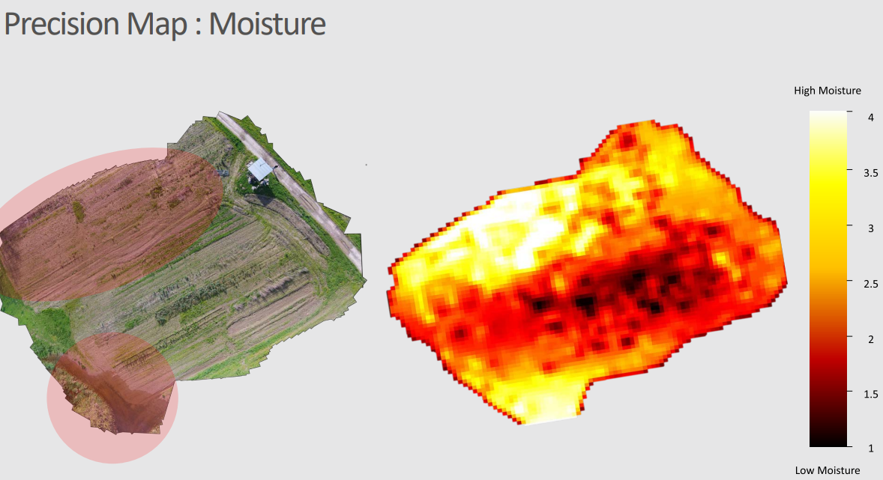
Sensori - Datu piemēri
Source: FarmBeats_UIUC (illinois.edu)

Slide 14
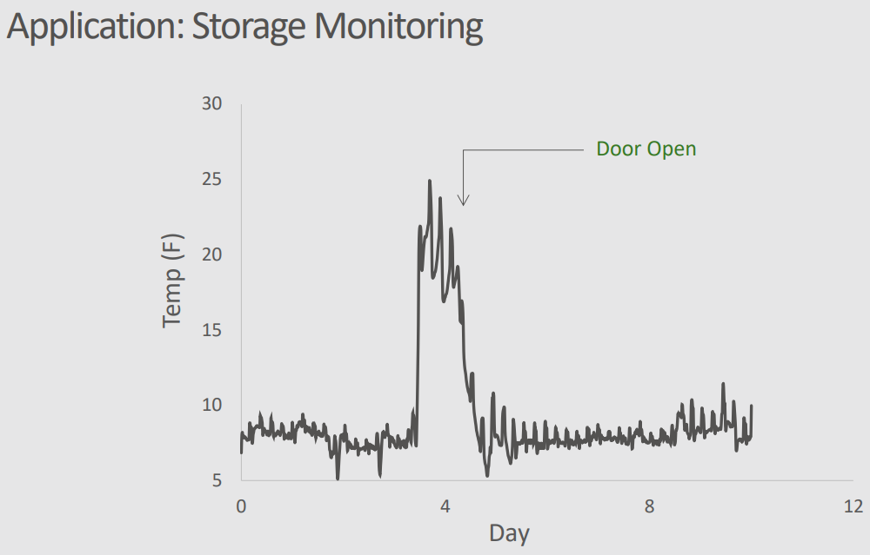
Sensori - Datu piemēri
Avots: FarmBeats_UIUC (illinois.edu)

Slide 15
But, why?
Precision in agriculture plays an extremely important role. Consequences might range from small losses of yield from poor irrigation to losing a whole field to disease.
Failure to check on newest weather alerts could withhold harvest from days to weeks.
This is where implementations like FarmBeats come in. They provide the farmer with up to date alerts and data, and provide a framework for further integration.
Imagine having a blight in a middle of the field of potatoes. Farmer could have a hard time noticing it where a drone could spot it in a couple of minutes.

Slide 16
Comments? Questions?

