Slide 1
Retail Analysis OF E-Commerce APP data
Tarun Kumar Sharma
Nikhil Sharma
Monu Kumar

Slide 2



MEET THE TEAM
TARUN KUMAR SHARMA​
MONU KUMAR​
NIKHIL SHARMA​
PD15_006
PD15_023
PD15_162

Slide 3
ABOUT pROJECT
Detailed Report on the E-Commerce Company that is continuously working on optimizing the app by capturing the insights.

Slide 4
Tables
First
Third
table is for all logins
In this table have data of items in each order and how much items got shipped and rejected
Second
Table have the details of orders placed by Customers

Slide 5
OBJECTIVES
DAILY LOGINS
The Number of Logins on Daily Basis.
Daily trends of logins and trends of conversion rate
The Number of orders placed per login
kpi
KPI used to check the performance of the app
insights
For productivity of Data.
2021
The biggest Drop in Sales
Conclusion
Conclusion of whole data

Slide 6
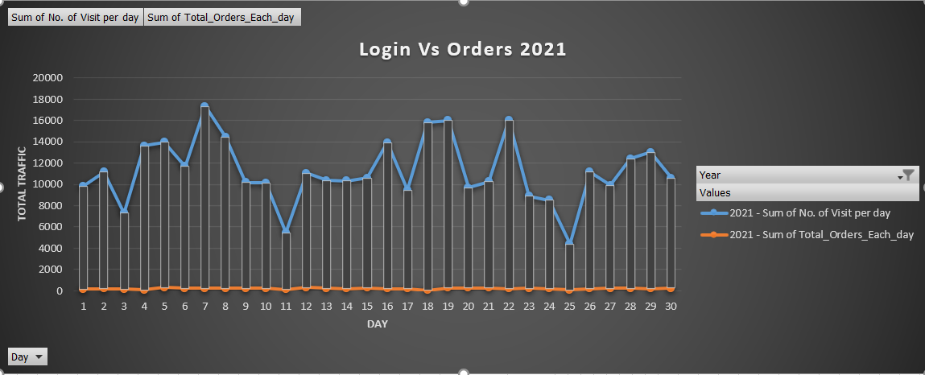
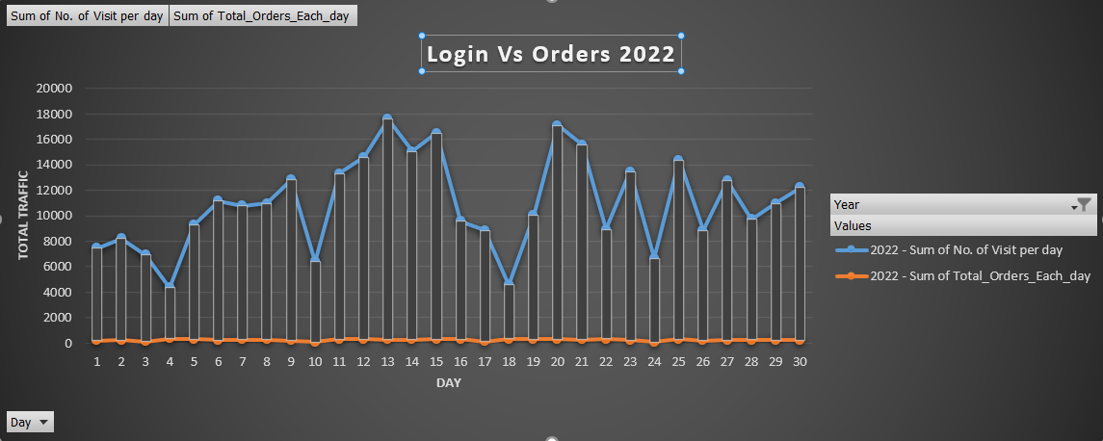
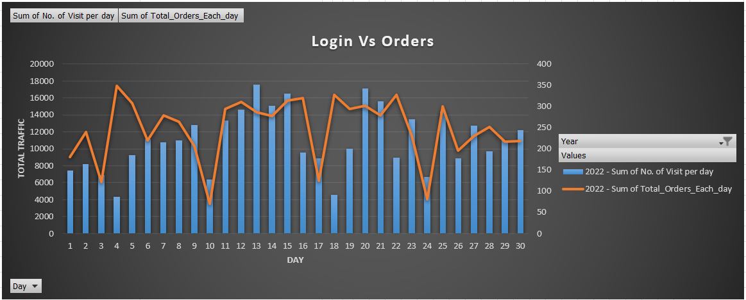
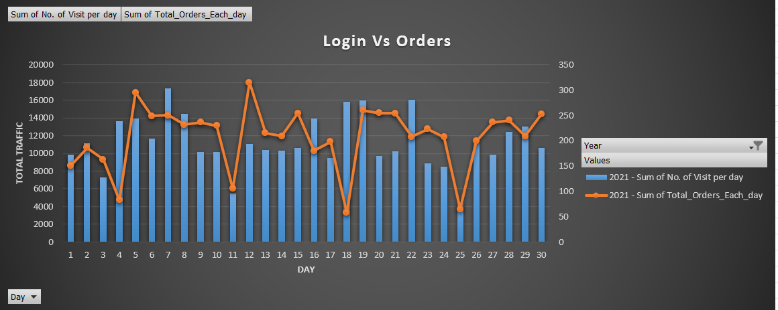
Daily trends of logins and trends of conversion rate
MORE LOGINS TO MORE ORDERS
TRAFFIC ON THE ECOMMERCE APP
BASED ON THE USAGE

Slide 7
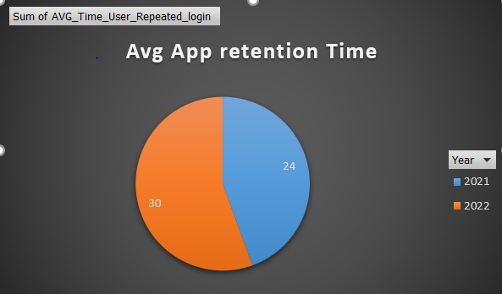
kpi
DAILY LOGIN USERS
MONTHLY LOGIN USERS
AVERAGE SCREENS PER VISIT

Slide 8
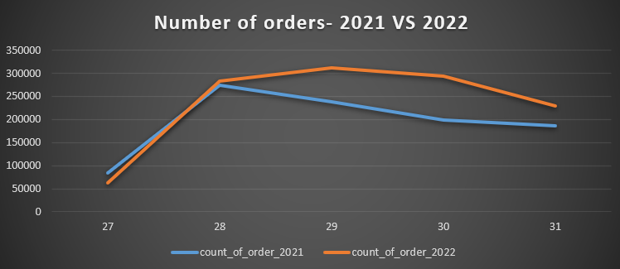
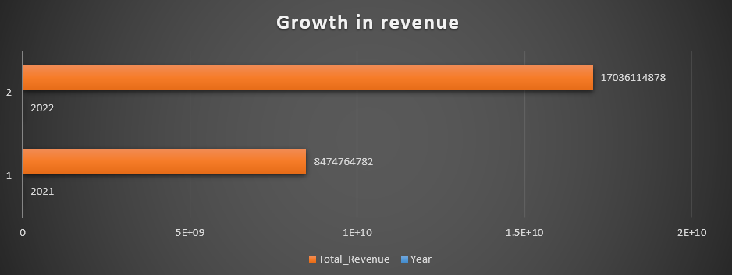
insights
GROWTH IN REVENUE (FOR BUSINESS PURPOSE)
GROWTH COUNTS OF ORDERS(FOR USAGE OF APP)

Slide 9
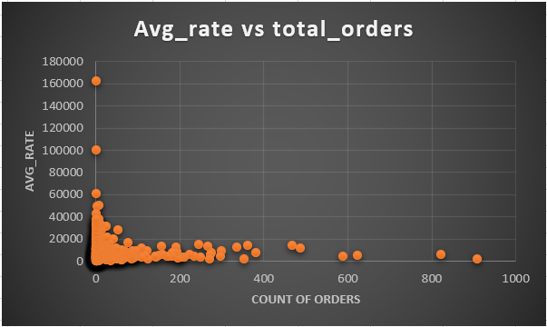
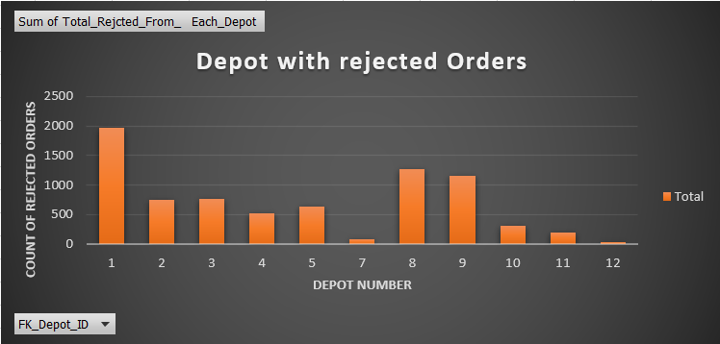
insights
Sales threshold value 40,000(FOR BUSINESS PURPOSE)
Rejected orders leads to loss of sales (around 7.1 cr.)

Slide 10
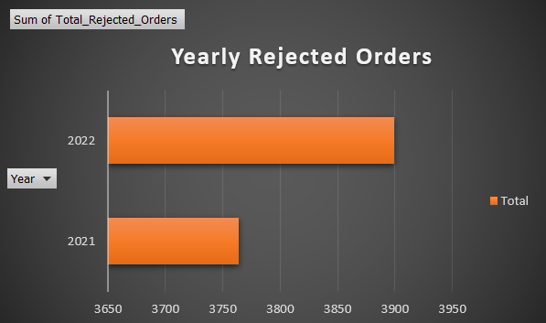
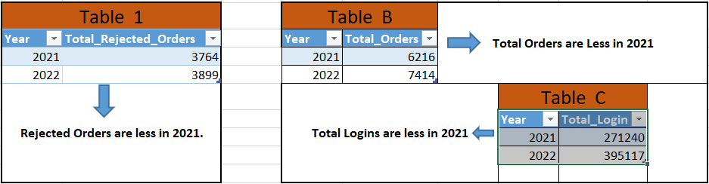
2021 BUSINESS MODEL
less customers login on app
LESS conversion of orders are also less in 2021.

Slide 11
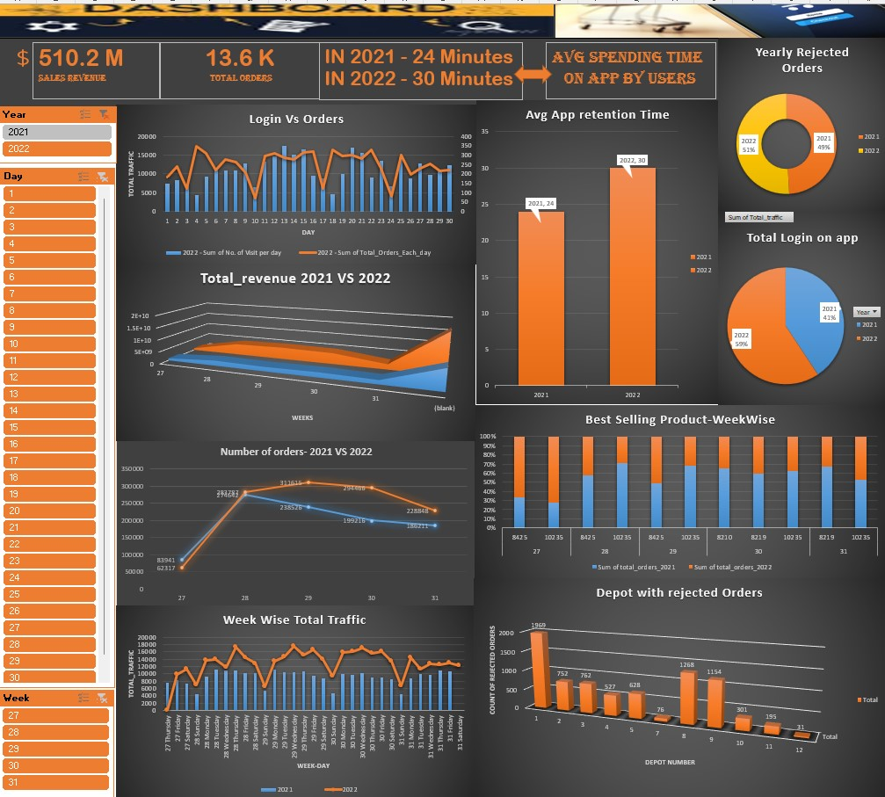
DASHBOARD

Slide 12
CONCLUSION
Affordable ITEMS SHOULD BE THERE FOR THE USERS
Convenient APP FOR THE USERS so our avg retention will increase
Growth strategy FOR THE BUSINESS MODEL SHOULD BE CHECKED ON a DAILY BASIS.
the Main target of focus should be on rejected orders by the depot.

Slide 13
DIFFICULTIES FACED DURING PROJECT
Limited DATA.
TIME MANAGEMENT DUE TO OFFICE HOURS.

Slide 14
Learnings
TEAM WORK TO DREAM WORK
REVISION TO EXCEL
HOW APP TRAFFIC EFFECT ON BUSINESS
FIRST EXPERIENCE TO MAKE DATA ANALYTICS PROJECT

Slide 15
THANK YOU

