Slide 1

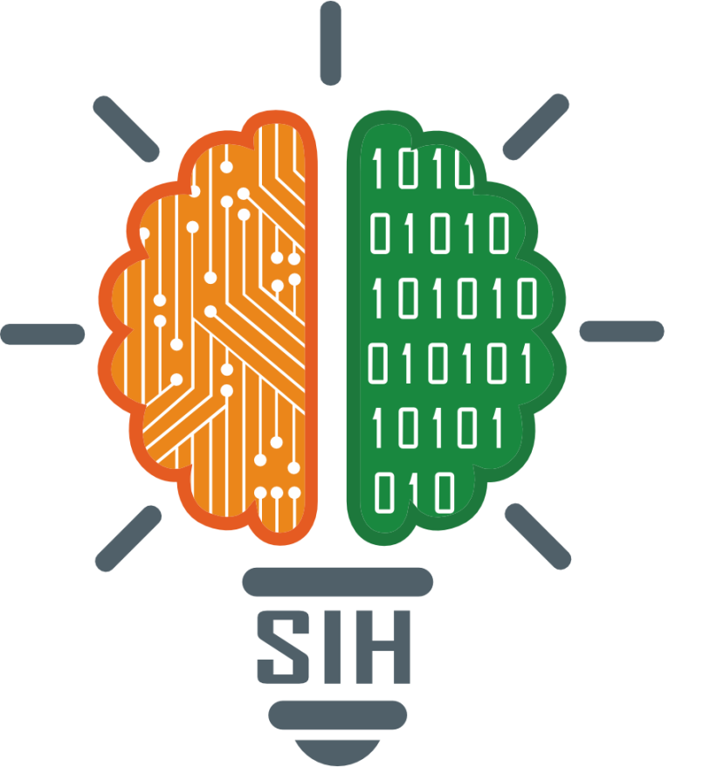
SMART INDIA HACKATHON 2024
Problem Statement ID – 1683
Problem Statement Title – Development of AI/ML based solution for detection of face swap based deep fake videos
Theme- Miscellaneous
PS Category – Software
Team ID –
Team Name – TechTonic

Slide 2
IDEA
TechTonic
IDEA / SOLUTION :
Our solution is a web app using AI/ML algorithms to detect face-swaps in videos. Users upload a video, which is processed by a deep learning model to identify deep fakes.
1. Facial Inconsistencies Detection: Utilize CNNs to identify facial inconsistencies and unnatural transitions in videos.
2. Temporal Analysis: Employ RNNs/LSTMs to analyze flagged sequences for anomalies over time.
3. Pose and Texture Verification: Apply Capsule Networks to detect discrepancies in facial pose and texture.
4. Enhanced Detection: Apply adversarial training with GANs to improve the model’s ability to detect deep fakes.
5. Comprehensive Analysis: Integrate audio-visual analysis and hybrid models for robust detection that cross-verifies audio and visual data.
Unique Value Propositions (UVP) :
Hybrid Detection: Combining CNNs, RNNs, Capsule Networks, and GANs for unmatched accuracy and adaptability to new deep fake methods.
User Accessibility: Delivered as a web app, our solution ensures seamless access without the need for specialized hardware, providing a convenient and efficient platform for deep fake detection.
Blockchain Integration: Feature to ensure the reliability of original content, providing an immutable trail.
Potential Modifications:
Redundant Eye Movement Detection: Detects subtle eye movement irregularities missed by traditional methods, improving deep fake detection accuracy.
Integration with Social Media and Video Conferencing: The solution can be integrated with social media and video conferencing platforms to enable real-time detection and automatic flagging of deep fakes, preventing the spread of manipulated content.

Slide 3
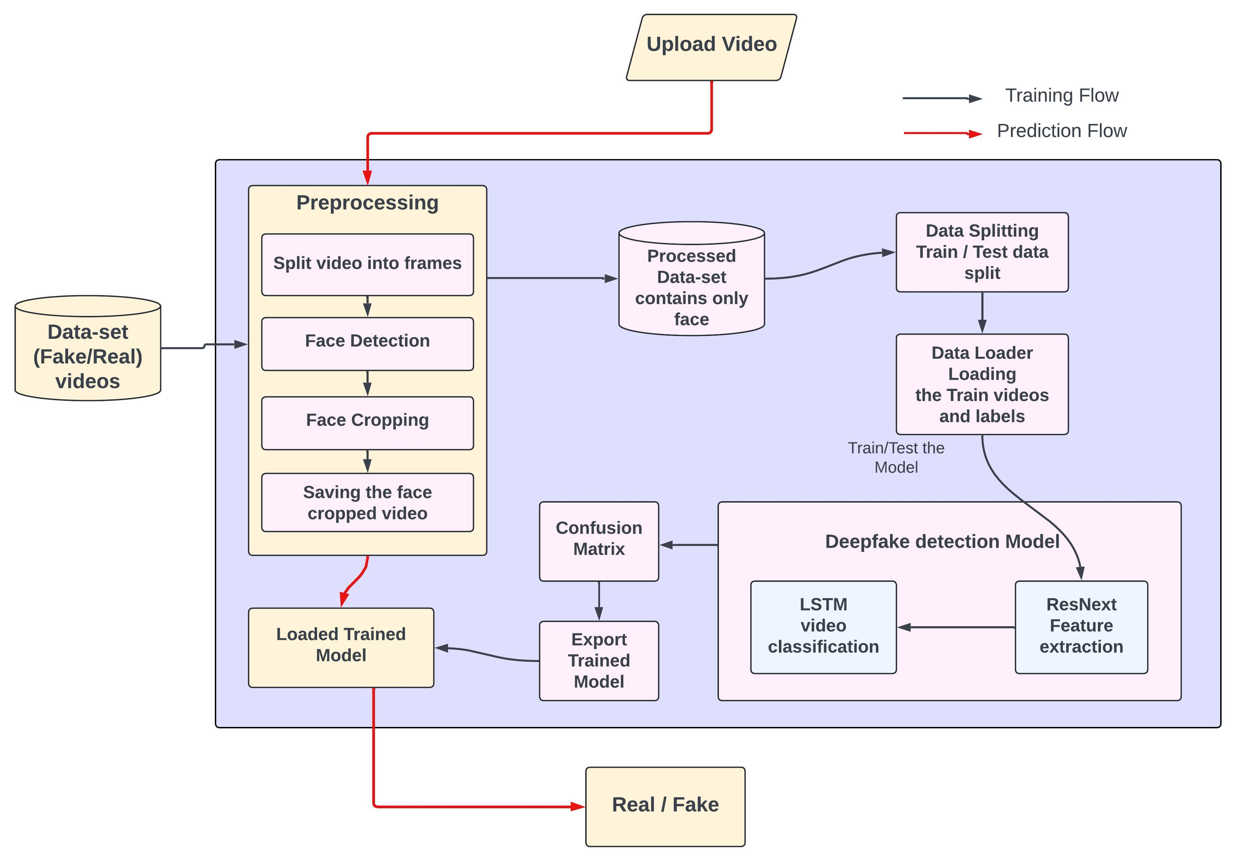



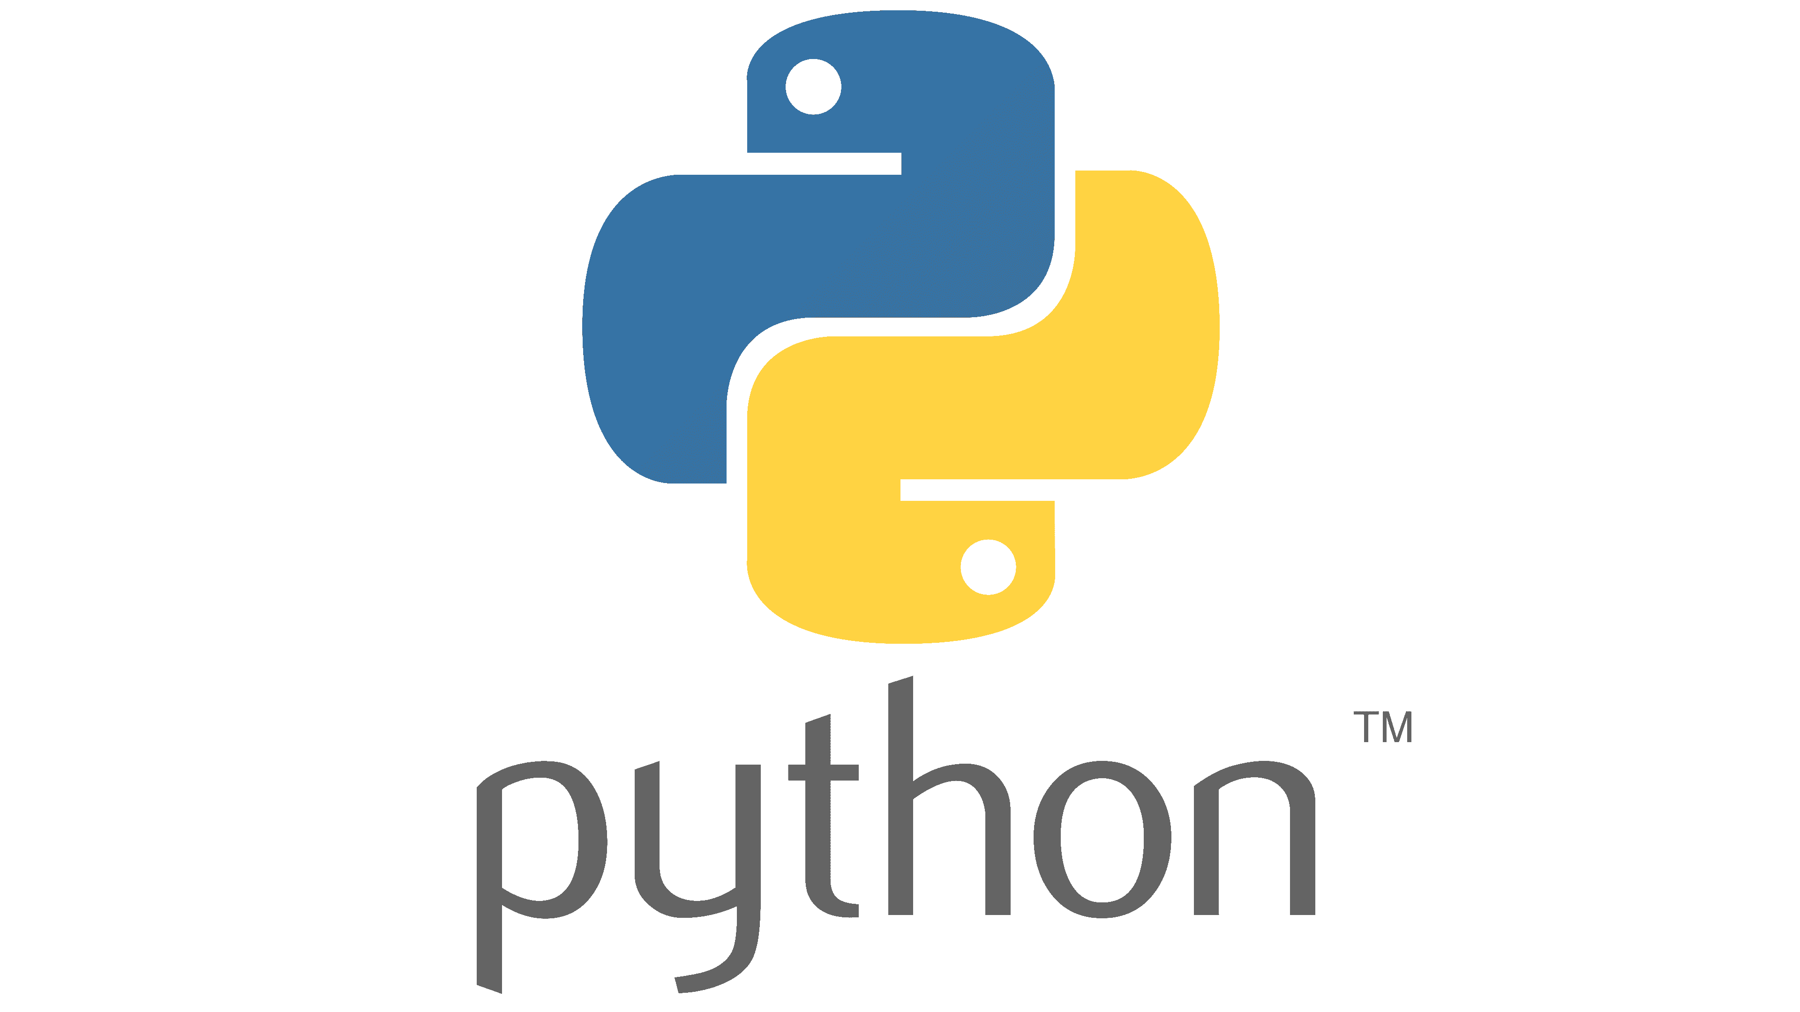

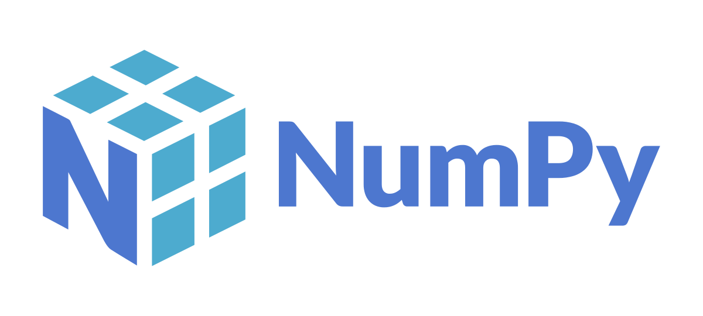

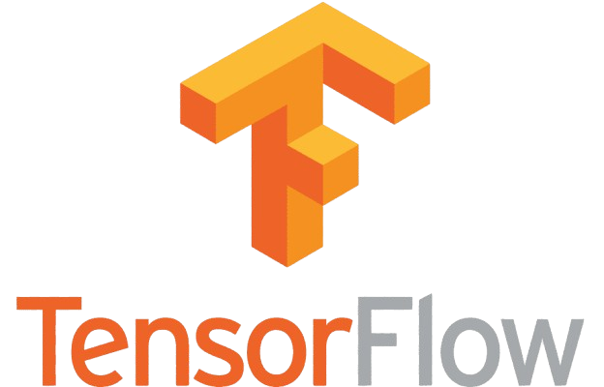

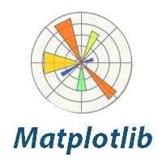

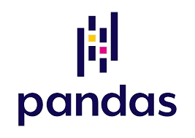

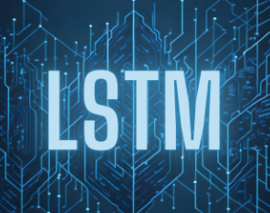

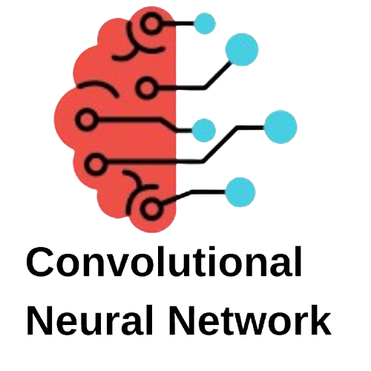

TECHNICAL APPROACH
TechTonic
PROCESS FLOW ARCHITECTURE :
TECHNOLOGIES USED :

Slide 4
FEASIBILITY AND VIABILITY
TechTonic
FEASIBILITY OF THE PROJECT :
Technical Feasibility: Leverages existing AI (CNNs, RNNs, GANs) and cloud services.
Operational Feasibility: Easy integration and deployment on various platforms. User-friendly interface ensures wide accessibility.
Financial Feasibility: Cost-effective using cloud resources and existing models. Potential for funding through grants and partnerships.
Business Feasibility: With rising demand across industries, the scalable web app offers strong revenue potential through subscriptions, licensing, and API access, while its cloud-based design keeps operational costs low for profitable, widespread adoption.
POTENTIAL CHALLENGES:
Challenge: High computational costs during model training and inference.
Risk: May slow down real-time detection.
Mitigation: Use pre-trained models and optimize for speed and accuracy.
Challenge: Ensuring model robustness against evolving deep fake techniques.
Risk: New deep fake methods could bypass detection.
Mitigation: Continuous model retraining with updated datasets.
Challenge: Limited availability of diverse and high-quality training data.
Risk: Inadequate data can reduce model effectiveness and accuracy.
Mitigation: Augment datasets with synthetic data and leverage transfer learning techniques.

Slide 5
IMPACT AND BENEFITS
TechTonic
POTENTIAL IMPACT ON THE TARGET AUDIENCE:
Security Agencies: Provides a critical tool for identifying manipulated content that could affect national security.
Media Companies: Helps in validating the authenticity of content before broadcasting, reducing the spread of misinformation.
General Public: Empowers individuals to verify the authenticity of online videos, increasing awareness and reducing susceptibility to deep fakes.
Content Creators: Protects creators from unauthorized use of their likeness or content, ensuring their intellectual property is safeguarded.
BENEFITS OF THE SOLUTION:
Social: Reduces the spread of misinformation and protects individuals from identity-based defamation.
Economic: Saves costs associated with fraud prevention and content validation.
Legal: Assists law enforcement agencies in identifying and mitigating crimes related to deep fakes, helping to maintain legal integrity and safeguard public figures.
Environmental: As a digital tool, the app reduces the need for physical verification processes, cutting down on resource usage.

Slide 6
RESEARCH AND REFERENCES
TechTonic
Deepfake Technology : Overview
Deepfake Video Detection Based on Spatial, Spectral, and Temporal Inconsistencies Using Multimodal Deep Learning
A Review of Deep Learning-based Approaches for Deepfake Content Detection
Utilizing CNN and SVM
Advancements in Deepfake Detection: A Deep Learning Perspective
Understanding LSTM Networks

