Slide 1
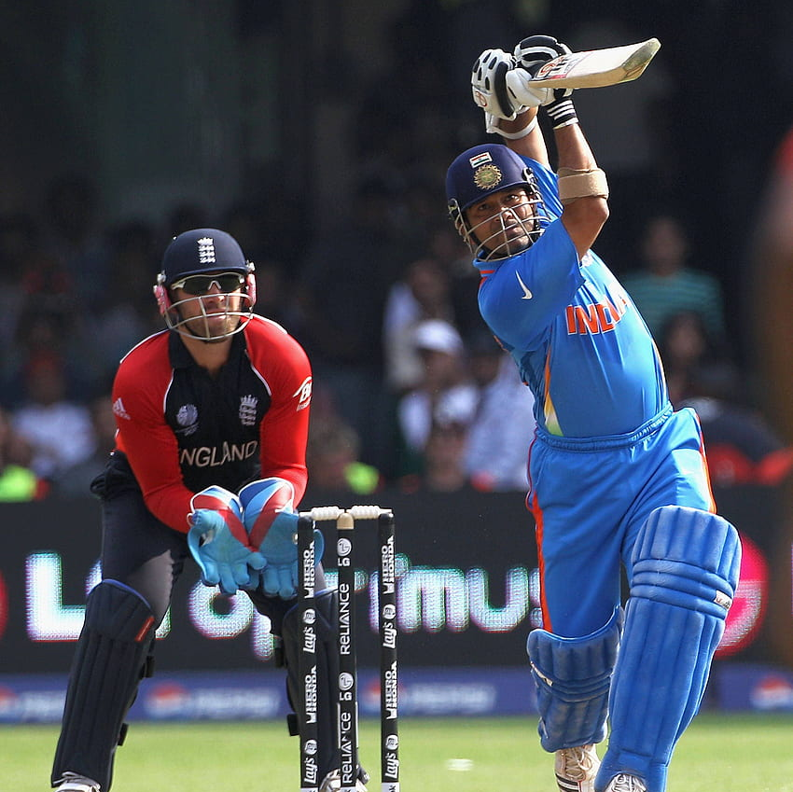
Run’s Prediction Based on Performance Metric’s
Group – 2
Alekhya Gopidi
Sri Lakshmi Supriya Ravipati
Nikhitha Maila
Nikshay Policepatel
Loknadh Venkata Krishna Sai Kona
Rakesh Maddirala

Slide 2
Introduction: Predicting the number of runs a team or player will score in a cricket match is a key aspect of sports analytics. By analyzing historical data and performance metrics, such as batting averages, player stats, and weather conditions, we can build a predictive model to estimate runs scored in a game.
Objective: To predict the number of runs a team or player will score in a game based on historical data and performance metrics. The focus is to build a predictive model using various features (such as batting average, player stats, weather conditions, etc.) to accurately estimate the runs.

Slide 3
Dataset
Data set contains 2,913 observations and 9 variables:-
Mat: Matches played (numeric).
Inns: Innings played (numeric).
NO: Not-outs (numeric).
Runs: Runs scored (numeric).
HS: Highest score (numeric).
Ave: Batting average (numeric).
Centuries: Number of centuries scored (numeric).
HalfCenturies: Number of half-centuries scored (numeric).
Ducks: Number of ducks (dismissals for zero runs) (numeric).
Source: https://www.kaggle.com/datasets/mahendran1/icc-cricket

Slide 4
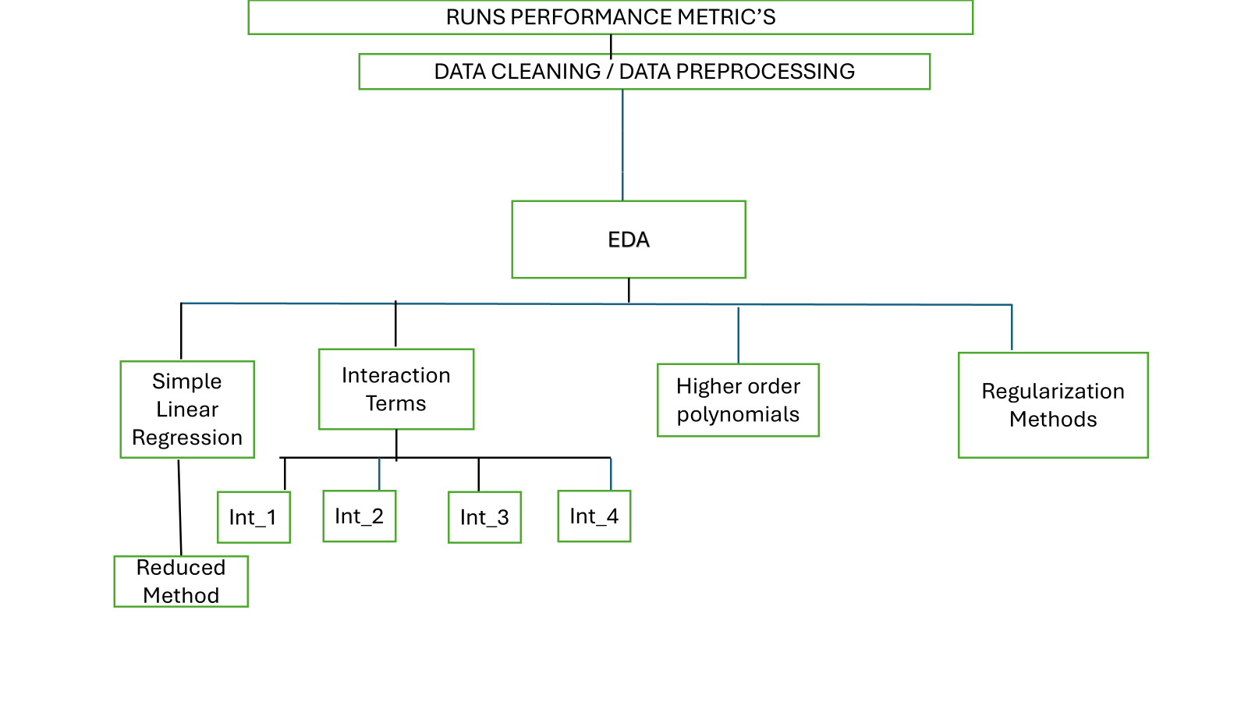
Pipeline

Slide 5
Data Cleaning and Preprocessing:
Handle Missing Data: Replaces "-" with NA and removes rows with missing values.
Remove Unneeded Columns: Drops Player and Span columns as they're not useful for analysis.
Convert to Numbers: Changes all columns to numeric for consistency.
Split Data: Divides data into 80% training and 20% testing sets.

Slide 6
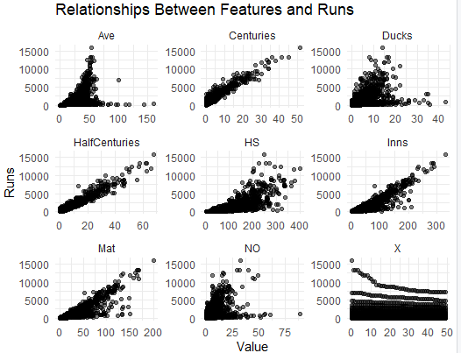
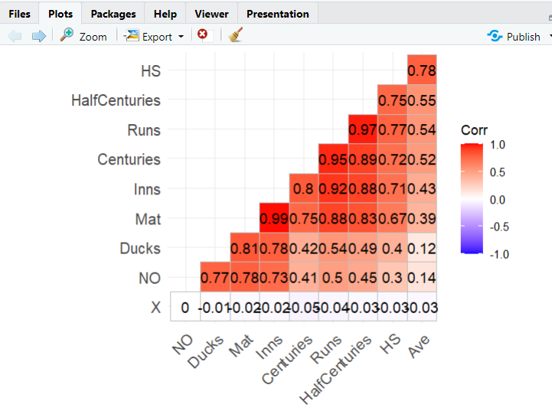
EDA
Strong correlation between Runs and Centuries (0.95), and between Runs and Half Centuries (0.97). This indicates that scoring centuries and half-centuries significantly contributes to the total runs scored.
Mat (matches played) and Inns (innings batted) are also highly correlated with Runs (0.87 and 0.91, respectively).
Relatively weak correlation between NO (not outs) and Runs (0.50) suggests limited influence.
Positive linear relationships are evident between Runs and variables such as Centuries, Half Centuries, and Ave (batting average)
Higher values in Centuries and Half Centuries strongly correspond to higher Runs.
Ducks appears to have no clear relationship with Runs.

Slide 7
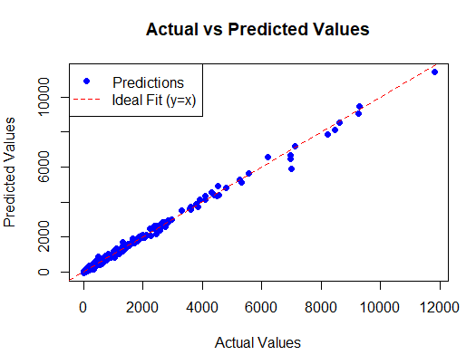
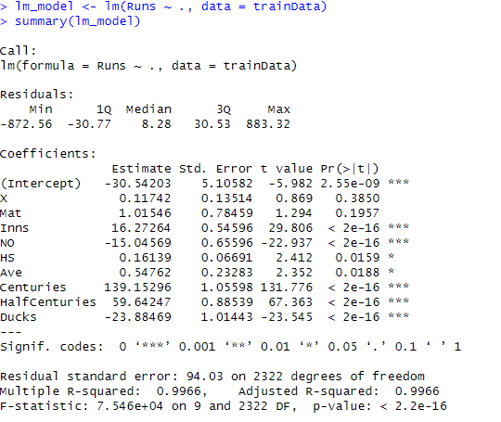
SIMPLE LINEAR REGRESSION MODEL

Slide 8
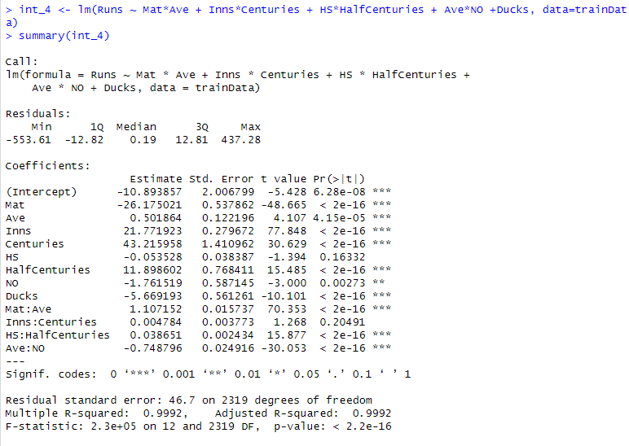
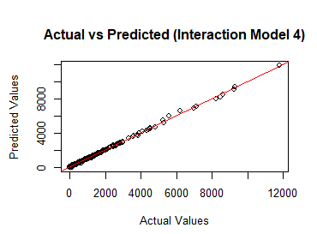

Models with Interaction Terms

Slide 9
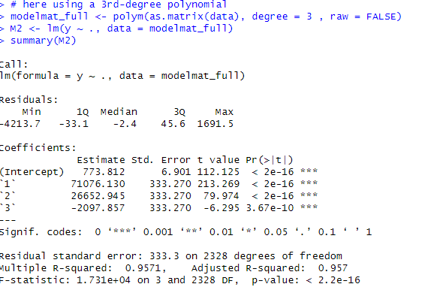
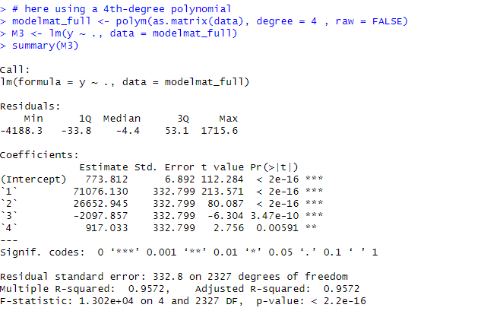
Models with Higher Order Terms

Slide 10
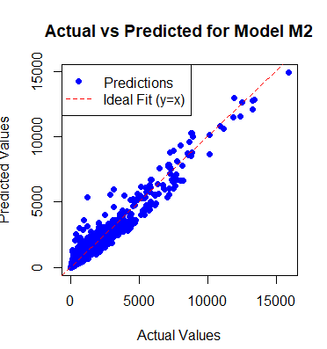
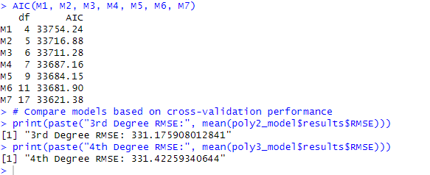
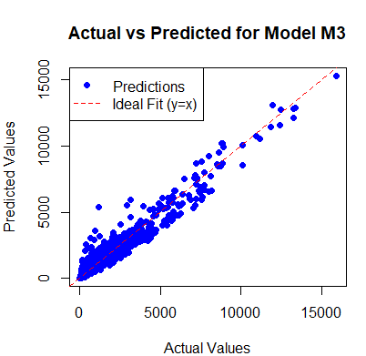
Models with Higher Order Terms
We have built 7 models using different degree’s.

Slide 11
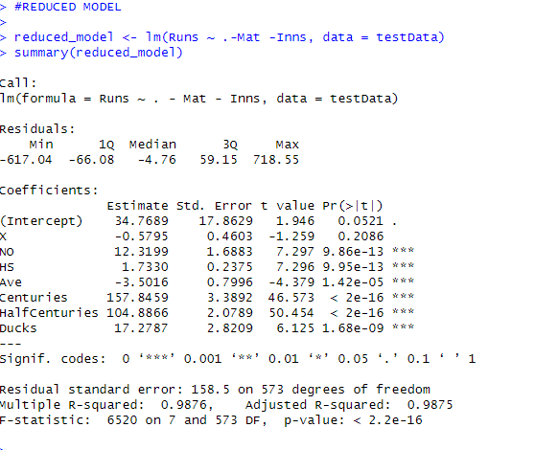
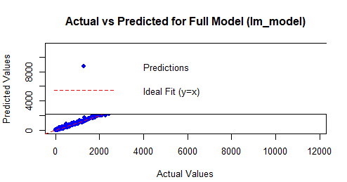
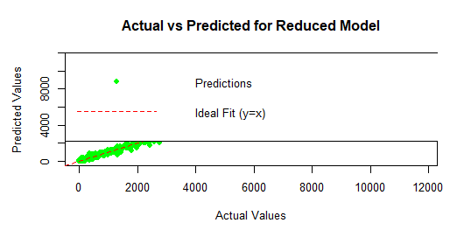
Reduced Model

Slide 12
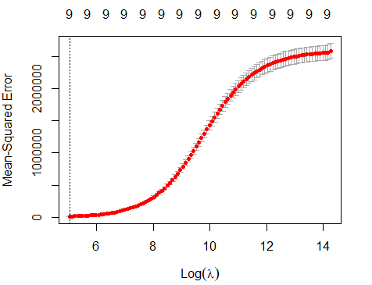
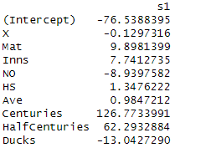
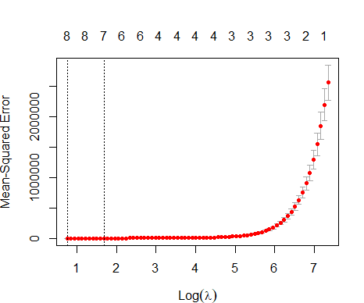
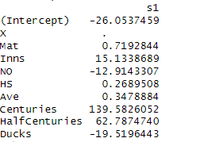
Regularization Methods
Ridge Regression
Lasso Regression

Slide 13
Model’s Evaluation and Comparison
MODEL | RMSE | MAE | R2
SIMPLE LINEAR MODEL | 95.03852 | 54.32660 | 0.9954815
REDUCED MODEL | 157.42841 | 102.40132 | 0.9876017
INTERACTION MODEL | 76.47479 | 44.90015 | 0.9970743
RIDGE REGRESSION | 127.42570 | 77.04604 | 0.9918771
LASSO REGRESSION | 95.15668 | 54.08893 | 0.9954703

Slide 14
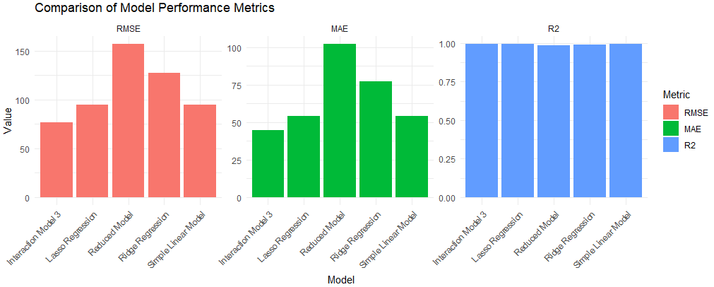

Slide 15
Challenges
Multicollinearity : Mat or Inns as they are highly correlated (VIF > 100).
Outlier’s observation 238 and possibly others are flagged as influential due to their combination of high leverage and large residuals
Non-significant predictors (X, Mat)
skewed features for Runs and HS.
Nonlinearity in the distribution of Data.

Slide 16
CONCLUSION
Among all the models Interaction Model 4 is useful model. It achieves the lowest prediction error and explains the most variance in the target variable.
Interaction model 4 is particularly insightful because it captured non-additive influence scenarios where the influence of one variable depends on the level of another.
Models often involve non-linear effects. Interaction terms allow us to model these relationships effectively.
Using Interaction Model 4 we fulfilled our objective to predict the Runs.
Runs=−10.893857−26.175021⋅Mat+0.501864⋅Ave+21.771923⋅Inns+43.215958⋅Centuries−0.053528⋅HS+11.898602⋅HalfCenturies−1.761519⋅NO−5.669193⋅Ducks +1.107152⋅(Mat⋅Ave)+0.004784⋅(Inns⋅Centuries)+0.038651⋅(HS⋅HalfCenturies)−0.748796⋅(Ave⋅NO)+ 1.107152 \cdot (\text{Mat} \cdot \text{Ave}) + 0.004784 \cdot (\text{Inns} \cdot \text{Centuries}) + 0.038651 \cdot (\text{HS} \cdot \text{HalfCenturies}) - 0.748796 \cdot (\text{Ave} \cdot \text{NO})+1.107152⋅(Mat⋅Ave)+0.004784⋅(Inns⋅Centuries)+0.038651⋅(HS⋅HalfCenturies)−0.748796⋅(Ave⋅NO)

Slide 17
Thank you
Any Questions?

