Slide 1
INDUSTRIAL TRAINING PROJECT · IT-2
AuditPilot
SAME PAGE, BEFORE AND AFTER FIXES
54
96
An AI website audit agent. Tools compute the facts; a local open-source LLM explains them.
/demo/bad
/demo/good
+42 points
Real scores from the running app, computed with no LLM
Nikshey Yadav · Roll No. 231302221
B.Tech CSE (Data Science) · 7th Semester · SGT University
Training: AccioJobs Pvt. Ltd. · 8 August to 18 March
Notes:
Namaste, main Nikshey Yadav hoon, SGT University se B.Tech CSE Data Science, 7th semester.
Meri training AccioJobs Pvt. Ltd. mein thi, aur ye mera project hai: AuditPilot.
AuditPilot ek AI website audit agent hai: tools facts nikalte hain, local LLM unhe explain karta hai.
Slide par jo 54 aur 96 hai, wo mere project ke do demo pages ka asli audit score hai.

Slide 2
TRAINING CONTEXT
What training gave me, and what I added
Covered in training
Extended beyond training
HTML
CSS
Express
REST API, SSE streaming
JavaScript
React
MongoDB
Mongoose models, indexes
AI
AI agents
JWT
login, protected routes
Node.js (a little)
MCP basics
Learned with AI-assisted development (Claude Code). I can explain every feature and decision.
AuditPilot · Nikshey Yadav
2
Notes:
Training mein humne HTML, CSS, JavaScript, React, AI aur AI agents seekhe, Node.js thoda, aur MCP ke basics.
Express, MongoDB aur JWT training mein cover nahi hue the.
Inhe maine Claude Code ke saath AI-assisted development se seekha aur is project mein use kiya.
Main ye openly bata raha hoon, aur har feature explain kar sakta hoon.

Slide 3
PROBLEM TO SOLUTION
From scattered checks to one clear answer
The problem
AuditPilot
Quality checks are manual
A different tool for SEO, accessibility, security and speed.
Reports are raw data
Hundreds of lines, no clear priority.
Cloud AI is not always allowed
Site data may be private.
One URL, 29 checks
Scores and evidence in milliseconds.
A local AI explains
Summary, fix plan and chat on your laptop.
Compare before and after
See exactly which issues were fixed.
AuditPilot · Nikshey Yadav
3
Notes:
Problem ye hai ki website quality ke liye alag alag tools chalane padte hain: SEO, accessibility, security, performance.
Aur report mein sirf raw data hota hai, ye samajh nahi aata ki pehle kya fix karein.
AuditPilot URL leta hai, 29 checks chalata hai, score aur evidence deta hai.
Phir local AI batata hai ki kya pehle fix karna hai, aur aap follow-up sawal bhi puch sakte ho.

Slide 4
TECH STACK
Every piece has a reason
React 19 + Vite
fast component UI
Express 5
REST API and SSE streaming
MongoDB + Mongoose
nested audit documents
JWT + bcrypt
stateless login, hashed passwords
cheerio + zod
HTML parsing, input validation
Recharts
score trend and charts
MCP SDK
same tools in Claude Code
Vitest + supertest
71 automated tests
Ollama + qwen2.5:3b
Open-source LLM running locally
Private
Free
Offline
AuditPilot · Nikshey Yadav
4
Notes:
Frontend React 19 aur Vite hai, charts ke liye Recharts.
Backend Express 5 hai, MongoDB Mongoose ke saath, login ke liye JWT aur bcrypt.
AI ke liye Ollama par open-source model qwen2.5:3b chalta hai: private, free, aur offline kaam karta hai.
MCP SDK se same tools Claude Code mein bhi chalte hain, aur Vitest se 71 tests likhe hain.

Slide 5
SYSTEM ARCHITECTURE
Two paths: facts first, AI second
MongoDB
users, audits, chat
Audit engine
29 checks + scoring
Target website
SSRF-guarded fetch
React UI
Vite, Recharts
Express API
auth, audits, chat (SSE)
Agent loop
max 5 steps, zod-validated
Ollama LLM
qwen2.5:3b via queue
Claude Code
or Claude Desktop
MCP server
stdio
Tool registry
5 tools, one source
Deterministic path: no LLM involved
AI path: local, optional, queued
AuditPilot · Nikshey Yadav
5
Notes:
Ye architecture hai. Browser mein React UI Express API se baat karta hai.
Hari line deterministic path hai: Express audit engine ko call karta hai, jo SSRF guard ke saath target website fetch karta hai. Isme LLM nahi hai.
Orange line AI path hai: agent loop queue ke through local Ollama model se baat karta hai.
Same tool registry MCP server ke through Claude Code ko bhi milti hai, aur sab data MongoDB mein save hota hai.

Slide 6
HOW THE AGENT WORKS
Tools compute the facts. The LLM only explains.
Your question
plus audit data preloaded
Local LLM
qwen2.5:3b, temp 0.1
Tool needed?
no
Streamed answer
tokens arrive live (SSE)
Max 5 steps per question
yes
Result to LLM
name, args, ms saved as trace
Run tool
zod-validated arguments
GUARDRAILS
Max 5 steps
Bad args: retry once
Own audits only
SSRF-guarded run_audit
1 LLM call at a time
Rate limits
AuditPilot · Nikshey Yadav
6
Notes:
Core principle ye hai: tools facts compute karte hain, LLM sirf explain karta hai.
Chat mein current audit ka data pehle se prompt mein hota hai, to zyada sawal bina tool ke solve ho jaate hain.
Agar zarurat ho to model tool maangta hai, server zod se arguments validate karke tool chalata hai, aur result wapas model ko deta hai.
Guardrails: maximum 5 steps, galat arguments par ek retry, user sirf apne audits dekh sakta hai, aur ek time par ek hi LLM call.

Slide 7
DATABASE DESIGN
Three collections, one nested document
User
Audit
Finding (embedded, 29)
_id
name
email (unique)
passwordHash (bcrypt)
1 : many
_id
user -> User
url, finalUrl, status
scores {overall, seo, accessibility,
security, performance}
summary, fixPlan
aiStatus: pending|ready|skipped|failed
llm {provider, model, mock}
durationMs, createdAt
index (user, url, createdAt)
embeds
id, category, severity
title, evidence
recommendation
embeds
ChatMessage (embedded)
role, content, note
toolCalls[]
ToolCall: name, args, resultSummary, ms
AuditPilot · Nikshey Yadav
7
Notes:
Database MongoDB mein hai. Do collections hain: User aur Audit.
Ek user ke bahut saare audits hote hain, aur Audit mein user ka reference hai. Index user, url aur createdAt par hai.
Findings, chat messages aur tool calls Audit document ke andar embedded hain, isliye ek query mein poori report mil jaati hai.
Mongoose models: User aur Audit, baaki sub-schemas hain.

Slide 8
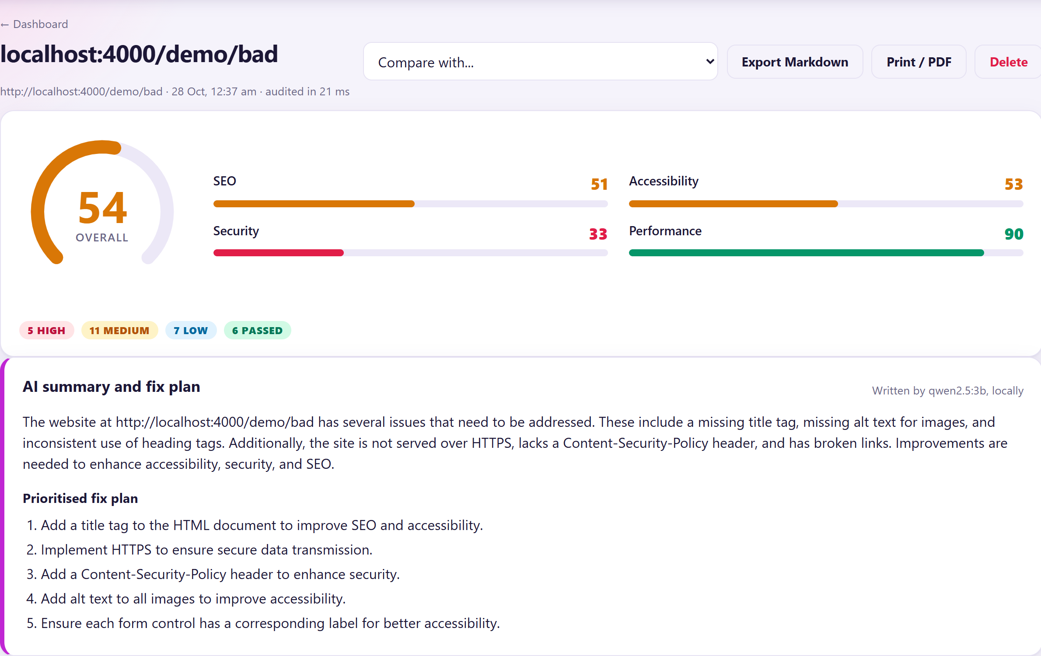
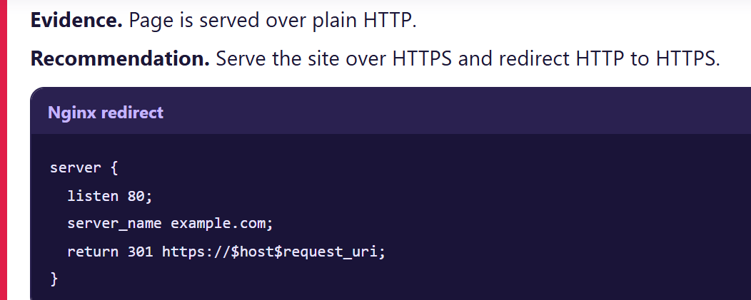
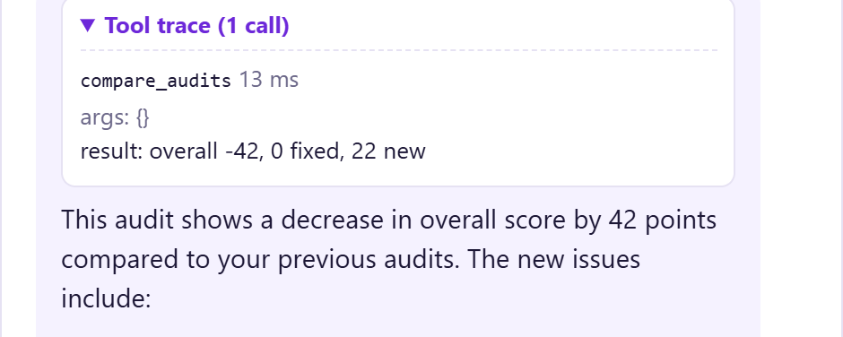
FEATURES
The running app, real screenshots
Evidence and a ready fix snippet per finding
Animated score gauge, category scores, AI summary written by the local model
Agent chat with a collapsible tool trace
Also: compare page · score-trend chart · Markdown export · print stylesheet · LLM mode badge in the header
AuditPilot · Nikshey Yadav
8
Notes:
Ye saare screenshots running app se Playwright se liye hain, asli local model qwen2.5:3b ke saath. Koi mock ya seeded text inme nahi hai.
Pehla: animated score gauge, chaar category scores aur AI summary. Doosra: har finding mein evidence aur Nginx ya Express fix snippet.
Teesra: agent chat, aur collapsible tool trace jisme tool ka naam, args aur time dikhta hai. Compare page agle slide par hai, 54 se 96.
Aur bhi hai: score trend chart, Markdown export, print stylesheet, aur header mein LLM mode badge.

Slide 9
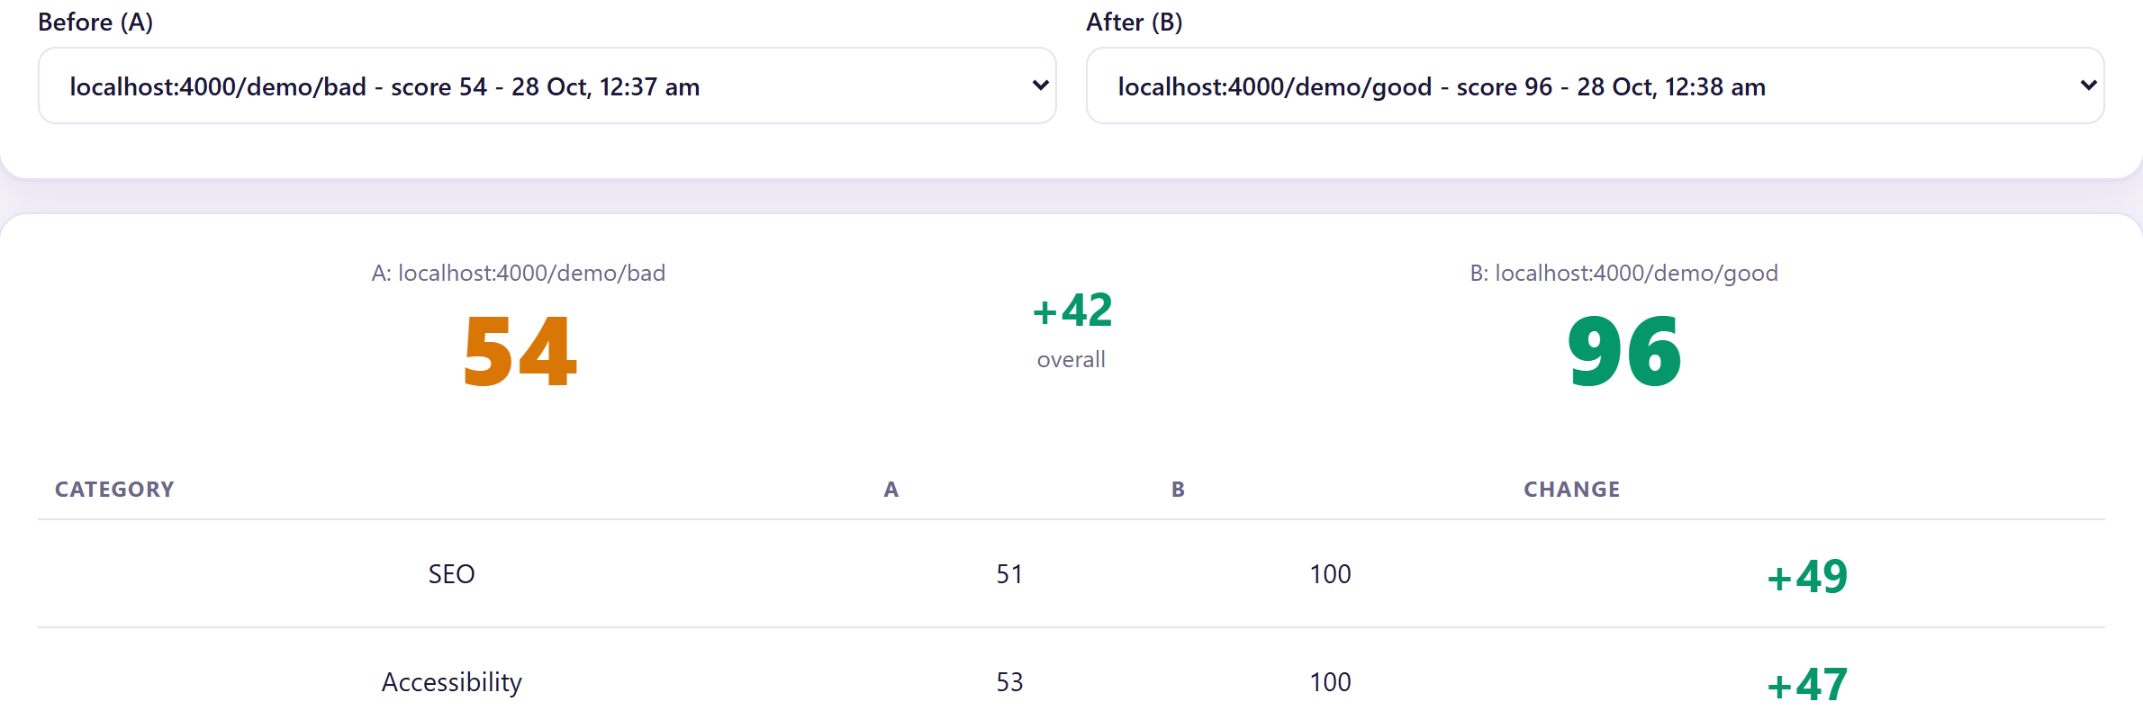
LIVE DEMO FLOW
Bad page to good page in four minutes
1
2
3
4
5
6
Audit demo (bad)
score appears instantly
Read the findings
while AI writes summary
Ask the agent
"what should I fix first?"
Audit demo (good)
same page, fixed
Compare
54 to 96, 22 issues fixed
Tool trace + MCP
same tools in Claude Code
Measured on this laptop
Audit: tens of milliseconds
AI summary: about 20 s (CPU)
Chat answer: 15 to 30 s
Scores never wait for the model
Real compare page: 54 to 96 (+42)
AuditPilot · Nikshey Yadav
9
Notes:
Demo ka flow: pehle demo bad page audit karte hain, score 54 aata hai, turant, bina LLM ke.
Findings dekhte hain, aur jab tak local model summary likhta hai, hum findings par baat karte hain. Phir agent se puchte hain: what should I fix first.
Phir demo good page audit karte hain, score 96, aur compare page par 22 issues fixed dikhte hain. Tool trace aur MCP ka demo last mein.
Ye numbers asli hain: laptop par CPU par model chalta hai, isliye AI answer mein 15 se 30 second lagte hain.

Slide 10
SECURITY AND TESTING
Built to be safe, proven by tests
Security layers
71 / 71
SSRF guard
http/https only, private + metadata IPs blocked, 3 redirects, 10 s, 2 MB
tests passing · npm test
JWT + bcrypt
protected routes, hashed passwords
Ownership checks
other users' audits return 404
Checkers + scoring + compare
19
SSRF guard
21
helmet, CORS, rate limits
per-user limits on audits and chat
Auth, API, ownership
10
zod validation
every input and every tool call
Agent, summary, SSE chat
18
MCP stdio client
3
AuditPilot · Nikshey Yadav
10
Notes:
Kyunki hum user ka diya URL fetch karte hain, SSRF guard zaroori hai: sirf http aur https, private aur localhost addresses block, metadata address block, max 3 redirects, 10 second timeout, 2 MB limit.
Login JWT se hai, passwords bcrypt se hash hote hain, helmet aur rate limit lage hain, aur ek user doosre ka audit nahi dekh sakta.
Testing mein 71 tests hain aur sab pass hote hain: 19 checker aur scoring, 21 SSRF, 10 API aur auth, 18 agent, aur 3 MCP ke.
Asli local model ka behaviour npm run check:llm aur manual run se check kiya, CI tests se nahi.

Slide 11
REFLECTION
What I learned, what was hard, what is next
Learned
Challenges
Future scope
Full-stack MERN with auth
JWT, validation, SSRF defence
Agent loop and tool calling
MCP: one registry, two clients
Testing with a mock LLM
A 3B model mangled an audit ID in a tool call: fixed with optional args and helpful errors
CPU LLM takes 15 to 30 s: background summary and a queue
Streaming with tool calls: tested on installed Ollama
Larger or fine-tuned models
RAG over WCAG and OWASP docs
Scheduled audits and alerts
CI integration (fail on low score)
More checks, JavaScript rendering
AuditPilot · Nikshey Yadav
11
Notes:
Seekha: poora MERN stack, JWT, SSRF jaise security risks, agent loop aur tool calling, MCP, aur testing.
Challenge: chhota 3B local model kabhi tool ke arguments galat bana deta tha, jaise audit ID mangle kar dena. Maine arguments optional kiye aur helpful error diya.
Local model CPU par slow hai, isliye summary background mein aur queue ke saath rakhi.
Future: bada ya fine-tuned model, docs par RAG, scheduled audits, CI integration, aur zyada checks.

Slide 12
Thank you
Questions and live demo
Nikshey Yadav · Roll No. 231302221
AuditPilot · B.Tech CSE (Data Science) · SGT University
Notes:
Dhanyavaad. AuditPilot mein tools facts nikalte hain, local open-source LLM unhe explain karta hai, aur sab kuch aapke laptop par chalta hai.
Ab main aapke sawalon ke liye taiyaar hoon.
Agar aap chahein to main live demo dobara dikha sakta hoon, ya koi bhi feature detail mein explain kar sakta hoon.

