Slide 1
SGT UNIVERSITY · DEPT. OF COMPUTER SCIENCE & ENGINEERING, SOET
THEMATIC ASSESSMENT — REVIEW 2 (UPDATED)
AI-Based YouTube Analytics and Content Strategy Prediction
Signal Studio: explainable forecasts, honest uncertainty and an on-device AI Coach
Vishal Kumar Upadhyay · 231302157
Nikshey Yadav · 231302221
Aditya Chauhan · 231302230
Arpit Gupta · 231302216
Yuvraj Singh Yadav · 231302221
Computer Science & Engineering, SOET — SGT University
01 / 19
Notes:
Review 2 builds on Review 1. In Review 1 we cleaned the data and trained the model. Now we explain the predictions, measure uncertainty, add an AI Coach that runs on the laptop, and package everything so it runs anywhere.

Slide 2
SGT UNIVERSITY · DEPT. OF COMPUTER SCIENCE & ENGINEERING, SOET
MOTIVATION
Problem Statement and What Is New
Can we predict how a YouTube video will perform before it is published?
Using only metadata a creator already controls: title, tags, description, category, timing
Goal: turn model findings into practical, explained content-strategy advice
NEW SINCE REVIEW 1
• Why this forecast: exact Shapley explanations
• How sure are we: tested 80% ranges
• Best time, Title lab and look-alike videos
• AI Coach: real on-device language model
• One-command setup for any laptop
• 131 automated tests and an online version
Computer Science & Engineering, SOET — SGT University
02 / 19
Notes:
Say the problem in one sentence, then list what is new. The rest of the deck follows this order.

Slide 3
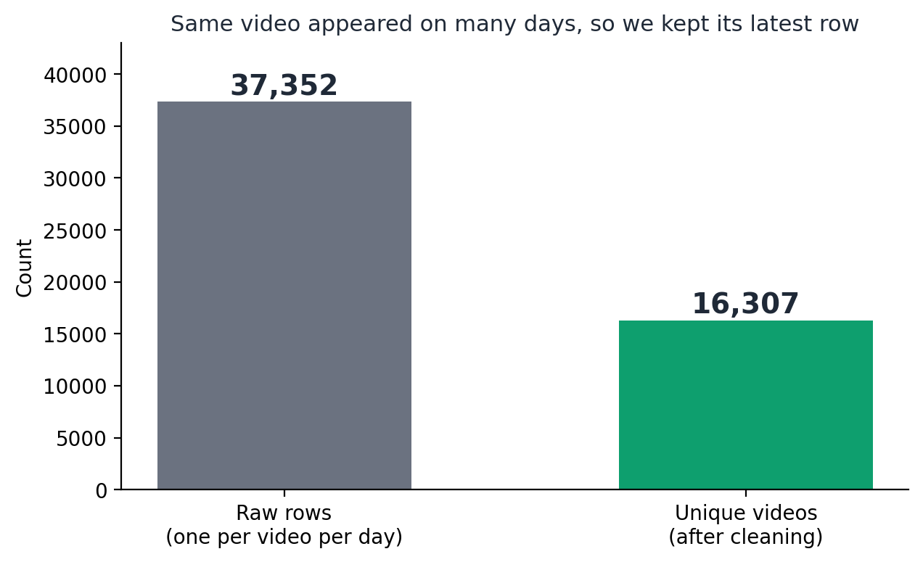
SGT UNIVERSITY · DEPT. OF COMPUTER SCIENCE & ENGINEERING, SOET
DATA
Dataset
UNIQUE VIDEOS AFTER DEDUP
37,352 → 16,307
Trending YouTube Video Statistics, Kaggle, India subset (2017-2018)
One row = one video on one trending day, so the same video repeats; we keep the latest snapshot
Limitation: only videos that already trended, so no failed-video comparison
Computer Science & Engineering, SOET — SGT University
03 / 19
Notes:
The dataset repeats each video once per trending day. Counting all 37,352 rows would over-weight videos that trended longer, so we keep each video once: 16,307 unique videos.

Slide 4
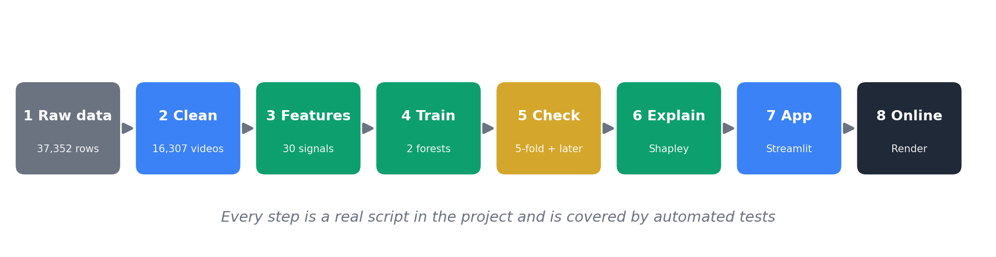
SGT UNIVERSITY · DEPT. OF COMPUTER SCIENCE & ENGINEERING, SOET
METHOD
Pipeline Overview
Every step is a real script with automated tests
Leakage firewall: likes, dislikes and comments are outcomes only, never inputs
Computer Science & Engineering, SOET — SGT University
04 / 19
Notes:
Eight steps from raw data to an online app. The important rule: likes and comments are never inputs, only part of the engagement target.

Slide 5
SGT UNIVERSITY · DEPT. OF COMPUTER SCIENCE & ENGINEERING, SOET
METHOD
Features and Targets
Features (30 inputs, known before publishing)
Targets (outputs)
Title packaging: length, digits, ?, !, capitals, emoji, how-to and urgency words
Target 1: views, log-transformed
Tags: count, length, multi-word share
Target 2: engagement rate = (likes + comments) / views
Description: length, links, hashtags, call to action
Timing: day and hour in IST, weekend, circular hour
Audit fixes since Review 1: hashtags and www links were never counted, tag quote marks differed between training and live input, and category 29 showed as "Unknown". All fixed, tested and the model retrained.
Category (one-hot)
Computer Science & Engineering, SOET — SGT University
05 / 19
Notes:
We audited our own code and found three hidden mistakes. They are fixed and each has a regression test.

Slide 6
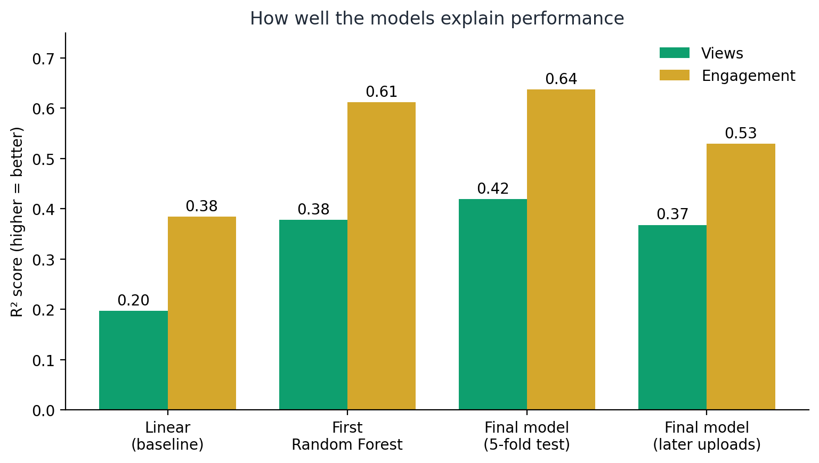
SGT UNIVERSITY · DEPT. OF COMPUTER SCIENCE & ENGINEERING, SOET
RESULTS
Model Results
VIEWS R²
0.20 → 0.42
ENGAGEMENT RATE R²
0.38 → 0.64
Baseline linear regression to the final Random Forest (5-fold cross-validation). On later-in-time videos: 0.37 and 0.53.
Computer Science & Engineering, SOET — SGT University
06 / 19
Notes:
R squared goes from 0.20 to 0.42 for views and from 0.38 to 0.64 for engagement. We also report the harder later-in-time test: 0.37 and 0.53.

Slide 7
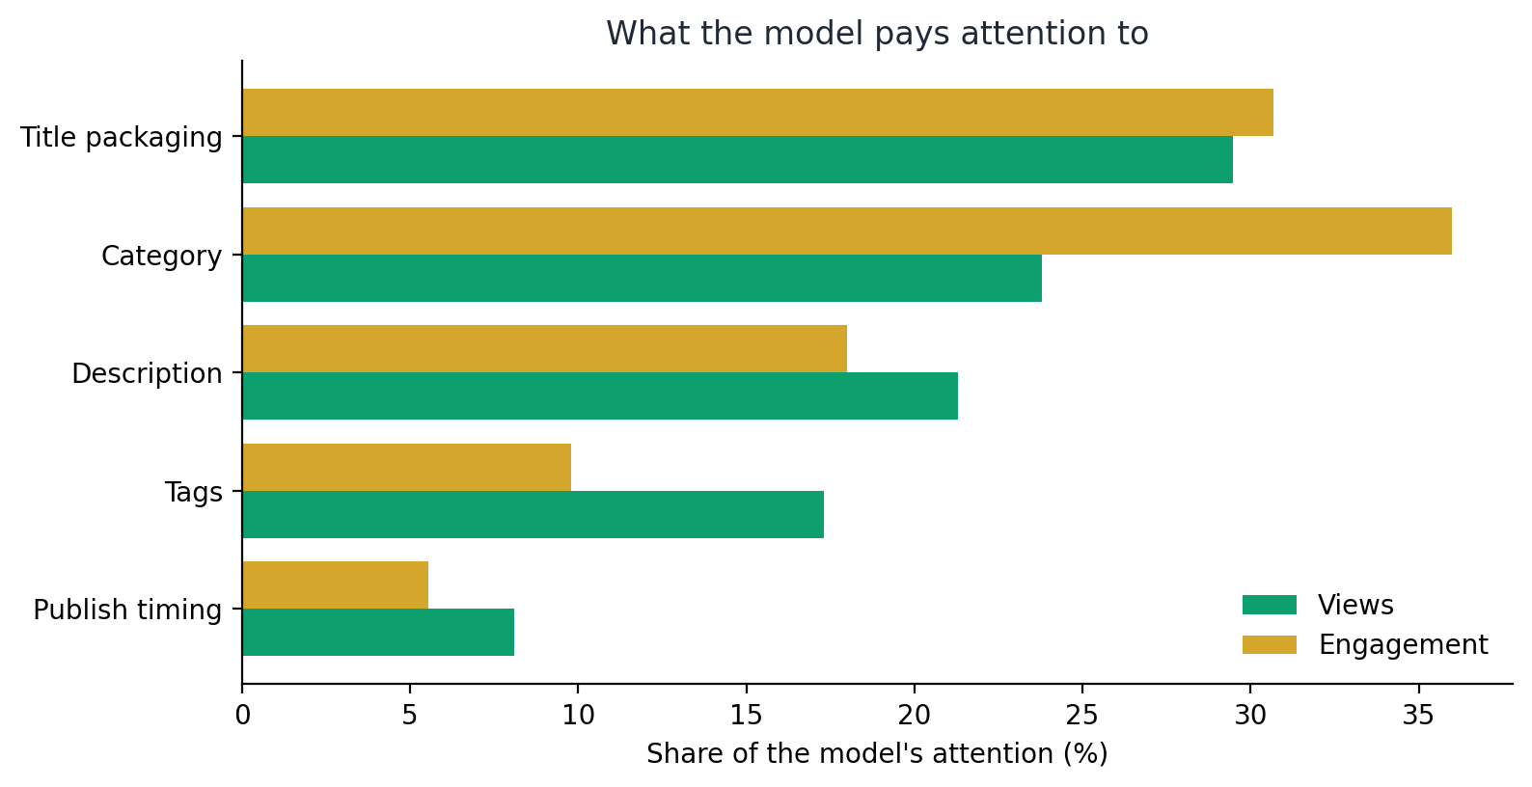
SGT UNIVERSITY · DEPT. OF COMPUTER SCIENCE & ENGINEERING, SOET
RESULTS
What the Model Pays Attention To
Title packaging, description and tags are things a creator controls
Category matters a lot for audience size but cannot be changed once the content is decided
Views and engagement depend on partly different factors
Computer Science & Engineering, SOET — SGT University
07 / 19
Notes:
Global importance by group. Remember these are associations learned from data, not proof of cause and effect.

Slide 8
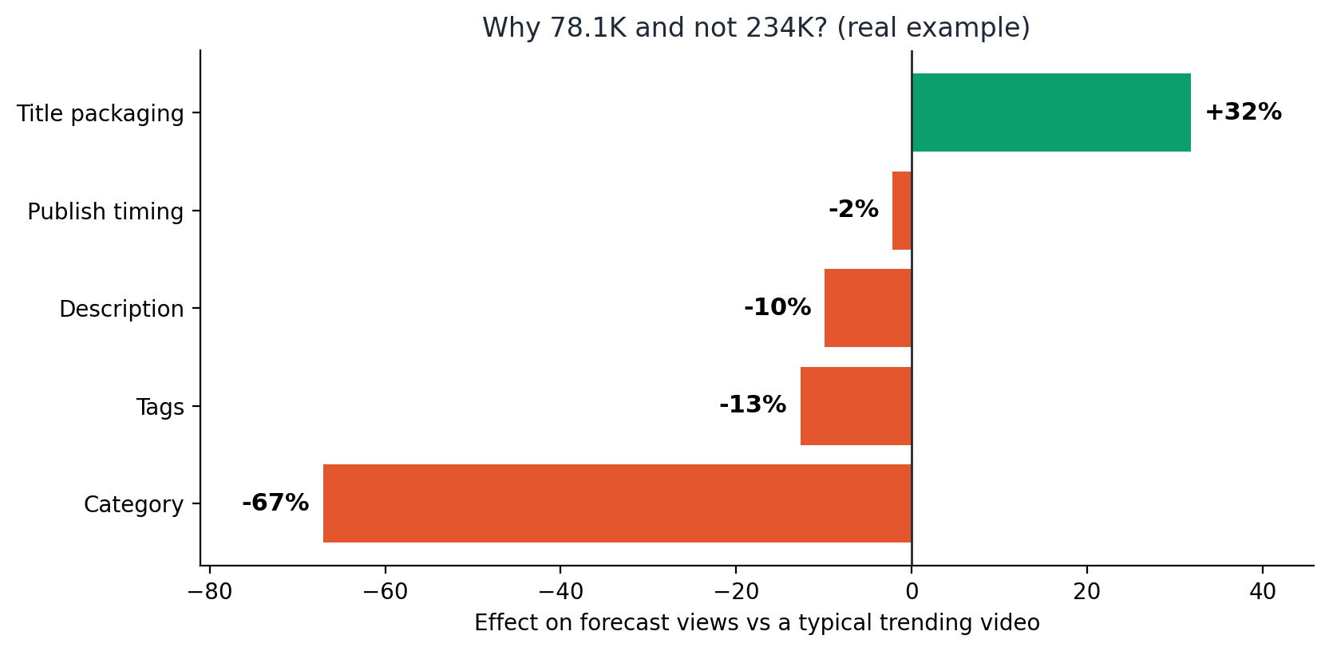
SGT UNIVERSITY · DEPT. OF COMPUTER SCIENCE & ENGINEERING, SOET
NEW · EXPLAINABILITY
Why This Forecast? Exact Shapley Values
Five groups of choices: title, tags, description, timing, category
Each group's fair share, found by trying every order (only 32 combinations)
Bars add up exactly to forecast minus a typical video (tested)
Real example: title +32%, tags -13%, description -10%
Computer Science & Engineering, SOET — SGT University
08 / 19
Notes:
Shapley idea: share credit fairly by averaging over every order. With five groups it is exact. Category is the biggest bar, but it is about audience size, not quality.

Slide 9
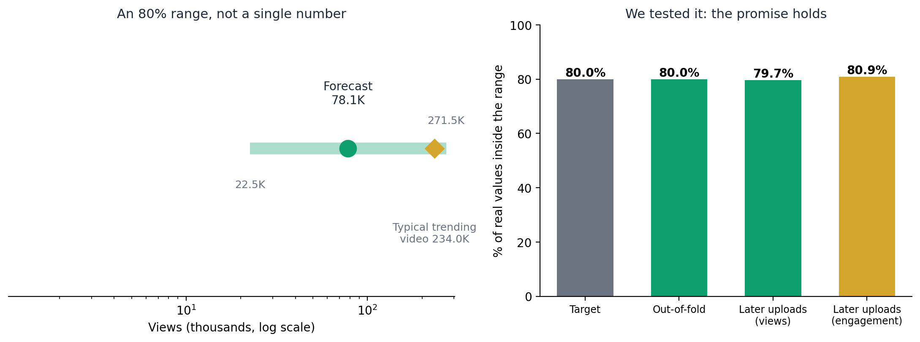
SGT UNIVERSITY · DEPT. OF COMPUTER SCIENCE & ENGINEERING, SOET
NEW · UNCERTAINTY
How Sure Are We? Tested 80% Ranges
Range from split-conformal prediction on out-of-fold errors
The promise was measured, not assumed
Typical views forecast: x0.29 to x3.5 of the truth, wide because metadata is a moderate signal
80.0%
79.7%
80.9%
out-of-fold
later uploads, views
later uploads, engagement
Computer Science & Engineering, SOET — SGT University
09 / 19
Notes:
We do not only claim an 80 percent range, we tested it on later videos: 79.7 and 80.9 percent.

Slide 10
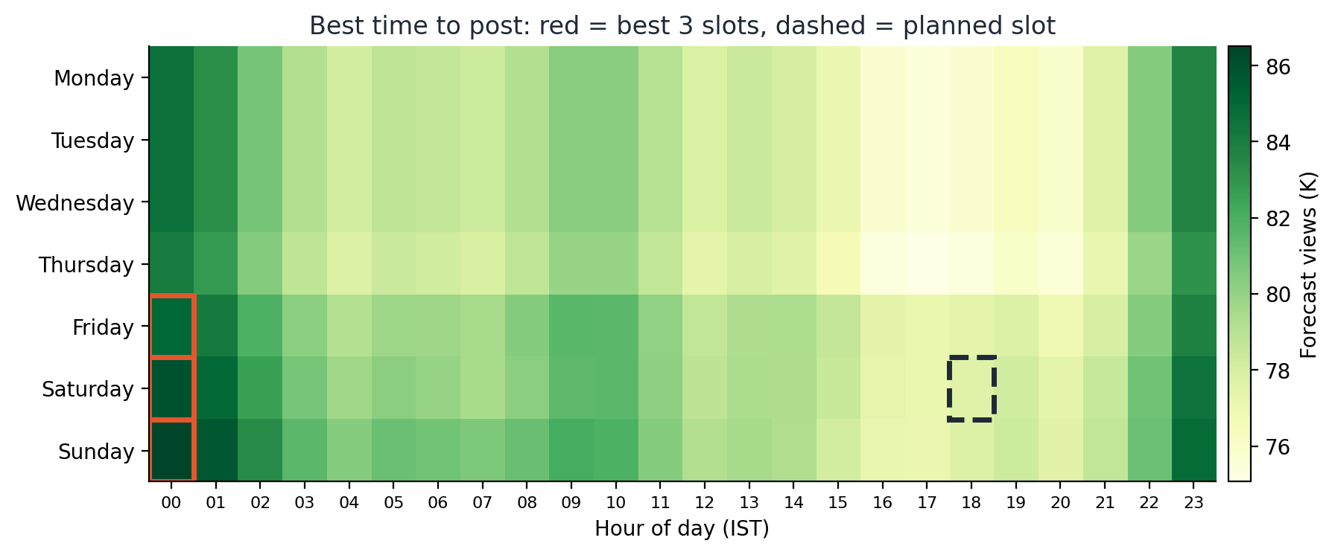
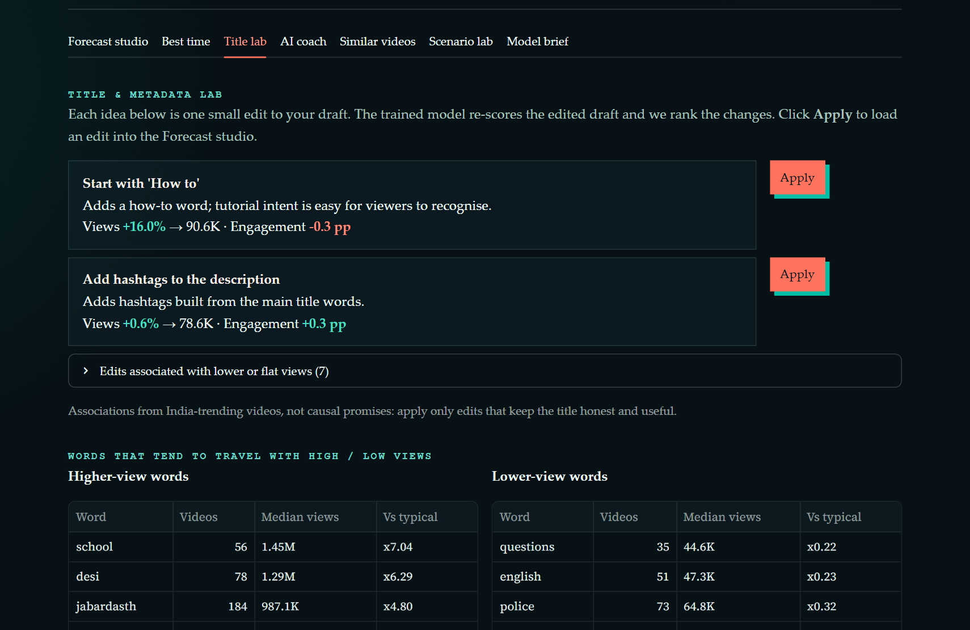
SGT UNIVERSITY · DEPT. OF COMPUTER SCIENCE & ENGINEERING, SOET
NEW · DECISION TOOLS
Best Time, Title Lab and Look-alikes
Best time: the same draft forecast in all 168 weekly slots (IST)
Title lab: ~12 edits re-scored by the model and ranked, one-click Apply
Look-alikes: TF-IDF similar trending videos as a second opinion
Computer Science & Engineering, SOET — SGT University
10 / 19
Notes:
Timing changes the forecast only about 9 percent, so what you post matters more than when you post. All edits are associations, not promises.

Slide 11
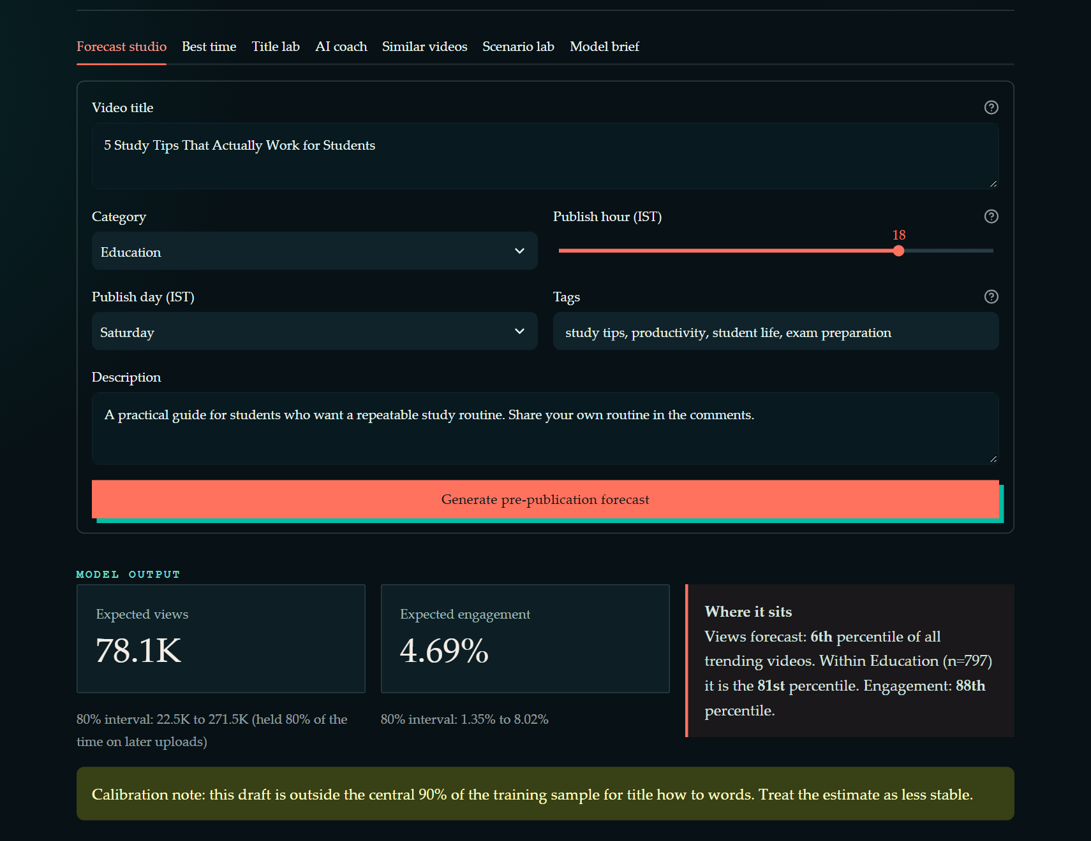
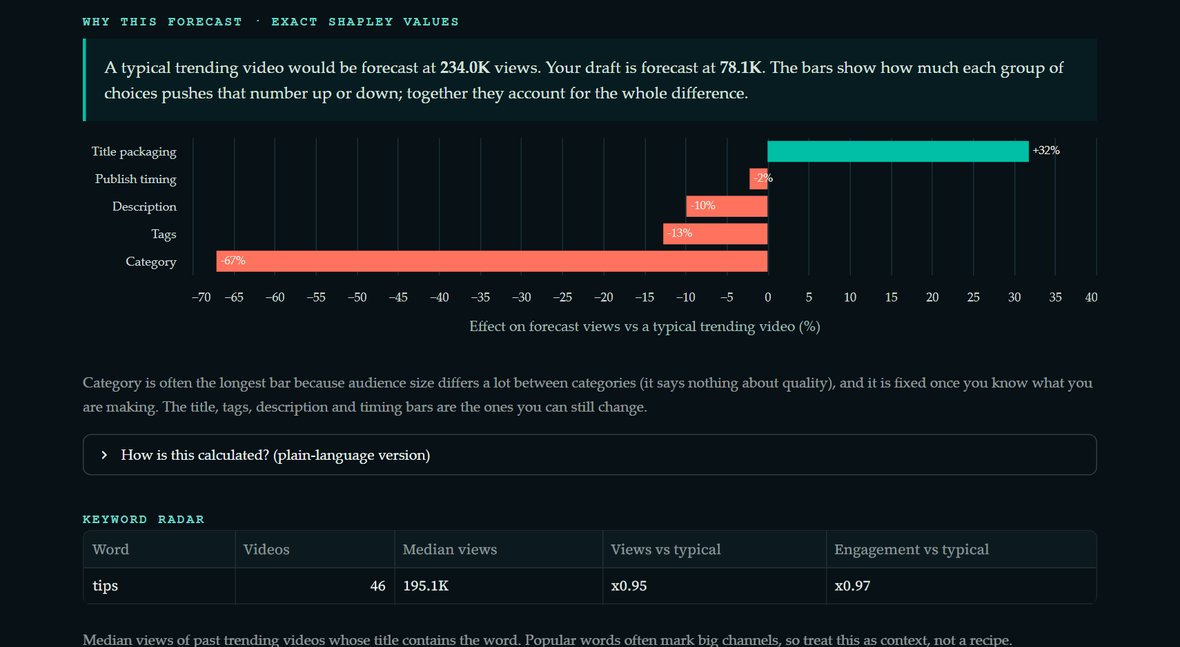
SGT UNIVERSITY · DEPT. OF COMPUTER SCIENCE & ENGINEERING, SOET
NEW · THE APP
Signal Studio in Action
Computer Science & Engineering, SOET — SGT University
11 / 19
Notes:
Live demo order: load an example, generate the forecast, read the Shapley chart, then show best time and title lab.

Slide 12
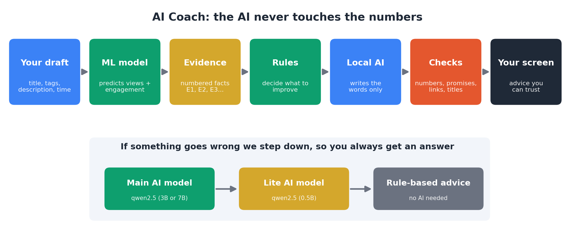
SGT UNIVERSITY · DEPT. OF COMPUTER SCIENCE & ENGINEERING, SOET
NEW · AI COACH
An On-device AI That Cannot Change the Numbers
ML model owns every number; re-scores any title or tag the AI proposes
Runs on the laptop with Ollama: free, private, no API key
AI sees only numbered evidence facts (E1, E2, ...)
Fallback chain: main AI, lite AI, rule-based advice
Computer Science & Engineering, SOET — SGT University
12 / 19
Notes:
The hybrid design: rules decide what to improve, the AI only writes the wording, checkers test every sentence.

Slide 13
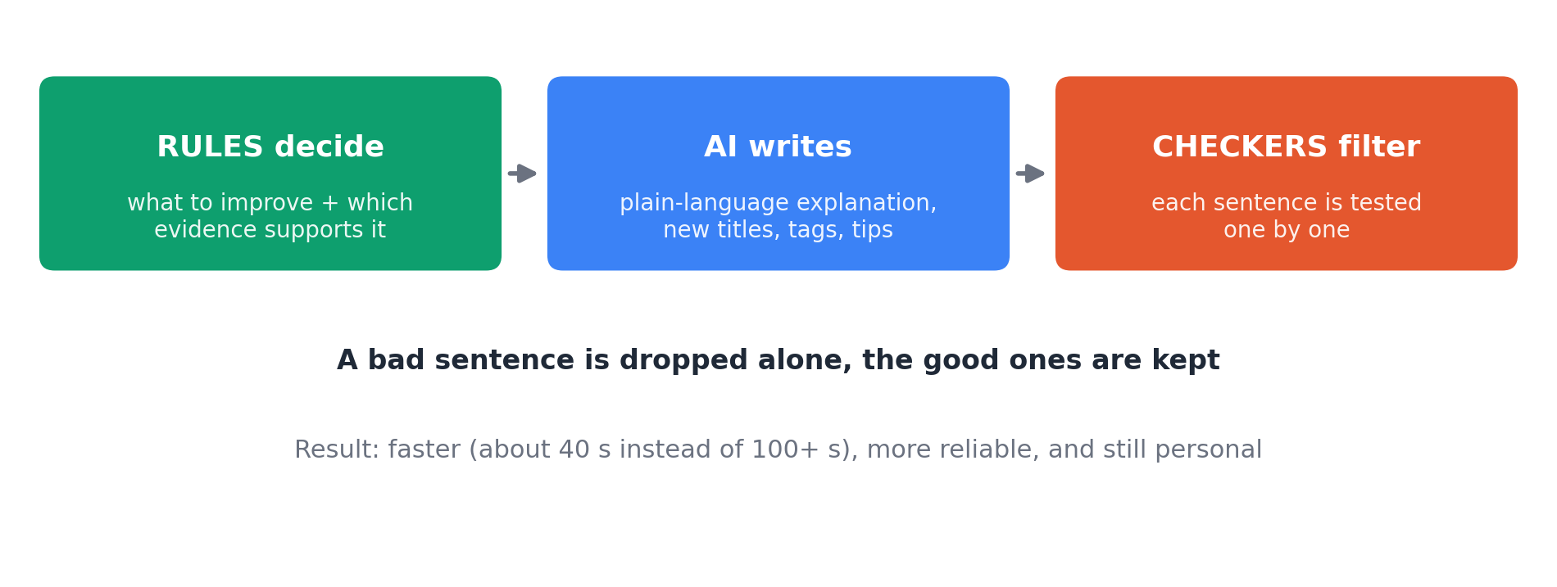
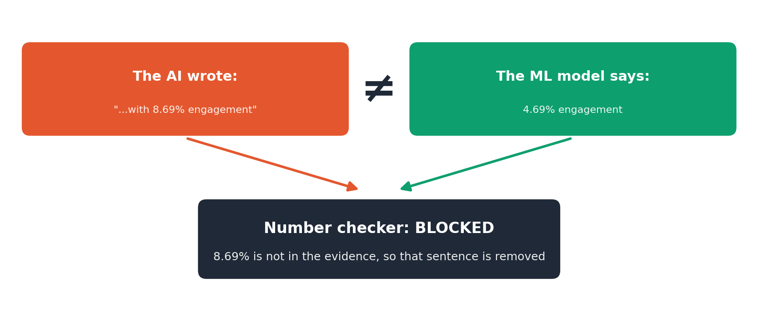
SGT UNIVERSITY · DEPT. OF COMPUTER SCIENCE & ENGINEERING, SOET
NEW · SAFETY
Catching Hallucinations
Each sentence is tested alone: numbers, promises, links, title quality
Real case: the AI wrote 8.69% engagement; the ML model said 4.69%. The sentence was removed.
If nothing survives the checks, we step down to the next model
Computer Science & Engineering, SOET — SGT University
13 / 19
Notes:
This is a real example from our own testing, which is why we never let the AI touch numbers.

Slide 14
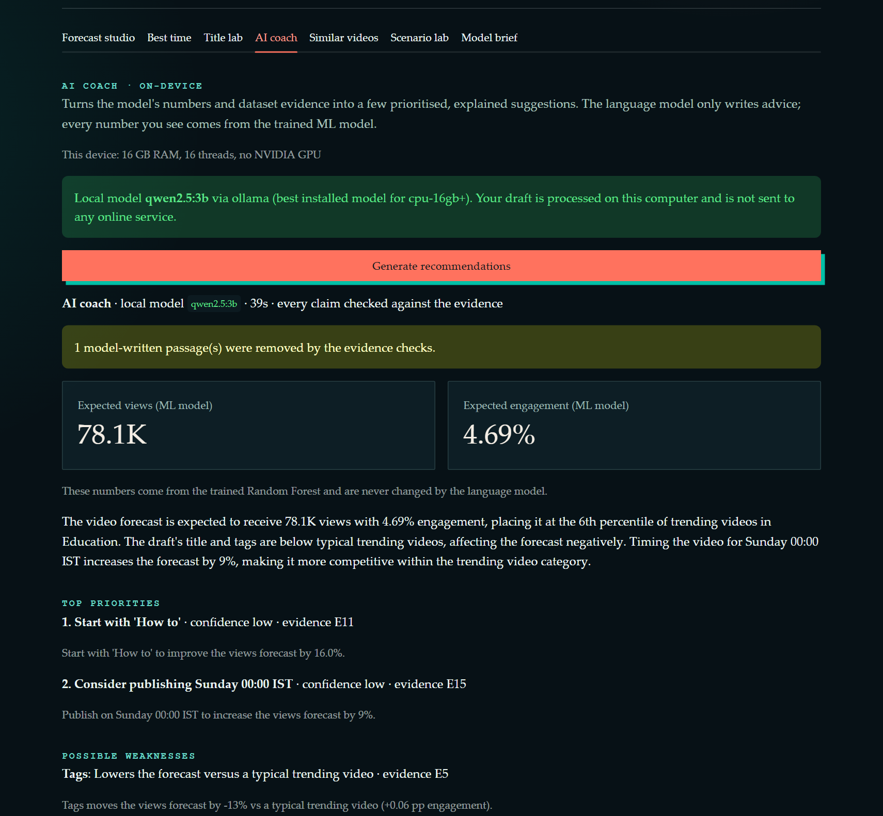
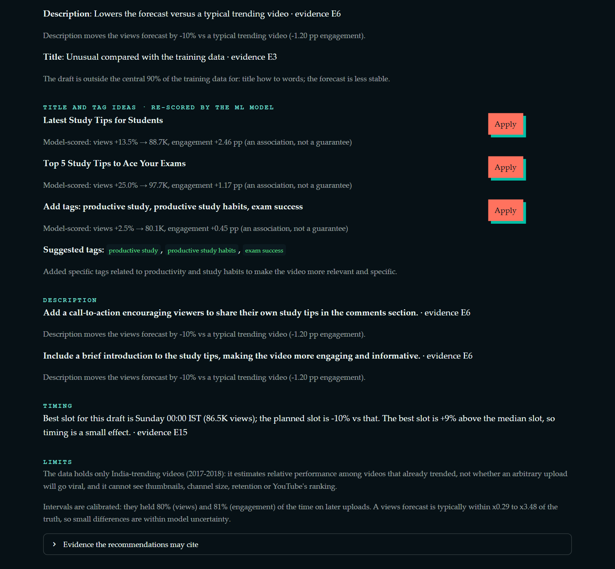
SGT UNIVERSITY · DEPT. OF COMPUTER SCIENCE & ENGINEERING, SOET
NEW · REAL RESULT
AI Coach Running the Real qwen2.5:3b Model
Computer Science & Engineering, SOET — SGT University
14 / 19
Notes:
This screenshot is from the real model on our laptop (no graphics card), about 40 seconds. Notice the ML numbers on top, the re-scored titles, and the removed sentence notice.

Slide 15
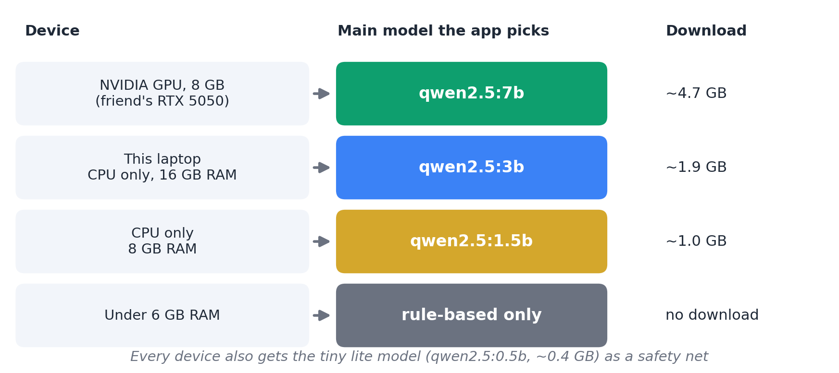
SGT UNIVERSITY · DEPT. OF COMPUTER SCIENCE & ENGINEERING, SOET
NEW · EVALUATION
Real Model Runs and Device-aware Choice
Real runs on 16 GB RAM, 16 threads, no NVIDIA GPU
Draft | Written by | Time | Removed
education | main AI (qwen2.5:3b) | 38 s | 1
music | main AI (qwen2.5:3b) | 37 s | 0
tech | main AI (qwen2.5:3b) | 37 s | 0
trailer | main AI (qwen2.5:3b) | 38 s | 2
Removed = model-written sentences discarded by the evidence checks.
App detects RAM and NVIDIA GPU memory and picks the model size
RTX 5050 8 GB laptop: plans qwen2.5:7b (planned, not tested here); this CPU laptop: 3B
Computer Science & Engineering, SOET — SGT University
15 / 19
Notes:
Be honest: the 7B model for the RTX 5050 laptop is planned but untested because we do not have that laptop.

Slide 16
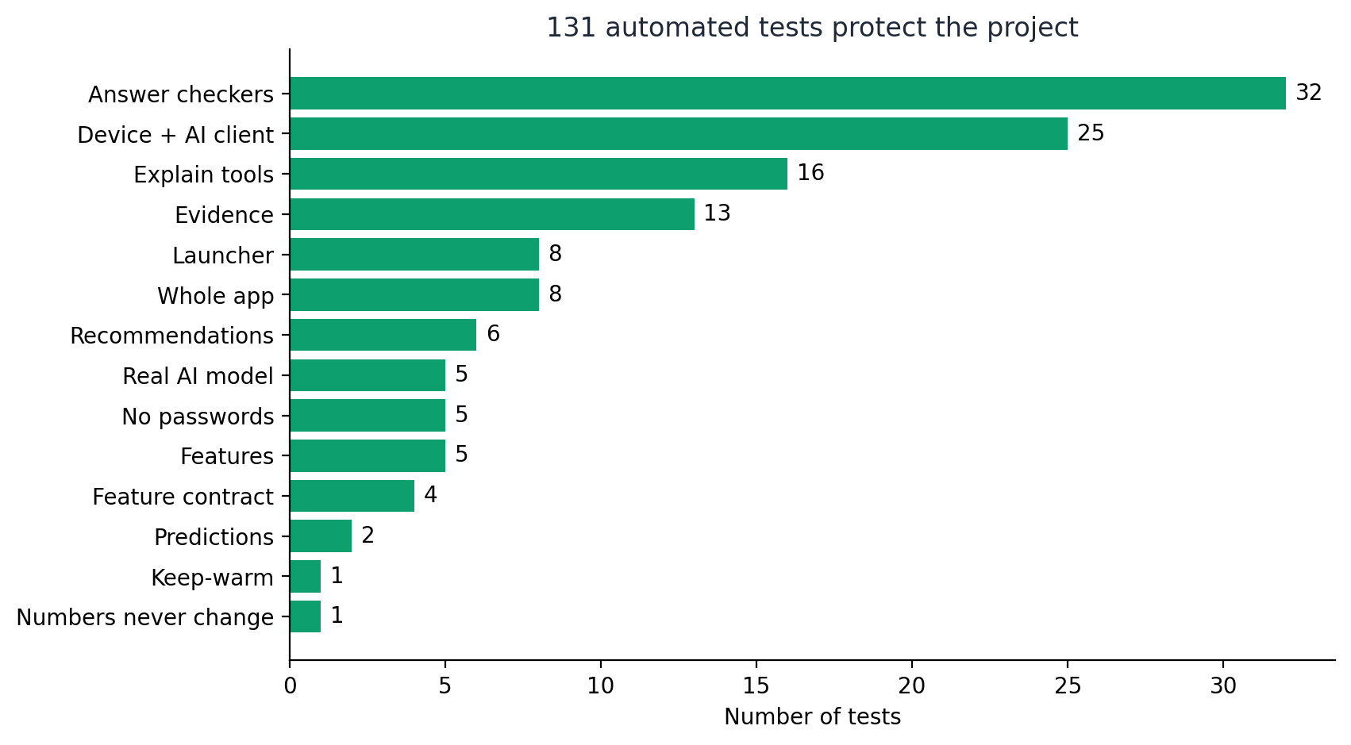
SGT UNIVERSITY · DEPT. OF COMPUTER SCIENCE & ENGINEERING, SOET
ENGINEERING
131 Automated Tests and a One-command Launcher
Golden test: forecasts for 7 drafts identical before and after the AI Coach
Tests call the real local AI when it is available
GitHub Actions runs every test on each push; secret-scan test
run.ps1 / run.sh: sets up, detects the device, installs Ollama, pulls the model, starts the app
Computer Science & Engineering, SOET — SGT University
16 / 19
Notes:
The golden test is the key: it proves the AI layer cannot secretly change a forecast.

Slide 17
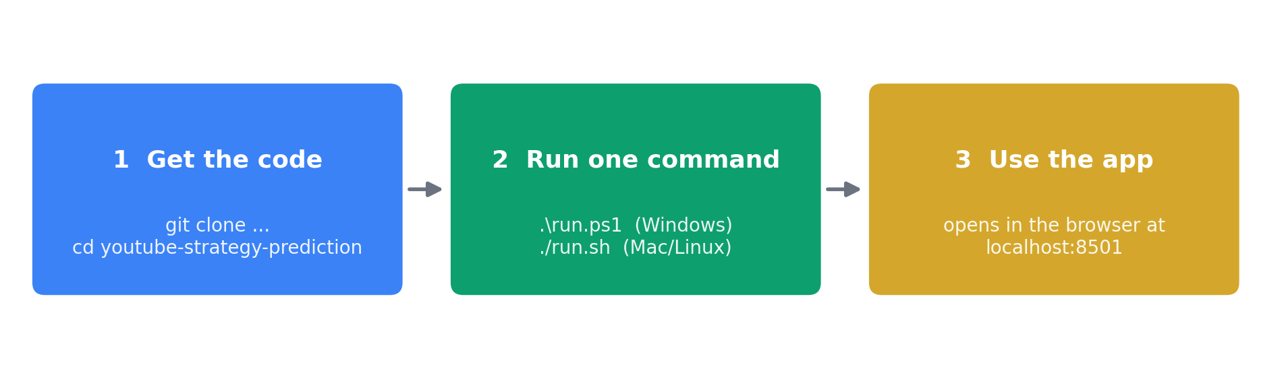
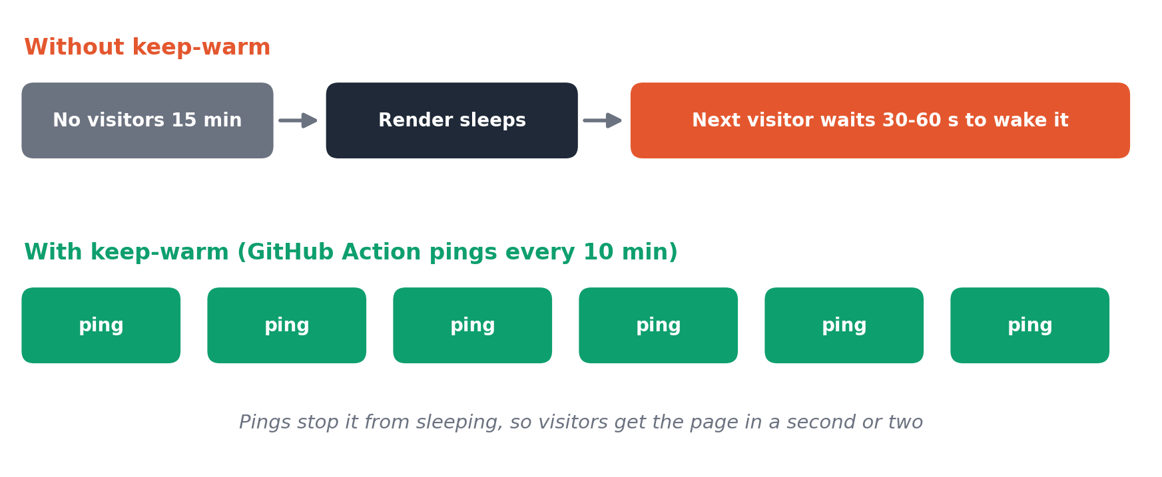
SGT UNIVERSITY · DEPT. OF COMPUTER SCIENCE & ENGINEERING, SOET
DEPLOYMENT
Run Anywhere and Online
Needs only Python 3.10+ and git; first run downloads Ollama and a model after asking
If the AI cannot start, the app still works with rule-based advice
Online: youtube-strategy-predictor.onrender.com (rule-based mode)
Keep-warm ping every 10 minutes to avoid the free-tier cold start
Computer Science & Engineering, SOET — SGT University
17 / 19
Notes:
Open the online site a minute before the demo. The free server sleeps when idle.

Slide 18
SGT UNIVERSITY · DEPT. OF COMPUTER SCIENCE & ENGINEERING, SOET
LIMITATIONS
Limitations and Honest Caveats
VARIANCE EXPLAINED BY PRE-PUBLISH METADATA
42% (views) to 64% (engagement)
views 42%
engagement 64%
Thumbnails, channel reputation and YouTube's ranking are not in the data
Only videos that already trended (India, 2017-2018): not a viral vs non-viral study
Shapley, keywords and edit rankings are associations, not causes
CPU laptop: AI answers take about 30 to 80 seconds; the 7B GPU path is untested
The online site runs without the AI model (free tier is too small)
Computer Science & Engineering, SOET — SGT University
18 / 19
Notes:
Say the limits out loud. Honest limits make the project more credible.

Slide 19
SGT UNIVERSITY · DEPT. OF COMPUTER SCIENCE & ENGINEERING, SOET
NEXT STEPS
Where We Go From Here
STEP 1
STEP 2
STEP 3
STEP 4
Test on the RTX 5050 laptop
Thumbnail and channel features
Broader data
Creator study
compare the 7B model with the 3B model
add the missing strong signals
include non-trending videos
check whether the advice is actually useful
Thank you. Questions?
Computer Science & Engineering, SOET — SGT University
19 / 19

