Slide 1
AI / ML • THEMATIC ASSESSMENT 4
01
AI-Based YouTube
Analytics & Content
Strategy Prediction
TITLE
TAGS
ML
MODEL
TIMING
Can pre-publication metadata help a creator make a better upload decision?
CATEGORY
TA4 FINAL EVALUATION
Regression • Explainability • Live demo
views + engagement
with honest limits
A decision-support model for already trending videos
Kaggle India trending-video snapshot • project results

Slide 2
AI / ML • THEMATIC ASSESSMENT 4
02
The decision happens before the video goes live
Creators choose metadata first, then receive feedback only after the key distribution window has passed.
1
Creator-controlled choices
2
Prediction task
3
Strategy output
Title, description, tags, category and publish time are known before upload.
Estimate relative views and engagement from only those pre-publication signals.
Translate model patterns into a transparent checklist and a live draft comparison.
The claim we can defend
Among videos that already trended in India, metadata helps estimate relative performance. It does not tell us whether an arbitrary upload will become viral.
Scope is explicit: decision support, not a viral/non-viral classifier
Kaggle India trending-video snapshot • project results

Slide 3
AI / ML • THEMATIC ASSESSMENT 4
03
A real India dataset — cleaned at the video level
Trending YouTube Video Statistics (Kaggle), India subset; each raw record is one daily trending snapshot.
RAW SNAPSHOTS
UNIQUE VIDEOS
37,352
16,307
DE-DUPLICATE
BY VIDEO ID
A video can appear on the trending list on several days.
Latest snapshot retained per video; no required-field rows were lost.
Why it matters: avoids over-weighting videos simply because they trended longer.
Date parsing precedes sorting so the retained record is truly the latest snapshot
Kaggle India trending-video snapshot • project results

Slide 4
AI / ML • THEMATIC ASSESSMENT 4
04
A reproducible AI/ML workflow
The project is a clear supervised-regression pipeline, from raw evidence to creator-facing guidance.
01
02
03
04
05
Clean
Engineer
Compare
Validate
Explain
Parse dates
Deduplicate
Pre-publish
features only
Linear, RF
and XGBoost
5-fold CV +
held-out test
Importance +
strategy advice
Leakage firewall: likes, dislikes and comment count are outcomes only — never inputs.
Scripts: clean.py → features.py → train.py → evaluate.py
Kaggle India trending-video snapshot • project results

Slide 5
AI / ML • THEMATIC ASSESSMENT 4
05
Feature engineering answers one question: what is known before publication?
Inputs are transparent enough to explain in a viva and practical enough for a creator to change.
PACKAGING
Title length • word count • number • question mark • capitals
TARGETS
Views
trained as log1p(views)
DISCOVERY
Tag count • category • description length
Engagement rate
(likes + comments) / views
TIMING
Publish day and hour, converted from UTC to IST
post-publication counts excluded from inputs
This protects the model from “cheating” and makes the live demo valid before upload.
Feature table preserves a strict separation between metadata and outcomes
Kaggle India trending-video snapshot • project results

Slide 6
AI / ML • THEMATIC ASSESSMENT 4
06
Random Forest delivered the strongest held-out performance
A simple linear baseline sets the floor; tree ensembles capture non-linear interactions among metadata signals.
Views R²
5-FOLD CROSS-VALIDATION
Linear
0.20
Views
Random Forest
0.38
RF R² 0.367 ± 0.012
XGBoost R² 0.337 ± 0.016
Engagement R²
Engagement
Linear
0.38
RF R² 0.598 ± 0.025
XGBoost R² 0.569 ± 0.050
Random Forest
0.61
The final saved models are size-tuned Random Forests.
Evaluation: 80/20 held-out test plus five-fold cross-validation
Kaggle India trending-video snapshot • project results

Slide 7
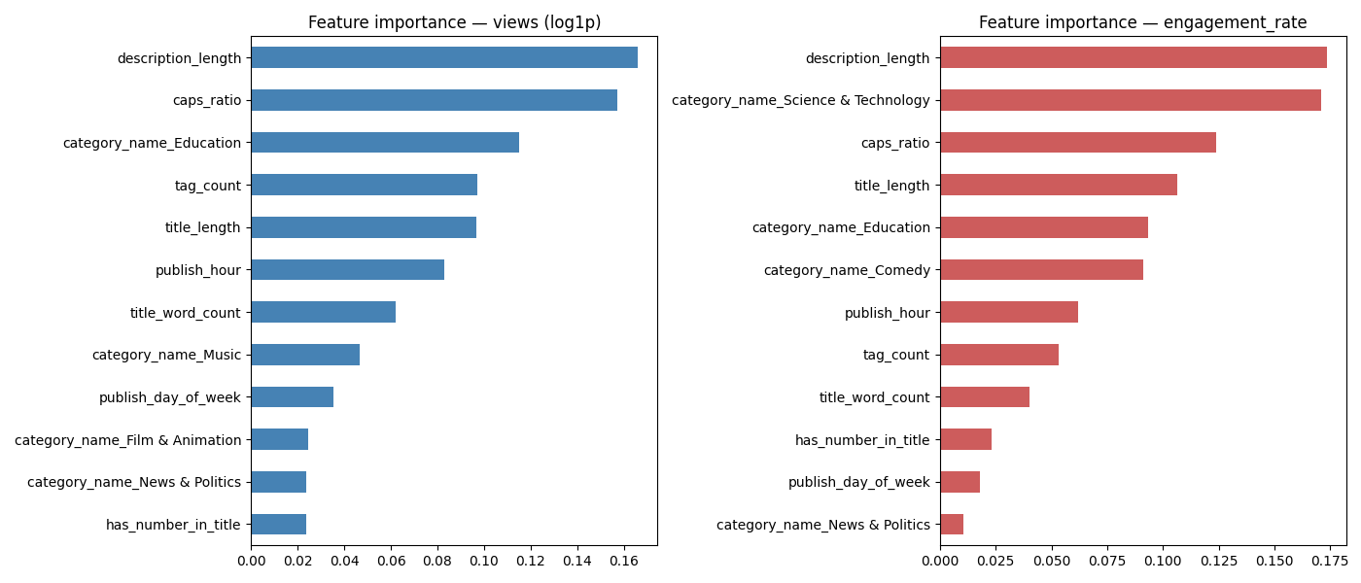
AI / ML • THEMATIC ASSESSMENT 4
07
Explainability turns a model score into discussion-ready evidence
Random Forest feature importance identifies signals the model relied on. These are associations, not causal guarantees.
Strongest signals in this fitted model
01
Description length
A proxy for how much searchable/contextual detail is provided.
02
Capitalisation style
A title-packaging signal that the model uses alongside other metadata.
03
Category signals
Context matters, but it is not the only driver of performance.
Feature importance describes the model’s behaviour; it does not prove causation
Kaggle India trending-video snapshot • project results

Slide 8
AI / ML • THEMATIC ASSESSMENT 4
08
From analytics to creator-facing recommendations
Each recommendation is tied to observed data patterns and is presented with its confidence boundary.
01
Write the description deliberately
02
Make title style intentional
Description length is the strongest feature in both fitted models.
Capitalisation and title structure matter, but overuse is not a guaranteed win.
03
Use consistent tags
04
Treat timing as a testable hypothesis
Tag count has a small positive correlation with views in this sample (r = 0.05).
Saturday 01:00 IST had the highest eligible median view count; timing effect is modest.
Evidence note: “Shows” has the highest median views among categories with at least 30 videos in this data (about 621,739; n = 121).
Recommendations support choices before upload; real audience testing still matters
Kaggle India trending-video snapshot • project results

Slide 9
AI / ML • THEMATIC ASSESSMENT 4
09
Six explainable tools turn one forecast into decisions
Every tool re-uses the same trained model and the same leakage-safe features; none needs the raw dataset at run time.
01
Why this forecast
02
Best time to post
03
Title lab
Exact Shapley values over five feature groups. The effects add up to forecast minus a typical trending video.
The same draft is scored in all 168 weekly slots (IST) and shown as a heatmap with the best three.
About twelve programmatic edits are re-scored by the model and ranked; one click applies an edit.
04
Similar videos
05
Keyword radar
06
Scenario lab
TF-IDF look-alike trending videos give an independent second opinion on the forecast.
Median views by title word, using only words that appear across 25+ different channels.
A/B comparison with an interval-overlap check, plus a category what-if chart.
All outputs are associations learned from data, not causal promises
Kaggle India trending-video snapshot • project results

Slide 10
AI / ML • THEMATIC ASSESSMENT 4
10
How sure is the model? We measured it, not assumed it
Split-conformal 80% intervals are calibrated on out-of-fold errors, then tested on later uploads the calibration never saw.
80.0%
79.7%
80.9%
Out-of-fold coverage
Later-upload coverage
Later-upload coverage
views and engagement intervals
views interval (chronological holdout)
engagement interval (chronological holdout)
Honest reading: a views forecast is typically within x0.29 to x3.5 of the truth. The interval is wide because pre-publication metadata is a moderate signal (R² 0.42 in cross-validation, 0.37 on later uploads). A wide, correct interval is better than a narrow, wrong one.
33 automated tests • GitHub Actions CI • deployed as a Streamlit web service
Kaggle India trending-video snapshot • project results

Slide 11
AI / ML • THEMATIC ASSESSMENT 4
11
TA4 live demo: compare draft decisions before upload
The interactive application makes the model tangible without hiding its limitations.
1 ENTER A DRAFT
2 GET A TRANSPARENT ESTIMATE
Title
Predicted views
expm1()
Category
Predicted engagement
as a %
Tags / description
3 COMPARE DRAFTS AND EXPLAIN THE INPUTS
Publish day and hour (IST)
Use estimates as a decision aid — not a promise.
Demo workflow: draft → feature row → saved model → human-readable result
Kaggle India trending-video snapshot • project results

Slide 12
AI / ML • THEMATIC ASSESSMENT 4
12
What the model cannot see is as important as what it can
A strong presentation states the boundaries of its evidence clearly.
1
2
3
TRENDING-ONLY SAMPLE
MISSING HIGH-IMPACT SIGNALS
MODEL FIT
The dataset has no non-trending comparison group, so we estimate relative performance among videos that already succeeded.
Thumbnail quality, channel reputation, audience retention and platform ranking signals are not available.
Pre-publication metadata explains about 42% of log-view variation (37% on later uploads) and 64% of engagement variation (53% on later uploads).
Responsible conclusion: the system supports better questions and comparisons, not certainty about a future audience.
Limitations are part of the result, not an afterthought
Kaggle India trending-video snapshot • project results

Slide 13
AI / ML • THEMATIC ASSESSMENT 4
13
How the project can grow from a strong baseline
The current system is deliberately interpretable; the next version can expand the evidence without sacrificing clarity.
01
Richer title semantics
02
Thumbnail intelligence
Readability, sentiment and topic features can add nuance beyond simple length and capitalisation.
Computer-vision features can capture visual packaging, a major missing signal today.
03
Better outcome dataset
04
Creator feedback loop
Collect fixed-age performance for trending and non-trending uploads to reduce survivorship bias.
Compare predicted versus actual outcomes, then retrain with newer data and real experiments.
Future work is a roadmap, not a claim about the current fitted model
Kaggle India trending-video snapshot • project results

Slide 14
AI / ML • THEMATIC ASSESSMENT 4
14
The takeaway
A student-built,
explainable ML system
that makes upload
choices discussable.
DATA
16,307 unique videos
MODEL
Random Forest + calibrated intervals
DEMO
Explain, time, edit, compare
LIVE
youtube-strategy-predictor.onrender.com
Thank you
Questions, model walkthrough, or live demo?
AI-Based YouTube Analytics and Content Strategy Prediction
Kaggle India trending-video snapshot • project results

