Slide 1




Weather Prediction Models for Prosumer Energy: Analyzing Effectiveness and Biases
AIT 664 – 002
FINAL PROJECT PRESENTATION
GEORGE MASON UNIVERSITY
PRESENTED BY
NIKU KUMARI JAWAHAR CHOWDARI
GUIDED BY:
PROF. SHARMIN SULTHANA

Slide 2

Content
Background Motivation
Research Questions
Data
Data Cleaning & Transformation
EDA
Feature Engineering & Selection
Machine Learning Models
Conclusion

Slide 3
Background Motivation
The project's background and motivation stem from the increasing importance of reliable weather predictions for households producing their own energy. As more people adopt renewable energy sources like solar panels, the weather becomes a critical factor in determining how much energy they can generate. Changes in temperature, cloud cover, and precipitation directly affect the availability of renewable energy, making it challenging for homeowners to manage their energy usage effectively. By exploring how different weather patterns impact energy production and consumption, this project aims to provide homeowners with valuable insights to optimize their energy usage. Additionally, addressing any biases in weather forecasting models is essential to ensure accurate predictions and help homeowners make informed decisions about their energy usage.

Slide 4
Research Questions
1. How effective are machine learning models in predicting weather variables such as temperature, dew point, and precipitation based on latitude/longitude coordinates and historical data?
2. What is the spatial and temporal variability of cloud cover and its impact on solar radiation availability for renewable energy production?
3. Can advanced statistical techniques uncover hidden patterns or relationships between weather variables and their impact on prosumers energy usage behavior?
4. What are the potential biases or limitations in weather forecasting models, and how can they be addressed to improve forecast accuracy?

Slide 5
About Data:
Dataset: Enefit public data
Data Source: https://www.kaggle.com/competitions/predict-energy-behavior-of-prosumers/data
The dataset comprises various files, each serving a specific purpose:
1. `train.csv`: This main CSV file contains information about consumers.
2. `client.csv`: This file contains client related information.
3. `forecast_weather.csv`: This file contains forecasted weather-related information.
4. `historical_weather.csv`: This file contains historical weather data.

Slide 6
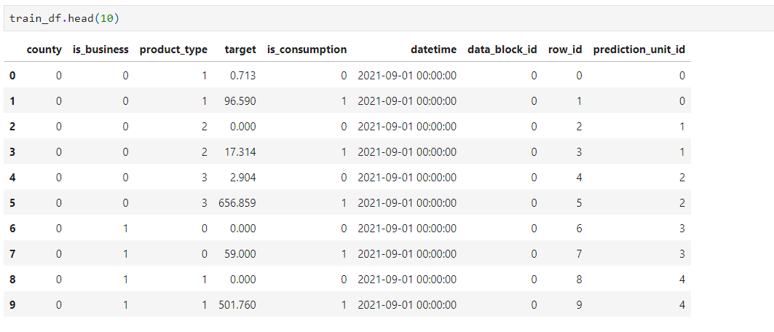
Data Cleaning & Transformation
Fig: Code snippet showing is_business and product_type in our train.csv file

Slide 7
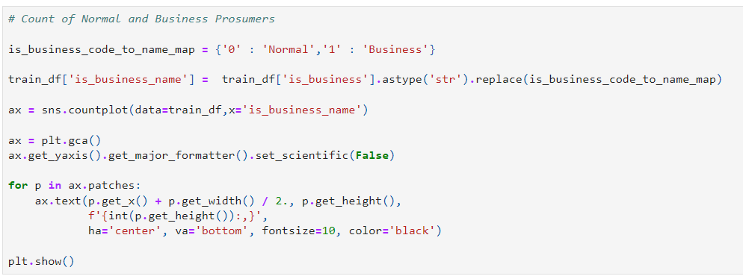
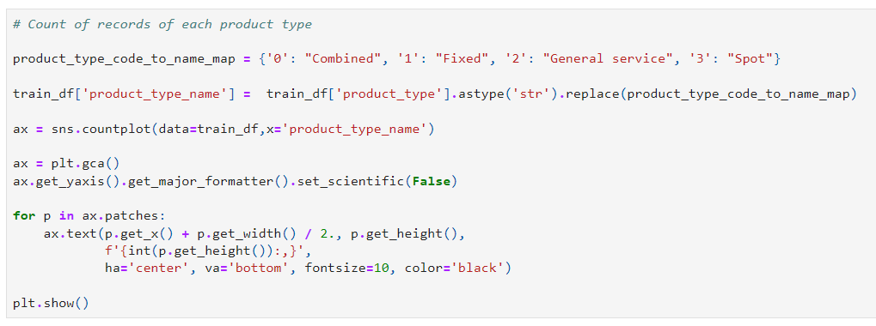
Data Cleaning & Transformation
The following code screenshots shows the mapping of the code values to text data

Slide 8
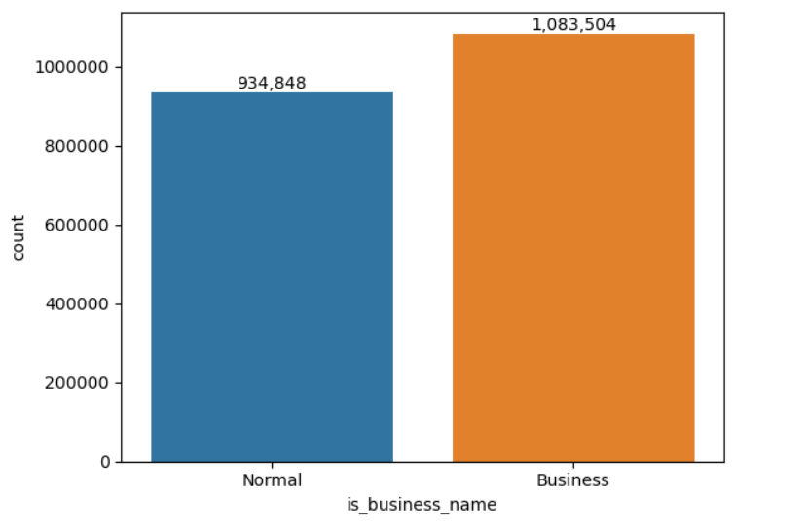
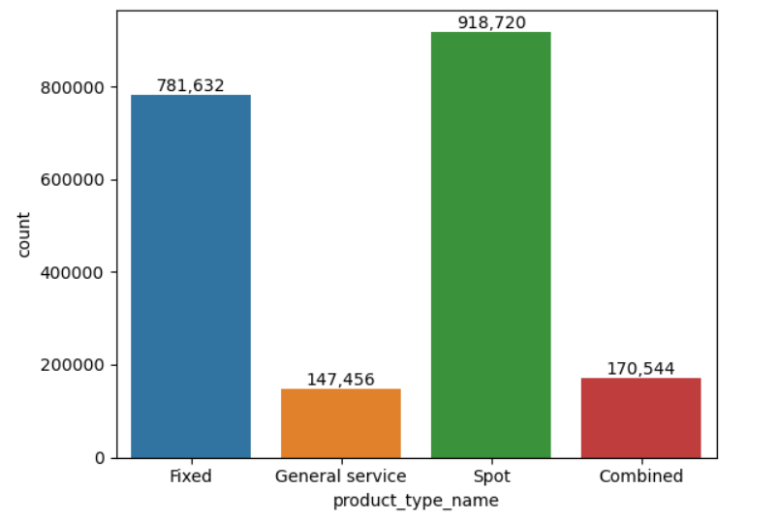
Exploratory Data Analysis
Fig: Count of diff. types of prosumers
Fig: Count of diff. types of Products or services

Slide 9
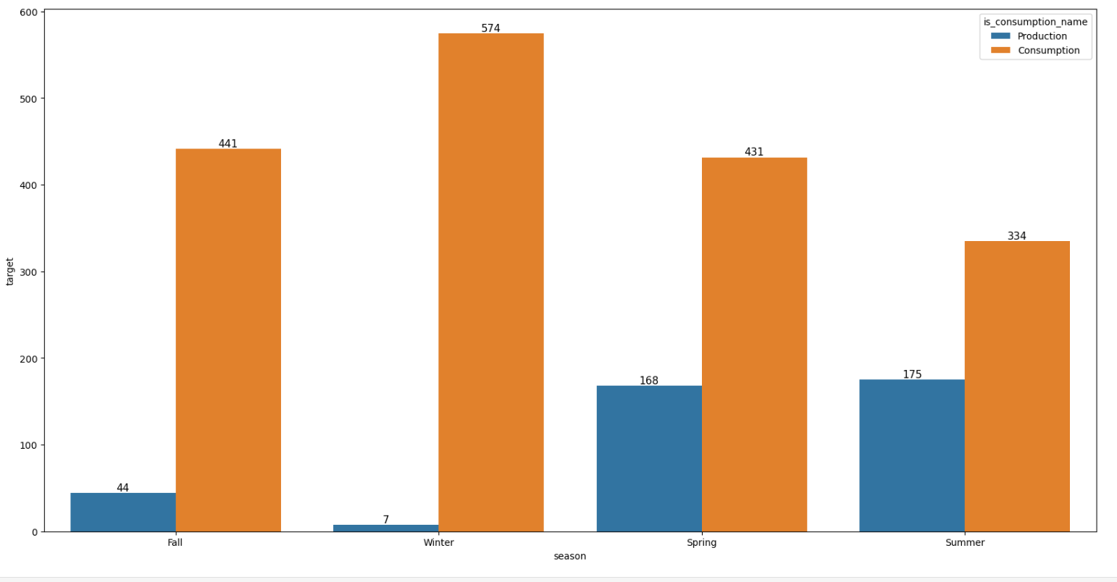
Exploratory Data Analysis
Fig: Season wise amount of energy produced and consumed by both normal and business prosumers

Slide 10
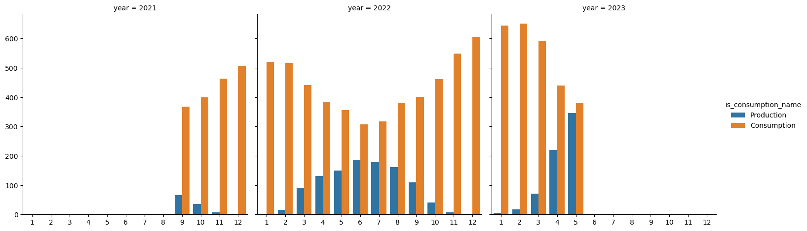
Exploratory Data Analysis
The above graph displays the monthly and yearly energy production and consumption by prosumers.

Slide 11
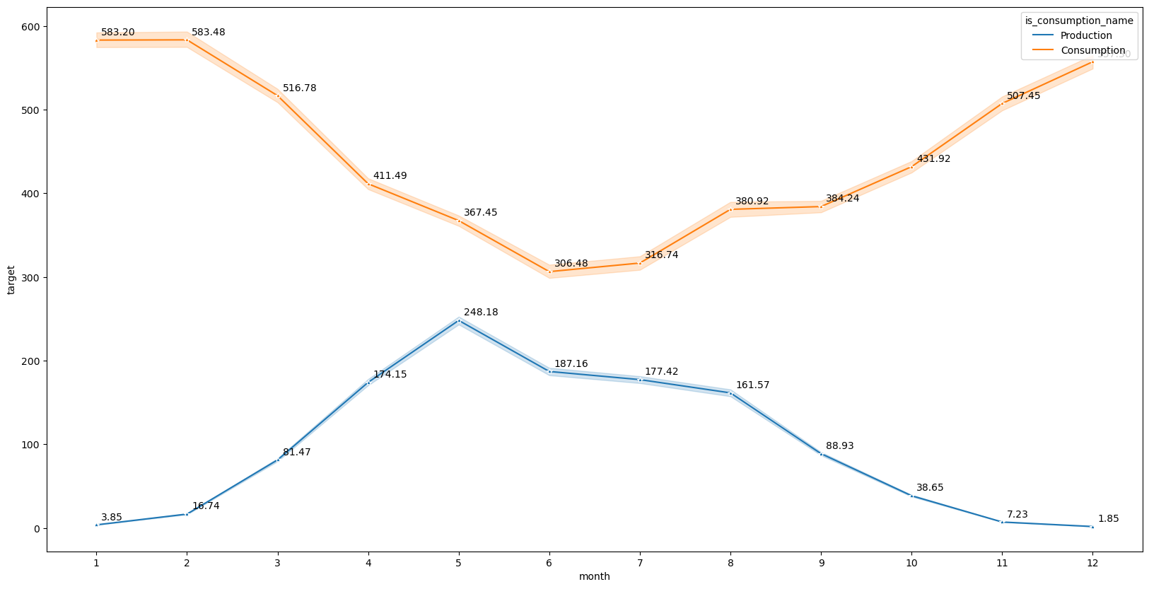
Exploratory Data Analysis
The above graph displays the energy production and consumption by prosumers on monthly basis.

Slide 12
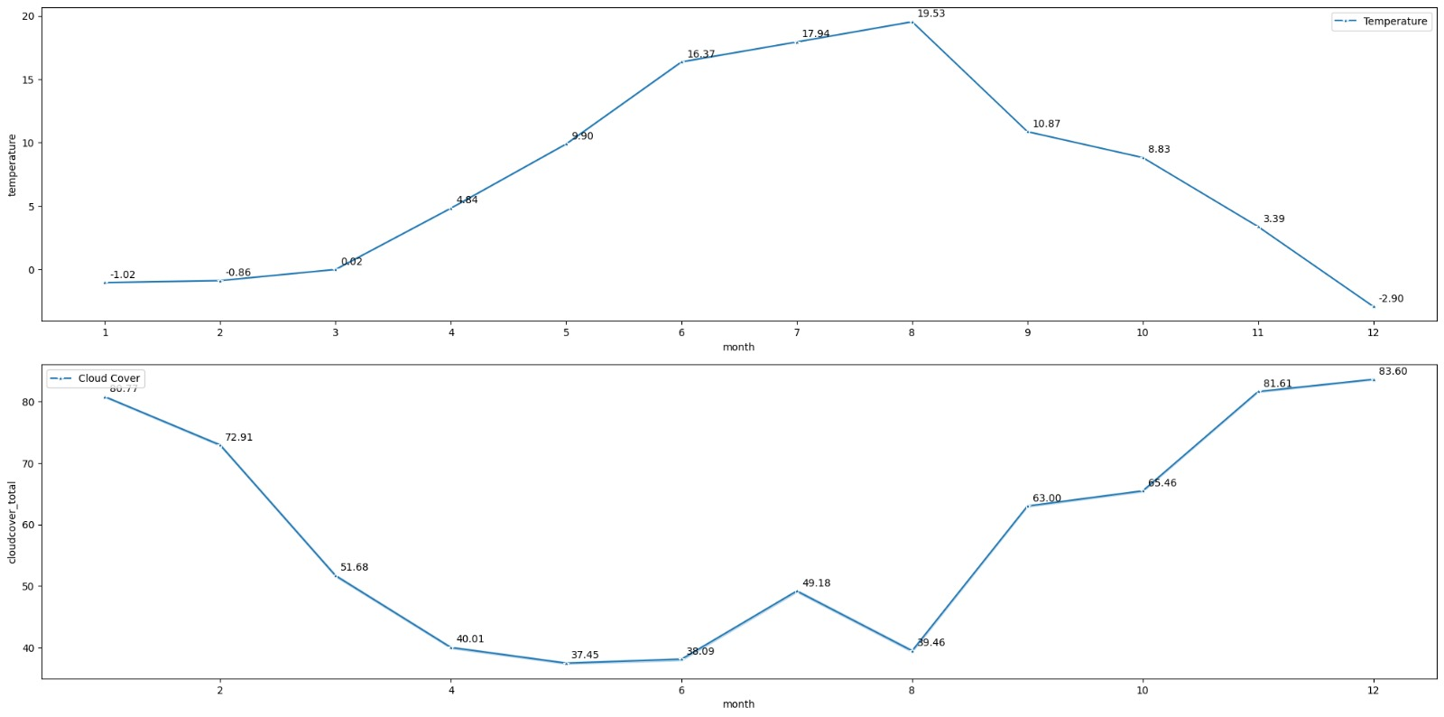
Exploratory Data Analysis
The above graph shows the relation between temperature and cloud cover over the season on monthly basis.

Slide 13
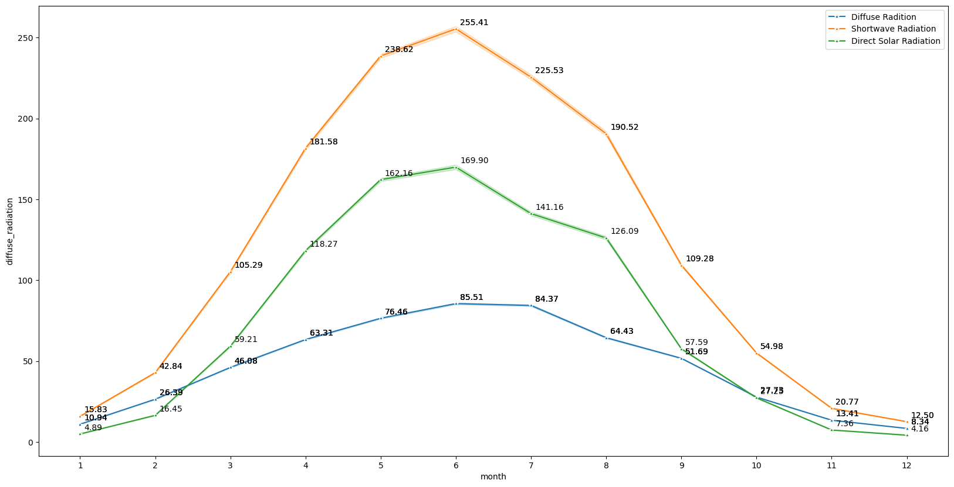
Exploratory Data Analysis
The above graph displays the distribution of diffuse radiation, shortwave radiation and direct solar radiation over the months.

Slide 14
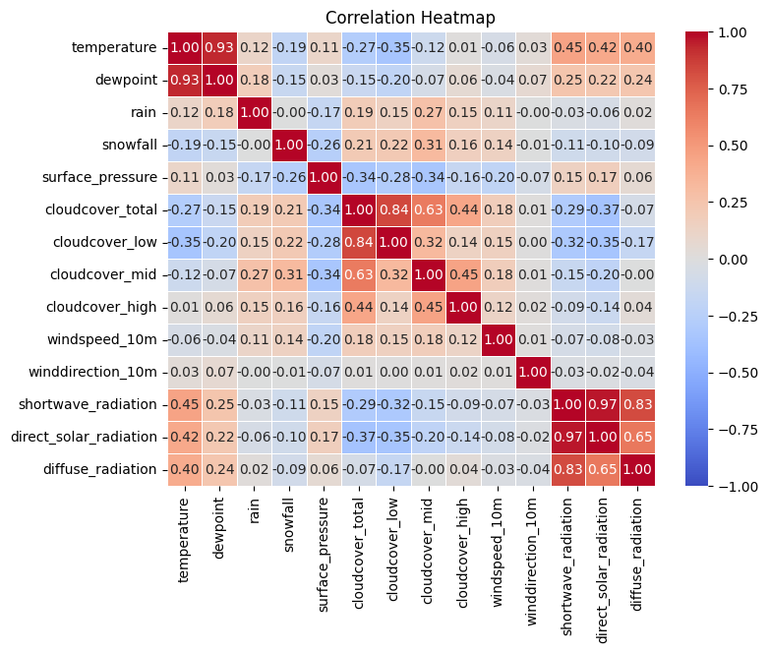
Feature Engineering & Selection
The graph shows the correlation heat map between the variables. Where red color indicates highest correlation and blue indicates lower correlation values.

Slide 15
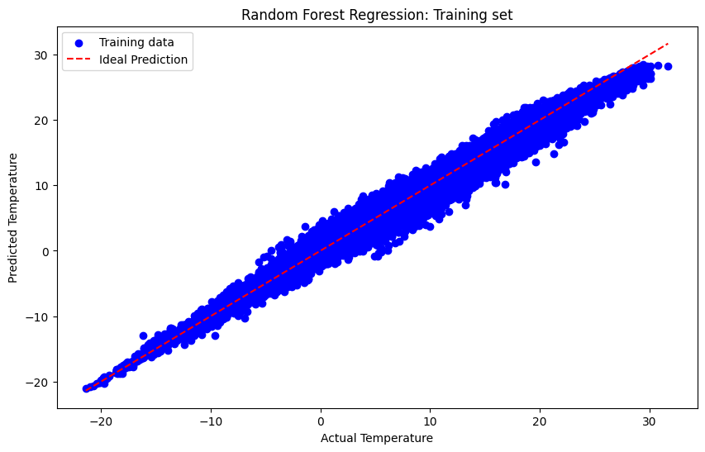
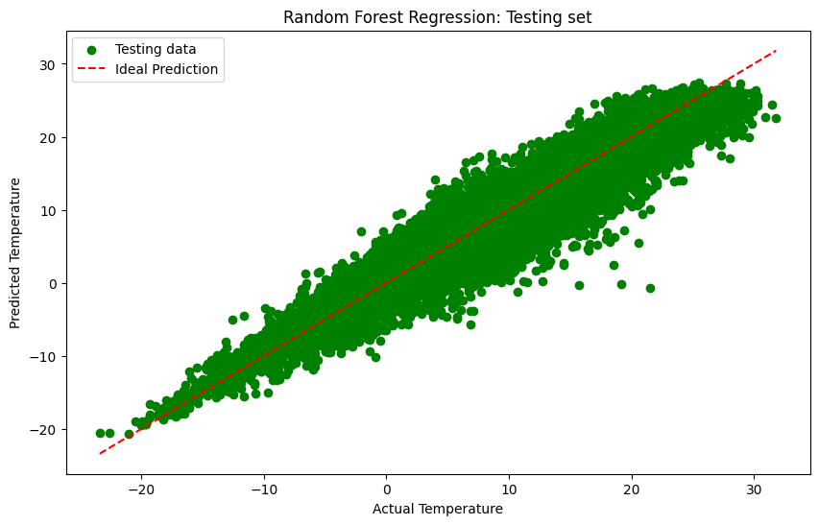
Machine Learning Models
The above two graphs shows the training and testing of the random forest regression models, respectively with 98% accuracy.

Slide 16
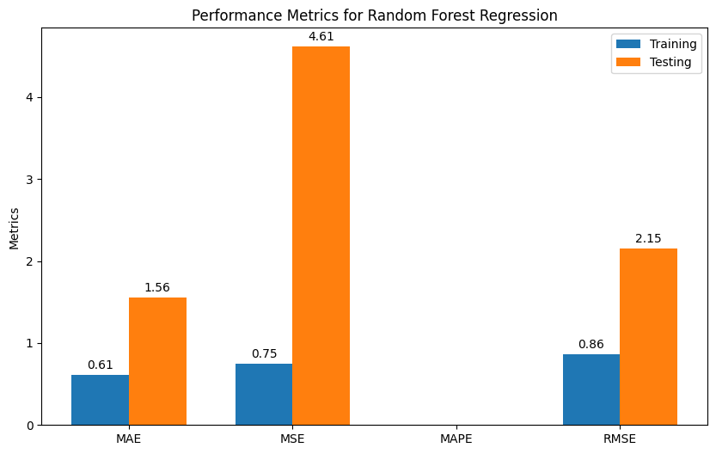
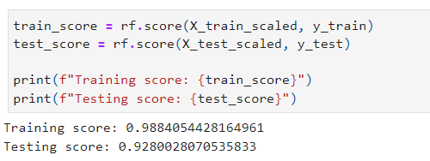
Machine Learning Models
The above graph shows the performance metrics for the random forest regression model with the MAE, MSE, MAPE and RMSE performance parameters.

Slide 17
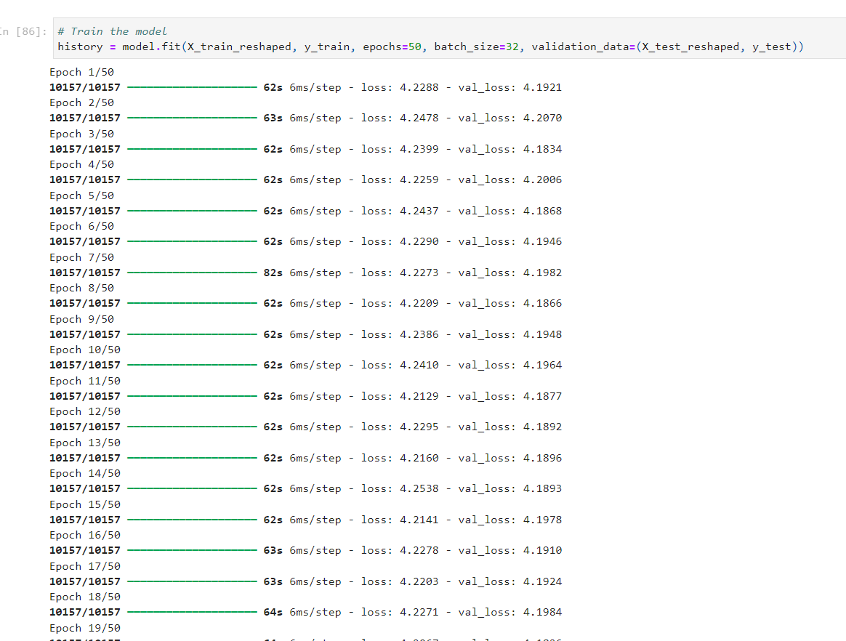
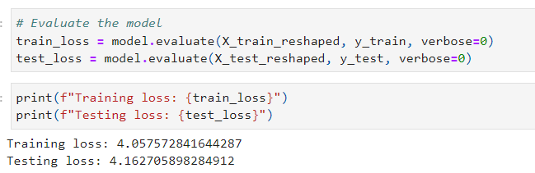
Machine Learning Models
The above code snippet shows the training of the LSTM model along with evaluation of the model and printing their loss value consequently.

Slide 18
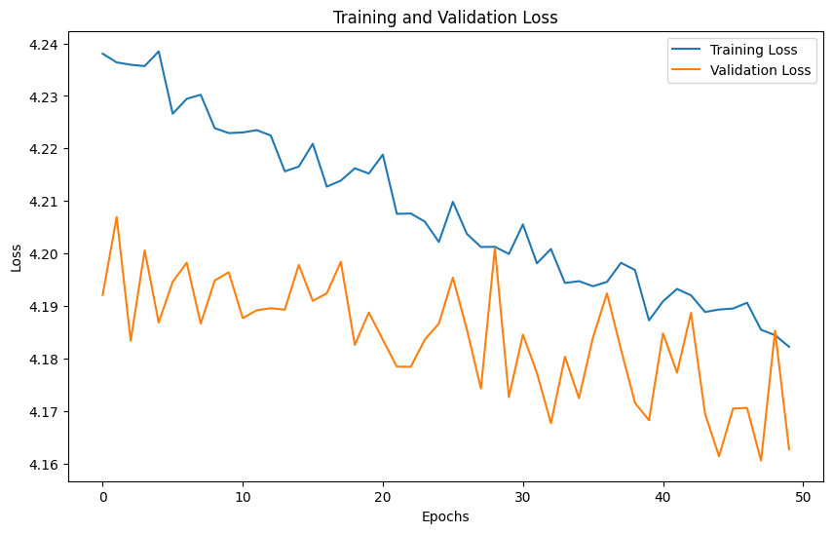
Machine Learning Models
The above graph shows the training and validation loss of the model.

Slide 19
Insights from ML Models for Weather Prediction
Random Forest Regression Model Insights:
Training Score: 0.9884
Testing Score: 0.9280
Evaluation Metrics:
MAE (Training: 0.61, Testing: 1.56)
MSE (Training: 0.75, Testing: 4.61)
RMSE (Training: 0.86, Testing: 2.15)
LSTM Model Insights:
Training Loss: 4.0576
Testing Loss: 4.1627

Slide 20
Uncovering Hidden Patterns in Weather Variables
Advanced statistical techniques, such as Pearson correlation analysis, can indeed uncover hidden patterns or relationships between weather variables and their impact on prosumers' energy usage behavior. Our findings from the Pearson correlation heatmap provide valuable insights into how different weather variables relate to each other and how they may influence energy usage behavior.
Impact:
By understanding the correlations between weather variables and their impact on energy usage behavior can help prosumers make informed decisions regarding energy consumption, production, and storage. By utilizing this knowledge, prosumers can optimize their energy usage patterns, maximize the benefits of renewable energy sources like solar and wind, and potentially reduce their overall energy costs and environmental footprint.

Slide 21
Conclusion
1. Model Effectiveness: Random Forest Regression exhibited high predictive performance, while LSTM provided valuable insights, underscoring the importance of leveraging machine learning models for weather prediction in prosumer energy systems.
2. Cloud Cover Dynamics: Analysis revealed spatial and temporal variations in cloud cover, influencing solar radiation availability. Understanding these dynamics is crucial for optimizing renewable energy production strategies.
3. Hidden Patterns Unveiled: Advanced statistical techniques uncovered correlations between weather variables and energy usage behavior, empowering prosumers to make informed decisions and maximize the benefits of renewable energy sources.
4. Addressing Biases: While no significant biases were detected in the data analysis, acknowledging potential biases in the data collection process is essential for enhancing the accuracy of weather forecasting models and ensuring reliable predictions for prosumer energy systems.

Slide 22
References
https://www.kaggle.com/competitions/predict-energy-behavior-of-prosumers/data
https://www.researchgate.net/publication/233871297_Analysis_of_energy_behaviour_profiles_of_prosumers
https://www.mdpi.com/1996-1073/16/7/3186

Slide 23
THANK YOU

