Slide 1
Making computer science learning effective and fun
www.cswonders.com

Slide 2
Your child’s time is so precious!
Your son or daughter has a unique pace
=> Personalized learning system
To validate and adapt to student’s learning
=> Data driven
To develop core skills
=> Interactive learning, focused on problem solving

Slide 3
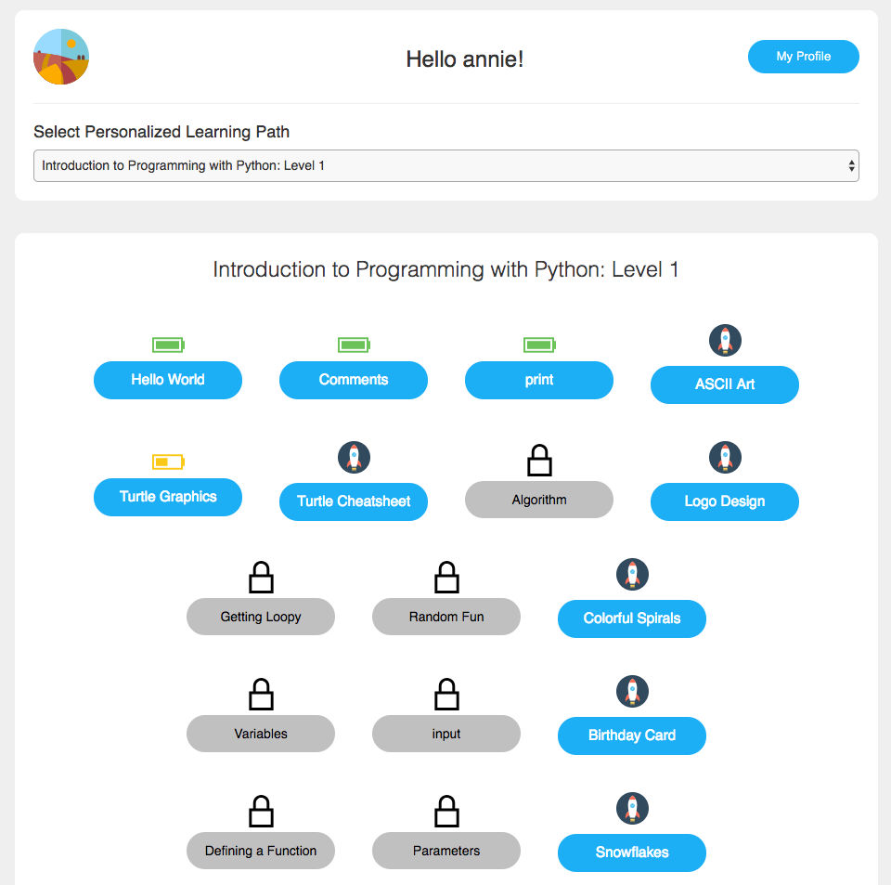
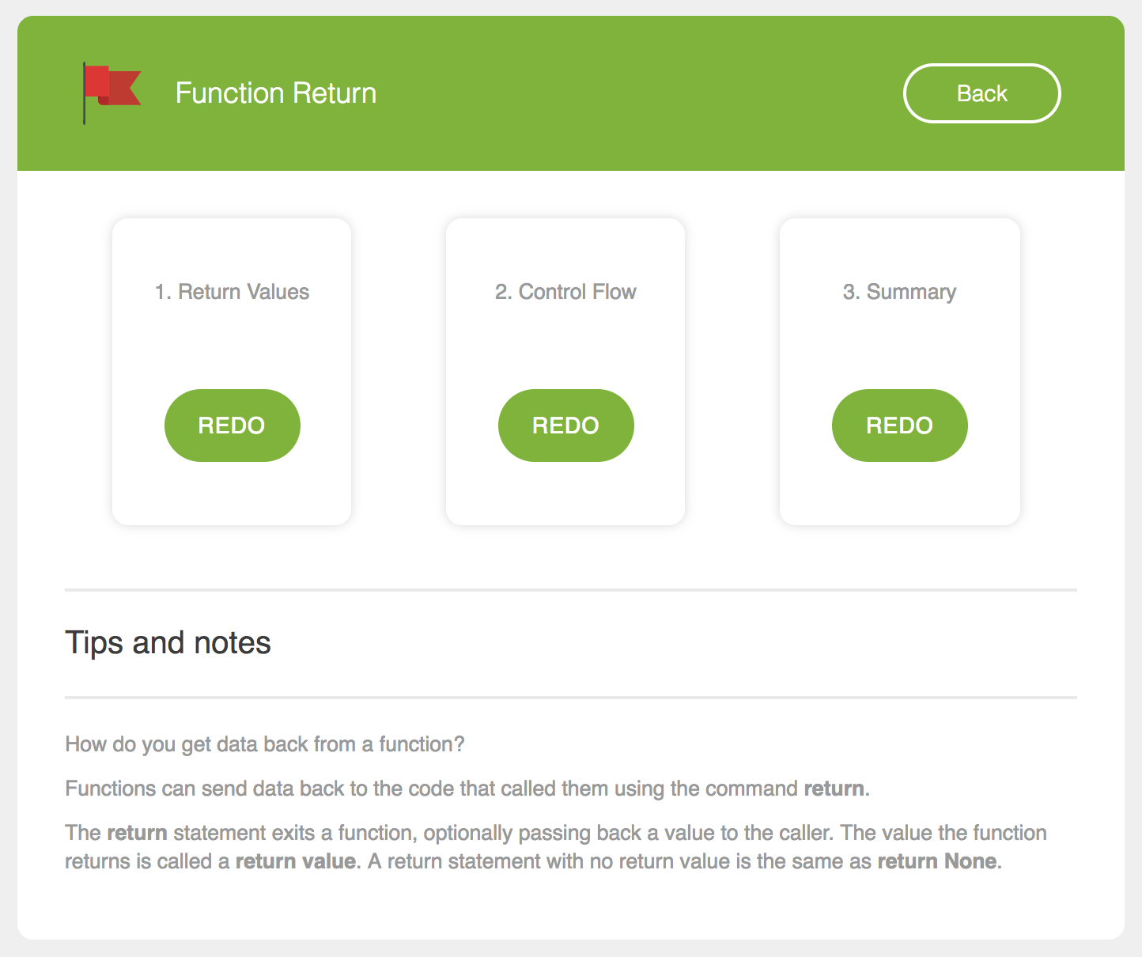
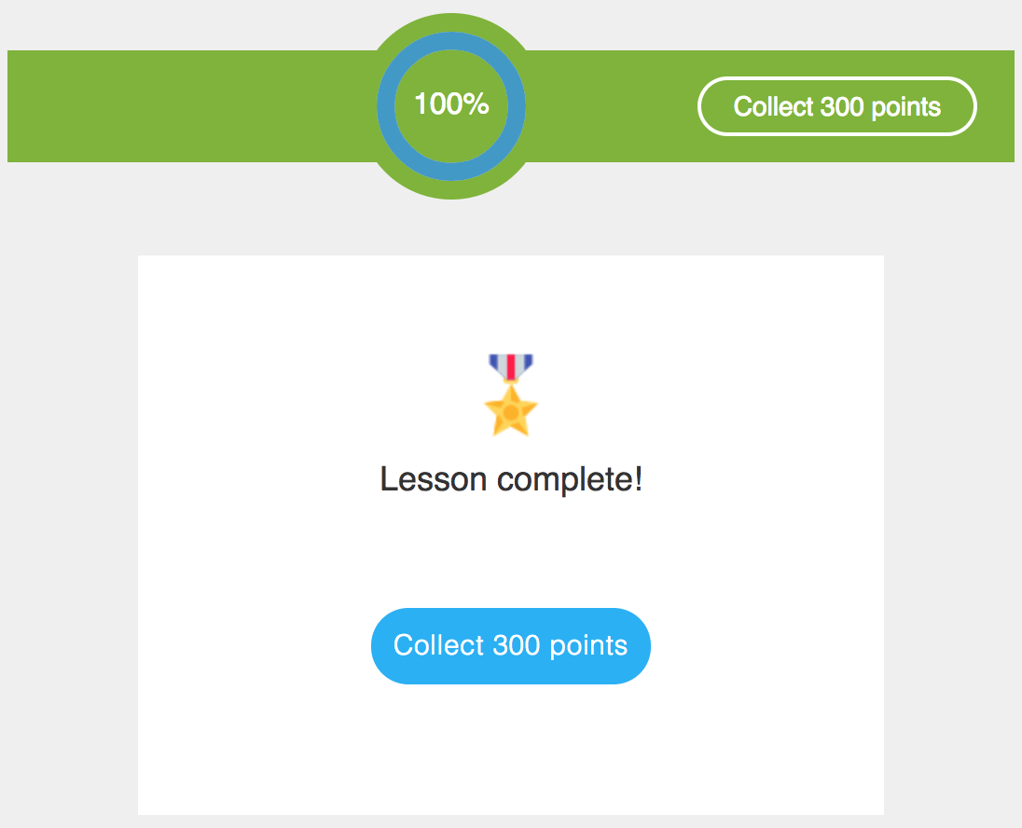
Personalized learning system
Learn at own pace
Track personal progress
Celebrate achievement

Slide 4
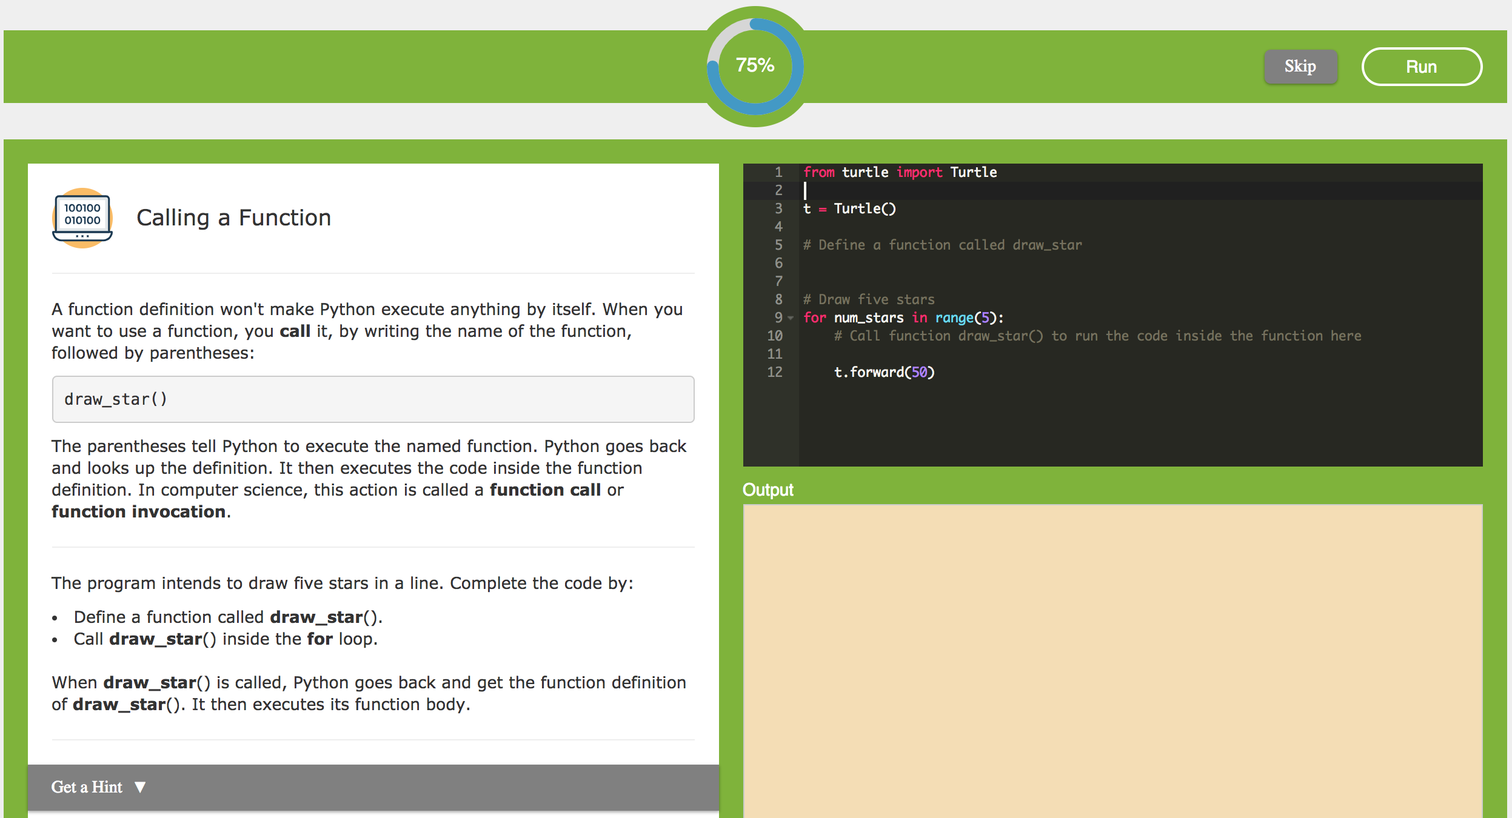
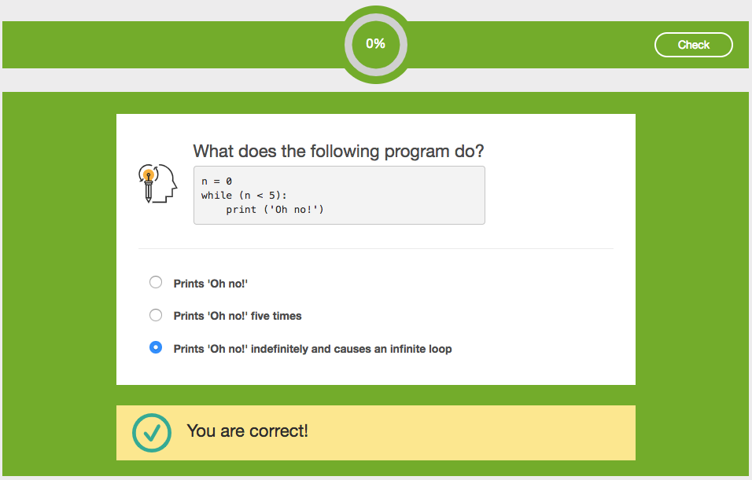
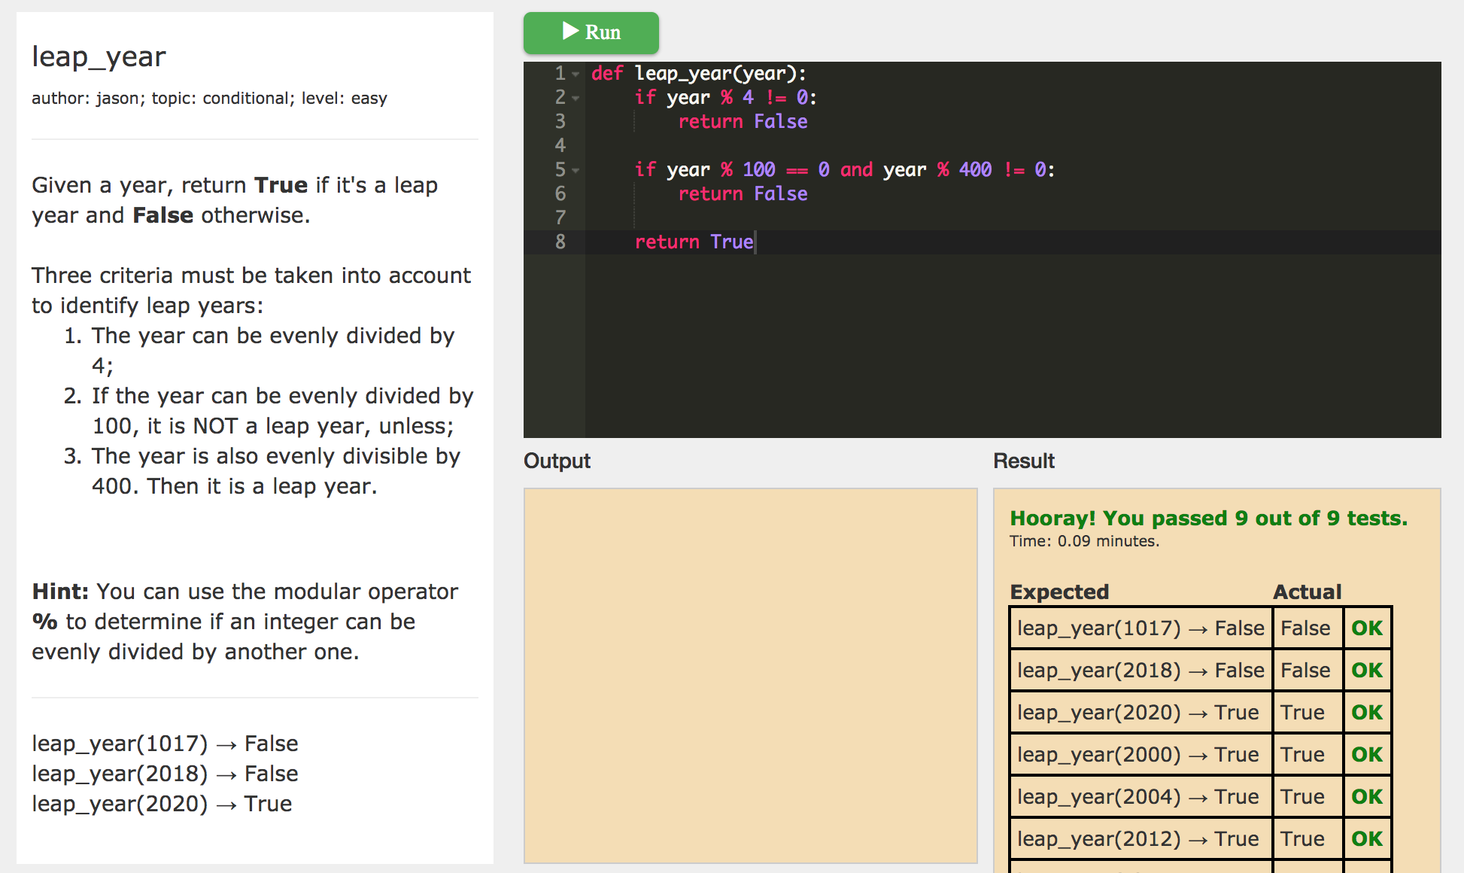
Data driven
Snippet
Learn by doing
Quiz
Reinforce key concepts
Nugget
Practice problem solving

Slide 5
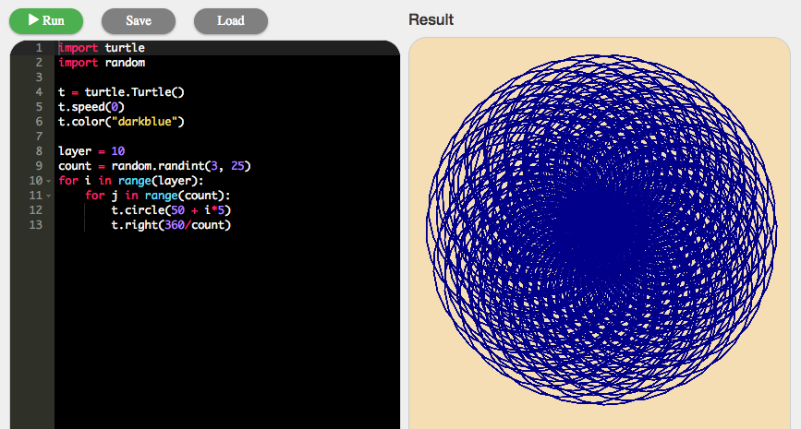
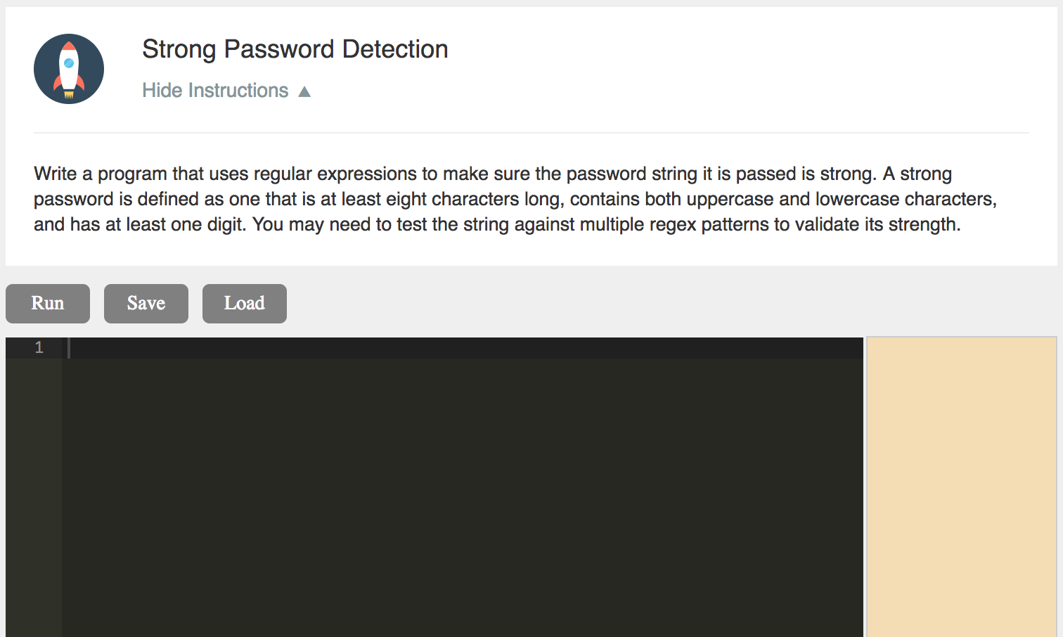
Interactive learning, focused on problem solving
Project
Become a builder & creator
CodePad
Try new ideas

Slide 6
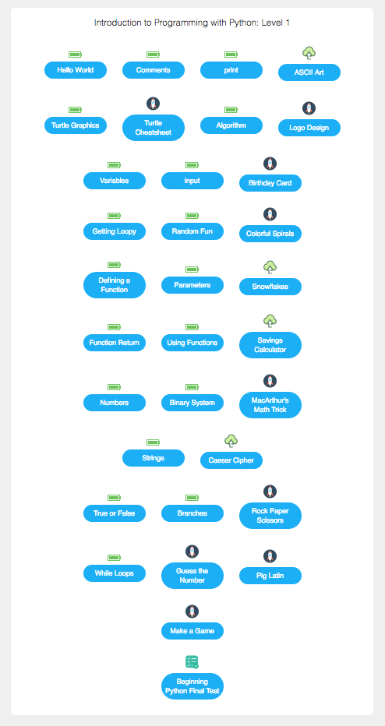
Python Level 1
input, output, Turtle Graphics, algorithm, loops, variables, functions, parameters, numbers, strings, binary system, random numbers, Boolean values, branches

Slide 7
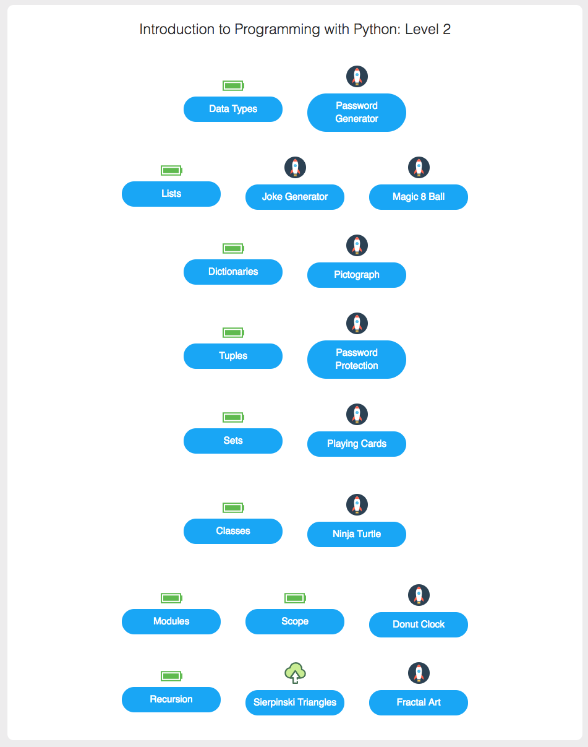
Python Level 2
data types, lists, list comprehension, dictionaries, tuples, classes and objects, inheritance, modules, Python standard library, namespace and scope, recursion

Slide 8
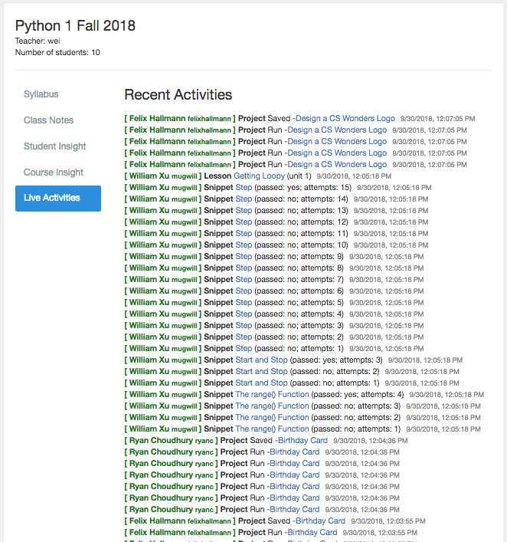
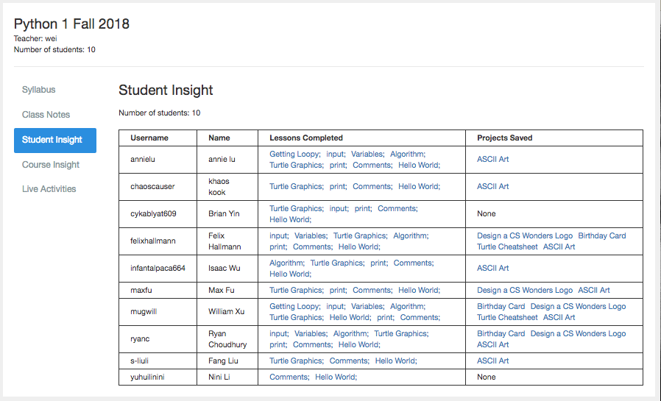
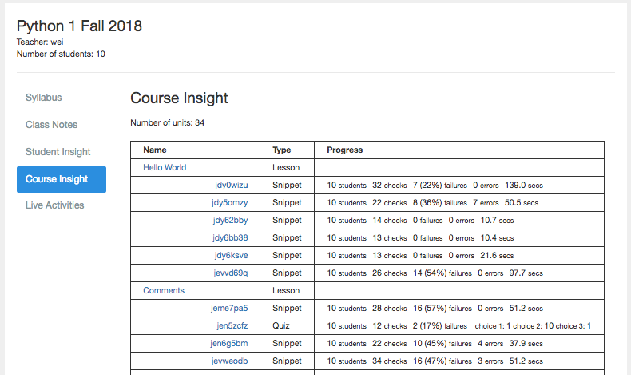
Teachers help students with rich set of tools
select courses, set up classroom,
monitor real-time dashboard,
create lessons, create quizzes, create nuggets, create projects, add notes

