Slide 1
FY 2021 – 2025
SALES
DATA ANALYTICS
PORTFOLIO
ANALYTICS
Power BI · SQL
Pandas · Excel
A comprehensive business intelligence case study covering
international markets, Amazon operations, P&L, and inventory
for a leading Indian garment export brand.
5
4+
20+
4
Dashboards
Data Sources
Yrs of Data
Tools
https://github.com/Nikul14

Slide 2
01
BUSINESS QUESTIONS
AMAZON
SALES
What we set out to answer with data
Q1 Which product category drives the most Amazon revenue?
Category Analysis
DASHBOARD
Q2 What is the Amazon FBA vs Merchant (FBM) revenue split?
Channel Mix
FY 2025
Q3 How has revenue trended over time (2004–2006)?
Time Series
₹15.74M
Total Revenue
Q4 What is the average order value across categories?
Pricing Insight
25.42K
Total Orders
Q5 What is the overall cancellation rate?
Operations KPI
23K
Units Sold
Q6 Which fulfillment model yields higher order value?
Fulfillment Strategy
0.14%
Cancellation

Slide 3
SOLUTION APPROACH
02
AMAZON SALES DASHBOARD
SQL
PANDAS
EXCEL
POWER BI
Data Extraction
Python Transform
Validation Layer
Visualization
Revenue by category via GROUP BY
Read raw CSV orders, normalize columns
SUMIF by category across 25K rows
Star-schema: Orders → Products → Date
Amazon vs Merchant filter with CASE WHEN
GroupBy category + fulfillment type
PivotTable: category × fulfillment
DAX: TotalRev, AvgOrderVal, Cancel%
Monthly revenue CTE + window LAG()
Resample daily→monthly for trend line
Conditional format: KPI red/amber/green
Donut: Amazon 69% vs Merchant 31%
Cancellation rate: COUNT(cancelled)/COUNT(*)
Detect outliers in order_value with IQR
FORECAST.ETS for next-quarter revenue
Bar chart top categories + date slicer
KEY INSIGHT · 'Set' category = ₹8M (51% of Amazon revenue) · Amazon FBA accounts for 69% · Avg order ₹619 · Only 0.14% cancellations

Slide 4
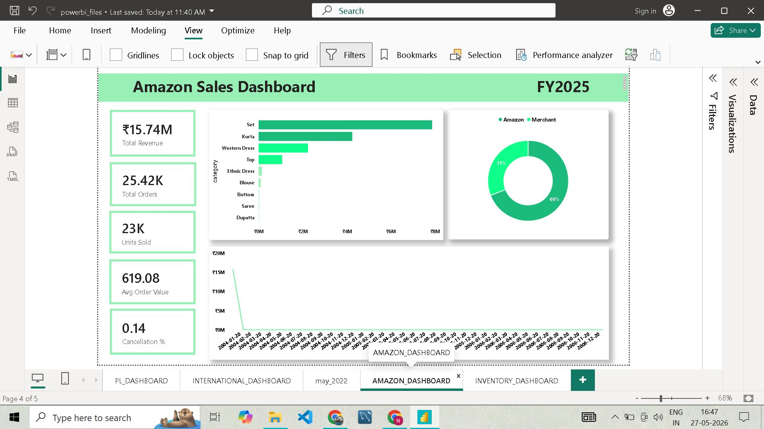
AMAZON SALES DASHBOARD
03
Dashboard Features & Visual Walkthrough
Revenue KPIs
₹15.74M total · 25K orders · 23K units at glance
Category Bar
10 categories ranked; Set leads with ₹8M revenue
FBA vs Merchant
Donut: 69% Amazon FBA · 31% Merchant split
Revenue Timeline
Line chart 2004–2006 with interactive date slicer
Low Cancellation
0.14% cancellation rate KPI card with alert logic

Slide 5
INTERNATIONAL
04
SALES DASHBOARD
INTL
SALES
Business Questions
Q1
Which style/SKU code generates the highest international revenue?
DASHBOARD
Who are the top international buyers by revenue contribution?
FY 2025
Q2
820.10
Avg Intl Rate
Q3
How has international revenue grown year-over-year (2000–2022)?
146
Intl Customers
Q4
What is the average selling rate in global export markets?
3M
Pieces Sold
Q5
How many total pieces have been sold internationally?
₹3.26M
Intl Revenue

Slide 6
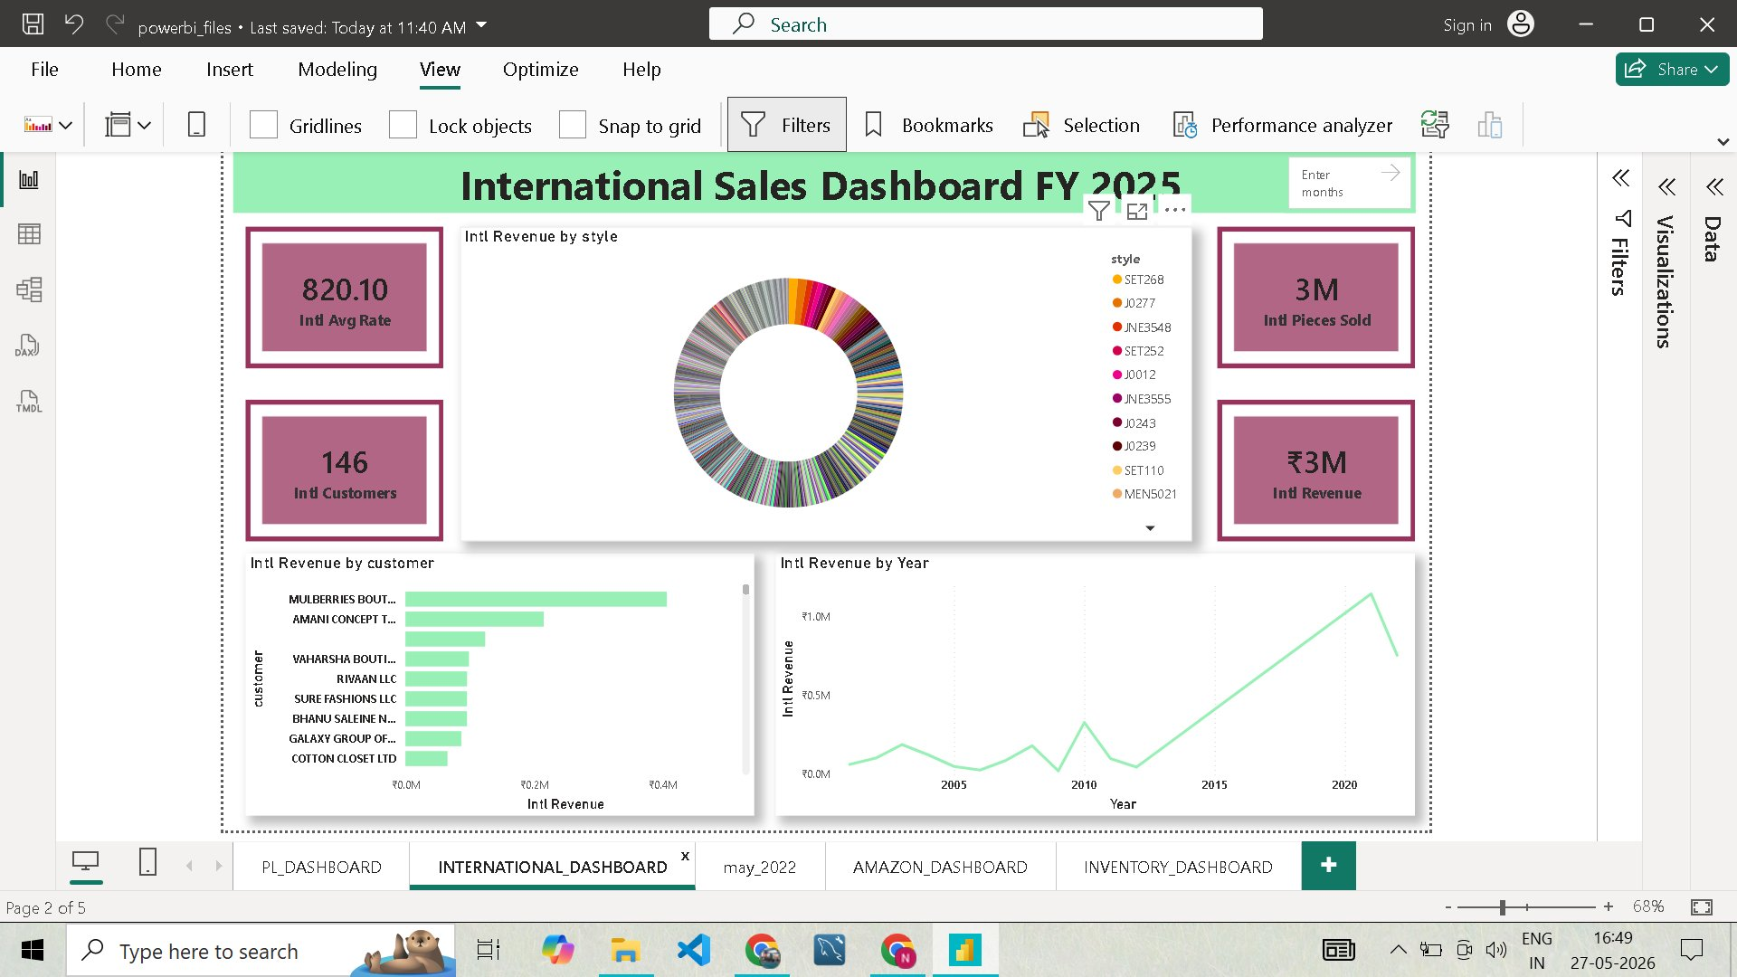
INTERNATIONAL DASHBOARD · SOLUTION & FEATURES
05
Style Revenue Donut
100+ style codes (SET26B, J0277 etc.) broken down by revenue
Top Customer Bar
8 buyers ranked; Mulberries Boutique leads at ~₹0.4M
20-Year Trend Line
Line chart 2000–2022, peak 2015–2020, recent dip visible
Month Filter
Granular monthly drilldown with 'Enter months' parameter
Rate & Volume KPIs
Avg rate 820 · 3M pieces sold · 146 unique export customers

Slide 7
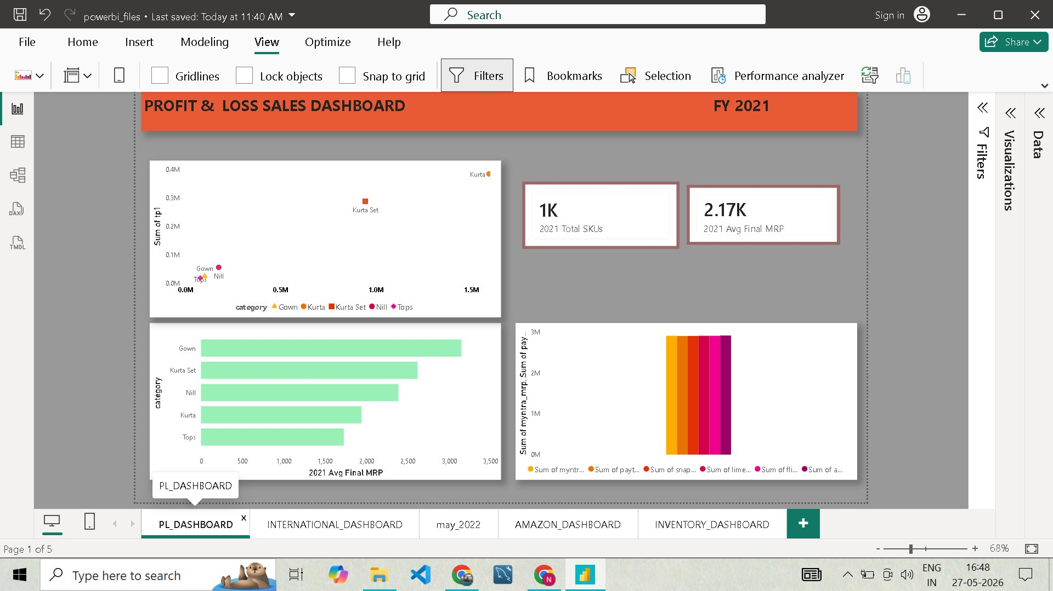
PROFIT & LOSS DASHBOARD
06
FY 2021 · Business Questions & Solution
QUESTIONS & APPROACH
Q1 Which category has highest avg final MRP?
→ SQL: AVG(final_mrp) GROUP BY category → Gown ₹3,200
Q2 TP vs Final MRP relationship?
→ Pandas scatter: Kurta Set shows strongest linear correlation
Q3 Total SKUs in 2021?
1K
₹2.17K
FY2021
→ COUNT(DISTINCT sku) = 1,000 unique product codes
2021 Total SKUs
Avg Final MRP
Period
Q4 Platform revenue comparison?
→ Power BI stacked bar: Myntra > Paytm > Snapdeal > Limeroad

Slide 8
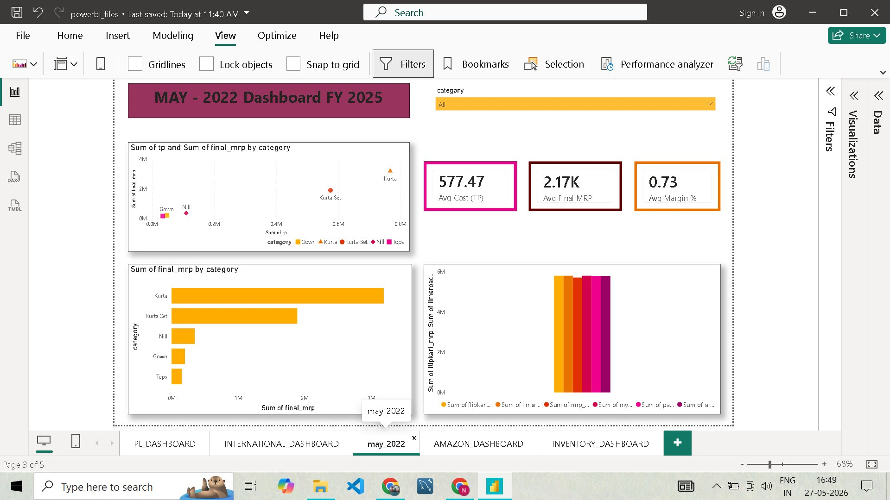
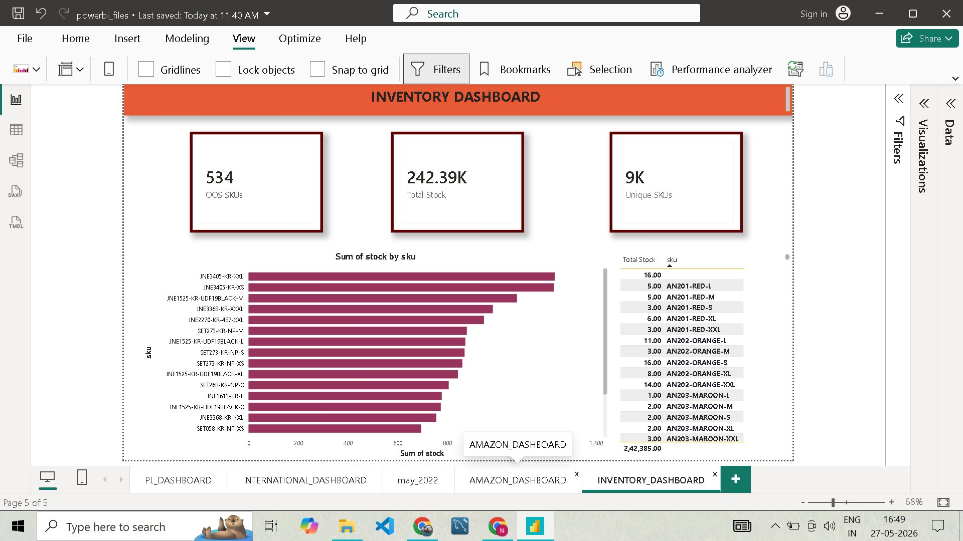
MAY 2022
07
INVENTORY
08
Dashboard · Stock Overview
₹577.47
₹2.17K
0.73%
534
242K
9K
Avg Cost TP
Avg MRP
Avg Margin
OOS SKUs
Total Stock
Unique SKUs
Category scatter: TP vs final_mrp bubble view
OOS flagging: 534 SKUs with zero stock identified
Platform breakdown: Flipkart · Myntra · Paytm · Snapdeal
SKU drill-down table with exact stock counts
All-category dropdown filter with dynamic refresh
Top-15 SKUs by volume: JNE3405-KR-XXL leads

Slide 9
TOOLS & METHODOLOGY
09
End-to-End Data Pipeline · From Raw CSV to Interactive Dashboard
SQL
PANDAS
EXCEL
POWER BI
Extract & Aggregate
Clean & Transform
Validate & Report
Visualize & Publish
GROUP BY revenue by category & month
Merge orders + products + date tables
SUMIF / INDEX-MATCH lookups
Star schema: fact_orders + 3 dims
CTE: multi-step P&L calculation
Pivot: category × platform matrix
PivotTable per channel + category
DAX: TotalRev, Margin%, AvgOrder
Window: RANK(), LAG() for growth %
Resample: daily orders → weekly trend
Conditional formatting for KPI bands
Slicers: date, category, channel, SKU
Cancellation: COUNT(CASE WHEN)
IQR outlier removal on order_value
FORECAST.ETS for Q-ahead projection
5 published report pages with drillthrough
Raw: CSV / DB
→
Extract: SQL
→
Transform: Pandas
→
Validate: Excel
→
Publish: Power BI

Slide 10
PROJECT
SUMMARY
5
Power BI Dashboards
534
OOS SKUs Identified
Intl · Amazon · P&L · May2022 · Inventory
Inventory gap analysis from 242K stock items
₹15M+
Total Revenue Tracked
20yr
Historical Data Analyzed
Amazon alone: ₹15.74M with 25K+ orders
International revenue trends 2000–2022
69%
Amazon FBA Dominance
0.73%
Avg Margin % (May 2022)
vs 31% Merchant — key fulfillment insight
Kurta & Kurta Set lead margin across platforms
★ https://github.com/Nikul14

