Slide 1

PROJECT DOCUMENTATION • REVIEW PAPER
StreetGuard AI
Pothole Reporter
A Review of Existing AI / ML-Based Pothole Detection
and Reporting Systems
Submitted by: NIKUL B. PRAJAPATI
Enrolment / Roll No.: 230610106018
Department: Civil Engineering Department
Institution: Government Engineering College, Palanpur
Prepared for Academic Submission
Date: July 2026

Slide 2






OVERVIEW
Agenda
01
02
Introduction & Need
Existing Systems Reviewed
03
04
Technologies & Core Concepts
Architecture, Database & Execution
05
06
Working Process, Dataset & Results
Advantages, Applications & Future Scope
StreetGuard AI Pothole Reporter
1

Slide 3

SECTION 1
Introduction
Road condition directly affects safety, travel time, and vehicle life — potholes form when water weakens the sub-base and traffic breaks up the surface.
Traditional detection relies on manual inspection or reactive citizen complaints — slow, inconsistent, and hard to scale across large road networks.
AI/ML now automates this: computer vision (CNN + YOLO) and vibration sensors detect potholes in real time, paired with GPS tagging and cloud dashboards.
This project documentation reviews existing AI/ML pothole detection & reporting systems as a technical foundation for StreetGuard.
Why It Matters
Roads are national infrastructure.
Every undetected pothole is a
safety risk and a repair cost
that compounds over time.
StreetGuard AI Pothole Reporter
2

Slide 4
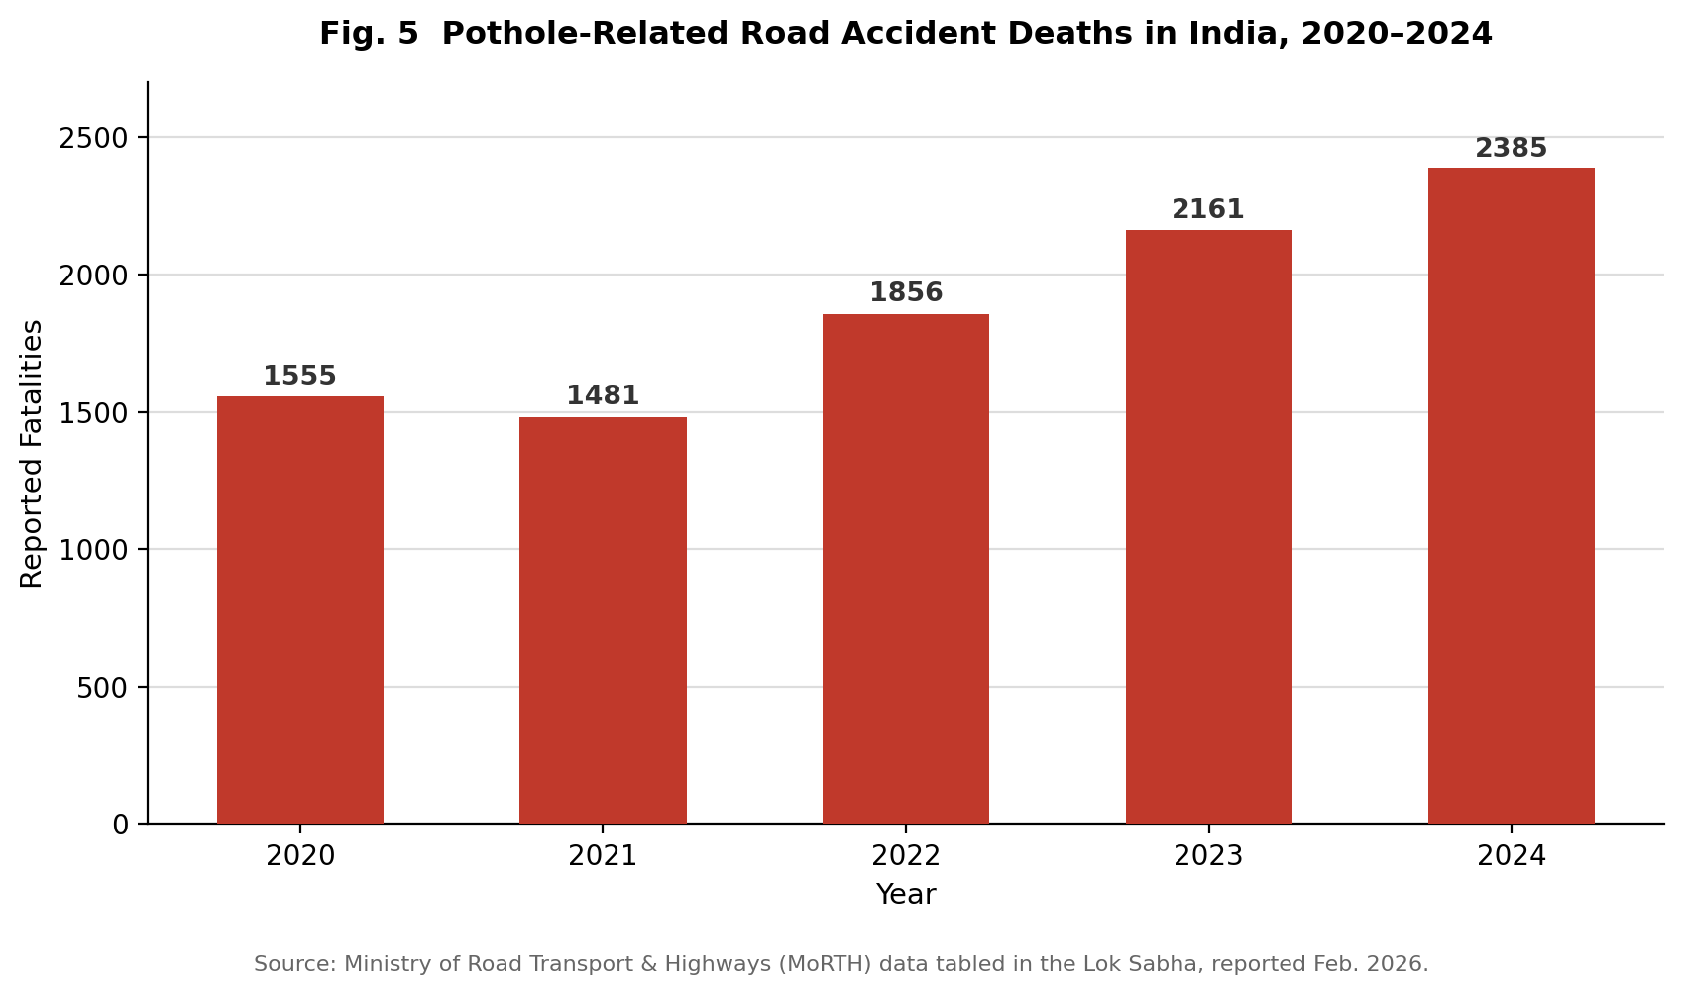
SECTION 1
Need of the Project
9,438
53%
$26.5B
pothole deaths in India,
2020–2024
rise in fatalities
over 5 years
US pothole vehicle-damage
cost in 2021 alone
StreetGuard AI Pothole Reporter
3

Slide 5




SECTION 2
Existing Systems Reviewed
YOLOv8-Seg Smart-City Platform
Spothole
RoadMetrics
Street Bump
Academic YOLO / RDD2022
Detection + depth-based severity + predictive maintenance (Pune, 2025).
Open-source citizen app: CNN detection, geocoding, municipal ticketing.
Bengaluru B2B startup surveying roads via windshield-mounted video.
Boston's 2011 accelerometer + GPS crowdsourced pothole sensing.
1,500-img Indian dataset (72.12% mAP); 6-country RDD2022 benchmark.
StreetGuard AI Pothole Reporter
4

Slide 6

SECTION 3
Technologies & Techniques Used
Languages & ML/DL
Computer Vision
Python, TensorFlow / PyTorch
Ultralytics YOLOv5 / YOLOv8
Flutter / Kotlin mobile apps
OpenCV pre-processing
YOLO single-shot detection
YOLOv8-Seg + ESRGAN + MiDaS
Sensors & Edge
Backend & Cloud
Accelerometer / gyroscope / GPS
Raspberry Pi, Jetson Nano
ADAS dash-cam hardware
Firebase / AWS, MySQL
Google Maps API / GIS
ARIMA & XGBoost analytics
StreetGuard AI Pothole Reporter
5

Slide 7
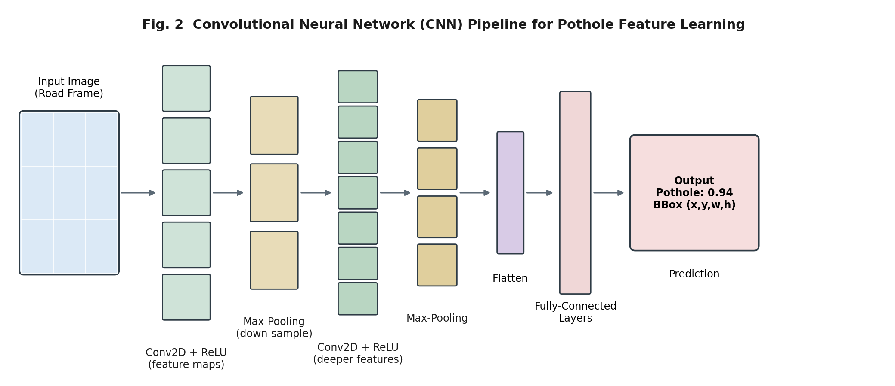
SECTION 4 — THE SCIENCE
How a CNN “Sees” a Pothole
Learnable filters slide across the image, producing feature maps for edges and textures.
ReLU activation + pooling add non-linearity and reduce dimensionality.
Deeper layers combine features into complex shapes — e.g. a pothole's dark, irregular outline.
Fully-connected layers output the final prediction.
StreetGuard AI Pothole Reporter
6

Slide 8
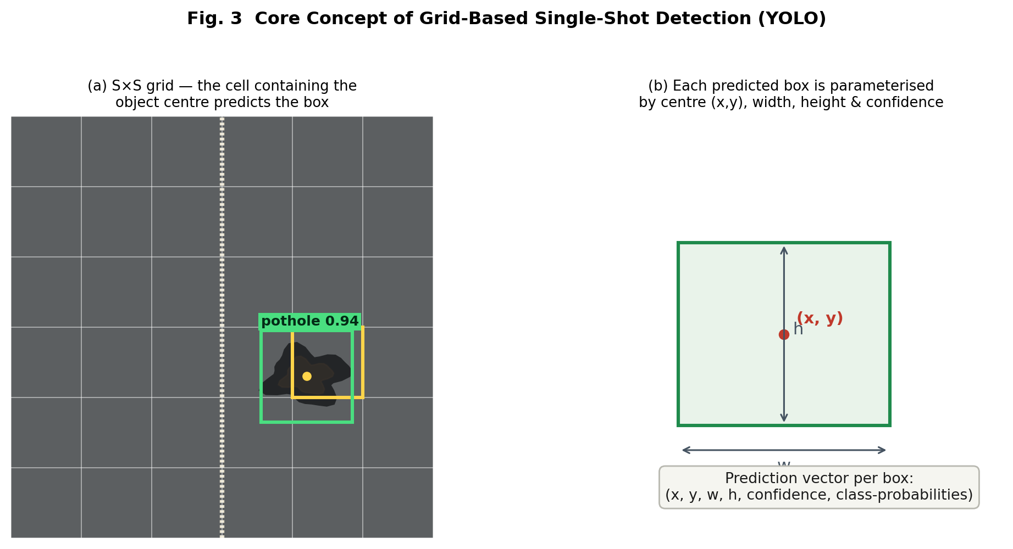
SECTION 4 — THE SCIENCE
Real-Time Detection with YOLO
YOLO (You Only Look Once) divides the frame into an S×S grid; the cell over an object's centre predicts its box.
Each box carries (x, y, width, height), a confidence score, and class probabilities — all in one pass, which is what makes it fast enough for live video.
Non-Maximum Suppression removes duplicate, overlapping boxes; YOLOv8-Seg adds pixel-level masks for exact pothole area.
StreetGuard AI Pothole Reporter
7

Slide 9
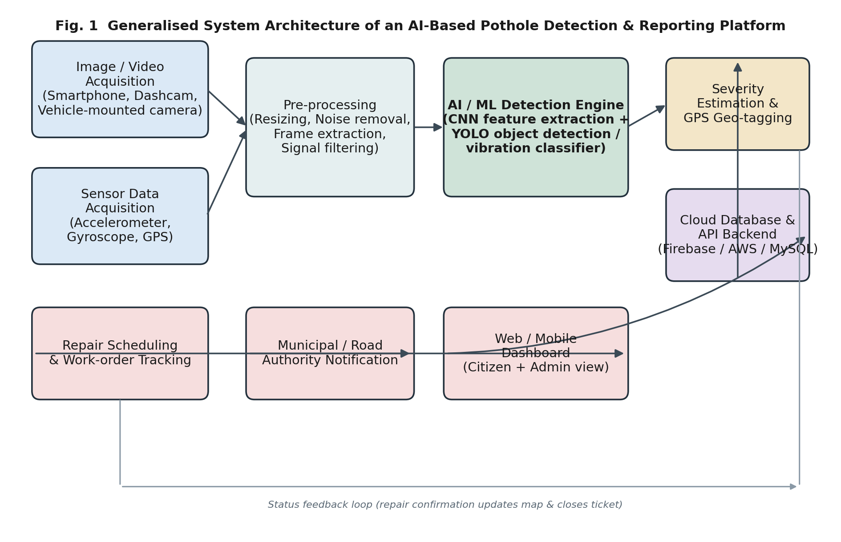
SECTION 5
System Architecture
StreetGuard AI Pothole Reporter
8

Slide 10
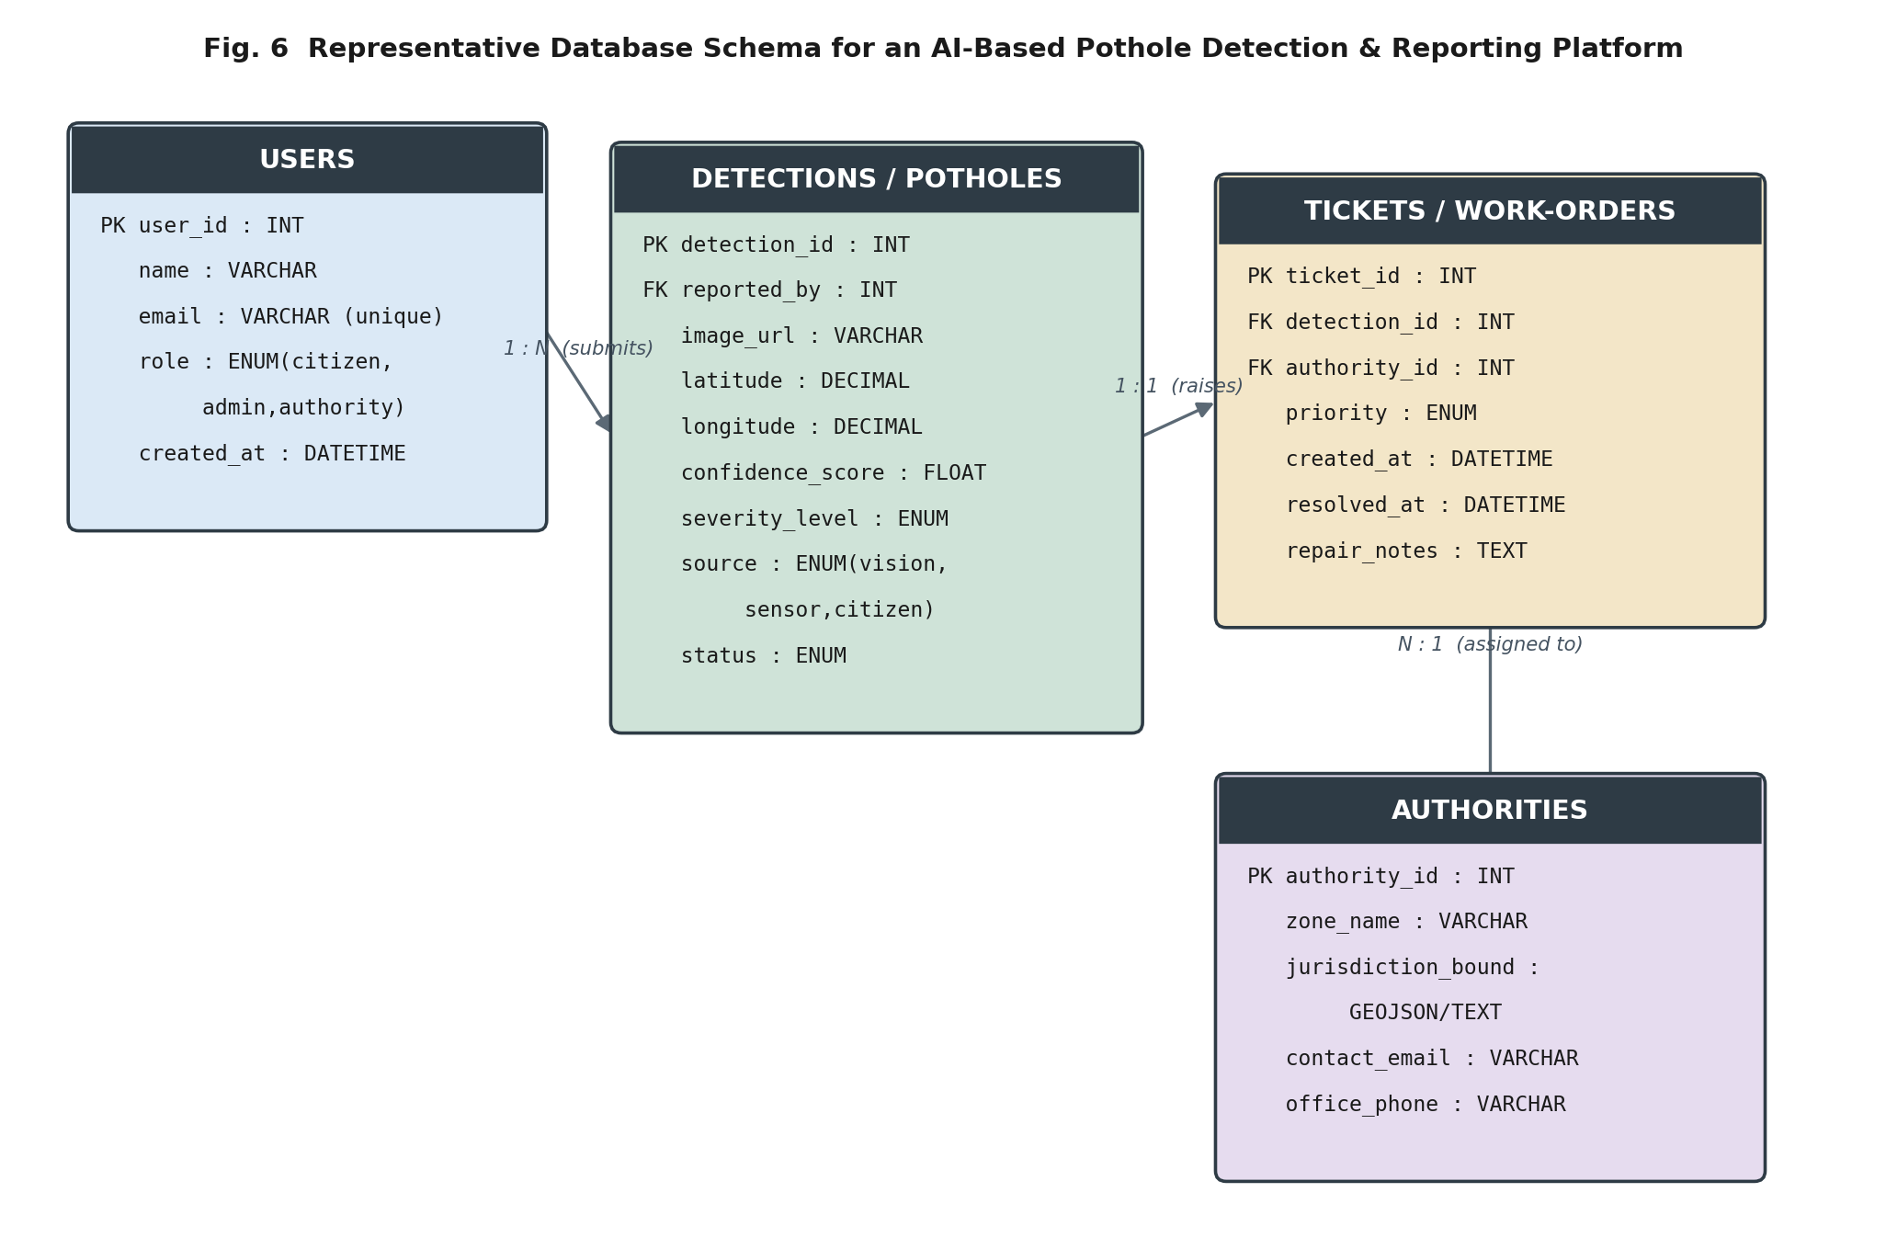
SECTION 5
Database Configuration
StreetGuard AI Pothole Reporter
9

Slide 11
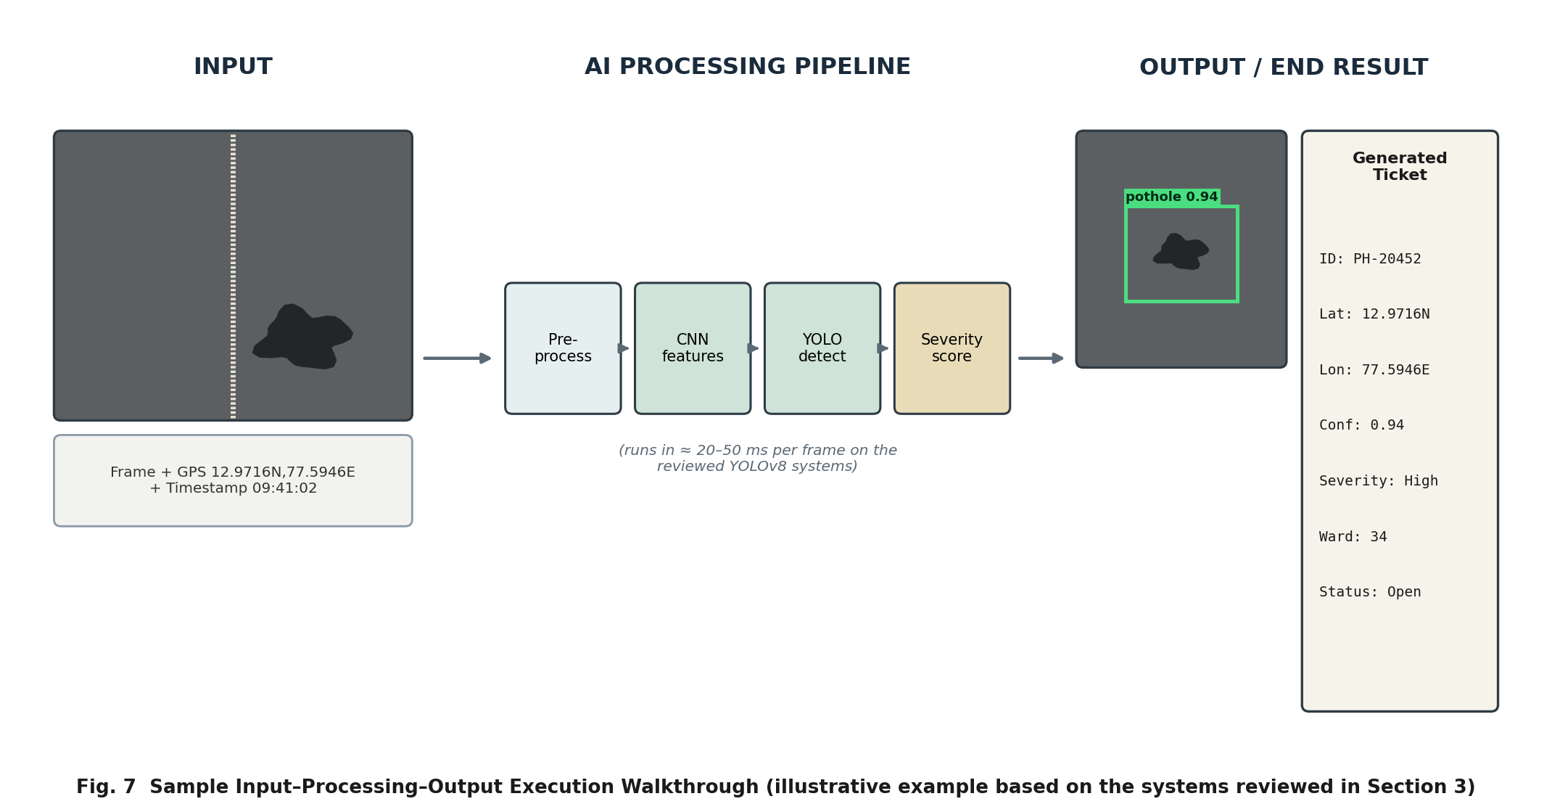
SECTION 5
Sample Input – Output Execution
StreetGuard AI Pothole Reporter
10

Slide 12
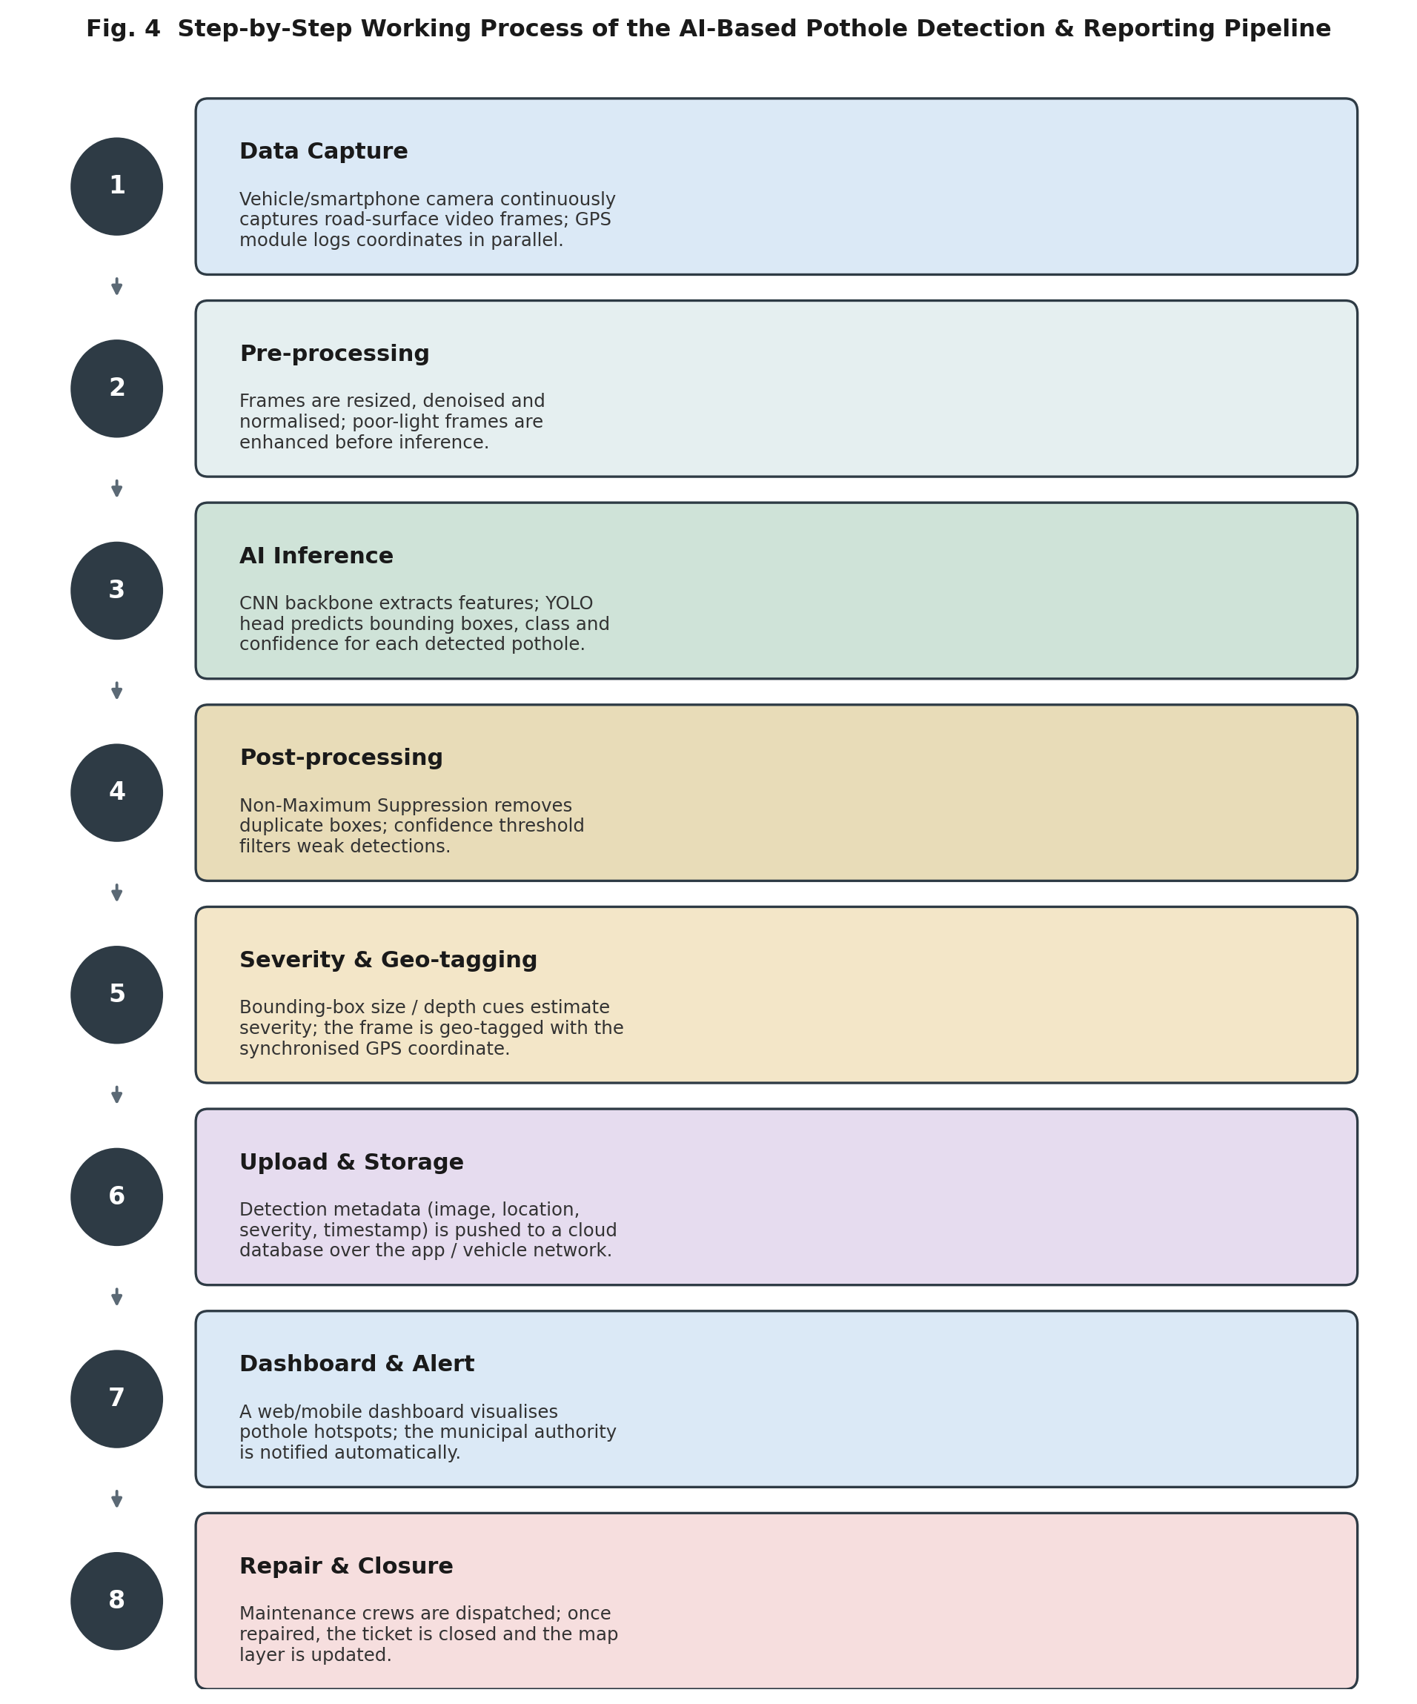
SECTION 6
Working Process
Capture → pre-process → AI inference run on-device in ≈20–50 ms per frame, fast enough for live video.
Severity scoring, upload, and dashboard notification follow, tolerating slightly higher latency.
Repair & closure is the one human-driven step — a crew is dispatched by severity, and the ticket closes once resolved, updating the public map.
StreetGuard AI Pothole Reporter
11

Slide 13
SECTION 7
Dataset Description
Dataset | Size | Coverage | Classes
RDD2022 | 47,420 images; 55,000+ instances | Japan, India, Czech Rep., Norway, USA, China | Crack types + pothole
Custom Indian Road | 1,500 images | Coimbatore & Idukki, India | Pothole
Roboflow Public | Open, community-sourced | Global | Pothole
Kaggle Pothole | 665 images | Global | Pothole
RDD2022 standardises benchmarking across six countries (CRDDC’2022 challenge). Smaller, region-specific datasets remain valuable because pothole colour, texture, and shape vary by geography.
StreetGuard AI Pothole Reporter
12

Slide 14
SECTION 7
Results & Performance Comparison
Vision-based detectors typically report 70–86% mAP/F1, depending on how closely training data matches the deployment region.
YOLO-family models run at real-time speeds (tens of ms/frame).
Vibration-based CNNs report high accuracy (93.24%) but on a different, simpler task — not directly comparable to vision mAP/F1.
StreetGuard AI Pothole Reporter
13

Slide 15


SECTION 8
Advantages
Continuous, automated monitoring — no manual survey needed
Objective, repeatable severity scoring
Real-time detection speed on live video
Precise GPS geo-tagging of every detection
Scales across a city or highway network cheaply
Transparent citizen tracking, report to repair
StreetGuard AI Pothole Reporter
14

Slide 16



SECTION 9
Benefits
Citizens
Government
Economy & Safety
Lower accident / injury risk
Simple photo-based reporting
Visible status tracking
Objective repair prioritisation
Lower long-term maintenance cost
Auditable service trail
Billions saved in vehicle damage
Fewer fatalities & injuries
Assistive value for visually impaired
StreetGuard AI Pothole Reporter
15

Slide 17
SECTION 10
Applications
Municipal & highway maintenance
Smart-city GIS infrastructure monitoring
ADAS & autonomous-vehicle path planning
Fleet management & route planning
Assistive tech for visually impaired
Highway asset-management surveys
StreetGuard AI Pothole Reporter
16

Slide 18

SECTION 11 – 12
Limitations & Future Scope
Limitations
Future Scope
Dataset bias — poor generalisation across regions
Sensitive to lighting, rain, and glare
False positives (shadows, manholes, rail crossings)
Compute limits on low-cost edge devices
Privacy concerns over continuous GPS/camera data
No standardised severity scale across vendors
Multi-sensor fusion (vision + vibration + depth/LiDAR)
Edge AI on 5G-connected fleet dash-cams
Drone-based aerial road surveys
Predictive maintenance via time-series forecasting
Tighter integration with autonomous-vehicle planning
Synthetic data to close regional dataset gaps
StreetGuard AI Pothole Reporter
17

Slide 19
SOURCES
Key References
D. Arya et al., “RDD2022: A multi-national image dataset for automatic Road Damage Detection,” arXiv:2209.08538, 2022.
J. Dharneeshkar et al., “Deep Learning based Detection of potholes in Indian roads using YOLO,” IEEE ICICT, 2020.
“Vision-Based Pothole Detection and Reporting System for Smart Cities (YOLOv8-Seg),” Pune, India, Dec. 2025.
GitHub — nirbhayph/spothole: AI-Powered Pothole Detection, Reporting and Management Solution.
“Bengaluru Startup Uses AI To Identify & Fix Potholes,” The Better India, 2023.
“Pothole Deaths In India Rise 53% In 5 Years,” Outlook India, Feb. 2026.
“AI Meets ADAS: Intelligent Pothole Detection for Safer AV Navigation,” MDPI Vehicles, 2025.
Full reference list (32 sources) is provided in the accompanying review paper.
StreetGuard AI Pothole Reporter
18

Slide 20
CONCLUSION
A Solid Foundation for StreetGuard
This review studied existing AI/ML pothole detection and reporting systems — vision-based, sensor-based, and crowdsourced — and consolidated their theory, architecture, database design, and performance. With thousands of preventable deaths and billions of dollars in damage annually, and detection methods already accurate and fast enough for real deployment, this body of work provides a strong technical foundation for building StreetGuard AI Pothole Reporter.
Thank You
Questions & Discussion Welcome

