Slide 1
Panic Buying Behaviour During Fuel Supply Uncertainty
Behavioural Economics – Module 4 Assignment
Nikunj Gour

Slide 2
Motivation / Context
• Global conflicts can affect oil supply
• News about shortages may trigger panic behaviour
• Consumers may refill fuel or LPG earlier
• Behavioural concepts: Loss aversion, Herd behaviour, Availability bias

Slide 3
Research Question
Does exposure to crisis-related news about fuel supply increase panic buying behaviour among consumers?

Slide 4
Experiment Design
Sample size: 52 respondents
Control group: Message stating fuel supply is stable
Treatment group: Message about geopolitical conflict affecting supply
Outcome variables: Fuel refill likelihood, LPG booking likelihood, Herd behaviour

Slide 5
Hypothesis
H0: Crisis news does not affect panic buying behaviour
H1: Crisis news increases panic buying behaviour

Slide 6
Result Summary
All p-values > 0.05 → Not statistically significant
 | Control | Treatement | P value
Fuel refill | 3.5 | 3.1 | 0.38
LPG booking | 3.25 | 3.05 | 0.32
Herd behaviour | 2.90 | 2.75 | 0.20

Slide 7
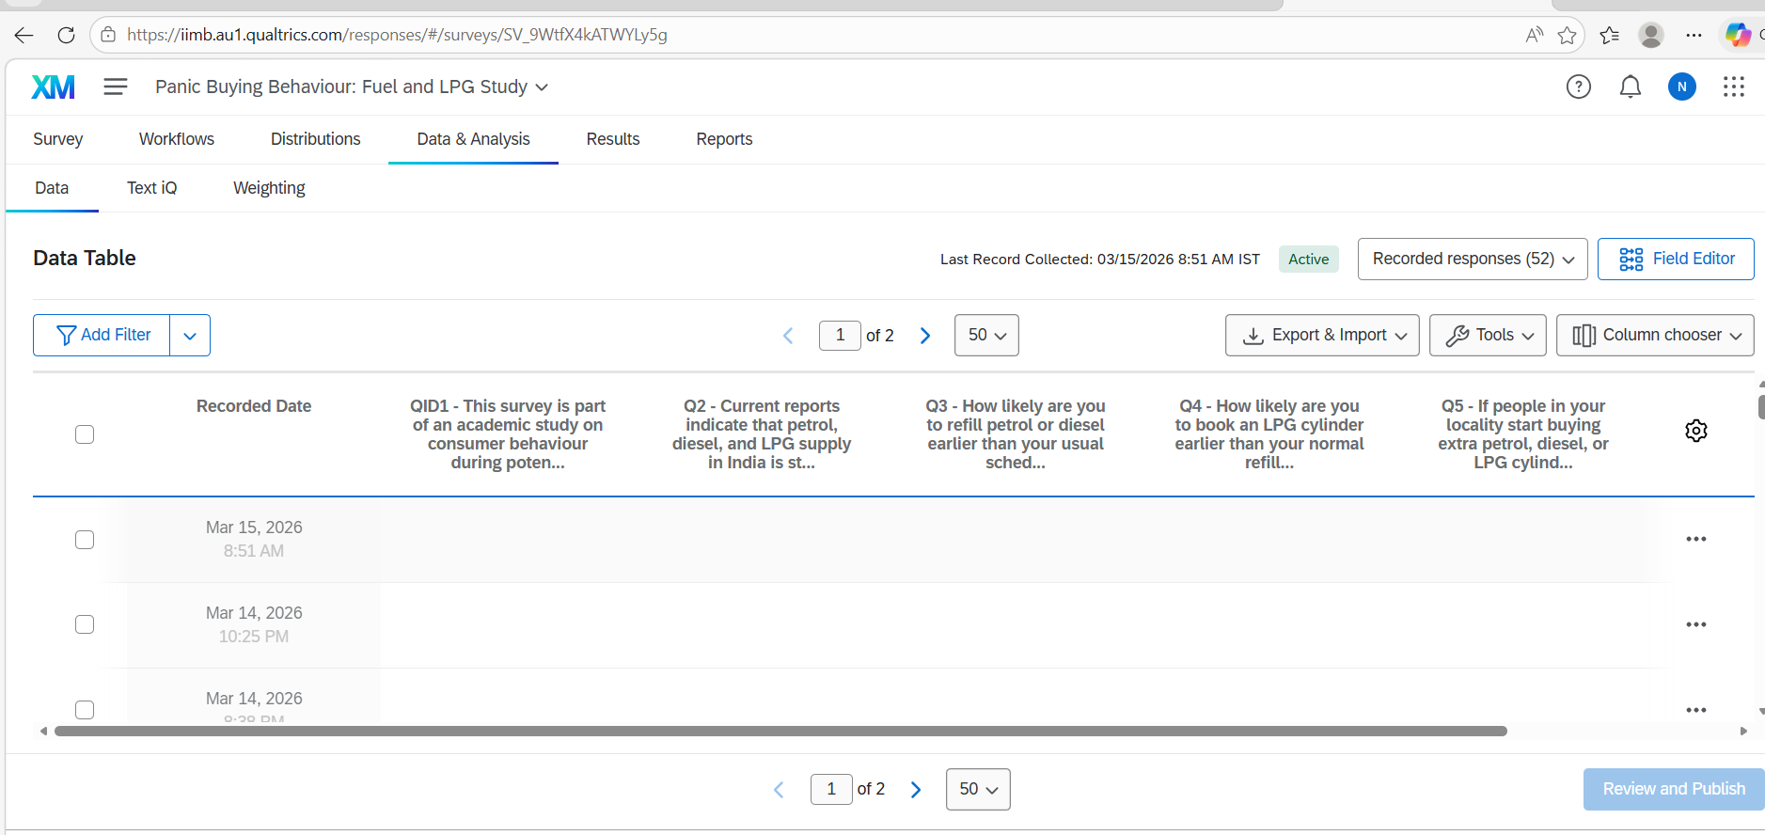
Survey Data Collection (Qualtrics)

Slide 8
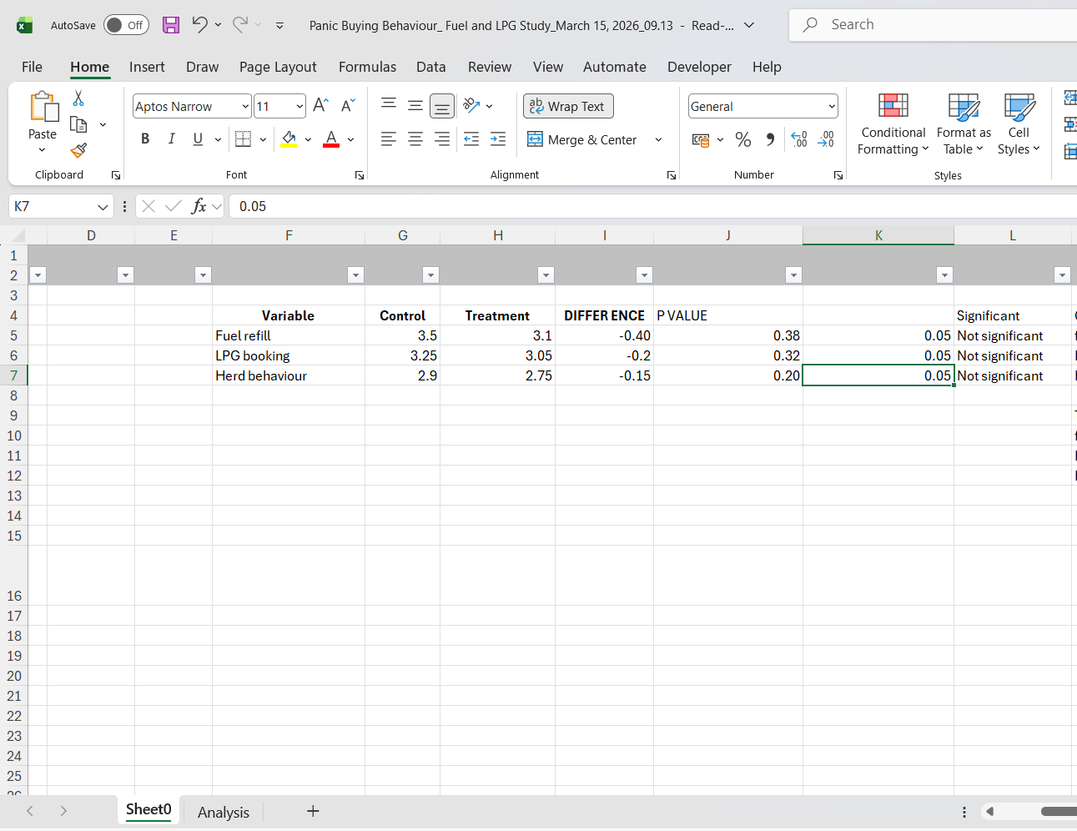
Data Analysis in Excel

Slide 9
Interpretation
Crisis news did not significantly increase panic buying behaviour
Differences between control and treatment groups were small
Consumers in the sample showed relatively stable behaviour

Slide 10
Conclusion
• Exposure to crisis information alone may not trigger panic buying
• Real shortages or price shocks may have stronger effects
• Clear communication from authorities can help avoid panic behaviour

