Slide 1
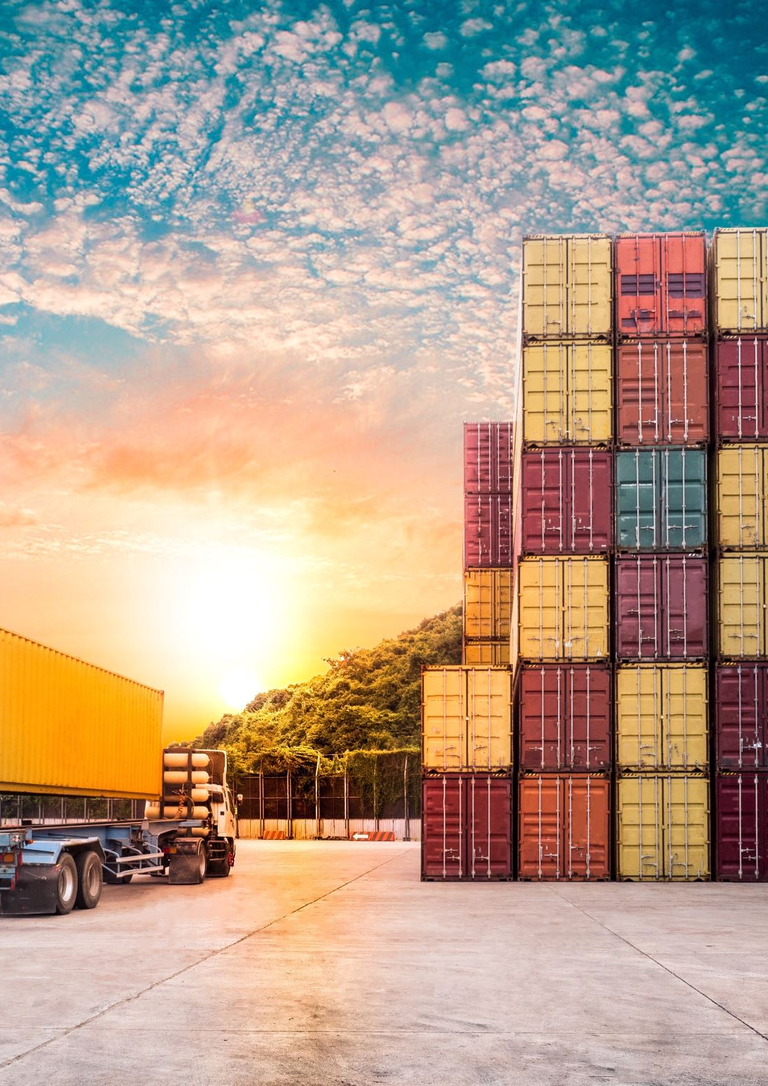
Title: Mediating Return Load Bookings for Marble Transport - A Venture Story
Introduction
Makrana is famous for its marble, but pickup owners delivering marble often face challenges in securing return bookings for their trips back. While they don't travel empty, finding a return load can be time-consuming and difficult.
Seeing this gap, I used my network to help a pickup carrying marble from Makrana to Andhra Pradesh. By arranging a return load booking from Andhra Pradesh, I ensured the pickup owner wouldn't face these challenges. In return, I earned ₹3000 as a commission for acting as a mediator. This simple yet effective solution turned into a profitable venture.

Slide 2
How the Venture Worked
Identifying the Problem: Pickup owners transporting marble from Makrana often struggled to find reliable return bookings for their journeys back. This was both a time-consuming and costly challenge for them.
Solving the Problem: Using my network, I arranged a return load booking for a truck traveling from Makrana to Andhra Pradesh. This ensured the pickup owner didn’t face difficulties in securing a return load and could complete the trip without delays
Profit Generation: As a mediator, I earned ₹3000 for successful return load booking arranged. This became a steady source of income by solving the problem of securing return bookings for truck owners.

Slide 3
Financial Breakdown
Here’s how the numbers look for this venture:
Particulars | Amount (₹)
Revenue (Commission per truck) | 3000
Cost of Goods Sold (COGS) | 0
Gross Profit | 3000
Operating Expenses | 0
Net Profit | 3000

Slide 4
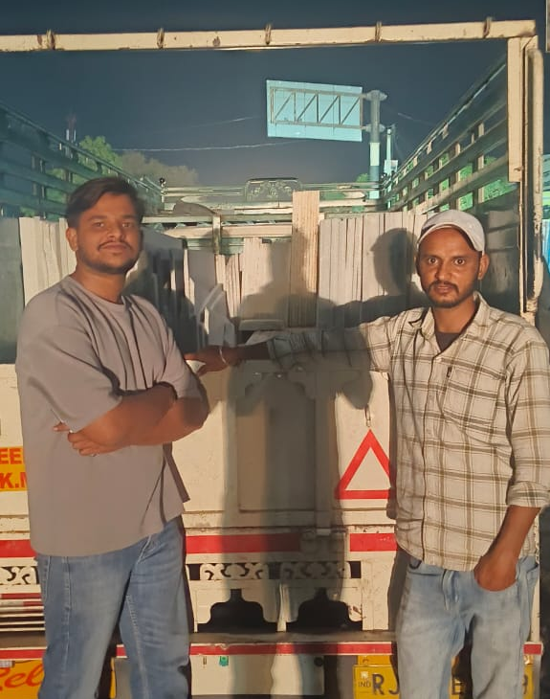
Learnings and Takeaways:
While doing this work, I observed three big gaps that can turn into real opportunities:
Pickup owners rarely get return bookings on time, so they often end up paying transporters (mediators) just to get loads — this cuts into their profits
Other takeaways.
Granite worth lakhs is transported daily by trucks, but there’s usually no insurance coverage for it.
If you ask why insurance is needed, it’s because granite is packed using wooden frames, which often break during transport, leading to major losses.
Solving these issues — with better return load systems and insurance options — can really improve the way marble and granite transport works.

