Slide 1

RETAIL STORE DASHBOARD
BY NIKUNJ GUPTA
MABSPG23030

Slide 2
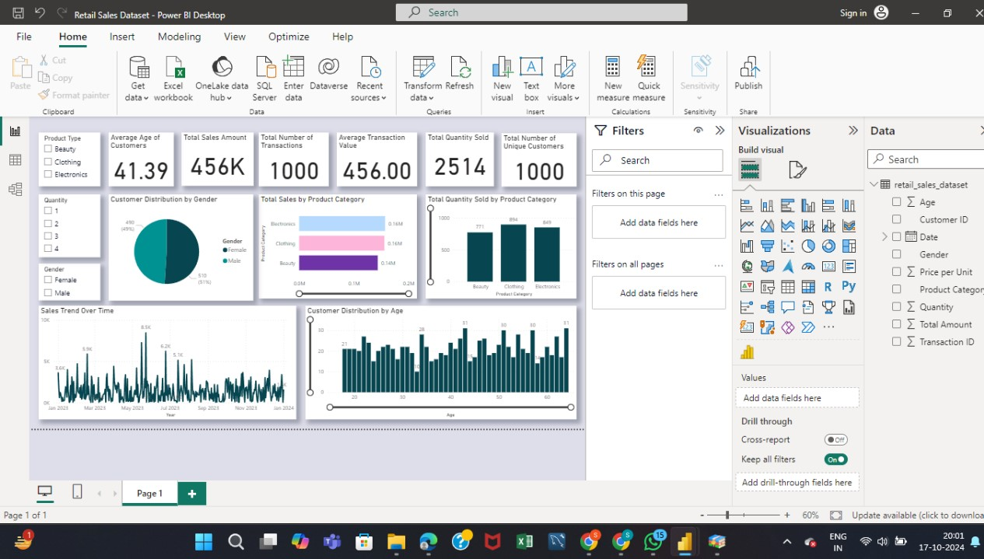
DASH BOARD

Slide 3
Introduction to the Dataset
Retail sales data is the basis for the analysis.
Key metrics included are:
Total sales.
Customer demographics.
Product category sales.
Sales trends over time.
The dashboard provides:
A comprehensive view of business performance.
Insights into customer behavior.
Product demand trends.

Slide 4
Key Performance Indicators (KPIs)
The following KPIs are used in the dashboard for retail sales analysis:
1. Average Age of Customers
2. Total Sales Amount
3. Total Number of Transactions
4. Average Transaction Value
5. Total Quantity Sold
6. Total Number of Unique Customers
7. Customer Distribution by Gender
8. Total Sales by Product Category

Slide 5
Key Results from the Dashboard
The dashboard shows the following key results:
1. The average customer age is 41.39 years.
2. Total sales amount is 456K with 1,000 transactions.
3. Average transaction value is 456, with a total quantity sold of 2,514 units.
4. Electronics is the top-selling product category (849 units).

Slide 6
Why These KPIs Are Important
These KPIs provide critical insights into business performance:
- The Average Transaction Value helps measure customer spending behavior.
- Total Sales Amount reflects overall business performance.
- Total Number of Transactions shows customer engagement.
- Customer Demographics provide valuable information for targeted marketing efforts.
- Product Category Performance helps understand demand trends.

Slide 7
Additional Results from the Dashboard
Additional insights include:
- Customer distribution by gender is almost equal (51% Male, 49% Female).
- Sales trends show peaks in April and June 2023, indicating seasonality or promotions.
- Most customers are between the ages of 30 and 50, aligning with the average age of 41.39.

Slide 8
Interpretation of Key Findings
The findings from the dashboard suggest a diverse and engaged customer base, with strong sales in electronics.
Key peaks in sales indicate potential areas for promotional activity. Understanding customer demographics and product performance can help optimize marketing strategies and inventory management.

