Slide 1

Team Name: Ctrl Alt Elite
Team Leader Name: Nikunj Kaushik
Problem Statement: Build an AI-powered solution that improves access to information,
opportunities for communities and public systems.

Slide 2









CONTEXT
STATUS QUO
Universal Access: Bridge the gap between policy intent and citizen benefit.
Instant Clarity: Reduce discovery time from ~45 minutes -> 2.7 sec.
Absolute Trust: Replace hearsay with source-backed, legally defensible answers.
OBJECTIVE
SOLUTION
Information Silos: Critical data fragmented across 50+ disconnected ministry portals.
The Innovation: An AI-Native Public Infrastructure that transforms complex government notifications into instant, legally grounded answers.
Language Exclusion: Notifications published primarily in complex, legalistic English.
Eligibility Maze: Complex rules hidden inside lengthy, unsearchable PDF documents.
The Promise: Bridges the "Last-Mile” Delivery Gap via a Voice-First, Multilingual Interface accessible on any device.
Static Search: Keyword search fails on intent-based queries like "farmer aid".
“
TARGET AUDIENCE
Reality Check: ~₹80,000 Crore in welfare funds go unclaimed annually due to this complexity.
”
Rural Population
Feature
Phone Users
Small
Merchants
Remote
Regions
Help
Centres

Slide 3









SOLUTION
HOW ARE WE DIFFERENT
FEATURE | General LLMs | Govt. Portals ( UMANG) | POLICY PULSE
Reliability | Prone to hallucinations | Official documents | Fact-checked logic
“Why Not” Logic | Vague or generic advice | No explanation provided | Exact criteria match
Audit Trail | Black-box (untraceable) | N/A (static links) | Citations Linked Responses
Last-Mile Access | Needs high speed internet | App/Website only | SMS and Voice Optimized
THE RESOLUTION LOOP
UNIQUE SELLING PROPOSITIONS
Ask Naturally
(user says in Hindi via voice- “mujhe kheti ke liye paise chahiye”)
Native Multilingual:
Interacts in 10+ Indian languages natively.
Retrieval-Grounded Responses- Every Answer linked to official source.
"Why Not" Engine
Explains exact reasons for rejection.
(you are eligible for Rs. 6000/year)
Actionable Answer
Instant Match
(system scans 1000+schemes
Found: PM KISAN Samman Nidhi
Omnichannel Access:
Works via Web, WhatsApp, SMS, Voice.
Drift Detection:
Tracks policy changes across different years.
(checks logic vs profile- land < 2 hectares? ✅yes.)
Verify Rules

Slide 4
FEATURES
THE COGNITIVE PIPELINE
INPUT LAYER
PROCESSING LAYER
OUTPUT LAYER
The Senses
The Brain
The Voice
Multi Format Ingestion
Reasoning Engine
Action Layer
Captures data from official Gazettes (PDF), News (CSV), and Voice.
Extracts and cleans Hindi/English text automatically.
Retrieves relevant policy chunk via semantic understanding
Deterministic Logic verifies age, income, caste and gender criteria
Drift Detection flags outdates rules and tracks changes
Converts complex logic into simple "Yes/No" answers.
Delivers via Web, WhatsApp, or SMS in 10+ languages.
Real-Time Analytics for governance monitoring.
Key Tech: OCR/ Speech-to-Text
Key Tech: Semantic Search + Rule Logic
Key Tech: API Wrapper/ SMS Interface

Slide 5





WORKFLOW
ARCHITECTURE PRINCIPLES
Input and ingestion
Response Delivery
Serverless-First: Zero infra management, auto-scaling.
AI-Native: Managed models (Bedrock) over custom ML.
Privacy Preserving: Encryption PII masking.(DPDP Compliant)
Retrieval-Grounded: 100% citations, zero hallucinations.
Offline-Optimized: Works on 2G/Edge networks.
Accepts user’s voice/texts + Ingests Official Gazettes.
Translates cited answer back to user’s language.
Query Translation
Eligibility Check
Converts regional query to English for precise match.
Verifies user data against retrieved rules.
Scheme discovery
Retrieves relevant policy chunks with source.

Slide 6
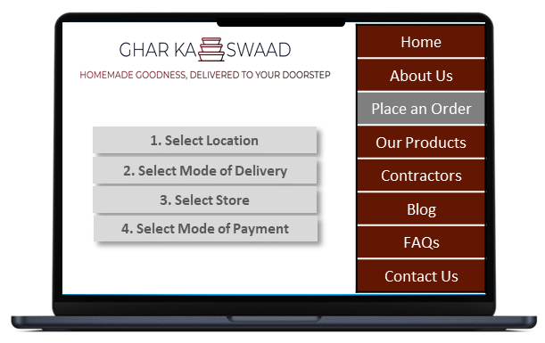
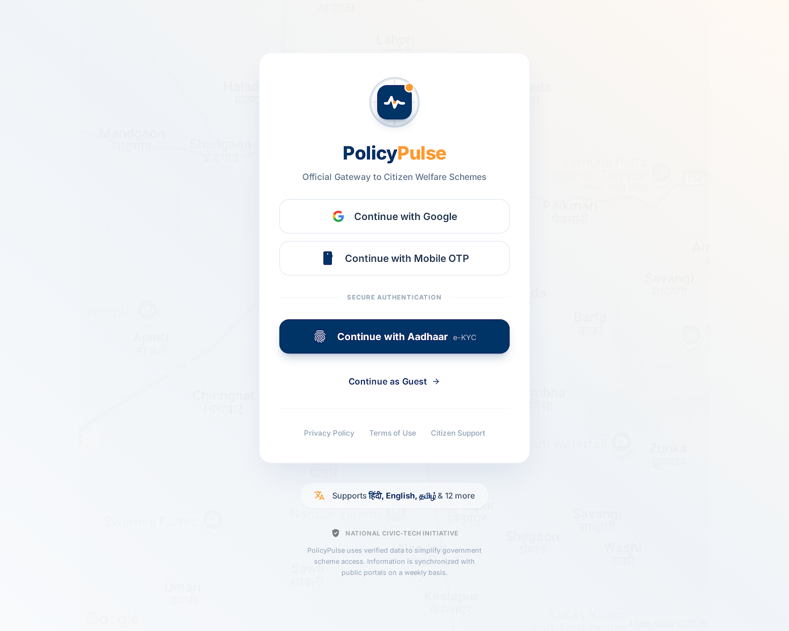
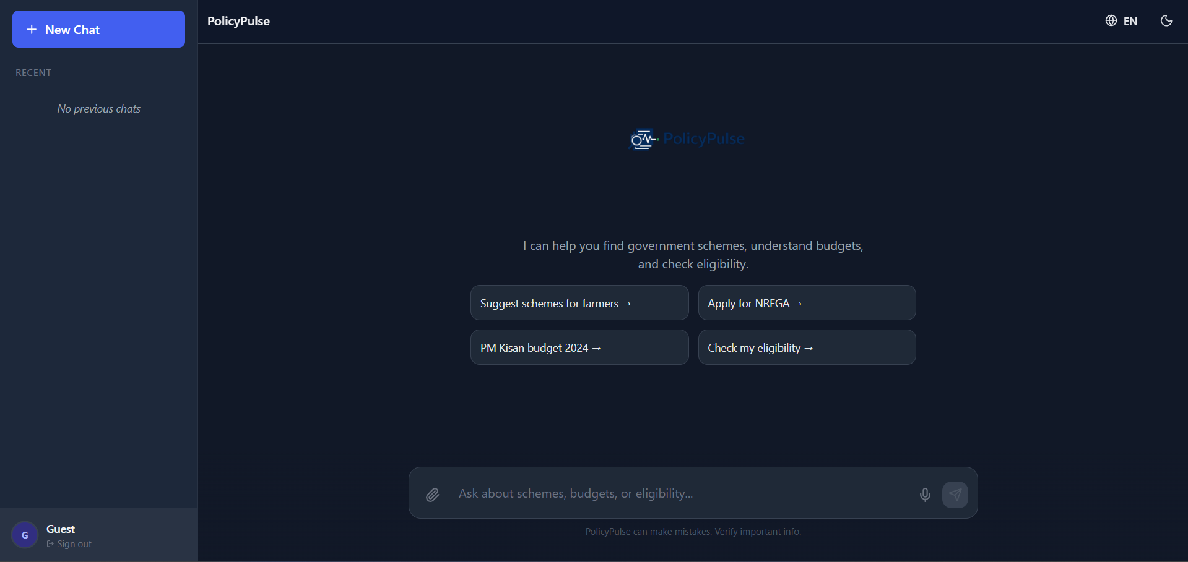
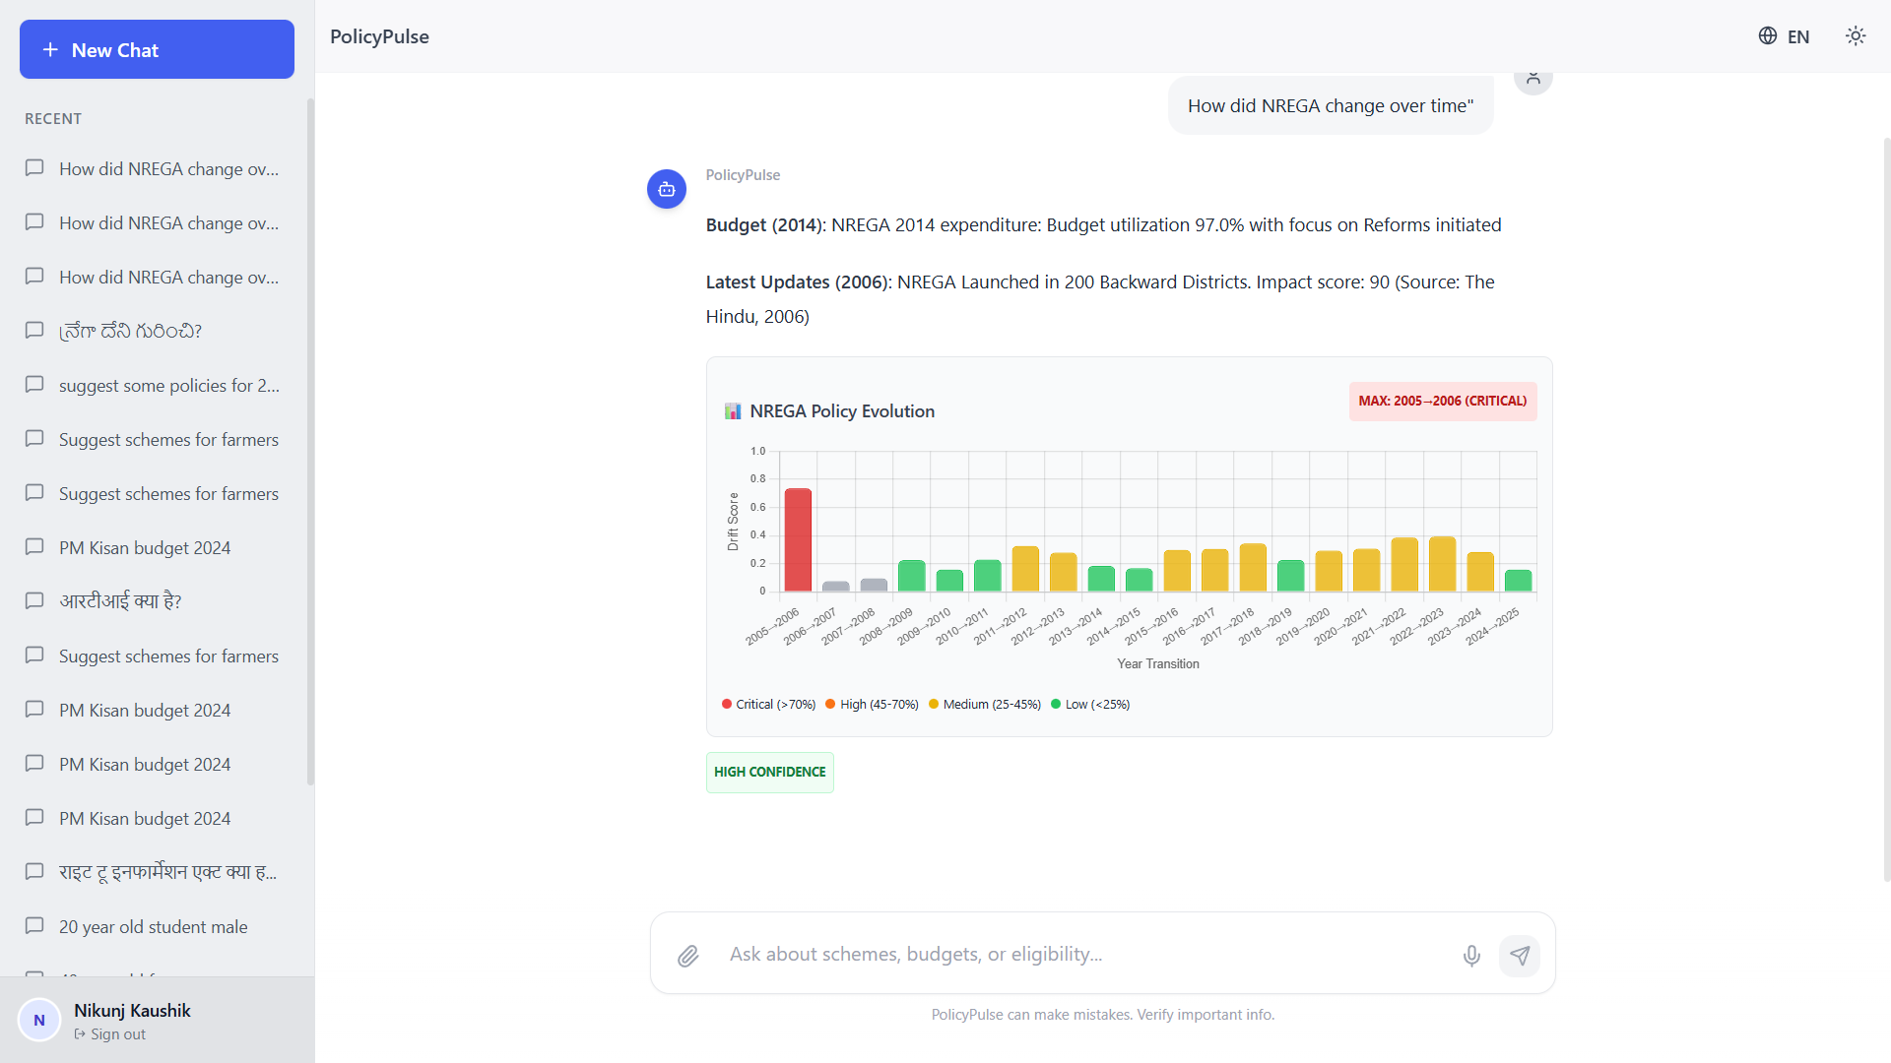
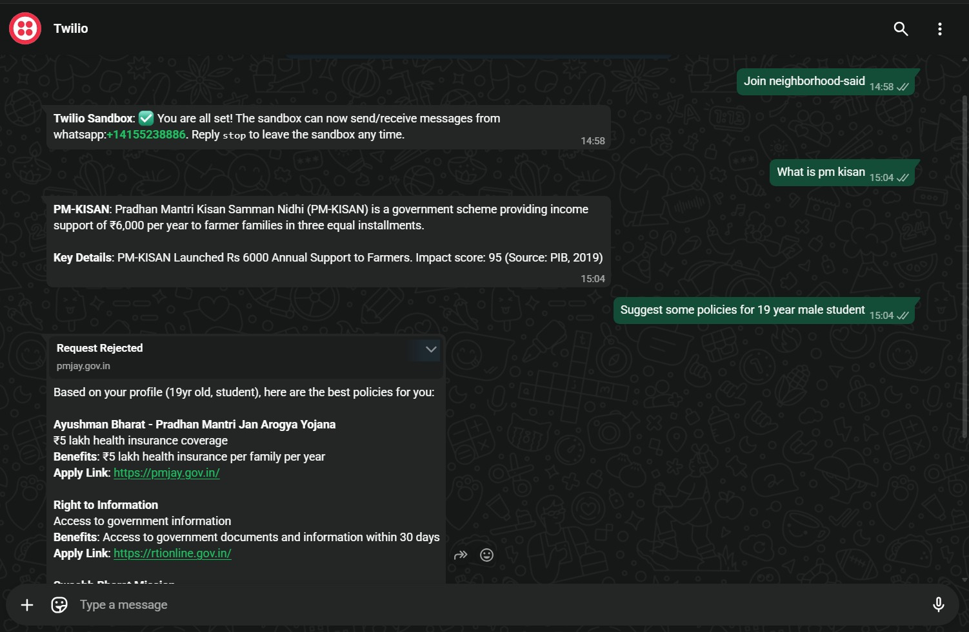
INTERFACE
Login Page
Main interface(Dark Theme). Left sidebar shows previous chat sessions.
Query Response (Drift Detection) under 2.7 seconds.
WhatsApp Integration
*These specimen are AI generated

Slide 7












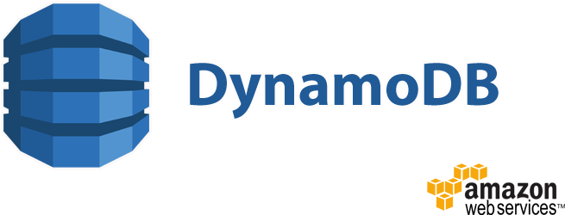







ARCHITECTURE
User Channels
(Amazon API Gateway)
Orchestrator
Traceability
Sources: Website, WhatsApp, SMS.
Format: Voice (Audio) or Text.
(Amazon API Gateway)
Routes API traffic.
Manages session context
(Amazon CloudWatch)
Audit Logs & Debugging.
Performance Monitoring (Latency).
Security Layer
Vector Store
Governance
(Amazon Cognito, IAM)
(Amazon DynamoDB, Lambda)
(Amazon QuickSight)
User Authentication.
Secure Session Management.
Stores Scheme Embeddings.
Fast Semantic Search
Analytics: "Most Searched Schemes".
Drift: "Policy Gap Detection"
Reasoning Engine
Delivery Layer
Ingestion Layer
(Amazon Bedrock, Amazon Q)
(Amazon SNS)
Model: Claude 4.5 Sonnet.
Action: Validates Eligibility Rules.
Eligibility: "Yes”/”No”.
Format: Local Language.
(Amazon Transcribe)
Transcribe: Audio ➔ Text.
Translate: Regional ➔ English.
Processing
Output

Slide 8
STACK
Component | Selected Tech | Strategic Benefit | Alternative (Why not?) | Estimated Cost (Monthly)
Reasoning Core | Amazon Bedrock (Claude 4.5 sonnet) | Highest Accuracy on ambiguous legal criteria. | Llama 3(Open Source; Risk of hallucination in govt data). | $3.50
Vector DB | Amazon Dynamo DB | Massive cost savings. Scale-ready via Zero- ETL to OpenSearch. | Open Search Serverless ($350/month- 1400x savings) | $.0.25
Compute | AWS Lambda (Python) | Zero idle cost; Scales to 1m queries instantly. | EC2 instances (wasted budget on 24/7 idle servers). | $0.05
Voice/Input | Amazon Transcribe | Native Indian dialect support. | OpenAI whisper (Data Sovereignty and privacy concerns). | $1.50
Embeddings | Titan Text v2 | 1536-dim vectors optimized for semantic search. | Pinecone (Adds vendor complexity and latency). | $0.10
App and Logic | React + Python (Fast API) | Cross-platform UI + Async performance. | Flutter/Node.js (Python libraries are superior for AI). | $0.00
 |  |  | TOTAL MONTHLY MVP | ~$10
 |  |  | TOTAL PRODUCTION COST (ESTIMATED) | ~$750 ($0.0007 per query)

Slide 9
IMPACT
INFRASTRCUTURE MODEL
IMPACT ANALYSIS
1
SaaS for States: Recurring subscription
2
API Monetization: Pay-per-query
3
Agent Freemium: Free for citizens; Premium
4
5
6
7
Hyper-Local Reach: Partnering with 500k+ Common Service Centres and MyGov for national rollout.
Data Licensing: Anonymized insights
Cost Leadership: Running at <$0.001/query
Cloud Scale: Zero-Touch expansion to
access for Banks and FinTech's.
for policy analytics dashboards.
tools for CSC VLEs.
for policy think-tanks.
ensures high margins.
22+ languages via AWS.
Trust and Transparency: 100% citation-backed answers eliminate misinformation.
Economic Velocity: Unlocks ₹80,000 Cr in unclaimed welfare funds annually.
Social Equity: Bridges the digital India divide for 300M+ non-English speakers.
Time Efficiency: Reduces 45-minute manual discovery to 2.7 seconds.

Slide 10


