Slide 1
Bill Management
Group no. 3, Group Mentor – Dr Madhuri Rao
Anurag Hale, Nikunj Mistry, Shubham Khose

Slide 2
Agenda
Introduction
About the topic
Features
Tools used
Progress

Slide 3
Introduction

Slide 4

Introduction
AIM :-To provide a secure and systematic billing software for a shop.
Problem statement: To build an Desktop application program to reduce the manual work and papers. The application will have a convinient features to manage their shopping bills. will have records of customer and rooms and facilities available for them.

Slide 5
ABOUT THE TOPIC

Slide 6
ABOUT THE TOPIC
The project, Bill Management System is a application that allows to track the products that customers buy and generate proper invoice.
Interactive GUI and the ability to manage user’s security and ease of access to the software.

Slide 7
Features

Slide 8
Features
This software is a user friendly to access the software.
Qr Code Generator & Scanner : Generate a new qrcode for new users in order to access the software.
Whatsapp automation: send the invoice to customer’s whatsapp.
Secure database in MySql and text (only read mode).

Slide 9
Python Libraries
Tkinter
numpy
Qrcode
Pywhatkit
Flask
Mysql connector
Open cv
Pyzbar

Slide 10
Tools Used

Slide 11



Tools Used

Slide 12
Progess

Slide 13
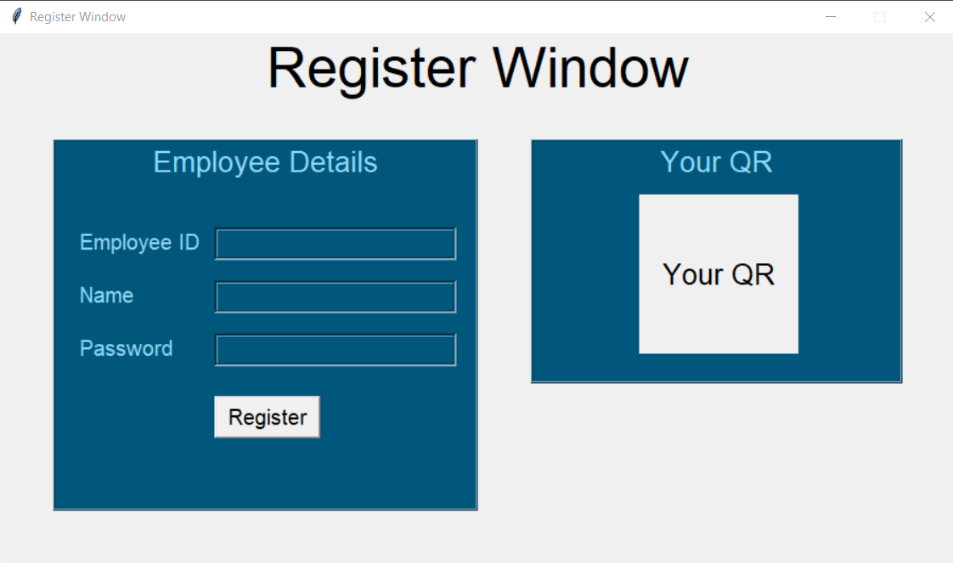
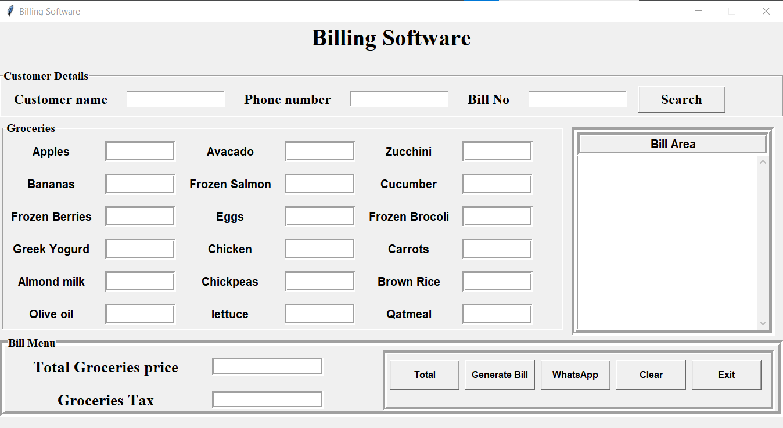
Progress

Slide 14
Thank you

