Slide 1
Bill Management
Group no. 3, Group Mentor – Dr Madhuri Rao
Anurag Hale, Nikunj Mistry, Shubham Khose

Slide 2
Agenda
Problem Statement
Literature Survey
Design
Implementation
Conclusion

Slide 3
Problem Statement

Slide 4

Problem statement
AIM :-To provide a secure and systematic billing software for a shop.
Problem statement: To build an Desktop application program to reduce the manual work and papers. The application will have a convinient features to manage their shopping bills. will have records of customer and rooms and facilities available for them.

Slide 5
Literature Review

Slide 6
Survey of existing System
In the existing system, most of the activities takes place manually, manually carrying out this activity in very tedious time consuming. As we have tried to develop computerized application so as to handle all the activity that are related to bills.
The existing system of Bill Management was manual. So all the daily routines is carried out manually and the bills are either being kept safely for years or are torn up within sometimes.
Since it is a manual system a lot of time is spent in communicating the information across different branches. There is a need for an integrated automated system, which has some centralized control over the entire process. Conventional System makes use of huge amounts of paper for recording transactions.

Slide 7
It can be used and access anytime as compared to paper bills.
To provide accurate records and other information about the individual customer.
To provide automatic monitoring record of the individual monthly consumption.
To test and evaluate the system in terms of efficiency and accuracy.

Slide 8
Python Libraries
Tkinter
numpy
Qrcode
Pywhatkit
Flask
Mysql connector
Open cv
Pyzbar
Autocomplete Entry

Slide 9
Design

Slide 10
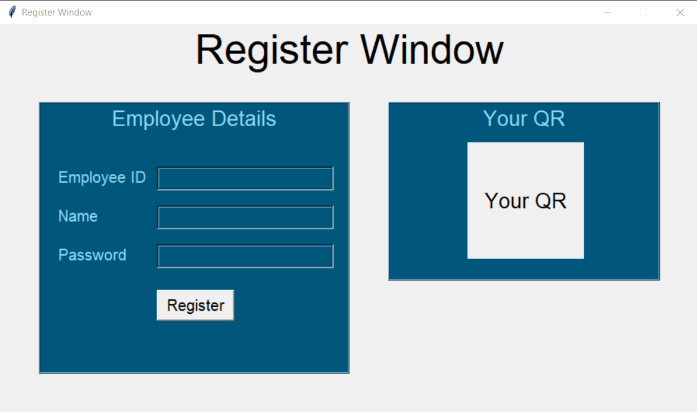
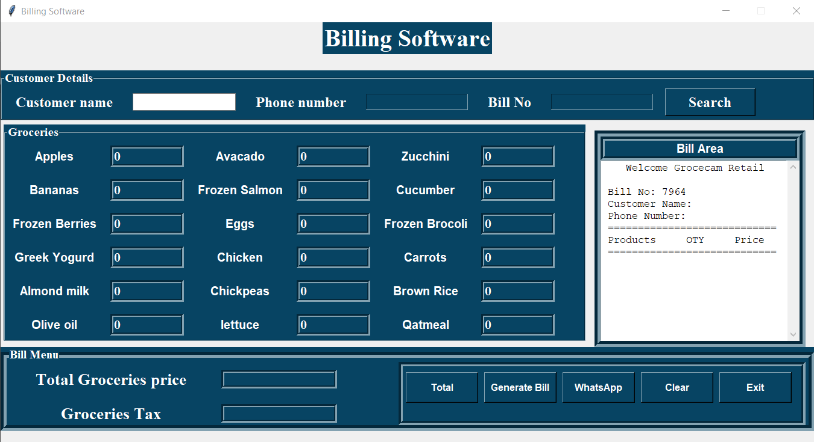
Design

Slide 11
Implementation

Slide 12
Implementation
This project is based on the billing of items in a supermarket. The first activity is based on adding the items to the system along with no of items purchased.
We use python to build the functionality of the application and graphics user interface (GUI). We use the MYSQL database to store the application data and transaction data. Using this database, we add, update, delete, and keep track of the transactions. We make use of different libraries of Python, like Tkinter, qrcode, pyzbar, MYSQL to build the application.

Slide 13
Overview of Steps using Libraries and Tools
• First, the layout of the system is made by using Tkinter
• Then, the store’s database is created using Mysql
• Connection between database and the GUI is created using Python
• Then, we create module to generate the bill
• “pyzbar” is used to create bar code reader (decoder) module
• “qrcode” is used to create the QR code generator module

Slide 14
B. Working of the system
Run the application
If the user is a new employee than click on register to create qr code else login button.
Qr scanner will scan the qr code
After successful password prompt bill gui pops up.

Slide 15
Conclusion

Slide 16
Conclusion
This project was about improving the existing billing system by making it digitalized. A better way of billing system was implemented. Instead of a printed bill, the customer obtained a digital copy of it, which reduced the wastage of paper. This also helped the seller to save the cost of buying paper. The bill was first stored in the seller’s system in an organized manner. After that, a QR code was generated, and this QR code could be scanned by the employee and be transferred to their device. This also ensured the customer wouldn’t lose their bill. This project was implemented to make the process of billing more efficient

Slide 17
Future Scope

Slide 18
Future scope
Improve the model so that it can run in low internet speed also.
Screenshot of qr scanner after succefully login.

Slide 19
Thank you

