Slide 1
Provision ODU2E services via API
Solution Walkthrough

Slide 2
High Level Overview
Script
Create Template
Output
JSON Input file:
Service Name
Protection Type
Service ID (must be unique)
AK end point
ZK end point
Mid nodes on the working path
Mid nodes on the protected path
Input JSON file
4k end
2k end
2k mid
10G circuit
4k end
2k end
2k mid
Delete Template
EPNM Jobs
Check Job Execution
1 JSON file -> 1 service

Slide 3
Use case covered
Following use cases are covered:
4K – 2K
2K – 2K
4K - 4K
Any combination of 2K and/or 4K on the working and protected paths
2K - 4K would require some extra code but being equivalent to 4K – 2K has been left uncovered

Slide 4
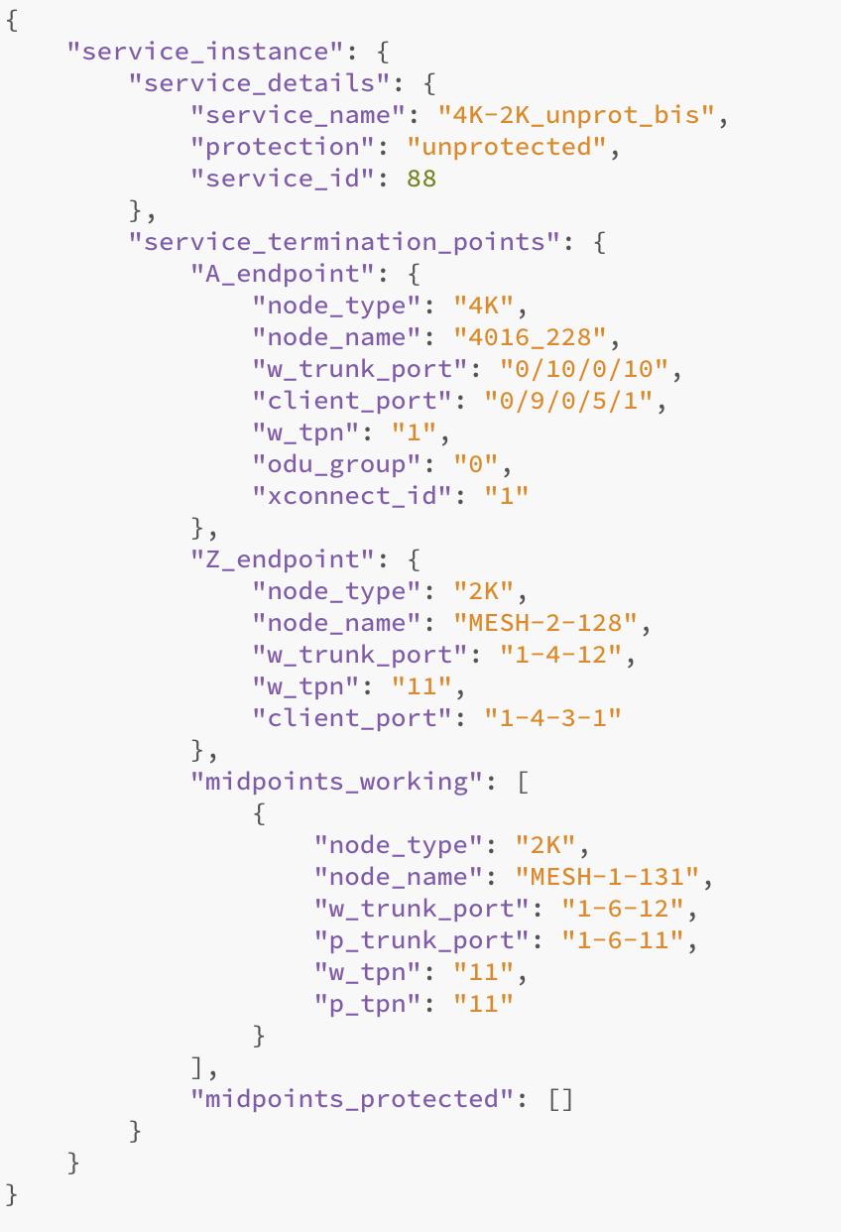
JSON Input File Example
JSON file contains:
Service details
Service termination points:
A Endpoint
Z endpoint
working path
protected path
Working path or Protected path can be empty lists

Slide 5
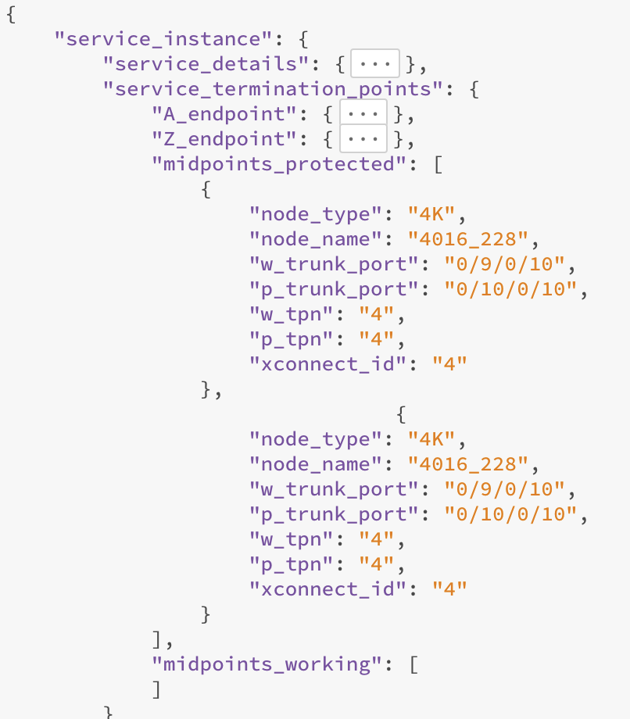
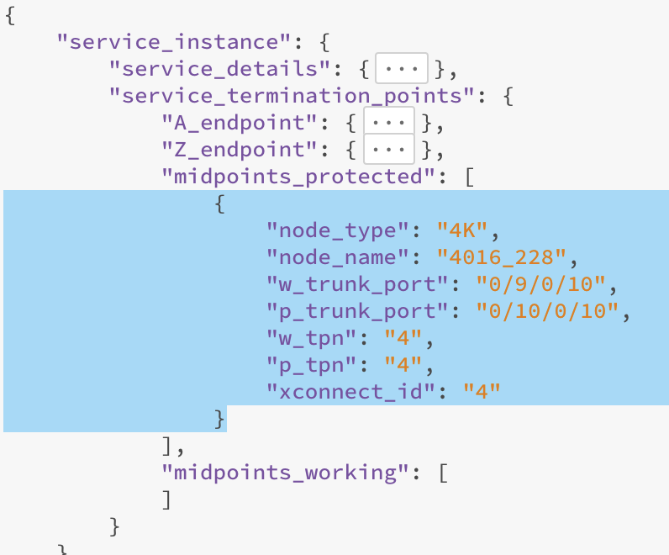
Add/Remove nodes on working/protected path
To add a node on the Working or Protected path, just copy/paste
Then edit node name, working and protected trunk ports and so on

Slide 6
Deliverables
EPNM Templates (to be imported in the EPNM server)
A script to generate Device ID list file (see next slide)
Two scripts to create protected and unprotected ODU2E
Two scripts to delete protected and unprotected ODU2E
A script to monitor templates execution
A script to validate input file against user typos and with some additional validations based on EPNM node inventory

Slide 7
Pre-Requirement – Device ID List File
EPNM Templates require an internal device ID to be passed once executed from API
Such ID list can be retrieved and created programmatically during script execution. This means executing an API GET for all devices in the system and would take long time, especially in large networks
Assuming nodes are not added and removed in EPNM frequently, we opted for an off-line script to be executed manually
Pro: Fast script execution
Cons: Off-line script needs to be executed all times nodes get added in EPNM

Slide 8
Pre-Requirement – Oracle dbauser password
Some parameters needs to be taken from EPNM DB as not exposed via API
One python script needs the EPNM oracle dbauser password to connect and execute SQL commands
This password needs to be taken from the EPNM server (a utility script already exists on all EPNM server to retrieve it) and update the dbapassword file delivered with this project files
The Oracle listener port also needs to be open on the EPNM firewall

Slide 9
EPNM Templates
Two sets of EPNM Templates are provided to create and delete ODU2E services
For each operation, two different templates are available to cover protected and unprotected ODU2E services
For mid nodes, there will be no difference and same templates can be used for both protection type
Templates will differe for each platform and for the role played (A end, Z end or mid node)

Slide 10
Script execution - Output file
EPNM Template execution is asynchronous and only returns a JOB-ID
Users needs to then use such JOB-ID to monitor templates execution and result
The create and delete ODU2E scripts generate a JSON file containing the list of all JOB-ID for each EPNM template being executed
An additional script is available to go through this list and check each job execution automatically

Slide 11
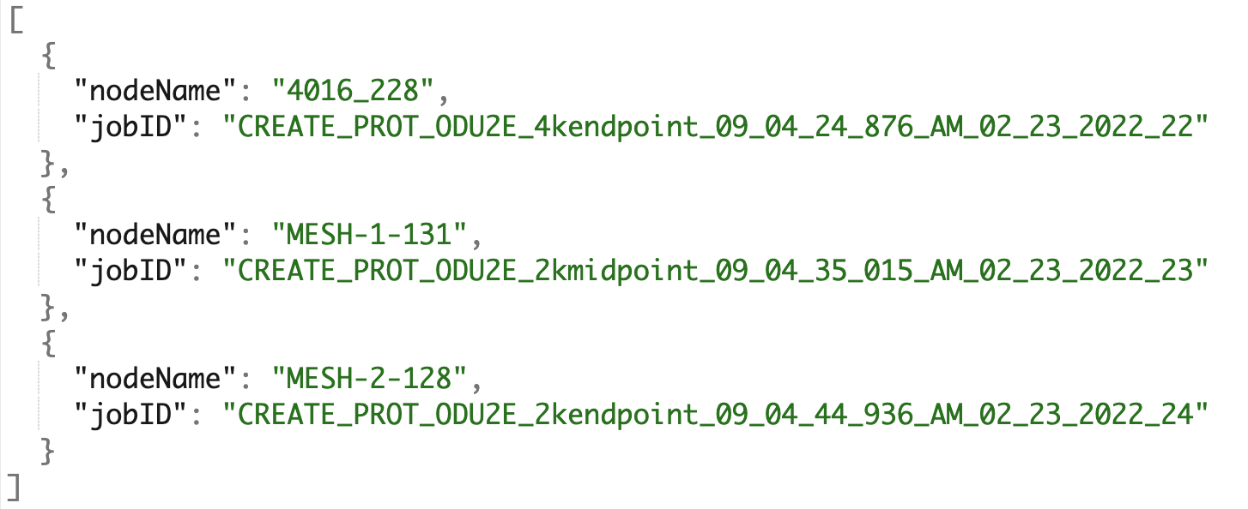
Output file example

Slide 12
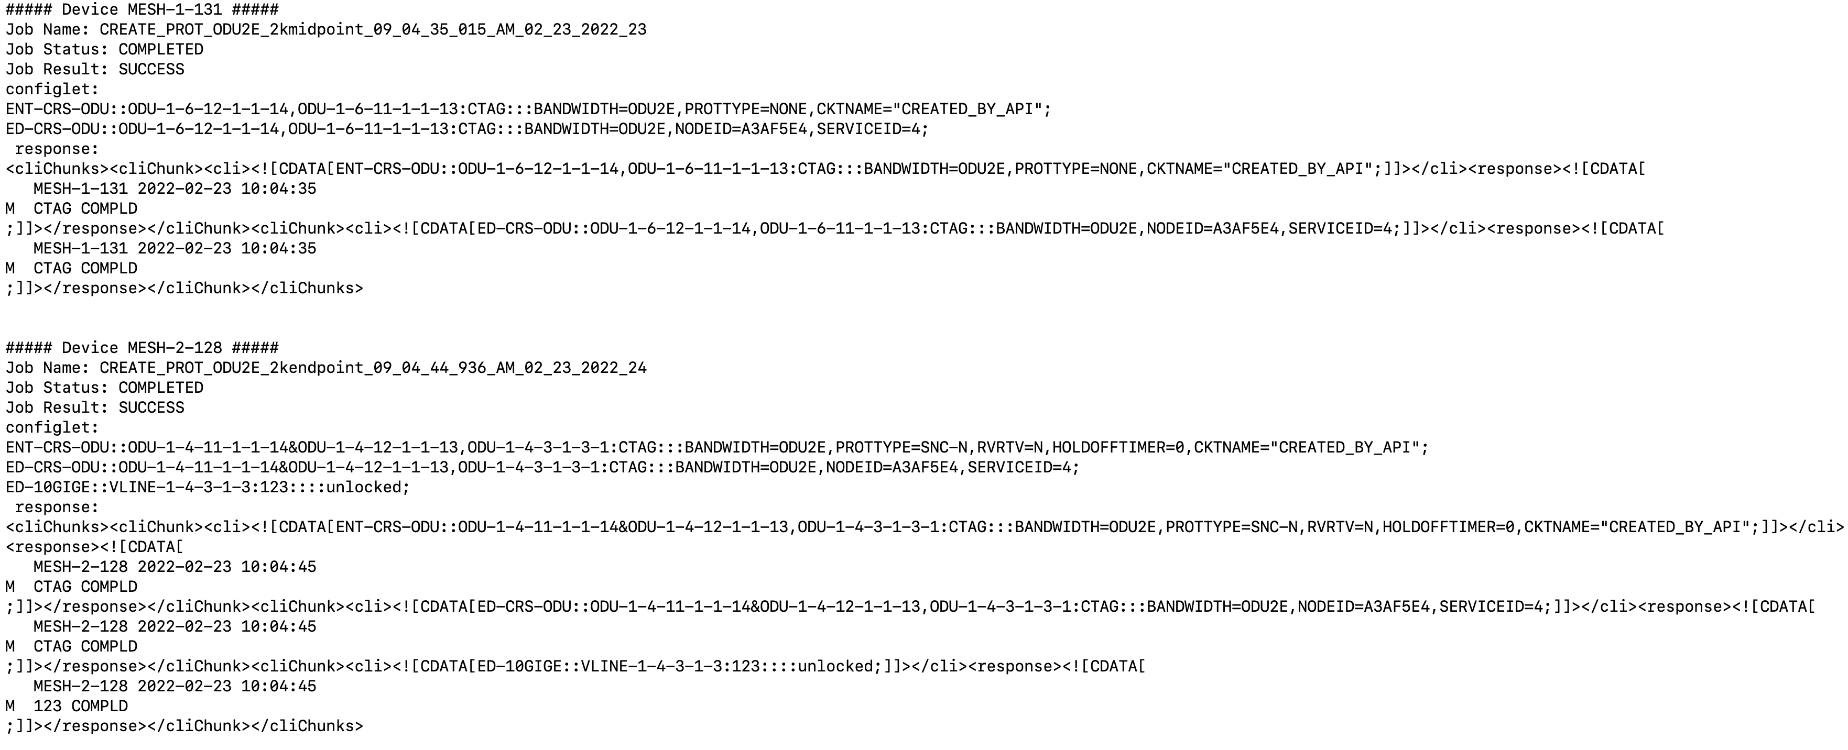
Jobs execution control result
All entries should report:
Status: COMPLETED
Result: SUCCESS

Slide 13
Workflow
Import the template file ExportedTemplates.zip in EPNM
Update dbapassword file with the output from EPNM script:
/opt/CSCOlumos/bin/getDatabaseParams.sh
Open Oracle listener port on EPNM firewall with:
sudo iptables -I INPUT 1 -p tcp --dport 1522 -j ACCEPT
Create the device ID list executing getDeviceID_progress.py
Create a JSON service file. Examples are available under service_file_examples folder (remember service_ID must be unique for each file)
Validate the JSON service file using validate_input_file.py

Slide 14
Workflow (Cont.)
Create a protected or unprotected ODU2E using createODU2E_Prot.py or createODU2E_unprot.py script, passing the EPNM IP address and JSON service file as script parameters
EX: python createODU2E_unprot.py 10.58.234.32 2K-2K_unprot.json
Validate template execution using jobHistory.py. Complete syntax will be provided at the end of the create script
EX: python jobHistory.py 10.58.234.32 Create_JobList2022-07-12_16:46_CEST.json
Verify service discovery state in EPNM GUI

Slide 15
Don'ts
JSON service file should be not edited if a service was created (even if partial or failed) and kept as is until the server is deleted
If a change in the JSON service file is required, then first make sure the associated service (or part of it) is deleted.
deleteODU2E_Prot.py and deleteODU2E_unprot.py can be used to delete a service. Those also require EPNM IP address and JSON service file as script parameters

