Slide 1
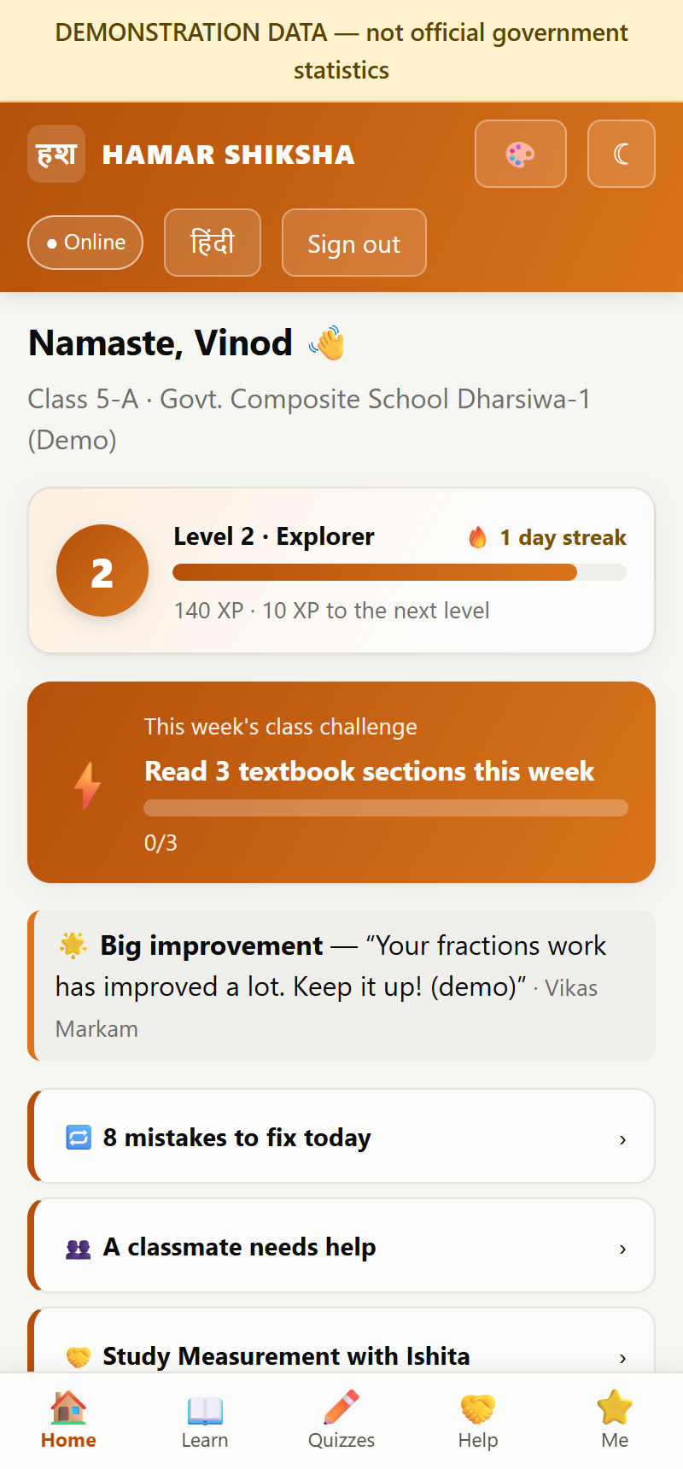
HAMAR SHIKSHA
हमर शिक्षा
An AI-enabled, offline-capable school education platform for Chhattisgarh — for administrators, teachers and every child.
Start the tour →
Open live demo ↗
Source on GitHub ↗
Holistic Approach for Meaningful Achievements & Reforms in Education
Notes:
Welcome. HAMAR SHIKSHA is one platform for the whole school system of Chhattisgarh: a command centre for administrators, an assistant for teachers and a learning app for students, built around a small AI model that runs locally. Use 'Start the tour' to open the agenda; every slide has buttons back to the agenda and to the live demo.

Slide 2






Choose where to go
Live demo ↗
Every tile is clickable. Each slide has a ☰ Agenda button to come back here.
01
02
03
The idea
For administrators
For teachers
Why HAMAR SHIKSHA, and the platform at a glance
State → division → district → block → school
Less paperwork, more teaching
04
05
06
For students
AI, curriculum and trust
Deploy and roadmap
Learn alone, or with help
A small local model grounded in SCERT books
Try it today, and where it goes next
Notes:
Agenda. Click any tile to jump to that part. The deck can be presented in order, or navigated live depending on the client's interests.

Slide 3
The idea
01
IN THIS SECTION
01 The challenge and our answer →
02 One platform, three portals →
Why HAMAR SHIKSHA, and the platform at a glance
03 All 16 objectives covered →
☰ Agenda

Slide 4






The challenge, and our answer
☰ Agenda
Live demo ↗
Today
With HAMAR SHIKSHA
Teachers spend hours on registers and reports instead of teaching
One tap to record what was taught; dashboards and reports build themselves
Many schools lack a teacher, or expertise, for some subjects
Teacher Saathi and the AI Class support teaching from the approved textbooks
Children who fall behind or stop coming are noticed late
Learning profiles, priority lists and attendance follow-up for every child
Remote schools have weak or no internet
Offline app; queued work syncs safely later; the AI model runs locally
Data sits in separate systems; officers cannot see the whole picture
One learner record and a command centre from state to classroom
Notes:
Each problem on the left has a direct answer on the right. The guiding rule of the platform: teachers enter nothing twice, and every number shown to an officer comes from records, not from extra forms.

Slide 5

One platform, three portals
☰ Agenda
Live demo ↗
Admin portal →
Student app →
Command Centre · map by division · grades · follow-up · digital use · recognition
SHARED CORE
AI Class tutor · practice · revision · textbooks · doubts · badges
Gyan SLM (local AI model)
Curriculum knowledge base (SCERT books)
One continuous learner record
Teacher portal →
Works offline →
Teacher Saathi · Pariksha · priorities · attendance · student help
Cached lessons and quizzes; attendance and answers sync later
Four modules on the shared core: Teacher Saathi · AI Class · Pariksha Engine · Command Centre
Notes:
Architecture in one picture: one small language model, one curriculum knowledge base and one learner record are shared by four modules and three role-specific portals. Click a portal card to jump to it.

Slide 6
All 16 project objectives are covered
☰ Agenda
Live demo ↗
01 Academic planning & milestones
02 Milestone tracking & grading
03 Teacher expertise gaps
04 AI support & AI classes
05 Classroom continuity
06 Less teacher workload
07 Unit, quarterly, annual tests
08 Child-wise learning profile
09 Automated analytics
10 Attendance–learning link
11 Personalised remedial support
12 Digital infrastructure use
13 Motivation & recognition
14 Teacher development
15 Monitoring for administrators
16 Offline, secure, scalable
Click any objective to see where it lives. Full mapping to screens and automated tests: docs/OBJECTIVES.md
Notes:
Every one of the sixteen objectives in the brief is implemented and has an automated test behind it. Click a tile to jump to the slide that shows it.

Slide 7
For administrators
02
IN THIS SECTION
01 Command Centre and division map →
02 Progress grades and corrective action →
State → division → district → block → school
03 Attendance follow-up and digital infrastructure →
☰ Agenda

Slide 8
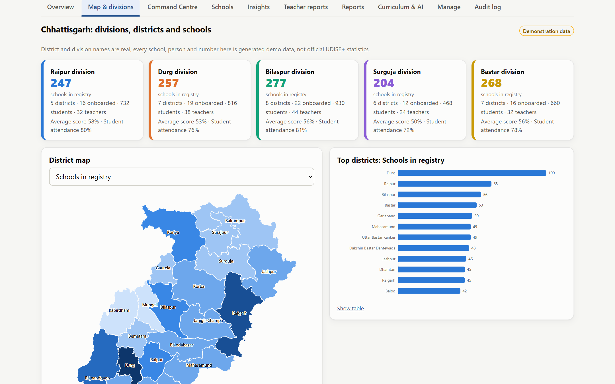
Command Centre and the division map
☰ Agenda
Live demo ↗
33
5
districts, real names
revenue divisions
5
1-8
drill-down levels
classes in every district
Raipur, Durg, Bilaspur, Surguja and Bastar divisions with their districts
Map coloured by schools, students, teachers, scores, attendance, schools on track, digital use
Click a district to drill down to block, school and class
Schools, people and figures in the demo are generated and clearly labelled.
Notes:
The state view groups all 33 districts into the 5 revenue divisions. The map can be coloured by many measures, including the new ones: schools on track, digital resource use and children needing follow-up. District and division names are real; all demo numbers are generated.

Slide 9
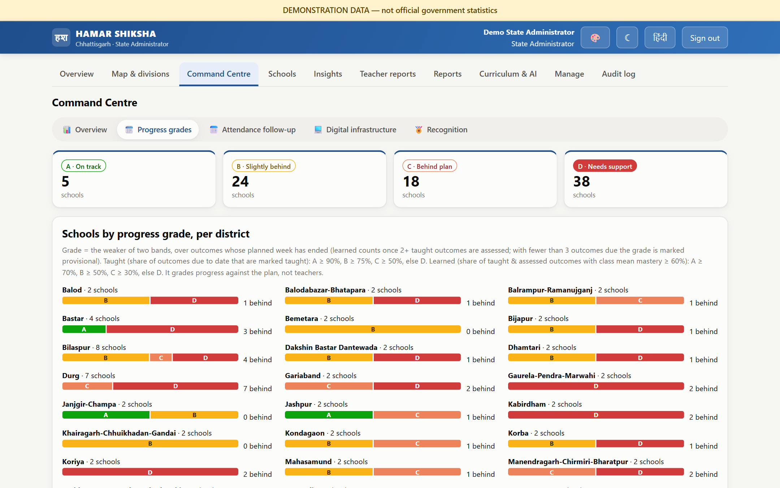
Progress grades with corrective action
☰ Agenda
Live demo ↗
A
On track
B
Slightly behind
C
Behind plan
D
Needs support
Planned → taught → learned, computed from one-tap milestones and students' answers
Every class-subject and school graded; nothing extra to fill in
Suggested next steps: outcomes to cover, outcomes to re-teach, support visits
Notes:
The grade is the weaker of two bands: how much of the plan was taught, and how much of what was taught was learned. It grades progress against the plan, not teachers. Schools graded C or D come with a suggested corrective action.

Slide 10
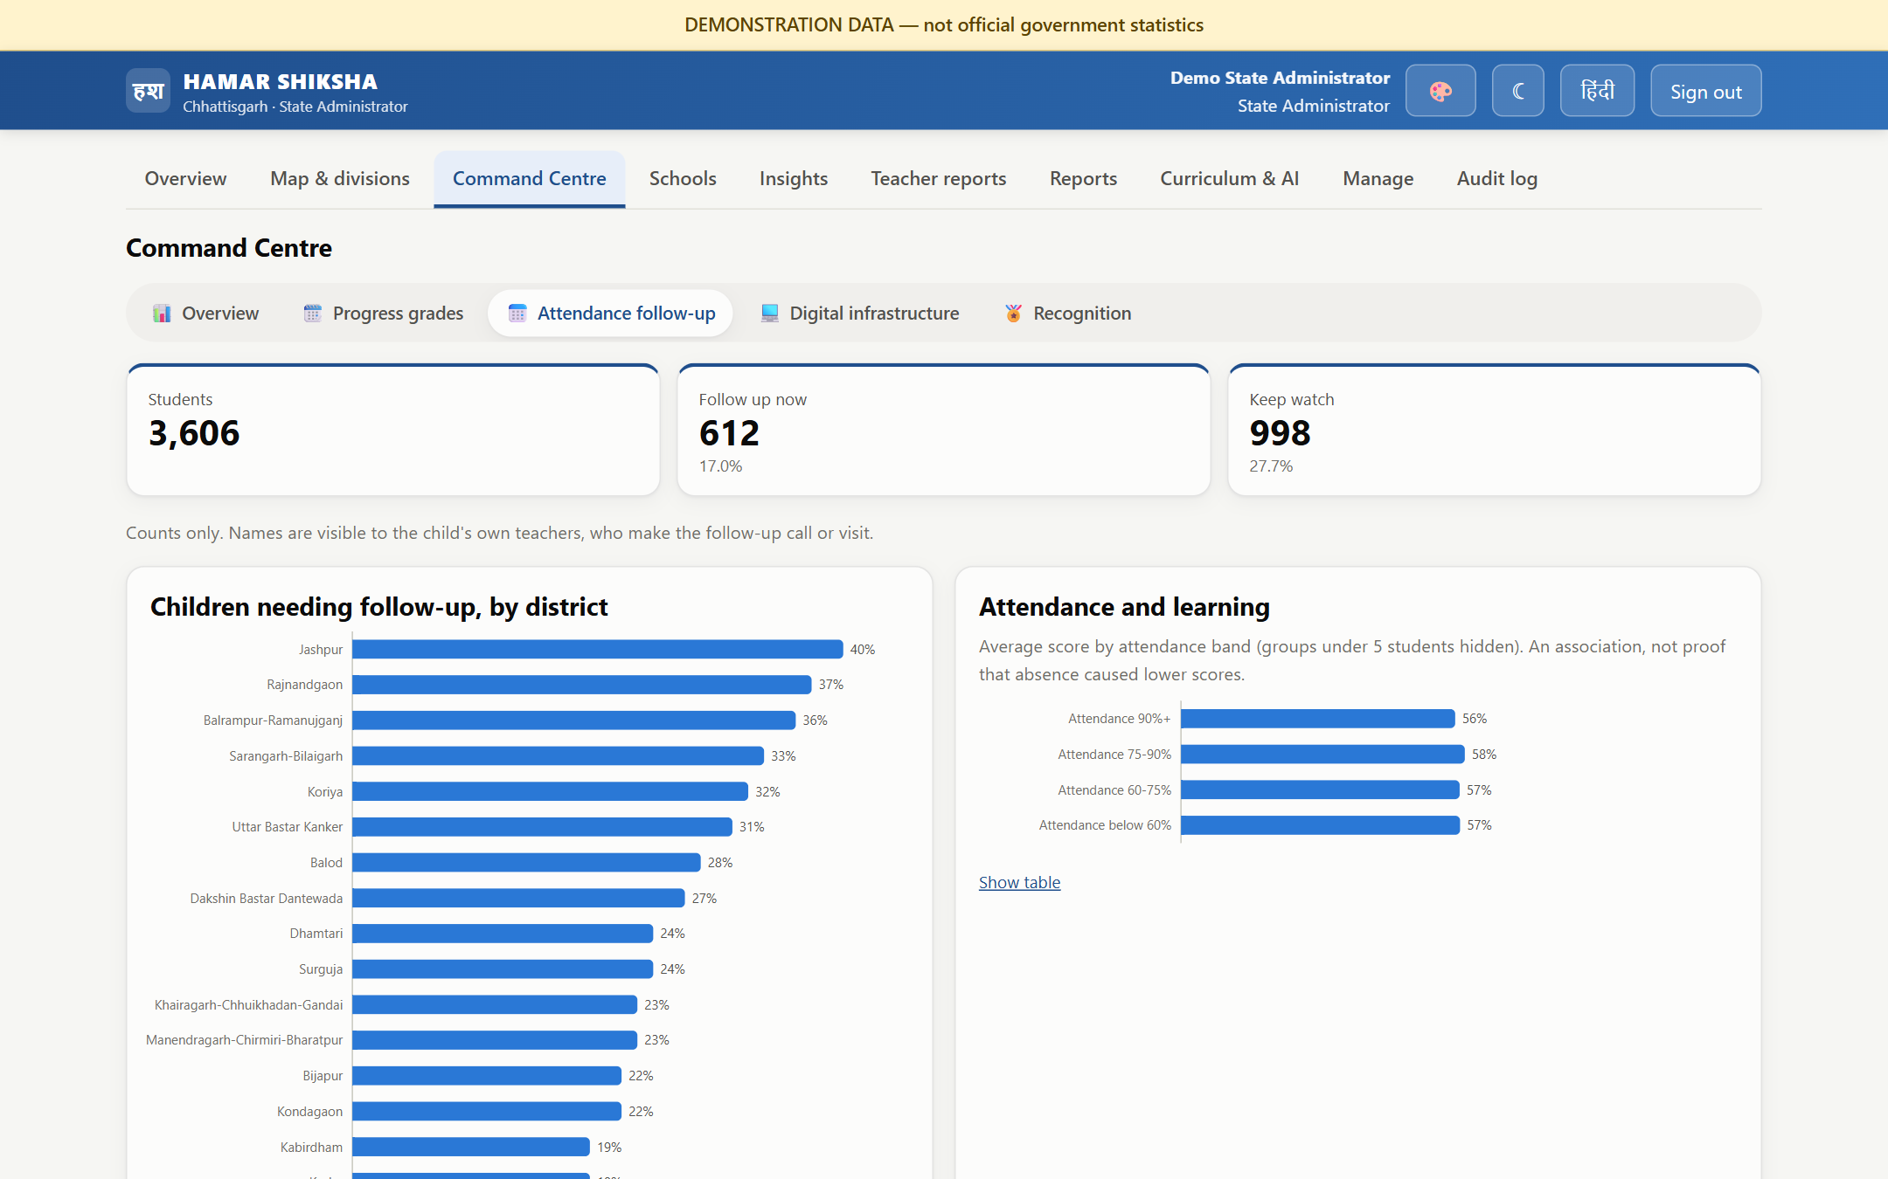
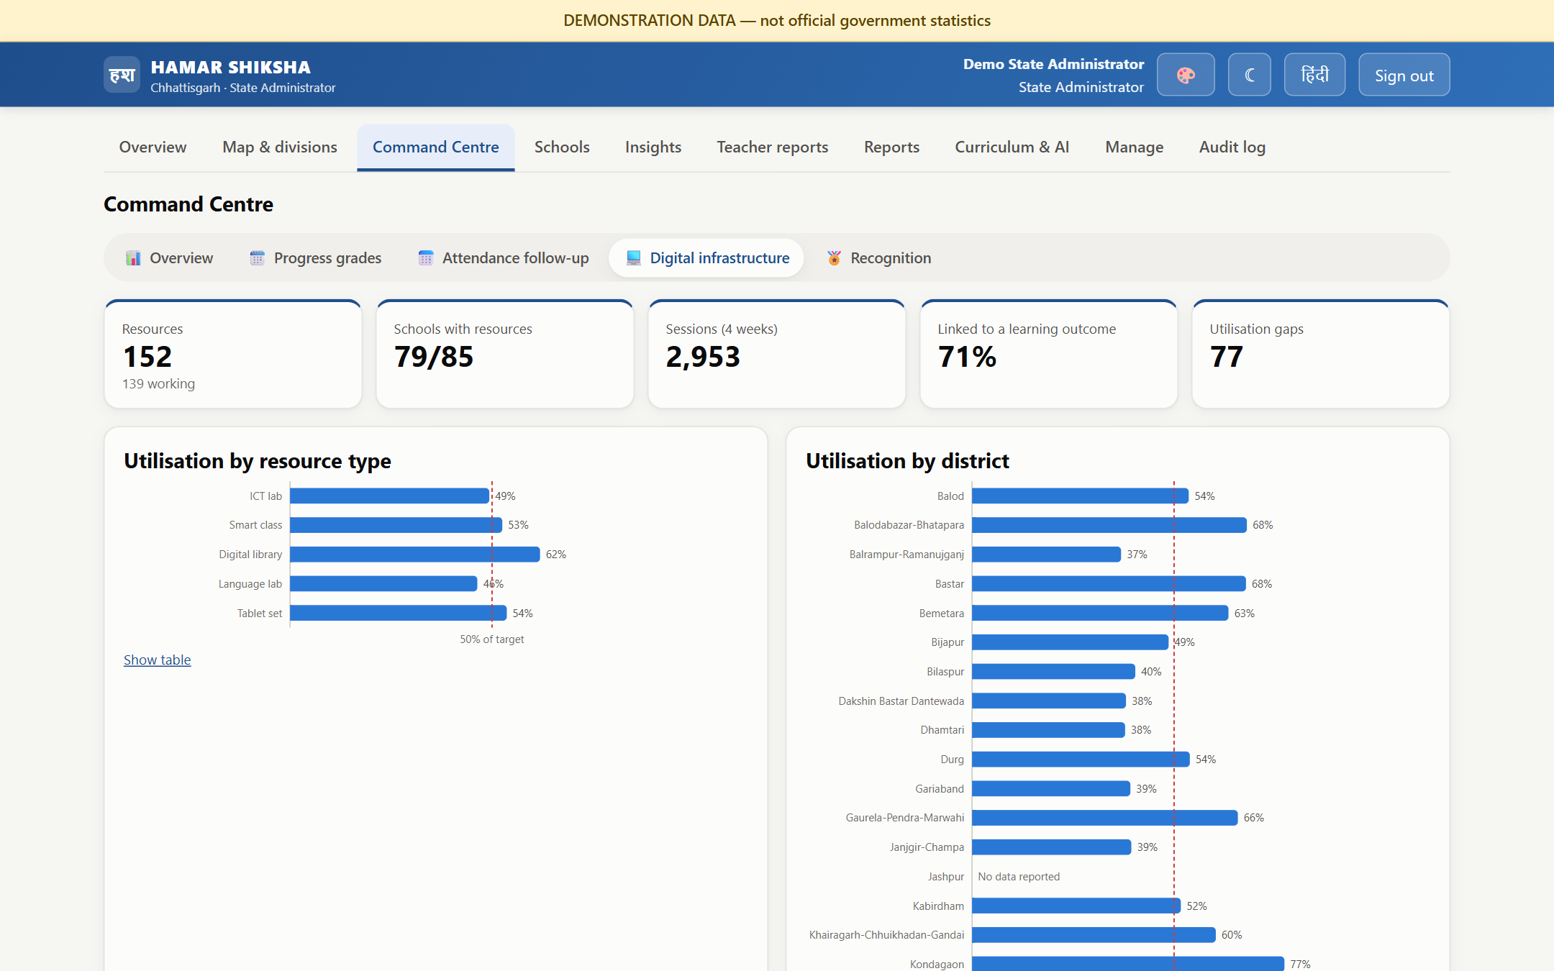
Attendance follow-up and digital infrastructure
☰ Agenda
Live demo ↗
Attendance follow-up
Digital infrastructure
Irregular, falling or stopped attendance flagged for a caring call or visit
Linked to the lessons a child missed and whether they were learned
Officers see counts only, never names
ICT labs, smart classes, libraries, language labs, tablets
Use against target, linked to learning outcomes
Gaps: not working, unused, under-used
Notes:
Two new analyses. Attendance follow-up lists children whose attendance is irregular, falling or has stopped, with the lessons they missed. Digital infrastructure shows whether existing labs and smart classes are used, for which subjects, and where the gaps are.

Slide 11
For teachers
03
IN THIS SECTION
01 Teacher Saathi: plans, lessons, doubts →
02 Pariksha Engine and weekly priorities →
Less paperwork, more teaching
03 Follow-up, digital resources, recognition →
☰ Agenda

Slide 12
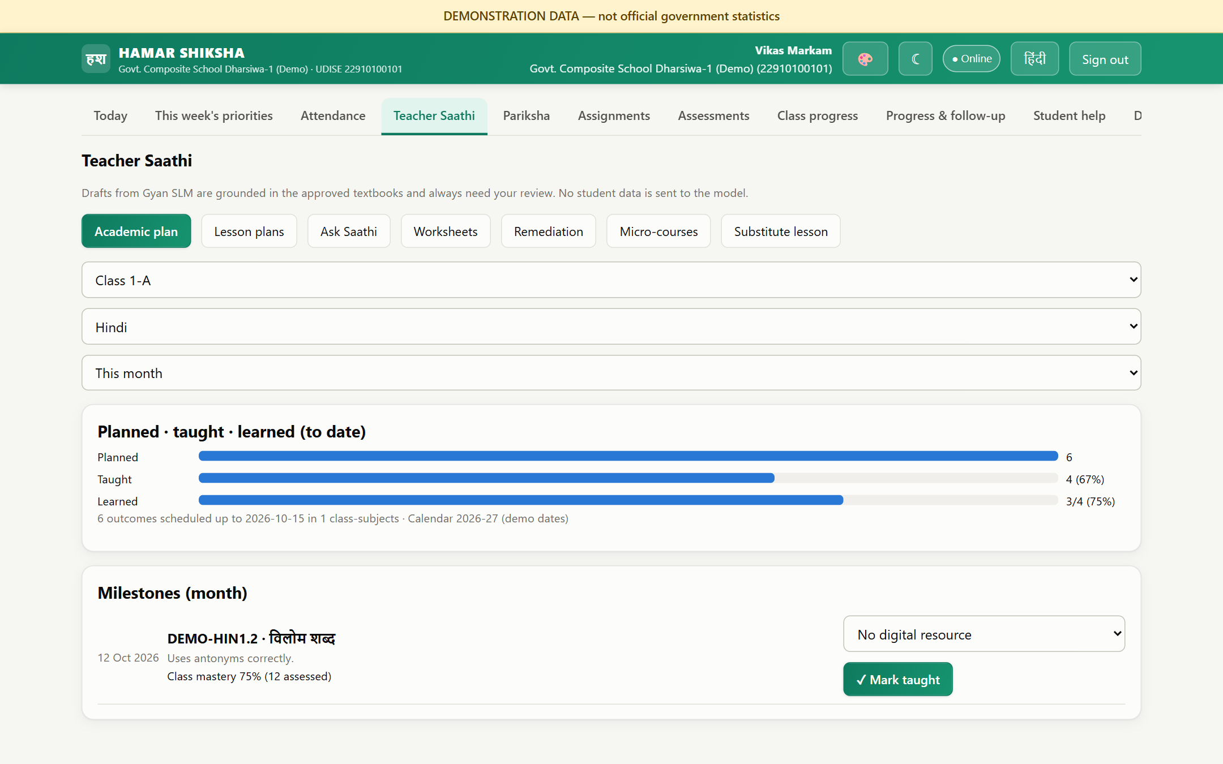





Teacher Saathi: AI drafts, the teacher decides
☰ Agenda
Live demo ↗
Year, month and week plan of learning outcomes
Lesson plans and worksheets from the textbook, with page citations
Ask Saathi any curriculum question, by voice too
Substitute lesson when a teacher is absent
Micro-courses recommended from students' results
Notes:
Teacher Saathi plans the year from the academic calendar, drafts lesson plans and worksheets grounded in the approved textbooks, and answers curriculum questions. Everything AI-generated is a draft until the teacher approves it.

Slide 13
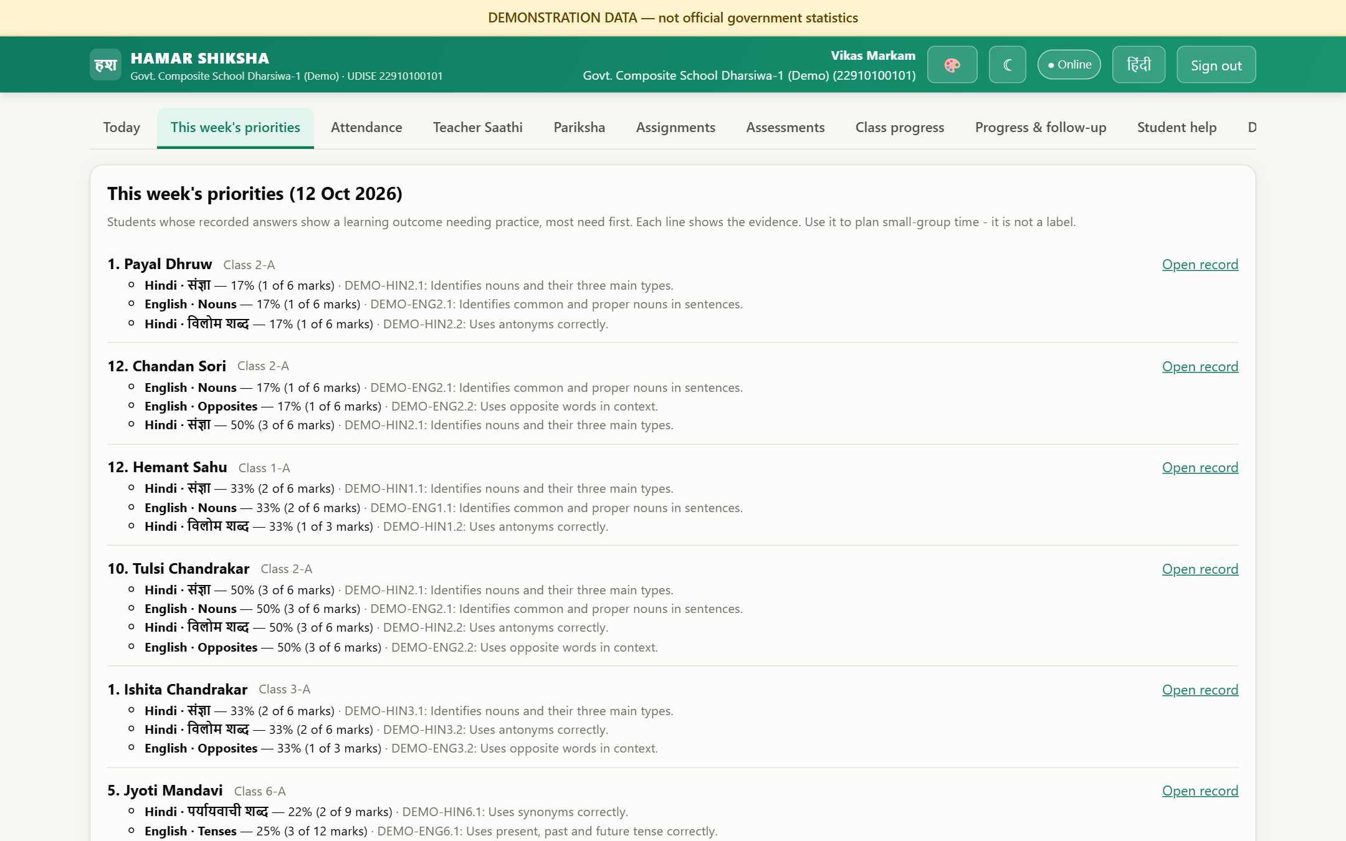
Pariksha Engine and the weekly priority list
☰ Agenda
Live demo ↗
Question bank by learning outcome
Unit, quarterly and annual tests built in minutes
Automatic marking
Uncertain answers go to the teacher's review queue
Child-wise learning profile
Achieved, developing, needs practice — with evidence
This week's priorities
Which child needs help, in what, and what to do
Notes:
Assessments are built from a question bank tagged by learning outcome. Marking is automatic; uncertain cases are routed to the teacher. The weekly priority list tells the teacher which child needs support, in which outcome, with the evidence.

Slide 14
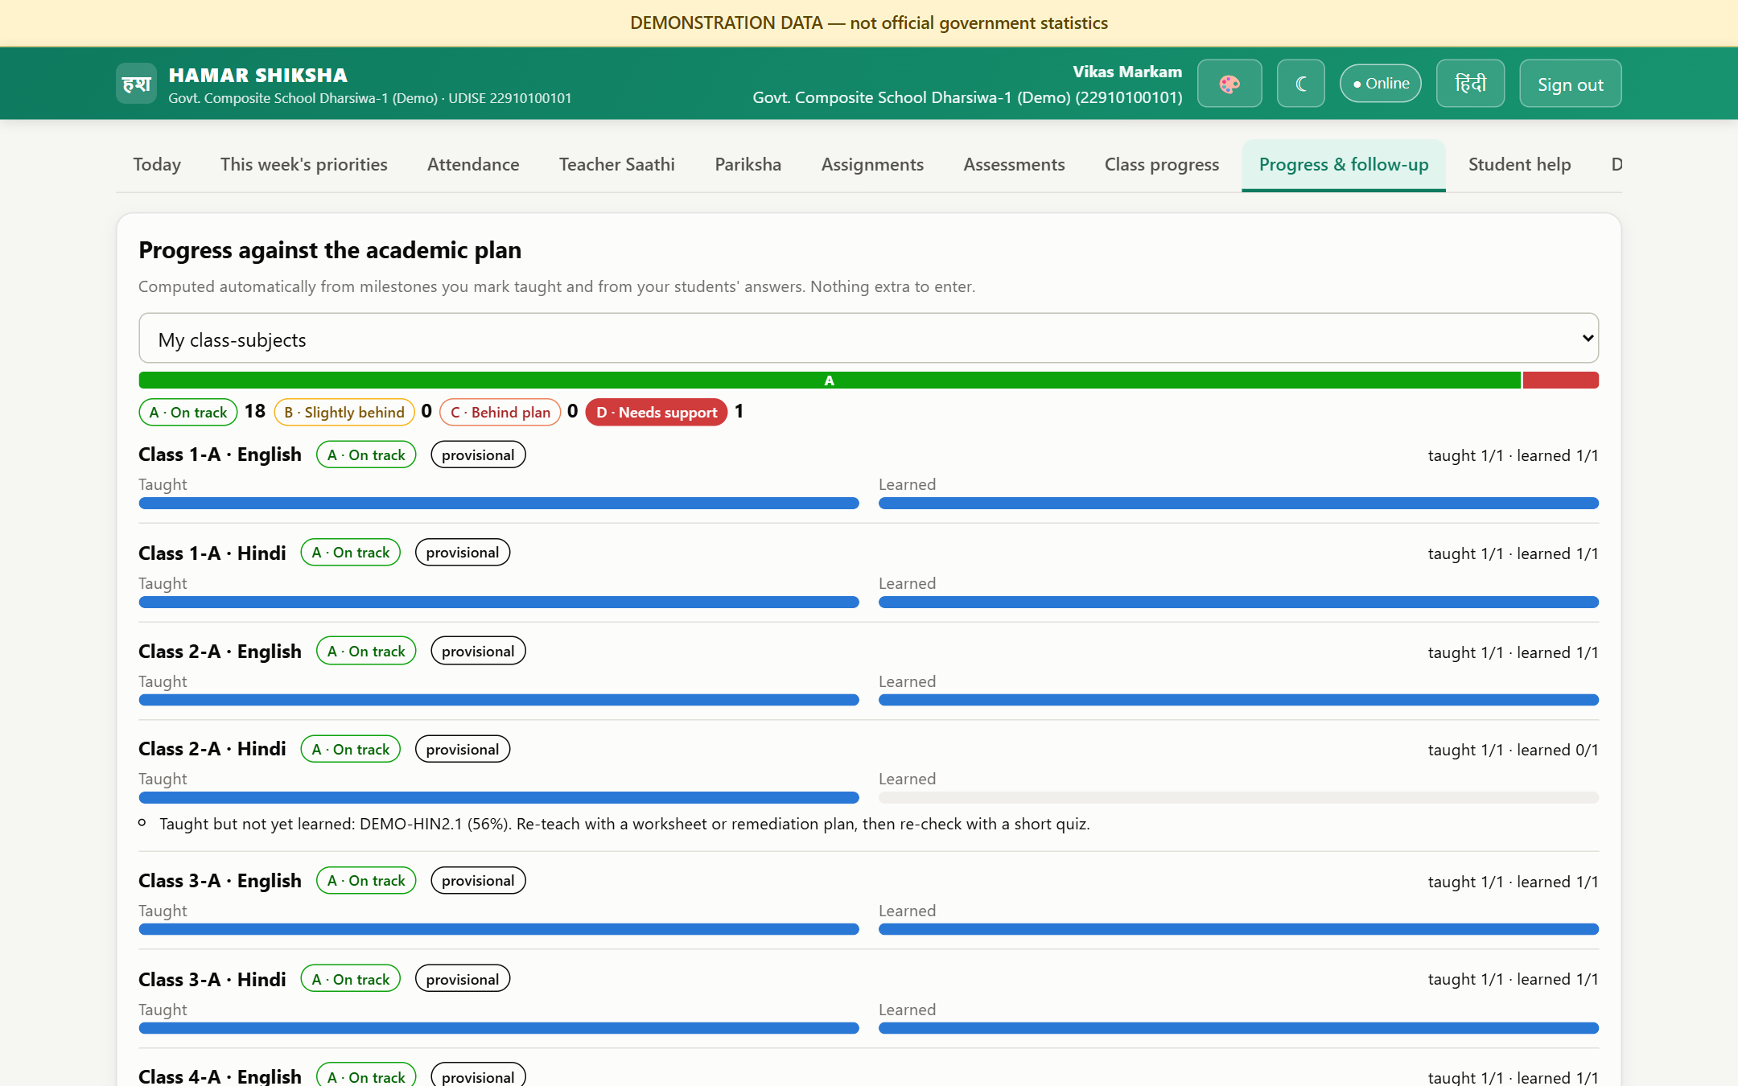
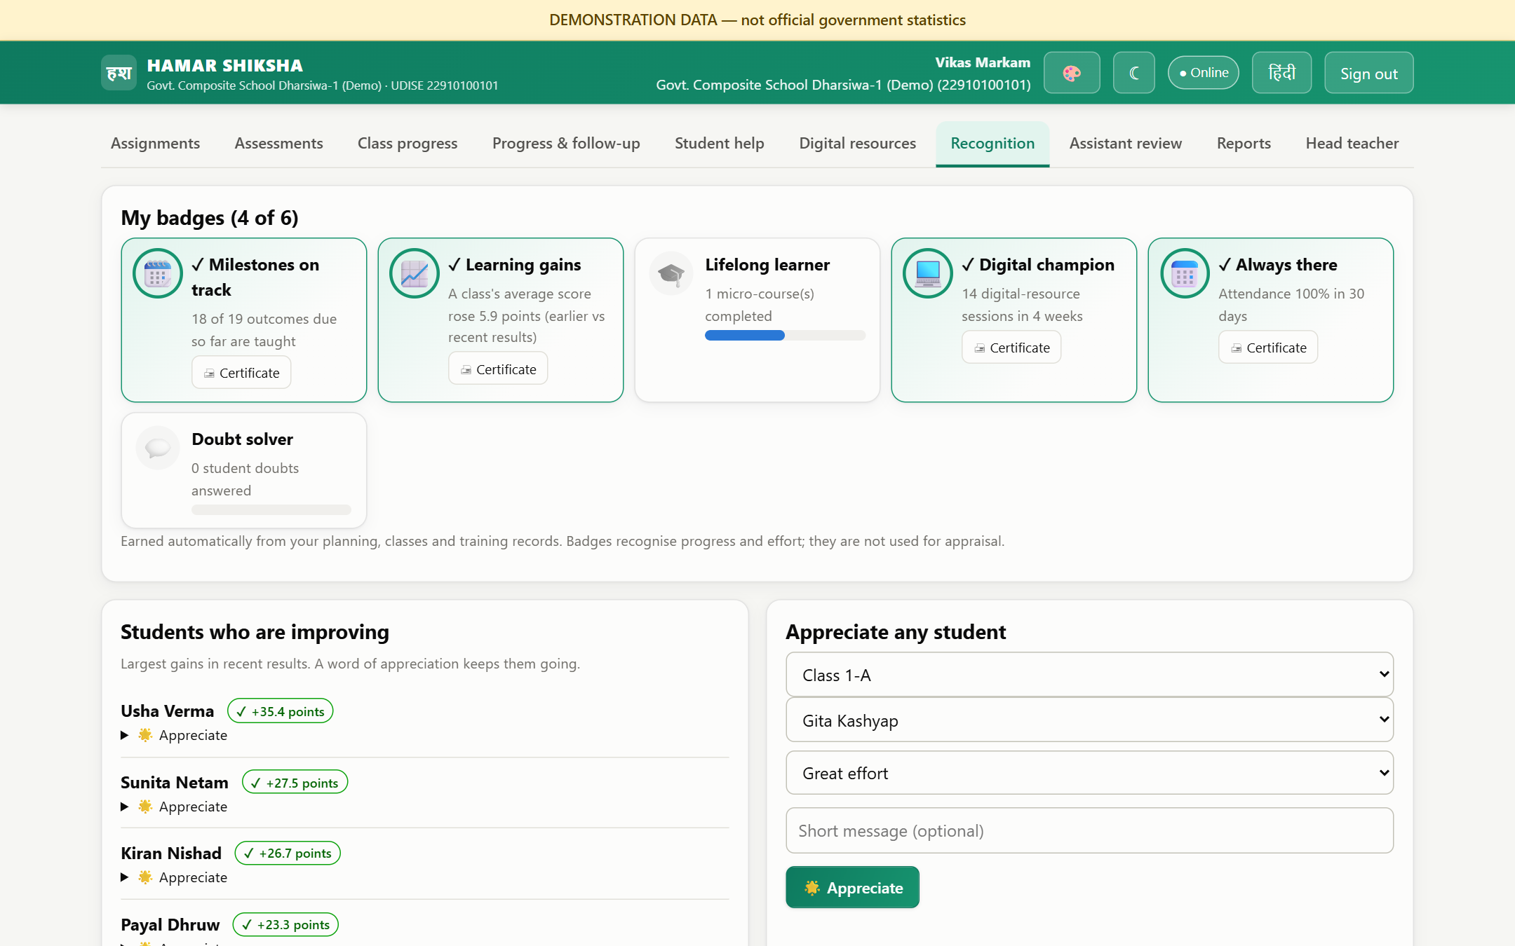
Follow-up, digital resources and recognition
☰ Agenda
Live demo ↗
Progress & follow-up
Recognition
Own class grades A-D with next steps
Children to call or visit, with lessons missed
Smart-class use recorded in the same tap as a milestone
Badges for milestones, learning gains, training, digital use
Appreciate improving students in one click
Head teachers and officers appreciate teachers
Notes:
Teachers see their own grades with next steps, the children who need a follow-up call, and their recognition: badges earned from records and appreciation from the head teacher or officers.

Slide 15
For students
04
IN THIS SECTION
01 A mobile-first app in Hindi →
02 Self-improvement and peer help →
Learn alone, or with help
☰ Agenda

Slide 16
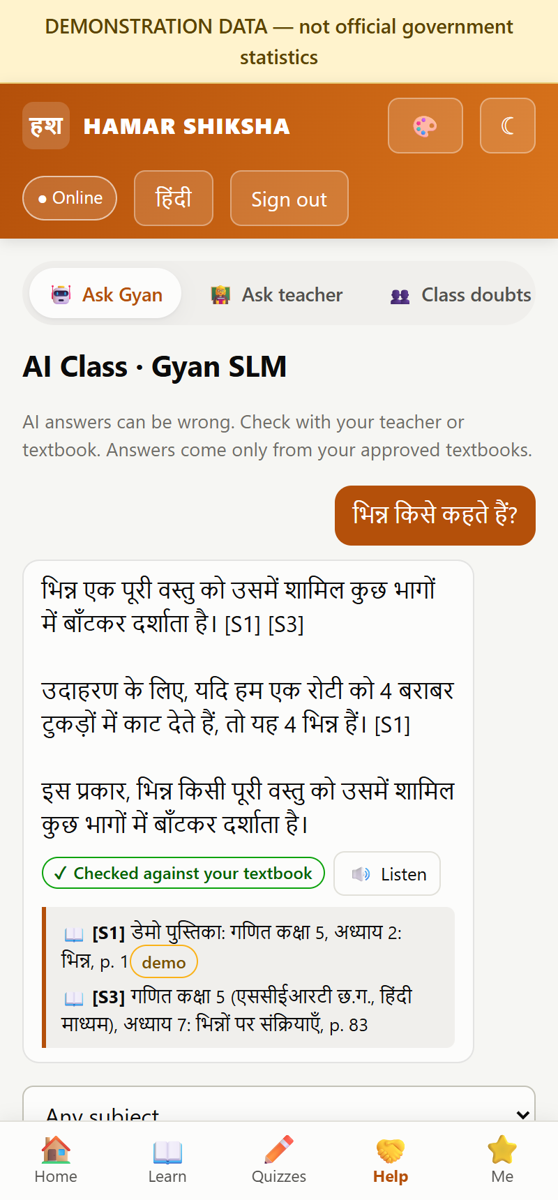
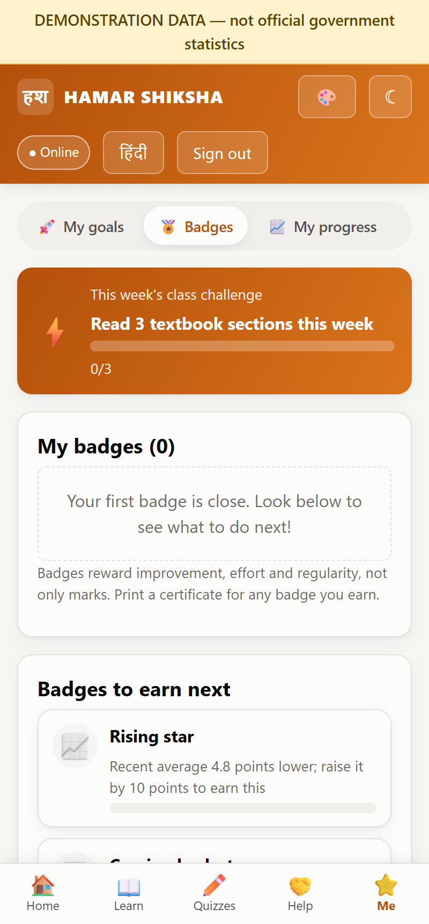
A mobile-first learning app, Hindi by default
☰ Agenda
Live demo ↗
Levels, XP and learning streaks
A weekly class challenge
Voice questions in Hindi or English
Light and dark themes, colour choices
Works offline; syncs later
Home: level, streak, weekly challenge, next steps
Ask Gyan: answers from the child's own textbooks
Badges and printable certificates
Notes:
The student app is designed for phones and opens in Hindi. The home screen shows the child's level, streak, this week's class challenge and what to do next.

Slide 17
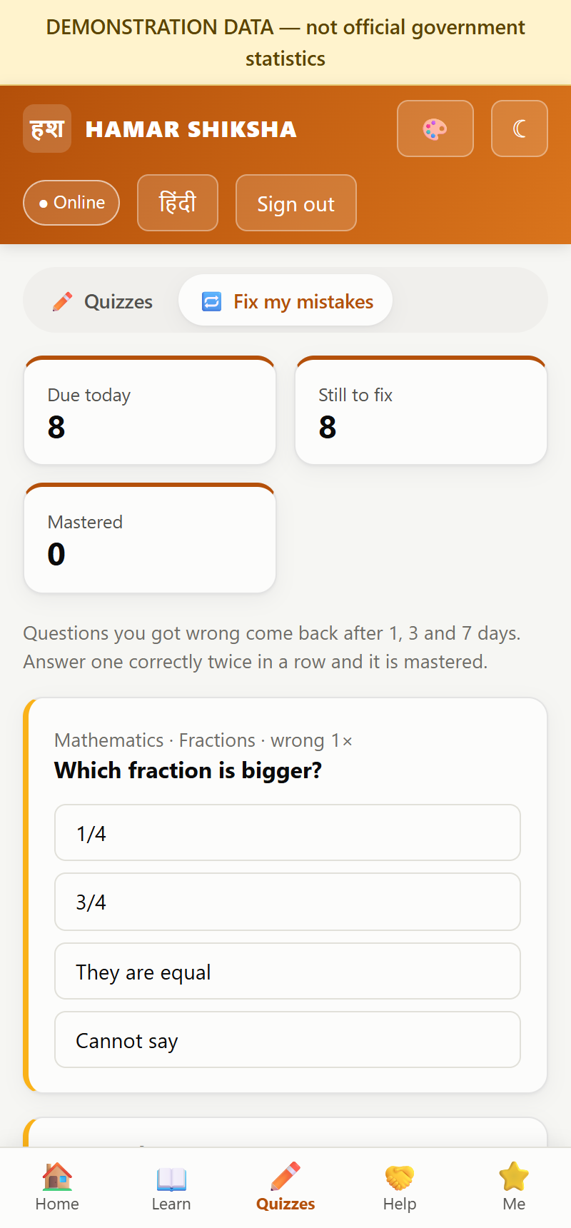
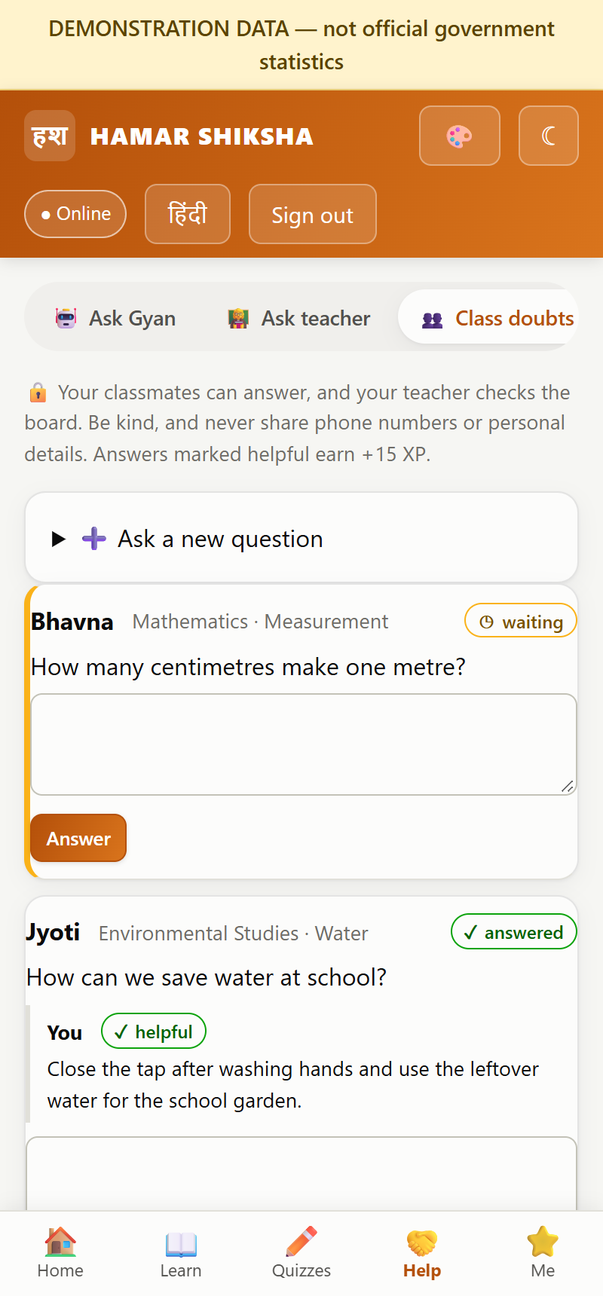





Improve by yourself, or with the help of others
☰ Agenda
Live demo ↗
Fix my mistakes
Spaced revision of every wrong answer
Textbook library
Read SCERT books chapter by chapter
Weekly goals
Set and track your own targets
Class doubt board
Classmates answer; teacher moderates
Study buddies
Paired by the teacher from mastery data
Notes:
Children can improve on their own — revising past mistakes, reading the textbook, setting goals — or with others: classmates answer doubts on a moderated class board, and teachers set up study buddies. Posts are screened for phone numbers, links and unkind words.

Slide 18
AI, curriculum and trust
05
IN THIS SECTION
01 Gyan SLM: answers with citations →
02 Offline, secure, private, safe →
A small local model grounded in SCERT books
☰ Agenda

Slide 19




Gyan SLM: answers grounded in SCERT textbooks
☰ Agenda
Live demo ↗
Question
Retrieve
Generate
Validate
Answer
typed or spoken
matching textbook passages
local model (llama3.2:3b)
citations and word coverage
with book, chapter, page
37
8
11,057
0
SCERT textbooks loaded
classes (1 to 8)
textbook passages
student data sent to the model
Runs on a school or state server: no cloud AI, no per-question cost
Hindi-medium books in Kruti Dev are converted to Unicode automatically
If the books do not cover a question, it says so instead of guessing
Notes:
Gyan SLM is a small open model that runs locally, combined with retrieval from the approved SCERT textbooks and a validation step that checks citations. 37 textbooks for classes 1 to 8 are loaded. Honest note: answers can still be wrong even when cited, so student use should start with teacher supervision.

Slide 20





Offline, secure, private and safe for children
☰ Agenda
Live demo ↗
Works offline
Secure access
Privacy by design
App shell, quizzes and rosters cached; attendance and answers queue and sync later, re-checked on the server
Separate portals, role and area scope on every request, strong passwords, admin two-step login, audit log
Minimal data, guardian consent, officers see aggregates; no ads, trackers or third-party scripts
Child safety
Multilingual
Scalable
Wellbeing phrases get CHILDLINE 1098 and alert the teacher; personal details and unkind posts are blocked
Hindi and English today; Chhattisgarhi, Gondi and Halbi on the roadmap
PostgreSQL and Docker for state infrastructure; 128 automated tests
Notes:
Trust is built in: offline mode cannot bypass permissions because every queued change is re-validated on the server; data is minimised; and child-safety screens protect students on the AI tutor and the class board.

Slide 21
Deploy and roadmap
06
IN THIS SECTION
01 How it is deployed →
02 Try the live demo →
Try it today, and where it goes next
03 Roadmap →
04 Future innovations →
05 What a pilot needs →
☰ Agenda

Slide 22

Demo today, state infrastructure tomorrow
☰ Agenda
Live demo ↗
Live demo on Vercel
State deployment (Docker)
All three portals, demo data, keyword search over textbooks
Opens in any browser, no installation
Code on GitHub; every push redeploys
AI model, vector search and voice need a server (see right)
State Data Centre or an empanelled cloud
PostgreSQL, HTTPS, backups, production safety checks
Local AI model, multilingual vector search and voice
Optional school nodes for remote areas
Open hamar-shiksha.vercel.app ↗
View source on GitHub ↗
Notes:
Today the platform runs as a public demo on Vercel. For a real rollout it runs as Docker containers on approved government infrastructure, where the AI model, vector search and voice run locally.

Slide 23
Try it now
☰ Agenda
Live demo ↗
Administrator
Teacher (head teacher)
Student (Class 5)
Login ID
Login ID
Login ID
state.admin
DEMO-T-001
st-demo01
Password
Password
Password
Demo@State2026
Demo@Teacher2026
Demo@Student26
Open portal ↗
Open portal ↗
Open portal ↗
Demonstration accounts and data only — no real student data. One teacher and one student login exist for every district.
Notes:
Hand the client these three logins; each button opens the right portal of the live demo.

Slide 24
Roadmap
☰ Agenda
Live demo ↗
1
2
3
Phase 1
Phase 2
Phase 3
Pilot (0-6 months)
Scale (6-18 months)
Transform (18+ months)
Pilot in selected blocks with SCERT
Teacher review panels for AI answers
UDISE+ and HRMS data connections
OCR for scanned textbooks
Security audit and DPIA
Android app with on-device model
Chhattisgarhi, Gondi, Halbi in text and voice
School-node sync for low-connectivity areas
Handwritten answer evaluation
Fine-tuning on approved, de-identified data
Validated early-warning for dropout risk
Parent engagement by IVR / WhatsApp
AI coaching for teacher professional growth
State academic planning from live data
Open APIs for DIKSHA and partners
Notes:
A three-phase roadmap: prove it in a supervised pilot, scale it with an Android app, regional languages and school nodes, then move to validated predictive tools and parent engagement. Timelines are indicative and depend on approvals.

Slide 25







Future innovations we can build
☰ Agenda
Live demo ↗
On-device AI tutor
Your own language
Notebook to marks
Early-warning, validated
A compressed model on low-cost Android phones, fully offline
Voice tutor in Chhattisgarhi, Gondi and Halbi, built with native speakers
Photograph handwritten answers; AI suggests marks, teacher confirms
Dropout and learning-loss signals tested against real outcomes with SCERT
Parents in the loop
Virtual labs
Teacher coaching
School mesh sync
Weekly progress by IVR or WhatsApp in the family's language
Simulated experiments for schools without science labs
Personal suggestions from lesson plans and class results
Schools share updates over local networks until internet returns
Notes:
These are future possibilities, not current features. Each builds on what already exists: the local model, the learner record and the offline sync.

Slide 26



What a pilot needs
☰ Agenda
Live demo ↗
Approvals
Honest status
SCERT permission for textbook use; agreement on grading and follow-up thresholds
All numbers in the demo are generated
AI answers can be wrong even when cited: start with teacher supervision
No live UDISE+ / HRMS connection yet
Grades and risk flags are transparent rules, to be validated
People
Teacher review panels for AI answers; a nodal officer per block
Hosting
State Data Centre or empanelled cloud; a GPU server for the AI model
Compliance
Security audit (CERT-In empanelled) and a DPIA under the DPDP Act 2023
Notes:
To move from demo to pilot we need approvals, a small review team, hosting and the standard security and privacy audits. We are open about current limits so expectations are right.

Slide 27
Thank you
धन्यवाद
Let's give every child in Chhattisgarh a teacher's help, a tutor and a voice.
Open live demo ↗
Source on GitHub ↗
☰ Back to agenda
Notes:
Close with the live demo open, and invite the client to sign in with the demo accounts.

