Slide 1

LOGO
Website
Created by
N.Prathyusha Reddy 22eg505k63 M.Anusha 22eg505k66 A.Vijayalaxmi 22eg505k67

Slide 2
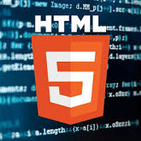
HTML stands for HyperText Markup Language. It is used to design the web pages. With the help of HTML, you can create a complete website structure. HTML is the combination of Hypertext and Markup language. Hypertext defines the link between the web pages and markup language defines the text docu- ment within the tag that define the structure of web pages.

Slide 3
Why HTML is used?
HTML is used to create the structure of web pages and website that are dis- played on the Internet. HTML basically contains Tags and Attributes that are used to design the web pages. Also, we can link multiple pages using Hyperlinks.

Slide 4

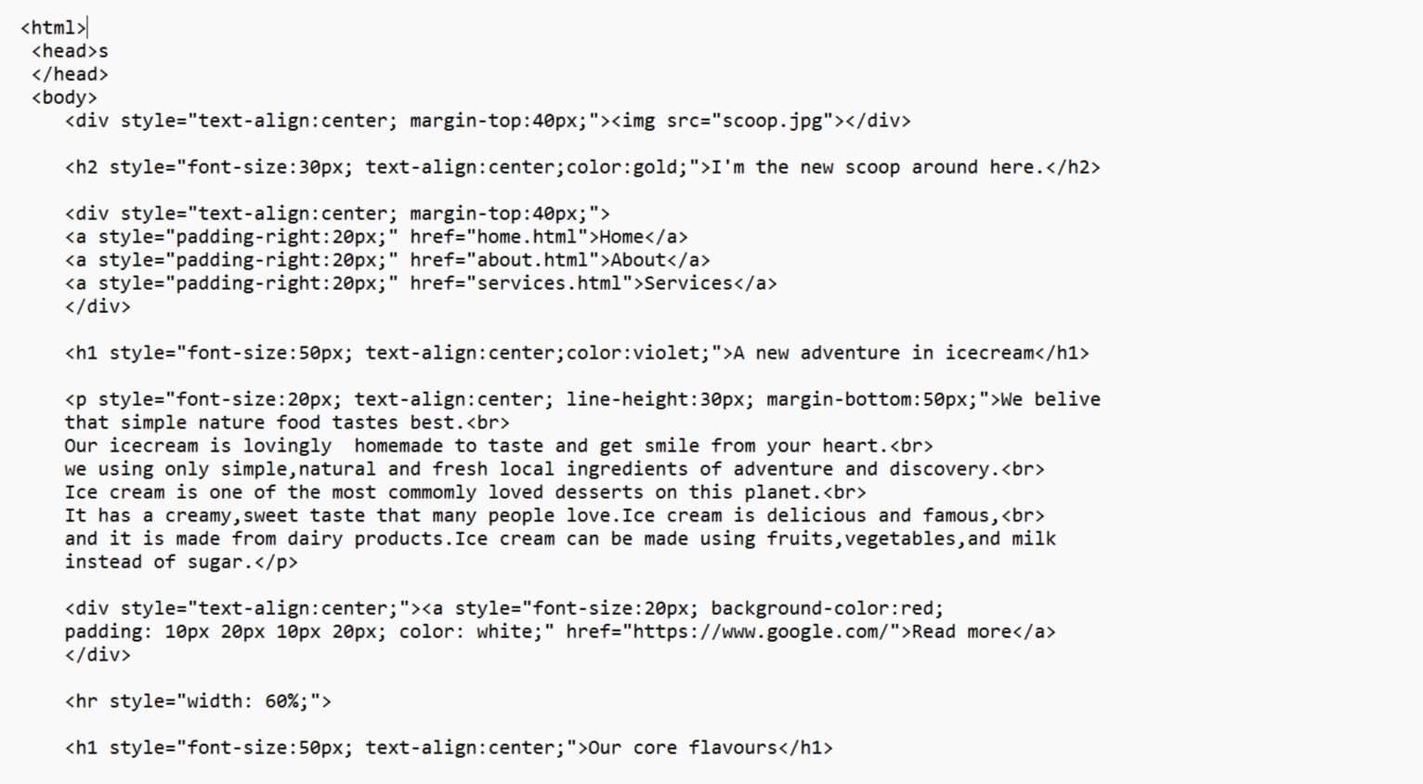

Slide 5
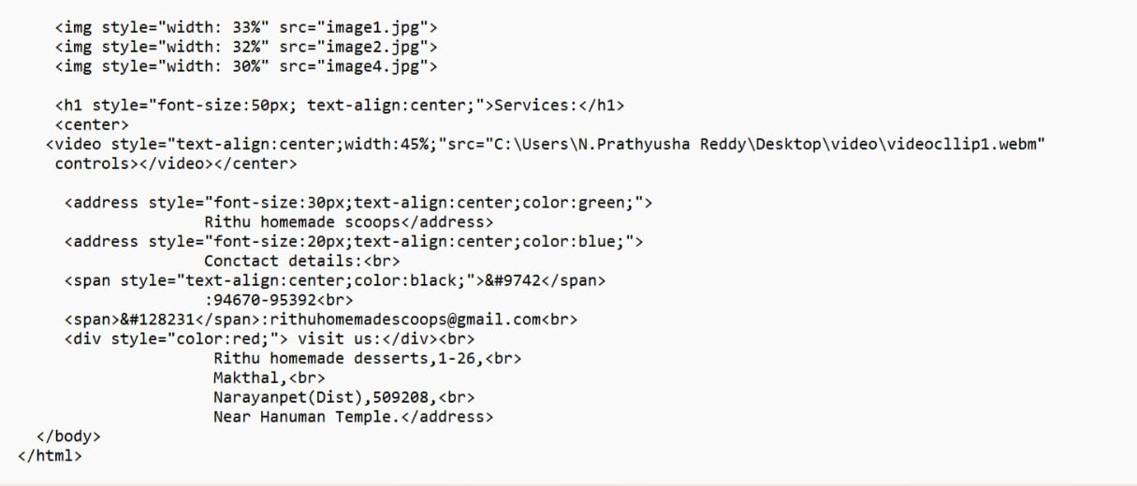

Slide 7
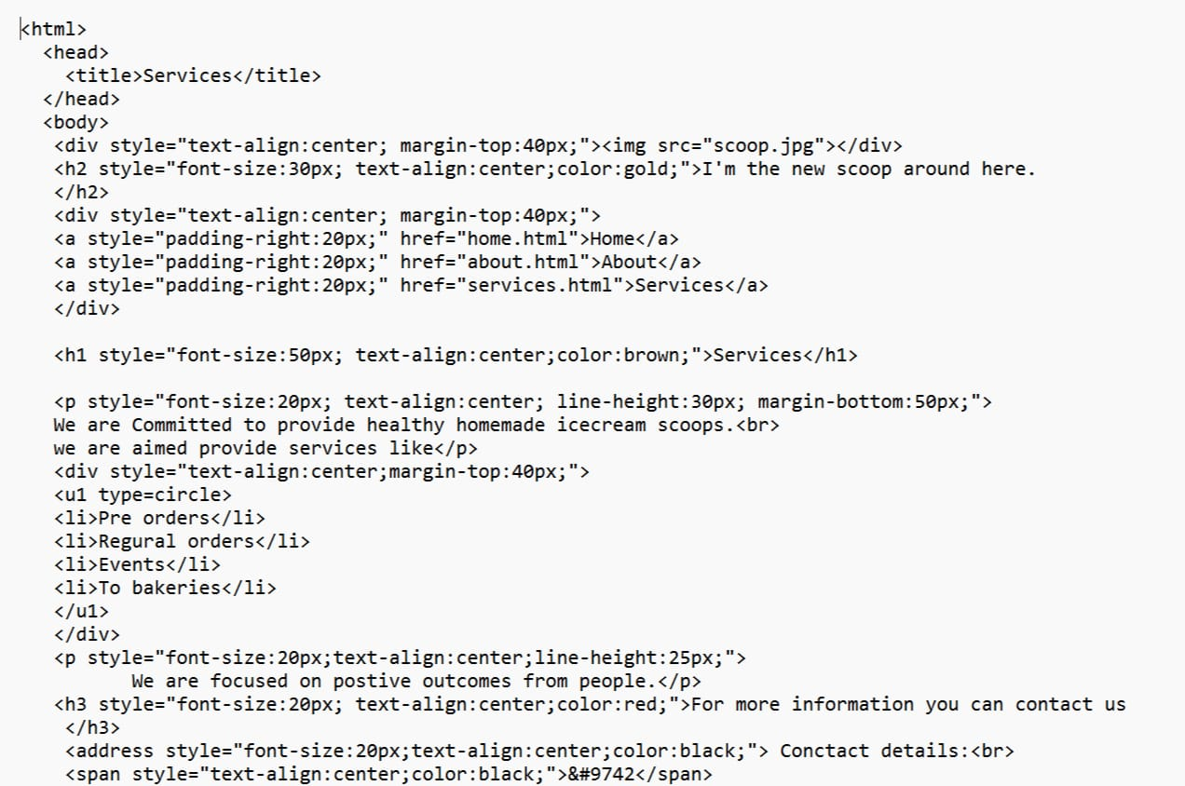

Slide 8
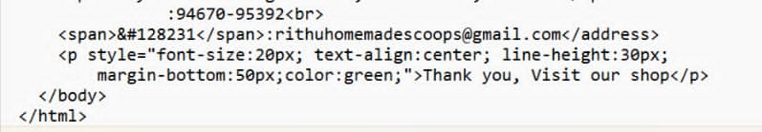

Slide 9
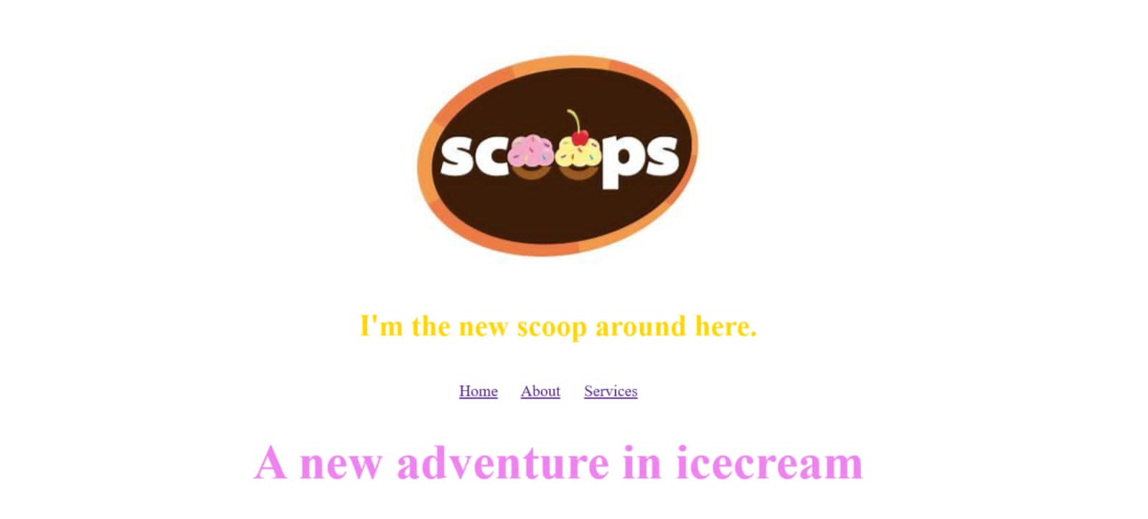

Slide 10
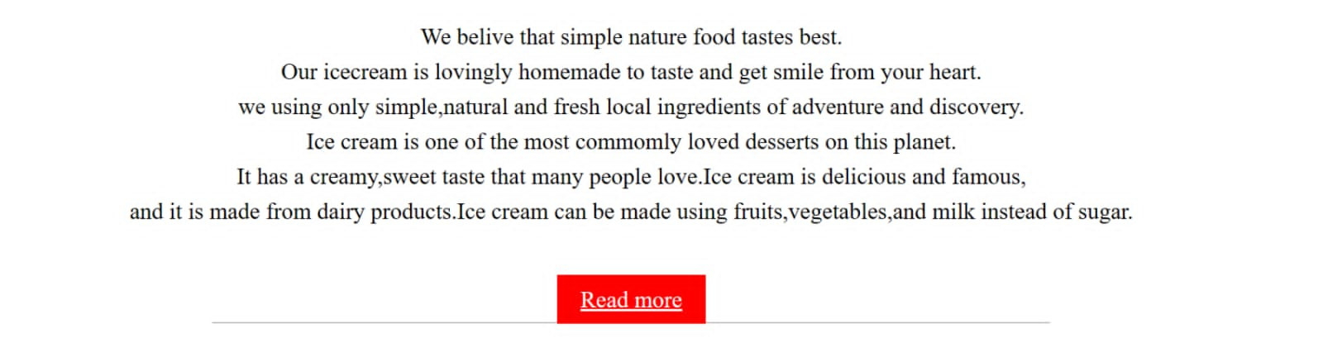

Slide 11
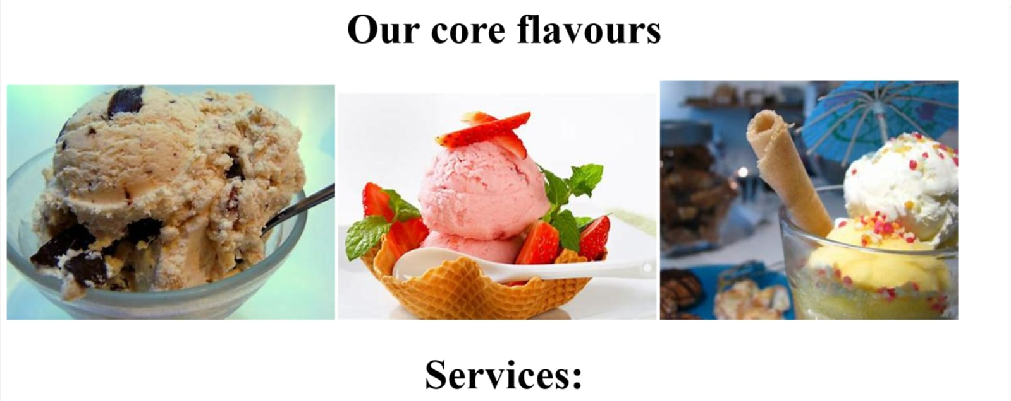

Slide 12
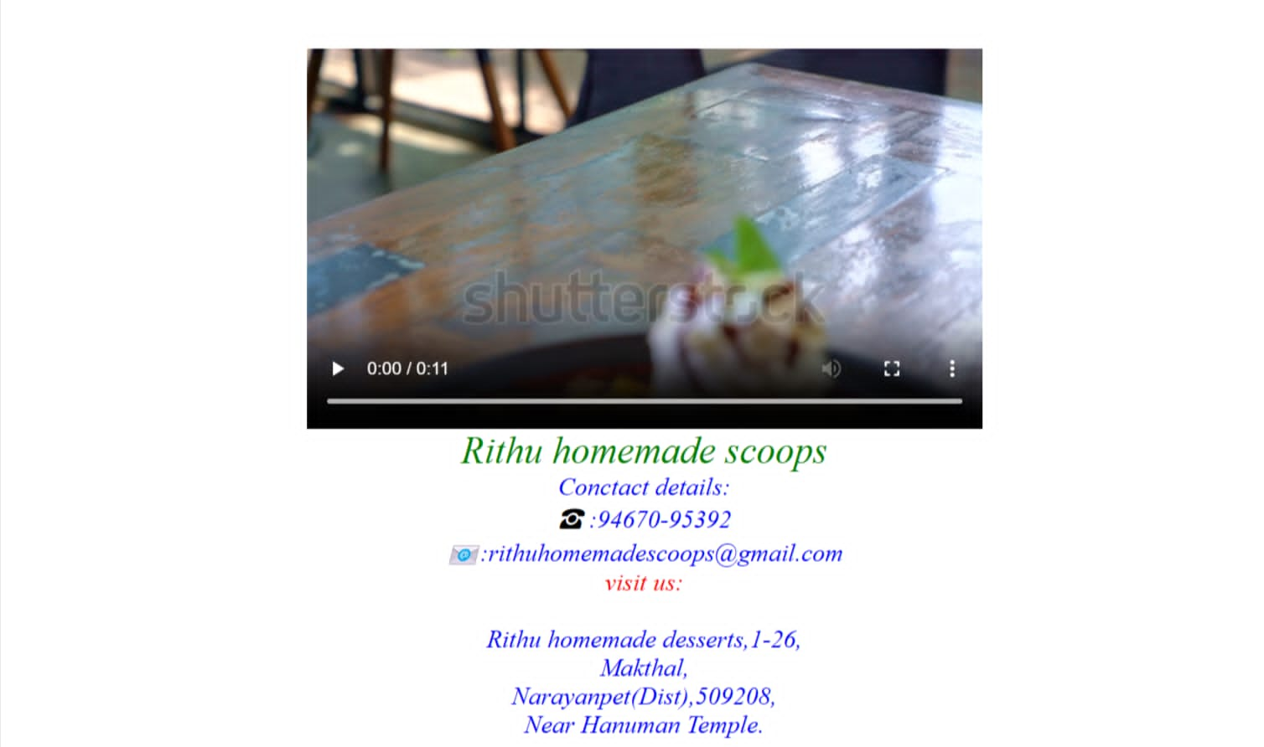

Slide 13
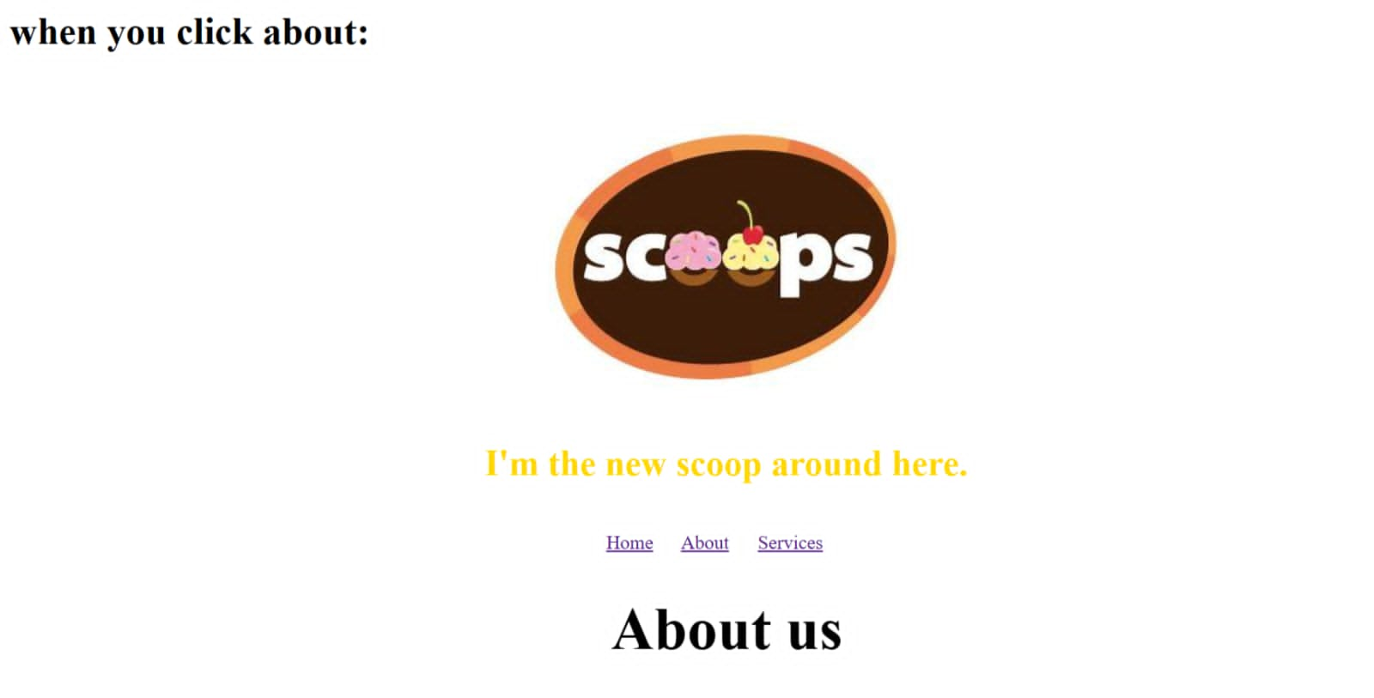

Slide 14
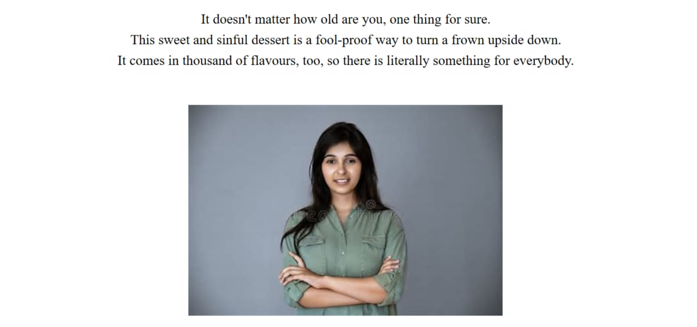

Slide 15
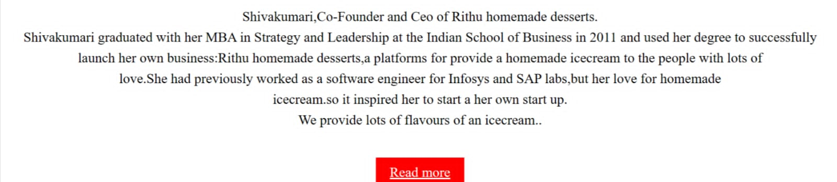

Slide 16
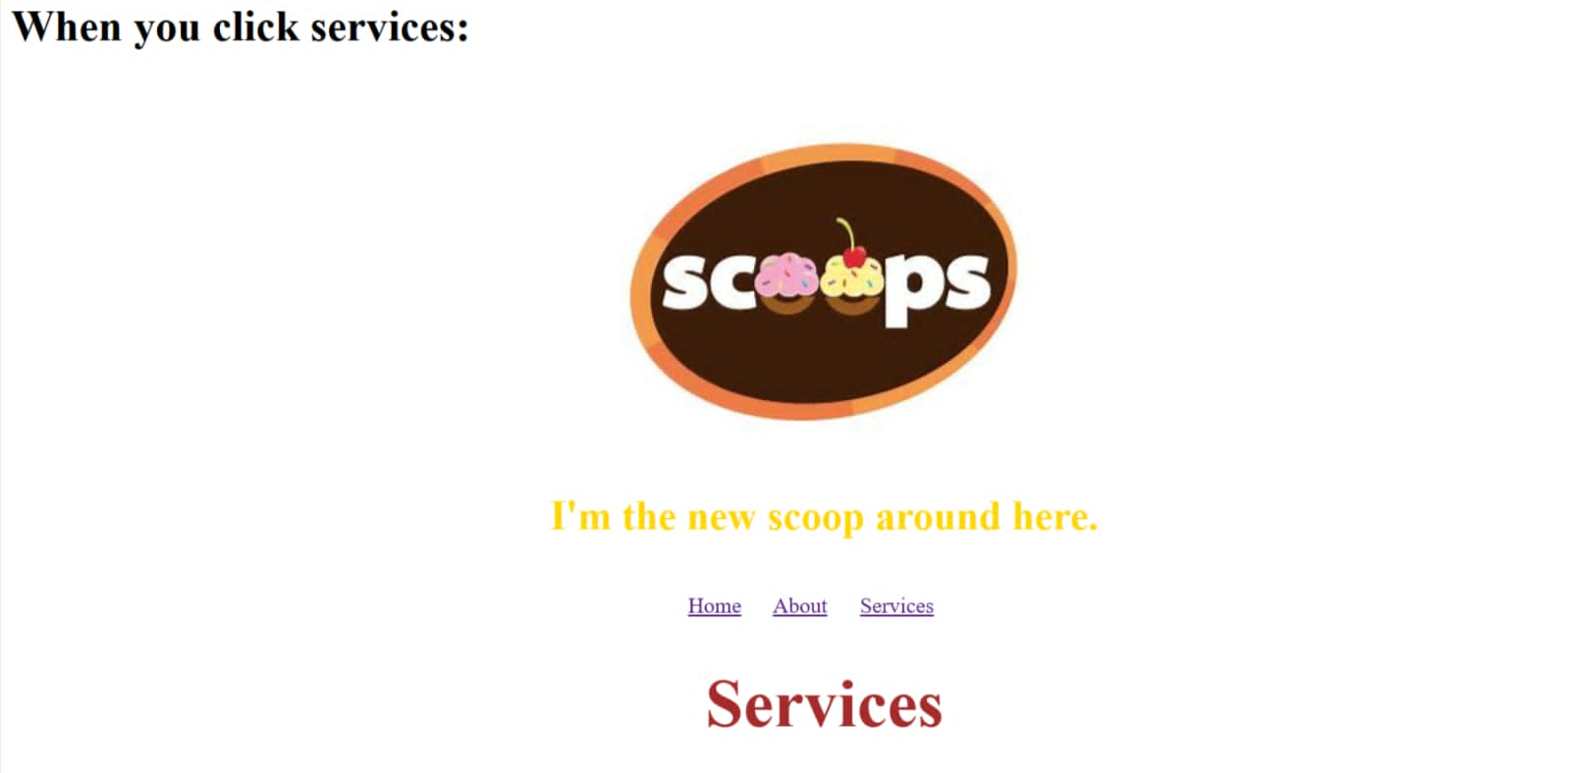

Slide 17
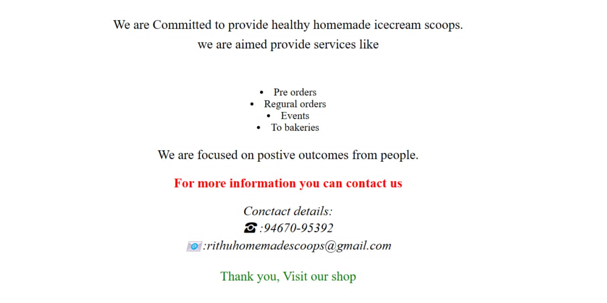

Slide 19
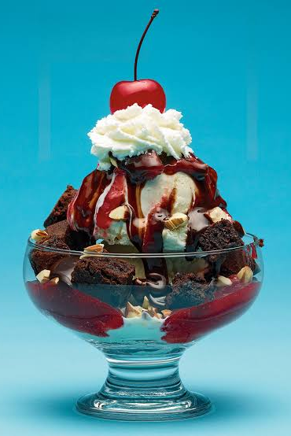
THANK YOU

