Slide 1
Sri Lankan global economic
Make by :central college maharagama

Slide 2
Total Sri Lanka is a very rich country from natural environment. Around the Sri Lanka there are lots of lovely places.

Slide 3
Our first solution is
Try keep our country clean
To protect the Sri Lankan tourism we must keep our country clean.
To keep our country clean we can use 4R consept.4R concept goes through
Recycle
Reduce
Reuse
Replace

Slide 4
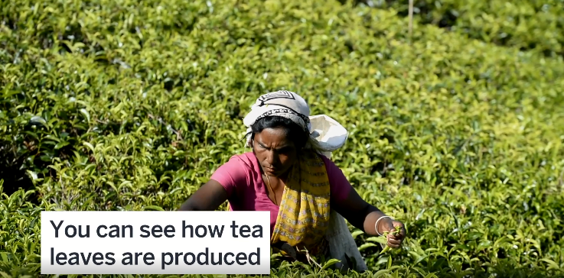
We must plant trees all over the country

Slide 5
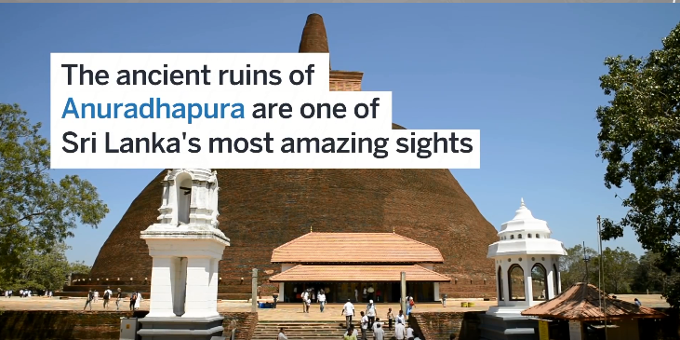
We must protect our ancient kingdom.

Slide 6
Our presentation is over thank you for everyone

