Slide 1
Introduction to Uta Cloud
by Akshay Waikar/Diaz

Slide 2
Objective
The objective of this PPT is to show you how to setup your UTA ClOUD Account so that you can deploy your Project:
1: Open your UTA Cloud account
2: Set up your database
3: How to set up your Project at the UTA Cloud

Slide 3
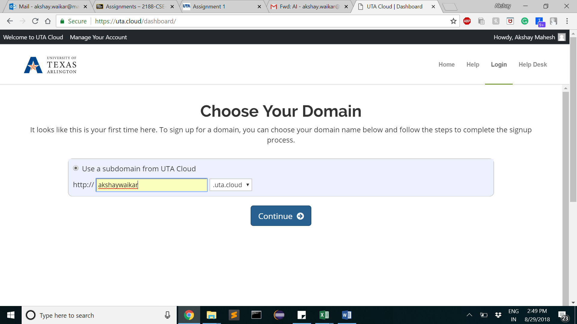
Open your UTA Account: 1. Go to https://uta.cloud, 2. Login with netID password

Slide 4
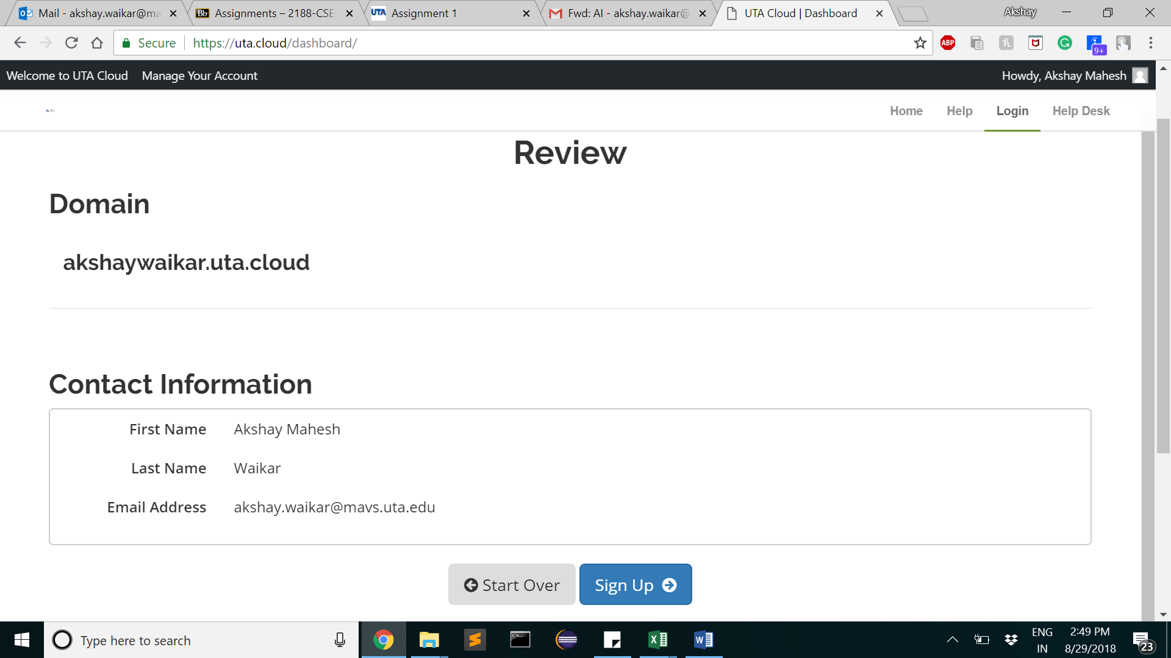
3. Click on Signup

Slide 5
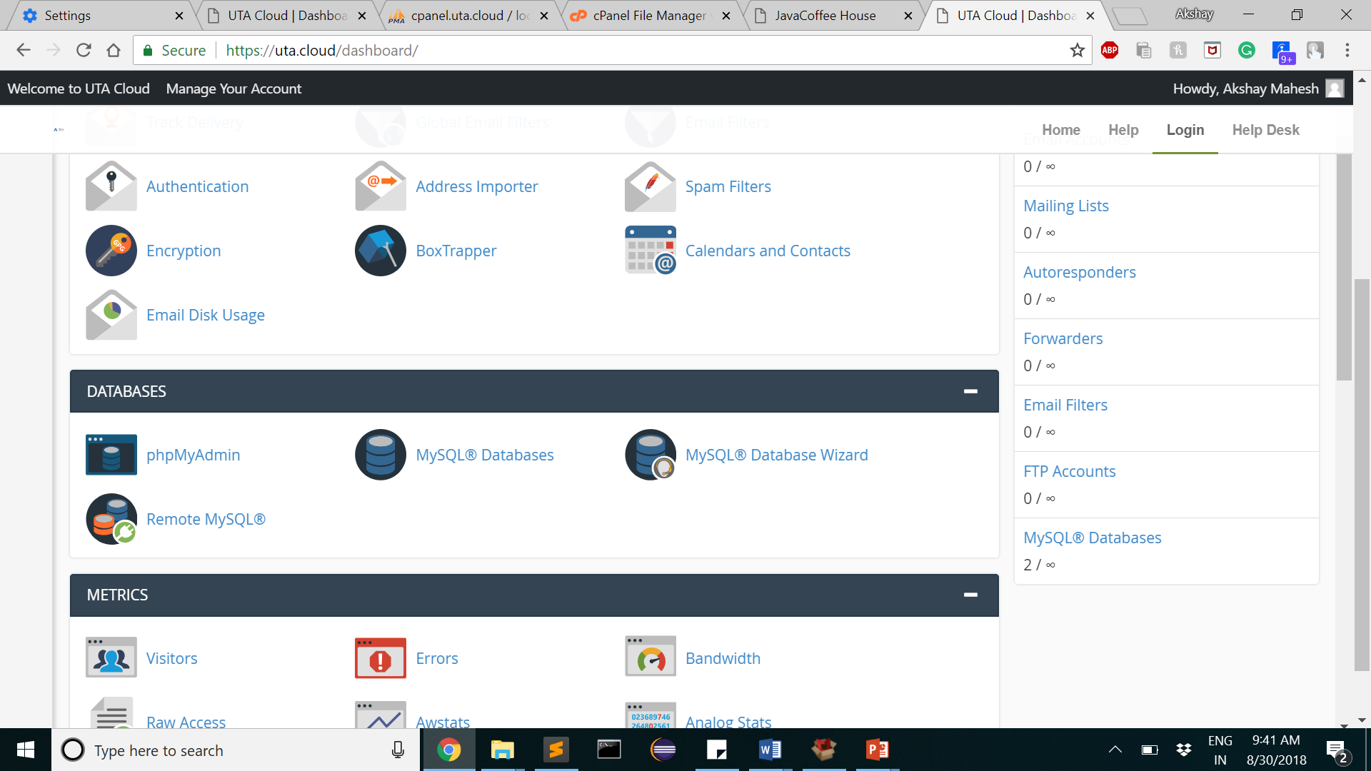
4. In dashboard, click on mySql database wizard

Slide 6
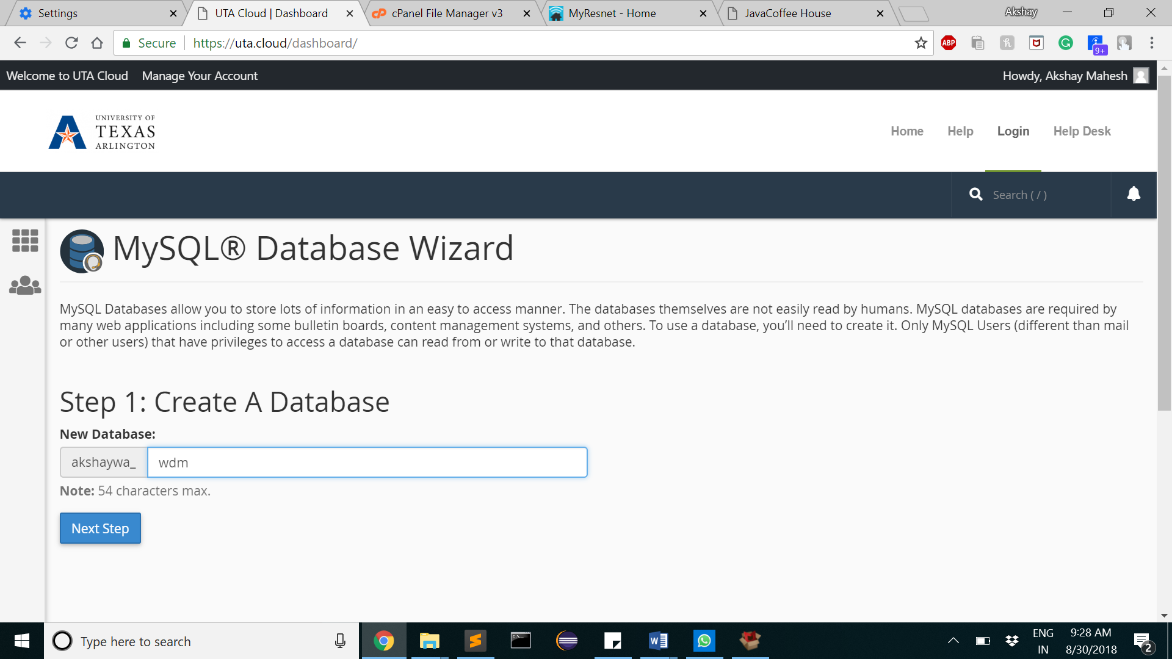
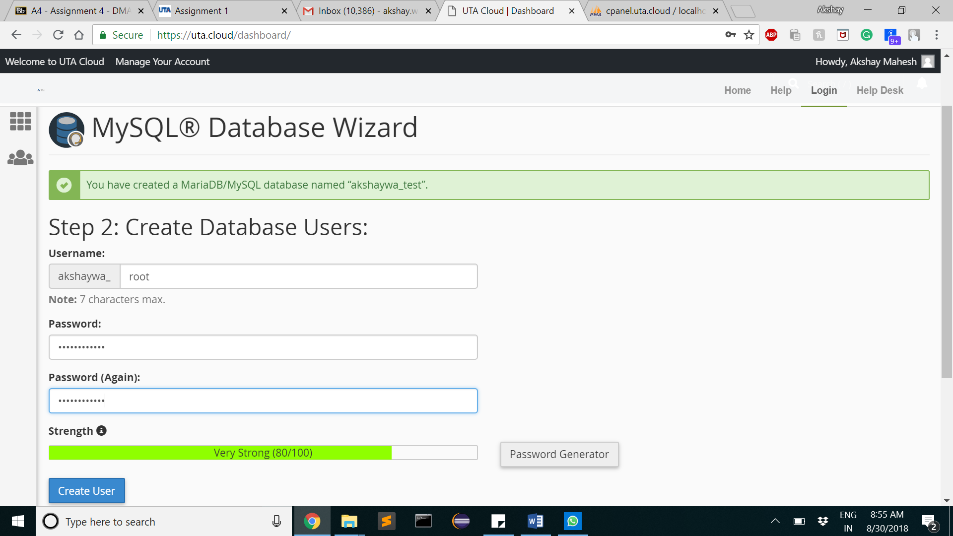
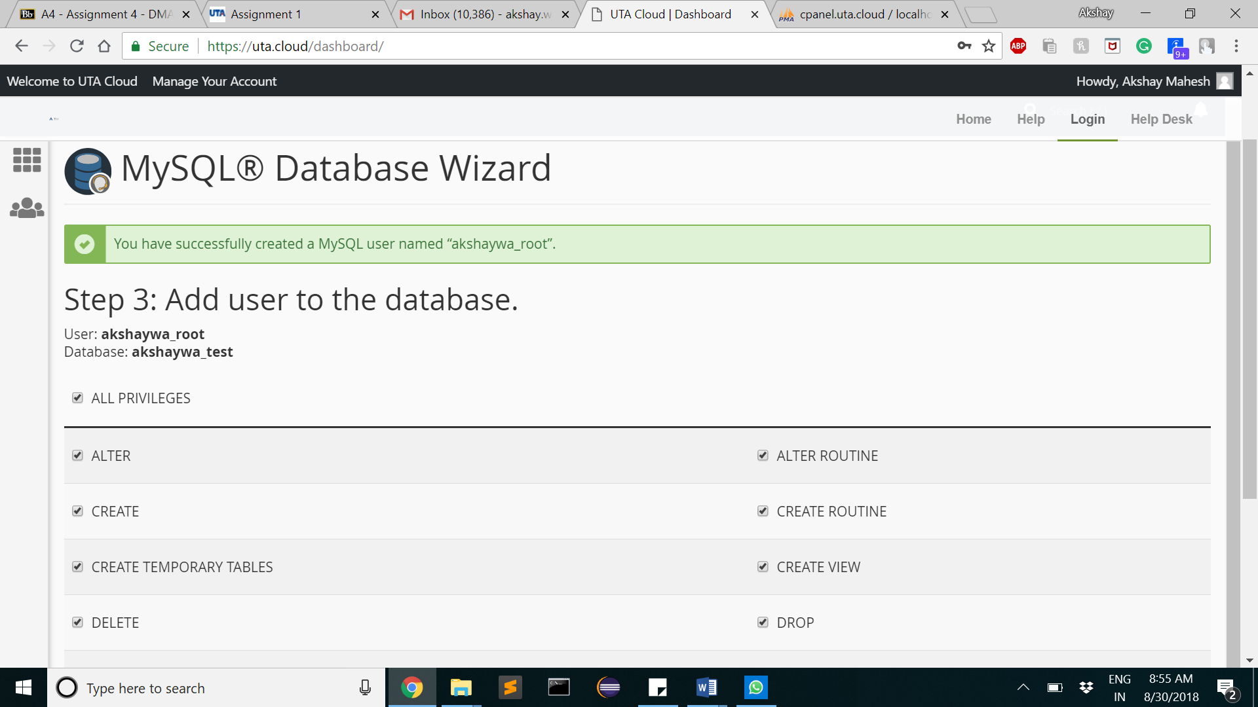
1. Creating database
Give db name
Click on all privileges
Give username and password
The database will now be seen in phpmyadmin

Slide 7
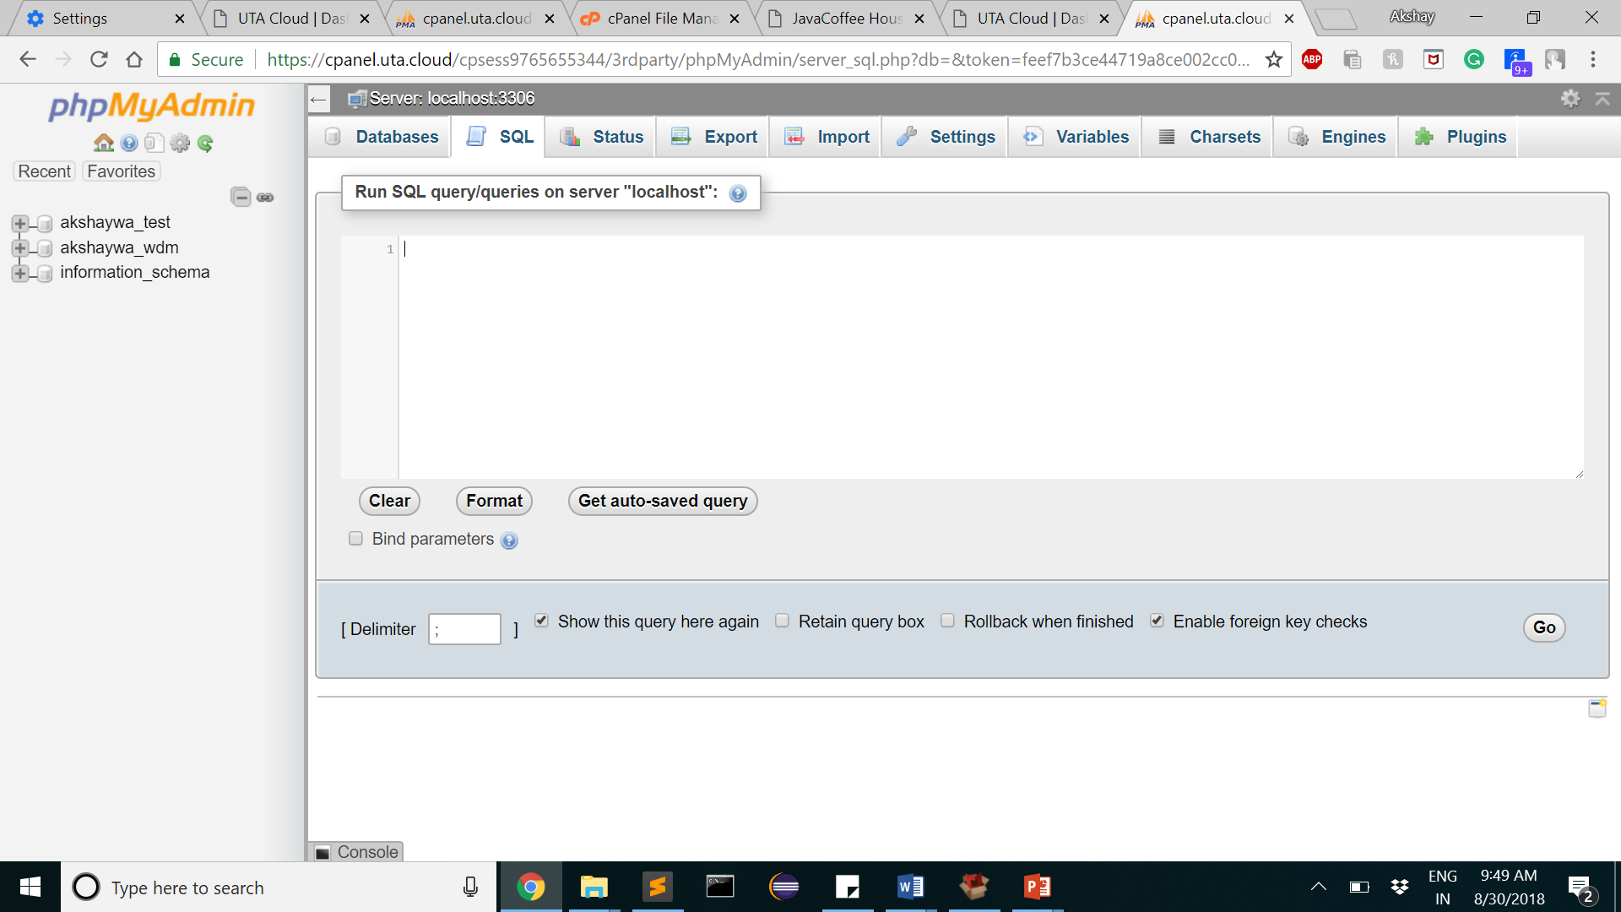
2. Creating SQL queries

Slide 8
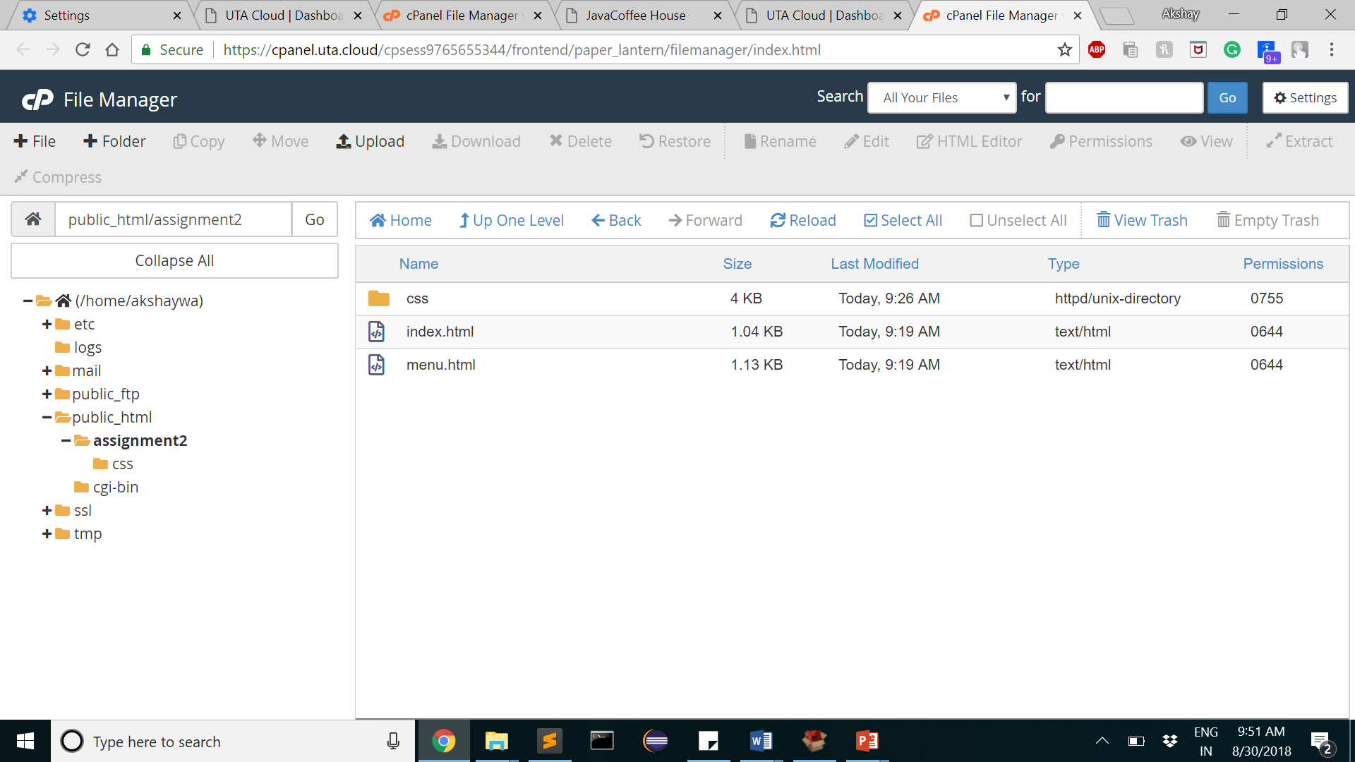
1. Using File manager->public_html->create your new folder
*The landing page is default.html inside public_html

Slide 9
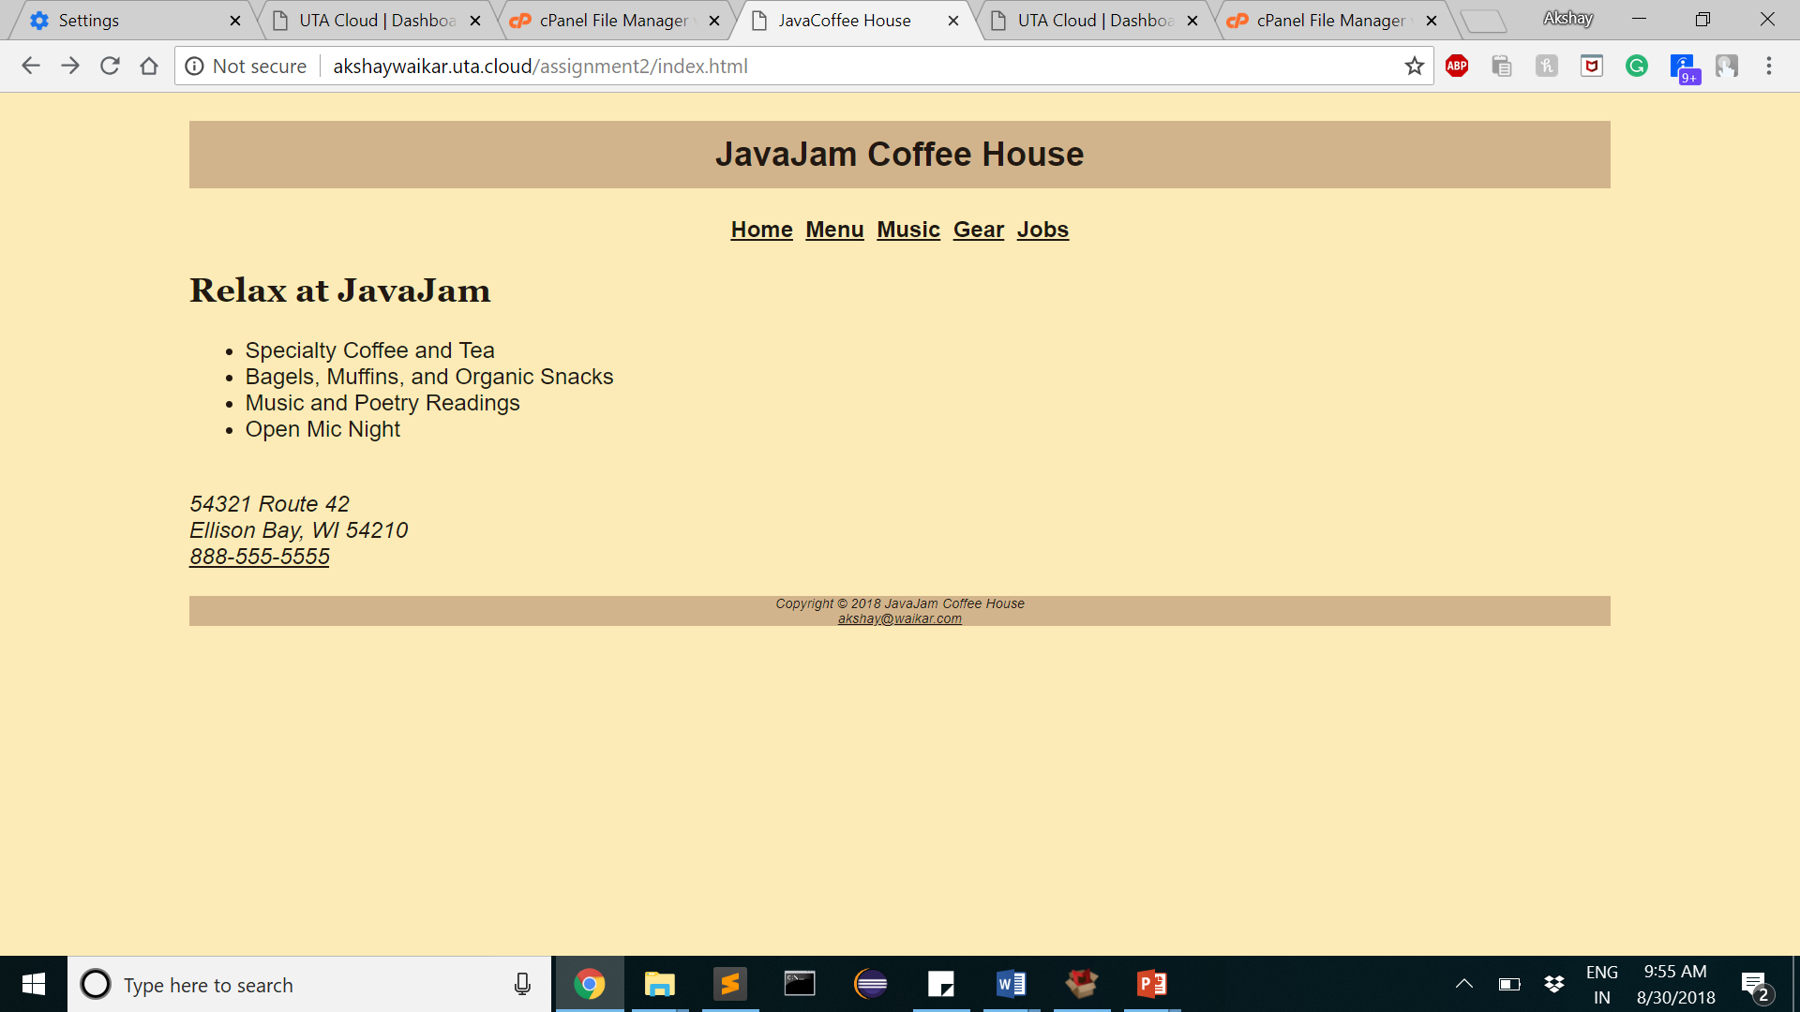
2. In Browser->your domain link/foldername/filename
Example : http://neelammakwana.uta.cloud/Makwana_portfolio/index.html

Slide 10
Thank you

