Slide 1
BLUESTOCK FINTECH
Mutual Fund Analytics
Capstone Project I — Final Presentation
Nilambar Sonu Behera | June 2026

Slide 2
Problem Statement & Objectives
Bluestock MF Analytics
Capstone Project I
Problem Statement
Retail mutual fund investors lack accessible, data-driven tools to compare fund performance, assess risk-adjusted returns, and receive personalised fund recommendations based on their risk appetite. Raw NAV data from AMFI exists but is unstructured and hard to analyse.
Objectives
✓ Build a robust ETL pipeline to ingest, clean, and load 10+ datasets into SQLite.
✓ Compute performance metrics: CAGR, Sharpe, Sortino, Alpha, Beta, VaR, CVaR.
✓ Develop a composite Fund Scorecard (0-100) based on weighted percentile ranks.
✓ Generate a 4-page analytical dashboard + interactive Power BI template.
✓ Implement a fund recommender system by risk appetite (Low / Moderate / High).

Slide 3
Data Sources & Architecture
Bluestock MF Analytics
Capstone Project I
10 Datasets | SQLite Database | 12 Tables | 80,000+ Records
Fund Master (40 funds)
NAV History (64,320 rows)
Scheme metadata, expense ratios, categories, risk grades
Daily NAV per scheme: Jan 2022 – May 2026 (~4.4 years)
Investor Transactions (32K+)
Benchmark Indices (8,050)
SIP, Lumpsum, Redemption records with investor demographics
NIFTY 50 & NIFTY 100 daily closing values
Portfolio Holdings (322)
SIP Inflows / Category
Top stock holdings and sector weights per equity fund
Industry-level monthly inflow and category-wise trends

Slide 4
System Architecture & Pipeline
Bluestock MF Analytics
Capstone Project I
📥 Ingest
🧹 Clean
🗄 Load
📊 Analyse
📈 Visualise
🤖 Recommend
→
→
→
→
→
Raw CSV + MFAPI live NAV fetch
Type coercion, dedup, validation
SQLite star schema 12 tables
EDA + Performance Metrics + Scoring
Dashboard PNGs PDF Export
Risk-based fund recommender
Python Stack: pandas | numpy | scipy | matplotlib | seaborn | sqlite3 | reportlab | python-pptx
Execution: python scripts/run_pipeline.py (master pipeline runner)

Slide 5
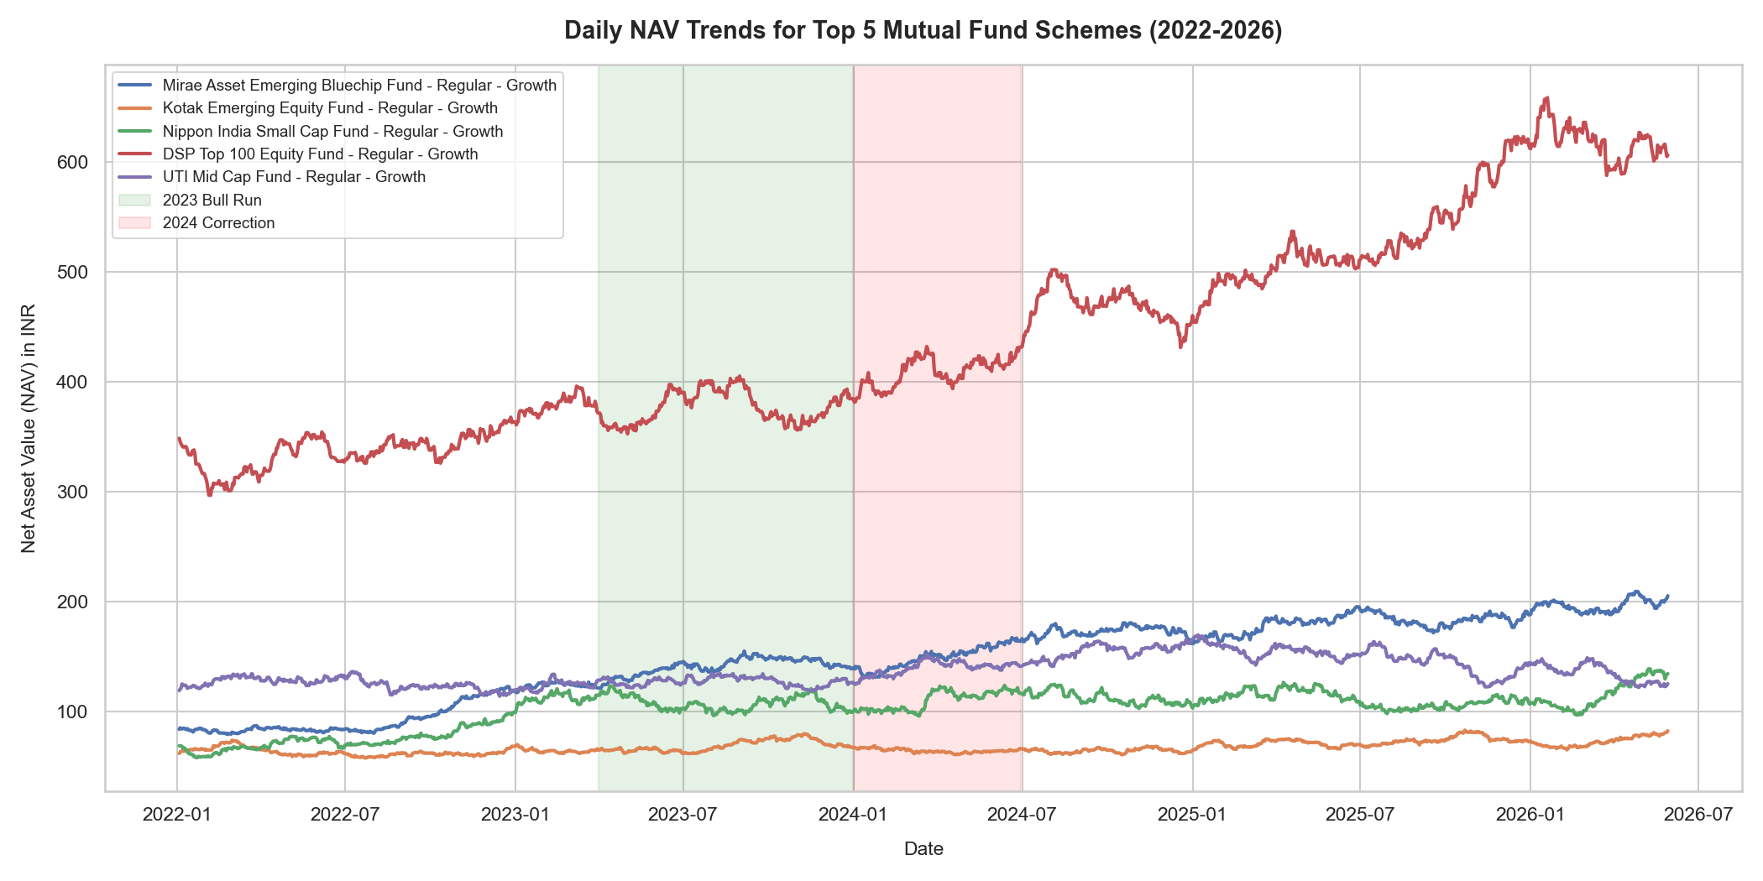
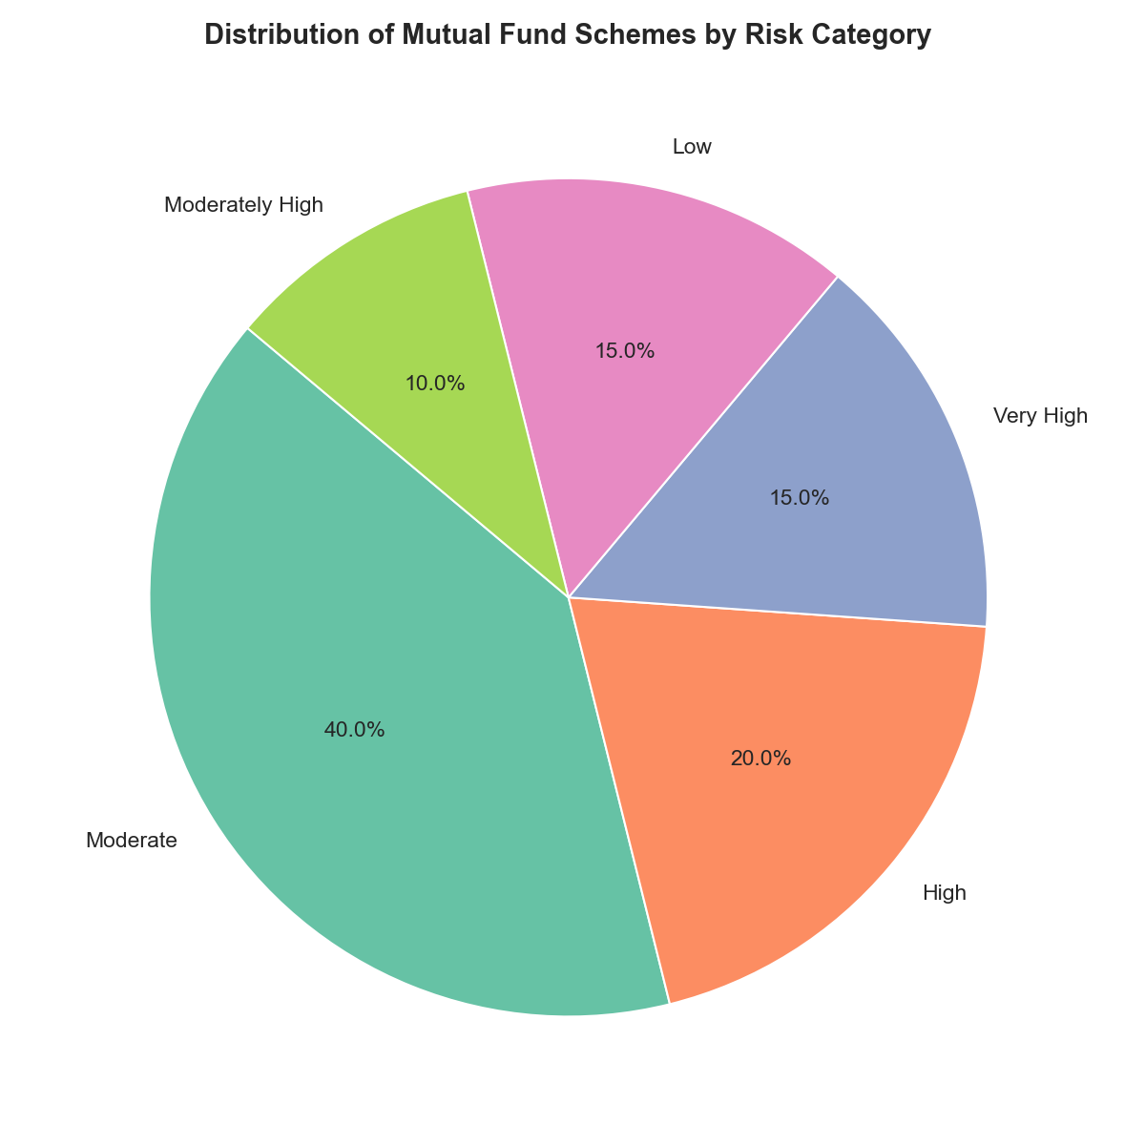
EDA Highlights — NAV Trends & Category Distribution
Bluestock MF Analytics
Capstone Project I
• Sustained NAV growth for equity funds post-2022 correction
• Large-cap and mid-cap dominate; debt/liquid funds show stable NAVs

Slide 6
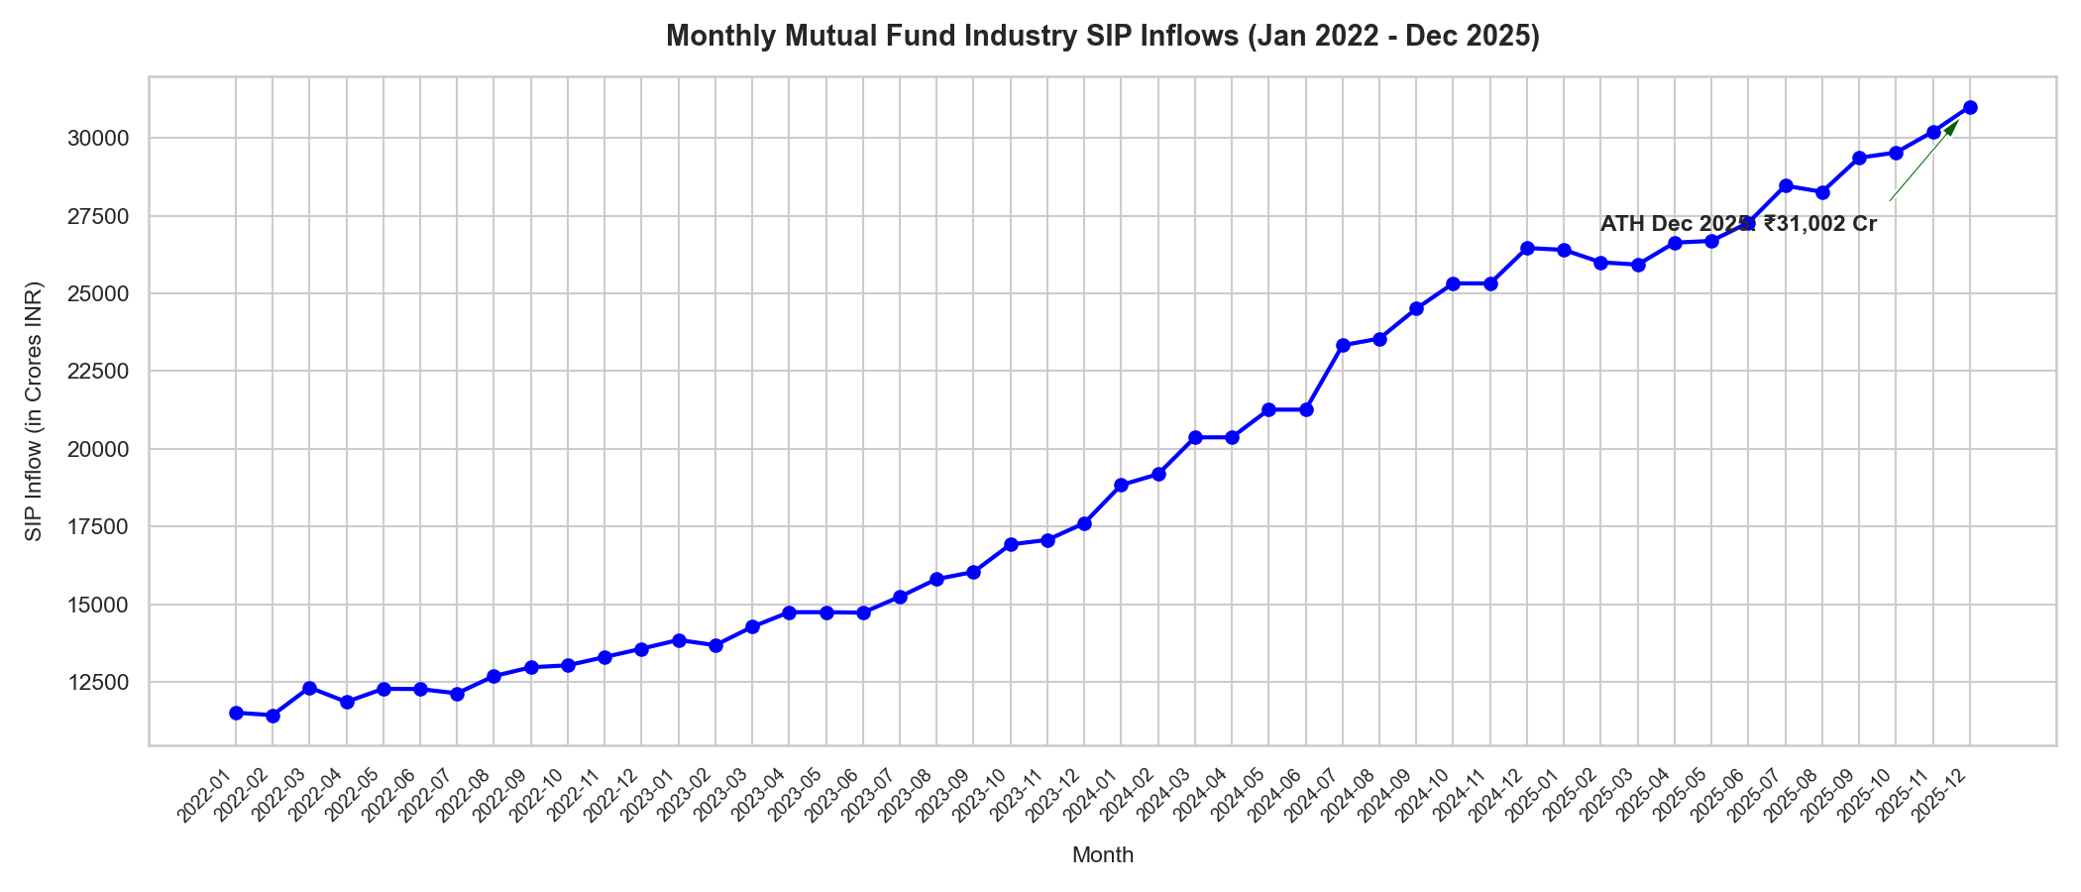
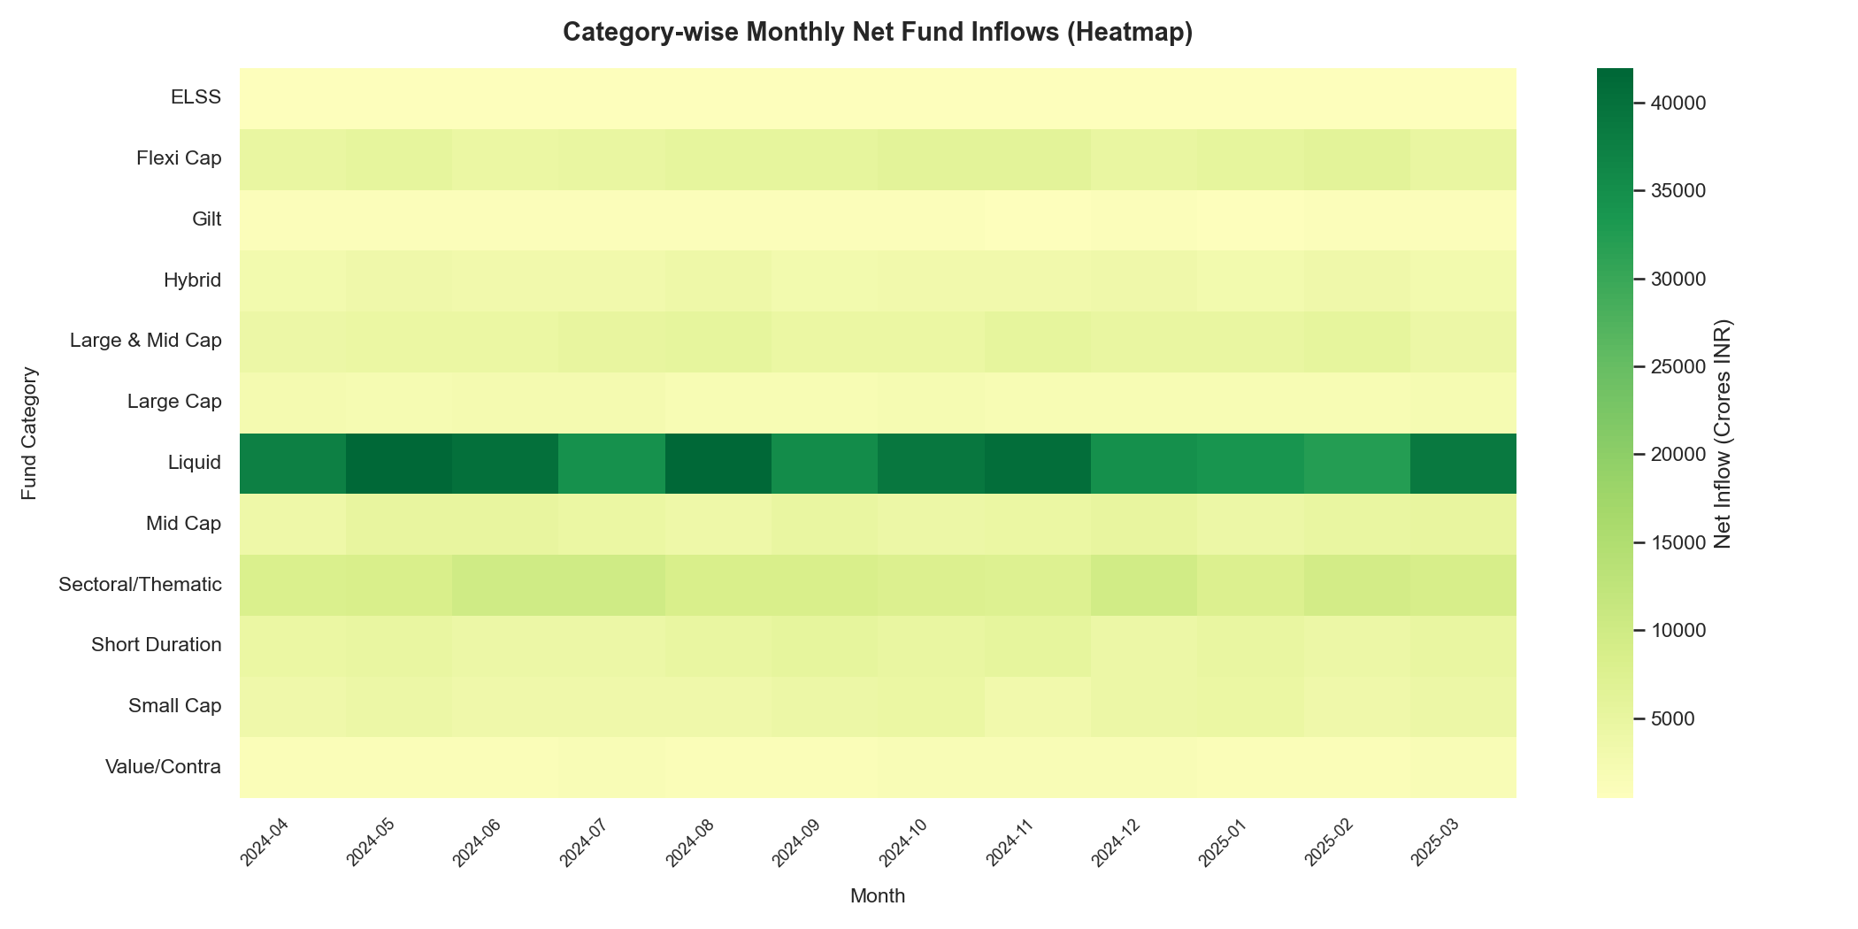
EDA Highlights — Investor Analytics & SIP Trends
Bluestock MF Analytics
Capstone Project I
• SIP inflows show consistent YoY growth — strong retail participation
• Equity-oriented categories receive highest net inflows in FY2025

Slide 7
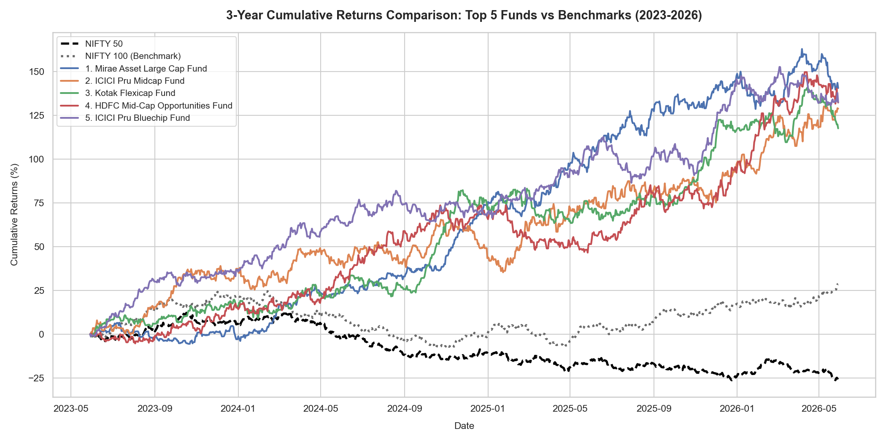
Fund Performance — Scorecard & Benchmark Comparison
Bluestock MF Analytics
Capstone Project I

Slide 8
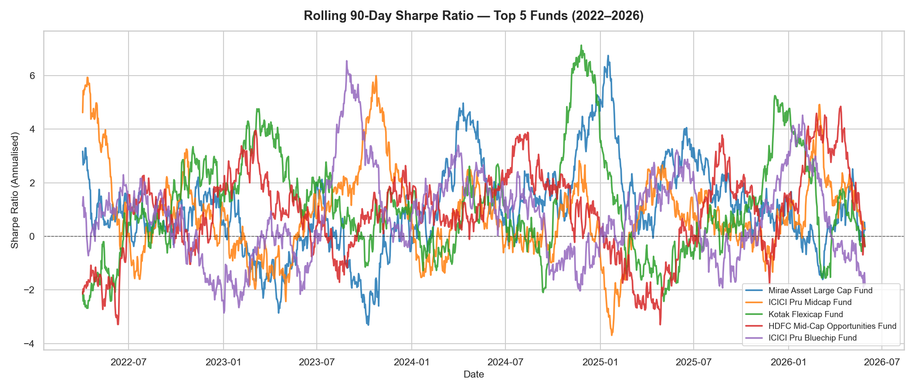
Fund Performance — Rolling Sharpe & VaR/CVaR
Bluestock MF Analytics
Capstone Project I
Top 5 Scorecard Funds
1. Mirae Asset Large Cap Fund
Score: 86.25
2. ICICI Pru Midcap Fund
Score: 82.88
3. Kotak Flexicap Fund
Score: 82.0
4. HDFC Mid-Cap Opportunities F
Score: 80.75
5. ICICI Pru Bluechip Fund
Score: 79.38

Slide 9
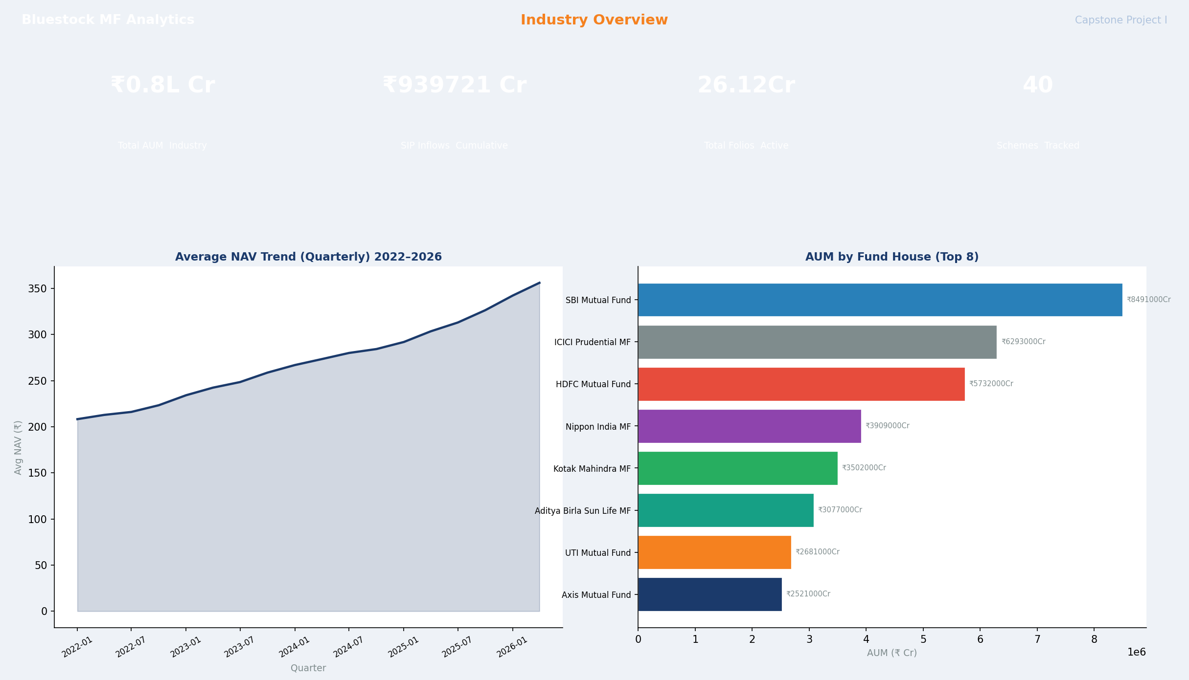
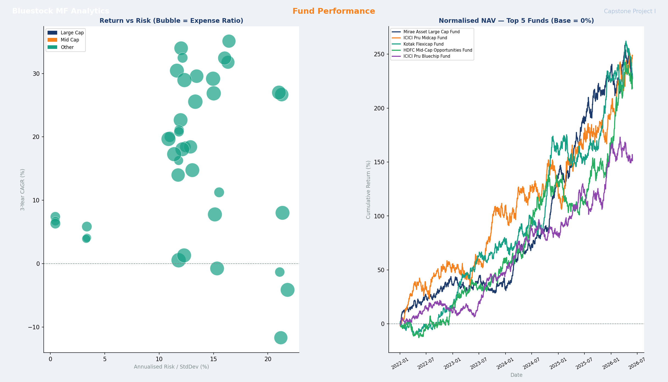
Dashboard — Industry Overview & Fund Performance
Bluestock MF Analytics
Capstone Project I
Page 1: KPI Cards + NAV Trend + AUM Distribution
Page 2: Return vs Risk Scatter + Normalised NAV Comparison

Slide 10
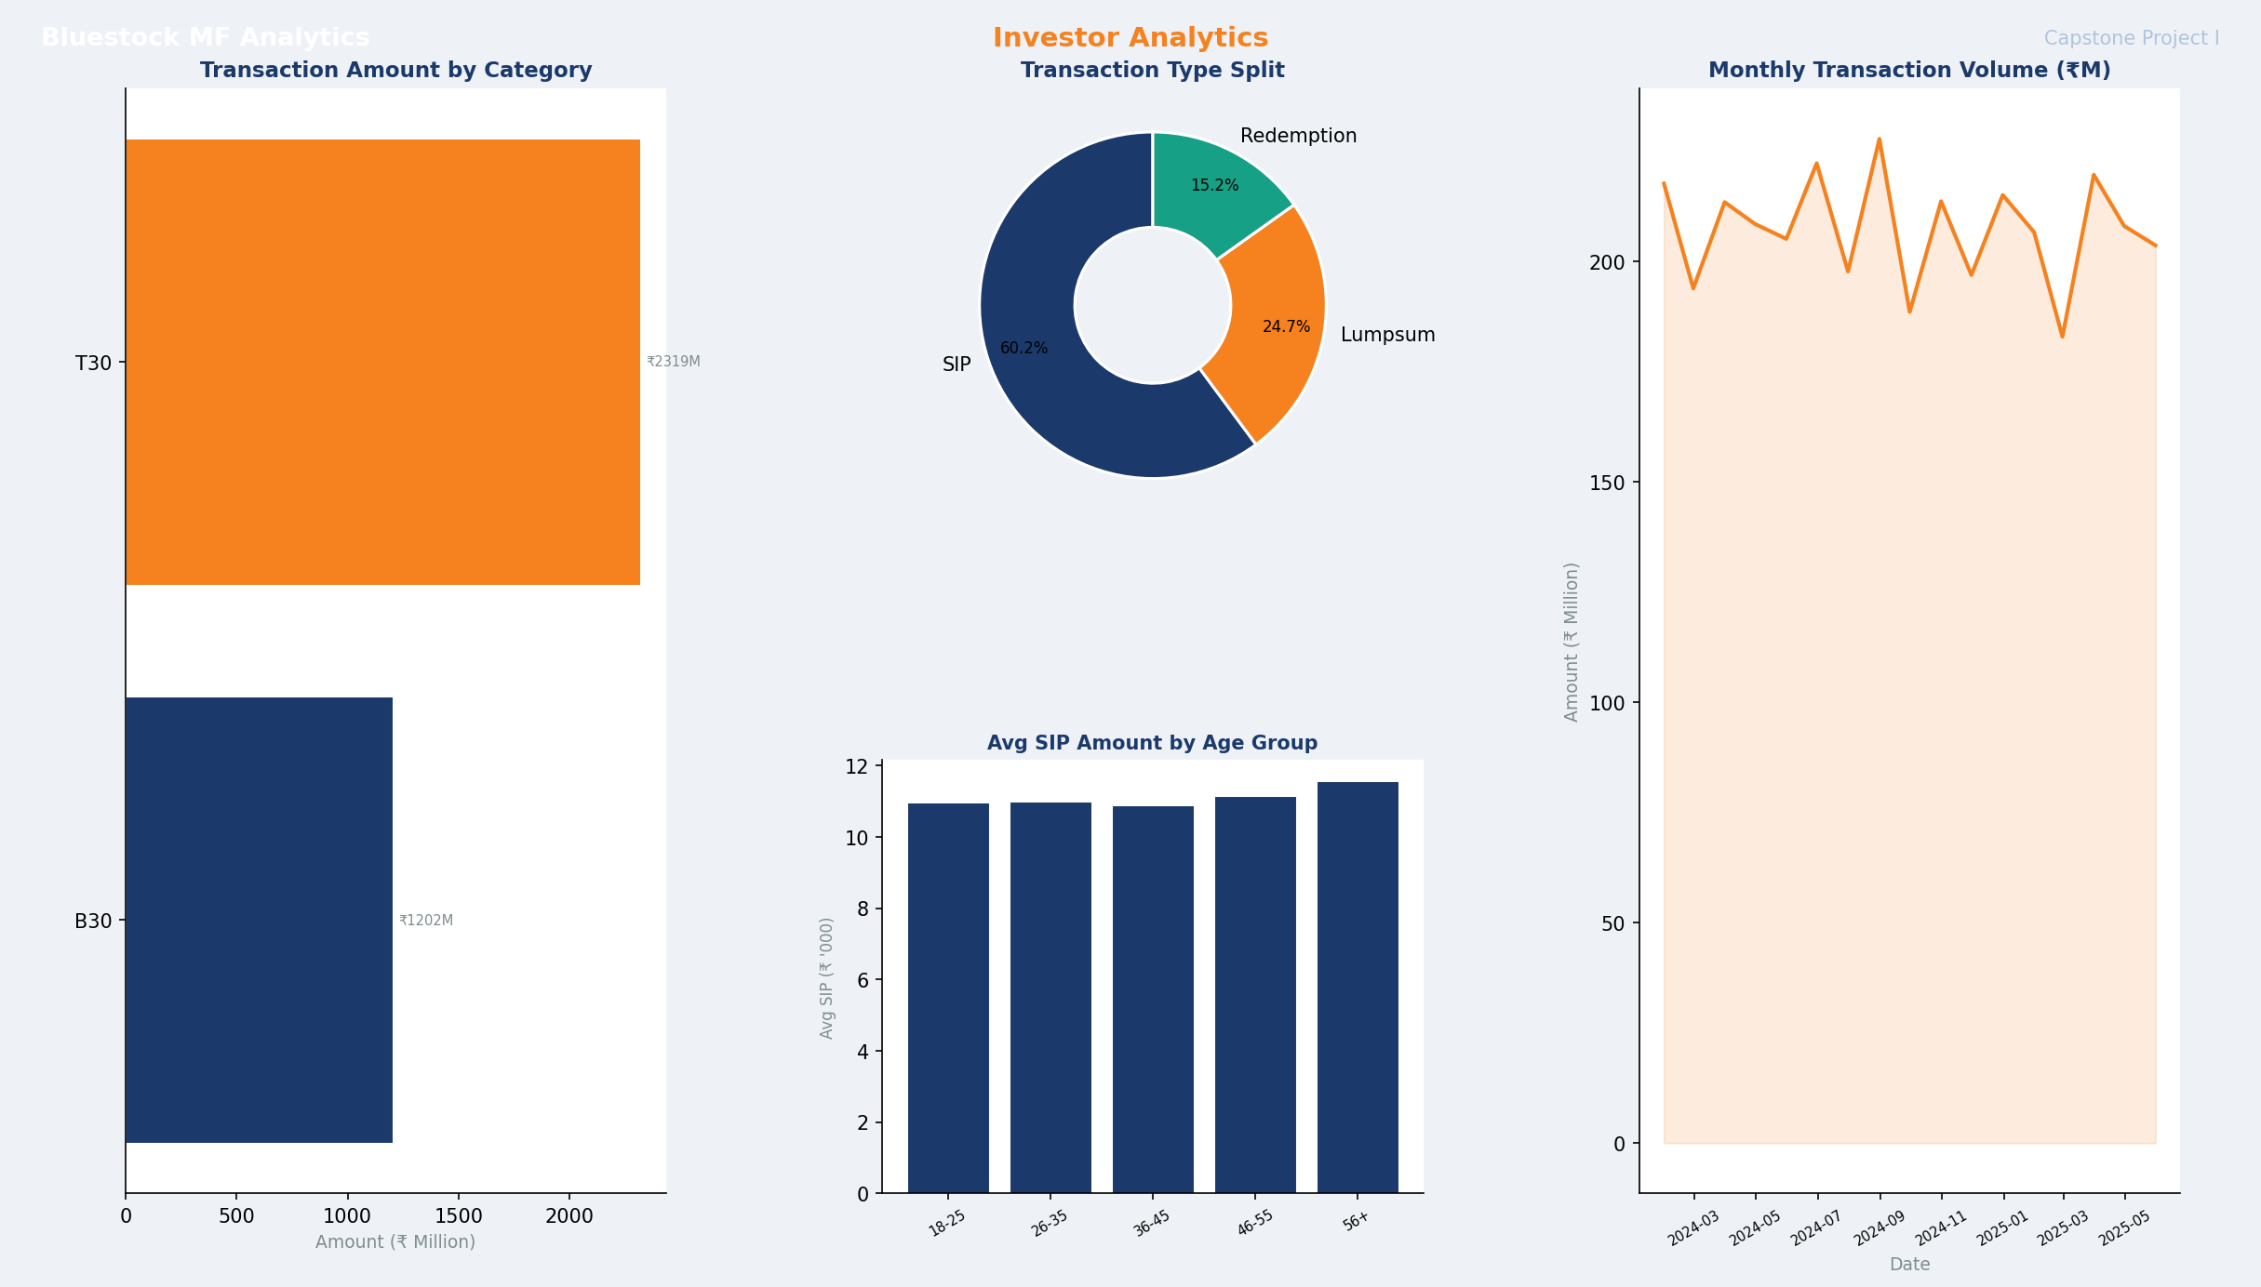
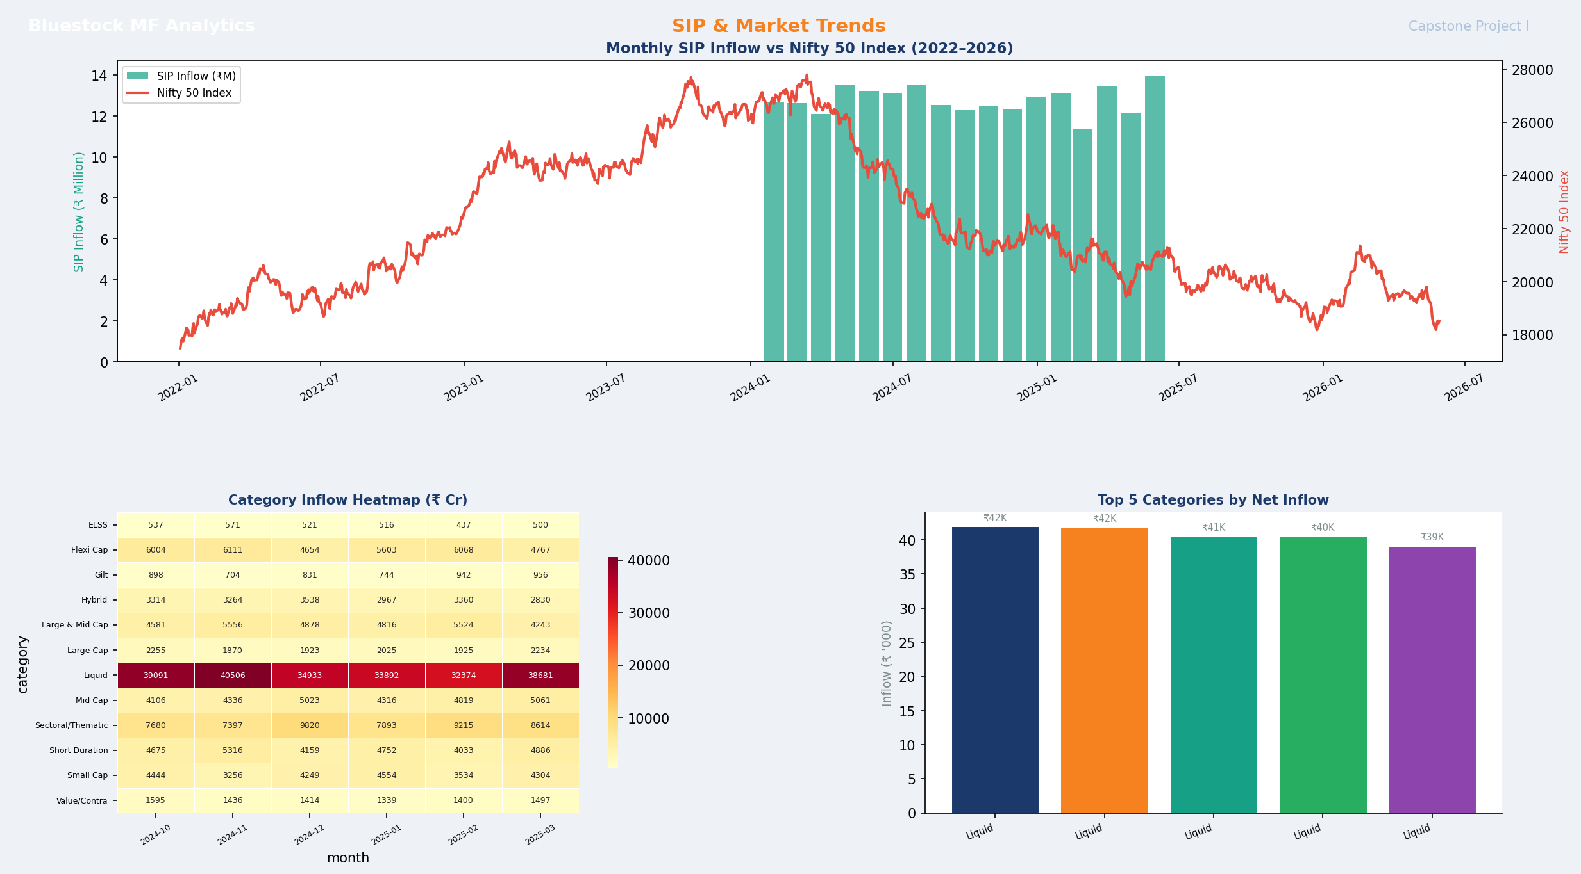
Dashboard — Investor Analytics & Market Trends
Bluestock MF Analytics
Capstone Project I
Page 3: Transaction Type Split + Monthly Volume Trends
Page 4: SIP Inflow vs Nifty 50 + Category Inflow Heatmap

Slide 11
Key Findings & Insights
Bluestock MF Analytics
Capstone Project I
🏆 Top Performer
📉 Risk Leaders
Mirae Asset Large Cap Fund (Score: 86.25) — best 3yr CAGR + Sharpe combination
Liquid funds show lowest VaR (<0.1% daily) — ideal for capital preservation
📈 Alpha Generators
💡 SIP Trends
Mid-cap active funds generate positive Alpha (>2% annually) vs NIFTY 100
97.8% of investors with 6+ SIPs have avg gaps >35 days — continuity opportunity
🏭 HHI Insights
👥 Cohort Insight
Sectoral funds have high portfolio concentration (HHI >500) vs diversified funds
2024 cohort has the most investors (4,456) with avg SIP of ₹10,987

Slide 12
Thank You
Bluestock Fintech — Mutual Fund Analytics Capstone Project I
Nilambar Sonu Behera | GitHub: NilambarSonu/mutual-fund-analytics
June 2026

