Slide 1
Customer shopping analysis

Slide 2
DATASET
The dataset is broad enough to reveal behavior patterns
The 3,900 purchase records span products, places, categories, and seasons—with fields to connect customer profiles to each transaction.
3,900
18
25
50
purchase rows
columns
products
locations
Also represented
Behavior fields
4 categories · 4 seasons
Customer, purchase, and shopping-behavior attributes
02

Slide 3
PREPARATION
STEP | PREPARATION
01 | Inspect structureReview fields and data quality.
02 | Impute ratingsFill 37 missing reviews with product-category medians.
03 | Standardize namesMake column names consistent.
04 | Engineer fieldsCreate age and purchase-frequency fields.
05 | Remove redundancyDrop the redundant promo-code field.
06 | Load for analysisMove cleaned data into PostgreSQL.
Six preparation steps made the purchase records consistent and ready for analysis.
03

Slide 4
ANALYSIS WORKFLOW
The analysis moves from transaction detail to decisions
Prepare the records, ask business questions, then bring the results together for review.
Python
Power BI
Prepare and clean purchase data.
Present results in a decision-ready dashboard.
SQL
Query the data to answer business questions.
04

Slide 5
PURCHASE PROFILE
The typical purchase is about $60, with a 3.75 rating
$59.76
3.75
44.1
$20–$100
Average review rating
Average customer age
Purchase amount range
Average purchase amount
05

Slide 6
PRODUCT PERFORMANCE
Product performance splits between rating and demand
Top-rated products and top-selling products by category are different views of performance; one list should not stand in for the other.
HIGHEST-RATED PRODUCTS
TOP-SELLING PRODUCTS BY CATEGORY
PRODUCT | RATING
Gloves | 3.86
Sandals | 3.84
Boots | 3.82
Hat | 3.80
Skirt | 3.78
Jewelry
Blouse
Sandals
Jacket
Demand leaders named in the analysis.
06
Source: Customer shopping behavior analysis

Slide 7
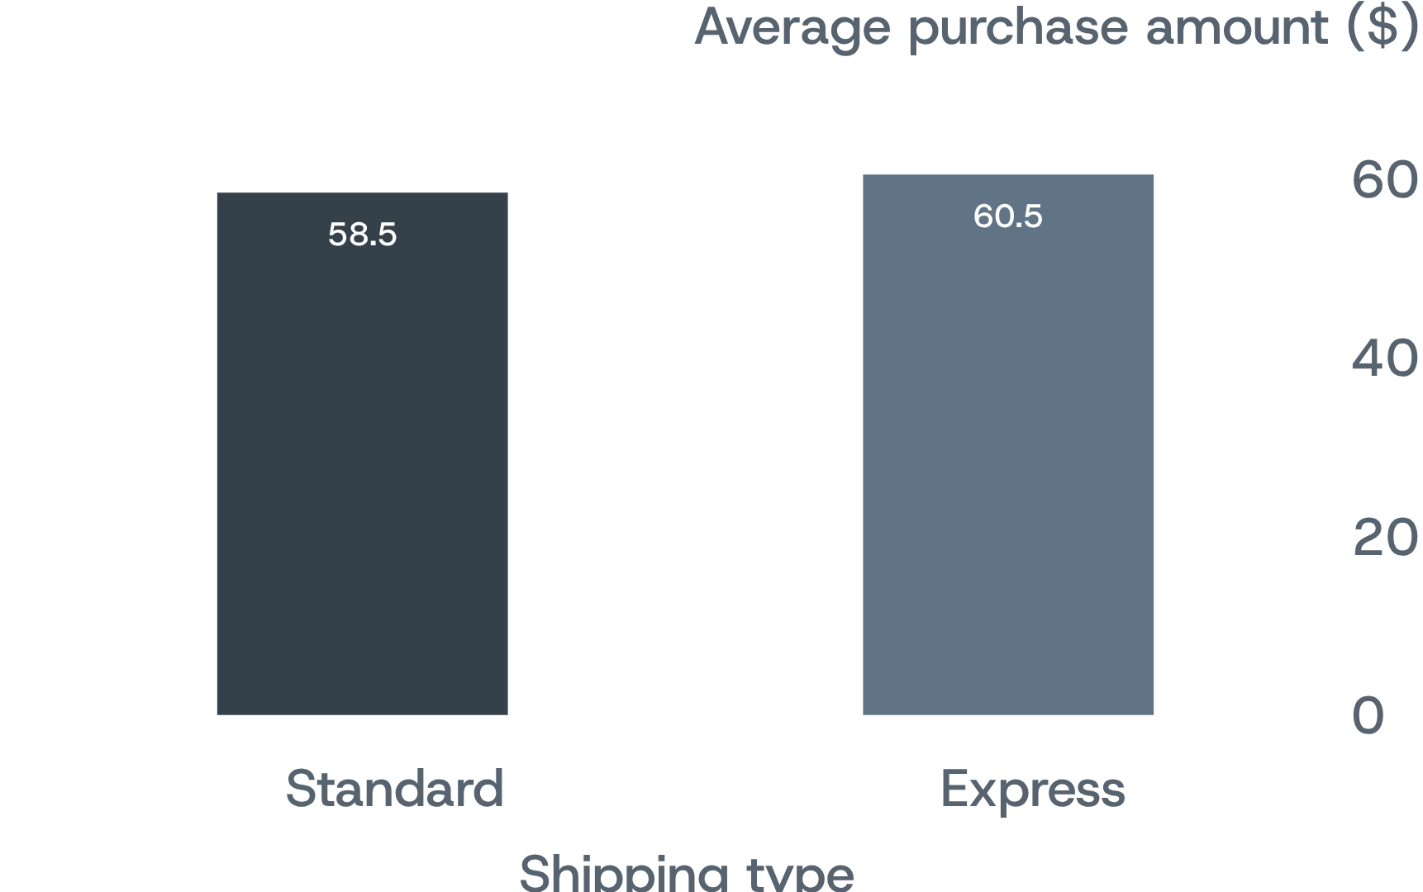
SHIPPING COMPARISON
Express shipping adds a small spend lift
Average purchase amount is modestly higher for Express than Standard shipping. Treat speed as a testable merchandising or service lever—not a proven driver of spend.
Average purchase amount in dollars. Source: Customer shopping behavior analysis
07

Slide 8
SUBSCRIPTION COMPARISON
Subscriptions have reach, but not a higher average basket
Subscribers make up a sizable group, but their average spend is slightly lower. Non-subscribers contribute more total revenue alongside their larger headcount.
SEGMENT | CUSTOMERS | AVG. SPEND ($) | REVENUE ($)
Subscribers | 1,053 | 59.49 | 62,645
Non-subscribers | 2,847 | 59.87 | 170,436
Source: Customer shopping behavior analysis
08

Slide 9
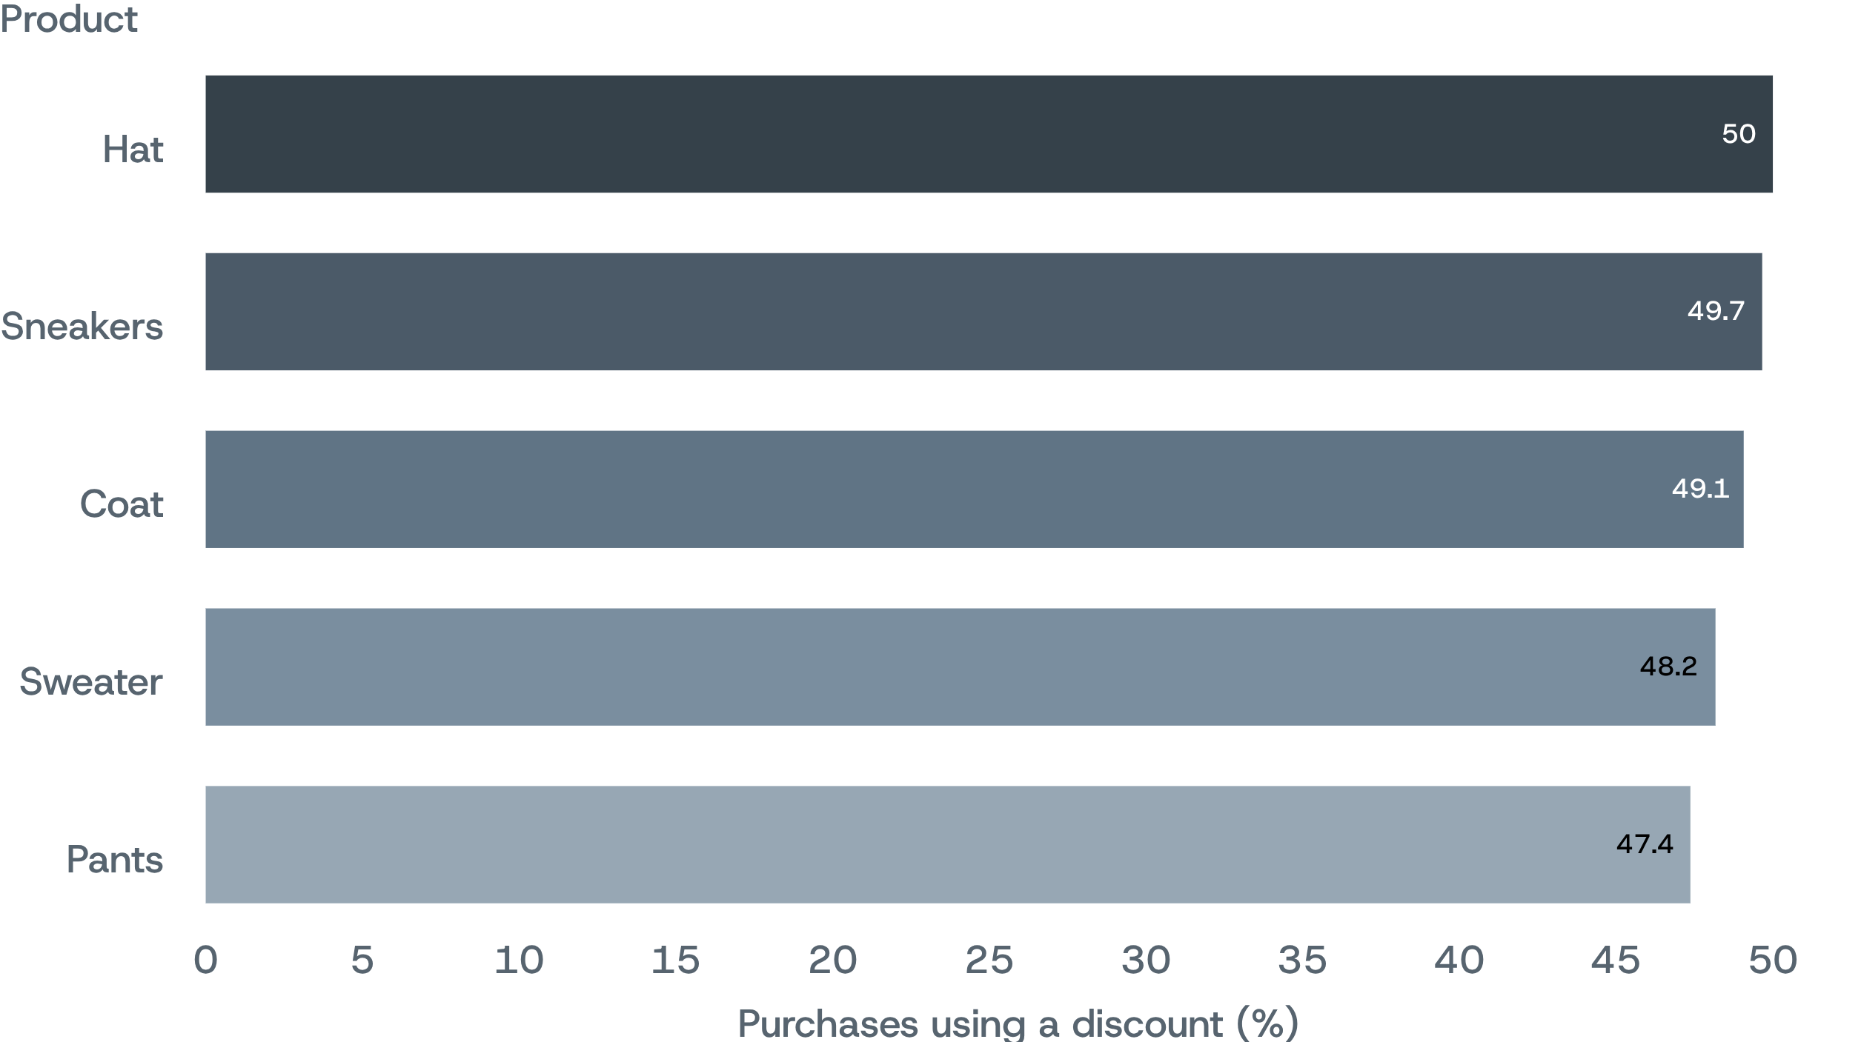
DISCOUNT USE
Discount dependence is concentrated in five products
Discounted purchases are most common for these five products. The concentration raises a margin-control question: where can discounting be reduced without weakening demand?
09
Discounted-purchase rate. Source: Customer shopping behavior analysis

Slide 10
Strategic Recommendations
01
02
03
04
05
Protect margin
Match product to demand
Refine shipping offers
Build subscription value
Anchor on customer value
Test lower discounts on Hat, Sneakers, Coat, Sweater, and Pants; monitor demand.
Use both purchase volume and ratings to guide assortment and product priorities.
Treat express shipping’s small spend lift as a test, not a proven broad growth lever.
Use the roughly $60 typical purchase and 3.75 rating as baselines; measure changes against them.
Focus on retention and convenience; subscription status alone does not raise average spend.
10

