Slide 1




HUMAN FACE RECOGNITION BY USING COMPUTER VISON
Team Name: Abstract Jacks
20BCE071 FENA PATEL
20BCE172 NILANJAN VYAS
20BCE175 NISARG SHAH
20BCE177 NISHANT PUNWANI
20BCE204 DHYAN PATEL

Slide 2
PROBLEM STATEMENT
HUMAN FACE RECOGNITION BY USING COMPUTER VISION
In this project, team task is to identify the human face real time from a CCTV with the help of a computer vision. After recognition of faces developed, software will return the face identity like employee code and date and time of recognition in a csv file. If CCTV camera frame (image from the Video) contains multiple faces, then developed model must have capability to recognize all the faces in frame.

Slide 3
INTRODUCTION
Facial recognition allows software to identify other images with same face or confirm an identity in real life. There have been developed many AI algorithms to get accurate results.
Some examples of Algos are:
CNN, ABPH and SVM.
Based on assessment of applications in the field today, the majority of facial recognition use case appear to fall into 3 major categories:
Security : Fraud Detection
Healthcare : In detecting diseases and diagnosis
Marketing: Conduct Targeted product Promotions
It is also used in detecting persons smoothly in attendance system in which the
faces are detected from the CCTV footage also. The use of face recognition can
save time and can also avoid the occurrence of errors such as human error and
even fraud that may be carried out, such as leaving an absence.

Slide 4
OUR
PROPOSED
APPROACH
For this project we have implemented LBPH (Local Binary Pattern Histogram) algorithm. It is used to recognize the face of a person both front face and side face.
First of all from the given dataset we converted that image to gray scale and cropped that image such that image mostly contains face.
Then we synthesized the data using python libraries.
After that, we trained the model on this augmented data and used the model for prediction.

Slide 5
WHY SHOULD ONE CHOOSE YOUR SOLUTION?
We used LBPH algo because it labels the pixels of an image by thresholding the neighborhood of each pixel and considers the result as a binary member. Therefore it becomes robust when it comes to lightning or bright images.
When the image becomes lighter or darker all the pixels in the neighborhood will be changed. Once, we will have enough dataset to train our model then the accuracy can be increased.
The LPBH Algo is easy to implement and easy to understand as local feature can be represented. It takes less time than the Convolution Neural Network (CNN) algorithm.
It has less computational cost and low complexity.

Slide 6
LIMITATIONS
It has less accuracy than Convolution Neural Network (CNN) Algorithm as
in LBPH we had worked on less datasets in comparison to CNN.
It has high false positive rate.
The person should be close to the camera for detection. The head pose of the person should straight to the camera.
Due to illumination, some part of the face may become invisible.
It does not perform well when the person is wearing accessories like sunglasses, jewelry or having changes in facial makeup or hair.

Slide 7
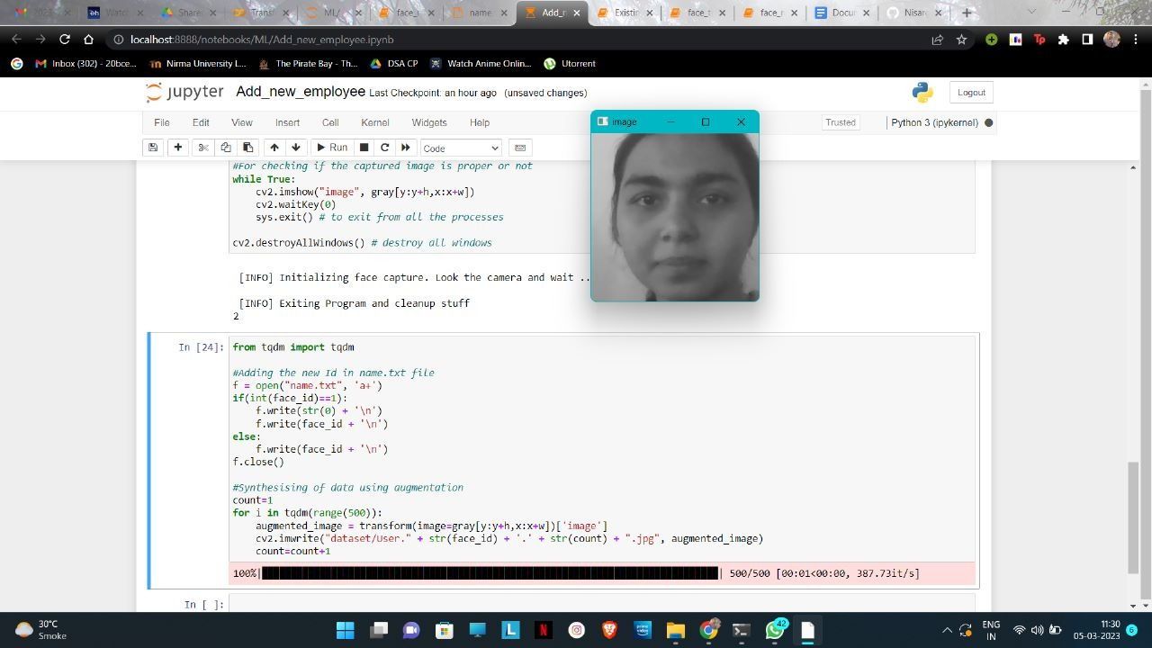
SCREENSHOTS

Slide 8



SCREENSHOTS

Slide 9
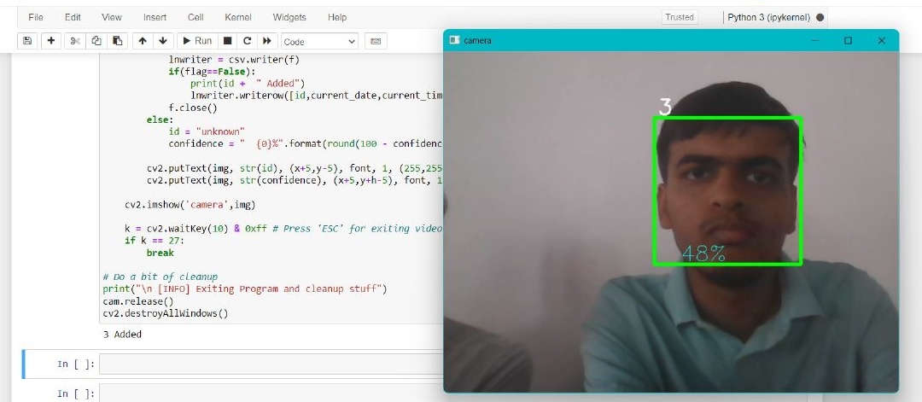
SCREENSHOTS

Slide 10
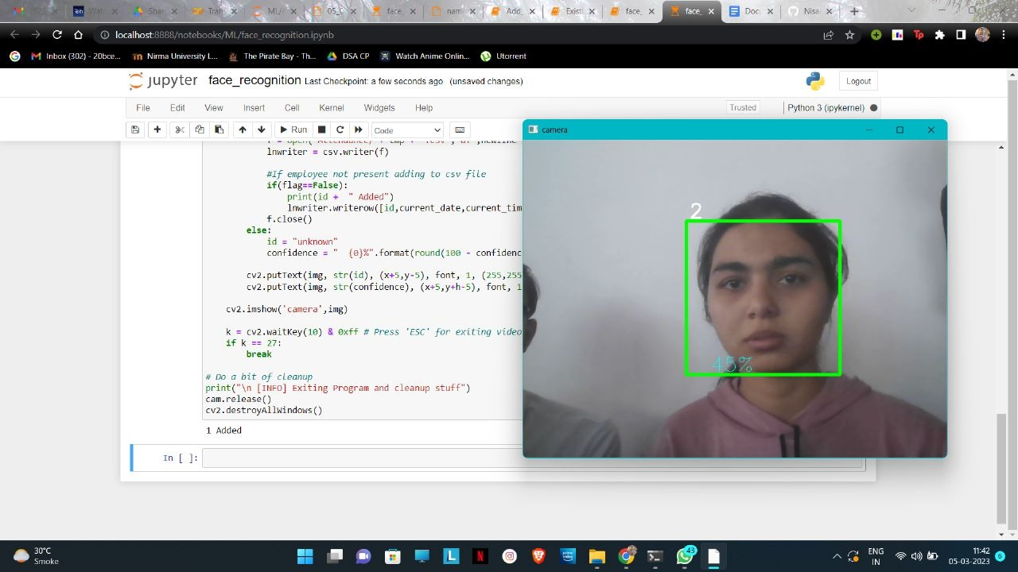

SCREENSHOTS

Slide 11
https://medium.com/mjrobot-org/real-time-face-recognition
https://www.analyticsvidhya.com/blog/2021/06/offline-data-augmentation-for-multiple-images/
https://towardsdatascience.com/face-recognition-how-lbph-works-90ec258c3d6b
REFERENCES

