Slide 1

SMART INVENTORY
GDP 02 - Android Team
Mid Term Presentation

Slide 2
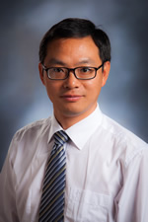
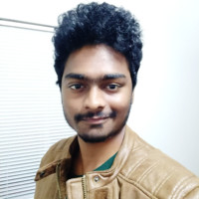
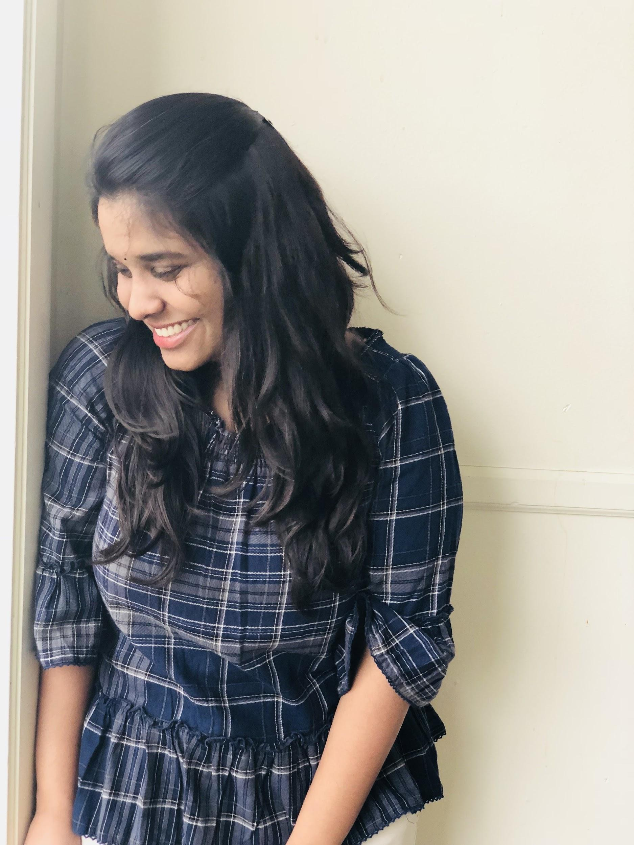
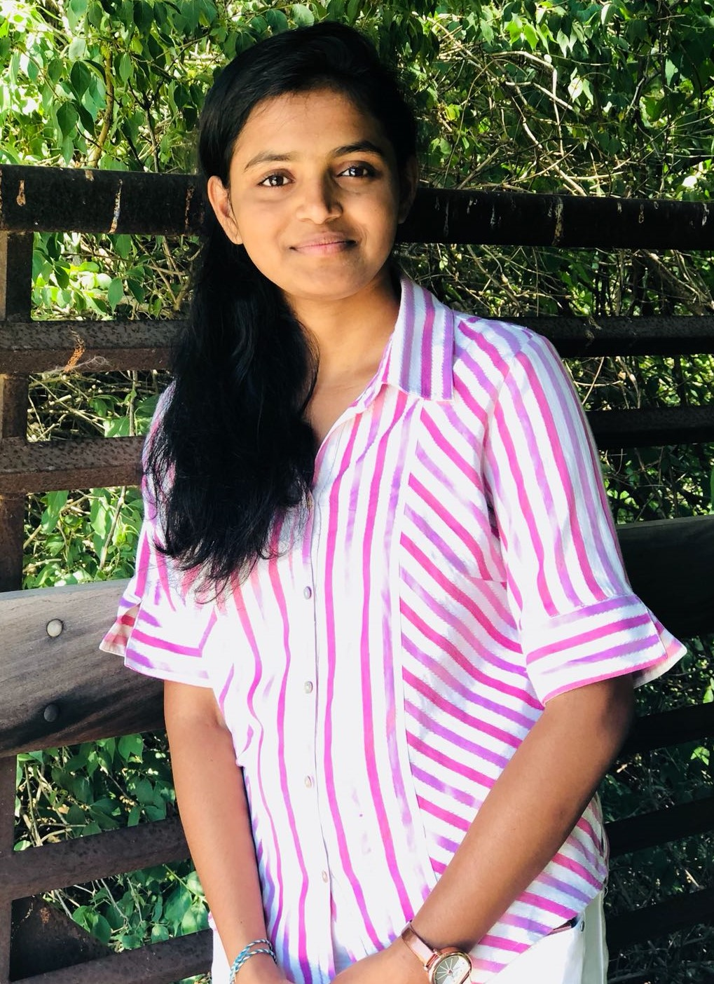
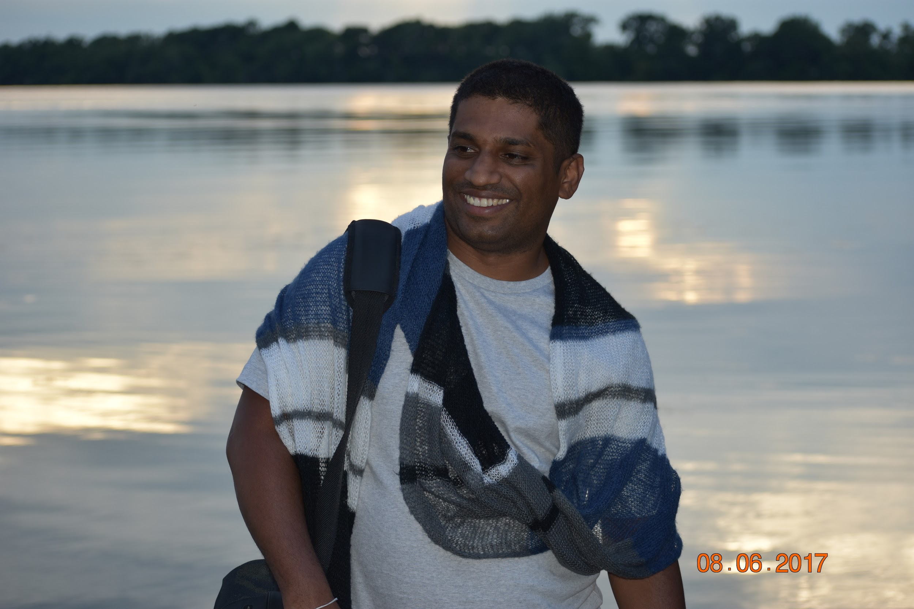

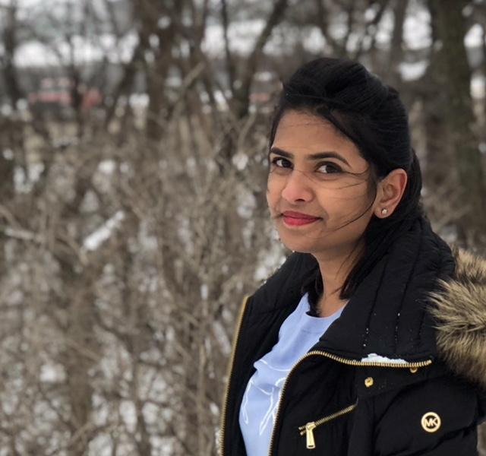
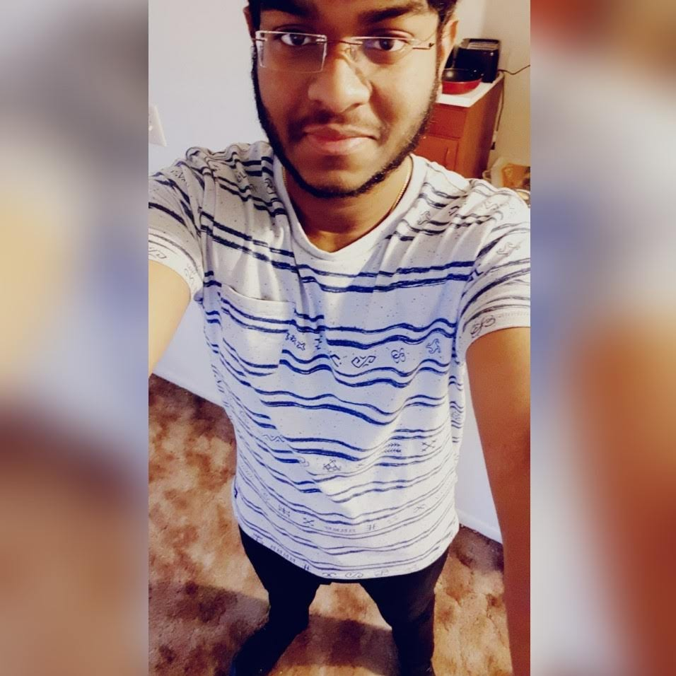
Stakeholders and Team Members
Rakesh Varma Rakashi
Snohitha Nadakudhiti
Lokeshwari Pittu
Dr.Qin Zhengrui
Nilantha Dambadeniya
Shivani Busireddy
Niharika Gundala
Karthik Raja Vemula

Slide 3
Team members and Abbreviations
Project Name: | Smart Inventory - Android
Trimester | Spring 2019
Team Members: | Rakesh Varma Nadakudhiti Snohitha Rakashi Lokeswari Pittu Nilantha Dambadeni Kalu Achchillage Shivani Busireddy Niharika Gundala Karthik Raja Vemula | RVN SR LP ND SB NG KRV

Slide 4
Contents
Introduction
Scope of the project
Timeline
Technologies
Development
Testing
Difficulties faced
Snohitha Rakashi 4

Slide 5
Introduction
Background of the project
Purpose of the project
Scope of the project
Main goal achieved
Snohitha Rakashi

Slide 6

Scope Of the Project
Vendor should publish the list of items
Users request admin to supply for items
Admin accepts and uploads the shipping label
After admin receives the items, he can make payment to the user
Snohitha Rakashi
Notes:
The scope of the project: Develop a mobile app for android devices. Vendor (Admin) should be able to publish a list of items that he is looking for to purchase. User can make request to admin to supplying those items. Then admin can accept and upload shipping labels to ship the items. Once the admin receive the items, he can verify and make payments to the user.

Slide 7
Timeline for Admin module development
Function | Week Number | Team Members
Admin user interface and Signup/login functionality | 1, 2 | LP,SB,SR,NG
Post/Cancel Announcement (Add/Edit/Delete items from the list) | 3,4 | SB, LP,SR
Approve/deny user supply request | 5,6 | SB, LP, NG
Generate and post shipping labels to the Client/User | 7,8 | SB, LP, NG,SR
Check and confirm user supply items | 10 | SB, LP
Make the payments to user | 11 | SB, NG, LP
Update the inventory | 12 | SB, LP,SR
Testing the admin/vendor app and Documentation | 2-13 | ND,NG,SR
Snohitha Rakashi

Slide 8
Timeline for Client/User module development
Function | Week Number | Team Members
View the list of items | 1, 2, 3 | ND, RVN,KRV
Clam/submit request for supply & shipping label | 4,5, 6 | ND,KRV
Update/edit request for supply & shipping label | 7, 9, 10 | ND,KRV
Develop the contact us page (Send and receive messages, live chat and other information) | 11 | ND, RVN
Conform admin confirmation of receiving items and Request payments | 12, 13 | ND
Testing the application, error correction and documentation | 3-14 | All
Snohitha Rakashi

Slide 9




Technologies
Android Studio
Firebase
Github
MS Visio
Snohitha Rakashi

Slide 10


Technologies
Moqups
MS Office (Word, Excel, PowerPoint)
Snohitha Rakashi

Slide 11
User Interface Design-Client
Niharika Gundala

Slide 12
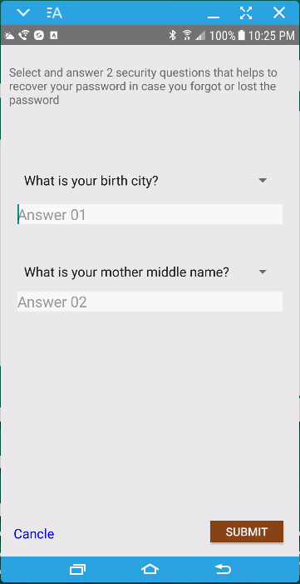
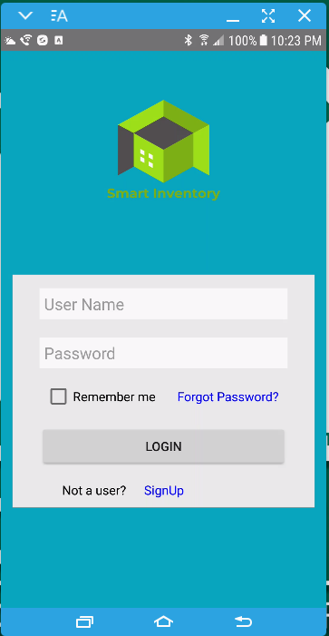
UI design
Niharika Gundala 12

Slide 13
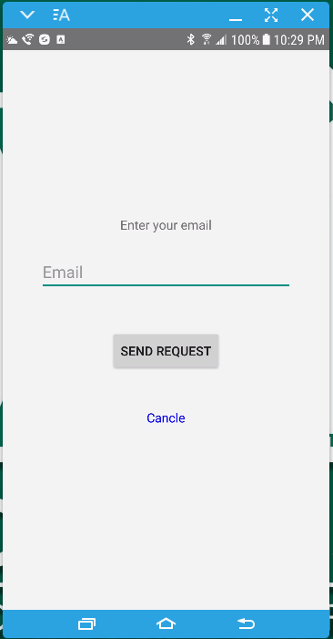
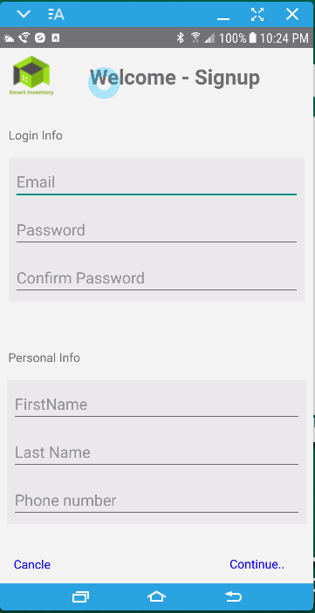
UI design
Niharika Gundala

Slide 14
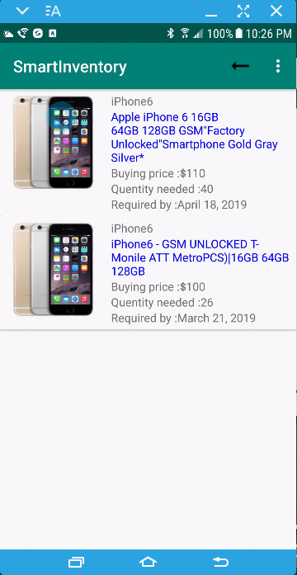
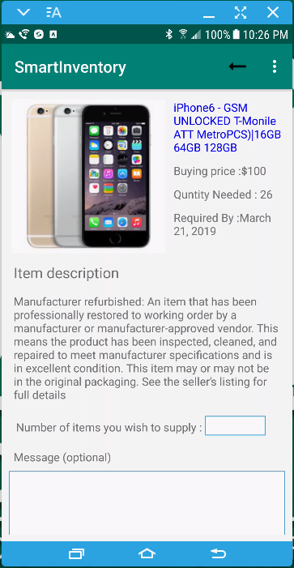
UI design : Make a supply request
Niharika Gundala

Slide 15
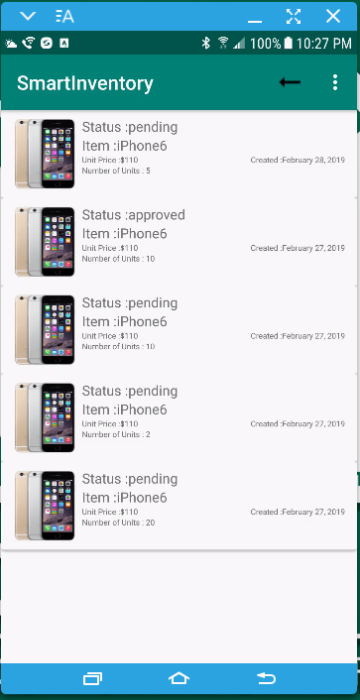
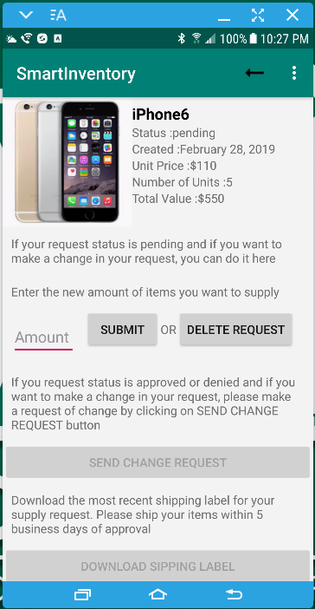
UI design : Supply history
Niharika Gundala

Slide 16
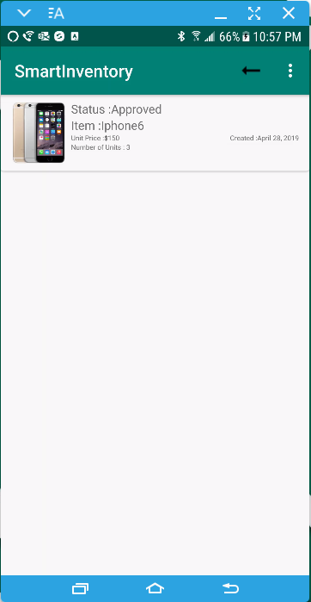
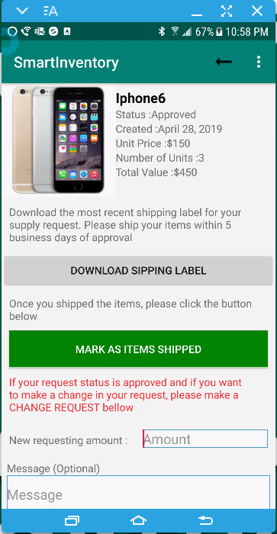
UI design : Supply history-Approved
Nilantha Dambadeniya

Slide 17
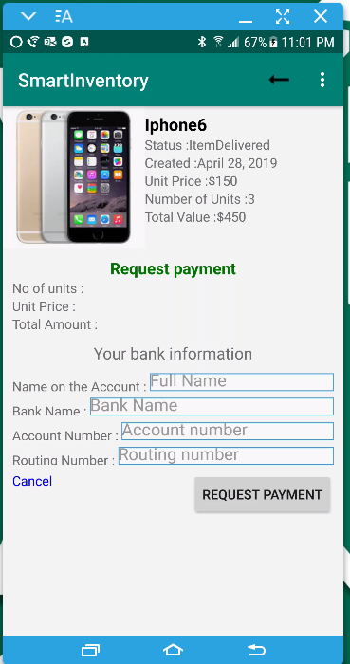
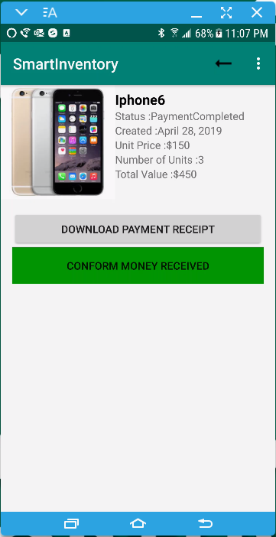
UI design : Supply history-Payment Request
Nilantha Dambadeniya

Slide 18
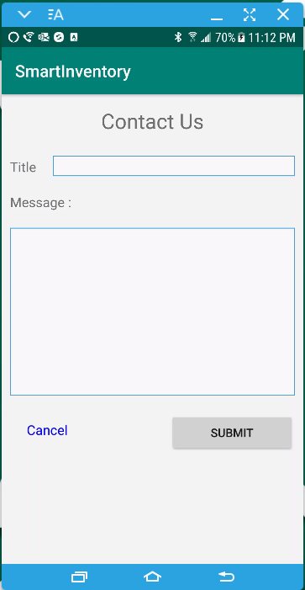
Contact us
Rakesh Varma Nadakudhiti

Slide 19
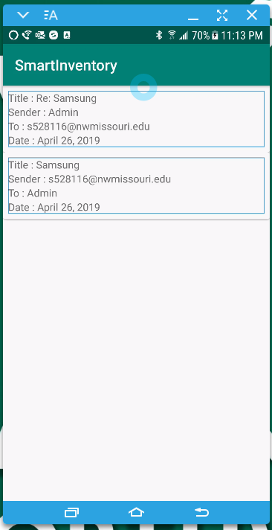
Messages
Rakesh Varma Nadakudhiti

Slide 20
User Interface Design-Admin
Karthik Raja Vemula

Slide 21
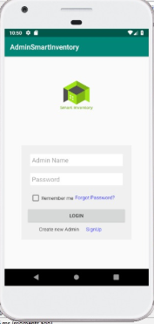
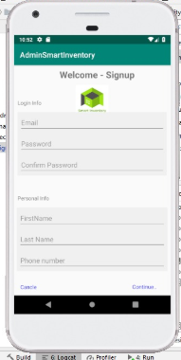
Sign up and Login
Karthik Raja Vemula

Slide 22
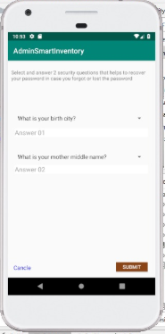
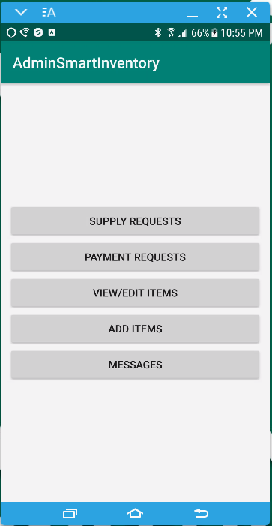
Log in and Admin dashboard
Karthik Raja Vemula

Slide 23
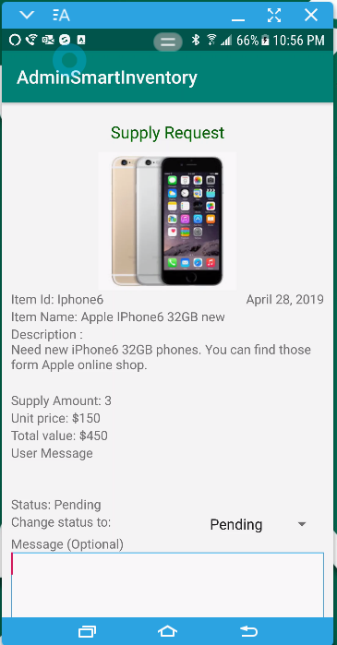
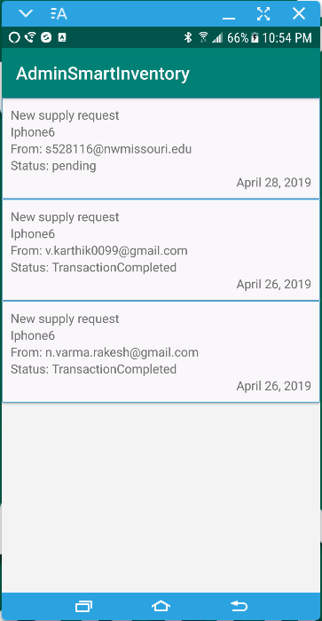
Supply Request – Approving supply request
Karthik Raja Vemula

Slide 24
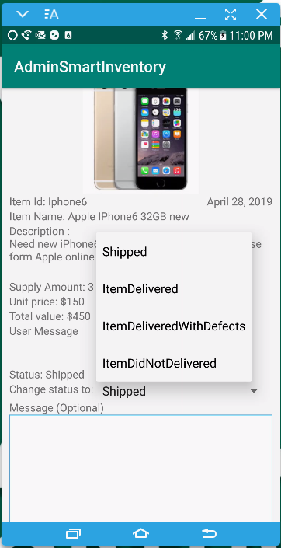
Supply Request – conform delivery
Karthik Raja Vemula

Slide 25
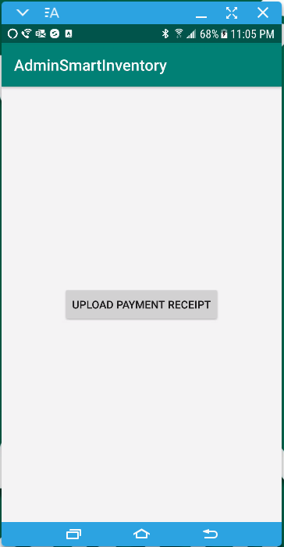
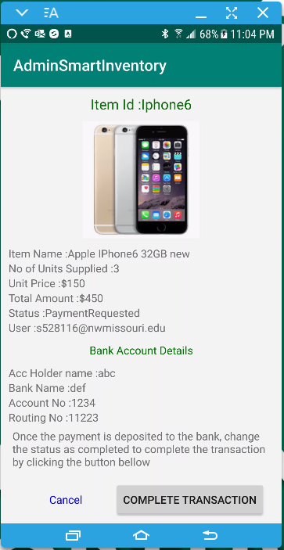
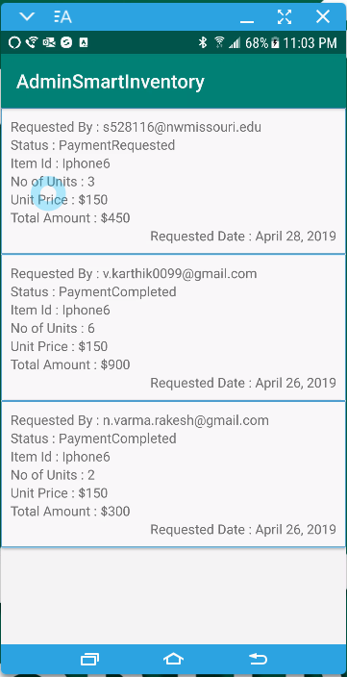
Payment Requests and Upload payment details
Lokeswari Pittu

Slide 26
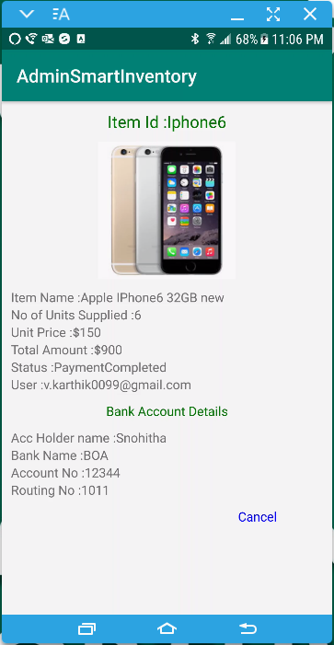
Transaction Completed
Lokeswari Pittu

Slide 27
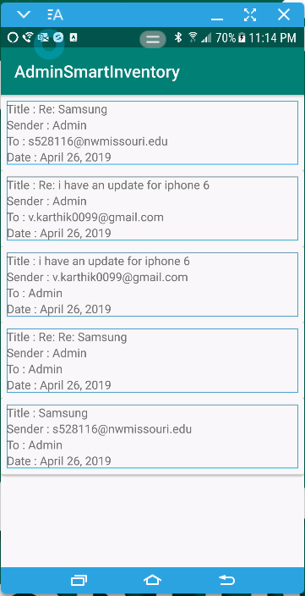
Messages
Lokeswari Pittu

Slide 28
Testing
Test Management tool:
JiRA
White Box Testing
Black Box Testing
Lokeswari Pittu

Slide 29
Challenges and obstacles
Understanding the user and user requirements
Learn and use new technologies
Communication
Working on the same code as a team
Conflicts in planings/ designs and implementing
Meeting goals and deadlines
Lokeswari Pittu

Slide 30

Live demo
http://www.infowan.net/Demo.html
Shivani Busireddy

Slide 31

Project Discussion
User client meeting
Standup meetings
Code Implementation
Testing of every functionality
Shivani Busireddy

Slide 32


Slide 33
Stakeholders and Team Members
Rakesh Varma Rakashi
Snohitha Nadakudhiti
Lokeshwari Pittu
Dr.Qin Zhengrui
Nilantha Dambadeniya
Shivani Busireddy
Niharika Gundala
Karthik Raja Vemula

Slide 34
Thank you!

