Slide 1
Ansible Automation

Slide 2
Hosts
Nilashish Chakraborty – Software Engineer, Ansible
Rohit Thakur – Software Engineer, Ansible
Rajat Agrawal – Training Consultant, GLS
Buvanesh Kumar – Software Engineer, PnT DevOps

Slide 3
What is Ansible?
●
An Open Source Automation Tool
●
An Automation Language
●
●
An Automation Engine
●
●
A Framework!

Slide 4
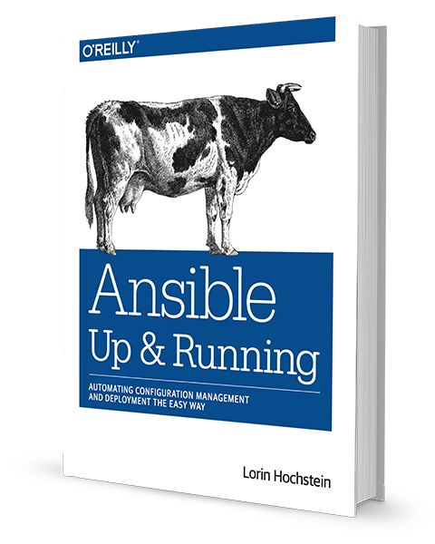
Community
THE MOST POPULAR OPEN-SOURCE AUTOMATION COMMUNITY ON GITHUB
●
39,000+ stars & 16,000+ forks on GitHub
●
4,600+ GitHub Contributors
●
Over 3000 modules shipped with Ansible
●
New contributors added every day
●
1,500+ users on IRC channel
●
Top 10 open source projects in 2017
●
World-wide meetups taking place every week
●
Ansible Galaxy: over 18,000 subscribers
●
500,000+ downloads a month
●
AnsibleFests in Austin, NYC, SF, London
http://ansible.com/community

Slide 5



Why Ansible? What Sets Ansible Apart?
SIMPLE
POWERFUL
AGENTLESS
Human readable automation
App deployment
Agentless architecture
No special coding skills needed
Conﬁguration management
Uses OpenSSH & WinRM
Tasks executed in order
Workﬂow orchestration
No agents to exploit or update
Usable by every team
Network automation
Get started immediately
Get productive quickly
Orchestrate the app lifecycle
More efﬁcient & more secure

Slide 6
WHAT CAN I DO USING ANSIBLE?
Automate the deployment and management of your entire IT footprint.
Do this...
Orchestration
Configuration
Application
Provisioning
Continuous
Security and
Management
Deployment
Delivery
Compliance
On these...
Firewalls
Load Balancers
Applications
Containers
Clouds
Servers
Infrastructure
Storage
Network Devices
And more...

Slide 7
ANSIBLE AUTOMATES TECHNOLOGIES YOU USE
Time to automate is measured in minutes
CLOUD
VIRT &
CONTAINER
WINDOWS
NETWORK
DEVOPS
MONITORING
AWS
Docker
ACLs
Arista
Jira
Dynatrace
Azure
VMware
Files
A10
GitHub
Airbrake
Digital Ocean
RHV
Packages
Cumulus
Vagrant
BigPanda
Google
OpenStack
IIS
Bigswitch
Jenkins
Datadog
OpenStack
OpenShift
Regedits
Cisco
Bamboo
LogicMonitor
Rackspace
+more
Shares
Cumulus
Atlassian
Nagios
+more
Services
Dell
Subversion
New Relic
Conﬁgs
F5
Slack
PagerDuty
OPERATING
STORAGE
Users
Juniper
Hipchat
Sensu
SYSTEMS
NetApp
Domains
Palo Alto
RHEL and Linux
+more
StackDriver
Red Hat Storage
+more
OpenSwitch
Zabbix
UNIX
Inﬁnidat
+more
+more
Windows
+more
+more

Slide 8










PUBLIC / PRIVATE
CLOUD
PUBLIC / PRIVATE
CMDB
CLOUD
ANSIBLE AUTOMATION ENGINE
USERS
INVENTORY
CLI
HOSTS
MODULES
PLUGINS
NETWORK
ANSIBLE
DEVICES
PLAYBOOK

Slide 9







PUBLIC / PRIVATE
CLOUD
PUBLIC / PRIVATE
CMDB
CLOUD
ANSIBLE AUTOMATION ENGINE
PLAYBOOKS ARE WRITTEN IN YAML
Tasks are executed sequentially
USERS
Invoke Ansible modules
INVENTORY
CLI
HOSTS
MODULES
PLUGINS
NETWORK
ANSIBLE
DEVICES
PLAYBOOK

Slide 10

PUBLIC / PRIVATE
CLOUD
PUBLIC / PRIVATE
CMDB
CLOUD
ANSIBLE AUTOMATION ENGINE
MODULES ARE “TOOLS IN THE TOOLKIT”
Python, Powershell, or any language
Extend Ansible simplicity to the entire stack
USERS
INVENTORY
CLI
HOSTS
MODULES
PLUGINS
NETWORK
ANSIBLE
DEVICES
PLAYBOOK
CORE
NETWORK
COMMUNITY

Slide 11
PUBLIC / PRIVATE
CLOUD
PUBLIC / PRIVATE
CMDB
CLOUD
PLUGINS ARE “GEARS IN THE ENGINE”
Code that plugs into the core engine
ANSIBLE AUTOMATION ENGINE
Adaptability for various uses & platforms
USERS
INVENTORY
CLI
HOSTS
MODULES
PLUGINS
NETWORK
ANSIBLE
DEVICES
PLAYBOOK

Slide 12
PUBLIC / PRIVATE
CLOUD
PUBLIC / PRIVATE
CMDB
CLOUD
INVENTORY
[web]
ANSIBLE AUTOMATION ENGINE
webserver1.example.com
webserver2.example.com
USERS
[db]
dbserver1.example.com
HOSTS
INVENTORY
CLI
[switches]
leaf01.internal.com
leaf02.internal.com
MODULES
PLUGINS
NETWORK
[firewalls]
ANSIBLE
DEVICES
checkpoint01.internal.com
PLAYBOOK
[lb]
f5-01.internal.com

Slide 13
PUBLIC / PRIVATE
CLOUD
PUBLIC / PRIVATE
CMDB
CLOUD
CMDB
ANSIBLE AUTOMATION ENGINE
USERS
CMDB
ServiceNow, Cobbler, BMC, Custom cmdb
INVENTORY
CLI
HOSTS
CLOUD
MODULES
PLUGINS
Red Hat Openstack, Red Hat Satellite, VMware,
NETWORK
ANSIBLE
DEVICES
AWS EC2, Rackspace, Google Compute Engine, Azure
PLAYBOOK

Slide 14
PUBLIC / PRIVATE
CLOUD
PUBLIC / PRIVATE
CMDB
CLOUD
ANSIBLE AUTOMATION ENGINE
USERS
INVENTORY
CLI
HOSTS
MODULES
PLUGINS
NETWORK
AUTOMATE EVERYTHING
ANSIBLE
DEVICES
Red Hat Enterprise Linux, Ubuntu, Debian,
PLAYBOOK
Cisco routers, Arista switches, Juniper routers,
Windows hosts, Checkpoint ﬁrewalls and more

Slide 15
Modules
Modules are bits of code transferred to the target system and executed to satisfy the task
declaration.
●
apt/yum
●
service
●
copy
●
synchronize
●
ﬁle
●
template
●
get_url
●
uri
●
git
●
user
●
ping
●
wait_for
●
debug
●
assert

Slide 16
Last Resort Modules
If Ansible doesn't have a module that suits your needs there are the “run
command” modules:
●
command
: Takes the command and executes it on the host. The most
secure and predictable.
●
shell
: Executes through a shell like /bin/sh so you can use pipes etc. Be
careful.
●
script
: Runs a local script on a remote node after transferring it.
●
raw
: Executes a command without going through the Ansible module
subsystem.
Note: These have no concept of desired state and should be used as a last resort.

Slide 17

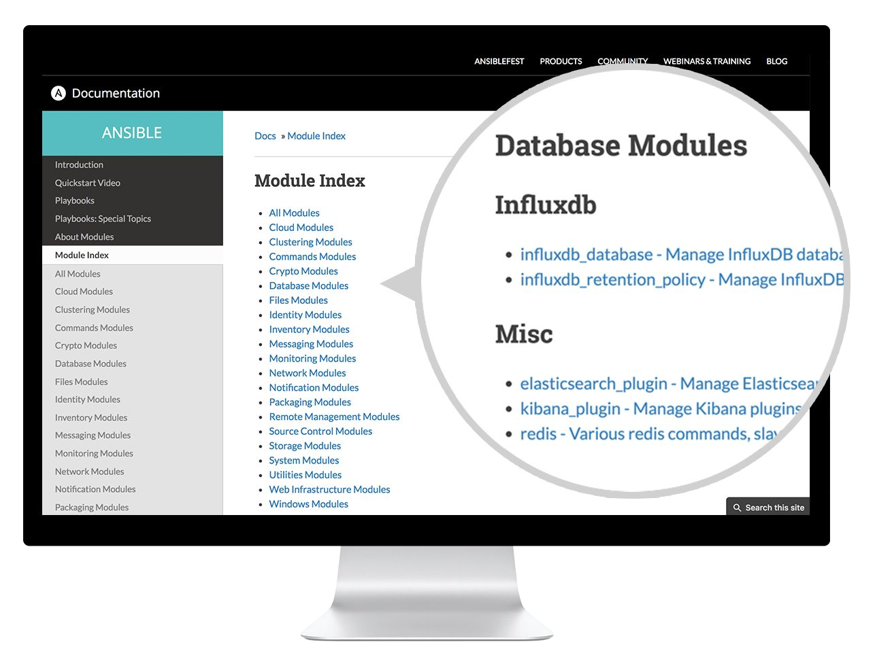
docs.ansible.com

Slide 18
Inventory
Inventory is a collection of managed hosts with associated data and
groupings that Ansible can connect and manage.
●
Hosts
●
Groups
●
Static or dynamic sources

Slide 19
Tasks
Tasks are the application of a module to perform a speciﬁc unit of work.
●
ﬁrewalld
: A directory should exist
●
yum
: A package should be installed
●
service
: A service should be running
●
copy
: copies a file from source to destination
●
git
: Clone a source code repository

Slide 20
Ad-Hoc Commands
An ad-hoc command is a single Ansible task to perform quickly, but
don’t want to save for later.

Slide 21
Ad-Hoc Commands
# check all my inventory hosts are ready to be
# managed by Ansible
$ ansible all -m ping
# collect and display the discovered facts
# for the localhost
$ ansible localhost -m setup
# run the uptime command on all hosts in the
# web group
$ ansible web -m command -a "uptime"

Slide 22
Plays & Playbooks
Plays are ordered sets of tasks to execute against host selections from
your inventory. A playbook is a ﬁle containing one or more plays.

Slide 23
Playbook Example
---
- name: install and start apache
hosts: web
become: yes
vars:
http_port: 80
tasks:
- name: httpd package is present
yum:
name: httpd
state: latest
- name: latest index.html file is present
copy:
src: files/index.html
dest: /var/www/html/
- name: httpd is started
service:
name: httpd
state: started

Slide 24
Human-Meaningful Naming
---
- name: install and start apache
hosts: web
become: yes
vars:
http_port: 80
tasks:
- name: httpd package is present
yum:
name: httpd
state: latest
- name: latest index.html file is present
copy:
src: files/index.html
dest: /var/www/html/
- name: httpd is started
service:
name: httpd
state: started

Slide 25
Host Selector
---
- name: install and start apache
hosts: web
become: yes
vars:
http_port: 80
tasks:
- name: httpd package is present
yum:
name: httpd
state: latest
- name: latest index.html file is present
copy:
src: files/index.html
dest: /var/www/html/
- name: httpd is started
service:
name: httpd
state: started

Slide 26
Privilege Escalation
---
- name: install and start apache
hosts: web
become: yes
vars:
http_port: 80
tasks:
- name: httpd package is present
yum:
name: httpd
state: latest
- name: latest index.html file is present
copy:
src: files/index.html
dest: /var/www/html/
- name: httpd is started
service:
name: httpd
state: started

Slide 27
Play Variables
---
- name: install and start apache
hosts: web
become: yes
vars:
http_port: 80
tasks:
- name: httpd package is present
yum:
name: httpd
state: latest
- name: latest index.html file is present
copy:
src: files/index.html
dest: /var/www/html/
- name: httpd is started
service:
name: httpd
state: started

Slide 28
Tasks
---
- name: install and start apache
hosts: web
become: yes
vars:
http_port: 80
tasks:
- name: httpd package is present
yum:
name: httpd
state: latest
- name: latest index.html file is present
copy:
src: files/index.html
dest: /var/www/html/
- name: httpd is started
service:
name: httpd
state: started

Slide 29
Handler Tasks
Handlers are special tasks that run at the end of a play if notiﬁed by
another task when a change occurs.
If a package gets installed or updated, notify a service restart task that
it needs to run.

Slide 30
Example Handler Task in a Play
tasks:
- name: httpd package is present
yum:
name: httpd
state: latest
notify: restart httpd
- name: latest index.html file is present
copy:
src: files/index.html
dest: /var/www/html/
handlers:
- name: restart httpd
service:
name: httpd
state: restarted

Slide 31
Roles
Roles are a packages of closely related Ansible content that can be
shared more easily than plays alone.
●
Improves readability and maintainability of complex plays
●
Eases sharing, reuse and standardization of automation processes
●
Provides a common directory structure for your playbooks.

Slide 32
Project with Embedded Roles Example
site.yml
roles/
common/
files/
templates/
tasks/
handlers/
vars/
defaults/
meta/
apache/
files/
templates/
tasks/
handlers/
vars/
defaults/
meta/

Slide 33
Project with Embedded Roles Example
# site.yml
---
- hosts: web
roles:
- common
- apache

Slide 34
Windows Automation

Slide 35
Requirements
●
PowerShell 3.0 or newer and at least .NET 4.0
●
A WinRM listener should be created and activated.
●
Supported Windows OS – 7, 8.1, 10, Server 2008, 2012, 2016, 2019

Slide 36
A Few Windows Modules
●
win_ping
●
win_product_facts
●
win_disk_facts
●
win_user
●
win_scheduled_task & win_scheduled_task_stats
●
win_hosts

Slide 37
AWX
An Upstream Project for Ansible Tower

Slide 38
AWX Features
●
Web UI
●
Rest API
●
Logging
●
RBAC
●
Job Scheduling
●
Secure Credentials Management
●
Notifications
●
Integrations with External Authentication Mechanism

Slide 39


Slide 40


Slide 41


