Slide 1
ANSIBLE COMMUNITY MEETUP KOLKATA,8TH APRIL,2023 HOW TO JOIN ANSIBLE COMMUNITY Sutapa Bhattacharjee CC-BY-SA 4.0

Slide 2
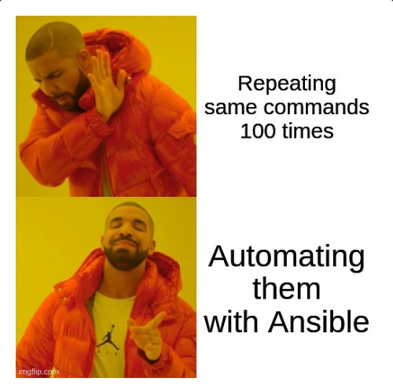


Ansible By Red Hat
An open-source automation tool that simplifies IT configuration management, application deployment, and task automation.

Slide 3
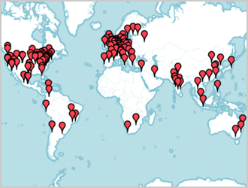
What is Ansible community ?
The Ansible community is a global community of users, contributors, and developers who use and support the open-source automation platform, Ansible.
The community is dedicated to sharing knowledge, best practices, and resources related to Ansible, as well as contributing to the development of the platform itself.
Worldwide Meetups locations
Source: https://www.ansible.com/community

Slide 4
WAYS TO JOIN ANSIBLE COMMUNITY
MATRIX
What Is Matrix?
Matrix is an open-source decentralized messaging and communication protocol that enables real-time communication over the internet.
Decentralized communication
Cross-platform compatibility
Open-source

Slide 5
VIA MATRIX .
To interact with the Ansible community Via Matrix we need..
A Matrix account (from Matrix.org)
A Matrix client (such as Element Webchat).

Slide 6
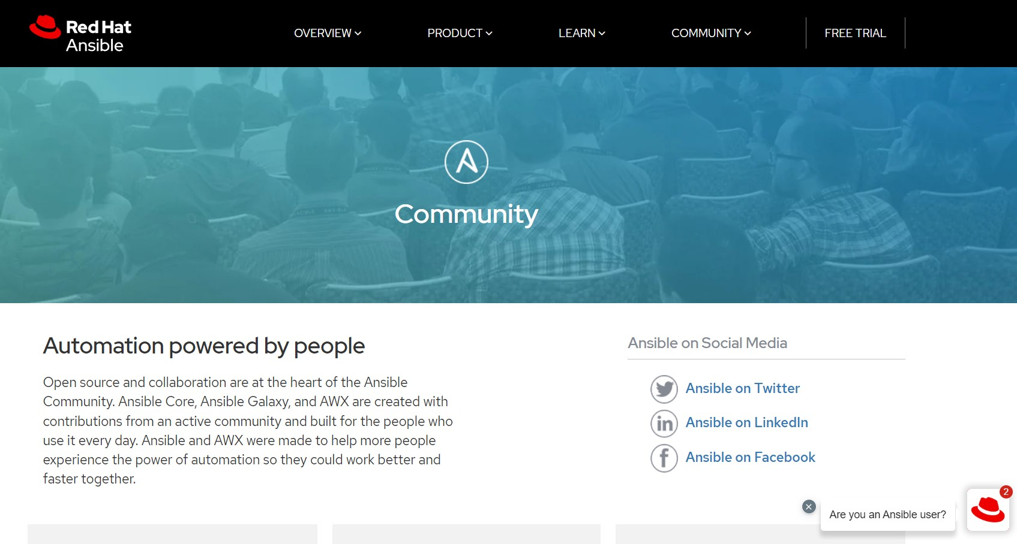
WEBSITE https://www.ansible.com/community
In this link over Real-time chat you will find Matrix rooms (social).You’ve to join over there.

Slide 7
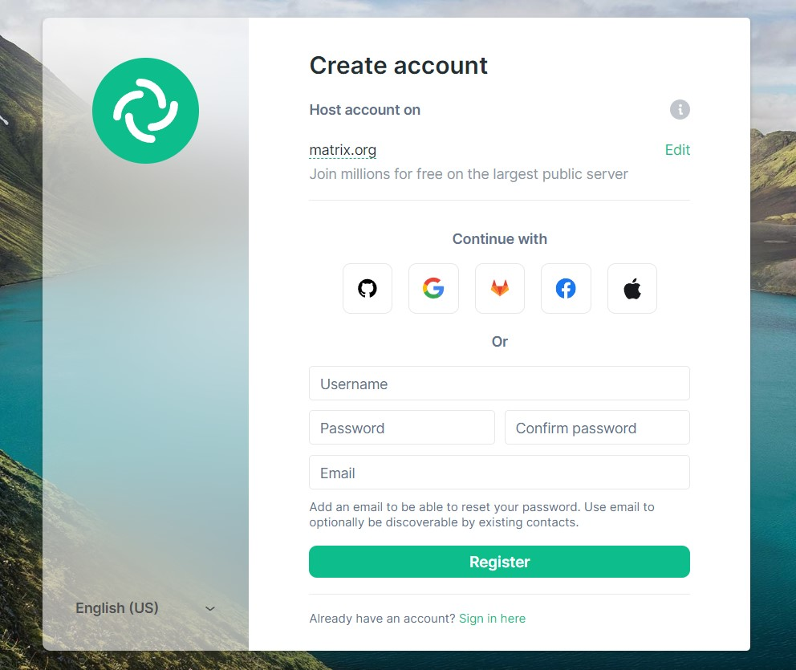
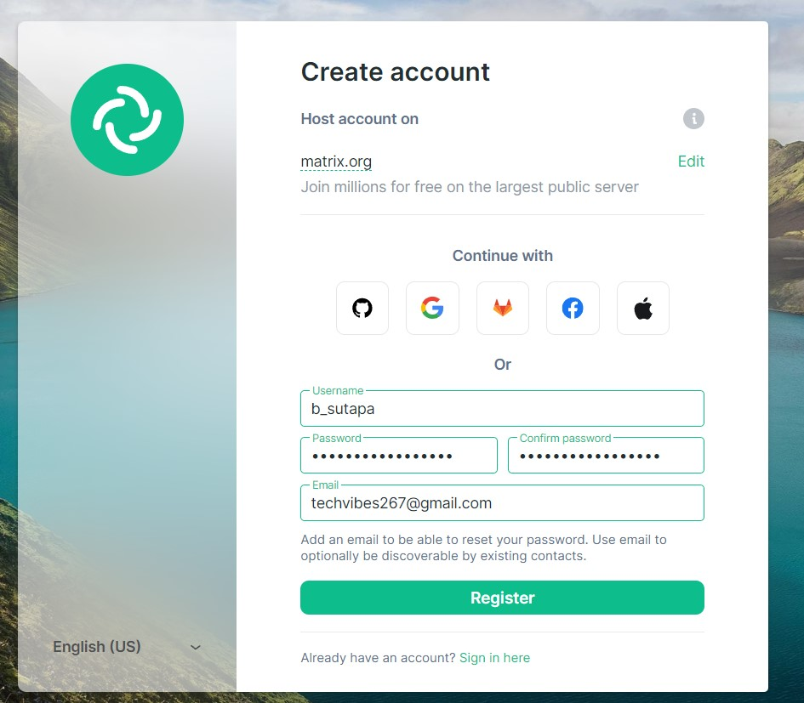
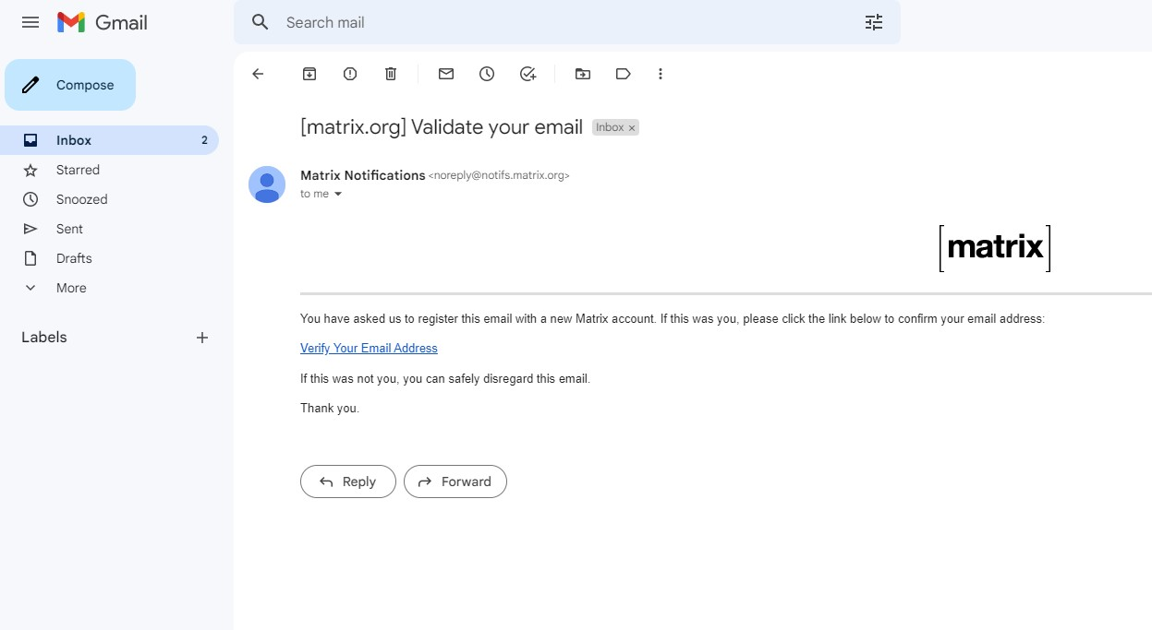
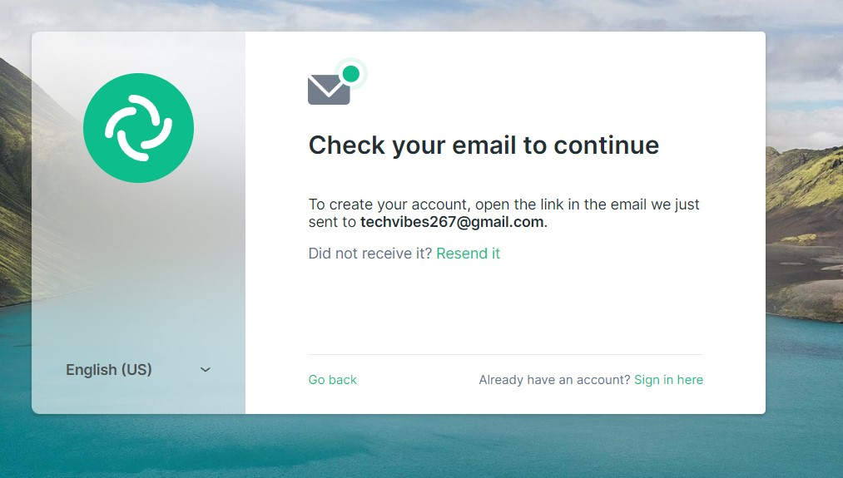
STEPS

Slide 8
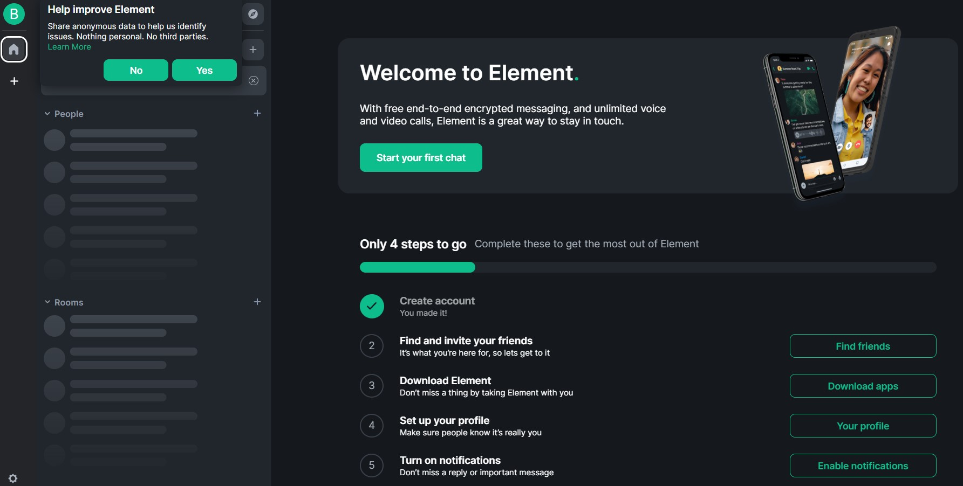
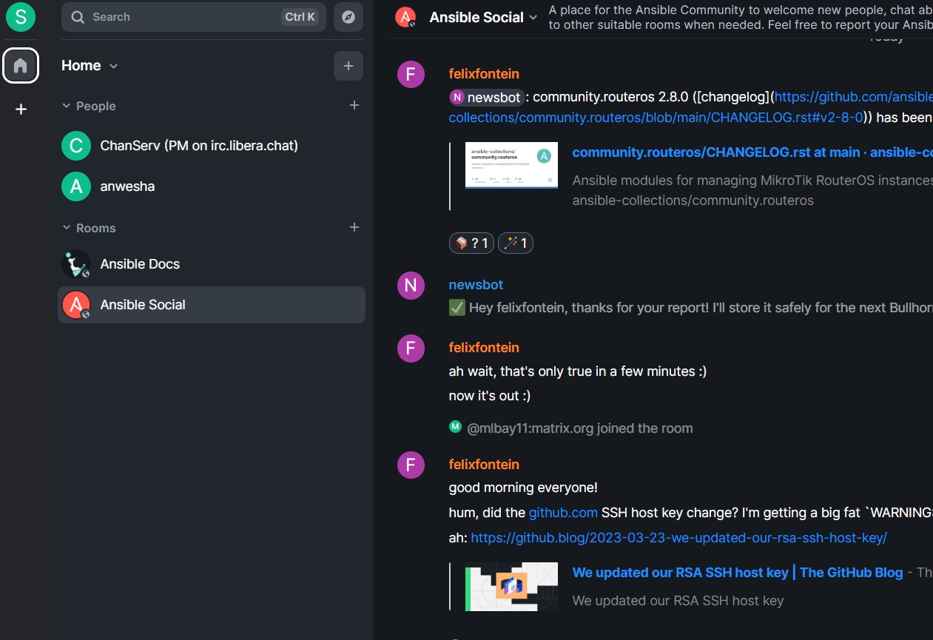
WELCOME MESSAGE

Slide 9
Other ways to join Ansible Community
Ansible Community
VIA MAILING LIST
ATTEND ANSIBLE EVENTS
CONTRIBUTE TO THE ANSIBLE PROJECT
VIA SOCIAL MEDIA PLATFORM

Slide 10

Bullhorn
Bullhorn is a weekly newsletter to keep you informed about ansible related updates & events.
Past editions: https://github.com/ansible/community/wiki/News
Subscribe here: https://github.com/ansible/community/issues/546.

Slide 11
Thank you
Sutapa Bhattacharjee CC-BY-SA 4.0
Linked in : https://www.linkedin.com/in/sutapa-bhattacharjee-104966111/

Slide 12
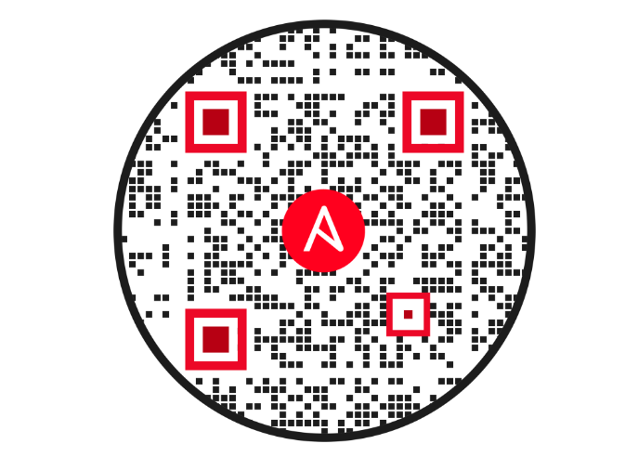
Feedback

