Slide 1

AgriCare
Empowering the Backbone of Our Nation
A Comprehensive Smart Farming Ecosystem for the Modern Farmer
May-2026
Software Group Project (CEUP201)
Smart Insights · Better Yields · Sustainable Future

Slide 2
CONTENTS
01
The Challenge & Our Vision
Problem Statement & Solution Overview
02
Core Platform Features
AI Detection, Market Connect, Crop Calendar, Subsidies
03
Technology & Intelligence
AgriBot Assistant & Technical Architecture
04
The Road Ahead
Future Roadmap & Vision
02

Slide 3
The Challenge / Problem Statement
Four Critical Gaps Holding Back Gujarat's Farmers
Information Gap
Disease Management
Lack of real-time access to market prices and weather updates leaves farmers vulnerable to price exploitation and unpredictable climate events.
Delayed identification of crop diseases leads to significant harvest loss. Traditional methods rely on visual inspection, often too late for effective intervention.
Resource Access
Language Barrier
Difficulty in navigating complex government subsidy schemes means eligible farmers miss out on critical financial and equipment support.
Digital tools often lack support for local dialects like Gujarati and Hindi, excluding a large segment of farmers from technology-driven solutions.
03

Slide 4
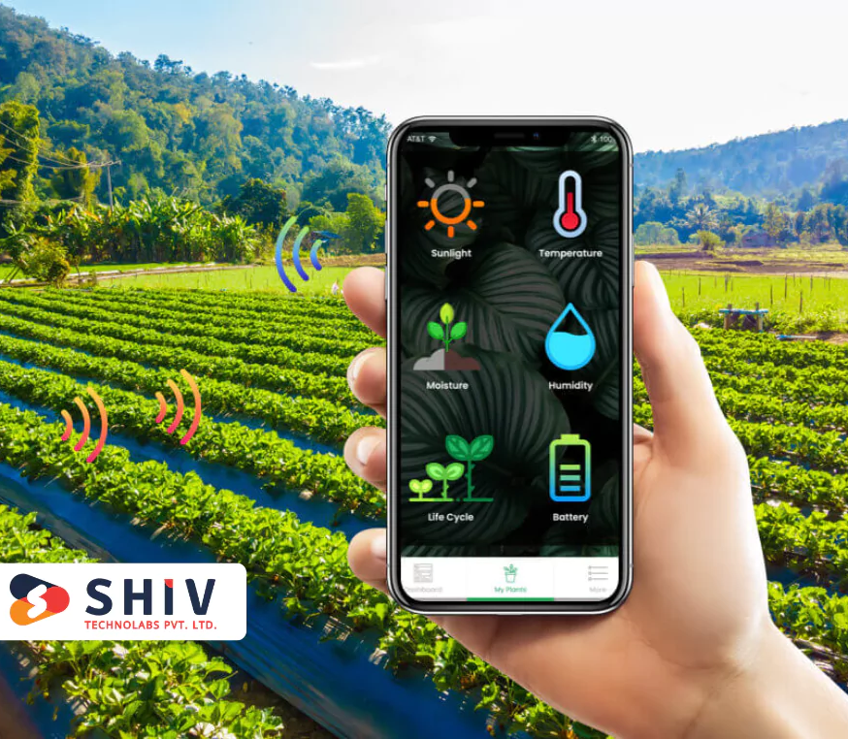
The Challenge / Our Solution
AgriCare: A Multilingual Platform for the Modern Farmer
Our Approach
Platform Vision
AgriCare is a multilingual digital platform that provides data-driven agricultural advisory, market transparency, and AI-powered diagnostic tools tailored for the regional needs of Gujarat.
• Bridges traditional farming with modern AI-driven insights
• Boosts productivity and sustainability for smallholder farmers
• Designed for farmers, agricultural administrators, and local vendors
• Supports Gujarati, Hindi, and English interfaces
04

Slide 5
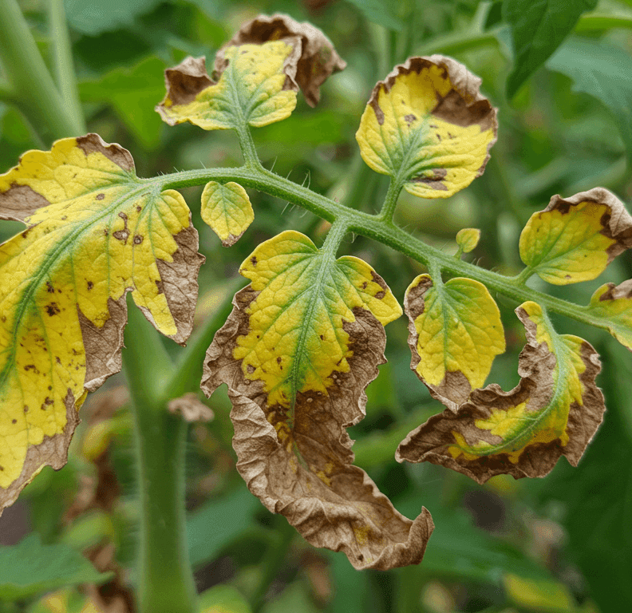
Core Features / AI Disease Detection
AI Disease Detection: Instant Diagnosis, Actionable Remedies
How It Works
Upload
Snap a photo of the affected crop
Analyze
Keras deep learning model identifies the disease
Act
Get remedies and pesticide recommendations from local shops
Powered by a custom-trained TensorFlow/Keras model for high-accuracy plant disease classification across major Gujarat crops.
05

Slide 6
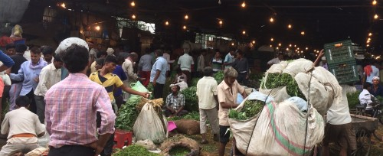
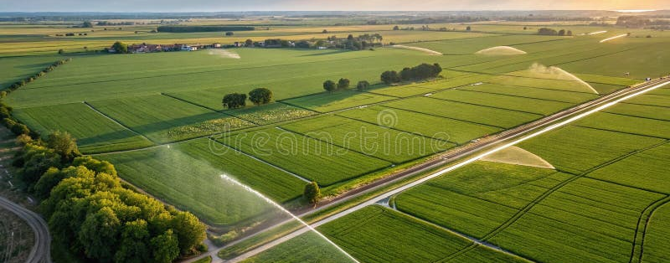
Core Features / Market & Weather
Market Connect & Weather Intelligence for Fair Trade
Market Data
Weather Station
◆ Hyper-local weather forecasts for every district
◆ Alerts for rainfall, drought, and extreme events
◆ Planning support for sowing and harvesting cycles
◆ Integrated with IMD data for accuracy
◆ Real-time tracking of crop prices across Gujarat Mandis
◆ Ensures fair trade and eliminates middleman exploitation
◆ Price alerts and trend analysis for major commodities
◆ Historical data to inform selling decisions
06

Slide 7
Core Features / Crop Calendar
Personalized Crop Calendar: District-Aware Advisory
Location-aware advisory system delivering step-by-step guidance from soil preparation to post-harvest management, validated via India Post API.
01
02
03
Pre-Sowing
Growing Season
Post-Harvest
• Soil testing recommendations
• Seed selection guidance
• Fertilizer planning
• Optimal sowing dates based on weather
• Irrigation scheduling
• Pest and disease monitoring
• Nutrient management
• Growth stage tracking
• Harvest timing optimization
• Storage best practices
• Market linkage for best prices
• Crop rotation planning
07

Slide 8
Core Features / Government Support
Government Subsidies & Support Made Accessible
Financial Subsidies
Equipment Subsidies
Seed Subsidies
• High-yield variety seeds
• Organic seed programs
• Seed replacement schemes
• Quality certification info
• Direct links to apply online
• Crop insurance schemes
• Interest subvention on farm loans
• Direct benefit transfers
• Disaster relief funds
• Eligibility criteria in local language
• Subsidized farm machinery
• Irrigation equipment support
• Solar pump installations
• Cold storage facilities
• Application process guidance
08

Slide 9
Technology & Intelligence / AgriBot
AgriBot: 24/7 AI Chat Assistant for Every Farmer
Key Capabilities
◆ 24/7 Availability
Round-the-clock agricultural support powered by Google Gemini AI
◆ Multilingual Support
Communicates in English, Gujarati, and Hindi for maximum accessibility
◆ Comprehensive Queries
Handles questions from pest control to financial planning and subsidy guidance
◆ Personalized Advice
Context-aware responses based on crop type, district, and season
AgriBot
Your personal AI farming companion
Powered by Google Gemini
◆ "What pesticide should I use for cotton bollworm?"
◆ "When is the best time to sow groundnut in Rajkot?"
09

Slide 10
Technology & Intelligence / Architecture
Technical Architecture: Built for Scale and Reliability
Frontend
Backend
Database
AI / ML
• HTML5
• Tailwind CSS
• JavaScript
• Responsive UI
• Mobile-first design
• PHP
• API management
• Server-side logic
• RESTful services
• Secure endpoints
• Supabase
• PostgreSQL
• Real-time sync
• Data integrity
• Scalable storage
• TensorFlow
• Keras models
• Image classification
• Gemini API
• NLP chatbot
10

Slide 11
The Road Ahead / Future Roadmap
Future Roadmap: From Platform to Ecosystem
AgriCare is evolving from an advisory platform into a comprehensive agricultural ecosystem connecting farmers, technology, markets, and community.
Phase 1
Phase 2
Phase 3
IoT Integration
E-Commerce
Community
• Real-time soil health monitoring
• Moisture and nutrient sensors
• Automated irrigation triggers
• Data-driven precision farming
Smart Sensors
• Direct-to-farmer seed sales
• Fertilizer and equipment store
• Verified supplier network
• Competitive pricing
Marketplace
• Share traditional knowledge
• Success story showcases
• Peer-to-peer learning
• Farmer networking
Social Platform
11

Slide 12

Smart Insights. Better Yields. Sustainable Future.
AgriCare — Gujarat's Smart Farming Platform
Bridging traditional farming with modern AI-driven insights
AgriCare · Gujarat's Smart Farming Platform
Empowering farmers with technology
Presented By :
24CE080 Garv Patel
24CE088 Mihir Patel
24CE089 Nilay Patel

