Slide 1
TIMELAPSE
Edmir, Luke, Sabi, Nilay, Deep

Slide 2
SINGLETON

Slide 3
The Singleton pattern ensures that a class has only one instance and provides a global point of access to that instance.

Slide 4
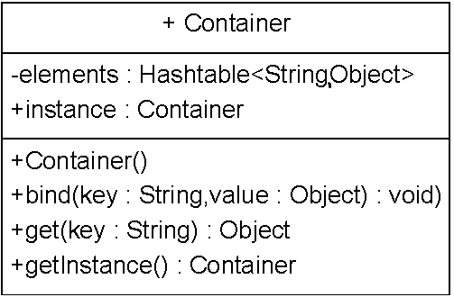
public class Container
{
public static Container getInstance() {
If (Container.instance == null){
Container.instance = new Container();
}
return Container.instance;
}

Slide 5
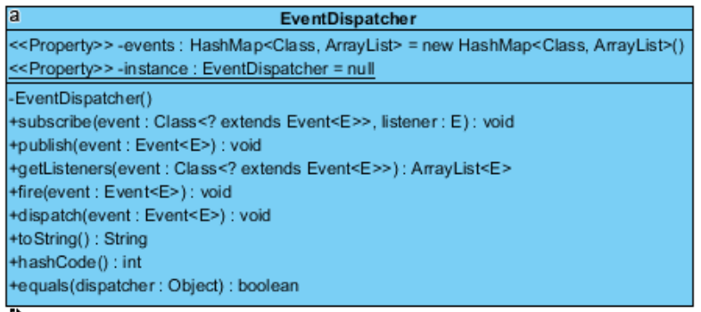
Event dispatcher
public class EventDispacher
{
public static EventDispacher getInstance() {
If (EventDispacher.instance == null){
EventDispacher.instance = new Container();
}
return EventDispacher.instance;
}

Slide 6
ADAPTER

Slide 7
The Adapter design pattern allows otherwise incompatible classes to work together by converting the interface of one class into an interface expected by the clients.

Slide 8
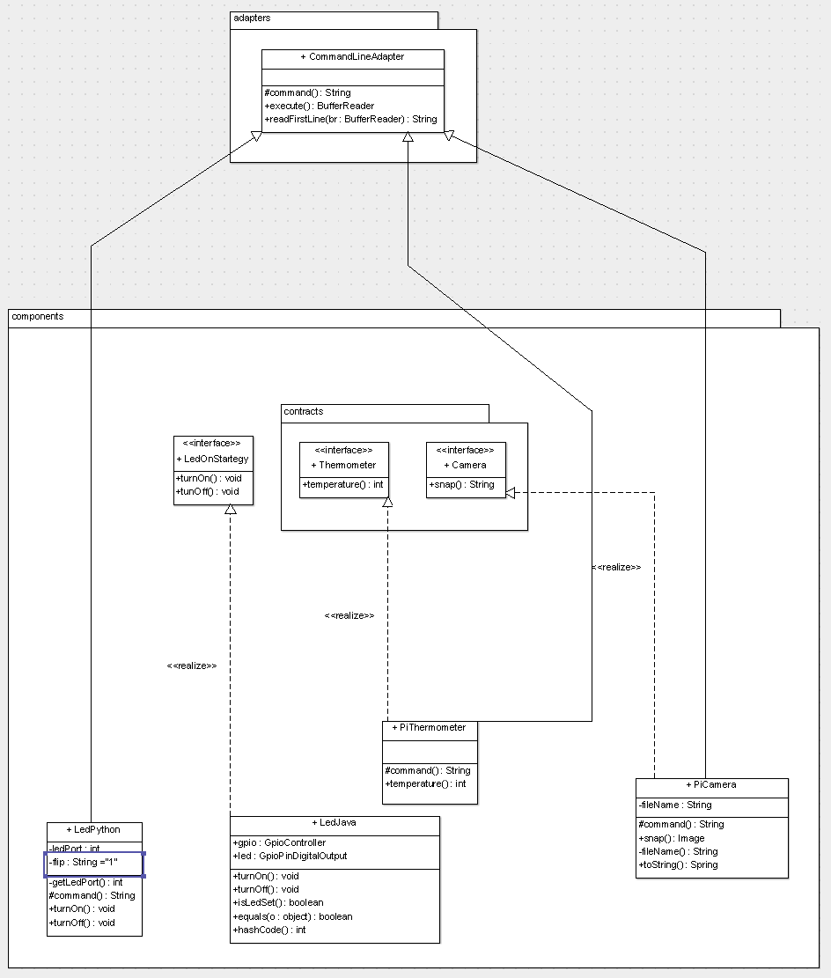

Slide 9
COMPOSITE

Slide 10
Compose objects into tree structures to represent whole-part hierarchies. Composite lets clients treat individual objects and compositions of objects uniformly.

Slide 11
